Slide 1

Tax Collection: Experimental Evidence from Tanzania
Tanzania
Team 3: Jinlun Zhang, Wanqiu Jiang, Xiaoyu Ma, Chuhong He, Komenan N’guessan, Tengkai, Yao
Notes:
- Give a brief overview of the business problem and analytics problem. - Provide a brief description of the data sources. - Identify and explain the rationale for the choice of techniques. - Present the results. - Discuss the business insight gained from the analysis. - Discuss issues (real or anticipated) in deploying insights as in the specific organization studied.
Font : Montserrat

Slide 2
Executive Summary
01
Project Background
02
Business Problem & Analytics Questions
04
Further Explore on Analytics Questions
03
Data Sources Introduction
05
Implementing Challenges

Slide 3
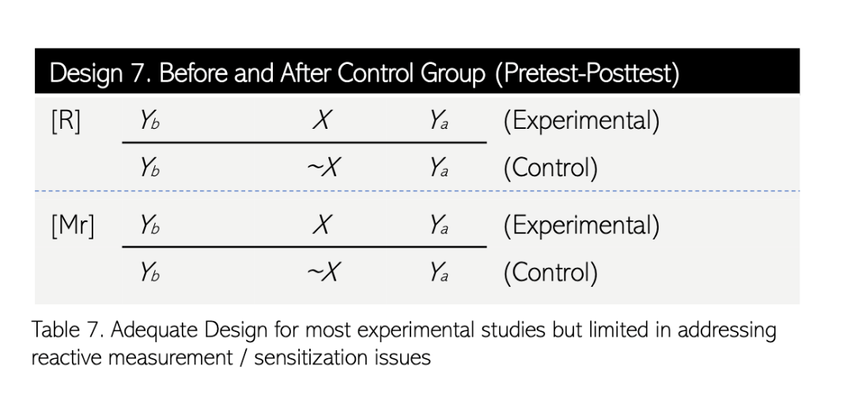
Background
Data Collection
The collection is done by the Tanzania's revenue authority, from the research paper (Mwaijande et al., 2021)
Experiment Design
Big-stick randomization method to assign taxpayers into 3 treatment groups and 1 control group
Baseline analysis to ensure that each treatment group was identical to the control group before the start of the intervention
No explicit pretest measurement of the subjects' tax compliance behaviours so no reactive measurement issue

Slide 4

Business Problem & Analytics Questions
What strategies can be implemented and preferred to enhance property tax collection and ensure comply with their obligations?
Accessing
Impacts of SMS Message Treatments on Tax Compliance
Analyzing Mjumbe Size Impact on Tax Compliance
Produce a robust linear analysis of relationship based on panel technique

Slide 5

Data Source
Total 21,328 taxpayers |  | 668 local leaders
Mjumbe ID: | mjumbe_id | Treatment Group: | T1, T2, T3
Payment Records: | amountpaid18_19, amountpaid19_20, amountpaid20_21 | Area Responsibility: | mjumbe_size
Compliance Status: | pay18_19, pay19_20, pay20_21 | Deadline Compliance : | before_deadline18_19, before_deadline19_20
Outstanding Amount: | outstanding19_20 | SMS Receipt: | nu_received_sms
Notes:
The data is derived from a randomized control trial (RCT) involving over 21,000 taxpayers and 668 local leaders, structured into various treatment groups. These groups received different combinations of interventions, including text message reminders with varying contents (general, educative, coercive, shaming) and direct involvement of local leaders in the tax collection process.

Slide 6
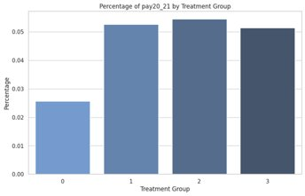
Question 1 - Methodology
Determine the impact of SMS treatments on the number of taxpayers making payments in fiscal year 2020/2021.
One-way Analysis of Variance (ANOVA)
Rationale: compare means of average payment number among 3 or more groups
Null Hypothesis (H0): no differences in mean values
Alternative Hypothesis (HA): at least one group has different mean value
Right- tail t-test
Rationale: compare means of average payment number between 2 treatment groups
Null Hypothesis (H0): mean of 1st group is less than mean of 2nd group
Alternative Hypothesis (HA): mean of 1st group is NOT less than mean of 2nd group

Slide 7
Question 1 - Results
1. Compare control group, treatment group 1, 2, and 3
ANOVA: P-value = 7.07^-10
At least one group have differences on the mean number of tax payments
2. Compare each treatment group to control group
Right-tail t-test
Treatment have overall improvement on tax compliance compared to control group
3. Compare treatment group 1, 2, 3
ANOVA: P-value = 0.85, failed to have significant differences among 3 treatment groups
Right-tail t-test:
Failed to conclude that there is a variation between different SMS message treatments on the tax compliance
Comparison | Group 1, control | Group 2, control | Group 3, control
P-value | 1.34^-9 | 7.1^-10 | 8.32^-9
Comparison | Group 2, 1 | Group 3, 2 | Group 3,1
P-value | 0.37 | 0.71 | 0.59

Slide 8
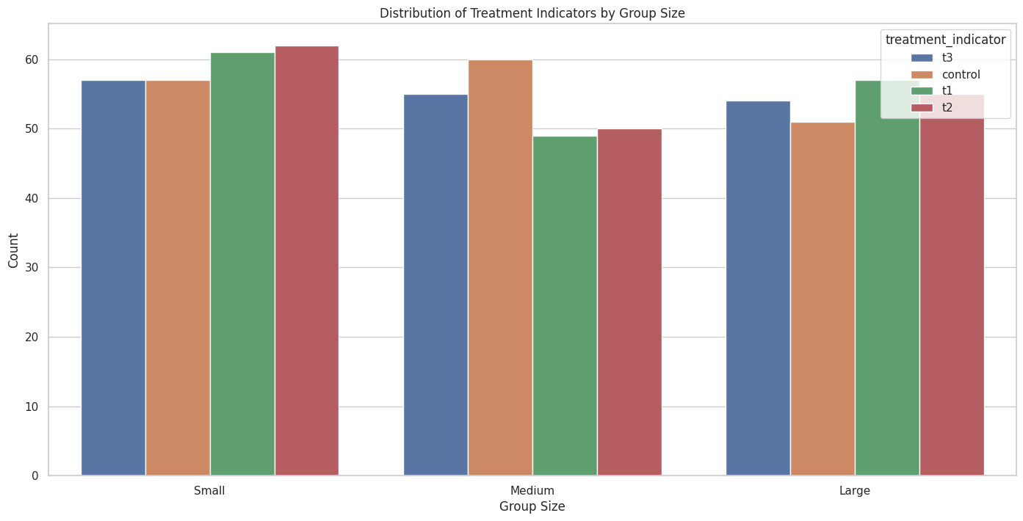
Question 2 Analyzing Mjumbe Size Impact on Tax Compliance
Technique : ANOVA + t-test
Results:
From the ANOVA test, the p-values result for small, medium and large size Mjumbe groups are 0.31, 0.29 and 0.96 respectively.
In small size Mjumbe, the p-value for T3 vs T1 and T3 vs T2 are both equal to 0.1, at our significance level, implying rejection of the null hypothesis.
In medium size Mjumble, the p-value for T1 vs T3 is under 0.1, implying strong evidence to support the alternative hypothesis, where the number of people paying in Treatment Group 1 is statistically significantly more than that of people in Treatment Group 3.
Figure: The bar chart displays the distribution of treatment indicators across small, medium, and large Mjumbe groups. This visualization aids in assessing the uniformity of treatment distribution among varying sizes of Mjumbe jurisdictions.
Notes:
Figure: The bar chart displays the distribution of treatment indicators across small, medium, and large Mjumbe groups. Each bar color represents a different treatment group, with the count reflecting the number of Mjumbes within each category and treatment. This visualization aids in assessing the uniformity of treatment distribution among varying sizes of Mjumbe jurisdictions.

Slide 9

Insights from Question 2
 | Small Size Mjumbe (SSM) | Meidum Size Mjumbe(MSM) | Large Size Mjumbe (LSM)
P-value (ANOVA) | 0.31 | 0.29 | 0.96
P-value (t-test) | T3 vs T1 0.1 | T1 vs T3 0.07
 | T3 vs T2 0.1 | T2 vs T3 0.11
For the large-sized Mjumbe group: No definitive recommendation can be made (due to uncertainty about the impact of different treatment)
For small Mjumbe groups: Choose the SMS messages that involve actual leader participation as it has the greatest positive impact on tax compliance
For medium-sized groups: SMS messages with or without including the threat of leader involvement should depend on the specific scenarios. However, actual leader involvement should be avoided (as SMS messages alone have produced better results than those involving the local leaders)
Notes:
Large Mjumbe Group: The impact of various SMS strategies on tax compliance remains unclear. No definitive recommendation can be made for the best SMS approach in these areas.
Small Mjumbe Group: SMS messages involving actual leaders (p-values = 0.1) significantly enhance tax compliance. This strategy is recommended for maximizing tax collection in small communities.
Medium Mjumbe Group: The p-value of 0.07 for T1 vs T3 indicates that SMS messages alone are more effective than those involving Mjumbe threats. This approach should be adopted to reduce operational costs and improve tax compliance in medium-sized areas.

Slide 10
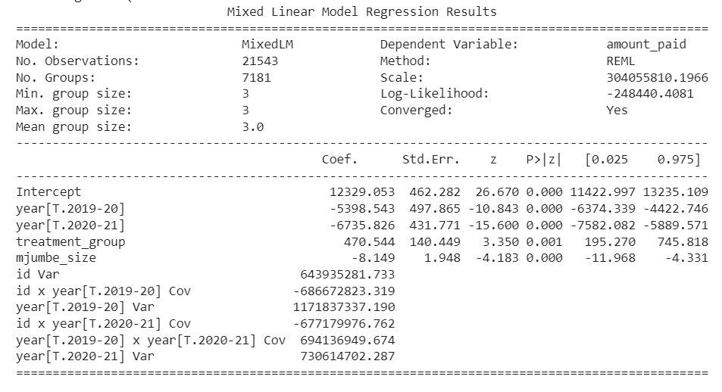
Question 3 Linear Analysis of Relationship based on Panel Technique
Technique : Panel technique- Random Effect (Due to time series nature of the experimental data, the panel technique is selected)
Results:
The model has a poor goodness of fit due to the large ‘scale’ value. Substantial variability in data that is unexplained by the model
Both year [T.2019-20] and year [T.2020-21] have negative coefficients, implying decrease trends in the ''amount_paid'' compared to the base year (2018-19)
Summary of Random effect

Slide 11

Insights from Question 3
Use the RE to make a robust model and determine the effect of Mjumbe and payment over time
The decreasing trend in payments over the years may needs to be investigated and addressed, possibly by researching the market trends, customer behaviors, or changing economic conditions.

Slide 12
Deployment Challenges & Considerations
Engagement and Performance of Mjumbe
Resource Allocation and Educational Outreach
Communication and Ethical Considerations
Cost-Benefit Analysis and Economic Complexity
Enhance engagement with effective local leaders.
Regularly assess and adjust compliance strategies based on Mjumbes' performance.
Prioritize resources in low compliance rate or high revenue potential areas.
Conduct education campaigns for better tax compliance understanding.
Emphasize Mjumbe’s reputation and effective communication.
Consider taxpayers’ ethics and moralities.
Limited information about opportunity costs associated with involving Mjumbes.
Economic environment and stability.

Slide 13

Thanks for Watching

Slide 14
Reference
Mwaijande, F., Kachwamba, M., Mwakalikamo, J., & Shirima, D. (2021). Local authorities and tax collection: Experimental evidence from Tanzania [Dataset]. In AEA Randomized Controlled Trials. https://doi.org/10.1257/rct.4875-1.1
Oppong-Tawiah, D. (2023). Causal Inference with Experimental Data I: Experiment Design. Lecture Slide Class 3.
Oppong-Tawiah, D. (2023). Causal Inference with Experimental Data II: ANOVA. Lecture Slide Class 4.
Oppong-Tawiah, D. (2023). Causal Inference with Experimental Data IIa – Panel Techniques. Lecture Slide Class 5.

Slide 15
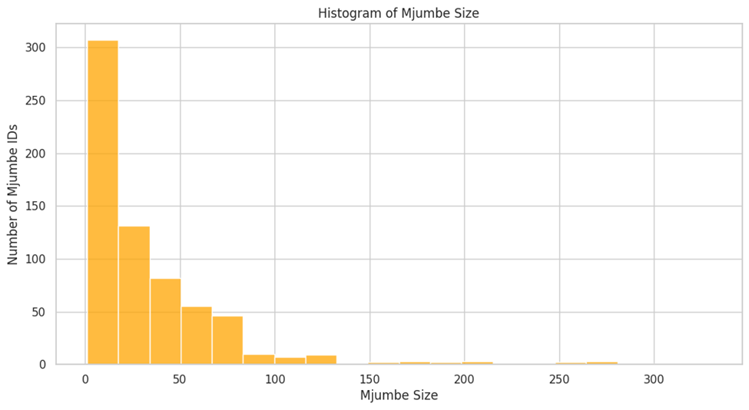
Appendix
Histogram illustrating the distribution of Mjumbe Size.

Slide 16
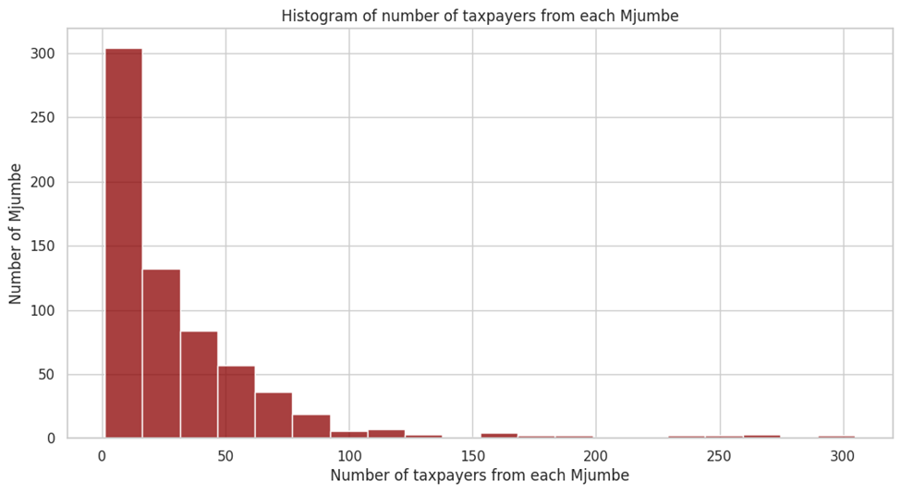
Appendix
Histogram displaying the number of taxpayers under the jurisdiction of each Mjumbe.

Slide 17
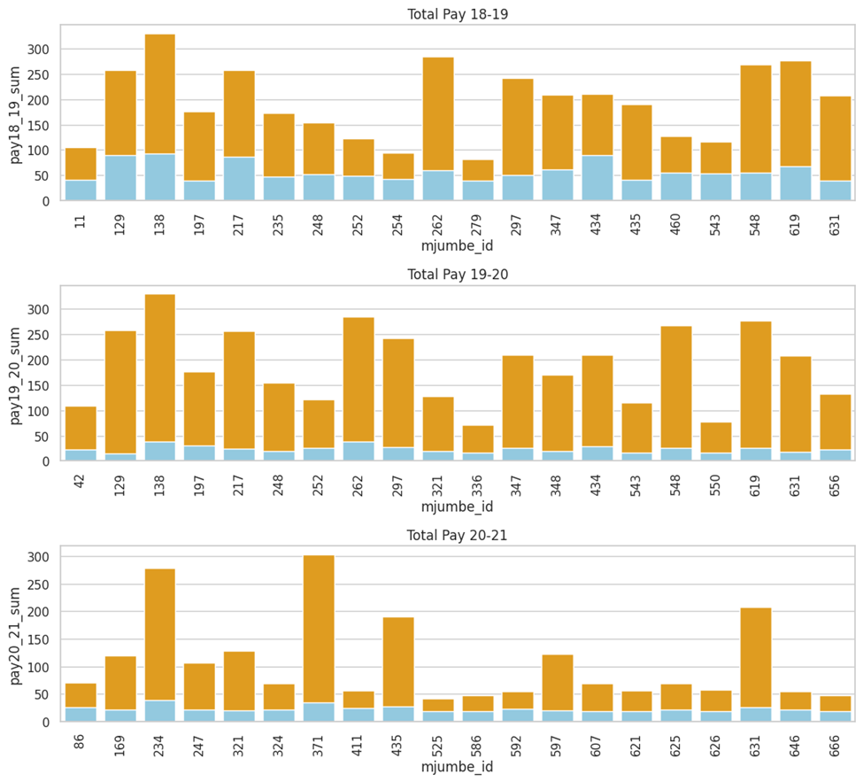
Appendix
Stacked Bar Charts of Total Payments per Mjumbe. Each chart represents a different fiscal year, showing the top 20 Mjumbes with the highest payment sums.

Slide 18
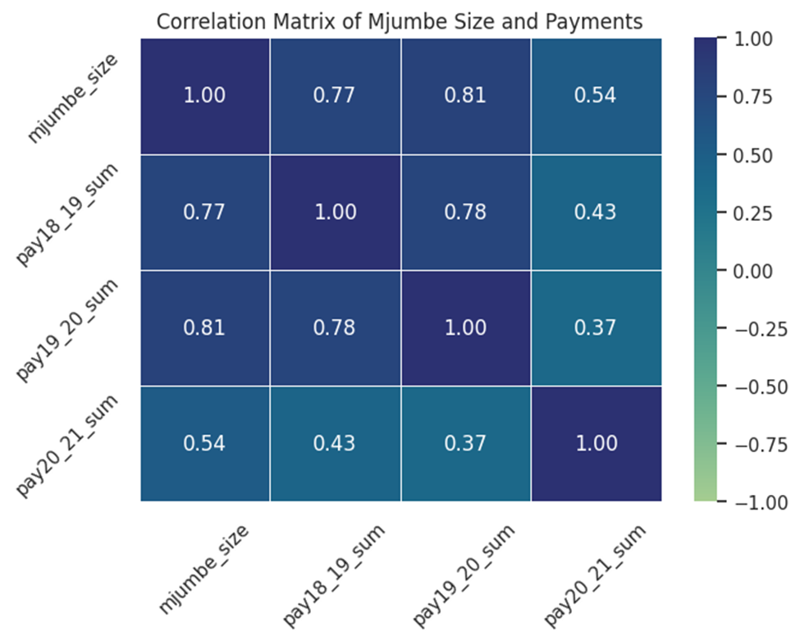
Appendix
Correlation Matrix of Mjumbe Size and Payments

