Slide 1
FINAL PROJECT · NEURAL NETWORKS COURSE
IoT Intrusion Detection
Systems
Detecting IoT botnet attacks using ML on network flow statistics
Jinhong Lin · Elton Chang · Shiwei Jiang
Dataset: BoTNeTIoT-L01 (Kaggle) · April 2026

Slide 2
01 — PROBLEM STATEMENT
What Are We Trying to Solve?
The Problem
Our Approach
IoT devices are increasingly targeted by botnets like Mirai and Gafgyt, which can compromise thousands of devices and launch large-scale DDoS attacks.
The challenge: distinguish malicious botnet traffic from normal IoT behaviour in real time — before compromised devices can be weaponised.
Train 4 ML models on 23 engineered network flow statistics
Binary detection: attack (0) vs normal (1)
Multiclass: identify botnet family & attack subtype
Evaluate feature importance, device generalization, and inference latency

Slide 3
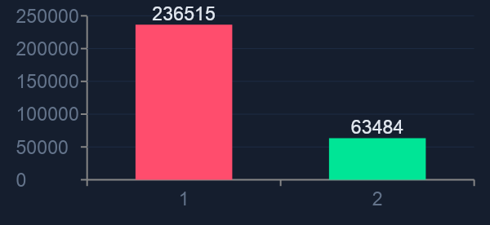
02 — DATASET & EDA
BoTNeTIoT-L01 Dataset
300K
400K
19
9
78.8%
Dataset 1 rows (sample)
Dataset 2 rows (sample)
Features used (4 pruned)
IoT Device types
Attack rate (Dataset 1)
Class Imbalance (Dataset 1 sample)
Key EDA Findings -> Pipeline Rationale
0 missing values in both datasets
4 features perfectly correlated (r=1.00) → removed
12 features highly skewed → log1p applied
2 botnet families: Mirai + Gafgyt
9 attack subtypes incl. UDP, TCP, SYN, ACK…

Slide 4
03 — PREPROCESSING PIPELINE
EDA-Driven Preprocessing Choices
01
Drop Redundant
02
Log1p Transform
Remove 4 perfectly correlated features (r=1.00). 23 → 19 features.
Apply log1p(|x|) to 12 highly skewed features to normalize distributions.
03
Standardize
04
Stratified Split
Fit StandardScaler on training data only. Apply to val + test to prevent data leakage.
70% train / 15% val / 15% test. Stratified by label to preserve class ratios.

Slide 5
04 — BINARY CLASSIFICATION RESULTS
Attack vs Normal — All 4 Models
0.9998
1.0000
0.58μs
5.66μs
Best F1-Macro (RF)
Best AUC-ROC (RF/HGB/MLP)
Fastest Latency (LogReg)
MLP Latency
Model | F1-Attack(0) | F1-Normal(1) | F1-Macro | AUC-ROC | Latency (μs)
LogReg | 0.9996 | 0.9984 | 0.9990 | 0.9999 | 0.577 ⚡
RF | 0.9999 ★ | 0.9997 ★ | 0.9998 ★ | 1.0000 ★ | 45.43
HGB | 0.9999 ★ | 0.9996 | 0.9997 | 1.0000 ★ | 15.34
MLP | 0.9997 | 0.9989 | 0.9993 | 1.0000 ★ | 5.66

Slide 6
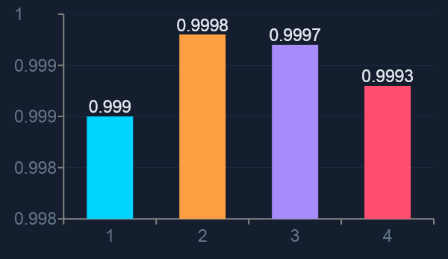
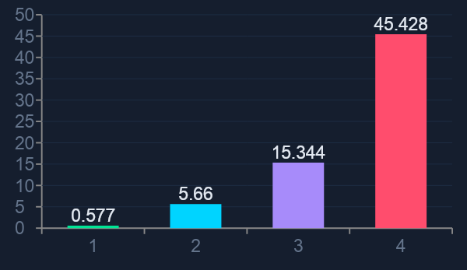
05 — LATENCY VS ACCURACY
Which Model is Best for Real-Time IDS?
F1-Macro by Model (test set)
Inference Latency μs/sample (lower = faster)
★ Recommendation: MLP offers the best balance — F1-Macro 0.9993 at 5.66 μs/sample (8× faster than RF, 0.0005 lower F1). LogReg at 0.58μs is ideal for ultra-low-latency edge deployment.

Slide 7
06 — MULTICLASS CLASSIFICATION
Attack Family & Subtype Identification
3-Class: Normal / Mirai / Gafgyt
9-Class: Attack Subtypes
Normal
ACK
Combo
Normal
F1 = 1.000
1.000 ✓
1.000 ✓
1.000 ✓
Mirai
F1 = 1.000
Junk
Scan
SYN
1.000 ✓
1.000 ✓
1.000 ✓
Gafgyt
F1 = 1.000
TCP
UDP
UDPPlain
0.99 ⚠
1.000 ✓
1.000 ✓
Near-perfect separation on this in-distribution benchmark sample; results should be interpreted as strong dataset separability rather than guaranteed field performance.
Only TCP precision drops slightly to 0.99; the remaining subtype scores are near-perfect on this sampled benchmark split.

Slide 8
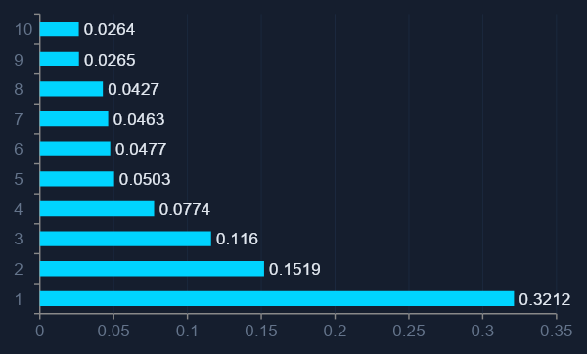
07 — FEATURE IMPORTANCE
Which Network Stats Matter Most?
Random Forest — Mean Decrease Impurity
Top Finding
MI_dir_L0.1_weight (packet count) alone accounts for 32.1% of RF decision power. Botnets generate enormous packet floods — raw volume is the #1 signal.
Top 10 vs All 19
Top 10 features: 0.9995 F1
All 19 features: 0.9993 F1 Exploratory result: a reduced top-10 feature set retained comparable performance, suggesting some extra features may be redundant.

Slide 9
08 — PER-DEVICE EVALUATION
How Consistent Is Performance Across the 9 Devices?
Device | F1-Attack | F1-Normal | Samples
Ecobee Thermostat | 1.0000 | 1.0000 | 47,231
Danmini Doorbell | 1.0000 | 1.0000 | 57,975
Ennio Doorbell | 1.0000 | 1.0000 | 19,908
Provision PT-737E Camera | 1.0000 | 1.0000 | 46,740
Provision PT-838 Camera | 1.0000 | 1.0000 | 47,743
Samsung SNH-1011-N Webcam | 1.0000 | 1.0000 | 21,146
SimpleHome XCS7-1003 Camera | 1.0000 | 1.0000 | 48,199
SimpleHome XCS7-1002 Camera | 0.9999 | 0.9998 | 48,775
Philips B120N10 Baby Monitor | 0.9999 | 0.9990 | 62,282
⚠️ However, this evaluation uses a random split where the same devices appear in both training and test sets. Therefore, results reflect strong in-distribution performance rather than true generalization to unseen devices (i.e., not a leave-one-device-out test).
✅ 7 of 9 devices achieve perfect F1 = 1.000. A single global model generalises across all IoT device types — no per-device retraining needed.

Slide 10
09 — GOAL ASSESSMENT
Are Our Research Goals Met?
Supported
Supported
Supported
Binary Detection
Attack Family ID
Subtype Classification
All 4 models ≥ F1-Macro 0.999. LogReg achieves this at 0.58 μs — real-time capable.
Normal / Mirai / Gafgyt are near-perfectly separated on the sampled benchmark split; interpret this as strong in-distribution performance.
9-class subtype performance is near-perfect on the sampled benchmark split, with TCP showing the main small deviation.
Supported
Supported
Caveated
Feature Importance
Device Generalization
Real-World Deployment
Packet count (MI_dir weight) = 32% of importance. An exploratory top-10 feature subset retained comparable performance.
Device-wise results are strong within the sampled benchmark, but this section is exploratory rather than a strict unseen-device test.
Latency goals met. But no temporal split — train/test from same capture session.

Slide 11
10 — CONCLUSION
Summary & Next Steps
Limitations
Key Results
No temporal split (in-distribution benchmark)
Dataset v2 has ~8.8% duplicate rows
9 devices from one lab environment
All 4 models achieve F1-Macro ≥ 0.999 on binary task
Botnet families (Mirai / Gafgyt) are near-perfectly separable on this benchmark
9-subtype classification near-perfect (~100% accuracy)
A reduced top-10 feature set retained comparable performance in an exploratory test
A single global model shows strong device-wise consistency within the sampled benchmark
MLP recommended: best accuracy-latency balance (5.66 μs)
Next Steps
Temporal train/test split for real-world estimate
Test on unseen devices / new attack variants
SHAP values for interpretability

