Slide 1

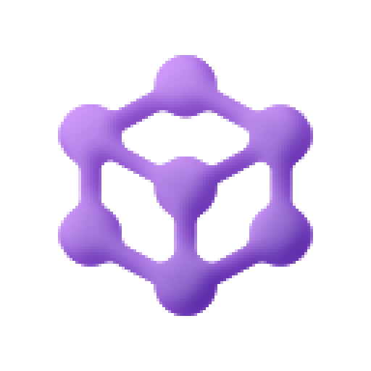
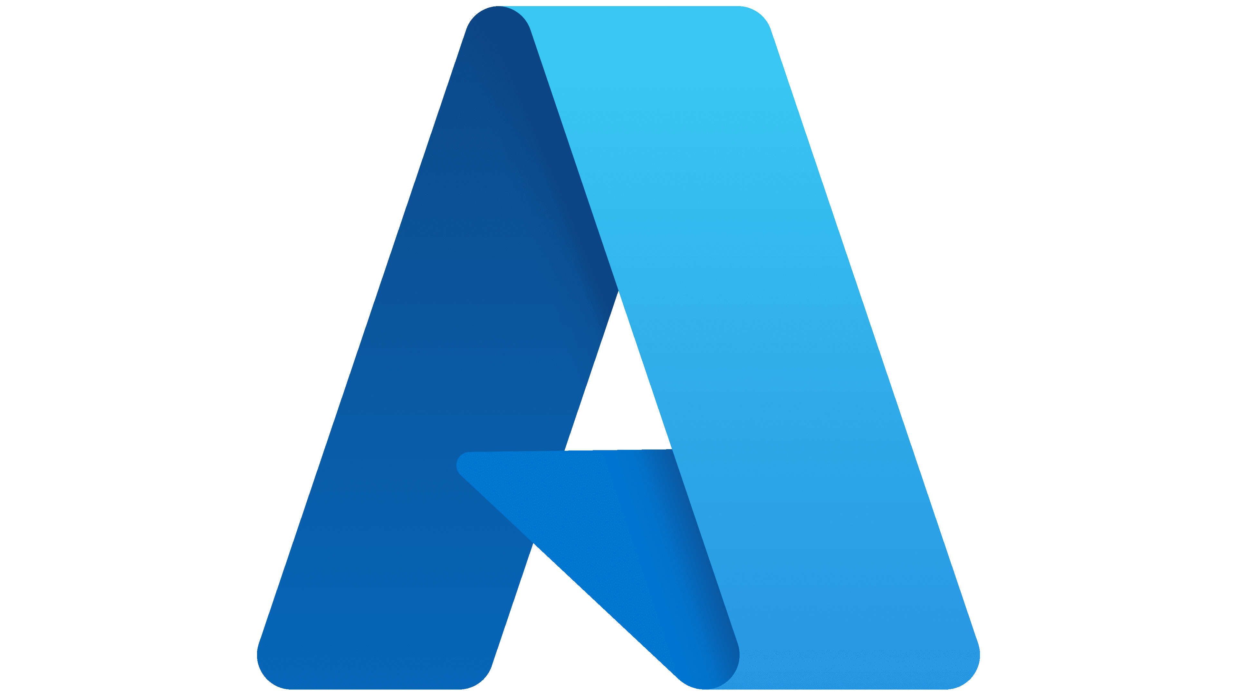
Microsoft
Microsoft Agent Framework
& Azure SRE Agent
Agent Primitives • Extensibility • Developer Tooling • Hands-On Labs
Jin Lee
AI Apps Solutions Engineer
Microsoft
Notes:
Welcome!
Resources:
- Agent Framework: github.com/microsoft/agent-framework
- SRE Agent: learn.microsoft.com/azure/sre-agent
- AI Toolkit: code.visualstudio.com/docs/intelligentapps/overview

Slide 2





Session Agenda
10m
Agent Framework & Architecture
Primitives, workflow patterns, and ecosystem
15m
Lab 1: Build Your First Agent
Hands-on with Agents, Threads, Runs, and Tools
10m
Developer Tooling
DevUI, VS Code AI Toolkit, and GitHub Copilot prompts
15m
Azure SRE Agent Deep Dive
Capabilities, memory system, and extensibility
10m
Labs 2 & 3: SRE Agent
Interaction, sub-agents, and MCP workflows

Slide 3
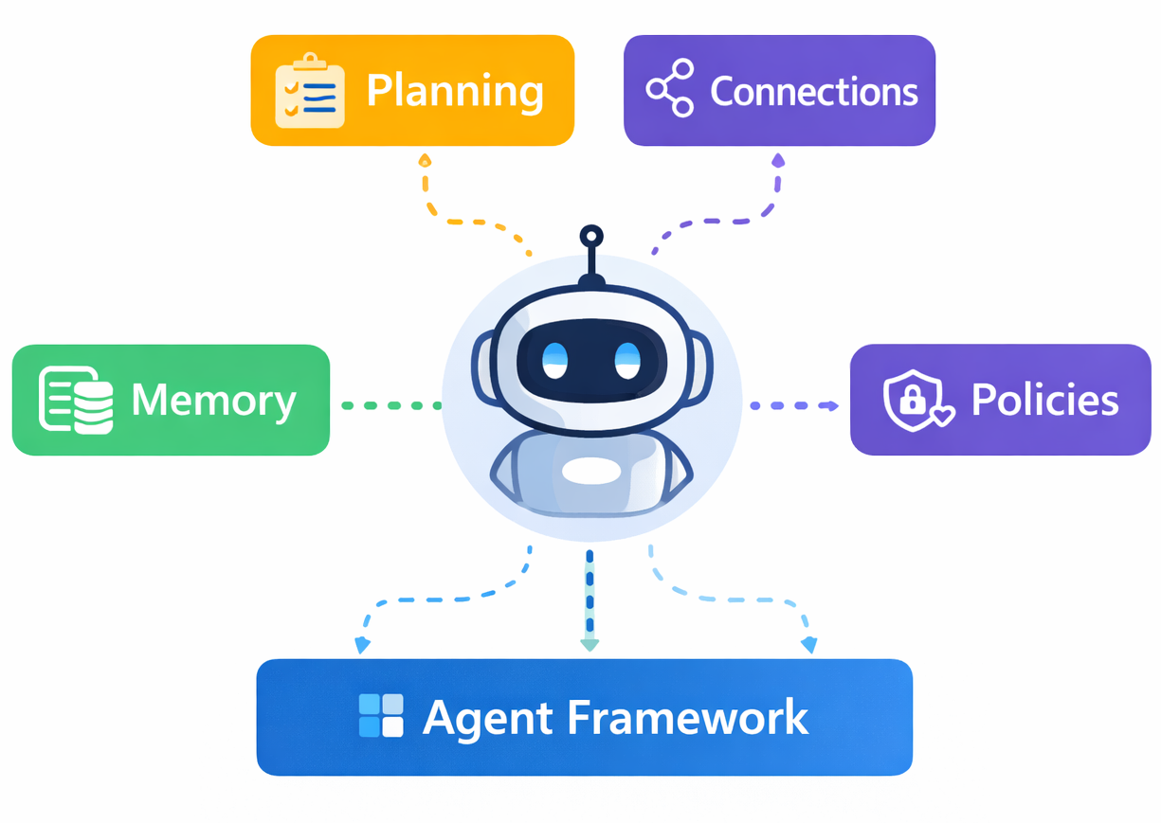
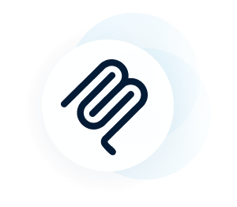
What even is an “Agent”?
Notes:
An AI agent is an LLM plus planning, memory, tools, and governance — and Microsoft Agent Framework provides the architecture that makes those capabilities reliable and enterprise-ready.

Slide 4
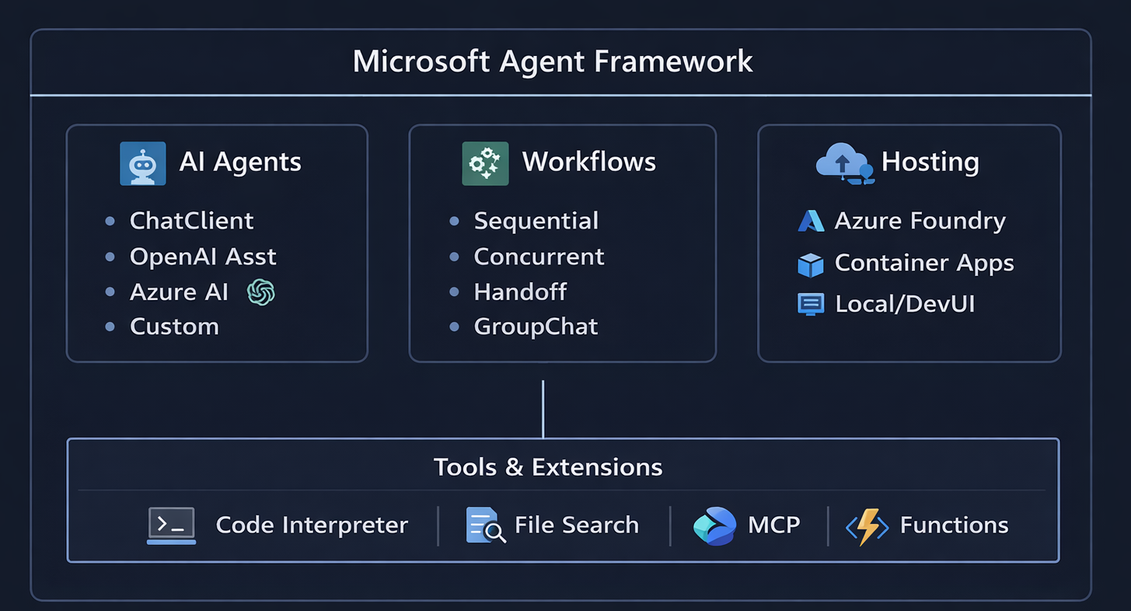
Microsoft Agent Framework: Architecture
Unifies Semantic Kernel + AutoGen into production-ready SDK
Python • .NET • Java | OpenTelemetry Observability | Entra ID Authentication
Learn more: learn.microsoft.com/agent-framework/overview/agent-framework-overview
Notes:
Architecture: learn.microsoft.com/agent-framework/overview/agent-framework-overview
Azure multi-agent: learn.microsoft.com/azure/architecture/ai-ml/idea/multiple-agent-workflow-automation

Slide 5




Agent Primitives: The Core Concepts
Agent
Thread
Run
Tools
AI persona with instructions, model, and tool bindings
Conversation container with server-side persistence
Single execution with status lifecycle
Code Interpreter, File Search, MCP, Custom functions
Agent → Thread → Run → Tool Calls → Response

Slide 6
Workflow Patterns
Sequential
Concurrent
Handoff
GroupChat
A → B → C → Result
A ┬→ Result
B ┤
C ┘
A ⇄ B ⇄ C
[A B C] ↔ Chat
Agents execute in order, passing results along the chain
Multiple agents work in parallel, results aggregated
Responsibility shifts between agents based on context
Agents collaborate in shared conversational space
Magentic
Human-in-the-Loop
General purpose multi-agent pattern
Pause and request input from humans at designated points
Learn more: https://learn.microsoft.com/en-us/agent-framework/user-guide/workflows/orchestrations

Slide 7


Lab 1: Agent Framework Basics
What You'll Build
1. Create an Agent with custom instructions
2. Bind tools (Code Interpreter + custom function)
3. Create a Thread and add messages
4. Execute a Run and handle tool calls
5. Retrieve and display the response
Prerequisites
Azure subscription
AI Foundry project
Python 3.10+
azure-ai-projects SDK
⏱ 15 minutes | Open: lab1-agent-basics.ipynb

Slide 8


Developer Tooling for Agent Framework
DevUI
VS Code AI Toolkit
Visual debugging for agent workflows
Chain-of-thought visualization
Real-time state monitoring
OpenAI-compatible API backend
devui ./agents --port 8080
Agent Builder with graph visualizer
Prompt engineering workspace
Agent Code Gen (Agent Framework default)
YAML → Code conversion
MCP server integration
Enhanced Tooling for Agentic Development
DevUI for visual debugging + AI Toolkit for rapid prototyping + OpenTelemetry for production observability
Learn more: learn.microsoft.com/agent-framework/user-guide/devui
Notes:
DevUI: learn.microsoft.com/agent-framework/user-guide/devui
AI Toolkit: code.visualstudio.com/docs/intelligentapps/overview
Golden Triangle: devblogs.microsoft.com/semantic-kernel/the-golden-triangle-of-agentic-development

Slide 9
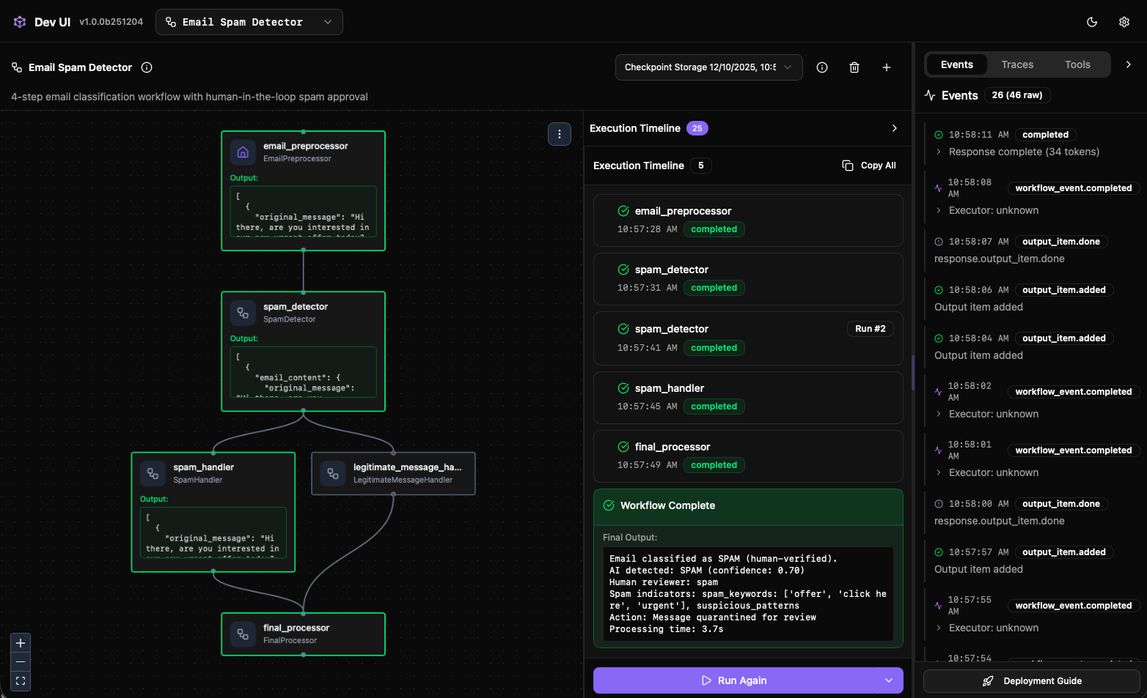
Developer Tooling for Agent Framework
DevUI
VS Code AI Toolkit
Visual debugging for agent workflows
Chain-of-thought visualization
Real-time state monitoring
OpenAI-compatible API backend
devui ./agents --port 8080
Agent Builder with graph visualizer
Prompt engineering workspace
Agent Code Gen (Agent Framework default)
YAML → Code conversion
MCP server integration
Enhanced Tooling for Agentic Development
DevUI for visual debugging + AI Toolkit for rapid prototyping + OpenTelemetry for production observability
Learn more: learn.microsoft.com/agent-framework/user-guide/devui
Notes:
DevUI: learn.microsoft.com/agent-framework/user-guide/devui
AI Toolkit: code.visualstudio.com/docs/intelligentapps/overview
Golden Triangle: devblogs.microsoft.com/semantic-kernel/the-golden-triangle-of-agentic-development

Slide 10
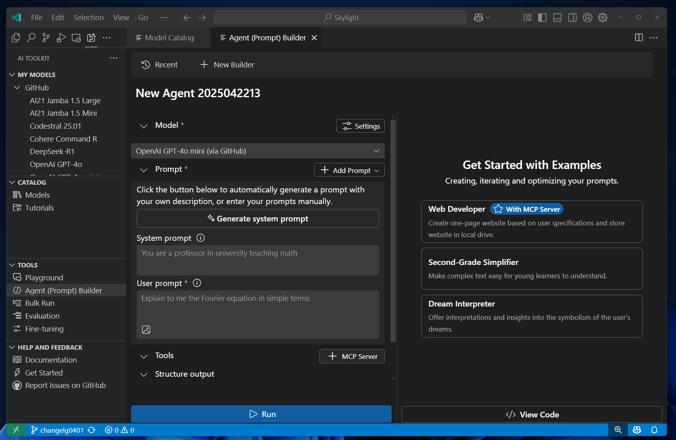
Developer Tooling for Agent Framework
DevUI
VS Code AI Toolkit
Visual debugging for agent workflows
Chain-of-thought visualization
Real-time state monitoring
OpenAI-compatible API backend
devui ./agents --port 8080
Agent Builder with graph visualizer
Prompt engineering workspace
Agent Code Gen (Agent Framework default)
YAML → Code conversion
MCP server integration
Enhanced Tooling for Agentic Development
DevUI for visual debugging + AI Toolkit for rapid prototyping + OpenTelemetry for production observability
Learn more: learn.microsoft.com/agent-framework/user-guide/devui
Notes:
DevUI: learn.microsoft.com/agent-framework/user-guide/devui
AI Toolkit: code.visualstudio.com/docs/intelligentapps/overview
Golden Triangle: devblogs.microsoft.com/semantic-kernel/the-golden-triangle-of-agentic-development

Slide 11



GitHub Copilot: Agent Framework Prompts
Use specialized prompts to accelerate migration and development
Semantic Kernel → Agent Framework Migration
# Key Transformations:
ChatCompletionAgent → ChatClientAgent
OpenAIAssistantAgent → AIAgent (via extensions)
InvokeAsync() → RunAsync()
[KernelFunction] → AIFunctionFactory.Create()
# Example:
# Before (Semantic Kernel)
var agent = await kernel.GetRequiredService<ChatCompletionAgent>();
await foreach (var msg in agent.InvokeAsync(thread)) { ... }
# After (Agent Framework)
var agent = client.GetChatClient(model).CreateAIAgent();
var response = await agent.RunAsync(thread);
Use with Copilot Chat:
github.com/microsoft/agent-framework/.github/upgrades/prompts/SemanticKernelToAgentFramework.md
Notes:
Migration prompt: github.com/microsoft/agent-framework/blob/main/.github/upgrades/prompts/SemanticKernelToAgentFramework.md
Code Migration blog: techcommunity.microsoft.com/blog/azure-ai-foundry-blog/empowering-multi-agent-solutions-with-microsoft-agent-framework---code-migration/4468094

Slide 12

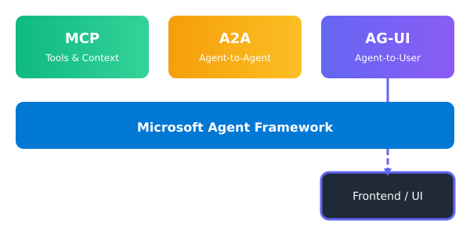
AG-UI: Agent-User Interaction Protocol
Key Features
Agentic Orchestration Surface for Humans
Real-Time Transparency
Human-in-the-Loop Control
Context + Memory Visualization
Bridges Agents to Enterprise Workflows
Event Types:
RUN_START
TEXT_DELTA
TOOL_CALL
STATE_DELTA
CUSTOM
RUN_END
Learn more: docs.ag-ui.com | github.com/ag-ui-protocol/ag-ui | dojo.ag-ui.com
Notes:
AG-UI Protocol: docs.ag-ui.com
GitHub: github.com/ag-ui-protocol/ag-ui
Microsoft Integration: learn.microsoft.com/agent-framework/integrations/ag-ui
AG-UI complements MCP (tools) and A2A (agent-to-agent) to complete the agentic protocol stack.

Slide 13


Azure SRE Agent
AI-powered service for monitoring, diagnosing, and resolving Azure infrastructure issues
20K+ Engineering hours saved
24/7 Continuous monitoring
NL Natural language commands
Core Capabilities
Anomaly Detection
Root Cause Analysis
Code-Aware RCA
Memory System
ML-based continuous monitoring
Correlate logs, metrics, deployments
Link to GitHub/ADO source
Learn from past incidents
Integrations:
Azure Monitor • PagerDuty • ServiceNow • GitHub • ADO • Dynatrace • New Relic • Datadog • Teams • Outlook
Learn more: learn.microsoft.com/azure/sre-agent/overview

Slide 14

SRE Agent: Memory & Extensibility
Memory System: "Never Explain Context Twice"
Team Facts
Runbook Retrieval
Session Learning
Remember preferences across conversations
Fetch relevant docs during troubleshooting
Improve from past incident patterns
Extensibility Model
Sub-Agent Builder
No-code specialized agents with triggers
MCP Servers
Bring your own actions via remote MCP
Built-in Actions
az cli, kubectl, GitHub, Teams, Outlook
Learn more: learn.microsoft.com/azure/sre-agent/subagent-builder-overview

Slide 15
Labs 2 & 3: SRE Agent Hands-On
Lab 2: SRE Agent Basics
Lab 3: Extensibility
Configure SRE Agent in Portal
Connect to Azure Monitor
Natural language queries
Anomaly investigation
Incident report generation
Create custom sub-agent
Define triggers & instructions
Build MCP server
Teams notification workflow
End-to-end incident automation
⏱ 10 min | lab2-sre-agent-basics.ipynb
⏱ 10 min | lab3-sre-extensibility.ipynb

Slide 16
Key Takeaways
1
Agent primitives (Agent, Thread, Run, Tool) abstract orchestration complexity
2
DevUI + AI Toolkit + OpenTelemetry form the "golden triangle" for development
3
GitHub Copilot prompts accelerate Semantic Kernel → Agent Framework migration
4
Azure SRE Agent applies agent patterns for enterprise-scale operational intelligence
5
Extensibility via sub-agents and MCP enables customization without rebuilding

Slide 17


Resources & Next Steps
Agent Framework GitHub
Agent Framework Docs
github.com/microsoft/agent-framework
learn.microsoft.com/agent-framework
Azure SRE Agent
DevUI Guide
learn.microsoft.com/azure/sre-agent
learn.microsoft.com/agent-framework/user-guide/devui
VS Code AI Toolkit
Copilot Migration Prompt
code.visualstudio.com/docs/intelligentapps
github.com/.../SemanticKernelToAgentFramework.md
📧 Questions? Feedback? Reach out or explore the docs above.

Slide 18
Questions?
Thank you for attending!
Workshop materials: lab1-agent-basics.ipynb | lab2-sre-agent-basics.ipynb | lab3-sre-extensibility.ipynb

