Slide 1
Distributed Snapshots
10/4/19

Slide 2
A note on channels and goroutines...
Using channels is easy, debugging them is hard…
Bullet-proof way: Keep track of how many things go in and go out
Always ask yourself: is this channel buffered?
In general, don’t use locks or atomic operations with channels (awkward)
Try not to nest goroutines (hard to reason about)
Notes:
Bullet-proof way: easier said than done, but it’s something to look out for when debugging. E.g. last iteration of for loop is often a tricky case.

Slide 3

Notes:
To illustrate why distributed snapshots are important, let’s look at an analogy. This is what most people think of when we say panorama. The view is so expansive such that no one camera can capture the whole thing at once.

Slide 4


Need synchronization
Notes:
The way people usually take panoramas is take many separate shots and stitch them together. There are a few ways to do this. The simplest is to just take each segment one after another. This works well if the view is largely static, like this one. An alternative is to have multiple cameras and click the shutter at the same time. However, this significantly reduces the gap between which objects can move from one frame to another, but requires synchronization in time. Also it’s not guaranteed to be 100% accurate, e.g. if you have a bird that flies really fast from left to right.

Slide 5
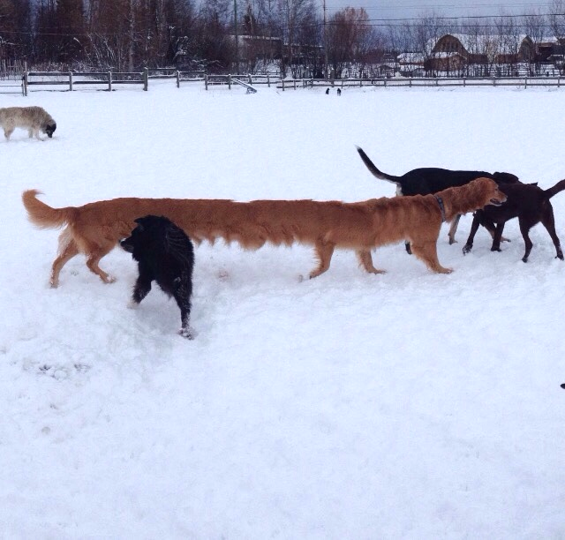

Slide 7


Slide 9
Distributed snapshots are easy to screw up
Must ensure state is not duplicated across the cluster
Must ensure state is not lost across the cluster
Messages in flight must also be recorded
But which ones?
Notes:
Why ensuring state is not duplicated or lost: the state could reflect exclusive ability to do something, e.g., propose new commands for a particular object

Slide 10
Event order:
Snap N1
N2 sends body
Snap N2
N1 receives body
Should record message!
N1
N2

Slide 11
Event order:
N2 sends body
Snap N2
N1 receives body
Snap N1
N1 already received the body in step 3
Should NOT record message
N1
N2
Notes:
Depending on the ordering of events, we may not always want to capture all the messages

Slide 12
Intuition: guarantee zero loss + zero duplication
If you haven’t snapshotted your local state yet:
Do NOT record future messages you receive
If you have snapshotted your local state:
Do record future messages you receive
Which one guarantees zero loss?
Which one guarantees zero duplication?
Notes:
Zero loss = record future messages
Zero duplication = do not record future messages

Slide 13
Chandy-Lamport snapshot algorithm
Key idea: Servers send marker messages to each other
Marker messages...
...mark the beginning of the snapshot process on the server
...act as a barrier (stopper) for recording messages
Notes:
Marker messages are the key component of the algorithm. They serve two purposes...

Slide 14
Refresher: system model
N processes in the system with no process failures
Each process tracks some state
Two FIFO unidirectional channels between every process pair P and Q
Channel also has state: the set of messages in the channel
All messages sent on channels arrive intact, unduplicated, in order
Notes:
From the lecture slides

Slide 15
Chandy-Lamport snapshot algorithm
Starting the snapshot procedure on a server:
Record local state
Send marker messages on all outbound interfaces
When you receive a marker message on an interface:
If you haven’t started the snapshot procedure yet, record your local state and send marker messages on all outbound interfaces
Stop recording messages you receive on this interface
Start recording messages you receive on all other interfaces
Terminate when all servers have received marker messages on all interfaces
Notes:
Matches earlier intuition: want to record future messages ONLY after we start the snapshot process.
Subtle additional requirement: record messages on all OTHER interfaces, not the one we received the marker message from. Why?
Ans: we know the other end has already recorded its local state
How: because it sent a marker message!
Whatever messages it sends afterward happened AFTER the snapshot (lies outside the “consistent cut” if you remember from lecture); not included in this snapshot
Otherwise might double-count state
Example of this later
Algorithm terminates when we’re sure that the marker messages have covered all the links in the system.

Slide 16
Token passing example 1
1 Token
0 Tokens
A
B

Slide 17
Token passing example 1
Event order:
A sends 1 token
0 Tokens
0 Tokens
1 Token
A
B

Slide 18
Token passing example 1
Event order:
A sends 1 token
A starts snapshot, sends marker
0 Tokens
0 Tokens
M
1 Token
A
B
Notes:
Green indicates node has been snapshotted

Slide 19
Token passing example 1
Event order:
A sends 1 token
A starts snapshot, sends marker
B receives 1 token
0 Tokens
1 Token
M
A
B

Slide 20
Token passing example 1
Event order:
A sends 1 token
A starts snapshot, sends marker
B receives 1 token
B receives marker, starts snapshot
0 Tokens
1 Token
A
B
M

Slide 21
Token passing example 1
Event order:
A sends 1 token
A starts snapshot, sends marker
B receives 1 token
B receives marker, starts snapshot
A receives marker, ends snapshot
0 Tokens
1 Token
A
B
We did not record the token message because B received it before B started the snapshot process
Notes:
If we had recorded the token message then we would have more than 1 token in the snapshot!

Slide 22
Token passing example 2
0 Tokens
1 Token
A
B

Slide 23
Token passing example 2
Event order:
B sends 1 token
0 Tokens
0 Tokens
A
B
1 Token

Slide 24
Token passing example 2
Event order:
B sends 1 token
A starts snapshot, sends marker
0 Tokens
0 Tokens
M
A
B
1 Token

Slide 25
Token passing example 2
Event order:
B sends 1 token
A starts snapshot, sends marker
A receives 1 token, records message
0 Tokens
0 Tokens
M
A
B
1 Token

Slide 26
Token passing example 2
Event order:
B sends 1 token
A starts snapshot, sends marker
A receives 1 token, records message
B receives marker, starts snapshot
0 Tokens
0 Tokens
A
B
M
1 Token

Slide 27
Token passing example 2
Event order:
B sends 1 token
A starts snapshot, sends marker
A receives 1 token, records message
B receives marker, starts snapshot
A receives marker, ends snapshot
0 Tokens
0 Tokens
A
B
1 Token
We recorded the token message because A received it after it has already started the snapshot process
Notes:
Why do we record the message this time? What’s the difference between this example and the previous?
If we did not record the message we would have ended up with 0 tokens in the system!

Slide 28
Token passing example 3
Which messages are definitely recorded*?
Which messages are definitely not recorded?
Which messages might be recorded?
* recorded as in-flight messages, i.e., as part of channel state rather than process state
m1
M
m2
A
B
m3
m6
M
m7
m4
m5
C
Notes:
Node A starts snapshot…

Slide 29
Token passing example 3
Which messages are definitely recorded*?
Which messages are definitely not recorded?
Which messages might be recorded?
*recorded as in-flight messages
m1
M
m2
A
B
m7
m3
m6
M
m7
m1, m3
m4
m5
C
m2, m4, m5, m6
Notes:
m7 is definitely recorded: it arrives at A after A sends the marker message and before C will have sent a marker message back to A.
m1, m3 are sent by A after it has sent the marker message, so those tokens will be snapshotted by A before they are sent as messages.
m2, m4 may be received by B, C before B, C receive the marker message, so they will be part of local state when it is time to snapshot. However, if B receives m2 AFTER C forwards the marker message from A, then m2 will be recorded as a message. Likewise with C receiving m4 after B forwards the marker message from A.
m5, m6 will be recorded as in-flight messages if they arrive at B, C after the marker message arrives. If they arrive before the marker message, they will be recorded as local state at B, C.

Slide 30
Assignment 2
You will implement the Chandy-Lamport snapshot algorithm
Application is a token passing system
Number of tokens must be preserved in your snapshots
Implementation uses discrete time simulator to order events
Simulator manages servers and injects events into the system
Server implements the snapshot algorithm
Notes:
What is a “discrete time simulator”?: Simulates passage of time in discrete steps, i.e., system is assumed to change only at each discrete time tick

Slide 31
Assignment 2 interfaces
func (sim *Simulator) Tick()
func (sim *Simulator) StartSnapshot(serverId string)
func (sim *Simulator) NotifySnapshotComplete(serverId string, snapshotId int)
func (sim *Simulator) CollectSnapshot(snapshotId int) *SnapshotState
What kind of state does the simulator need to keep track of?
Time, topology, channels to signal the completion of snapshots

Slide 32
Assignment 2 interfaces
func (server *Server) SendToNeighbors(message interface{})
func (server *Server) SendTokens(numTokens int, dest string)
func (server *Server) HandlePacket(src string, message interface{})
func (server *Server) StartSnapshot(snapshotId int)
What kind of state does the server need to keep track of?
Local state, neighbors, which interfaces received markers, recorded messages

Slide 33
Assignment 2
Due 10/17 (Thursday) at 11:59pm!
Notes:
I.e., in ~2 weeks---this one is harder than previous exercises

Slide 34
Distributed database exercise
Notes:
The kind of question that might get asked on the midterm...

Slide 35
x = 1, y = 1, z = 1
d = 4, e = 5, x = 1
A
B
C
d = 4, f = 10, y = 1
Notes:
See handout

Slide 36
x = 1, y = 3, z = 1
d = 8, e = 10, x = 1
A
B
Set(d, 8)
C
d = 4, f = 10, y = 3
Notes:
Solution

