Slide 1
Dynamo / Bayou
10/11/19
[Adapted from Andrew Or’s]
Notes:
Notes to future preceptors:
There’s a lot of material to cover in this precept—all three of us more or less rushed through the slides. Should you find yourself short on time, we would suggest keeping mind what was already extensively covered in class and opt to focus instead on what wasn’t.
The preceptors got some questions on concepts that we surprisingly found intuitive. For example: the math behind the majorities and quorums, virtual nodes vs. physical nodes, Dynamo handling reconciliation (it passes to the client, but I guess the paper’s diagram doesn’t really make that clear for a beginner).

Slide 2
A Note on Assignment 2
You will need to handle concurrent snapshots.
Concurrent snapshots should not interfere with each other.
Capture state (state = number of tokens) at the time of marker reception.
Start snapshot at server by calling StartSnapshot on the server object.
Always update your local state (state = number of tokens).
Snapshotting process should not affect operation of system.

Slide 3
Some context...
Dynamo and Bayou both offer high availability and weak consistency
Most traditional databases offer strong consistency and low availability
Not suitable for modern applications with super high demands
What are some example applications of each?
Flight ticket booking (HA)
Amazon shopping carts (HA)
Offline edits (HA)
Billing services (SC)
Bank accounts (SC)
Both are desirable properties, but why can’t we achieve both in a system?
Notes:
Relational database management systems
It’s commonly very costly to achieve strong consistency. There are many different protocols for achieving that but these usually take multiple round trips across the cluster and take a long time. Also they’re simply not possible when enough nodes fail or are unreachable.
ASK THEM to give definition of availability and consistency
ASK THEM example applications
(For bank accounts you could argue either way; you don’t want people at the ATM to have to wait forever, but at the same time you must ensure the balance is above zero. But the basic idea is you never want to fudge someone’s bank balance because you want to give them a better experience at the ATM.)

Slide 4
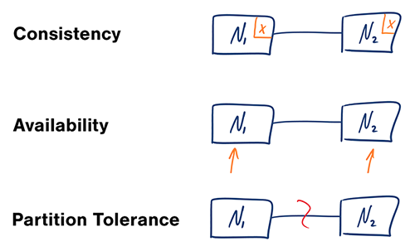
CAP Theorem
During network partitions, impossible to achieve both C and A
Notes:
CAP theorem says that during network partitions, it’s impossible to achieve both consistency and availability.
Consistency here means that reads will observe the most recent write. all future writes must observe values previously written to the system. This is the strongest form of consistency and there are many weaker forms, as we will see shortly, but this is what people usually mean when they say consistency in this context.
Availability means that read and write requests must be serviced by all live nodes (nodes that have not failed). For reads, there are no guarantees about the answer, and for writes, there are no guarantees about whether future reads will read your value, but the requests will succeed.
A COMMON misconception here is that you can “pick 2 out of 3” of these 3 properties. This is wrong and doesn’t make any sense. E.g. you can’t pick C and A because networks will fail and partitions are bound to happen.

Slide 5
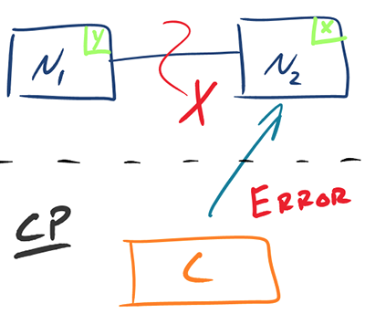
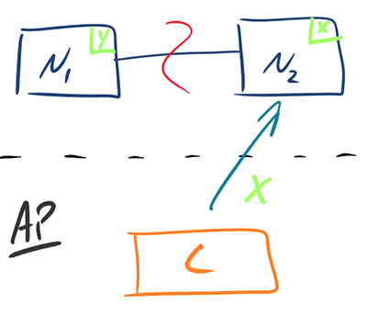
CAP Theorem
Notes:
To see why we can’t have both consistency and availability during a network partition, let’s look at the following example. Suppose here we have two servers N1 and N2, and a client C below the dotted line. When there is a partition between the two servers and client contacts N2, N2 can’t confidently write a value to the system consistently because it can’t talk to N1. Therefore, it has no choice but to return error. Thus, the system here is not available, but it has not violated any consistency constraints.
Now suppose we don’t care about consistency but we do want the system to be available during network partitions. Then if a client contacts N2 then we’ll simply write X to N2, even if we know N1 is not also updated. Thus, the system on the right is available but cannot offer any consistency guarantees.
IMPORTANT*: Note that these definitions of consistency and availability are extremes. In real systems there are many levels of consistency and availability and systems usually choose from a spectrum. This is just to get an intuition of why there is a fundamental tradeoff between the two properties. Although network partitions are very real errors in practice, this tradeoff is also applicable when the system is running smoothly.
To tie things back to our original discussion, Dynamo and Bayou are both systems that favor availability over consistency. And this is related to the particular use cases that these systems service.

Slide 6

Availability is important
Tens of millions of customers at peak times
Tens of millions of shopping cart requests, 3 million checkouts per day
Hundreds of thousands of concurrently active sessions
Strict Service-Level Agreements (SLAs) translate to business value
Notes:
First let’s start with Dynamo. It’s used internally for many services but the one that’s exposed to the user is shopping carts. It’s got tons of demand and is very related to revenue for the company. Bad experience on the website turns users away, which translates to lost revenue.

Slide 7
Dynamo
Fully decentralized, highly available key-value store
Always writeable, resolve conflicts during reads
API for clients to specify requirements (99.9th percentile)
Departure from RDBMS: simpler functionality, fewer guarantees, runs on commodity hardware (low-end, broadly compatible, non-specialized machines)
Notes:
SLA in terms of latency
NOTE: availability in this context does not simply mean we should always return success to the client. It also means we need to do it within a certain time bound (like 300ms) 99.9% of the time.
(we may want to define what “commodity hardware” means)

Slide 8
Techniques for achieving availability
Consistent hashing for partitioning key space
Vector clocks for reconciling conflicts during reads
Sloppy quorums for handling temporary failures
Anti-entropy using Merkle trees for syncing key-value pairs
Gossip-based protocol for membership notifications
Notes:
There are many techniques described in the paper. We will summarize them here.
IMPORTANT: It’s easy to get lost in the implementation details while we go through this list. Try to think about how each technique serves to achieve the high level goal of availability while going through each of them.

Slide 9
Techniques for achieving availability
Consistent hashing for partitioning key space
Vector clocks for reconciling conflicts during reads
Sloppy quorums for handling temporary failures
Anti-entropy using Merkle trees for syncing key-value pairs
Gossip-based protocol for membership notifications

Slide 10
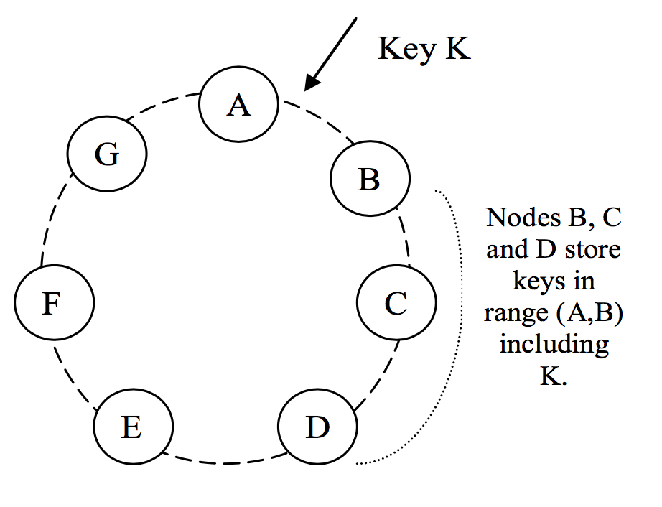
Consistent Hashing
Virtual Nodes
Assign each node a random position on the ring
Node owns the preceding key range
For fault tolerance, replicate each key at N successor nodes in the ring
Virtual nodes: each physical node gets assigned multiple nodes on the ring (e.g. B, D, F)
Notes:
Emphasize: “consistent” here has NOTHING to do with the “consistency” we talked about earlier.
The picture on the right: these are virtual nodes, NOT physical nodes.
What’s the purpose of the virtual nodes?
(From the paper)
If a node becomes unavailable (due to failures or routine maintenance), the load handled by this node is evenly dispersed across the remaining available nodes.
When a node becomes available again, or a new node is added to the system, the newly available node accepts a roughly equivalent amount of load from each of the other available nodes.
The number of virtual nodes that a node is responsible can decided based on its capacity, accounting for heterogeneity in the physical infrastructure.
(TL;DR virtual nodes help you achieve more uniform distribution of load across physical nodes)
Note that virtual nodes has NOTHING to do with replication. That is done by walking the circle clockwise from the key and picking the first N unique nodes.

Slide 11
Consistent Hashing
Desirable properties?
Uniform distribution of load
Minimum object movements when nodes join or leave the ring
Number of virtual nodes can be adjusted for device heterogeneity
Notes:
Primary advantage of consistent hashing:
purely distributed, no centralized lookup
no single point of failure
no extra hop to do lookup
hashing gives uniform distribution in general
nodes joining or leaving the system only affect immediate neighbors
Remember our original goal is to design a system that has high availability. How does this provide that?
Uniform distribution of load helps with load balancing
No overloaded server —> no unavailable server
Zero hop DHT: all nodes know exactly what nodes are responsible for which key range
The zero hop part really helps with latency SLAs

Slide 12
Techniques for achieving availability
Consistent hashing for partitioning key space
Vector clocks for reconciling conflicts during reads
Sloppy quorums for handling temporary failures
Anti-entropy using Merkle trees for syncing key-value pairs
Gossip-based protocol for membership notifications

Slide 13
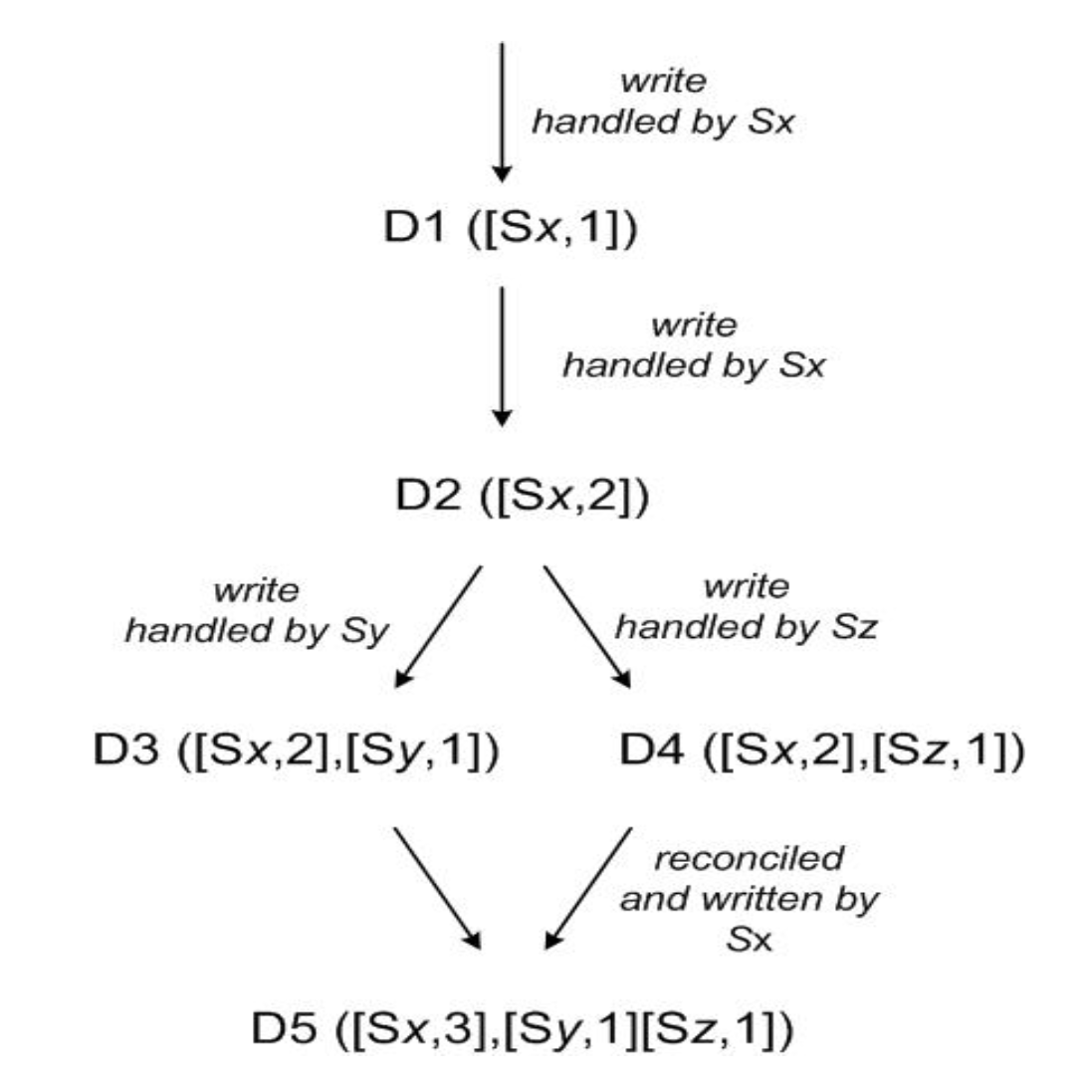
Conflict resolution
Two machines write different values to the same key
Vector clocks: list of (node, count) pairs where count is incremented on write
If one vector clock subsumes another, discard older value
Else, return all conflicting values to client
Notes:
Note that here we're only tracking causal dependencies between updates to a single object item, NOT across all items in key-value store.

Slide 14
Context contains vector clocks
Dynamo client API is simple:
get(key) (value, context)
put(key, value, context)
Common pattern: put after get

Slide 15
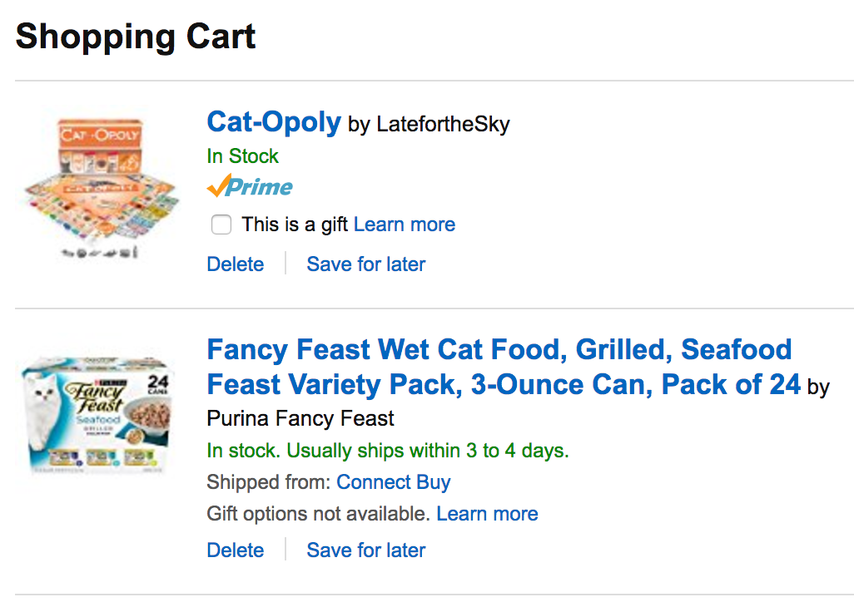


Notes:
Let’s say you and your brother are both trying to buy cat supplies at the same time on the same account. However, servers in the cloud somewhere are failing and your shopping cart is now updated to two different values. How to resolve the conflict?
Well, in the customer’s best interest, Amazon should not lose any items that were added to the cart, so we can just take the union of them. This is also in Amazon’s best interests because now you’re paying them more $$.

Slide 16

DELETE
Notes:
This kind of conflict resolution is highly specific to the application. In fact, this has some potential unexpected results: deleted items can resurface if we’re just taking the union of the shopping carts. This may be acceptable in some applications but not others. In our case, it’s OK because amazon has a ton of confirmation steps before the user actually buys the things. Also he can cancel at any time.

Slide 17
Conflict resolution
Two machines write different values to the same key
Vector clocks: list of (node, count) pairs where count is incremented on write
If one vector clock subsumes another, discard older value
Else, return all conflicting values to client
Notes:
RECAP
So this is how conflict resolution is done in Dynamo. Note: In practice this RARELY happens. 99.9% requests saw exactly 1 version, less than 0.001% saw 2 or more. Though it happens rarely we still need to handle it unfortunately!
(From the paper)
In our next experiment, the number of versions returned to the shopping cart service was profiled for a period of 24 hours. During this period, 99.94% of requests saw exactly one version; 0.00057% of requests saw 2 versions; 0.00047% of requests saw 3 versions and 0.00009% of requests saw 4 versions. This shows that divergent versions are created rarely.
QUESTION: How is this related to availability?
Writes are now always available, because you don’t check for consistency before writing. You just write
Leave conflict resolution to the reads. This happens so little of the time the extra overhead doesn’t really contribute to the latency even in the 99.9th percentile case.

Slide 18
Techniques for achieving availability
Consistent hashing for partitioning key space
Vector clocks for reconciling conflicts during reads
Sloppy quorums for handling temporary failures
Anti-entropy using Merkle trees for syncing key-value pairs
Gossip-based protocol for membership notifications

Slide 19
Sloppy Quorums
Write to N nodes, return success when W < N nodes respond
Read from N nodes, return value(s) from R < N nodes
Typically, W+R > N means at least one writer and one reader overlap, so values are consistent
Sloppy here means skip nodes that have failed, such that even if W+R > N, the readers and writers may not overlap = not consistent!
Notes:
By “skip” here we mean the hinted handoff mechanism. Writes now go to virtual nodes next in the ring which are not the N = 3 nodes that the reads try to read from. This is why readers and writers may not overlap.

Slide 20
Sloppy Quorums
Example:
Typical values are N = 3, W = R = 2
Nodes C and D have failed, so key k is written to E and F instead
Nodes C and D recover, and now client tries to read from C and D = stale value
Notes:
We can’t JUST rely on sloppy quorums because clients get stale value that may never get updated. If we just leave it at that then this system is not even eventually consistent. We need to get the new value for K back to C and D somehow.

Slide 21
Hinted Handoff
“Hint” refers to the node the data originally belongs to
Example:
Nodes E and F remember they are writing on behalf of C and D
As soon as C and D recovers, E and F transfer their values for k to C and D
Notes:
Dynamo does this using “hinted handoff”, where the hint refers to the location information of the original data. So hinted handoff is really part of making sloppy quorums work.

Slide 22
Sloppy Quorums
Write to N nodes, return success when W < N nodes respond
Read from N nodes, return value(s) from R < N nodes
Typically, W+R > N means at least one writer and one reader overlap, so values are consistent
Sloppy here means skip nodes that have failed, such that even if W+R > N, the readers and writers may not overlap = not consistent!
Notes:
RECAP
We saw that sloppy quorums sacrifice consistency when things fail. How does this help with availability?
If we always try to ensure readers and writers overlap, then if enough things fail we might end up waiting for the nodes to come back up. This may take a long time = in the meantime the system is not available.
If we always just pick from N healthy nodes, then we’ll return ASAP without waiting for any failed nodes to come back up

Slide 23
Techniques for achieving availability
Consistent hashing for partitioning key space
Vector clocks for reconciling conflicts during reads
Sloppy quorums for handling temporary failures
Anti-entropy using Merkle trees for syncing key-value pairs
Gossip-based protocol for membership notifications

Slide 24
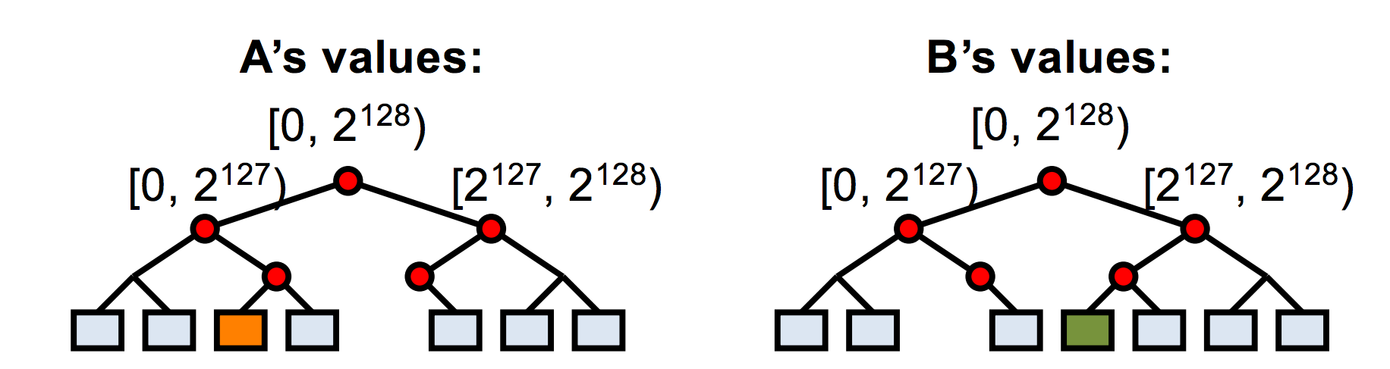
Anti-entropy using Merkle trees
Goal: minimize durability loss from above techniques
Nodes responsible for the same key spaces exchange Merkle trees
Find differences quickly while exchanging little information
Notes:
Anti-entropy means reducing differences between the state stored across the replica nodes (remember we replicate the same partition to N different nodes in the ring). In an ideal world we’ll have the exact same data on all N nodes, but this doesn’t happen in practice because:
Writes keep coming in and are not immediately propagated to all replicas
Nodes join and leave the ring: partitions are passed around across the nodes in the process
NOTE:* Anti-entropy is necessary for eventual consistency because we want the replicas to all EVENTUALLY return a consistent view of all the values in the key range. This is a pretty weak guarantee (and may in fact never happen if writes keep coming in)!
Anyway, to make anti-entropy faster, Dynamo uses this special data structure called Merkle trees. Each leaf node corresponds to an actual key value pair, and all other nodes are hashes of its children.
When exchanging information in an anti-entropy session, nodes start at the root and exchange only the hash in the root. If the hash matches, great, the two nodes agree and the session terminates. Otherwise, the two nodes keep traversing down the tree until they find the value that doesn’t match. In this case the orange and green values are at odds. So A and B will exchange orange and green to each other such that the root hashes become the same.
NOTE: Only leaf nodes correspond to actual key value pairs. The tree itself stores the hashes of the values. Why not just store the hash of the key? (Because values might get updated for the same key, in which case we want the change to be reflected on both nodes).
How does this provide availability?
It doesn’t, really (at least not directly)
It just helps with eventual consistency, which is a level of consistency that can be achieved in a highly available system

Slide 25
Techniques for achieving availability
Consistent hashing for partitioning key space
Vector clocks for reconciling conflicts during reads
Sloppy quorums for handling temporary failures
Anti-entropy using Merkle trees for syncing key-value pairs
Gossip-based protocol for membership notifications

Slide 26
Membership notification
Gossip-based protocol to propagate membership changes
Each node learns the key spaces handled by all other nodes
Result: zero-hop distributed hash table (DHT)
Clearly not infinitely scalable, but storage requirement not a problem in practice
Notes:
This helps with read and write latency of each request, which helps Dynamo achieve its SLAs.
In practice the storage requirement has been pretty OK because it only scales with the number of nodes and partitions, NOT the number of key value pairs (which would be prohibitive). As long as you keep your dynamo deployment small enough (fewer nodes, like 10s or 100s) then you should be fine.

Slide 27
Bayou
What is it?
Weakly consistent, replicated storage system
Goals:
Maximize availability, support offline collaboration
Minimize network communication
Agree on all values (eventually)
Notes:
Also tries to achieve availability, but one big difference between bayou and dynamo is that bayou also additionally makes supporting offline collaboration one of its main goals

Slide 28
Bayou Writes
Primary
Versions
P: 0
A: 0
B: 0
W(X, 4)
Client 1
Legend
Commit Timestamp:Write Timestamp:Write Server
A
Versions
B
Versions
P: 0
A: 0
B: 0
P: 0
A: 0
B: 0

Slide 29
Bayou Writes
Primary
Versions
∞:1:P W(X,4)
P: 1
A: 0
B: 0
Client 1
Legend
Commit Timestamp:Write Timestamp:Write Server
A
Versions
B
Versions
P: 0
A: 0
B: 0
P: 0
A: 0
B: 0
Notes:
EXPLAIN THE COLON SYNTAX (Commit timestamp:write timestamp:write server) Commit timestamp is infinity if tentative write.

Slide 30
Bayou Writes
Primary
Versions
∞:1:P W(X,4)
P: 1
A: 0
B: 0
Client 1
W(Y, 8)
Legend
Commit Timestamp:Write Timestamp:Write Server
Client 2
A
B
Versions
Versions
W(X, 3)
P: 0
A: 0
B: 0
P: 0
A: 0
B: 0

Slide 31
Bayou Writes
Primary
Versions
∞:1:P W(X,4)
∞:7:P W(Y,8)
P: 7
A: 0
B: 0
Client 1
W(Z, 8)
Legend
Commit Timestamp:Write Timestamp:Write Server
Client 2
A
B
W(Y, 4)
Versions
Versions
∞:7:A W(X,3)
P: 0
A: 7
B: 0
P: 0
A: 0
B: 0

Slide 32
Bayou Writes
Primary
Versions
∞:1:P W(X,4)
∞:7:P W(Y,8)
P: 7
A: 0
B: 0
Legend
Commit Timestamp:Write Timestamp:Write Server
A
Versions
B
Versions
∞:7:A W(X,3)
∞:12:A W(Y,4)
P: 0
A: 12
B: 0
∞:5:B W(Z,8)
P: 0
A: 0
B: 5

Slide 33
Bayou Anti-Entropy
P
Versions
∞:1:P W(X,4)
∞:7:P W(Y,8)
P: 7
A: 0
B: 0
Anti-Entropy Session
A & B
A
Versions
B
Versions
P: 0
A: 0
B: 5
∞:5:B W(Z,8)
∞:7:A W(X,3)
∞:12:A W(Y,4)
P: 0
A: 12
B: 0
∞:5:B W(Z,8)
P: 0
A: 0
B: 5
P: 0
A: 12
B: 0
∞:7:A W(X,3)
∞:12:A W(Y,4)

Slide 34
Bayou Anti-Entropy
P
Versions
∞:1:P W(X,4)
∞:7:P W(Y,8)
P: 7
A: 0
B: 0
A
Versions
B
Versions
∞:5:B W(Z,8)
∞:7:A W(X,3)
∞:12:A W(Y,4)
P: 0
A: 12
B: 5
∞:5:B W(Z,8)
∞:7:A W(X,3)
∞:12:A W(Y,4)
P: 0
A: 12
B: 5

Slide 35
Bayou Commit
P
Versions
1:1:P W(X,4)
2:7:P W(Y,8)
P: 7
A: 0
B: 0
Primary commits its entries
A
Versions
B
Versions
∞:5:B W(Z,8)
∞:7:A W(X,3)
∞:12:A W(Y,4)
P: 0
A: 12
B: 5
∞:5:B W(Z,8)
∞:7:A W(X,3)
∞:12:A W(Y,4)
P: 0
A: 12
B: 5

Slide 36
Bayou Write
P
Versions
1:1:P W(X,4)
2:7:P W(Y,8)
P: 7
A: 0
B: 0
Write after anti-entropy session
Write timestamp = max(clock, max(TS)+1)
Client 1
D(Y)
A
Versions
B
Versions
∞:5:B W(Z,8)
∞:7:A W(X,3)
∞:12:A W(Y,4)
P: 0
A: 12
B: 5
∞:5:B W(Z,8)
∞:7:A W(X,3)
∞:12:A W(Y,4)
∞:13:B D(Y)
P: 0
A: 12
B: 13
Notes:
D(Y) == delete(Y)

Slide 37
Bayou Anti-Entropy
P
Versions
1:1:P W(X,4)
2:7:P W(Y,8)
P: 7
A: 0
B: 0
Anti-Entropy Session
P & B
P: 0
A: 12
B: 13
∞:5:B W(Z,8)
∞:7:A W(X,3)
∞:12:A W(Y,4)
∞:13:B D(Y)
A
Versions
B
Versions
1:1:P W(X,4)
2:7:P W(Y,8)
∞:5:B W(Z,8)
∞:7:A W(X,3)
∞:12:A W(Y,4)
P: 0
A: 12
B: 5
∞:5:B W(Z,8)
∞:7:A W(X,3)
∞:12:A W(Y,4)
∞:13:B D(Y)
P: 0
A: 12
B: 13
P: 7
A: 0
B: 0

Slide 38
Bayou Anti-Entropy
P
Versions
1:1:P W(X,4)
2:7:P W(Y,8)
∞:5:B W(Z,8)
∞:7:A W(X,3)
∞:12:A W(Y,4)
∞:13:B D(Y)
P: 7
A: 12
B: 13
Anti-Entropy Session
P & B
Primary respects causality
A
Versions
B
Versions
∞:5:B W(Z,8)
∞:7:A W(X,3)
∞:12:A W(Y,4)
P: 0
A: 12
B: 5
1:1:P W(X,4)
2:7:P W(Y,8)
∞:5:B W(Z,8)
∞:7:A W(X,3)
∞:12:A W(Y,4)
∞:13:B D(Y)
P: 7
A: 12
B: 13
Notes:
Since the Primary begins its log at 1 and each commit timestamp is incremented by 1 B knows that it’s tentative write will be committed after those writes with commit timestamps 1 and 2.

Slide 39
Bayou Commit
P
Versions
1:1:P W(X,4)
2:7:P W(Y,8)
3:5:B W(Z,8)
4:7:A W(X,3)
5:12:A W(Y,4)
6:13:B D(Y)
P: 7
A: 12
B: 13
Primary commits Its entries
A
Versions
B
Versions
∞:5:B W(Z,8)
∞:7:A W(X,3)
∞:12:A W(Y,4)
P: 0
A: 12
B: 5
1:1:P W(X,4)
2:7:P W(Y,8)
∞:5:B W(Z,8)
∞:7:A W(X,3)
∞:12:A W(Y,4)
∞:13:B D(Y)
P: 7
A: 12
B: 13

Slide 40
Bayou
P
Versions
1:1:P W(X,4)
2:7:P W(Y,8)
3:5:B W(Z,8)
4:7:A W(X,3)
5:12:A W(Y,4)
6:13:B D(Y)
P: 7
A: 12
B: 13
After a number of commits
and anti-entropy sessions
(without further writes)
A
Versions
B
Versions
1:1:P W(X,4)
2:7:P W(Y,8)
3:5:B W(Z,8)
4:7:A W(X,3)
5:12:A W(Y,4)
6:13:B D(Y)
P: 7
A: 12
B: 13
1:1:P W(X,4)
2:7:P W(Y,8)
3:5:B W(Z,8)
4:7:A W(X,3)
5:12:A W(Y,4)
6:13:B D(Y)
P: 7
A: 12
B: 13

Slide 41
Bayou and Dynamo similarities
Anti-entropy to achieve eventual consistency
Exchange vector clocks to determine order of operations
Expose conflict resolution to application
High availability!
Notes:
Also tries to achieve availability, but one big difference between bayou and dynamo is that bayou also additionally makes supporting offline collaboration one of its main goals

