Slide 1
Introduction: Sparse Identification of Nonlinear Dynamics (SINDy)
SINDy (Sparse Identification of Nonlinear Dynamical Systems) is a machine-learning method for discovering governing equations from data.
i.e. SINDy can guess the coefficients of the governing equations when we give the data to SINDy.
SINDy can be applied to linear and nonlinear dynamical systems.

Slide 2
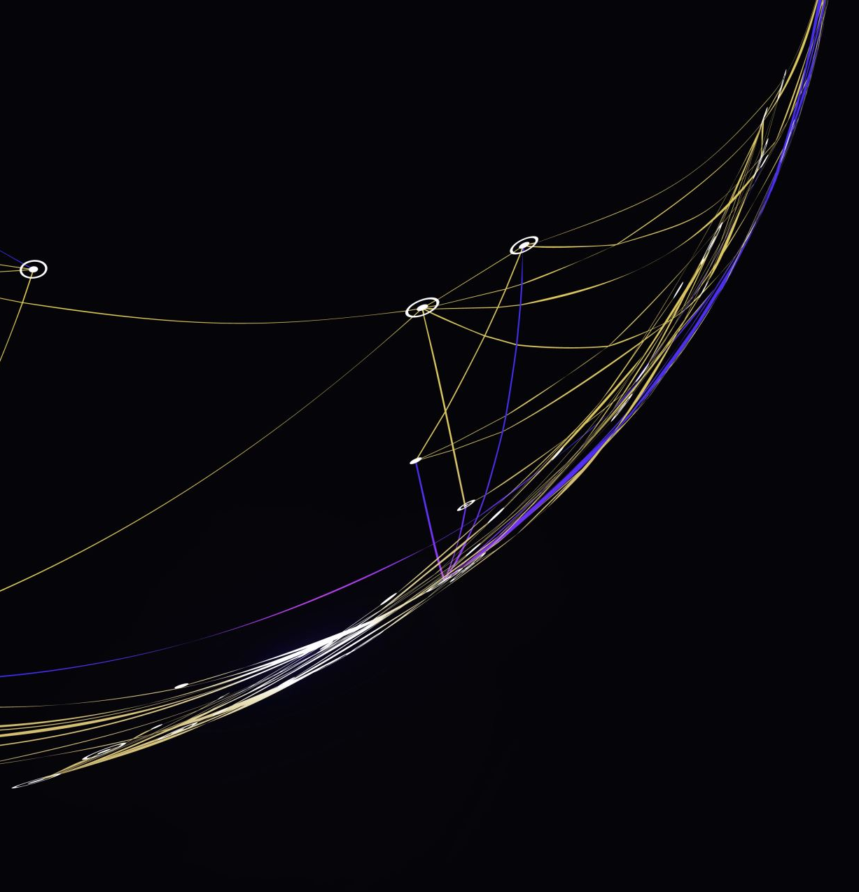

Optimizing Linear 3D dynamical systems
We will consider the following Linear 3D system:
$\frac{d}{dt} \left[\begin{matrix}x \\ y \\ z\end{matrix}\right]= \left[\begin{matrix}−0.1 & −2 & 0 \\ 2 & −0.1 & 0 \\ 0 & 0 & −0.3\end{matrix}\right] \left[\begin{matrix}x \\ y \\ z\end{matrix}\right]$
Assume this is a true system that is unknown.
Also, assuming we know x, y, and z, SINDy will try to find differential equations that fit x, y, z. However, SINDy has a threshold parameter that user must specify.

Slide 3
Goal: Finding “Optimal” Threshold with respect to Minimizing Linear, Nonlinear, and Total Errors in an efficient way
I used several approaches to find an “optimal” threshold for SINDy
The “optimal” threshold (in my case): minimize the number of searches to find one the smallest minimum linear error in a fast way.
i.e., Find the minimum linear error in the fastest way without doing 1000 times folds conventional numerical iterations.
e.g. For 5 decimal places, I can find the minimum linear error with 50 model calculations with my algorithm. However, a Linear Search algorithm would take 50,000 model calculations.

Slide 4
Linear Search Algorithm
Linear Search is inefficient and hugely time-consuming
Basically, we search every threshold and need to see which one would give us the least amount of error
This would work if we lived forever in space and time, so it is impossible
Average Linear 3D Dynamical Systems with a linespace of 50 will run for 2 seconds
Meaning that 1 million searches will take 2 million seconds

Slide 5
Searching Decimal Window Algorithm
We developed this algorithm since we are looking for minimum values
There are so many optimal thresholds that it is unlikely to find an absolute max or min (i.e., multiple thresholds exist for the same minimum linear error.)
Here, we narrow down our search to a specific decimal search window
Gradient Descent is used in a machine learning algorithm that uses a cost function and follows the gradient of that cost function to find the minimum.
However, we are willing to use a slightly modified version, we will call it the Searching Decimal Window Algorithm

Slide 6
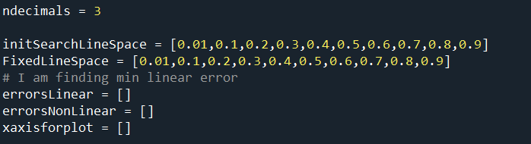
The initial search space
This is the setup for our search space. We will search through each decimal place, so our initial search space is [0.01 0.1 0.2 .. 0.9 ]. We need to go one decimal place further because it is impossible to have 0 as an optimal digit. So, we need to go one more decimal place for the first element in the array.
The fixed line space should not be changed, and it is only for calculating the subsequent iterations of search space
We also define 3 arrays that we need to plot and save errors

Slide 7

Searching Decimal Window Algorithm
We will find the “optimal” threshold by searching the first decimal places, and we find the best for the first decimal place and decide on the next set of thresholds to test.
We have to overcome Python’s limit on floating point operations by using the Decimal package, which stores the number as a string and not as a float type.
Storing numbers this way is very inefficient and cumbersome to calculate numbers, but, for each decimal place, we only need to test 10 thresholds so this inefficiency could be overlooked

Slide 8
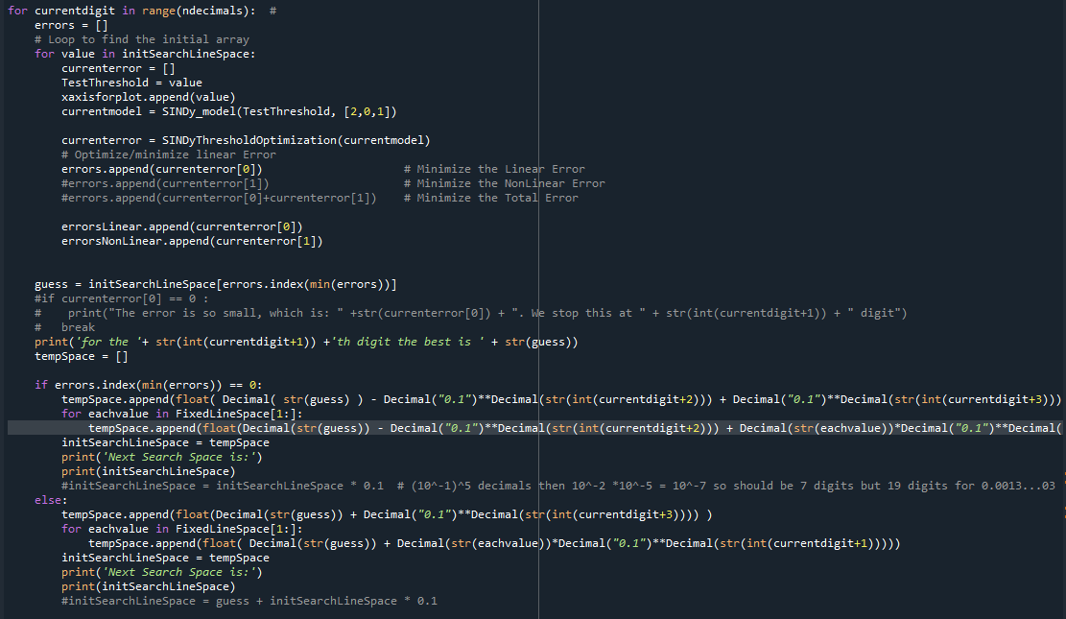
Decimal Search Window Algorithm: Error function
Linear Error (min): Since we are working with a Linear 3D model, a dynamical system without non-linear terms, we could calculate the absolute difference error of the coefficients
LinErr is how far away the coefficient is between SINDy and the true linear model.
Non-Linear Error: Just like the Linear error, any non-Linear term that is generated is the Non-Linear error
NonLinErr is generated by SINDy system by overfiting the data.
NonLinErr should not exist in the true model because our intended system is linear only.
Total Error: This is simply the sum of the Linear Error and Non-Linear Error
We try to find the “optimal”(best) threshold that minimizes linear, non-linear, or total Error. For sure, our decimal search window algorithm is better than the linear search algorithm.

Slide 9
Decimal Search Window (DSW) Algorithm: Error measurements
We calculate the Linear Error by subtracting the actual coefficient from the simulated coefficient provided by SINDy, taking the absolute value of it, doing the same for every coefficient, and adding it all up.
For the Non-Linear Errors we will take the absolute value of all the non-Linear errors and add them all up
We could include other methods of calculating errors like the mean square error, but in my testing, it yields the same results for an optimal threshold. This makes me believe that the method of obtaining the Error is not important

Slide 10
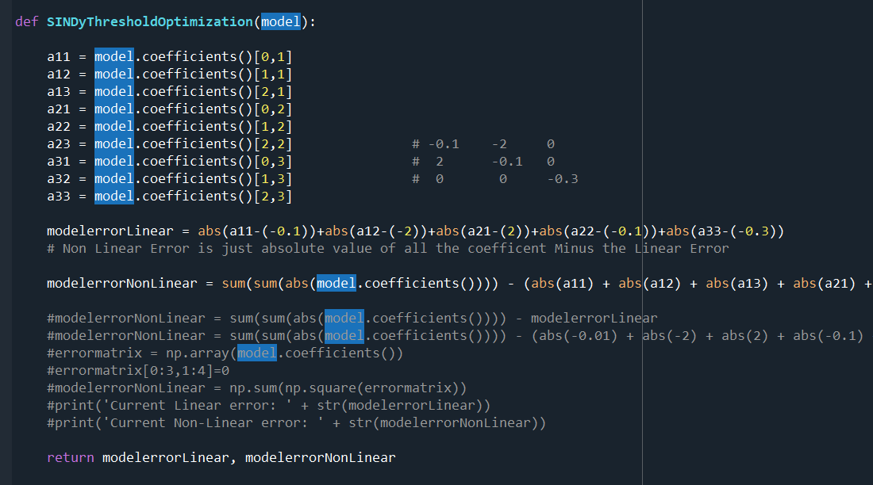
Error function code

Slide 11
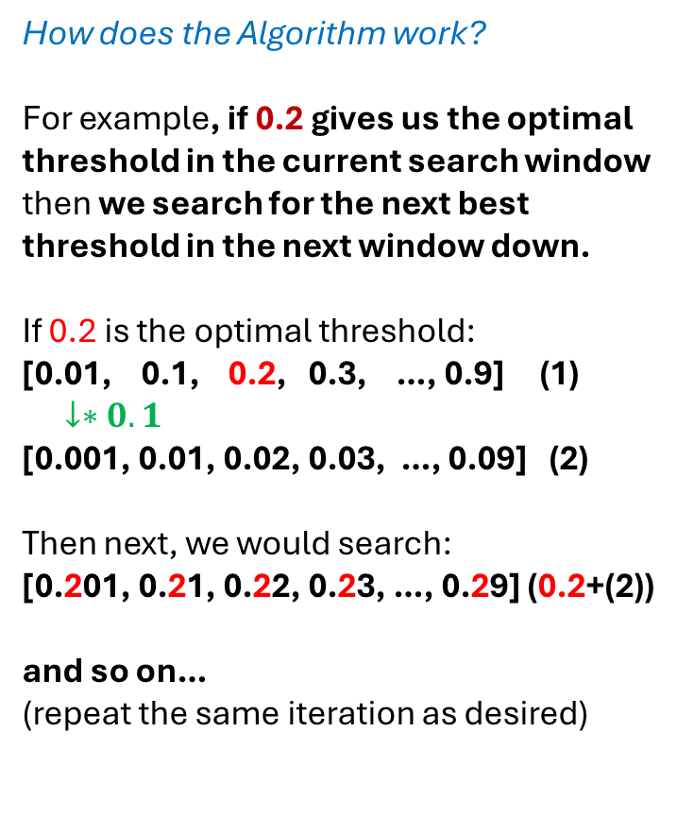
The Search Window Algorithm
How does the Algorithm work?
For example, if 0.2 gives us the optimal threshold in the current search window then we search for the next best threshold in the next window down.
If 0.2 is the optimal threshold:
[0.01, 0.1, 0.2, 0.3, …, 0.9] (1)
$↓∗0.1$
[0.001, 0.01, 0.02, 0.03, …, 0.09] (2)
Then next, we would search:
[0.201, 0.21, 0.22, 0.23, …, 0.29] (0.2+(2))
and so on…
(repeat the same iteration as desired)

Slide 12
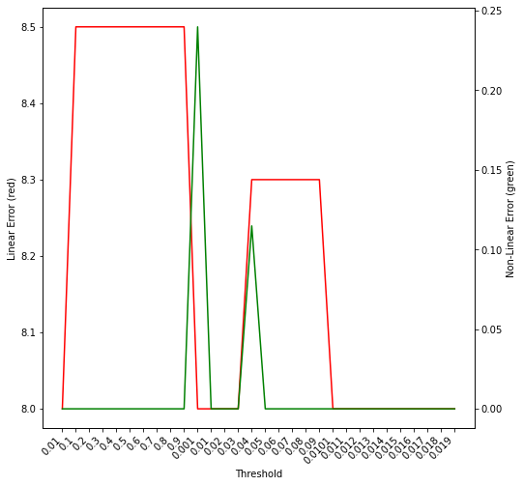
SDW: Sample Graph (Continue)
We use a 2 vertical axis approach to graphing our results
- Linear errors are Red (on the left y-axis)
- Non-linear errors are Green (on the right y)
Since the scale of linear error and non-linear error is significantly different if we want to plot them the y-axis on the left is Linear Errors and the y-axis on the right is the non-linear Error
X-Axis is all the thresholds we tried
- if ndecimal=3, 30 steps sided in the x-axis
As you can see some thresholds give very large Non-Linear errors but have smaller Linear errors, but for some thresholds like 0.01 the linear error is large, but the non-linear error is small

Slide 13
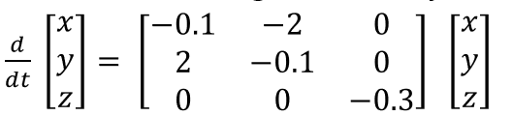
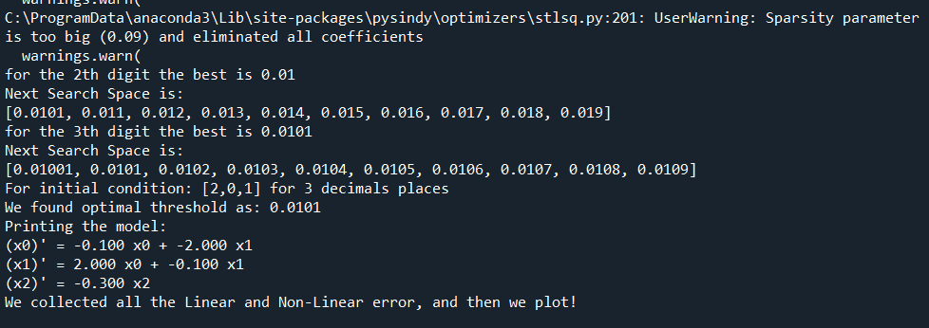





Sample Run Outputs (Continue)

Slide 14
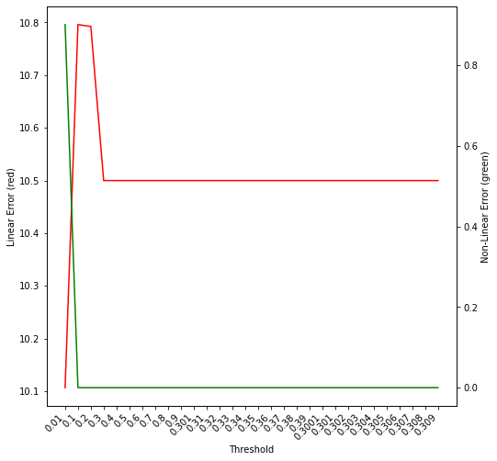
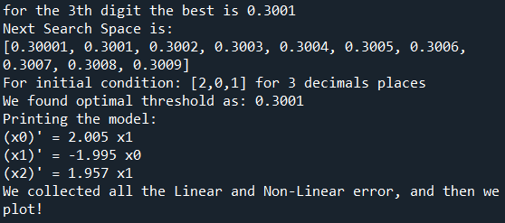

Test another Matrix
$\frac{d}{dt} \left[\begin{matrix}x \\ y \\ z\end{matrix}\right]= \left[\begin{matrix}−0.1 & 2 & 0 \\ −2 & −0.1 & 0 \\ 0 & 2 & −0.3\end{matrix}\right] \left[\begin{matrix}x \\ y \\ z\end{matrix}\right]$
errors.append(currenterror[0]+currenterror[1])
# Minimize the Total Error

Slide 15
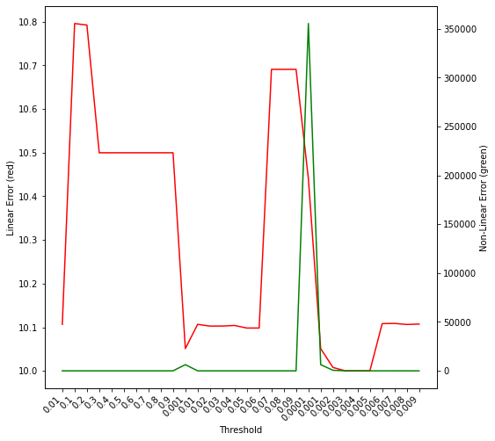
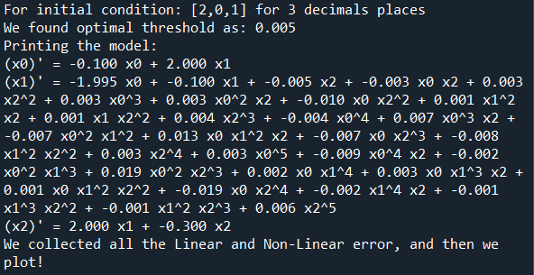

Test another Matrix
$\frac{d}{dt} \left[\begin{matrix}x \\ y \\ z\end{matrix}\right]= \left[\begin{matrix}−0.1 & 2 & 0 \\ −2 & −0.1 & 0 \\ 0 & 2 & −0.3\end{matrix}\right] \left[\begin{matrix}x \\ y \\ z\end{matrix}\right]$
errors.append(currenterror[0])
# Minimize the Linear Error

Slide 16
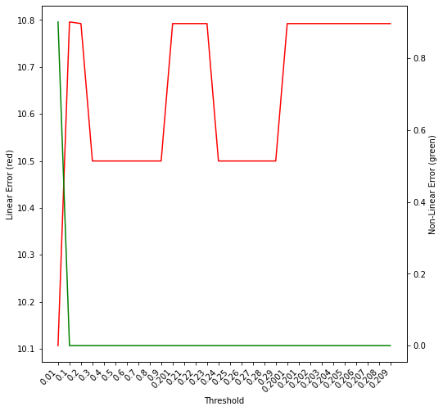
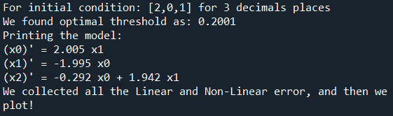

Test another Matrix
$\frac{d}{dt} \left[\begin{matrix}x \\ y \\ z\end{matrix}\right]= \left[\begin{matrix}−0.1 & 2 & 0 \\ −2 & −0.1 & 0 \\ 0 & 2 & −0.3\end{matrix}\right] \left[\begin{matrix}x \\ y \\ z\end{matrix}\right]$
errors.append(currenterror[1])
# Minimize the NonLinear Error

Slide 17
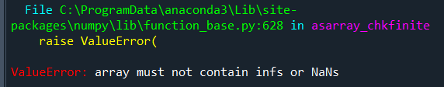
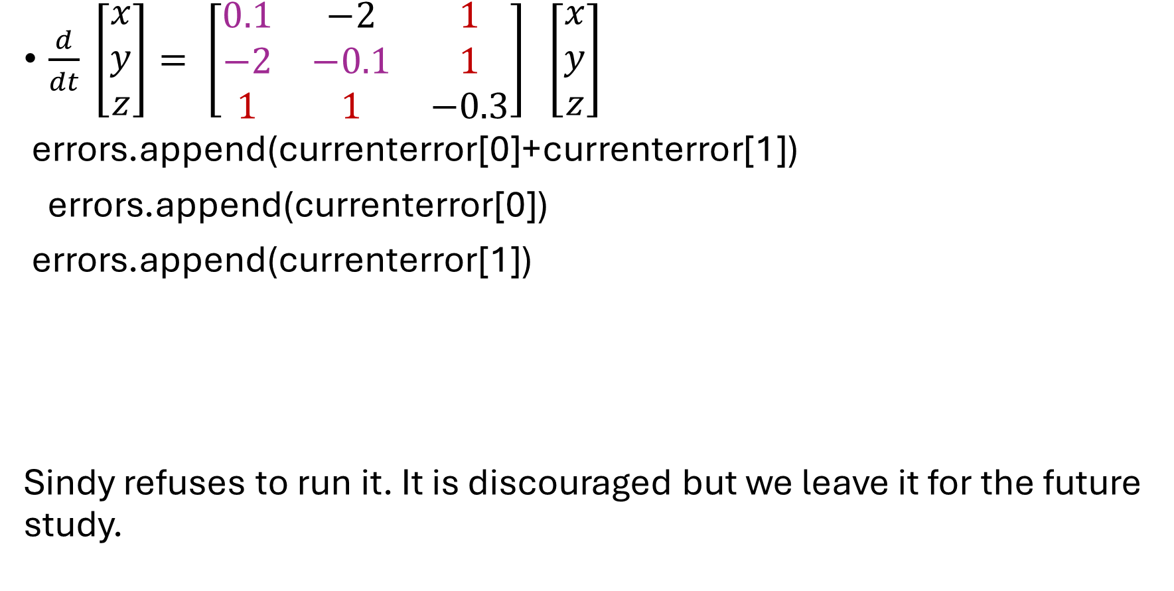
Test another Matrix
$\frac{d}{dt} \left[\begin{matrix}x \\ y \\ z\end{matrix}\right]= \left[\begin{matrix}0.1 & −2 & 1 \\ −2 & −0.1 & 1 \\ 1 & 1 & −0.3\end{matrix}\right] \left[\begin{matrix}x \\ y \\ z\end{matrix}\right]$
errors.append(currenterror[0]+currenterror[1])
errors.append(currenterror[0])
errors.append(currenterror[1])
Sindy refuses to run it. It is discouraged but we leave it for the future study.

Slide 18
Conclusion:
It is not easy to choose the best Thresholds.
SINDy is quite sensitive to Threshold parameters.
There are a lot of unknown factors and curiosities we need to explore and study…

