Slide 1
Smart Glass—
Visible
Vehicles Controlling System

Slide 2
Expected Functions
—Distance Controlling
Distance Displaying, Reminding & Warning (in Smart Windshield Glass)
Automatic Braking
Distance Judgement (from the traffic lights)

Slide 3
Necessity of Smart Glass—Safety
Avoiding Interacting with Voices (eg. navigation purposes in voices)
Focus merely on Road Conditions (no need to look at other screen)
More Salient Image Presentation (visible:Quantitative & Intuitive)
Complete Visible Platform—(eg. put dash board/fuel gauge on the Glass…)

Slide 4
Feasibility Analysis
Sensor：Ranging Sensor
Grove - Starter Kit Plus
Intel Galileo/Edison (Arduino)
Car Models
Smart Glass
Ultrasonic Ranging
Laser Ranging
Infrared Ranging
Radar Ranging

Slide 5
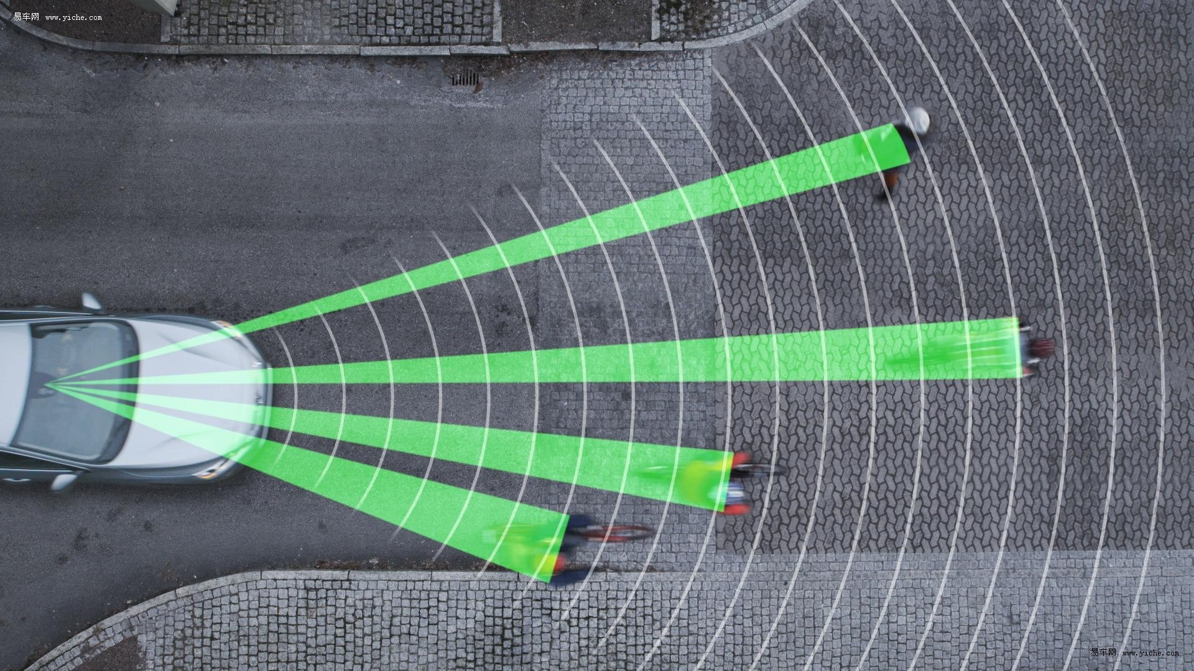
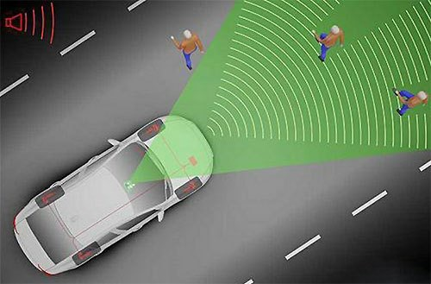
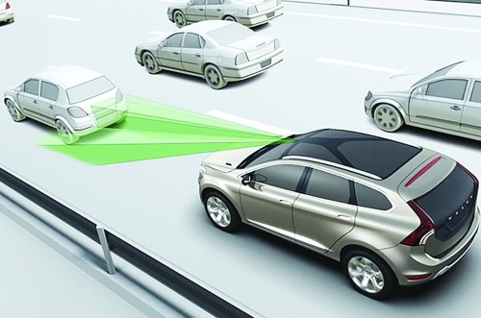
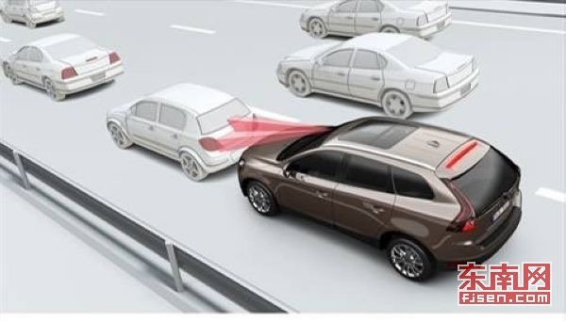
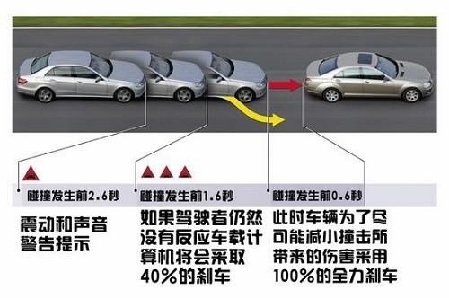
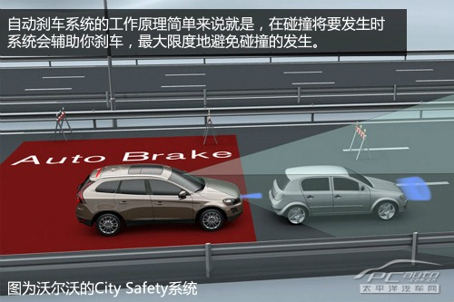
Industry Status—
CITY SAFETY of Volvo

Slide 6
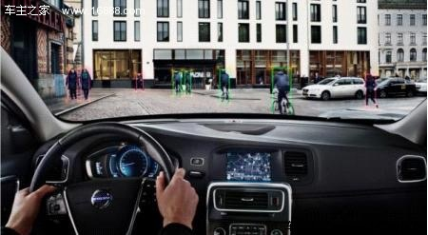
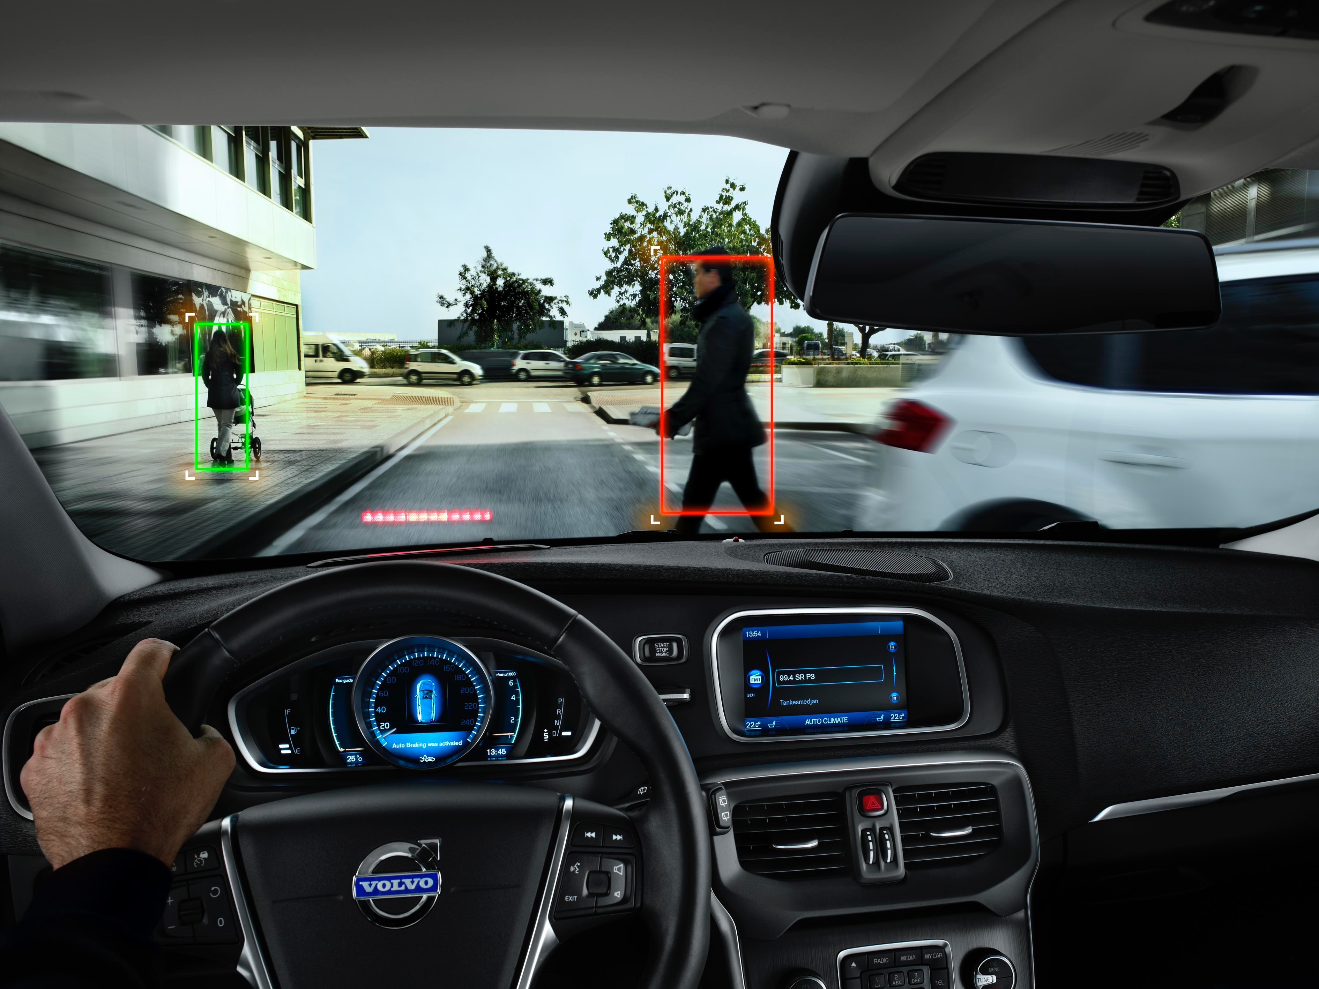
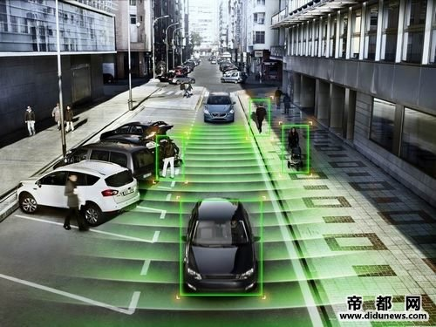
Improvements—
Combining with Smart Glass

