Slide 1
AN AGENTIC COURTROOM FOR SCAM DEFENCE
GUILTY
G A V E L
Every scam gets a fair trial.
The AI investigates. You judge.
HOKKIEN MEE IS RED · GAVEL · 2026
Notes:
0:00–0:08 — GAVEL. Every scam gets a fair trial. The AI investigates; you judge.

Slide 2
THE PROBLEM
Scams are won in moments of decision.
Seconds, engineered.
Scores, not verdicts.
Never 'probably' safe.
A parcel-fee SMS, a bank alert, a job offer. The moment of decision is short — and every second of it is built against the person holding the phone.
Detectors return a number and call it an answer. They never show their working, and they never let you see why.
Honest bills, delivery notices and bank alerts arrive every day — and get counted as risk alongside the scams.
Today's defences answer the wrong question: 'is this on a blocklist?' — never 'what should I do, right now?'
02 / 12
Notes:
0:08–0:33 — Scams are won in moments of decision. Detectors return a score; we hand the person a trial.

Slide 3
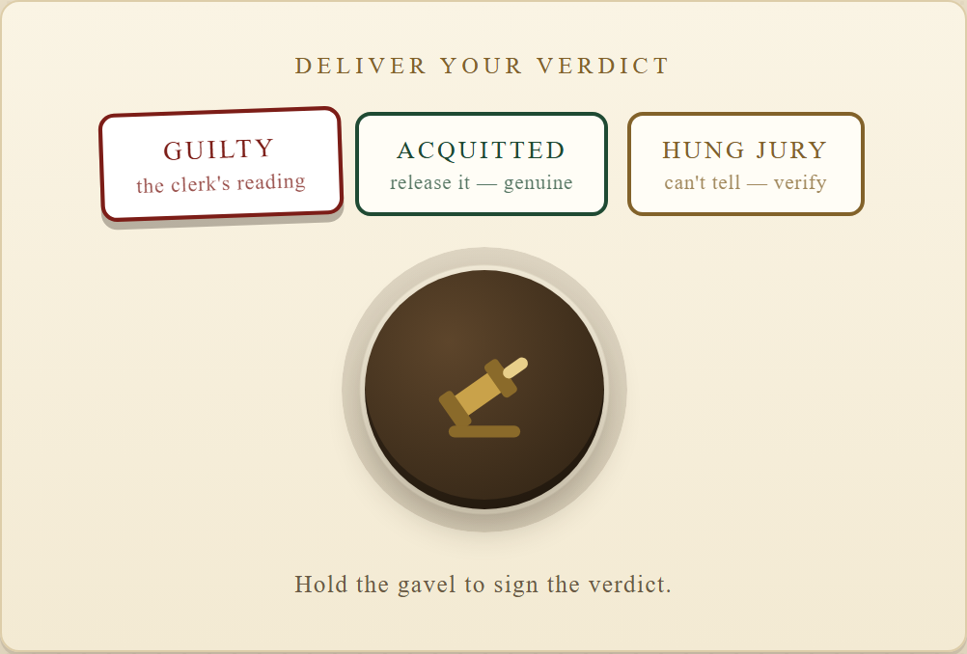
THE IDEA
A courtroom, not a scanner.
Anything suspicious — a message, a link, a QR code, a document, a voice note — is booked as a case and put on trial.
The Prosecutor files numbered exhibits, pinned to the exact words that raised them.
The Defence argues the benign reading — the brand's real domain, the shape of a genuine notice.
The Clerk writes the bench memo — charge, evidence, counter-evidence, honest confidence.
The gavel zone — the verdict is yours to swing.
GUILTY · ACQUITTED · HUNG JURY — then the gavel is yours.
03 / 12
Notes:
0:33–0:58 — One metaphor: exhibits, prosecutor, defence, clerk — and the gavel stays with the user.

Slide 4
THE TRIAL
Five steps, one courtroom.
1
2
3
4
5
Book a case
Exhibits filed
Officers speak
Swing the gavel
The sentence
Paste a message, upload a file, scan a QR code — or speak it.
Numbered findings, each quoted back to your own words.
Prosecutor, defence and clerk — every line checked against the record.
GUILTY, ACQUITTED, or HUNG JURY when the evidence cannot decide.
Next-five-minutes checklist, a cooling clock, redacted alerts.
No account. No install. The court convenes in your browser — with or without a network.
04 / 12
Notes:
0:58–1:18 — Five steps. No account, no install, works offline.

Slide 5
THE ENGINE AND THE OFFICERS
Three readers, three officers.
THE ENGINE
THE OFFICERS
A text classifier trained and calibrated on 5,574 labelled messages.
Offline URL anatomy — homoglyphs, subdomain chains, credentials in the URL, shorteners.
QR decode: where the code actually goes, before you tap.
Document and voice intake — text is extracted, never executed.
Deterministic triage runs first, with zero network.
The Prosecutor opens the case and reads the strongest exhibits. The tools ran first — deterministically, before any officer speaks.
The Defence argues the benign reading — the brand's real domain; the honest notice.
The Clerk writes the bench memo: charge, evidence, counter-evidence, honest confidence band.
Every drafted speech passes a verification gate before it may speak.
One engine, two implementations — the Python training pipeline and the live TypeScript runtime are parity-tested.
05 / 12
Notes:
1:18–1:43 — The tools are deterministic and run first; the agents argue over a fixed record. They cannot choose what to inspect.

Slide 6
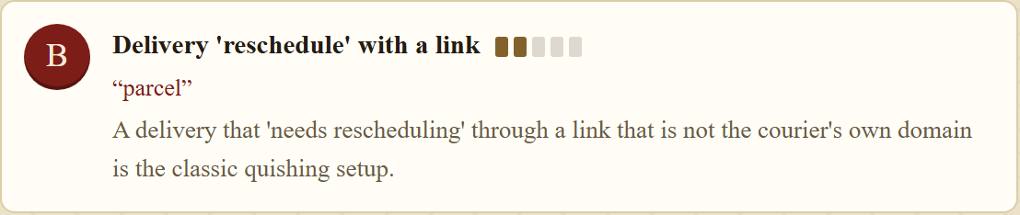
THE VERIFICATION GATE
Every word on screen is sourced.
Every quoted word in a drafted speech must exist character-for-character in the court record.
Exhibit A — quoted back onto the message itself, character for character.
A draft that invents evidence is discarded — fabricated quotes reach the screen zero times, by construction. No model? Offline, rate-limited, or failing the gate, the scripted bench compiles the officers' arguments deterministically from the exhibits — the courtroom completes every trial.
06 / 12
Notes:
1:43–2:03 — The gate checks every quote character-for-character; failed drafts never reach the screen.

Slide 7
MEASURED NUMBERS
Measured, not promised.
0.9990
96.8%
96.0%
0.44%
0.06
HELD-OUT AUC
PRECISION
SCAM RECALL
FALSE ALARMS
MS PER CASE
classifier · UCI SMS Spam, 5,574 msgs · calibration error 0.0060
shipped engine · 1,032 held-out messages
shipped engine · 1,032 held-out messages
of genuine messages · 0.87% sent to hung jury
on device · every case, no network needed
24/24 authored golden cases pass in the shipped test suite · every published number is regenerated by the repository's own evaluation scripts.
07 / 12
Notes:
2:03–2:25 — Held-out numbers, reproduced by the repo's scripts.

Slide 8
PRIVACY
Nothing is blocked, sent, or filed without you.
0
Local mode — the message never leaves the device. No upload, no network, no trace.
Masked by default — personal identifiers are stripped before anything is shared, with you or with anyone you warn.
Installs nothing — it runs on a free tier and keeps your archive in your own browser.
messages leave the device in local mode
Privacy is the default — not a setting you have to find.
08 / 12
Notes:
2:25–2:37 — Local mode: nothing leaves the device; identifiers masked before sharing.

Slide 9
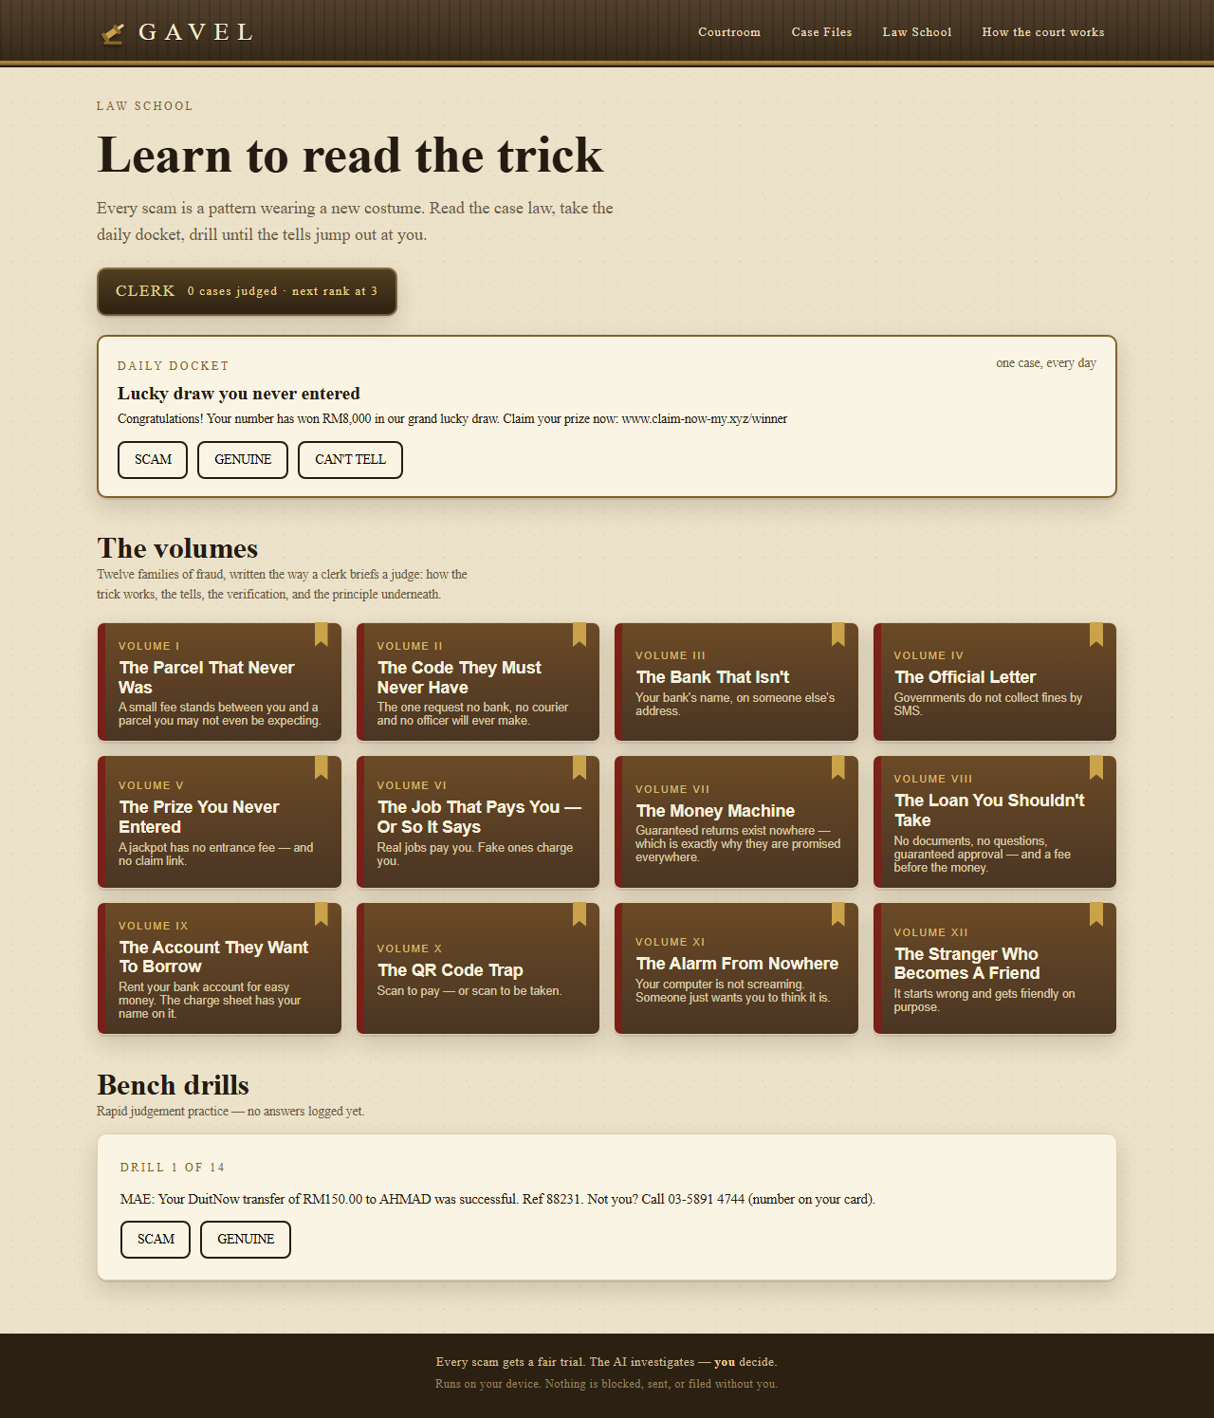
LAW SCHOOL
Every case teaches the next one.
Scam types written up as case law, distilled from official guidance — then practised until they stick.
Case law — scam types written up as case law distilled from official guidance.
Daily Docket — one case to judge every day.
Drills — pattern-spotting practice between real cases.
Ranks — earned by judging real cases, not by reading about them.
Awareness programmes lecture. GAVEL makes you practise.
09 / 12
Notes:
2:37–2:49 — Law School turns cases into practice.

Slide 10
THE BUSINESS
Who pays, and why it holds.
WHO PAYS
MARKET · BOTTOM-UP
MODEL
The family buyer — the person who forwards the parcel SMS to the group chat — at RM4.90 a month. And the bank, telco or e-wallet that would rather prevent a transfer than reverse one.
8.0M Malaysian households × RM4.90/month ≈ RM470M/year consumer TAM. 27 banks, 5 telcos, 10 e-wallets × a RM250k pilot ≈ RM10M/year initial institutional segment. Assumptions, not forecasts.
Free single cases. A RM4.90/month family plan. White-label licence and per-case API for institutions. Local-first forensics keep marginal cost near zero: we pay for tokens only when the court speaks.
Trust is the moat — the product is auditable by the person who pays for it.
10 / 12
Notes:
2:49–3:04 — Who pays: the family buyer and the institution. Bottom-up sizing; assumptions stated as assumptions.

Slide 11
THE HONEST RECORD
What it cannot do — yet.
WHAT IT CANNOT DO
WHAT COMES NEXT
Text and language — the classifier is trained on English-labelled SMS corpora; local slang beyond that leans on pattern rules.
Anatomy, not reputation — links are judged offline by structure; domain age and live lookups are not consulted.
A compiled voice when offline — without a model service the speeches are assembled, not drafted. The trial completes; the prose is plainer.
Advice, never action — GAVEL blocks nothing and contacts no one. The decision stays where it belongs.
A public-record check — domain and phone reputation, consulted with consent, filed as one more exhibit.
More local voices — Bahasa Malaysia and regional scam corpora, contributed with consent.
A deeper school — case law that grows from real verdicts.
Limits are docketed, not hidden — uncertainty goes to a hung jury, never to a confident guess.
11 / 12
Notes:
3:04–3:22 — Limits docketed: English corpus, anatomy not reputation, advice never action.

Slide 12

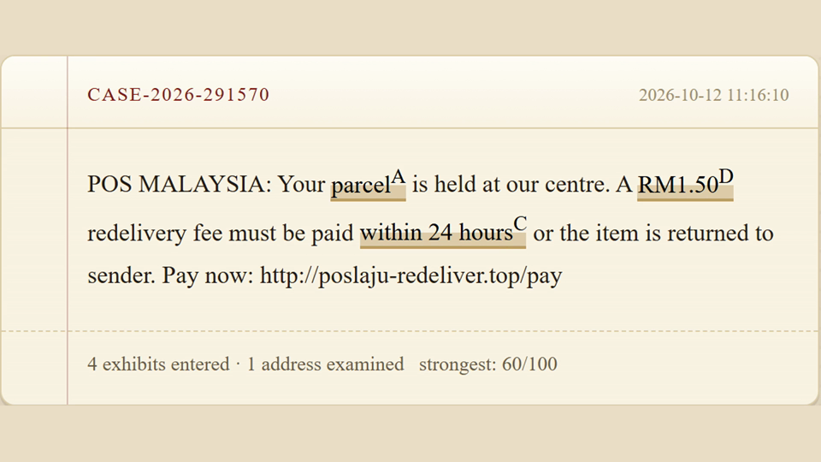
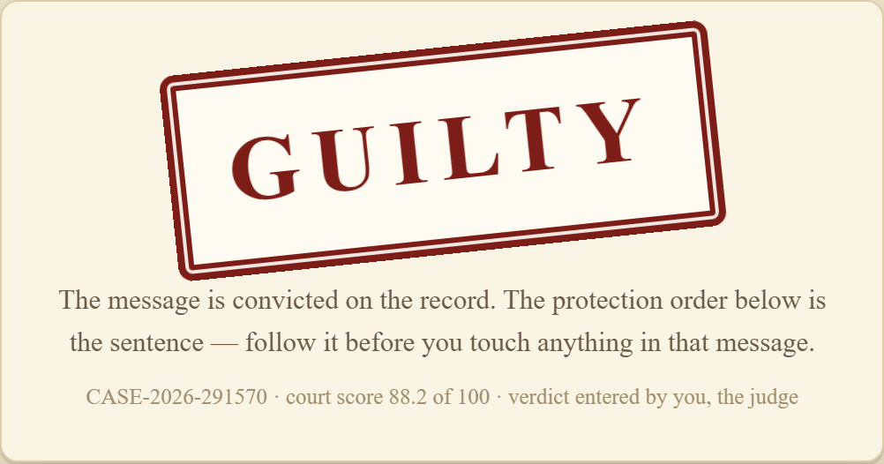
LIVE DEMO
The courtroom is open.
gavel-liard.vercel.app
Scan the code, or type the address. Nothing to install.
Pick a case from the docket — or bring your own suspicious message.
Judge it yourself — watch the reads, exhibits and speeches, then swing the gavel.
Scan to open GAVEL
Judging a case takes about a minute. The court remembers every one.
12 / 12
Notes:
3:22–5:00 — Play the embedded film (1:33), then point at the URL. If behind schedule, skip the film and run one live case.

