Slide 1



Design and Implementation of a
RAG-Based Teacher–Student
Co-Learning System
Department of Electrical and Electronic Engineering
The University of Hong Kong
Final Defense | July 2026 | Jin Yue (3036494489)

Slide 2
OVERVIEW
1
Task Scope &
Motivation
2
Background
Review
3
Benchmark &
Evaluation
4
Visual
Results
5
Conclusions &
Future Work

Slide 3


Scope
Background
Benchmark
Results
Conclusion
Task Scope: build a course-deployable Teacher–Student Co-Learning (SOLO) Bot
Shared Course KB
Traceable RAG QA
SOLO Practice Loop
One course knowledge base written by teachers and read by students; supports PDF/PPT/Word/Excel/images with OCR.
Hybrid retrieval + grounding gate + sentence-level citations linking answers to file and page/slide.
Tiered exercise generation/grading under SOLO, plus teacher export of questions and scores (no full transcripts).

Slide 4
Scope
Background
Benchmark
Results
Conclusion
Motivation: why a course RAG system is needed
Motivation: why a course RAG system is needed
General LLMs cannot sync with private course materials
Answers often lack locatable evidence (hallucination risk)
QA alone does not close the teaching–learning loop
Course corpora are multi-format and bilingual
Motivation: why a course RAG system is needed
Shared KB + hybrid retrieval (dense + BM25 + RRF)
Three-band grounding gate + citation coverage repair
SOLO-informed practice and feedback export
Single-process FastAPI deployment for one course

Slide 5
Scope
Background
Benchmark
Results
Conclusion
Background Review: RAG for trustworthy course QA
Trustworthiness requires gates, refinement, and citation checks; retrieving more passages alone is insufficient.
60%
Text can be changed by clicking and re-entering. In the top “Start” panel
90%
80%
40%
RAG combines parametric LLMs with non-parametric retrieval so answers can be grounded in updatable corpora (Lewis et al.).
Education settings need private materials, verifiable citations, and more than one-shot QA — a closed instructional loop.

Slide 6
Scope
Background
Benchmark
Results
Conclusion
Background Review: methods used in this system
Retrieve small children; expand to page/slide parents for generation.
Tiered practice from Biggs & Collis; aligns generation with cognitive levels.
Hybrid Retrieval
Grounding Gate
SOLO Taxonomy
Parent–Child Chunks
Dense + BM25 fused by RRF, then cross-encoder re-ranking with graceful fallback.
Three bands: none / weak / grounded; decide mainly on the second hit.

Slide 7
Scope
Background
Benchmark
Results
Conclusion
From gaps to system requirements
Private corpus
Traceability
Learning loop
Deployability
Must index teacher materials and session uploads with OCR fallback.
Every course claim must map to file + page/slide; weak evidence → labelled fallback.
QA → practice → grading → teacher feedback export.
Single-worker FastAPI + Docker; local embeddings/re-rank; hosted generation only.

Slide 8
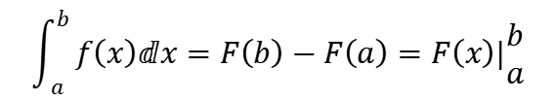
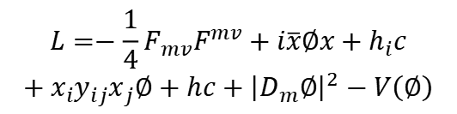
Scope
Background
Benchmark
Results
Conclusion
UPLOAD
/ ASK
System pipeline (end-to-end)
Clarify the research question
Ingest → Retrieve → Gate → Generate → Cite → Practice/Export
Determine the optimization goals
Parse (+OCR) → token-budget chunks → embed/FAISS;
Rewrite+HyDE → Dense∥BM25 → RRF → re-rank → corrective ≤1;
Three-band gate → refine/LiM order → LLM answer → citation repair;
SOLO quizzes & teacher export (aggregated only).
GOAL
GOAL
GOAL
Multi-objective optimal scheduling model
1
$$\int_{a}^{b}{f\left(x\right)ⅆx=F\left(b\right)−F\left(a\right)=F\left(x\right)|\begin{matrix}b \\ a\end{matrix}}$$
NSGA-II
DATA
solution set
$$L=−\frac{1}{4}F_{mv}F^{mv}+i\overline{x}∅x+h_{i}c$$
$$+x_{i}y_{ij}x_{j}∅+hc+{\left|D_{m}∅\right|}^{2}−V\left(∅\right)$$
2
Analyze the non-inferior relationship between the objectives
ANSWER
+ QUIZ

Slide 9
Scope
Background
Benchmark
Results
Conclusion
Benchmark Composition (ELEC6081)
Evaluation set design
 | Sample 1 | Sample 2 | Sample 3 | Sample 4 | Sample 5
project 1 | 12 | 1 | 22 | 74 | 15
project 2 | 45 | 45 | 27 | 13 | 85
project 3 | 22 | 42 | 56 | 95 | 13
project 4 | 24 | 22 | 33 | 43 | 85
project 5 | 56 | 84 | 65 | 12 | 49
Evaluation set design
• 65 course questions (on-topic + out-of-scope)
• Corpus: course materials (calibration and regression)
• Metrics: grounded precision/recall; context precision
• Tools: tools/rag_eval.py (full & grounding-only)
• Models: bge-small-zh (gate calib.); e5-small + MiniLM (re-rank regime)

Slide 10
Scope
Background
Benchmark
Results
Conclusion
Evaluation and Results — Grounding Gate (H1)
Selected thresholds (cosine)
multi_strong / single_strong / second_support
= 0.62 / 0.75 / 0.62
Grounded precision ≈ 0.982
Grounded recall ≈ 0.982
Key finding
Thresholding the second hit outperforms merely raising the top-hit bar:
high precision without collapsing recall.
Fail-safe: weak/none → labelled general answer.

Slide 11
Scope
Background
Benchmark
Results
Conclusion
Evaluation and Results — Re-ranking (H2)
单位
Context precision on 10-question probe
Fusion-order baseline → after cross-encoder re-ranking:
mean context_precision 0.380 → 0.613 (Δ +0.233).
Rises on 7/10 questions; demotes quiz fragments that only share vocabulary.
Under re-rank score scale, thresholds must be re-calibrated (H3).
20
40
60
80
100
120
140
单位

Slide 12
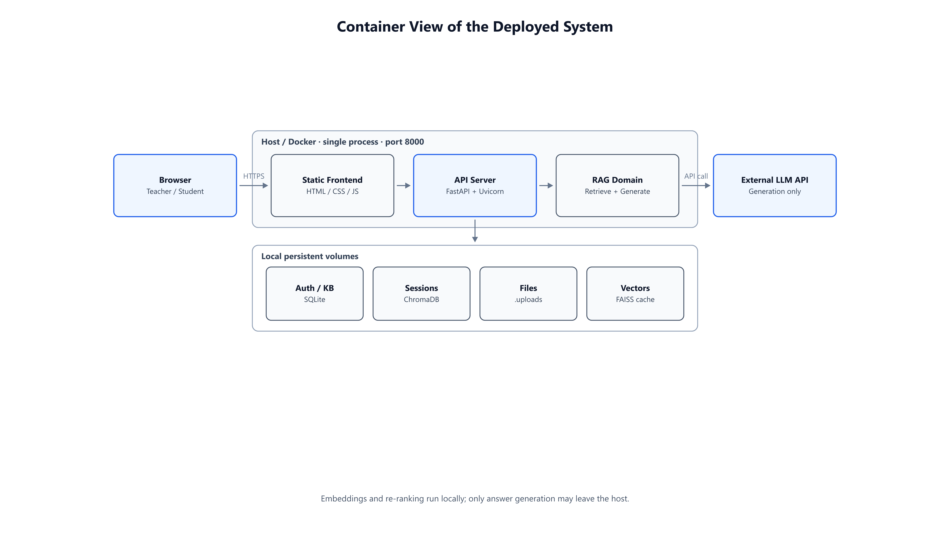
Scope
Background
Benchmark
Results
Conclusion
Visual Results — System container view
Figure 4.1 Deployed system
Browser → FastAPI single process → local stores (SQLite/Chroma/FAISS/files);
only generation may call external LLM (qwen-plus).

Slide 13
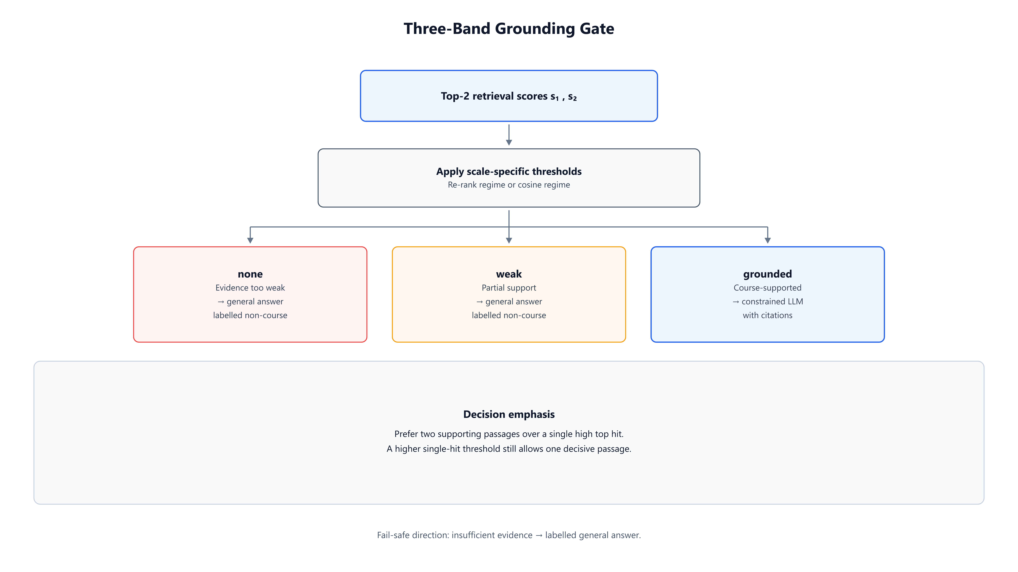
Scope
Background
Benchmark
Results
Conclusion
Visual Results — Grounding gate & pipeline
Figures 5.1 / 5.3
End-to-end ingest–retrieve–generate pipeline;
three-band gate: none / weak / grounded.

Slide 14

Scope
Background
Benchmark
Results
Conclusion
Conclusions — what was delivered
Three contributions
Shared course KB with multi-format parsing and OCR
Traceable RAG: hybrid retrieval, grounding gate, citations
SOLO practice + teacher feedback export boundary
Validated on ELEC6081 questions; gated P/R ≈ 0.982
Deployable prototype: FastAPI + Docker + local models
Fail-safe behaviour when evidence is weak
Deterministic tests for ownership and export rules

Slide 15
Scope
Background
Benchmark
Results
Conclusion
Conclusions — experimental takeaways
Gate calibration
Re-ranking
Second-hit thresholding yields high precision and recall together; raising only the top hit trades away too much recall.
Cross-encoder improves context precision (+0.233 on the probe); score-scale change requires re-calibration.

Slide 16
Scope
Background
Benchmark
Results
Conclusion
Conclusions — operational principles
Prefer two supporting passages over one lucky top hit.
Evidence first
Scale discipline
Closed loop
Cosine and re-rank scores use separate threshold families.
QA, practice, and teacher export form one instructional cycle.
Text can be changed by clicking and re-entering.

Slide 17
Scope
Background
Benchmark
Results
Conclusion
Limitations and Future Work
01
02
03
04
Single course
One course / one instance; multi-course isolation out of scope.
Parsing limits
Complex tables/layouts and estimated page numbers remain weak.
Threshold transfer
Gates depend on corpus and embedding/re-ranker; must re-calibrate.
Future work
Stronger parsing, multi-course config, deeper SOLO adaptivity, HTTPS/IdP.

Slide 18








Scope
Background
Benchmark
Results
Conclusion
Contributions to practice
Product
Method
Engineering
Evaluation
Teacher–student co-learning bot over a shared course KB.
Calibrated three-band gate + hybrid retrieval + citations.
Tested ownership, export boundary, and deployable stack.
Course-specific benchmark with on/off-topic questions.

Slide 19



Acknowledgements
Dr. Andrew H.C. Wu
Department of ECE, HKU
Department of ECE, HKU
Supervisor
Supervisor
Supervisor

Slide 20
Thank you
Questions & Discussion
Final Defense | July 2026 | Jin Yue (3036494489)

