Slide 1

Design and Implementation of a
RAG-Based Teacher–Student
Co-Learning System
Jin Yue · 3036494489
MSc(Eng) Electrical and Electronic Engineering
The University of Hong Kong
Supervisor: Dr. Andrew H.C. Wu
Final Oral Defense
July 2026

Slide 2
Overview
01
02
03
04
Task Scope
What the system covers
Motivation
Why this problem matters
Background Review
RAG and related methods
System & Pipeline
Technical implementation
05
06
07
08
Benchmark
ELEC6081 evaluation set
Results
Gate & re-ranking evidence
Visual Results
Architecture figures
Conclusions & Future
Takeaways and limits
Overview
2 / 16

Slide 3
Task Scope
Build a course-deployable HKU Teacher–Student Co-Learning (SOLO) Bot on retrieval-augmented generation.
Shared course knowledge base
Traceable RAG question answering
SOLO practice & feedback loop
• One KB per course: teachers write, students read
• Formats: PDF, PPT, Word, Excel, CSV, TXT, MD, images
• OCR fallback for scanned / image pages
• Session uploads stay private to the session
• Hybrid retrieval: dense + BM25 + RRF
• Cross-encoder re-ranking with fallback
• Three-band grounding gate (none / weak / grounded)
• Sentence-level citations with file + page/slide
• Tiered exercises guided by SOLO taxonomy
• Automated grading against answer keys
• Teacher export of questions and scores
• Export boundary: no full conversation transcripts
Task Scope
3 / 16

Slide 4
Motivation
1
Private course knowledge
General LLMs cannot sync with the latest slides, handouts, and course-specific materials.
2
Missing provenance
Fluent answers without file/page evidence are hard to trust in teaching.
3
Incomplete learning loop
QA alone does not support practice, grading, and teacher feedback.
4
Messy real corpora
PDFs, slides, tables, OCR pages, and bilingual terminology break naive pipelines.
Motivation
4 / 16

Slide 5
Background Review
RAG paradigm
Trustworthy generation
• Retriever + generator: condition answers on retrieved passages (Lewis et al.)
• Updates the non-parametric store without retraining the LLM
• Compared with direct answering: better sync, traceability, lower hallucination risk
• Reflection / corrective retrieval (e.g. CRAG-style three-band structure)
• Evidence position matters (Lost-in-the-Middle)
• Citations must be enforced, not merely requested
Retrieval stack used here
Pedagogy: SOLO taxonomy
• Multilingual dense embeddings + BM25 lexical channel
• Query rewrite / HyDE; reciprocal rank fusion; cross-encoder re-rank
• At most one corrective re-query when top evidence is weak
• Biggs & Collis: structural complexity of learner responses
• Guides tiered item design from unistructural to relational
• Supports a closed loop beyond one-shot QA
Background Review
5 / 16

Slide 6
Technical Implementation — Architecture
Single-process FastAPI + static frontend; local embeddings/re-ranking; external LLM only for generation (qwen-plus).
Presentation
Login · Teacher console · Assistant · KB · Quiz · Export
Application
Auth/admin · Session/file/QA APIs · Exercises · Orchestration
Domain
Parsing/OCR · Hybrid retrieval · Grounded generation · Quiz/grading
Infrastructure
SQLite (auth+KB) · ChromaDB (sessions) · FAISS vectors · Files
ChromaDB stores sessions/messages/quizzes — not document vectors. Document vectors live in FAISS.
Technical Implementation
6 / 16

Slide 7
Technical Implementation — End-to-End Pipeline
Ingest
Retrieve
Generate
Teach loop
Parse (+OCR)
Rewrite + HyDE
3-band gate
SOLO quiz
Token chunk
Dense ∥ BM25
Refine / LiM
Grading
→
→
→
Parent–child
RRF fusion
LLM answer
Teacher export
Embed → FAISS
Re-rank ≤1 fix
Citation repair
Fail-safe fallback
Technical Implementation
7 / 16

Slide 8
Technical Implementation — Three-Band Grounding Gate
Decision emphasises the second-ranked hit: course-covered questions usually have two strong passages; out-of-scope items often have one accidental hit then a drop.
none
weak
grounded
Evidence too weak → labelled general answer (non-course)
Partial support → labelled general answer; boundary may call sufficiency judge
Course-supported → constrained LLM answer with citations
Selected cosine-regime thresholds (Table 5.3 / §8.5)
multi_strong / single_strong / second_support = 0.62 / 0.75 / 0.62
Re-ranking regime uses a separate threshold family (e.g. strong ≈ 0.80) — scale discipline matters.
Boundary weak cases: sufficiency judge on top-5 passages; fail-safe treats judge failure as insufficient.
Technical Implementation
8 / 16

Slide 9
Benchmark Composition
ELEC6081 evaluation setting
What is measured
• Course: graduate biomedical signal processing materials
• 65 questions: on-topic + deliberately out-of-scope
• Fields: question, ground_truth, expected_grounding (for OOS)
• Harness: tools/rag_eval.py (full and grounding-only modes)
• Gate calibration embedding: BAAI/bge-small-zh-v1.5 (re-rank off)
• Re-rank regime: multilingual-e5-small + MiniLM cross-encoder
• Generation endpoint: DashScope-compatible qwen-plus
• Grounded precision / recall of the three-band gate
• Context precision under fusion-order vs re-ranking
• Ownership / export-boundary conformance (deterministic tests)
• Design goal: answer course questions; refuse non-course ones
• Thresholds are corpus-specific — not copied from public benchmarks
• On-topic and off-topic items are both required for gate value
Benchmark Composition
9 / 16

Slide 10
Evaluation and Results — Grounding Gate (H1)
0.982
0.982
0.62/0.75/0.62
Grounded precision
selected setting
Grounded recall
selected setting
Threshold triple
multi / single / second
Finding
• Raising only the top-hit threshold can remove fabrication but refuses too many legitimate questions.
• Requiring two passages to clear 0.62 keeps precision and recall high together.
• Selected thresholds are pinned by unit tests against high-precision-only alternatives.
• Fail-safe: weak / none routes to an explicitly labelled general-knowledge answer.
Evaluation and Results
10 / 16

Slide 11
Evaluation and Results — Re-ranking (H2)
Fusion-order baseline
After cross-encoder
context_precision = 0.380
context_precision = 0.613
mean over 10-question probe
mean over 10-question probe
Δ = +0.233; improves on 7 of 10 questions.
• Re-ranking demotes quiz/tutorial fragments that only share vocabulary (e.g. percentage tokens).
• Cross-encoder reads query and passage jointly — single-vector pre-query embeddings cannot.
• Under the re-rank score scale, gate thresholds must be re-calibrated (H3 / scale discipline).
Evaluation and Results
11 / 16

Slide 12
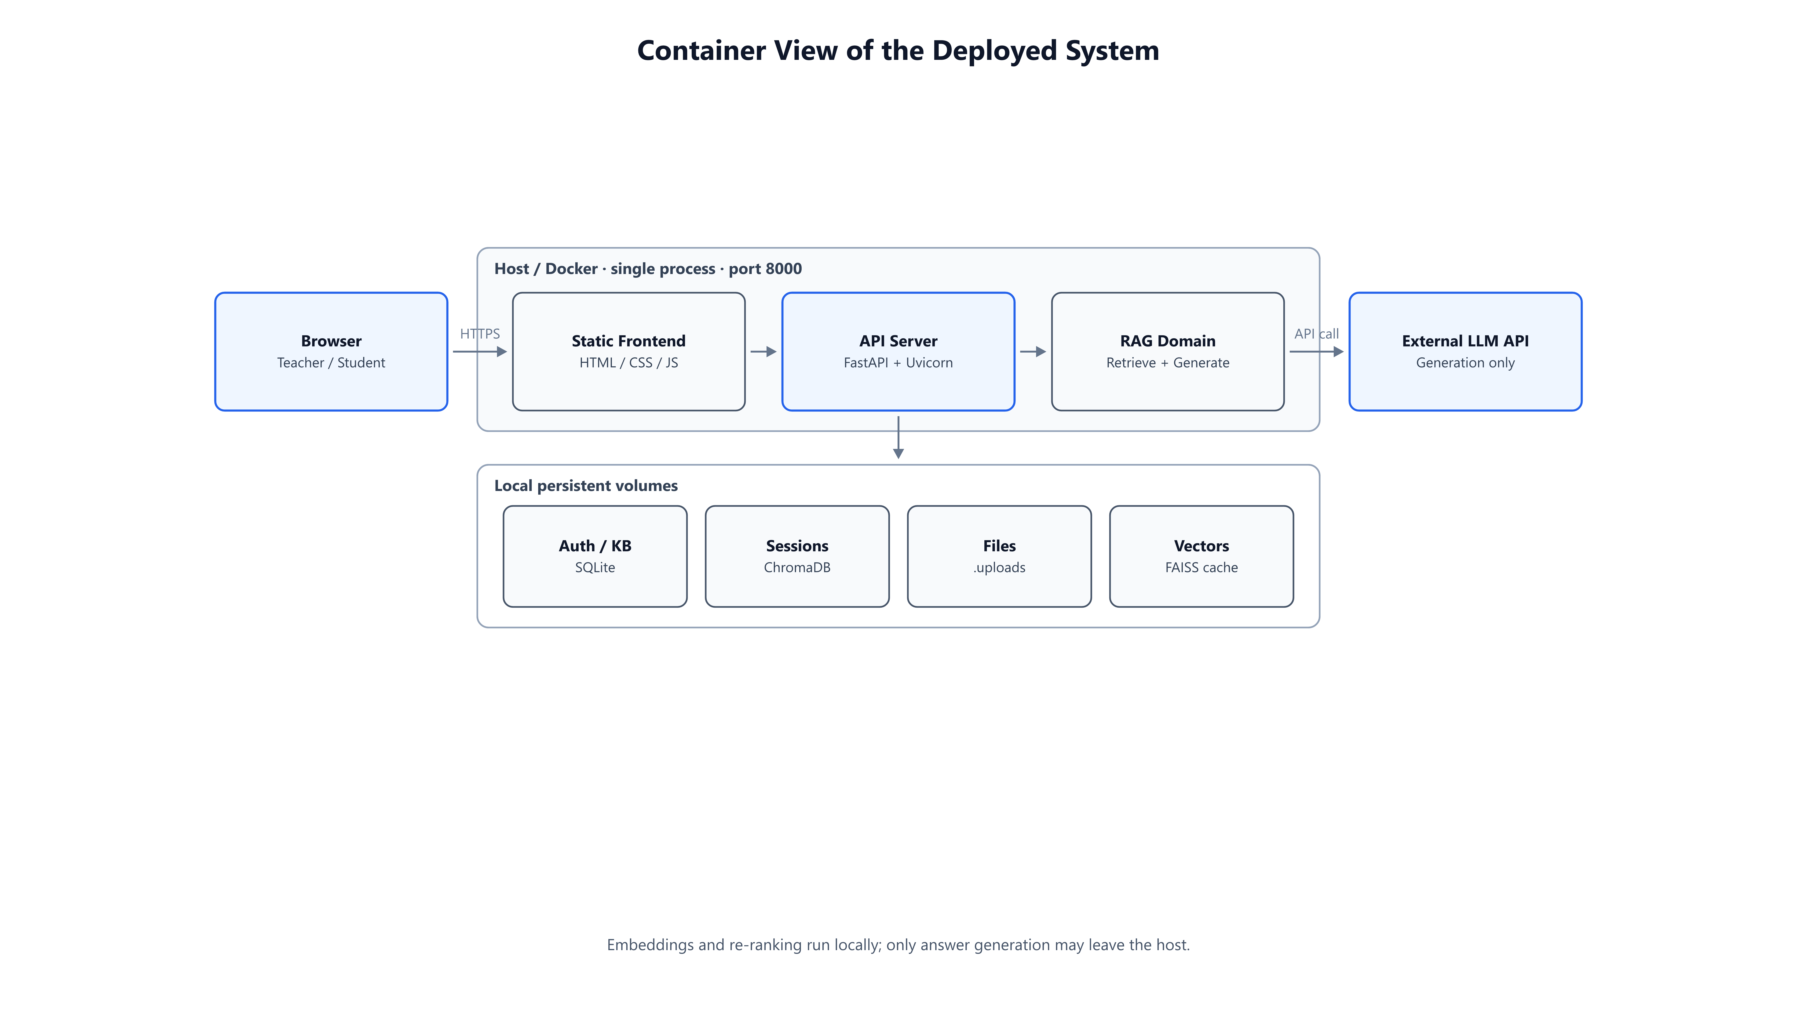
Visual Results — Container View (Fig. 4.1)
Visual Results
12 / 16

Slide 13
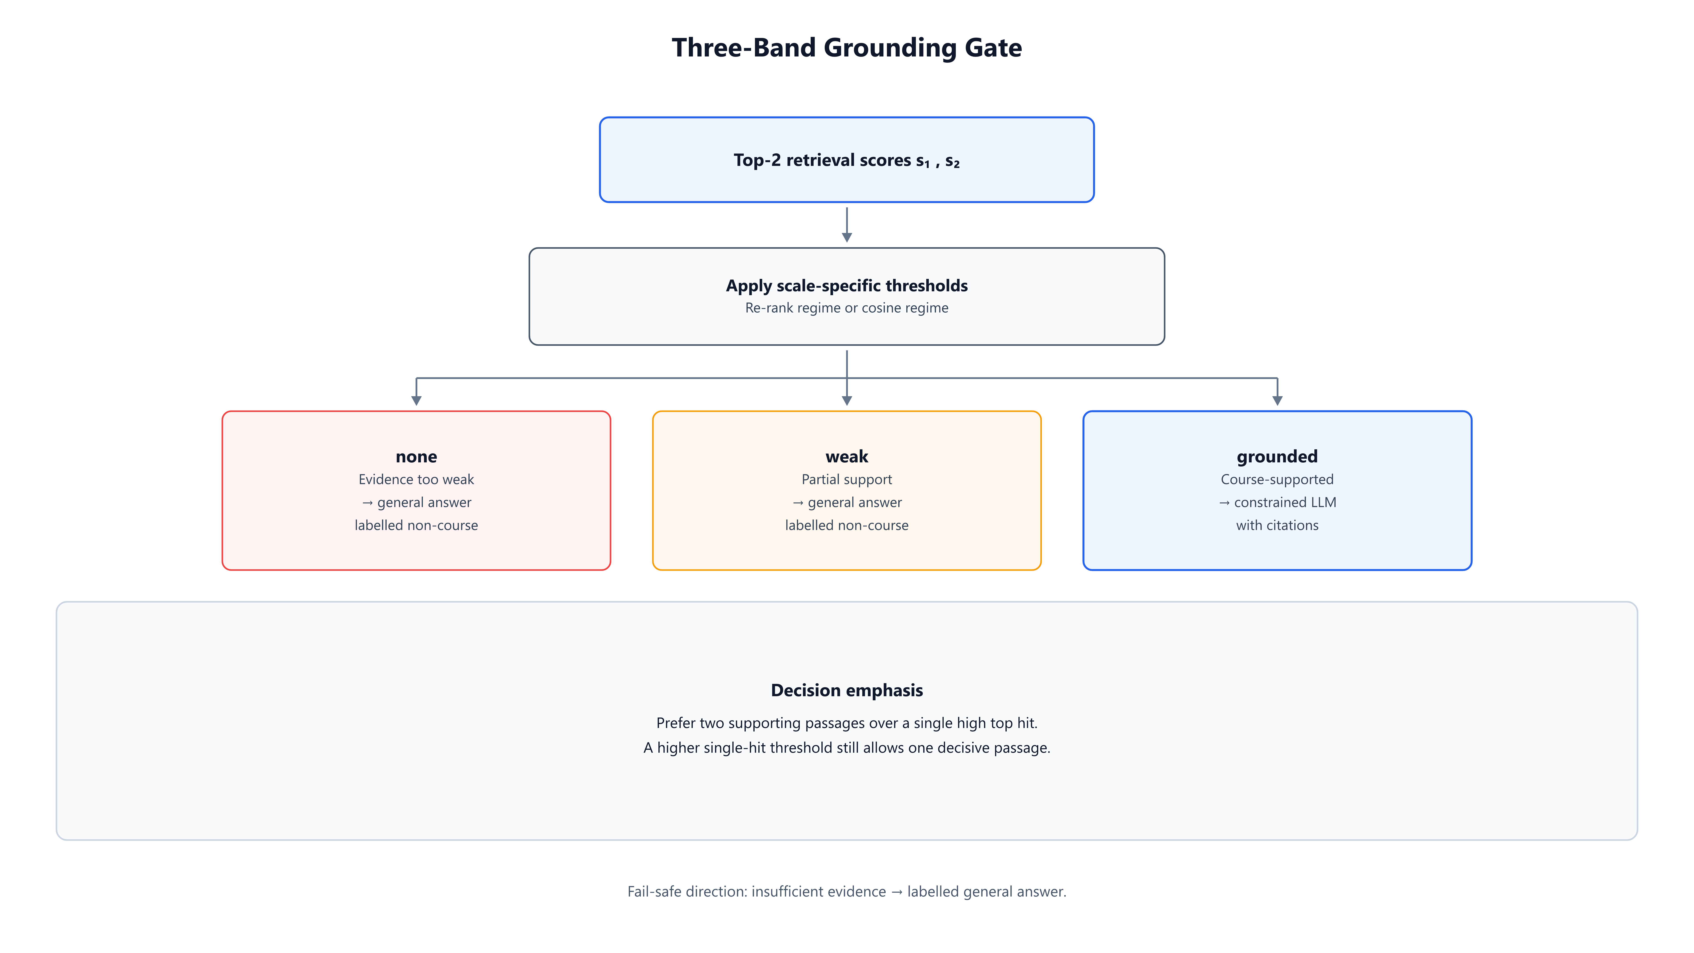
Visual Results — Grounding Gate (Fig. 5.3)
Visual Results
13 / 16

Slide 14
Conclusions
Product
A deployable teacher–student co-learning bot over one shared course KB.
Method
Hybrid retrieval + calibrated three-band gate + citation coverage repair.
Pedagogy
SOLO-informed practice and an export path that preserves privacy boundaries.
Evidence
On ELEC6081: gate P/R ≈ 0.982; re-ranking lifts context precision by +0.233.
Conclusions
14 / 16

Slide 15
Limitations and Future Work
Limitations
Future work
• Single course / single instance — no multi-course isolation yet
• Gate thresholds do not transfer across models or growing KBs
• Complex layouts, noisy scans, and estimated page numbers remain weak
• Practice adaptivity is still shallow compared with full tutoring
• Multi-course configuration and stronger campus deployment (HTTPS / IdP)
• Better layout-aware parsing and more reliable location anchors
• Continued recalibration of gate and re-rank thresholds on course sets
• Deeper SOLO-adaptive practice and richer teacher analytics
Limitations and Future Work
15 / 16

Slide 16
Thank you
Questions & Discussion
Jin Yue · 3036494489
Supervisor: Dr. Andrew H.C. Wu · ECE, HKU

