Slide 1
ELEC6098 Electronic Commerce & Mobile Commerce
Dr. Wilton Fok

Slide 2
Enabling Technology: Location Base Service

Slide 3
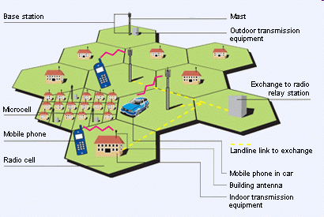
Enabling Technology: Location Base Service
Cellular radio network is the foundation for location base services
GSM is a cellular network
→ mobile phones connect to it by searching for cells in the immediate vicinity.

Slide 4
GSM
GSM (Global System for Mobile Communications is/was the most popular standard for mobile telephony systems in the world.
GSM is considered a 2G mobile phone system.
It facilitates the wide-spread implementation of data communication applications into the system.
Advantages
Roaming
Switch carriers without replacing phones
Support SMS
Support SIM Card
Support a worldwide emergency telephone number feature 112

Slide 5
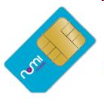
SIM Card in GSM
SIM Card = Subscriber Identity Module
A detachable smart card containing the user's subscription information and phone book.
This allows the user to retain his or her information after switching handsets.
User can also change operators while retaining the handset simply by changing the SIM.
Some operators will block this by allowing the phone to use only a single SIM
→SIM locking

Slide 6

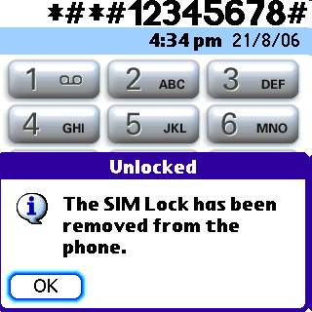
SIM locking
Some mobile phone operators restrict handsets that they sell for use with their own network.
Implemented by a software feature of the phone.
Because the purchase price of the mobile phone to the consumer is typically subsidized with revenue from subscriptions, operators must recoup this investment before a subscriber terminates service.
Ways to unlock the SIM
Contact the provider to remove the lock for a fee,
utilize private services to remove the Lock, or
Make use of free or fee-based software and websites to unlock the handset themselves.
More shown on youtube

Slide 7
GSM improvement
1997 Introduce of General Packet Radio Service (GPRS)
1999 Introduce higher speed data transmission using Enhanced Data Rates for GSM Evolution (EDGE).

Slide 8
Network structure
The structure of a GSM network:
Base Station Subsystem
base stations and their controllers
Network and Switching Subsystem
part of the network most similar to a fixed network). This is sometimes also just called the core network.
GPRS Core Network
the optional part which allows packet based Internet connections
Operations support system (OSS)
for maintenance of the network.

Slide 9
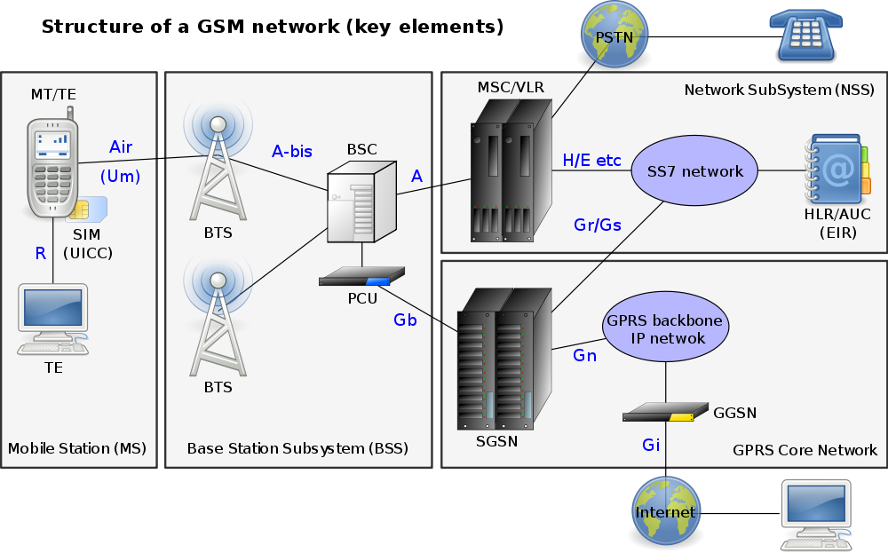
Network structure
Base Station Subsystem
Network and Switching Subsystem
GPRS Core Network
Operations support system (OSS)

Slide 10
Cell sizes and coverage
There are 5 different cell sizes in a GSM network
Macro,
Micro,
Pico,
Femto and
Umbrella cells.

Slide 11
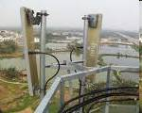
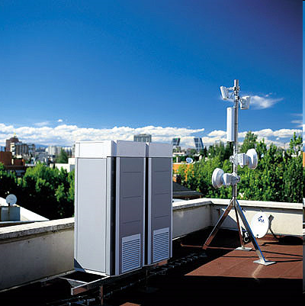
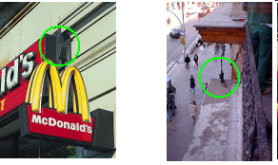
Cell sizes and coverage
The coverage area of each cell varies according to the implementation environment.
Macro cells
Cells where the base station antenna is installed on a mast or a building above average roof top level.
Micro cells
Those antenna height is under average roof top level; they are typically used in urban areas.

Slide 12
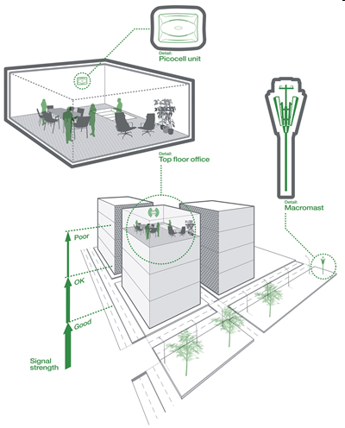
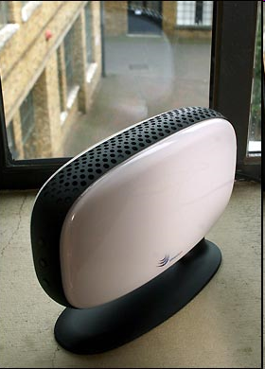
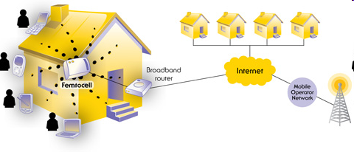
Cell sizes and coverage
Picocells
Small cells whose coverage diameter is a few dozen metres; they are mainly used indoors.
Femtocells
Cells designed for use in residential or small business environments and connect to the service provider’s network via a broadband internet connection.
Umbrella cells
Used to cover shadowed regions of smaller cells and fill in gaps in coverage between those cells.
Femtocells

Slide 13
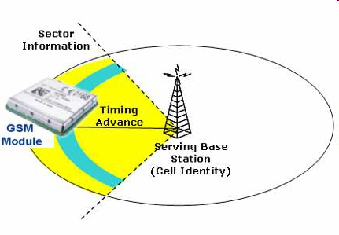
Cell sizes and coverage
Cell horizontal radius varies depending on:
antenna height,
antenna gain
propagation conditions from a 300m -35km

Slide 14
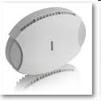
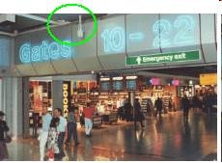
Cell sizes and coverage
Indoor coverage is also supported by
indoor picocell base station, or
an indoor repeater with distributed indoor antennas fed through power splitters,
to deliver the radio signals from an antenna outdoors to the separate indoor distributed antenna system.
E.g. In shopping centers or airports.

Slide 15
Cellular Network
Use multiple low-power transmitters (100 W or less)
Areas divided into cells
Each served by its own antenna
Served by base station consisting of transmitter, receiver, and control unit
Band of frequencies allocated
Cells set up such that antennas of all neighbors are equidistant (hexagonal pattern)
910MHz
920MHz
915MHz

Slide 16
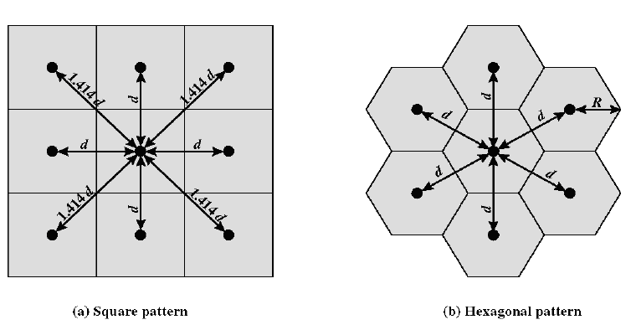
Cell Format

Slide 17
Frequency Reuse
Adjacent cells assigned different
frequencies to avoid interference or crosstalk
Objective is to reuse frequency in nearby cells
10 to 50 frequencies assigned to each cell
Transmission power controlled to limit power at that frequency escaping to adjacent cells
The issue is to determine how many cells must intervene between two cells using the frequency
910MHz
920MHz
915MHz
noise
910MHz

Slide 18
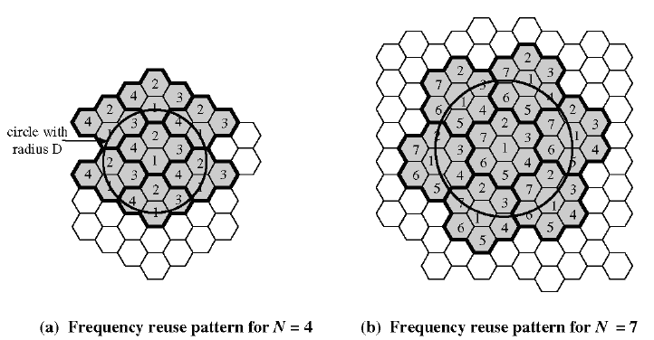
Frequency Reuse
N=1,3,4,7,9,12,13,16,19 ..

Slide 19
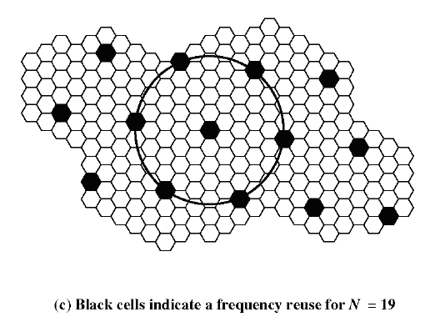
Frequency Reuse
Larger N
Longer distance between cell with the same frequency
Less co-channel interference
Co-channel
interference

Slide 20
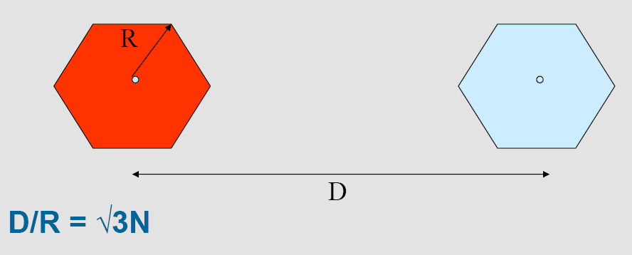
Frequency Reuse
Power is inversely proportional to Distance (Inverse square law)
→ Signal to Noise is proportional to N²

Slide 21
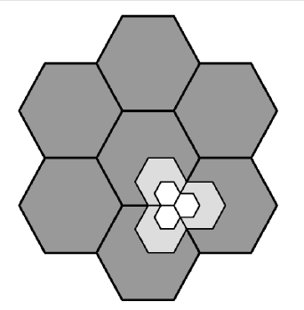
Approaches to Cope with Increasing Capacity
Adding new channels
Frequency borrowing
frequencies are taken from adjacent cells by congested cells
Cell splitting
cells in areas of high usage can be split into smaller cells
Cell sectoring
cells are divided into a number of wedge-shaped sectors, each with their own set of channels
Microcells
antennas move to buildings, hills, and lamp posts
Cell Splitting

Slide 22
Capacity vs Accuracy
When N is large
Less co-channel interference
Stronger signal to noise ratio
Smaller cell-site
More accurate in location estimation
But require more frequency resources
910MHz
920MHz
915MHz
Co-channel
interference
910MHz

Slide 23
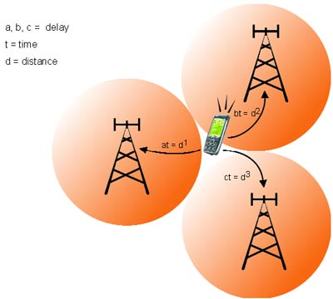
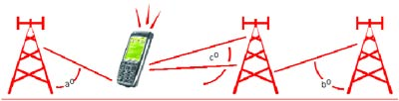
Methodologies for location estimation
Time of arrival (TOA)
Time predict distance
3 distance data locate a point
Angle of arrival (AOA)
3 angles location a point

Slide 24
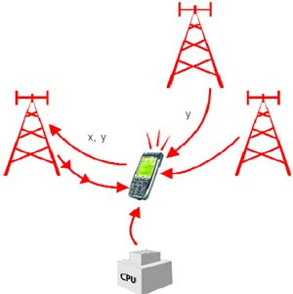
Methodologies for location estimation
Time difference of arrival (TDOA)
If it can only access two Base-station, distance between base-stations provide the 3rd information

Slide 25

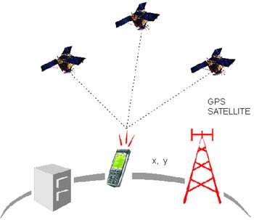
Methodologies for location estimation
Enhanced observed time difference (EOTD)
Cell global identification (CGI) and Timing advance (TA)
Signal strength (SS)
Global Positioning System (GPS)
Control Plane Locating

Slide 26
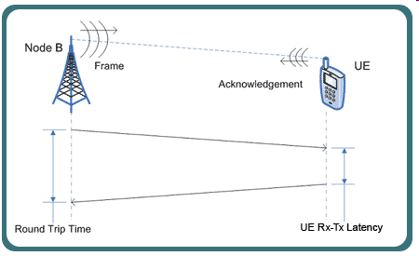
Methodologies for location estimation
Control plane locating
Service provider gets the location based on the radio signal delay of the closest cell-phone towers (for phones without GPS features) which can be quite slow as it uses the 'voice control' channel.
Some primitive LBS services use a single base station, with a 'radius' of inaccuracy, to determine a phone's location. This technique was the basis of the E-911 mandate and is still used to locate cell phones as a safety measure.
More details
http://www.hkwtia.org/

Slide 27
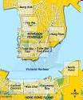
Error of location base estimation
Scattering
Shadowing
Reflection
Diffraction
Co-channel interference

Slide 28
What’s is Location Base Service
A location-based service (LBS) is an information and entertainment service, accessible with mobile devices through the mobile network and utilizing the ability to make use of the geographical position of the mobile device
E.g. identify a location of a person or object such as discovering the nearest banking cash machine or the whereabouts of a friend or employee.

Slide 29
Basic operation modes of LBS
Pull
The customer initiates mobile positioning measurement at the same time when one requests for a service
Push
The request for service (and hence mobile positioning) is not technically made by the customer but by the service provider
Tracking
Someone (person or service) asks for a location of the mobile terminal (Person, vehicle, fleet etc.)

Slide 30
Class discussions: What are the applications of LBS?

Slide 31
Applications of Location base Services
Emergency services
Mobile advertising
Location sensitive billing
Fraud protection
Asset tracking
Fleet management
Intelligent transportation systems
Mobile yellow pages
parcel tracking and vehicle tracking services
Location base coupons or advertising
personalized weather services and
location-based games
Requesting the nearest business or service, such as an ATM or restaurant
Locating people on a map displayed on the mobile phone
Receiving alerts, such as notification of a sale on gas or warning of a traffic jam

Slide 32
Applications of Location base Services
Resource tracking with dynamic distribution.
Taxis, service people, rental equipment, doctors, fleet scheduling.
Resource tracking.
Objects without privacy controls, using passive sensors or RF tags, such as packages and train boxcars.
Finding someone or something.
Person by skill (doctor), business directory, navigation, weather, traffic, room schedules, stolen phone, emergency calls. Targeted advertising, buddy list, common profile matching (dating)

Slide 33
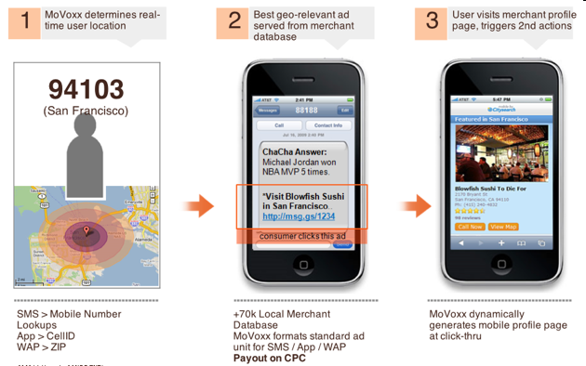

Values of LBS
Use as a filter
to restrict results of search that are close enough to the customers’ location
Use as a pointer
to show the location of the customers as a dot on a map in tracking services
Use as a definer/launcher for “area alarm
i.e. to launch a pre-defined activity (e.g. send a MSMS) with customer enters/leaves a certain area

Slide 34
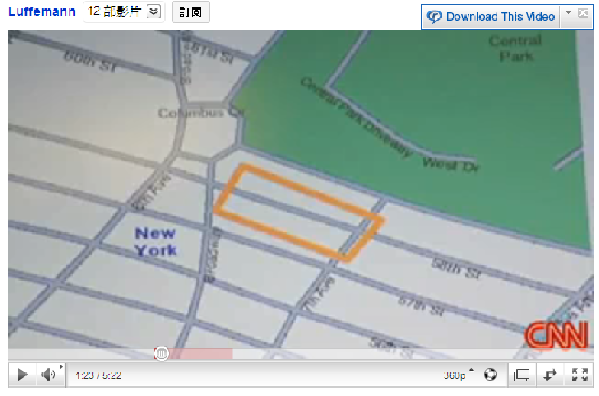
CNN news on location Base service
http://www.youtube.com/watch?v=NwuW5BCaj-I

Slide 35
Class discussions: What are the issues/problems of LBS?

Slide 36
What are the issues/problems of LBS?
Privacy
Accuracy
Coverage
Useless information (Garbage information)
Information overload

Slide 37
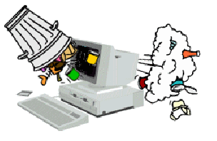
Major issues faced by LBS
Accuracy of location
Mobile network was primarily built for communication, not positioning
If location data is not accuracy, the information is not useful (Garbage in, Garbage out)
Limiting choice of service

Slide 38
Major issues faced by LBS
Investment vs penetration
Extraction of network measurement for position calculation remains a difficult and expensive task
Network base solution offers a full-base penetration → but large investment
Terminal based solution is relatively less expansive but largely limits penetration

Slide 39
Major issues faced by LBS
Business Model (Willingness to pay)
Consumer market: position information in most cases are just “nice-to-have”. There is no killer application
Enterprise users are more willing to pay a higher fee
Inter-operability between operators
Cross border continuity
Difference in positioning accuracy
Commercial models in roaming

Slide 40
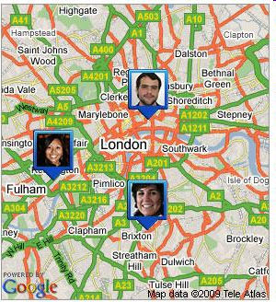
Major issues faced by LBS
Privacy
Opt-in/ Opt-out policy
Applications development/service provider
Dilemma of In-house/out-source development
Outsourcing the service/development can reduce the cost of operation. But the operator’s network data are very sensitive and involve privacy issues.

Slide 41
Q&A

Slide 42
Enabling Technology: QR CODE

Slide 43
Barcode vs QR Code
Barcode
a code consisting of a group of printed and variously patterned bars and spaces and sometimes numerals that is designed to be scanned and read into computer memory and that contains information (as identification) about the object it labels.
QR Code
a matrix barcode (or two-dimensional code), readable by QR scanners, mobile phones with a camera, and smartphones.

Slide 44
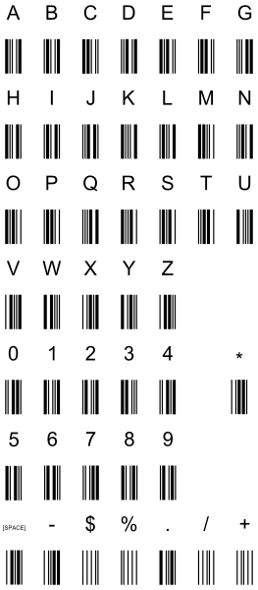

Different Codes
Code 39
Defines 43 Characters.
Typically used in non-retail areas.
Arguably the simplest barcode.

Slide 45

Different Codes
Code 128
Defines the entire 128 ASCII character set.
Typically used in shipping/retail.

Slide 46
How does a scanner/smartphone interpret a barcode?
Each barcode is interpreted similarly and yet also slightly differently as well.
Barcodes also happen to be less complex that QR Codes.
Barcodes can use scanners, whereas QR Codes require something else (i.e smartphones, computer, game machines)

Slide 47

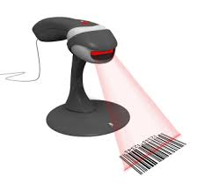


Barcodes
Light from Scanner
Light Reflection
Barcode scanners are made of 3 different parts: an illuminator, a convertor, and a decoder.
The illuminator shoots out a line of light (typically red) at the barcode.
Light will reflect from the barcode (from anywhere that is not black) in the form of a wave.
The convertor converts the wave into a readable form for the device.
Decoder reads the converted information.
Barcode

Slide 48

QR Codes
Certain applications on a smart phone / portable gaming device can scan QR codes.
Instead of bouncing off an image via light, QR Codes are interpreted from a picture skipping the light wave process.

Slide 49
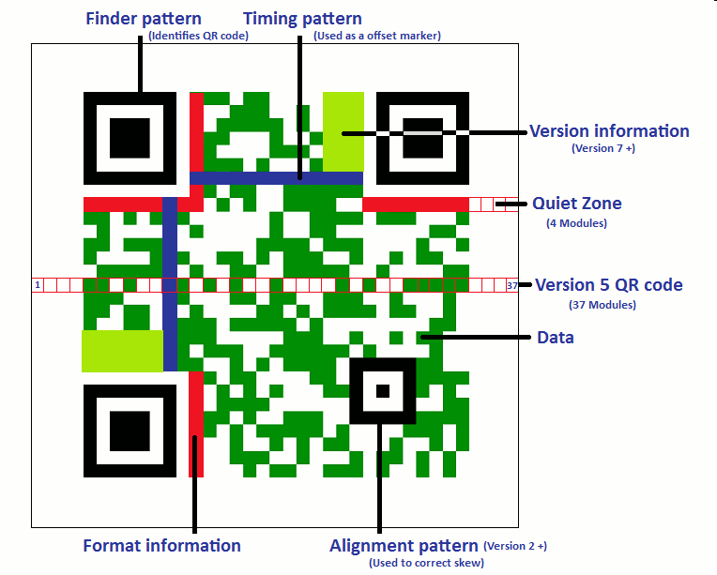
QR Code

Slide 50
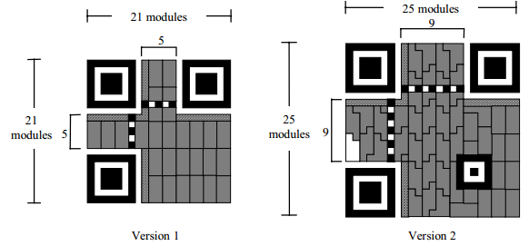
QR Codes
Interpretation of the code is that excluding the no zones, each black module is a 1 bit and a white one is a 0 bit.
0
1

Slide 51
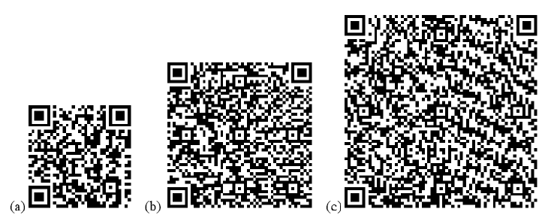
QR Code
QR codes currently support alphanumeric data capacities of up to about 400 bytes and binary capacities of up to about 270 bytes,
Handsets requirement:
macro focus
resolutions of several megapixels
Fig. QR codes encoding alphanumeric data “a123456789a12…” of length (a) 40, (b) 100, (c) 200 characters

Slide 52
QR Code
The capacity (when read by a typical camera phone without macro focus, but with resolution of one megapixel or more)
close to 100 bytes of alphanumeric characters or
70 bytes of binary data
Error control:
The QR symbology supports error correction using the Reed-Solomon method.
There are four levels of error correction, selectable according to the operating environment.
The capability ranges from correcting about 7% of the data in a code, to about 30%.

Slide 53
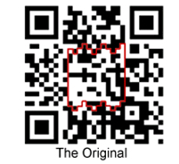
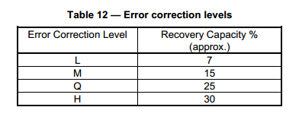
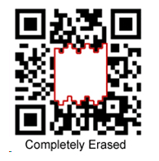

QR Codes
Error Correction
This allows other images to be placed into the code without any issues.
Still works!

Slide 54
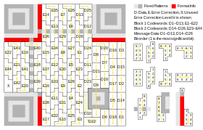
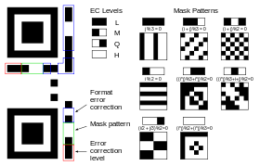
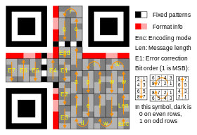
Algorithm of QR Code (not exam)
http://en.wikipedia.org/wiki/QR_Code

Slide 55
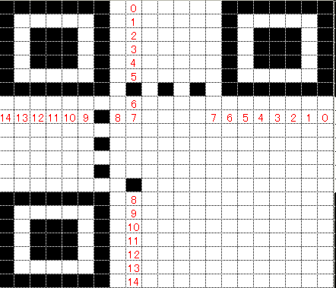

Create a QR Code
http://www.swetake.com/qr/qr1_en.html

Slide 56
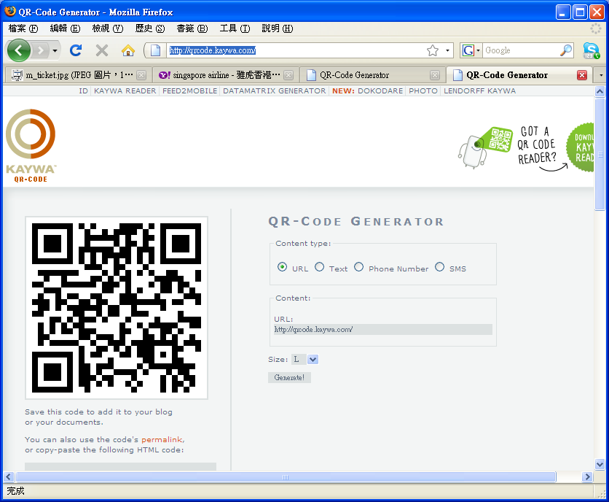
QR Code generator
http://qrcode.kaywa.com/

Slide 57
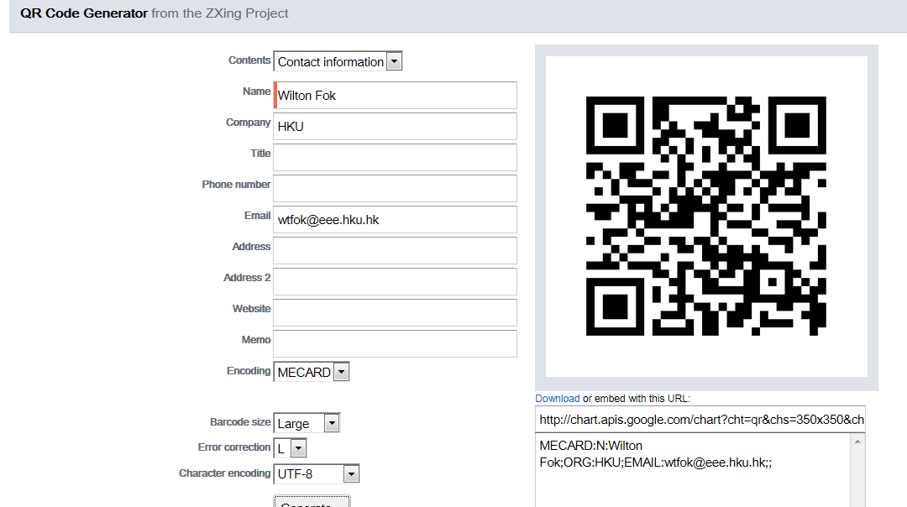
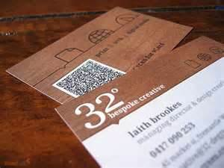
QR Code generator
http://zxing.appspot.com/generator/

Slide 58
What are the benefits of QR Code?

Slide 59
Benefits of QR Code
Benefits of QR Code for:
consumers,
marketing,
mobile industries
Wireless Operators
Handset Manufacturers
Application and Service Providers

Slide 60
Benefits to Consumers
Reading a mobile code is faster and more convenient
than transcribing data such as URLs, telephone numbers and SMS messages into handsets.
Less error-prone
→ error correction in the codes guarantees against entering incorrect data.
No need to navigate to the appropriate application on their handset
It is implicit in the type of data in the code. \
Especially helpful with respect to web browsers
users find difficult to locate and operate on their handsets.

Slide 61
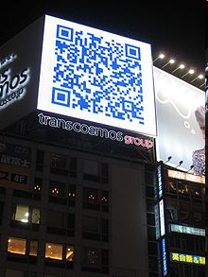
Benefits to Marketer
Encourage users to participate in promotional campaigns
compared to manual transcription of URLs etc., mobile codes increase response rates.
Enable print advertising
QR code can be placed in media formats, markets and physical locations, marketers can measure which placements were more effective than others.

Slide 62
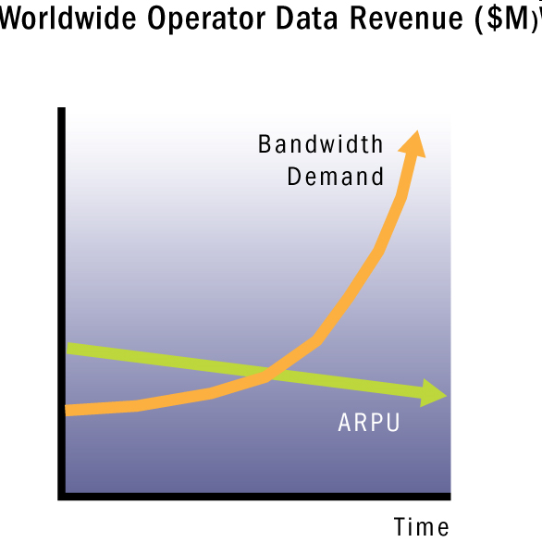
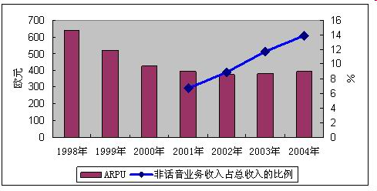
Benefits to Wireless Operators
In the past, SMS did not scale in usability, mainly ringtone downloads only
QR codes promote mobile internet as more connections are made direct from advertisement to web.
Increase operator’s ARPUs (Average Revenue Per User) through more and more rewarding internet connections.
ARUP of Orange Source:
http://wiki.mbalib.com/w/index.php?title=Orange%E5%85%AC%E5%8F%B8&variant=zh-tw

Slide 63
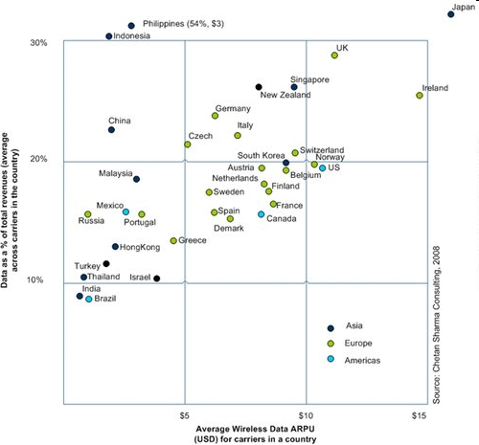
Benefits to Wireless Operators
ARUP and ratio of Data Service

Slide 64

Benefits to Wireless Operators
Operators can help drive the reach and scale of the mobile code scanning opportunities by ensuring that scanning clients and applications are pre-installed in the mobile devices.

Slide 65

Benefits to Wireless Operators
Operators may be able to associate such user inquiries with the user’s preferences based on his/her subscription profile
Selling customer profiles to advertisers creates a new stream of revenue.
Target marketing with deeper profile data of prospective customers.
Privacy concerns need to be considered as applicable.

Slide 66
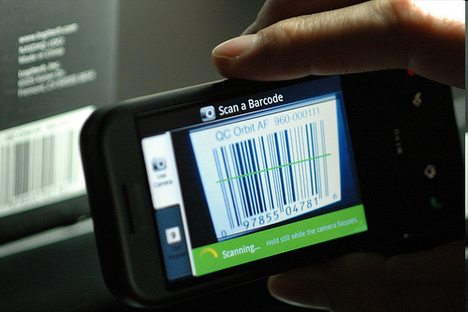
Handset Manufacturers
Feedback from mobile code adoption in Japan suggests that, once established in the market, mobile code readers become a “must have”.
Handset companies will want to provide a compelling reason to upgrade to their mobile code-enabled terminals.

Slide 67
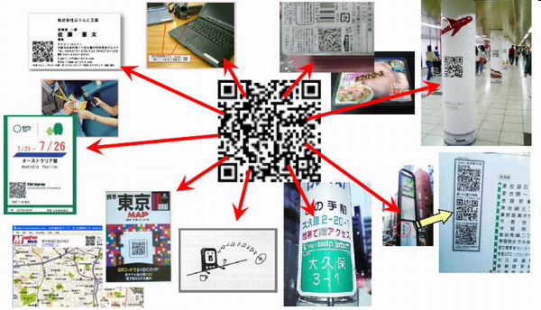
Application and Service Providers
Provides the new internet experience, impact on mobile content and service provision.
Innovate new user interaction with mobile codes, and in new mobile code support services.
Both application and service sectors have the opportunity for significant growth, perhaps enabling different actors in the value chain

Slide 68
References
http://en.wikipedia.org/wiki/QR_Code
Open Mobile Alliance - White Paper on Mobile Codes
http://www.openmobilealliance.org/Technical/release_program/docs/MobileCodes/V1_0-20081024-A/OMA-WP-MobileCodes-20081024-A.pdf
UID Solutions - UID Products and Services for US Military Contractors and DoD. Barcode History Timeline. Retrieved from http://www.uidsolutions.com/barcodetimeline.html
Qr readers. (n.d.). Barcode Technology Timeline. Retrieved from http://www.qrreaders.net/articles/barcode-technology-timeline.html
What Is A QR Code And How Does It Work?. http://www.youthedesigner.com/2011/09/29/what-is-a-qr-code-and-how-does-it-work/.
How Barcode Scanners Work. http://www.carolinabarcode.com/how-barcode-scanners-work-a-69.html.
Information technology — Automatic identification and data capture techniques — Bar code symbology — QR Code. http://raidenii.net/files/datasheets/misc/qr_code.pdf.

