Slide 1

Design and Implementation of a
RAG-Based Teacher–Student
Co-Learning System
Jin Yue · 3036494489
MSc(Eng) Electrical and Electronic Engineering
The University of Hong Kong
Supervisor: Dr. Andrew H.C. Wu
Final Oral Defense
July 2026

Slide 2
Overview
01
02
03
04
Task Scope
What the system covers
Motivation
Why this problem matters
Background Review
RAG and related methods
System & Pipeline
Technical implementation
05
06
07
08
Benchmark
ELEC6081 evaluation set
Results
Gate & re-ranking on ELEC6081
Visual Results
Architecture figures
Conclusions & Future
Takeaways and limits
Overview
2 / 16

Slide 3
Task Scope
Goal: a course-deployable Teacher–Student Co-Learning (SOLO) Bot using retrieval-augmented generation.
Shared course knowledge base
Traceable RAG question answering
SOLO practice & feedback loop
• One KB per course: teachers write, students read
• Formats: PDF, PPT, Word, Excel, images (+ OCR)
• OCR fallback for scanned / image pages
• Session uploads stay private to the session
• Hybrid retrieval: dense + BM25 + RRF
• Cross-encoder re-ranking with fallback
• Three-band gate: none / weak / grounded
• Citations target file + page/slide when metadata allows
• Tiered exercises guided by SOLO taxonomy
• Automated grading against answer keys
• Teacher export of questions and scores
• Export omits full conversation transcripts
Task Scope
3 / 16

Slide 4
Motivation
1
Private course knowledge
General LLMs are not kept in sync with latest slides, handouts, and course-specific materials.
2
Missing provenance
Fluent answers without file/page evidence are hard to trust in teaching.
3
Incomplete learning loop
QA alone does not provide practice, grading, and teacher feedback.
4
Messy real corpora
PDFs, slides, tables, OCR pages, and bilingual terms often break naive pipelines.
Motivation
4 / 16

Slide 5
Background Review
RAG paradigm
Faithfulness constraints
• Retriever + generator: condition answers on retrieved passages (Lewis et al.)
• Updates the non-parametric store without retraining the LLM
• Relative to direct answering: better material sync and traceability; can reduce unsupported claims
• Reflection / corrective retrieval (e.g. CRAG-style three-band structure)
• Evidence position matters (Lost-in-the-Middle)
• Citation checks should be enforced, not left to prompting alone
Retrieval stack used here
Pedagogy: SOLO taxonomy
• Multilingual dense embeddings + BM25 lexical channel
• Query rewrite / HyDE; reciprocal rank fusion; cross-encoder re-rank
• At most one corrective re-query when top evidence is weak
• Biggs & Collis: structural complexity of learner responses
• Guides tiered item design from unistructural to relational
• Supports practice beyond one-shot QA
Background Review
5 / 16

Slide 6
Technical Implementation — Architecture
Single-process FastAPI + static frontend; embeddings/re-ranking run locally; external LLM used for generation (qwen-plus).
Presentation
Login · Teacher console · Assistant · KB · Quiz · Export
Application
Auth/admin · Session/file/QA APIs · Exercises · Orchestration
Domain
Parsing/OCR · Hybrid retrieval · Grounded generation · Quiz/grading
Infrastructure
SQLite (auth+KB) · ChromaDB (sessions) · FAISS vectors · Files
ChromaDB stores sessions/messages/quizzes — not document vectors. Document vectors live in FAISS.
Technical Implementation
6 / 16

Slide 7
Technical Implementation — End-to-End Pipeline
Ingest
Retrieve
Generate
Teach loop
Parse (+OCR)
Rewrite + HyDE
3-band gate
SOLO quiz
Token chunk
Dense ∥ BM25
Refine / LiM
Grading
→
→
→
Parent–child
RRF fusion
LLM answer
Teacher export
Embed → FAISS
Re-rank ≤1 fix
Citation repair
Fail-safe fallback
Technical Implementation
7 / 16

Slide 8
Three-Band Grounding Gate
CRAG-inspired gate. Decision emphasises the second-ranked hit: on this corpus, course-covered questions often have two strong passages; out-of-scope items often show one accidental hit then a drop.
none
weak
grounded
Evidence too weak.
→ labelled general answer
(not a course conclusion)
Partial support.
→ labelled general answer;
boundary may call sufficiency judge
Treated as course-supported.
→ constrained LLM answer
with citations
Cosine-regime thresholds calibrated on ELEC6081 (Table 5.3 / §8.5)
multi_strong / single_strong / second_support = 0.62 / 0.75 / 0.62
Re-ranking regime uses a separate threshold family (strong ≈ 0.80); not interchangeable.
Boundary weak cases: optional sufficiency judge on top-5; labelled fallback if judge fails.
Technical Implementation
8 / 16

Slide 9
Benchmark Composition
ELEC6081 evaluation setting
What is measured
• Course: graduate biomedical signal processing materials
• 65 questions: on-topic + deliberately out-of-scope
• Fields: question, ground_truth, expected_grounding (for OOS)
• Harness: tools/rag_eval.py (full and grounding-only modes)
• Gate calibration embedding: BAAI/bge-small-zh-v1.5 (re-rank off)
• Re-rank regime: multilingual-e5-small + MiniLM cross-encoder
• Generation endpoint: DashScope-compatible qwen-plus
• Grounded precision / recall of the three-band gate (65 questions)
• Context precision: fusion-order vs re-ranking (10-question probe)
• Ownership / export-boundary checks (deterministic unit tests)
• Design goal: answer when course-supported; otherwise label as general knowledge
• Thresholds are corpus-specific — not transferred from public benchmarks
• On-topic and off-topic items are both needed to assess the gate
Benchmark Composition
9 / 16

Slide 10
Evaluation and Results — Grounding Gate (H1)
0.982
0.982
0.62/0.75/0.62
Grounded precision
65-q ELEC6081, cosine
Grounded recall
65-q ELEC6081, cosine
Threshold triple
multi / single / second
Finding (relative to alternatives on this set; not a global optimum claim)
• Raising only the top-hit threshold can cut fabrication but refuses many legitimate course questions.
• Requiring two passages to clear 0.62 yields high precision and recall together here (0.982 / 0.982).
• Selected thresholds are pinned by unit tests against a high-precision-only alternative.
• Fail-safe: weak / none → explicitly labelled general-knowledge answer (not a silent course claim).
Evaluation and Results
10 / 16

Slide 11
Evaluation and Results — Re-ranking (H2)
Fusion-order baseline
After cross-encoder
context_precision = 0.380
context_precision = 0.613
mean over 10-question probe
mean over 10-question probe
Δ = +0.233 on mean context_precision; higher on 7 of 10 probe questions.
• Example effect: demotes quiz/tutorial fragments that mainly share surface vocabulary.
• Cross-encoder scores query–passage pairs jointly; bi-encoder retrieval scores do not.
• Under the re-rank score scale, gate thresholds need re-calibration (H3 / scale discipline).
Evaluation and Results
11 / 16

Slide 12
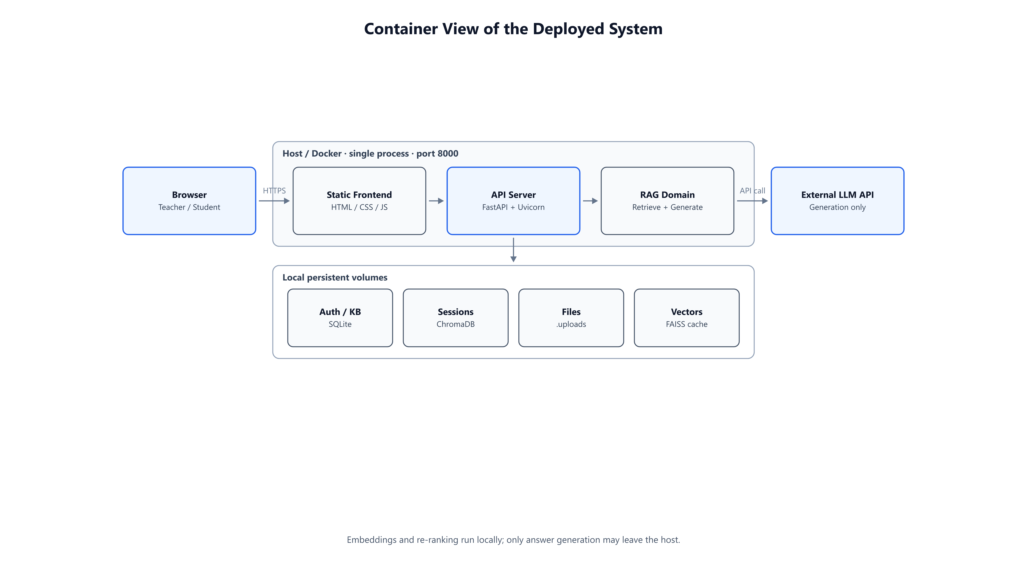
Visual Results — Container View (Fig. 4.1)
Visual Results
12 / 16

Slide 13
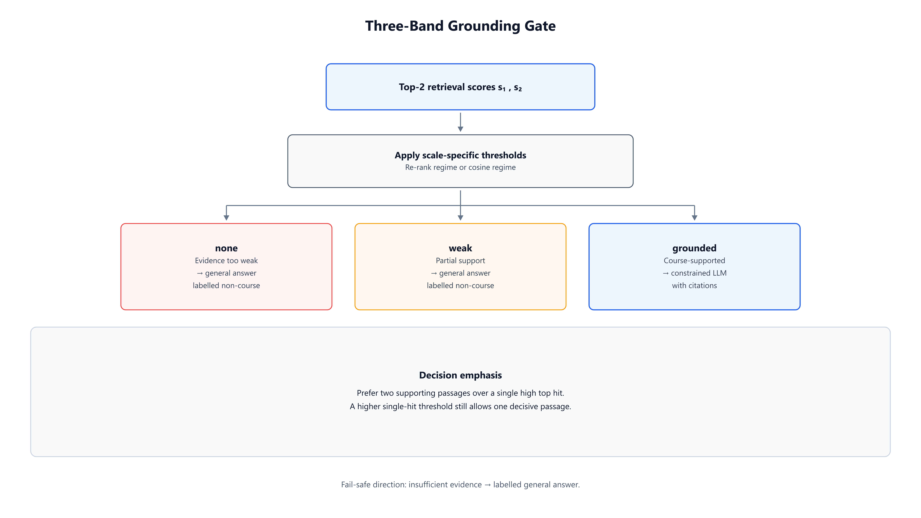
Visual Results — Grounding Gate (Fig. 5.3)
Visual Results
13 / 16

Slide 14
Conclusions
Product
A working teacher–student co-learning bot over one shared course KB (single-course scope).
Method
Hybrid retrieval + CRAG-inspired three-band gate (corpus-calibrated) + citation coverage repair.
Pedagogy
SOLO-informed practice; export limited to questions and scores (no full transcripts).
Evidence
ELEC6081: gate P/R = 0.982 (65-q, cosine); context_precision +0.233 after re-rank (10-q probe).
Conclusions
14 / 16

Slide 15
Limitations and Future Work
Limitations
Future work
• Single course / single instance — no multi-course isolation yet
• Gate thresholds do not transfer across models or growing KBs
• Complex layouts, noisy scans, and estimated page numbers remain weak
• Practice adaptivity is still shallow compared with full tutoring
• Multi-course configuration and stronger campus deployment (HTTPS / IdP)
• Better layout-aware parsing and more reliable location anchors
• Continued recalibration of gate and re-rank thresholds on course sets
• Deeper SOLO-adaptive practice and richer teacher analytics
Limitations and Future Work
15 / 16

Slide 16
Thank you
Questions & Discussion
Jin Yue · 3036494489
Supervisor: Dr. Andrew H.C. Wu · ECE, HKU

