Slide 1
Predict Future Sales
Predict total sales for every product and store in the next month.
Team Members and Tasks
About Project
Approach
Progress
Next Steps

Slide 2
Team Members and Tasks
Jin Zhang
Yun Yang
· Create Linear Models and Evaluate
· Deep Learning in this Project
· EDA and Feature Engineering
· Create Stacked Ensemble Super-Model

Slide 3
About Project
We are provided with daily historical sales data of a Russian market. Our Objective is to forecast the total amount of products sold in every shop for the test set. And there is a challenge for us that the list of shops and products slightly changes every month, so creating a robust model that can handle such situations is complicated and important for accuracy.
As for EVALUATION of the project, we will evaluate performance of each model and record results, then we will create stack ensemble model based on the top models, then evaluate it.

Slide 4
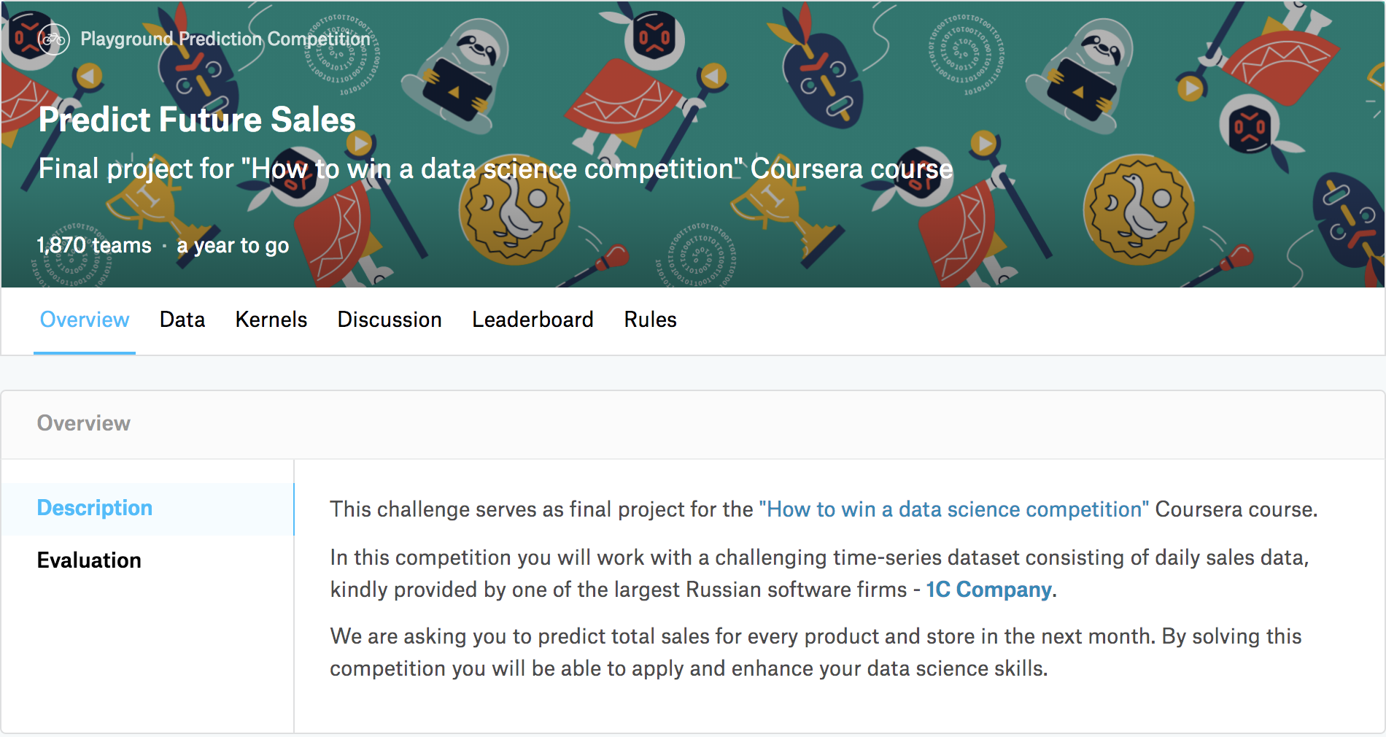
Data Source
https://www.kaggle.com/c/competitive-data-science-predict-future-sales

Slide 5
Approach
To build a effective predictive model, we are
Pre processing the data
Building predictive models using Linear Regression, Decision Tree Regression, SVM Regression and XG Boost Regression train data
Evaluating and comparing the performance of each model using test data
Creating stacked ensemble super-model

Slide 6
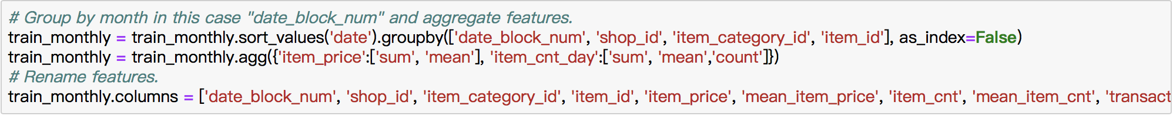
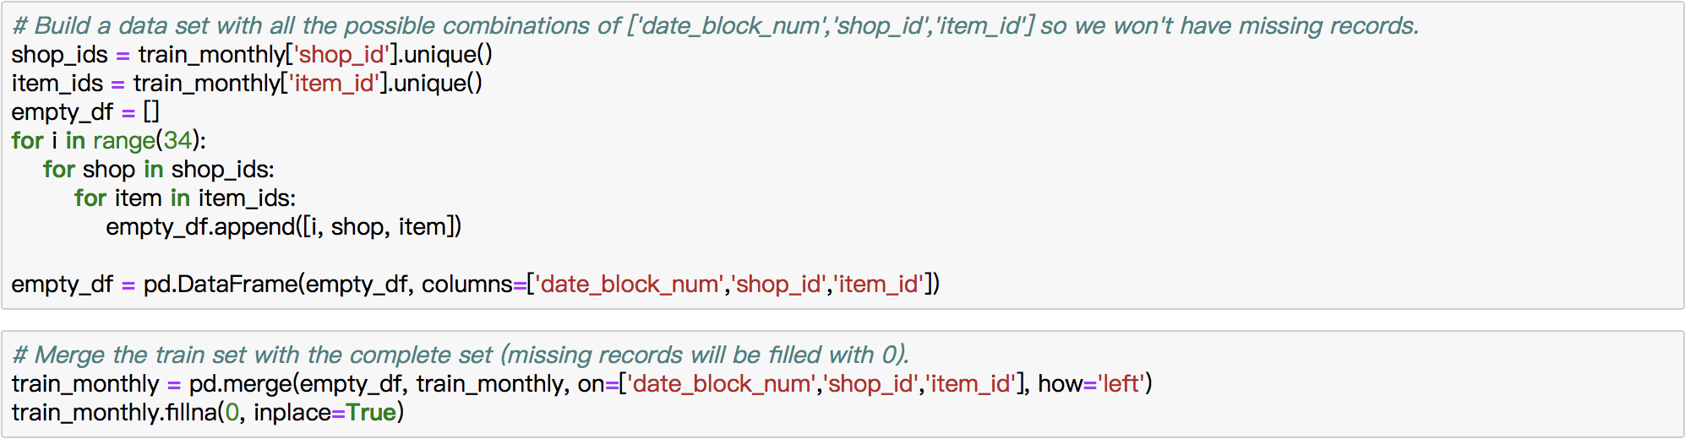
Progress Join datasets together and data preprocessing

Slide 7
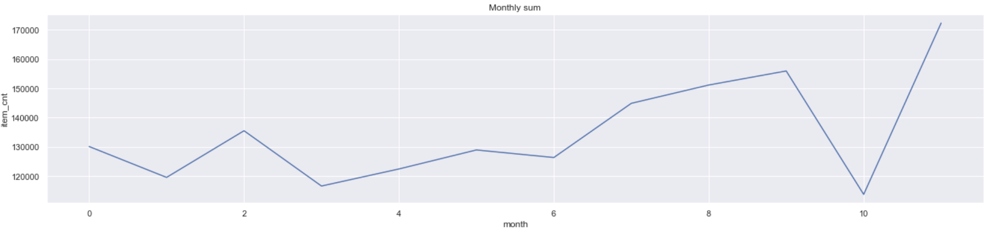
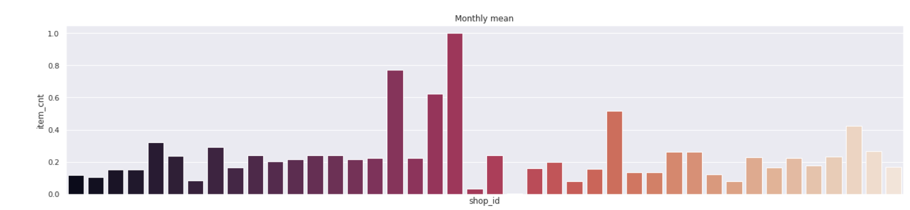
Progress EDA

Slide 8
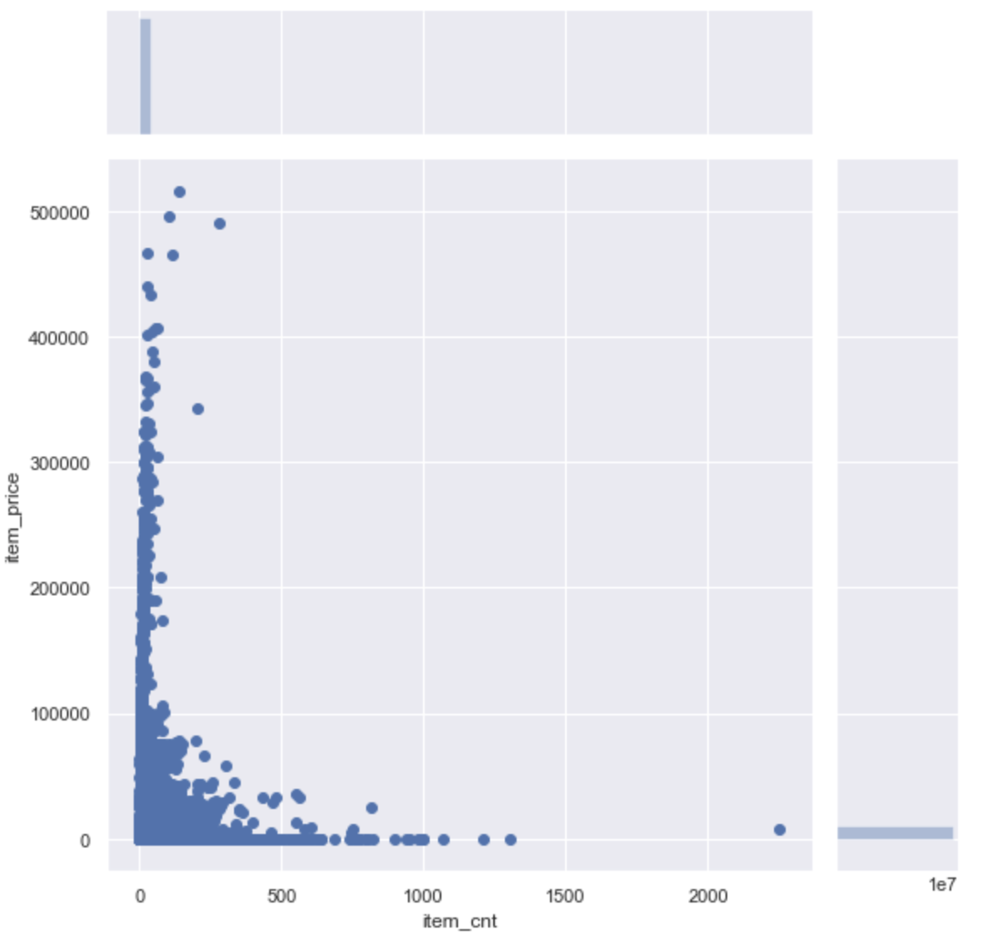
Progress Outliers

Slide 9
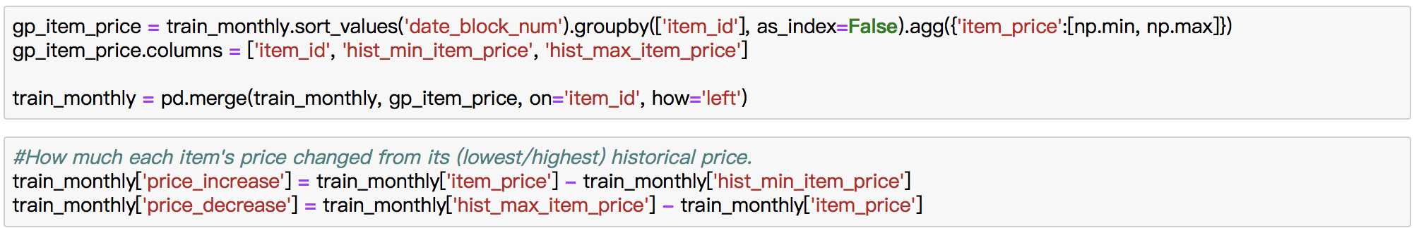
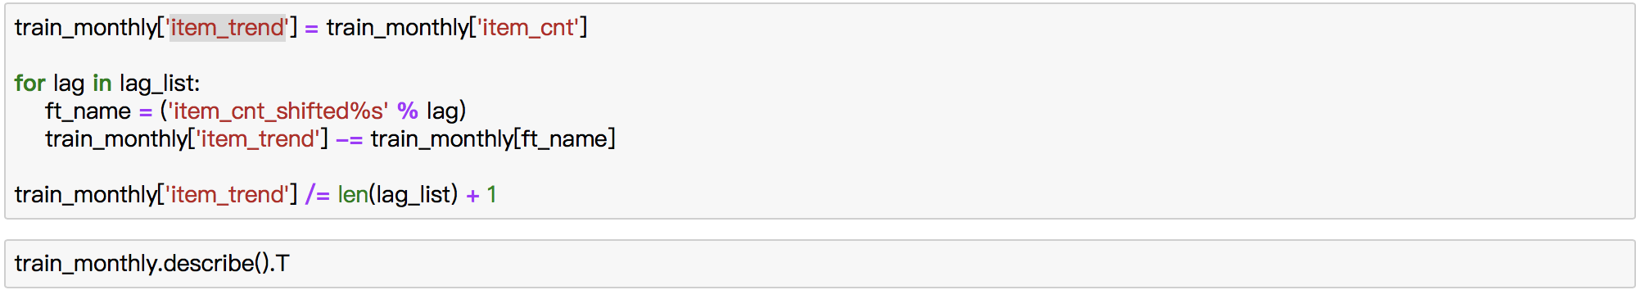
Progress Feature Engineering
Group Based Features
Item Sales Count Trend

Slide 10
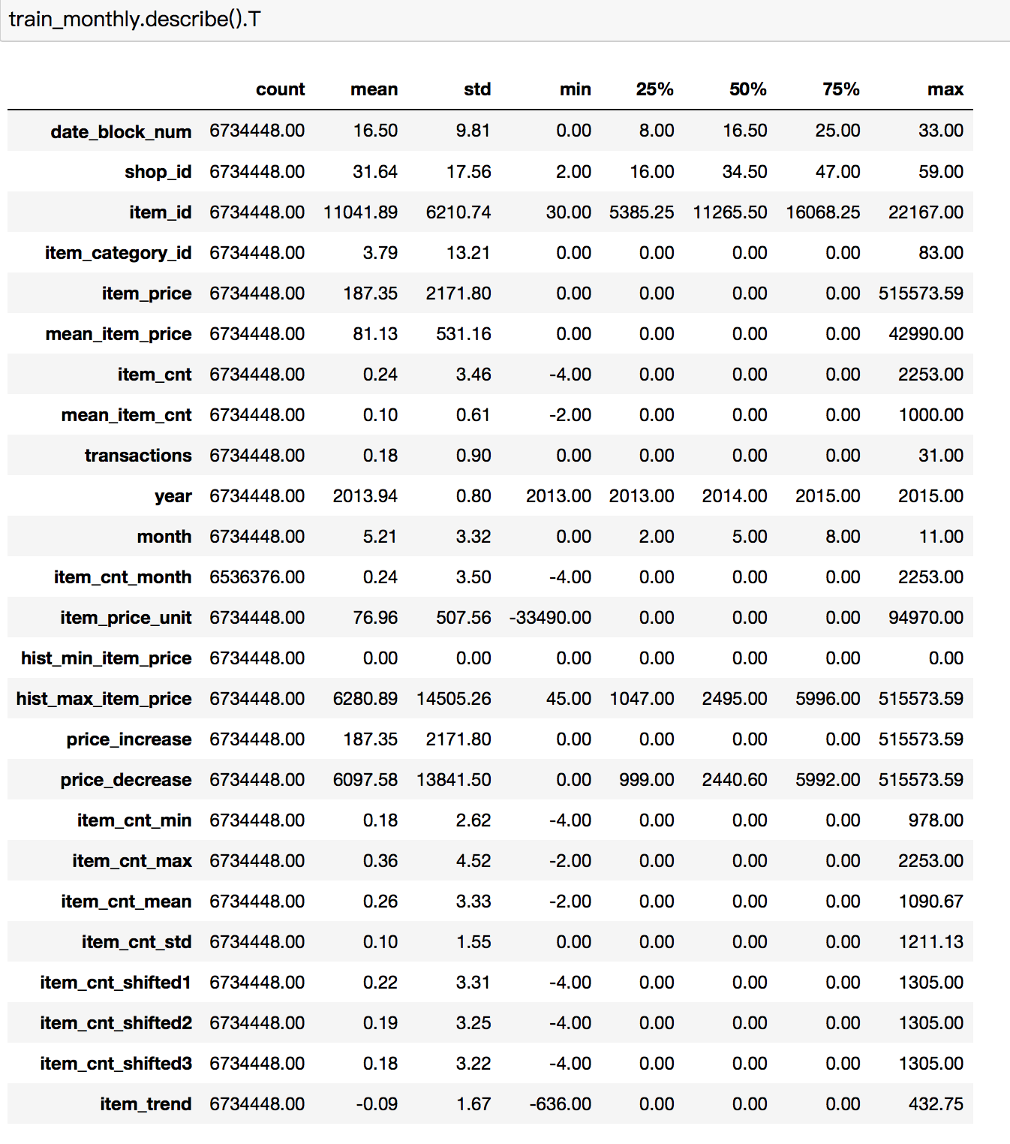
Progress Feature Engineering Result

Slide 11
Next steps
We already done the EDA, and next couple days ,I will extract some highly correction feature, maybe create some new feature if it necessary.
After that , We will start the modeling part, ( The regression models,
Inorder to improve the accuracy ,We can try bagging , to create the stacked ensemble super – model. Or maybe ,MLP using Tensorflow.
In the end, we should do cross-validate the super model We made and make a high accuracy predition.

Slide 12
The models we will use next.

