Slide 1
PUBG Finish Placement Prediction
INFO 7245 Final Project
JinZhang

Slide 2
Data Source
https://www.kaggle.com/c/pubg-finish-placement-prediction/data
I was given over 65,000 games' worth of anonymized player data.
What's the best strategy to win in PUBG? Should you sit in one spot and hide your way into victory, or do you need to be the top shot? This is just the basic thought from the Kaggle.
But in my project, I am not only doing the winning stats prediction also I decided to predict the player performance score ( This is my own creative assumption more detail later)

Slide 3
Basic Workflow
My project will involve with a measurement on things like `heals`, `killPoints`, `kills`,`longestKill`,`teamKills`,`vehicleDestroys`,`winPoints`, and other factors to predict the winPlacePct which is the rank of a team.
Also My Own interest : The player’s performance score
Then a MLP using Tensorflow will be implemented by several steps, the over 65,000 games' worth of anonymized player data will be reshaped in order to fit in the Machine Learning model.

Slide 4
My Assumption : The player’s The player’s performance score
Introduction : A game in PUBG can have up to 100 players fighting each other. But most of the times a game isn't "full". There is no variable that gives me the number of players joined. So I create one new feature : called 'playersJoined’
Based on the playersJoined feature we can create (or change) a lot of others to normalize their values.
create the killsNorm and damageDealtNorm features for player.
When there are 100 players in the game it might be easier to find and kill someone, than when there are 90 players.
So this case, normalize the kills in a way that a kill in 100 players will score 1 (as it is). And with other feature like is it a long-distance kill or is it a headshot etc. will give the player an additional score.
In 90 players it will score (100-90)/100 + 1 = 1.1

Slide 5
My Assumption : The player’s The player’s performance score
I will analyze this score.
This will give me the answer of flowing question.
The best strategy to win in PUBG.
Should I sit in one spot and hide your way into victory?
Do I need to be the top shot?

Slide 6
Content
Introduction : About the project
Data processing : EDA Normalization, Feature Engineering
Structure of the model
Basic Booting and Gbm RDF etc.
Stacked Ensemble Super-Model
MLP Using Tensorflow model: performance, the accuracy
Prediction and analysis

Slide 7
My progress
EDA Done
Feature Engineering done and created 10 new features. hope it can help the modeling.
Basic Booting and Gbm RDF Processing
Stacked Ensemble Super-Model Processing
MLP Using Tensorflow model: performance, the accuracy preliminary ideas

Slide 8
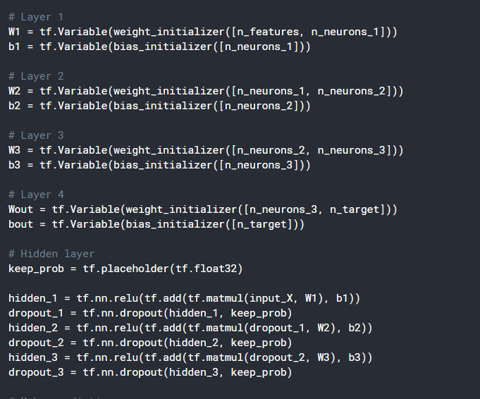
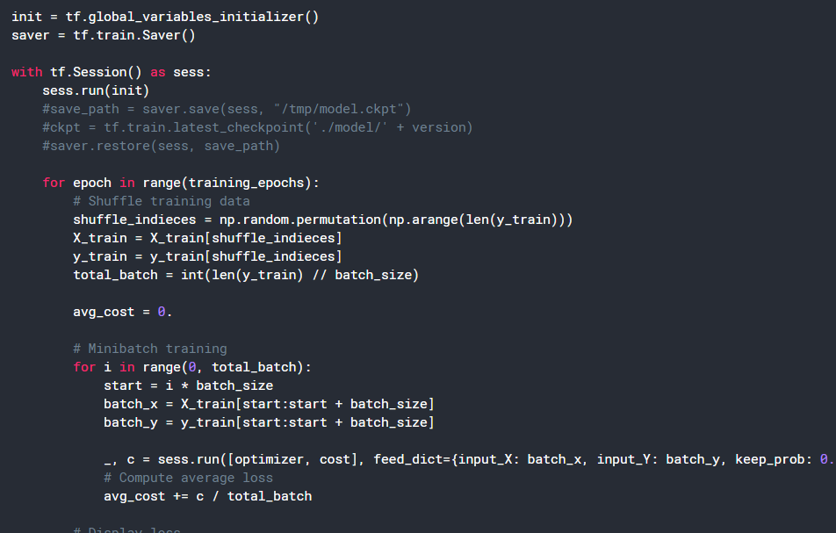
MLP using tensorflow Snippet of the code
Notes:
weight_decay, dropout prevent overfitting
batch normalization: improve the speed, or achieving the same accuracy with fewer steps
Dropout -> randomly drop units(along with its connections) during training
Flattern multi dimensions -> one dimensions for fully connected layer

Slide 9
Thank You

