Slide 1
Classification of
12 plant seedlings
Jin Zhou

Slide 2
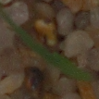
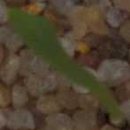
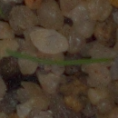
Introduction
The dataset consists of plant seedling images by Aarhus University
Image of individual seedlings cropped out
Seedlings of 12 unique plants at several growing stages
Black-grass
Maize
Sugar beet
Charlock
etc.
https://vision.eng.au.dk/plant-seedlings-dataset/

Slide 3
Preprocessing
250 images for each plant
Converted images to numpy array, each image represented by 49152 features
128 by 128 pixel, 3 for each of RBG value
Giving one unique label to each plant
0 to 11
Normalized using StandardScaler()
15% Test, 12.75% Validation, 72.25% Train

Slide 4
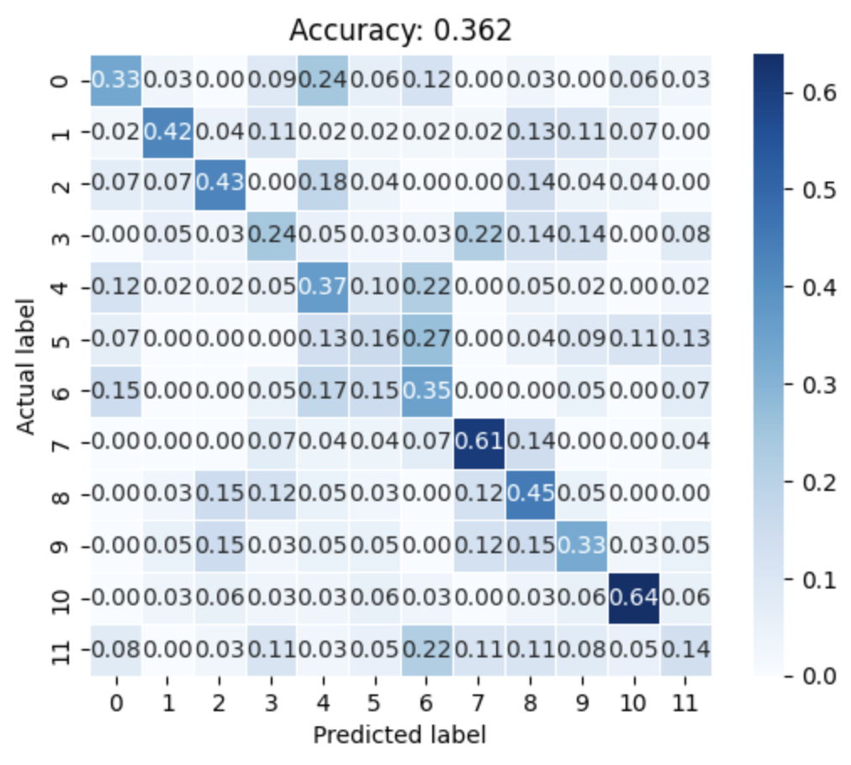
Logistic Regression
Feature Transformations
Normal
Squared
Cubic
Regularization
C = [0.00000001, 0.00001, 0.001, 0.01, 0.1, 1, 10, 100, 1000, 100000]
𝜆 = 1/C
LASSO, Ridge
Best result
X, LASSO, C=10
Test accuracy = 36.2%

Slide 5
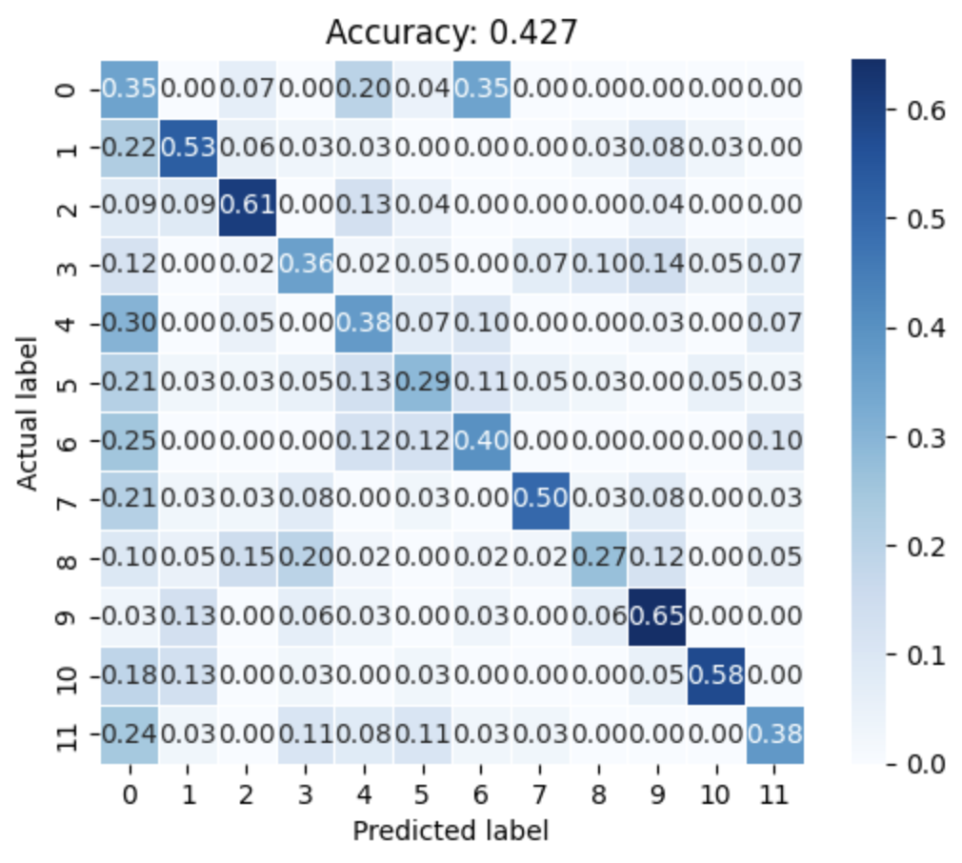
Simple Vector Machine
Kernel functions
Linear
Polynomial
Radial-basis function(rbf)
Regularization
L2²
Same Cs as Logistic Regression
Best result
X, rbf, C=10
Test accuracy: 42.7%

Slide 6
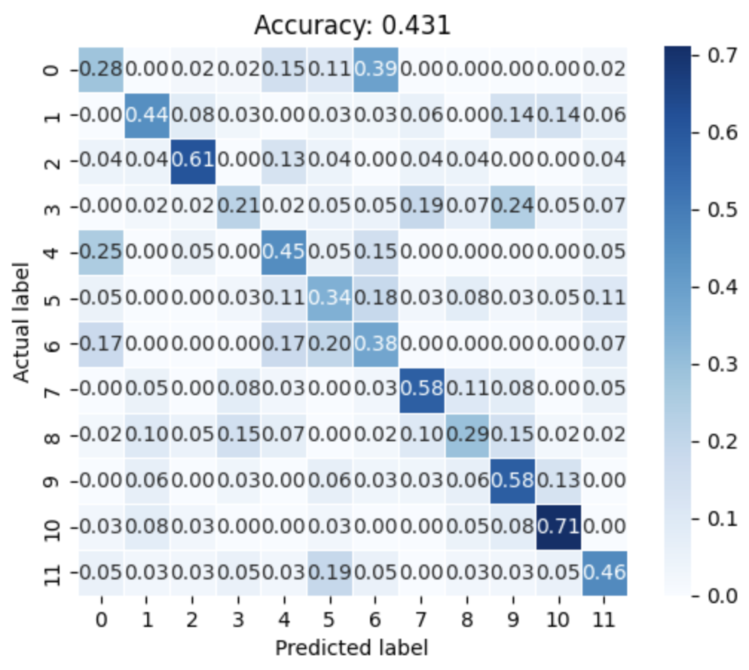
Neural Network
Activation Functions
Logistic(Sigmoid)
Rectified Linear Unit(Relu)
Tanh
Three hidden layer structures
(200)
(400,200)
(600,400,200)
Regularization
L2(Ridge)
𝜆 = 1/C
Best Result
(400,200), ReLu, 𝜆=1
Test Accuracy = 43.1%

Slide 7
Conclusion
Dataset is not linearly separable
Logistic regression being the worst model
36.2%
Neuron Network does the best job
Accuracy of 43.1% on the testing set
SVM performed only a little worse than Neuron Network
42.7% Accuracy
Improvements
Larger/Better neuron network structure
Larger Datasets
Clearer pictures

Slide 8
Thank you!
Questions?

