Slide 1

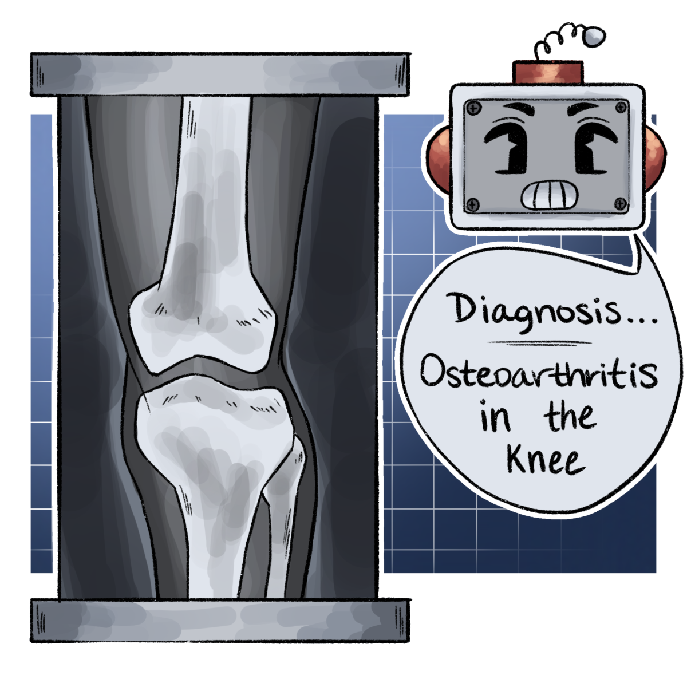
Knee Osteoarthritis Severity Grading
Jinalkumari Vaniya
Advisor: Corey Elowsky
Notes:
Hello everyone! My name is Jinalkumari Vaniya. I am a Data Science Major. Today, I am presenting my project on Knee Osteoarthritis severity grading using multimodal approach.

Slide 2
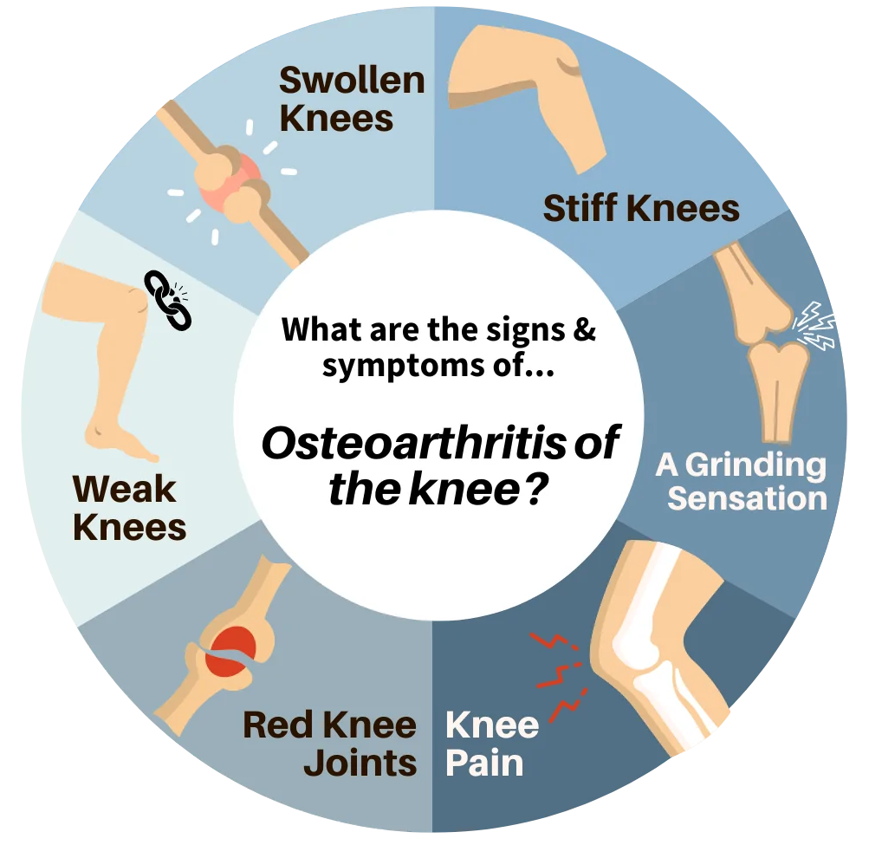
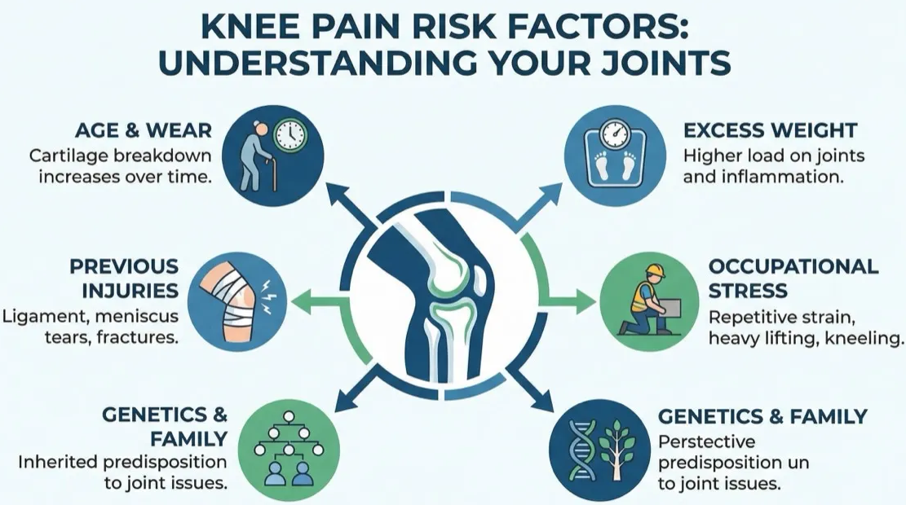
Background
Notes:
Knee osteoarthritis is one of the most common causes of disability. It can occur due to aging, wear and tear, previous injuries, or sometimes hereditary factors. Common symptoms include knee pain during walking or exercise as well as stiffness.

Slide 3



Problem Statement
⚕️ Manual diagnosis
⏱️ Time-consuming
❗ Subjective
Notes:
Currently, knee X-rays are analyzed manually by radiologists. This process is time-consuming, subjective, and can vary between observers. This makes early diagnosis difficult.

Slide 4
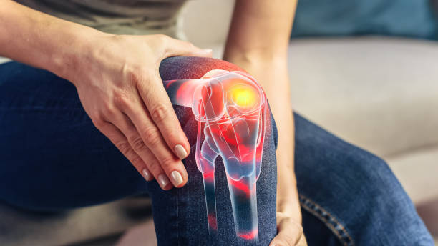

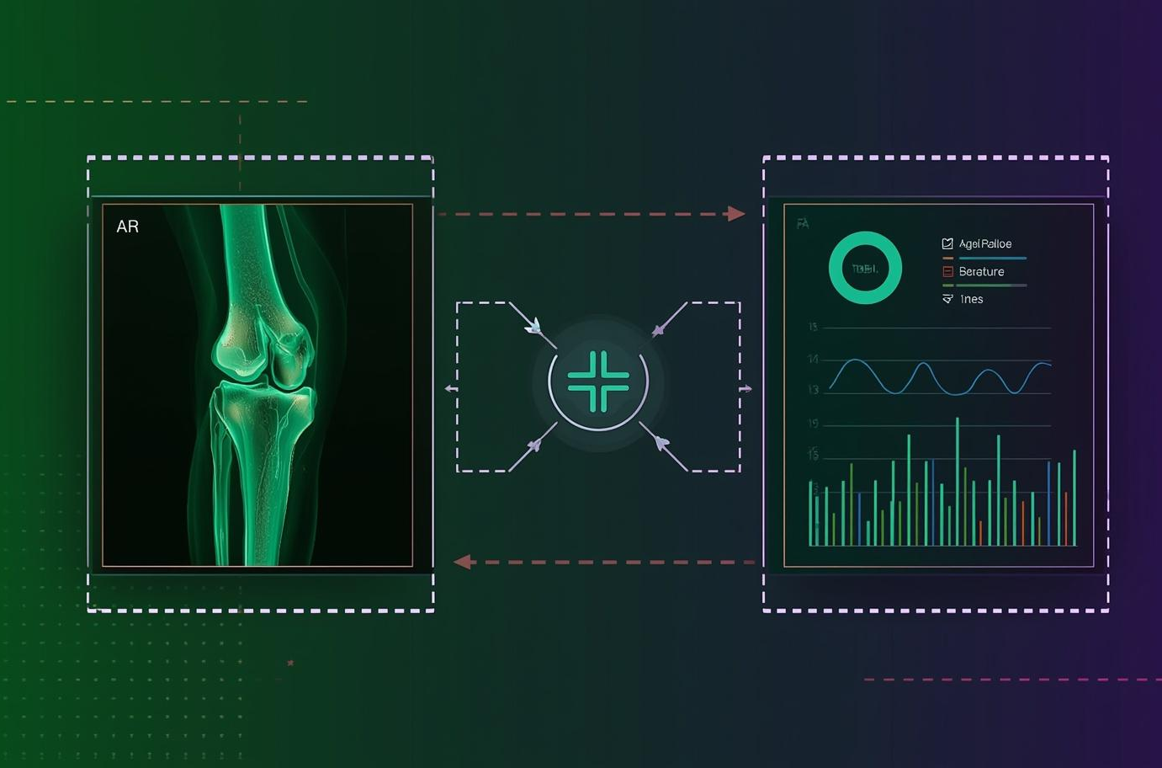
Project Goal
Early detection
Improve prediction with metadata and X-ray images
AI Assistance
Notes:
The goal of this project is early detection of osteoarthritis. Most existing models use only X-ray images. In this project, I combine X-ray images with metadata to improve prediction. I also added AI-based suggestions to provide user assistance.

Slide 5
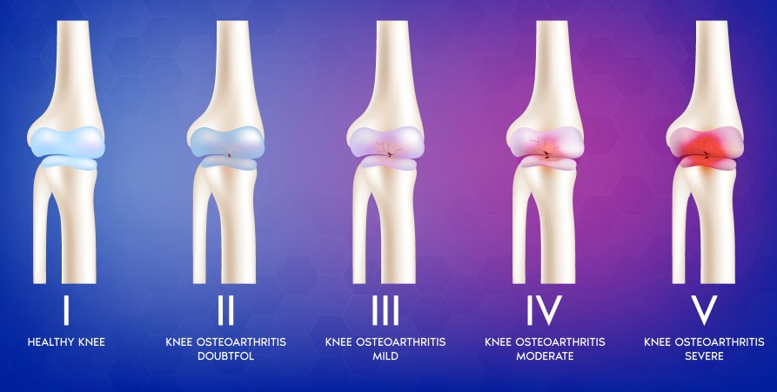
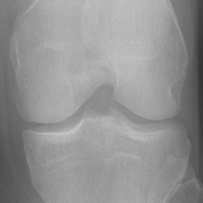
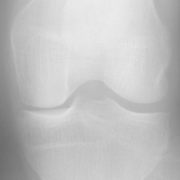
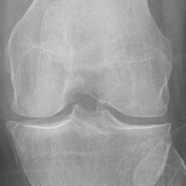
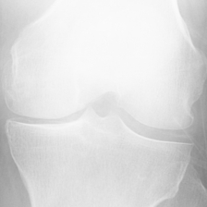
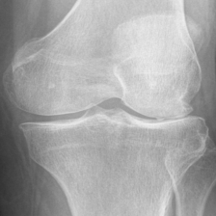
Dataset
X-ray images
Clinical + Radiographic metadata
Labels/ KL grade (0,1, 2, 3, 4)
Metadata
KL Grade 0
KL Grade 1
KL Grade 2
KL Grade 3
KL Grade 4
Notes:
The dataset includes both X-ray images and Clinical as well as radiographic metadata. The metadata includes features such as Age, BMI, Gender, Joint space Narrowing, Osteophytes, and several other features. The Severity of knee osteoarthritis is graded by Kellgren–Lawrence or KL grading system, where KL0 represents healthy knee and KL4 represents severe osteoarthritis.

Slide 6
Approach
Image models
Metadata models
Image + Metadata (Multimodal) models
Resnet model
Metadata model
Naïve model
Resnet Metadata model
Swin Tiny model
Swin metadata model
Notes:
I developed three type of models.
1. Image only models, including CNN based ResNet model and Swin Tiny transformer model.
2. Metadata only models
3. Multimodal models, which combines image and metadata. Within Multimodal models, I explored three variants. The Naive model converts metadata into an image strip and append it to the X-ray images. The other two models are swin + metadata multimodal and resnet + metadata multimodal models.

Slide 7
Ordinal Approach
Multiclass classification
Treats classes as independent
Predicts one class
Ordinal Classification
Uses Threshold based ranking
Respects the order (0 4)
Notes:
I trained models using both multi-class classification and ordinal classification. Multi-class classification predicts one class directly and treats all classes as independent. Since osteoarthritis is a progressive disease, I used ordinal models, which predict thresholds and use ranking instead of treating grades as independent classes.

Slide 8
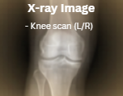
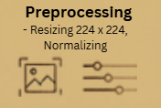
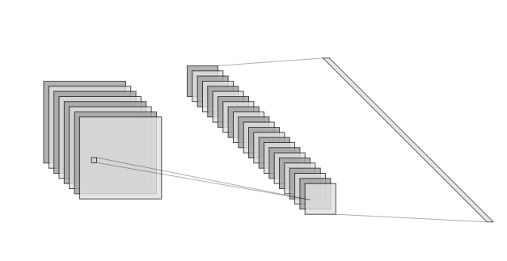
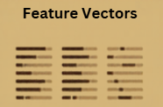
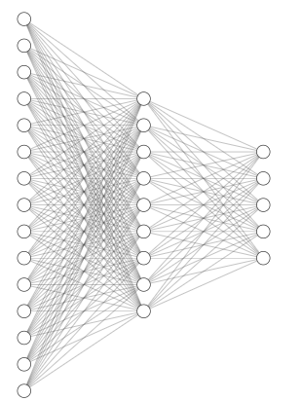
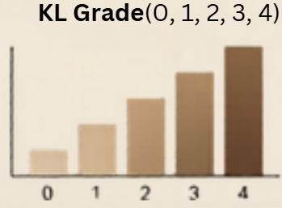

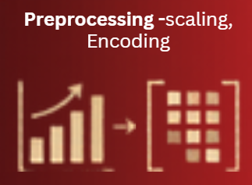

Multimodal Pipeline
Fusion Layer
NN (Resnet/Swin)
NN (Resnet/Swin)
Notes:
In the multimodal pipeline, the X-ray image is first preprocessed and passed through a neural network to generate a feature vector. Similarly, the metadata is processed and passed through neural network to produce a feature vector. Both are then combined and passed through a fusion layer to predict the KL Grade.

Slide 9
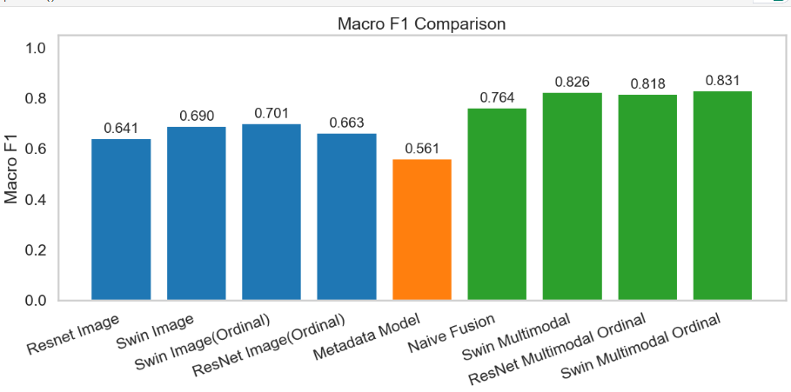
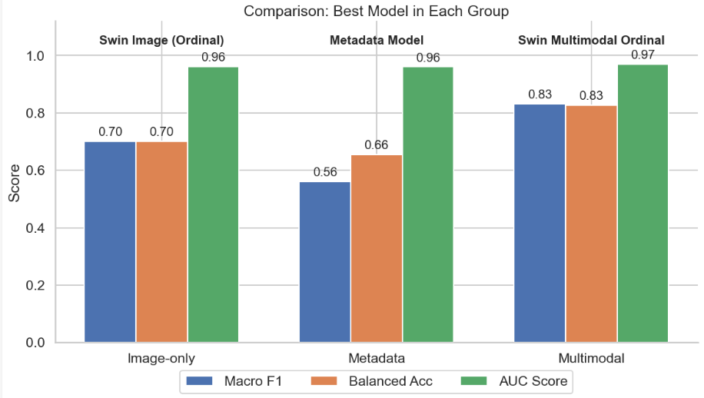
Evaluation
F1 Score
Balanced Accuracy
AUC Scores
Confusion Matrix
Best Image model (Swin Ordinal) F1 score: 0.70
Best Multimodal model (Swin + Metadata Ordinal) F1 score: 0.83
Ordinal models performed better than multi-class models.
Ordinal Multimodal model (Swin) achieved 13% higher F1 score than best Image only model
Notes:
For evaluation, I used F1 score, confusion matrix, AUC score, and balanced accuracy. The results show that the Swin ordinal model is the best image-only model, achieving an F1 score of 0.70. The best multimodal model is the Swin plus metadata ordinal model, which achieves an F1 score of 0.83. This represents a 13 percent improvement, and it also shows that ordinal models perform better than multi-class models.

Slide 10
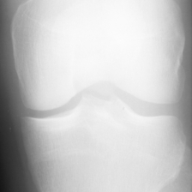
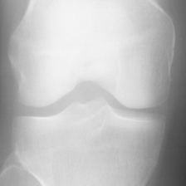
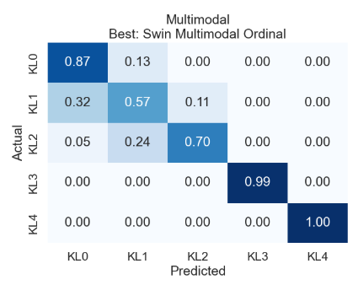
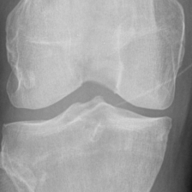
Results
KL1 Image predicted as KL0
KL0 Image
Best – Swin + Metadata Ordinal
F1 score: 0.83
KL1 Image predicted as KL2
KL2 Image
Notes:
The confusion matrix of the best multimodal model shows that KL1 is the hardest class to predict. It often misclassifies KL1 as KL0 or KL2 due to overlapping features.

Slide 11
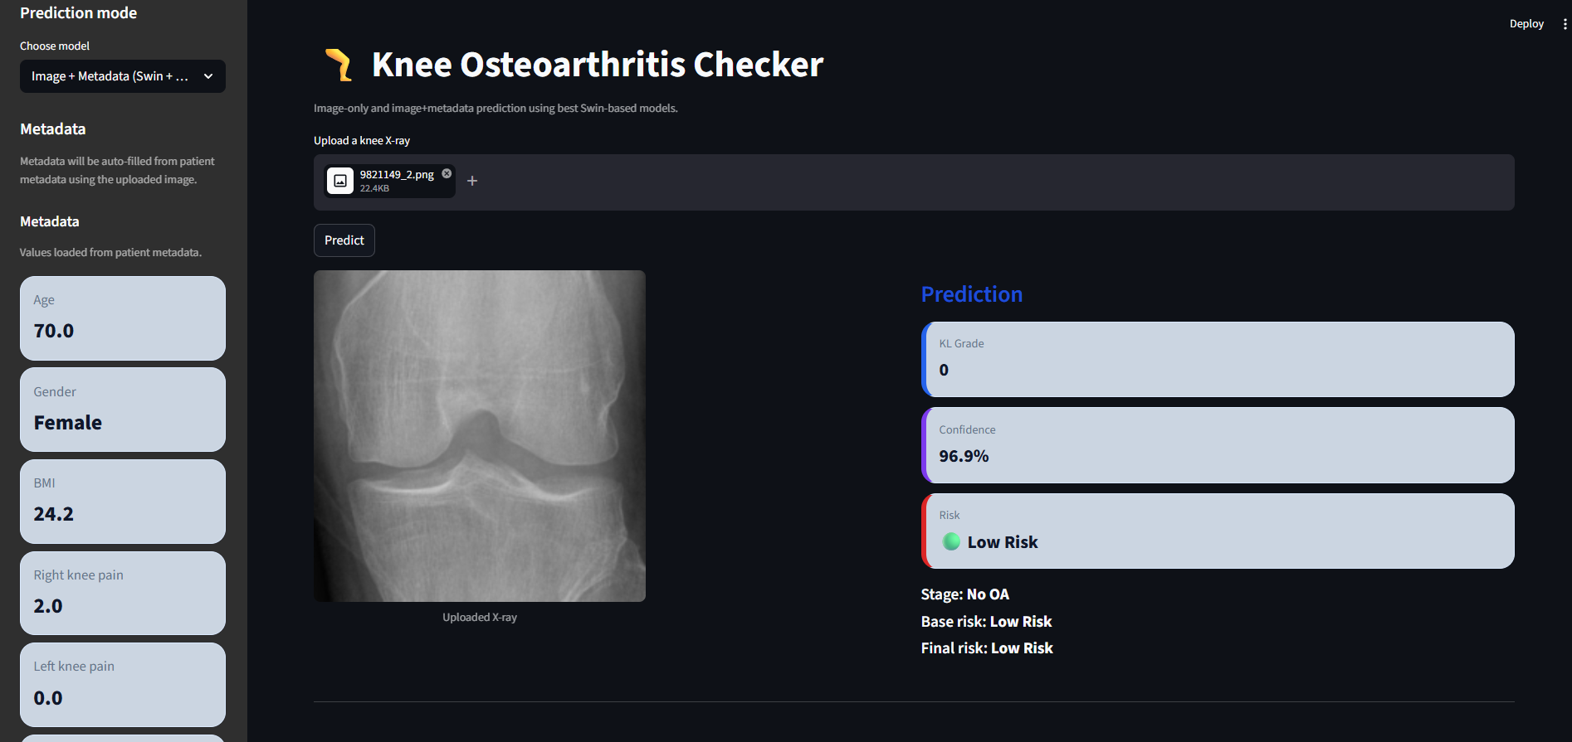
UI Demo
User uploads image → gets KL grade + risk
Notes:
I also developed a Streamlit interface where users can upload an X-ray image. The system predicts the KL grade using the best image-only model and the best multimodal model and displays confidence score and risk level. It also provides AI-generated health guidance using a Groq model. In multimodal mode, it uses linked clinical and radiographic metadata.

Slide 12
Conclusion
Multimodal models outperform Image only models
Ordinal classification improves prediction consistency
Difficult to differentiate early-stage Grades (KL0, KL1, KL2 )
Higher grades (KL3, KL4) are easier to predict
Notes:
To conclude, multimodal models outperform image only models. Ordinal classification improves prediction consistency. Early-stage grades (KL0, KL1, KL2) are difficult to distinguish due to overlapping features. Higher grades (KL3, KL4) are easier to predict due to clearer structural differences.

Slide 13

Future Enhancements
Adding unobserved data such as previous knee injury, surgery history, hereditary data
Use larger dataset and better fusion techniques to improve KL1 prediction.
Notes:
For future enhancements, we can add additional metadata such as previous knee injury, surgery history, and hereditary factors. I also plan to explore advanced multimodal fusion techniques and use larger datasets to improve KL1 prediction.

Slide 14
Thank you
Notes:
Thank you!

