Slide 1

IDRIB
ICU Risk-Scoring Bot: Competitive Market Analysis & Technical Architecture
Predicting 30-day ICU Readmission at the Moment of Discharge
MS Health Informatics · Hofstra University · April 2026

Slide 2




What IDRIB Does — Unique Positioning
Discharge-Point Prediction
Automated Interventions
Scores risk at the moment of ICU discharge — exactly when patient disposition decisions are made. Competitors only monitor in-ICU.
HIGH risk instantly triggers nurse call within 24hrs, PCP appointment, pharmacist review, and patient SMS monitoring — no manual triage.
SHAP Explainability Per Patient
Dual Bot Layer
Every score shows top 3 clinical drivers: e.g. 'Risk driven by rising creatinine, CHF, prior ICU admission.' Builds clinician trust.
Vina AI (patient-facing SMS/voice) + Vedi (clinician dashboard showing top-10 high-risk discharges today). Covers both sides of care.

Slide 3
Competitive Landscape & Market Opportunity
IDRIB vs. Competitors
Market Opportunity
Competitor | Gap vs IDRIB
Epic eRI | In-ICU only; no discharge score; Epic-locked
APACHE IV | Static admission score; no ML; no bot layer
iREAD (Lancet) | Academic model only; no intervention or patient bot
LACE Score | Rule-based; no ML; no real-time update; no bot
Health Catalyst | Vendor lock-in; no ICU depth; no patient SMS/voice
$3.95B
Global CDSS Market (2025)
→ $8.10B by 2034
18%+
AI ICU Sub-Segment CAGR
Fastest-growing segment
2,500+
Hospitals Penalized (FY2024)
CMS HRRP up to 3% Medicare
$65K
Avg. ICU Readmission Cost
Direct ROI for CFOs

Slide 4
IDRIB Output & Path to Market
Risk Tier Output
Immediate Next Steps
HIGH RISK
Nurse call 24hr + PCP + pharmacist + SMS
01
FDA Regulatory Engagement
Score: 70–100
Pre-submission meeting for SaMD classification (510k or De Novo). Pursue Breakthrough Device designation.
MEDIUM RISK
PCP follow-up + discharge education
Score: 40–69
02
Full MIMIC-IV Retraining
LOW RISK
Standard discharge protocol
Apply for access at physionet.org. Full 65K patient dataset projects AUROC 0.75–0.82 vs current 0.607.
Score: 0–39
03
Academic Medical Center Pilots
2–3 AMC partnerships for prospective clinical validation. FHIR-compatible API works across Epic, Cerner, MEDITECH.
IDRIB Project · MS Health Informatics · Hofstra University · MIMIC-IV Demo v2.2 · April 2026 · Confidential

Slide 5
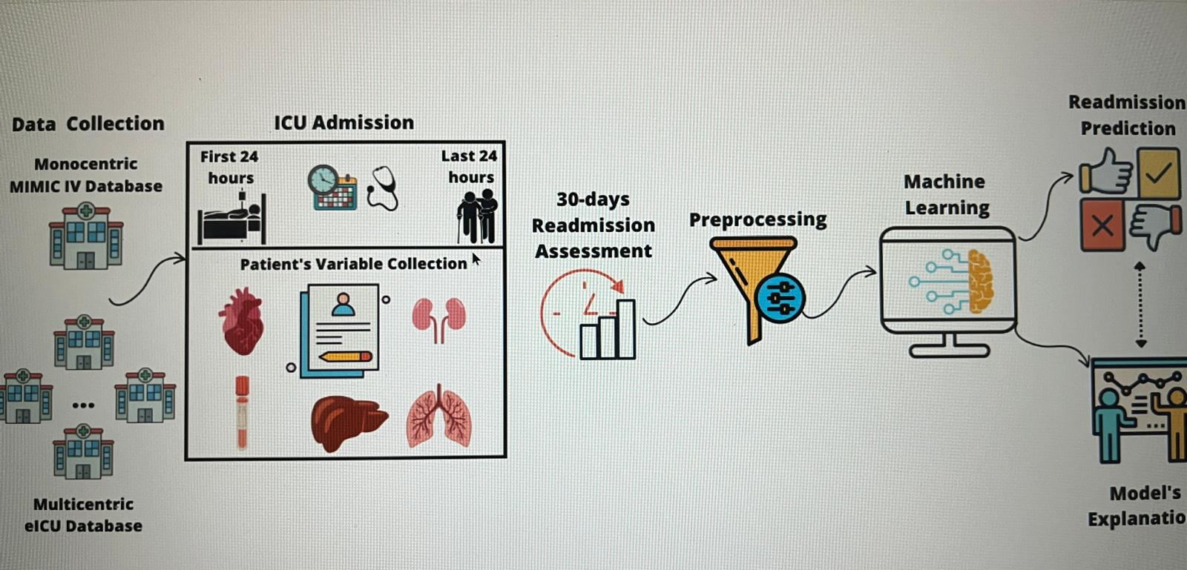

Slide 6
Research Paper :
https://www.nature.com/articles/s41597-022-01899-x (Nature Scientific Data)
https://www.thelancet.com/journals/eclinm/article/PIIS2589-5370(25)00044-6/fulltext (Lancet eClinicalMedicine)
https://arxiv.org/html/2309.13781v4
https://pmc.ncbi.nlm.nih.gov/articles/PMC8437217/
https://pmc.ncbi.nlm.nih.gov/articles/PMC9069814/

