Slide 1



Understanding Open-Source
Ecosystem
Prof. Ashutosh Tripathi, Assistant Professor
CSE Engineering

Slide 2
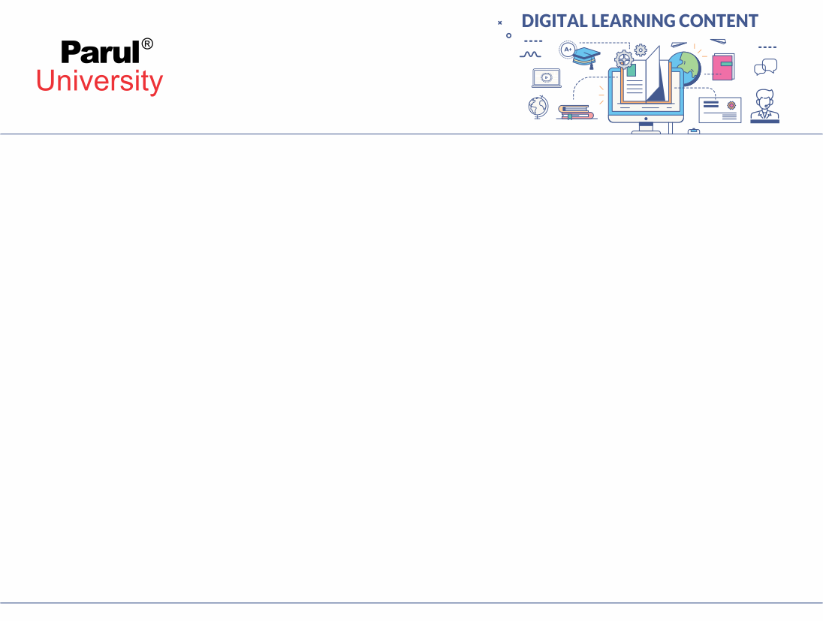

CHAPTER-4
Introduction

Slide 3
Virtualization Technologies
Virtualization technologies are software-based technologies that allow multiple virtual instances of operating systems or applications to run on a single physical computer or server. Virtualization provides a way to utilize hardware resources more efficiently, improve scalability, and enhance the flexibility and manageability of IT environments.
Here are some of the key virtualization technologies:
Xen: An open-source hypervisor developed by the Xen Project. It can run on both x86 and ARM architectures and is commonly used in cloud computing environments.
Oracle VirtualBox: An open-source virtualization software that supports running multiple guest operating systems on various host systems.
Parallels Desktop: A virtualization software for macOS that enables users to run multiple guest operating systems on a Mac computer.
Microsoft App-V (Application Virtualization): Allows applications to be delivered to users as virtual applications, decoupling them from the underlying operating system.

Slide 4
5.Hypervisor (Virtual Machine Monitor - VMM): A hypervisor is a software layer that allows multiple virtual machines (VMs) to run on a single physical machine. There are two main types of hypervisors: Type 1 (bare-metal) and Type 2 (hosted). Type 1 hypervisors run directly on the hardware, while Type 2 hypervisors run on top of a host operating system.
6.VMware vSphere/ESXi: Developed by VMware, vSphere is a suite of virtualization products, with ESXi being the bare-metal hypervisor that powers it. vSphere provides various features for managing and optimizing virtualized environments.
7.Microsoft Hyper-V: Microsoft's virtualization platform, which comes as a role in Windows Server. Hyper-V allows users to create and manage virtual machines on Windows-based systems.

Slide 5
Containerization Technologies
By default, containerization technology derives from virtualization's advancements. Another common name for it is OS-level virtualization.
Containerization is all about packaging the requirements of an application under development in the form of a base image. This image can run in an isolated space (containers) on different systems. It is crucial to remember that these containers share the same OS.
Types of containers
Docker: a containerized platform that is open-sourced and mixes an app's source code with the existing OS and all of its relevant libraries and dependencies. It enables the running of the relevant code in any computing environment.
LXC: An OS-based container that, if it includes a single Linux kernel acting as the host OS, enables an app to operate on numerous Linux computers virtually.

Slide 6
Development Tool Kit
A development toolkit, also known as a software development toolkit or SDK (Software Development Kit), is a set of software tools, libraries, and resources that developers use to create applications or software for a specific platform, operating system, or programming language. These toolkits streamline the development process by providing pre-built functions and APIs (Application Programming Interfaces) that allow developers to interact with the platform's features and services.
The specific components of a development toolkit can vary depending on the target platform or programming language, but some common elements may include:
Libraries: Pre-written code modules that provide functionality for common tasks, such as handling graphics, networking, data processing, etc.
APIs: Interfaces that allow applications to interact with the underlying platform, operating system, or other services. This could include APIs for accessing hardware features, system functions, cloud services, etc.

Slide 7
3. Sample Code: Code examples that demonstrate how to use different components of the toolkit in practical applications.
4. Compiler or Interpreter: Tools to translate source code into machine code or bytecode that can be executed on the target platform.
5. Debugging Tools: Tools for identifying and fixing errors and issues in the code during the development process.
6. Profiling Tools: Tools that analyse the performance of the application to identify bottlenecks and areas for optimization.

Slide 8
Examples of popular development toolkits include:
Android SDK: For developing applications for the Android operating system.
iOS SDK: For developing applications for Apple's iOS platform.
.NET Framework: A development framework for building Windows applications and web services.
Java Development Kit (JDK): For developing Java applications.
Node.js: A JavaScript runtime that includes a variety of libraries for building server-side applications.
Unity: A popular game development platform that provides various tools and libraries for creating games.

Slide 9
Debuggers
Debuggers are essential tools used by developers to identify and fix bugs or issues in software code. They allow programmers to closely examine the program's execution, inspect variables and data, and track the flow of the code to understand how the program behaves. Debugging is a crucial part of the software development process, as it helps ensure the reliability and correctness of the final product.
Key features of debuggers include:
Breakpoints: Developers can set breakpoints in the code, which pause the program's execution at a specific line or function. This allows them to inspect the program's state at that point and step through the code one line at a time.

Slide 10
Debuggers
Popular debuggers vary depending on the programming language and platform being used. Some widely used debuggers include:
GDB (GNU Debugger): A powerful open-source debugger commonly used for C, C++, and other languages.
LLDB: A debugger commonly used for macOS and iOS development.
Visual Studio Debugger: Integrated into Microsoft Visual Studio IDE for debugging .NET applications and other languages.
Xcode Debugger: Integrated into Apple's Xcode IDE for debugging macOS and iOS applications.

Slide 11
Programming Language
A programming language is a formal language designed to instruct a computer to perform specific tasks. It serves as a means of communication between humans and computers, allowing programmers to write instructions in a format that the computer can understand and execute. Programming languages are used to develop software applications, scripts, algorithms, and other computational tasks.
There are numerous programming languages available, each with its own syntax, semantics, and features. Some popular programming languages as of my last update in September 2021 include:
Python , C , C++ , Java , ……etc.

Slide 12
LAMP
LAMP is an acronym that refers to a popular and commonly used software stack for web development. It is an open-source solution that combines four key components to create dynamic and robust web applications. Each letter in the LAMP acronym represents one of these components:
Linux: The operating system (OS) of the server hosting the web application. Linux is chosen for its stability, security, and cost-effectiveness. It provides the foundation for the entire LAMP stack.
Apache: The web server software that handles incoming HTTP requests from web browsers and serves web pages and resources to users. Apache is one of the most widely used web servers and is known for its reliability and flexibility.
MySQL: A relational database management system (RDBMS) used to store and manage the application's data. MySQL is popular for its speed, scalability, and ease of use, making it a favoured choice for web applications.
PHP: A server-side scripting language used for creating dynamic web content. PHP is embedded within HTML to generate web pages on the server before sending them to the client's browser.

Slide 13
Open Source Database Technologies
Open-source database technologies are database management systems (DBMS) that are released under open-source licenses, allowing users to access, modify, and distribute the source code freely. These databases offer an alternative to proprietary solutions and have gained significant popularity due to their cost-effectiveness, flexibility, and active community support.
Some of the prominent open-source database technologies as of my last update in September 2021 include:
MySQL: One of the most popular open-source relational database management systems. MySQL is widely used for web applications, content management systems, and various other applications requiring a robust and scalable database.
PostgreSQL: A powerful and feature-rich open-source object-relational database system. PostgreSQL is known for its extensibility, support for advanced data types, and compliance with SQL standards.

Slide 14
Open Source Database Technologies
3. MariaDB: A fork of MySQL, created by the original developers of MySQL. MariaDB retains MySQL's core functionality while adding new features and performance improvements.
4. MongoDB: An open-source NoSQL database that uses a document-oriented data model. MongoDB is well-suited for handling unstructured or semi-structured data and is commonly used in modern web applications and big data solutions.
5. SQLite: A self-contained, serverless, and zero-configuration open-source database engine. SQLite is widely used in embedded systems, mobile apps, and as a local storage solution for desktop applications.

Slide 15
References
https://chat.openai.com/

Slide 16


www.paruluniversity.ac.in

