Slide 1

Made by :
Gunjan Lalwani
Renu Hadke
Jinansi Thakkar

Slide 2
Content
Problem Statement
Solution
Important Use cases
Screenshots

Slide 3

Major Challenges faced by E-commerce industry is
Shipment Services
Cash on Delivery
Customer Satisfaction

Slide 4
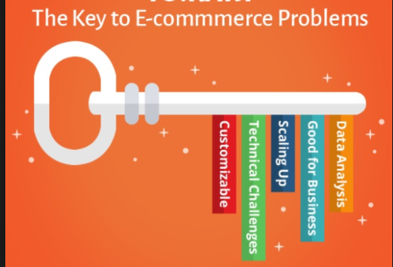
Solution :
Easy delivery will help the customer to view all the products from every seller which are present near the customer.
Customer can get the product delivered within a day as the seller and customer is in the same area.
Customer can also apply for Cash On Delivery option .
.

Slide 5
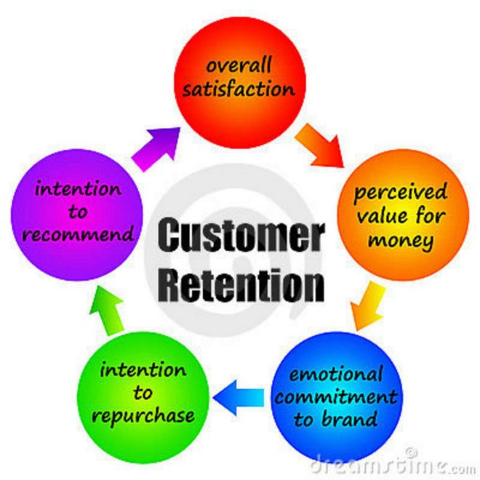
Purpose of Easy Delivery

Slide 6
OBJECT MODEL

Slide 7
WORK FLOW

Slide 8
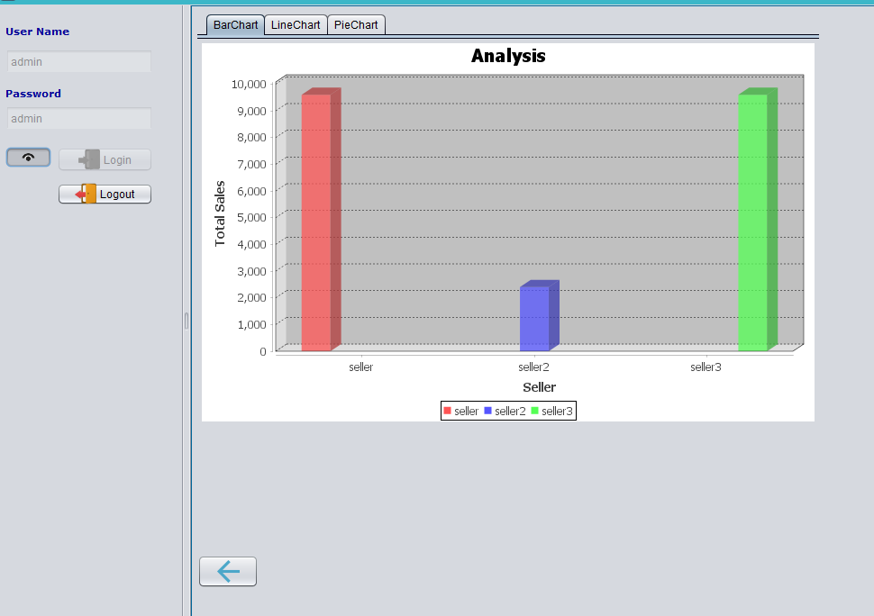
Important Use cases and Screenshots
Admin can view Analysis of seller sales , commission of seller and shipping sales via graphs

Slide 9
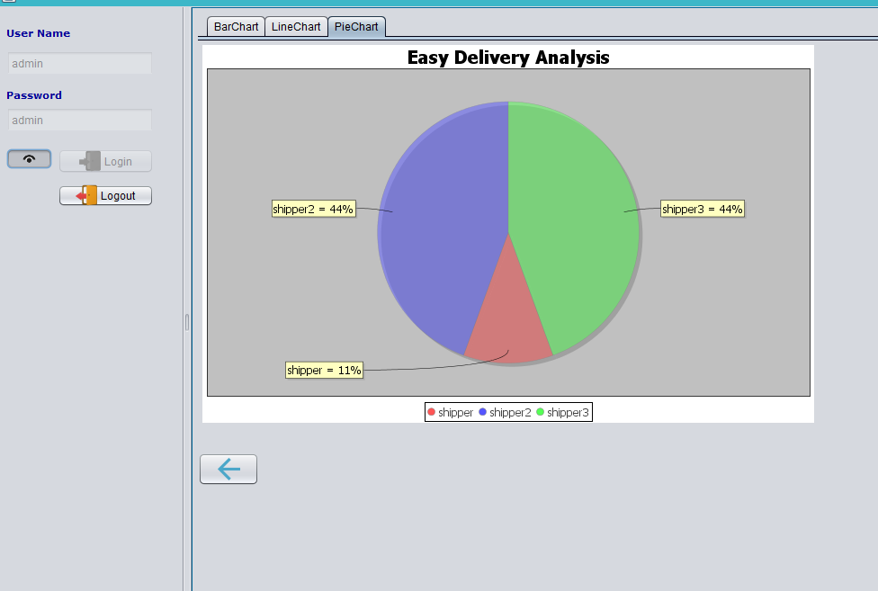
Shipping Analysis

Slide 10
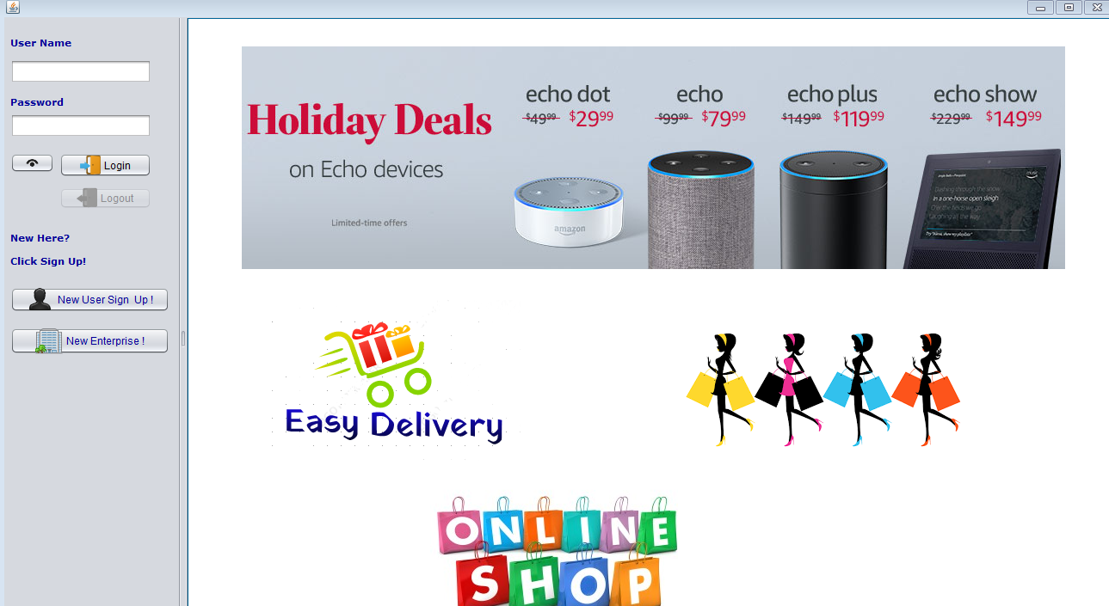
Homepage of Easy Delivery

Slide 11
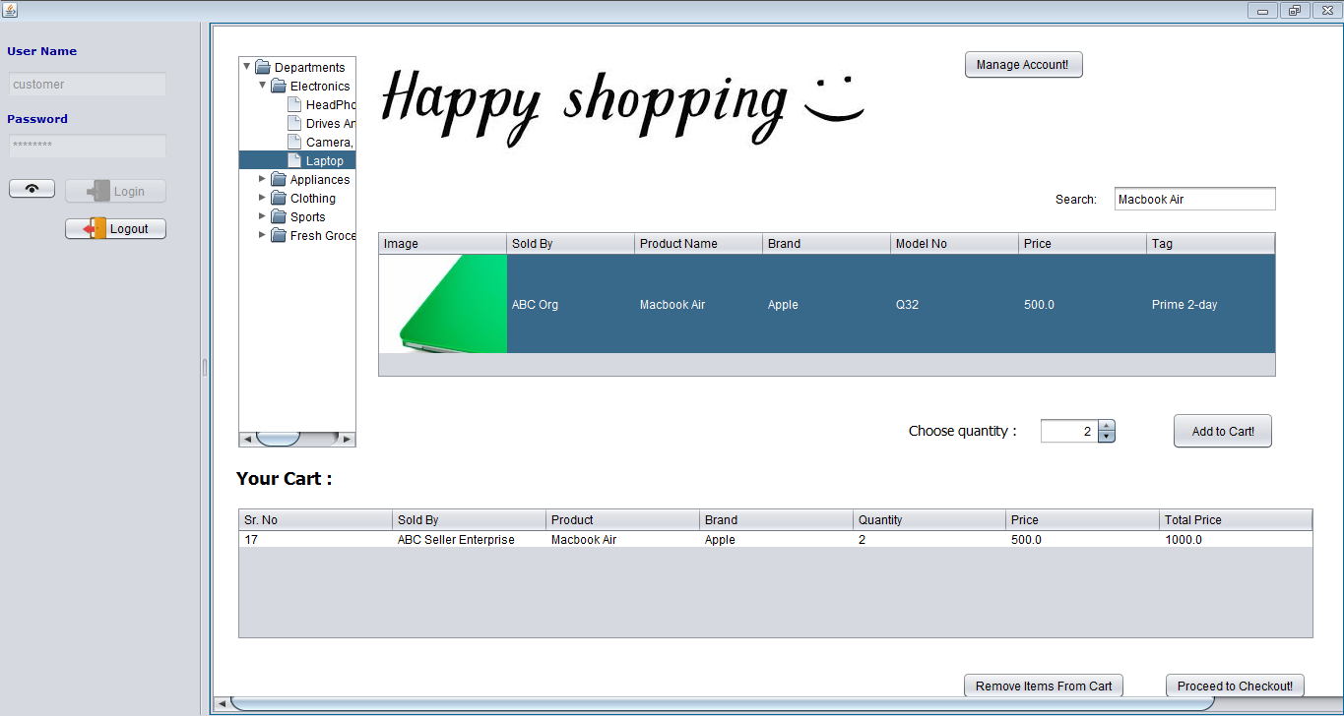
Customer can register to the application securely and view the products available near to it by every seller.

Slide 12
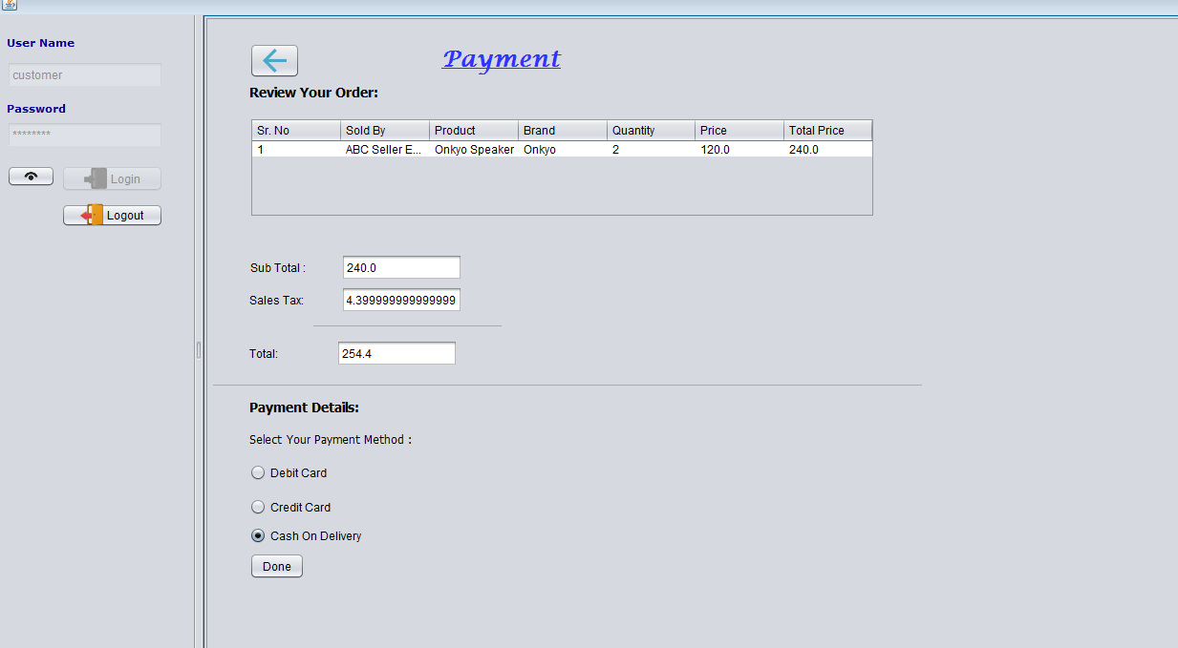
Customer will be delivered products by the shipment Company which are near so that the order is delivered on time.

Slide 13
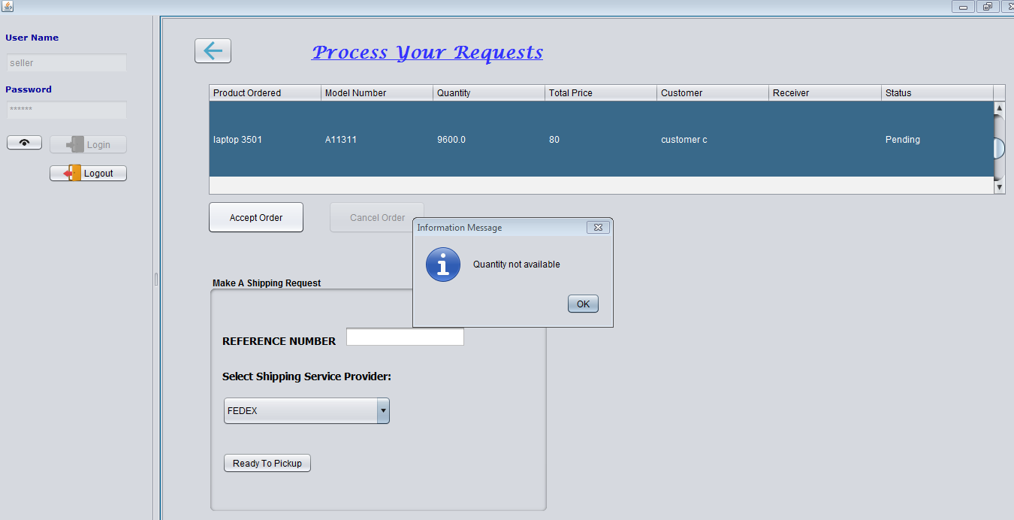
Seller can view the customer’s request and can accept the order. The order will be accepted when there is quantity available in seller’s stock.

Slide 14
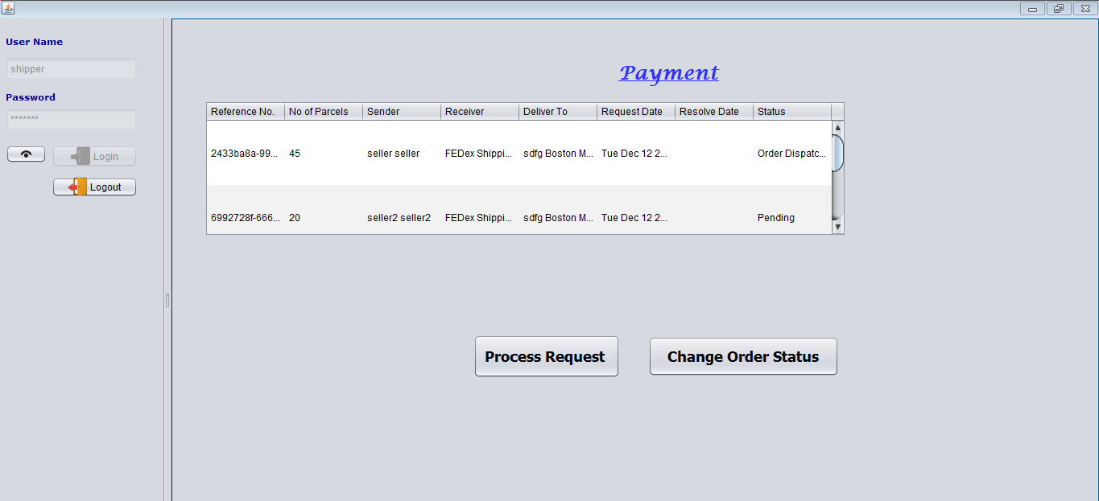
Shipping Organization can process the order received by the seller and change the order status accordingly like order processing or order dispatch. Customer will be notified about the order status.

Slide 15
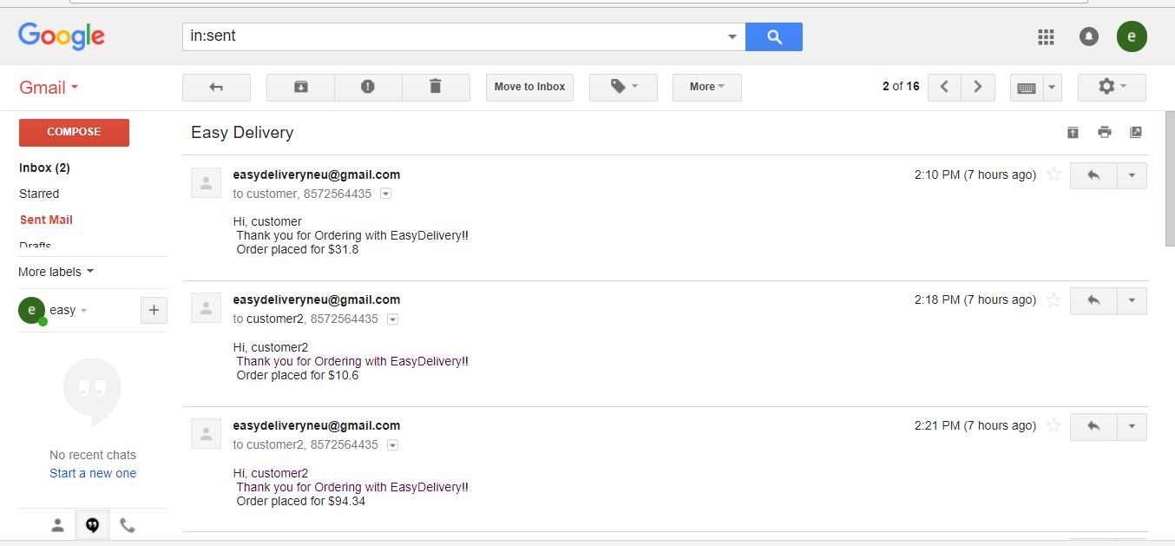
Mail system to handle messages between seller and customer for order confirmation.

Slide 16
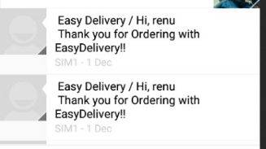
Customer will receive and SMS for the confirmation of their order.

Slide 17
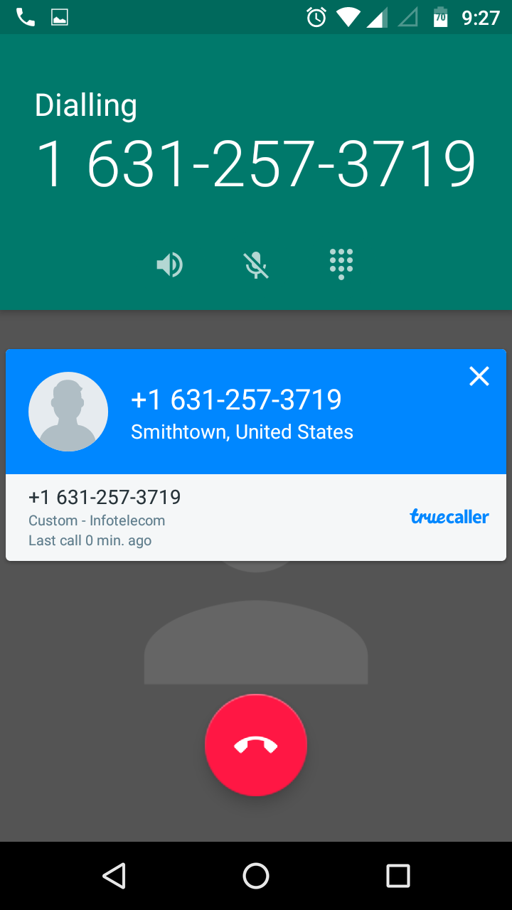
Customer can file a complaint by calling Easy Delivery admin

Slide 18
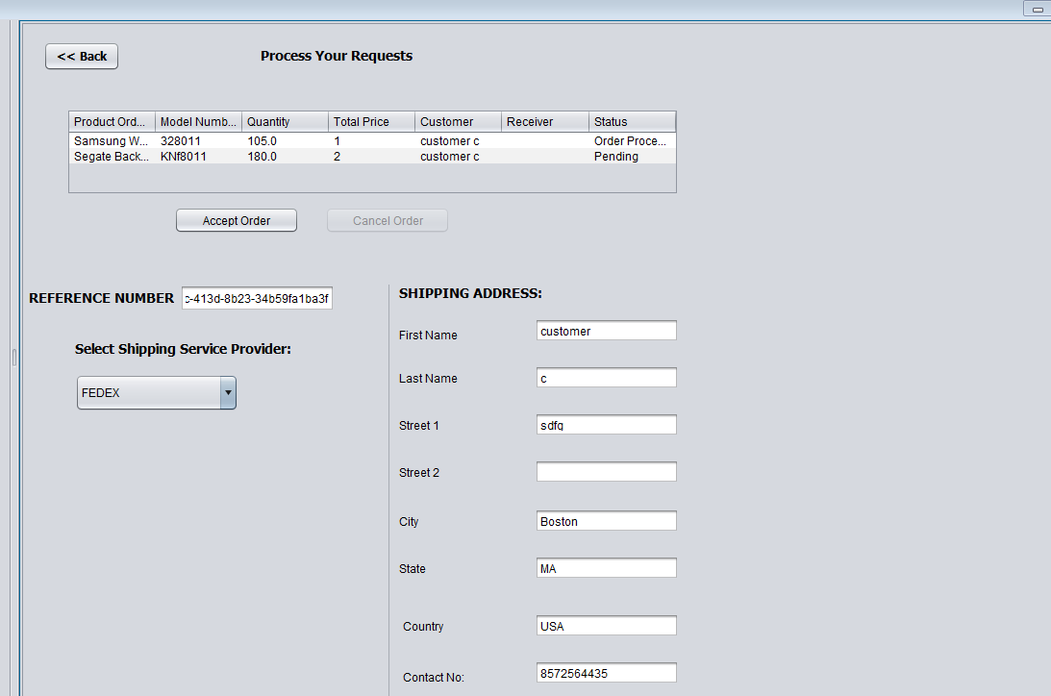
Screenshots
Seller Panel

Slide 19
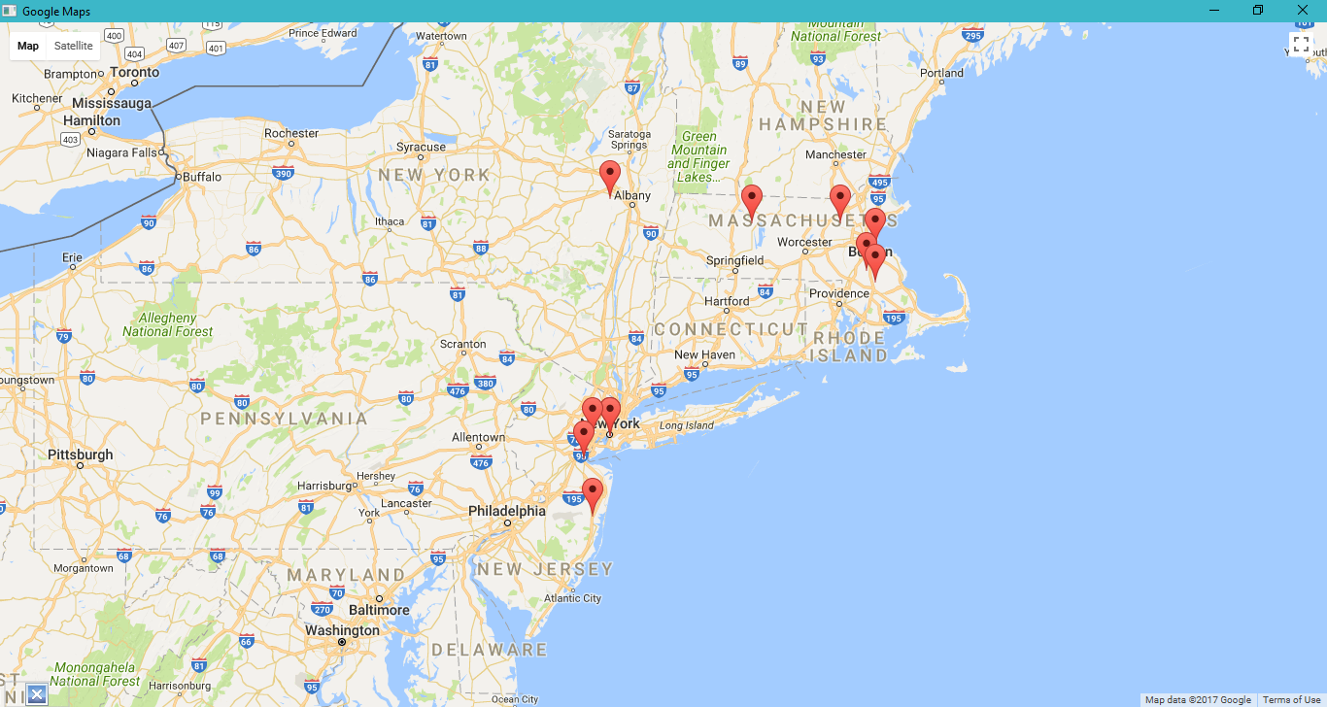
Easy Delivery admin can see the customers via google map

Slide 20


