Slide 1
Jinat Ferdouse
Electrical & Electronics Engineer BD tech limited

Slide 2
Eco Sounder
What is Eco Sounder?
A type of SONAR
Used to determine the depth of water by transmitting sound pulses into water.
SONAR = SOund Navigation And Ranging.

Slide 3
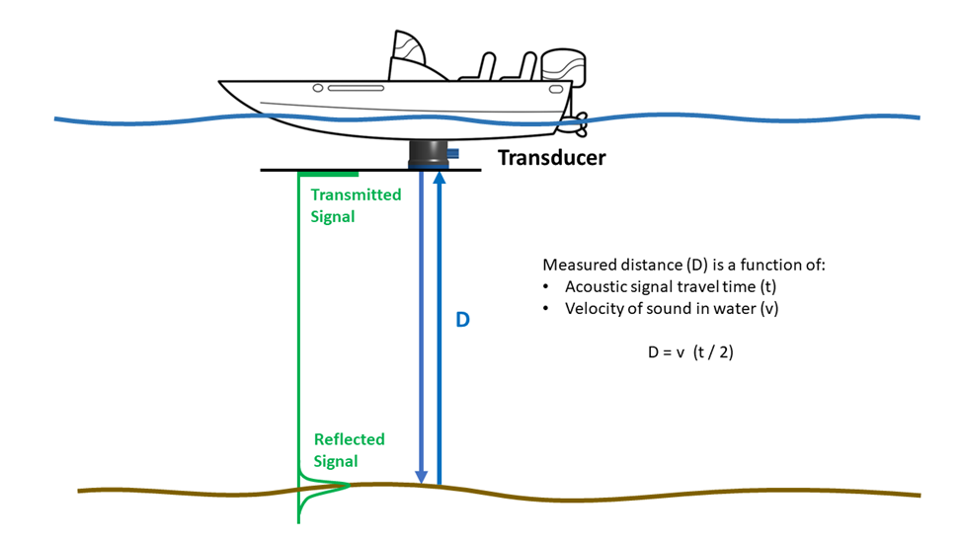
Basic Working Formula
To determine the depth of water ,we consider the time interval between emission and return of a pulse and the speed of sound .

Slide 4
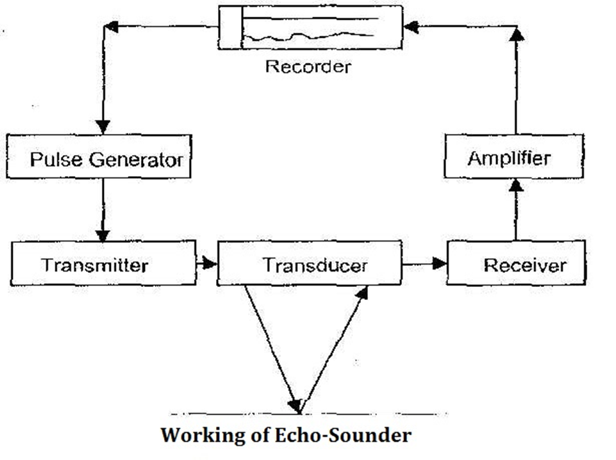
Working Principle of Eco Sounder

Slide 5
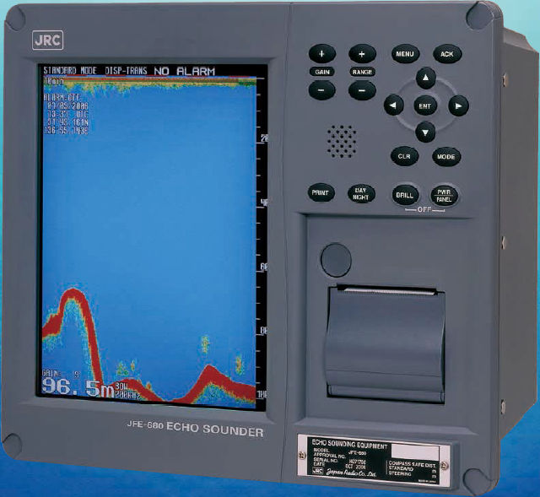
Digital Recorder

Slide 6
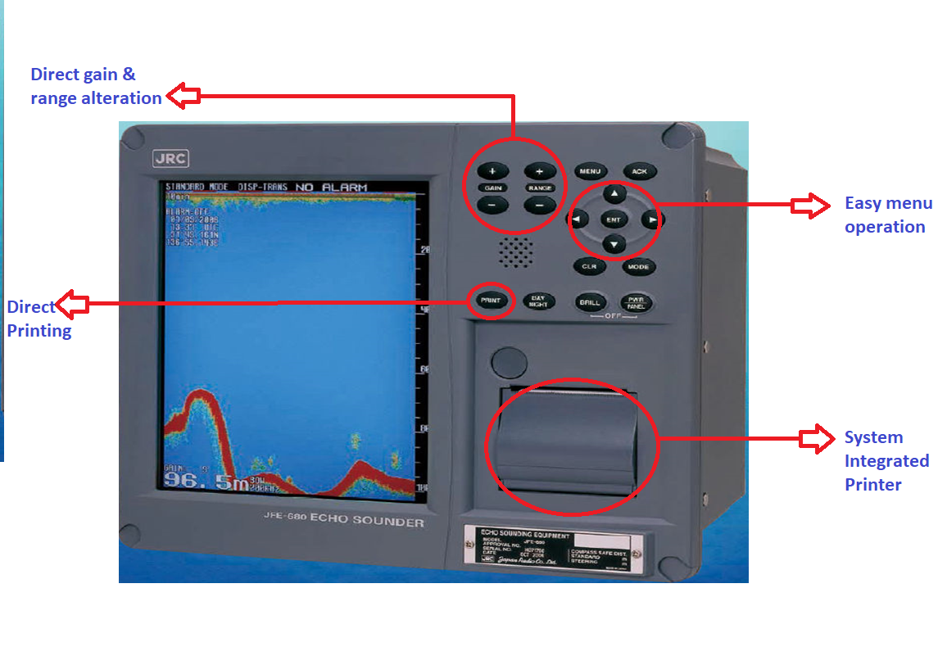

Slide 7
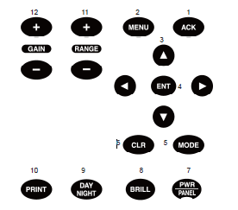
Name | Function
ACK | Cancels the buzzer.
MENU | Displays the menu.
 | Move a cursor.
ENT | Selects an item.
MODE | Switches the display modes
CLR | Clears an item.
PWR/ PANEL | Switches the equipment power on and off.
BRILL | Adjusts the screen brilliance.
DAY NIGHT | Enhances the visibility of the screen.
PRINT | Starts printing or Data output.
(RANGE) +/– | Switches the depth range to shallow or deep.
(GAIN) +/– | Adjusts the sensitivity high or low.

Slide 8
Menu Button
DISPLAY > ALARM > INITIAL > PRINTER CON > COMMUNICATION > MAINTENANCE >
Display Mode
Standard Mode.
2.History Mode.
3.Docking Mode.

Slide 9
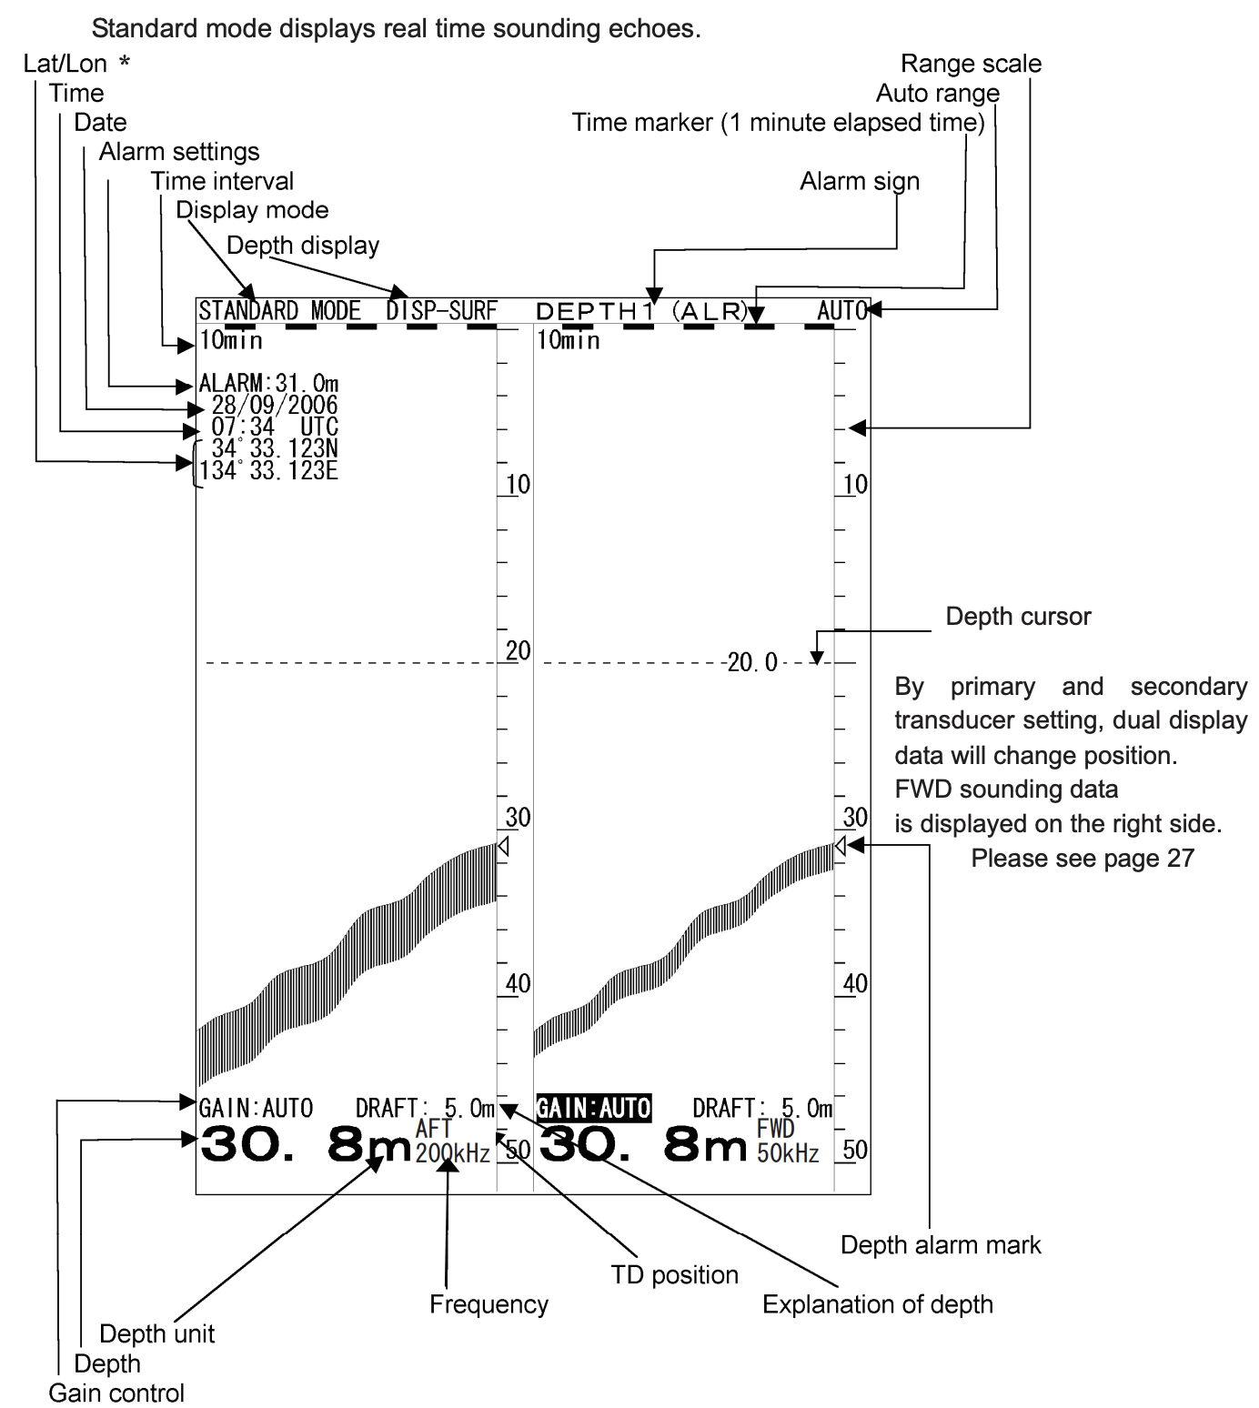
1.STANDARD MODE:

Slide 10
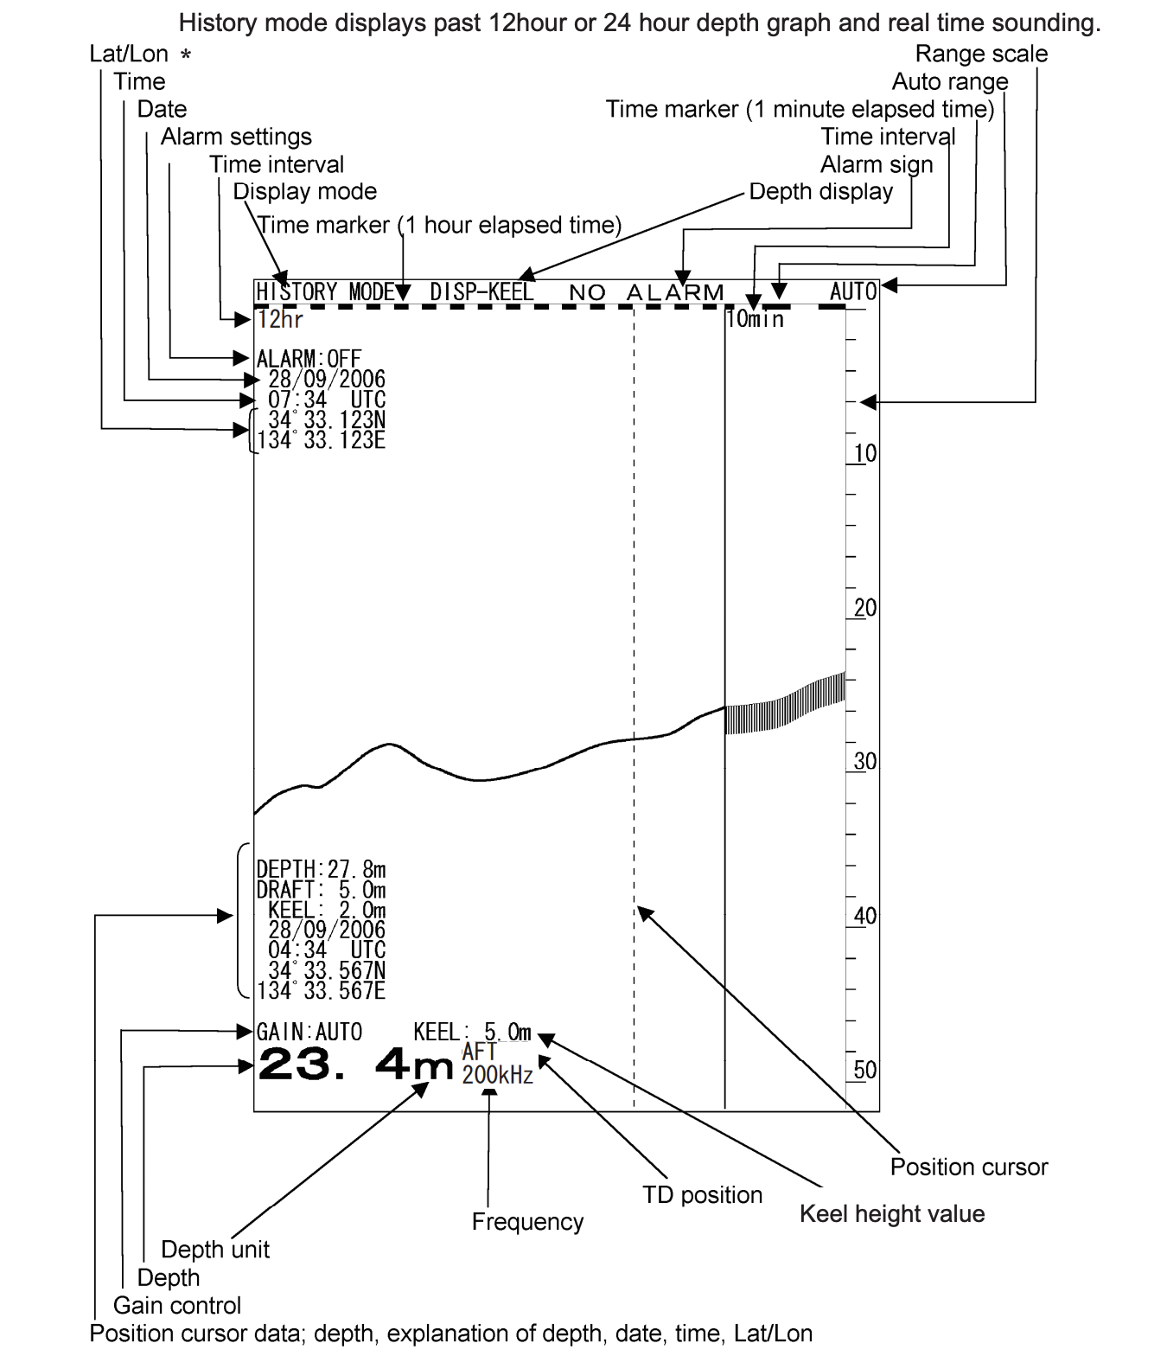
2.HISTORY MODE

Slide 11
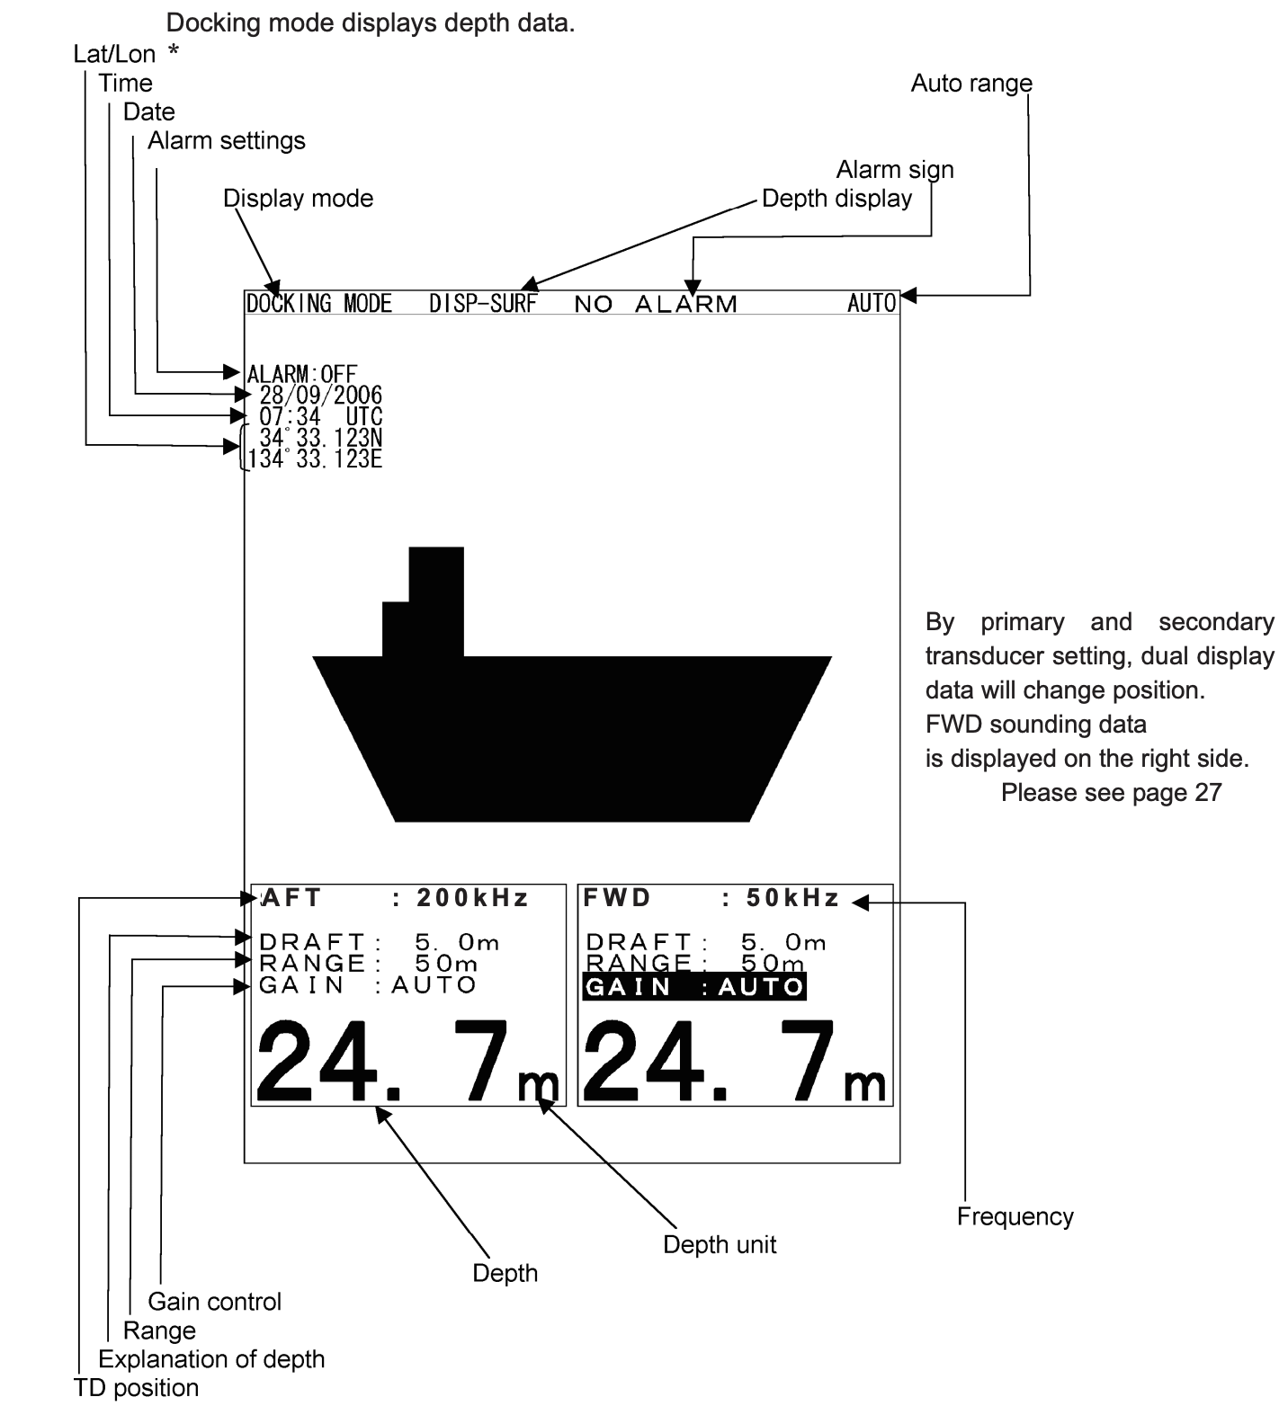
3.DOCKING MODE

Slide 12
DISPLAY
DISPLAY
DISPLAY > ALARM > INITIAL > PRINTER CON > COMMUNICATION > MAINTENANCE >
SCROLL SPEED SLOW STD FAST
CLUTTER 1 2 3 4 5 6 7 8 9 10
GAIN MANUAL AUTO
RANGE MANUAL AUTO
FRD DRAFT 0.0 ( 0.0 to 50.0)
AFT DRAFT 0.0 ( 0.0 to 50.0)

Slide 13
ALARM
DISPLAY > ALARM > INITIAL > PRINTER CON > COMMUNICATION > MAINTENANCE >
ALARM
KEY ACT OFF ON
DEPTH ALARM OFF ON
DEPTH SETTING 0.0 ( 0.0 to 99.9 )
DEPTH LOST OFF ON
TX ALARM OFF ON
RX ALARM OFF ON

Slide 14
INITIAL
DISPLAY > ALARM > INITIAL > PRINTER CON > COMMUNICATION > MAINTENANCE >
INITIAL
MEMORY LENGTH 12hrs 24hrs
DEPTH DISPLAY MODE SURF KEEL
PRIMARY
FREQURENCY OFF 200KHz 50KHz
POSITION FRD MID AFT
KEEL 0.0 ( 0.0 to 99.9)
SECONDARY
FREQURENCY OFF 200KHz 50KHz
POSITION FRD MID AFT
KEEL 0.0 ( 0.0 to 99.9)

Slide 15
PRINTER
DISPLAY > ALARM > INITIAL > PRINTER CON > COMMUNICATION > MAINTENANCE >
PRINTER CON
PRINTER OFF ON
PRINT MODE COPY HISTORY LOG
LOGBOOK PRINT OFF .5MIN 1MIN 5MIN 10MIN
SPEED 4800bps 9600bps 19200bps

Slide 16
COMMUNICATION
DISPLAY > ALARM > INITIAL > PRINTER CON > COMMUNICATION > MAINTENANCE >
communication
ALARM OFF ON
SYSTEM OFF ON
PRINTER PORT OUT PRINTER PC

Slide 17
MAINTENANCE
DISPLAY > ALARM > INITIAL > PRINTER CON > COMMUNICATION > MAINTENANCE >
MAINTENANCE
SELF TEST
CONTROL UNIT
LCD UNIT
POWER SUPPLY TEST
ALARM TEST
PRINTER TEST

Slide 18
The End

