Slide 1

Car Insurance Rates
Group Members
Dhruv
Jinseo
Rachel
Devi
Ardeshir
Factors that Determine your Monthly Premiums

Slide 2
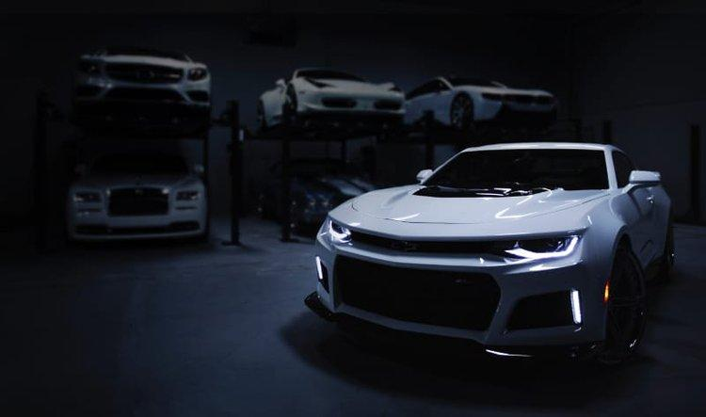
Introduction
Informed decisions
Affordability
Premium Optimization
Financial Protection
Customized Coverage

Slide 3
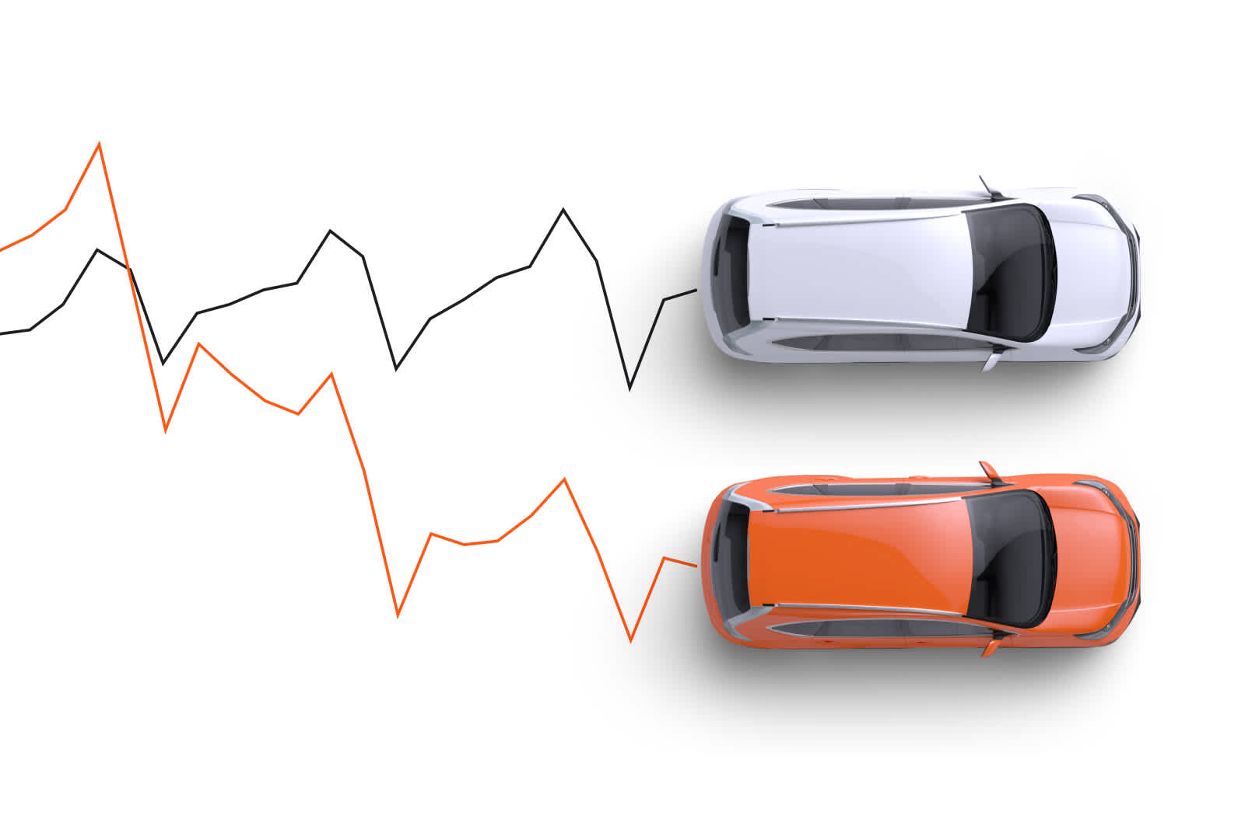
Topics of Discussion
Vehicle characteristics
Driver Characteristics
Correlation and creating a prediction model?
Which state has the most number of insurance claims and why?

Slide 4

Challenges

Slide 5
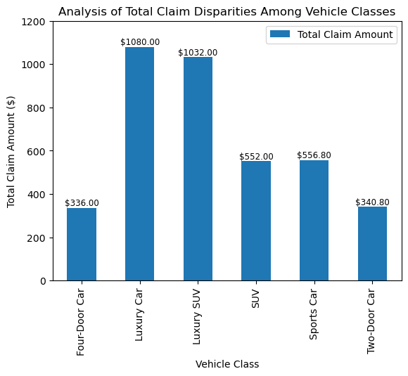
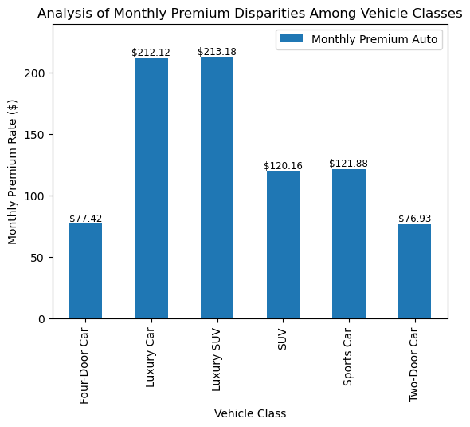
Analysis of Total Claim & Monthly Premium Disparities Among Vehicle Classes
Vehicle Characteristics
Notes:
These two graphs compares the total claim amount and the monthly premium rate between different vehicle class/types. From our analyzed data, it’s shown that:
Luxury car and SUV have the highest monthly premium rate: could be due to higher repair cost which could be supported by it having the highest total claim amount compare to other vehicle class

Slide 6
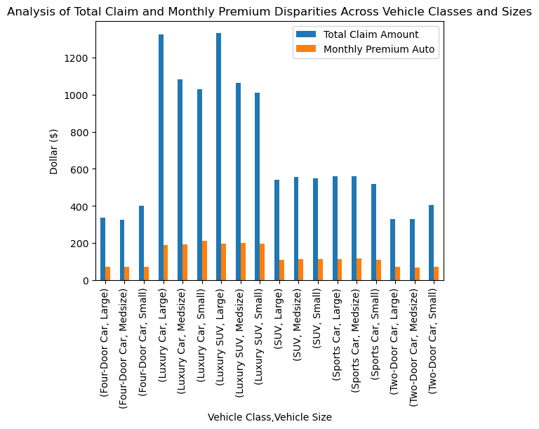
Monthly Premium Rate
There is minimal variation in monthly premium rates across different vehicle sizes among same vehicle class.
Luxury cars and SUVs command the highest monthly premium rates.
Total Claim Amount
Large and luxury vehicles typically incur higher total claim amounts.
Small four-door and two-door cars show comparatively higher total claim amounts when compared to other vehicle sizes.
Notes:
Monthly Premium Rate:
Luxury cars and luxury SUVs have the highest monthly premium rates. This phenomenon is likely attributable to the higher initial cost of these vehicles, resulting in elevated repair expenses. There is minimal variation in monthly premium rates across different vehicle sizes within the same vehicle class.
Total Claim Amount:
Larger and luxury vehicles typically have higher total claim amounts. This trend may be attributed to the potential for larger vehicles to cause more extensive damage, resulting in increased claim amounts. Luxury cars also have higher total claim amounts due to their higher repair costs.
The total claim amount for large and medium-sized two-door and four-door vehicles is approximately the same, with small-sized vehicles having the highest total claim amount. This trend may be due to the larger market presence of small two-door and four-door vehicles.

Slide 7

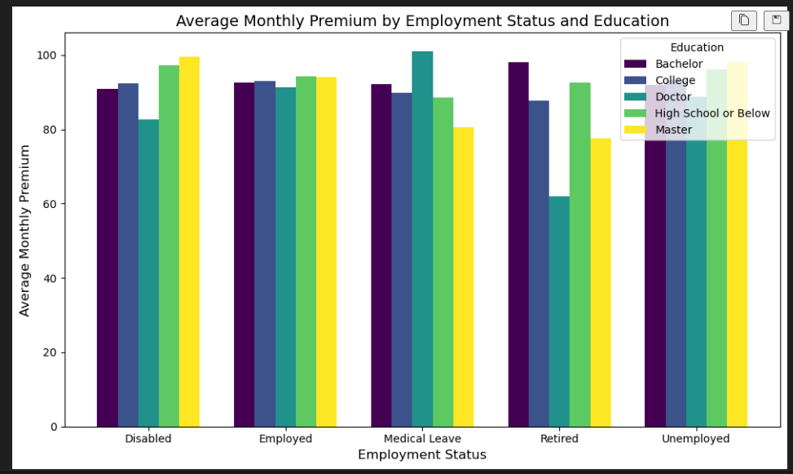



Impact of Driver’s Employment and Education on premium

Slide 8

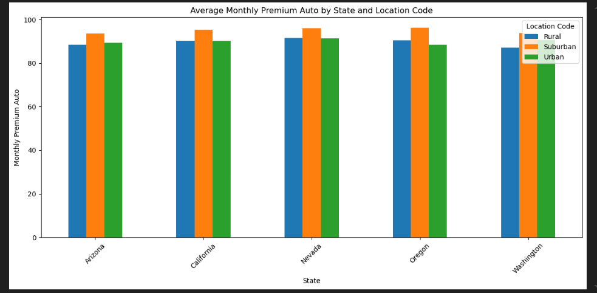


Impact of Driver’s state and location on monthly premium

Slide 9

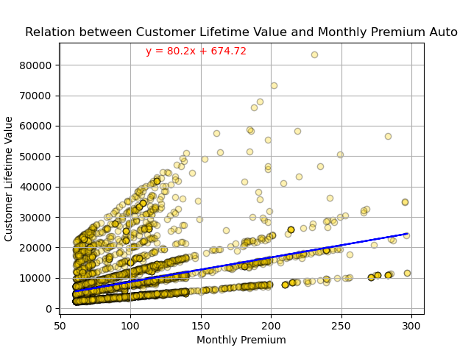
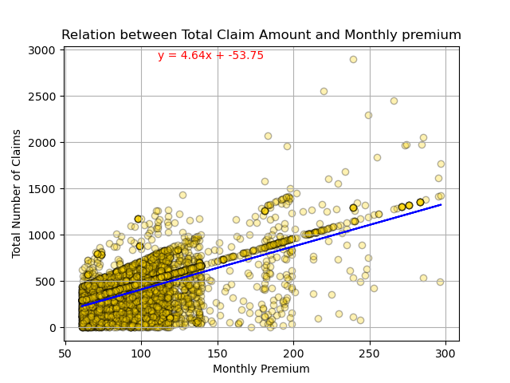
Correlation and creating a Predictive Model
R-Value
Strength
Usage
Make it better

Slide 10


Which state has the highest number of claims and why.
● Arizona
● California
● Nevada
● Oregon
● Washington

Slide 11
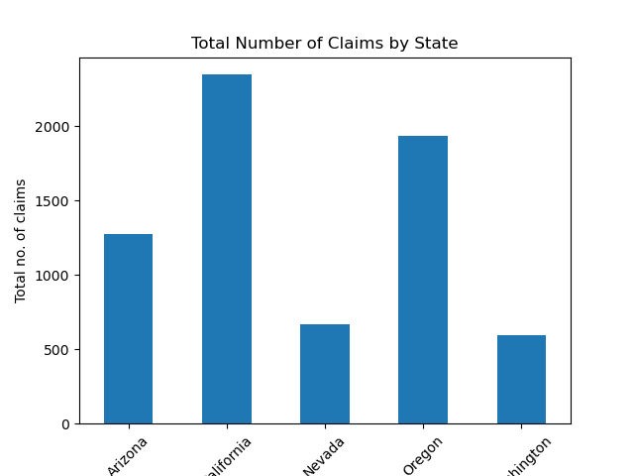

Which state has the highest number of claims and why.
Arizona 1,273
California 2,346
Nevada 665
Oregon 1,937
Washington 596
Around 2,500 Claims
a year

Slide 12

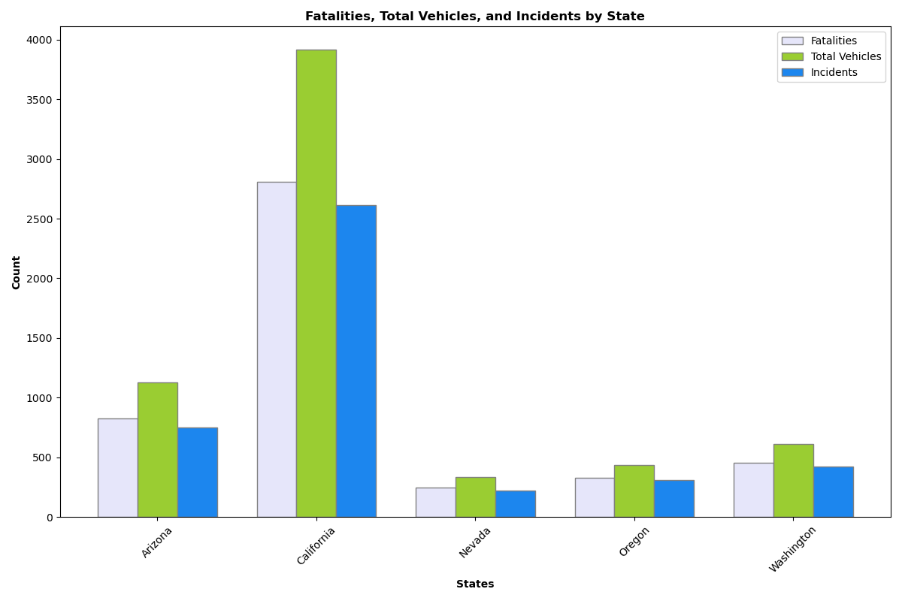


Fatalities, Total Vehicles, and Incidents by State
# of Fatals
# of Vehicles
# of Incidents

Slide 13


California, and Why?
Arizona 7.3 million
Washington 7.7 million
Nevada 3.1 million
Oregon 4.2 million
The sheer volume of vehicles, combined with various demographic and geographic factors
A higher frequency of traffic incidents
39 million

Slide 14


