Slide 1
Distributed Data Center Optimization for Energy Cost Reduction
August 2014
Masaki Samejima

Slide 2


Background
Ambient air cooling
PV
Data center
Data center
Electricity
rate
Electricity
rate
VM
Moved to the site where
Performance is maintained
More green energy is generated
Brown energy is cheaper
etc.
t
t
Susanoo
Estimate performance and energy consumption
Optimize operations based on the estimation
Notes:
Electricity rate:
Kansai, Okinawa : High electricity rate ( over 20yen/kwh when the usage < 120kwh)
Tohoku, kyusyu: about 17yen/kwh

Slide 3
Background
In Japan, the government suggests that a data center has its backup data center in a remote location for earthquakes.
However, running cost such as energy cost is necessary for backup data centers, which is a barrier to introduce backup.
It is necessary to reduce the energy cost by
Considering the different electricity rate in different areas and different peak time (Dynamic pricing)
Utilizing the photovoltaics (PV) charged in battery and ambient air cooling
Ambient air cooling
PV
Data center
Data center
Electricity
rate
Electricity
rate
VM
Moved to the site where
Performance is maintained
More green energy is generated
Brown energy is cheaper
etc.
t
t
Notes:
Electricity rate:
Kansai, Okinawa : High electricity rate ( over 20yen/kwh when the usage < 120kwh)
Tohoku, kyusyu: about 17yen/kwh

Slide 4
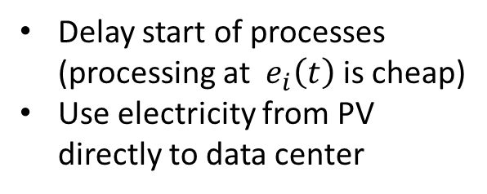
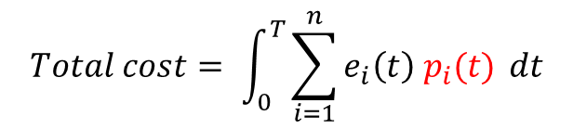
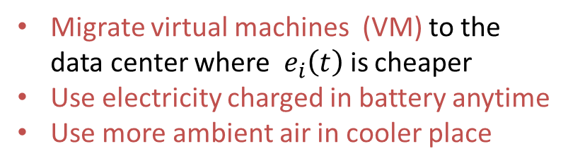
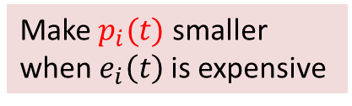
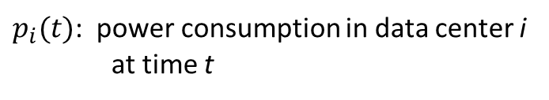
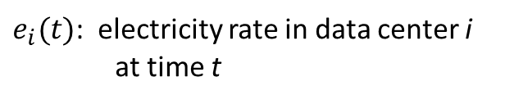
Research Purpose
Reduce total energy cost by changing power consumption in each data center during a certain period
$$Total cost= \int_{0}^{T}{\sum_{i=1}^{n}{e_{i}\left(t\right) p_{i}(t)} dt}$$
$e_{i}(t)$: electricity rate in data center i
at time t
$p_{i}(t)$: power consumption in data center i
at time t
Make $p_{i}(t)$ smaller
when${ e}_{i}\left(t\right)$ is expensive
How to change power consumption
No delay and less power consumption
Conventional approach
for one data center
New approach
for multiple data center
Delay start of processes (processing at ${ e}_{i}\left(t\right)$ is cheap)
Use electricity from PV directly to data center
Migrate virtual machines (VM) to the data center where ${ e}_{i}\left(t\right)$ is cheaper
Use electricity charged in battery anytime
Use more ambient air in cooler place

Slide 5
Distributed data center management system
temperature
PV generation
Electricity
rate
Concept : Consider the geographical condition of
1) Electricity rate
t
t
t
Workload
estimation
Workload
assignment
to each data center
Power
consumption
simulator in data center
Energy cost
estimator
3) Temperature of ambient air
2) Amount of PV generation

Slide 7
Problem formulation
Because of new operations for reducing energy cost, it is necessary to formulate this problem newly

