Slide 1
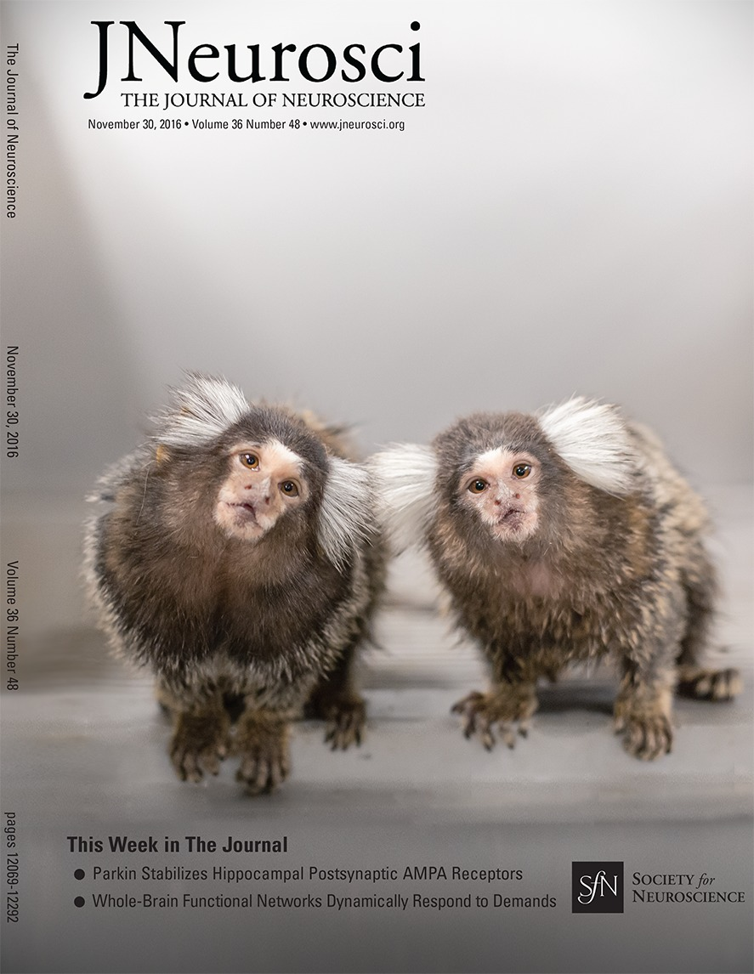
Work Report

Slide 2

I want to ask three question for marmoset’s brain:
Q#1: For marmoset’s brain, can spontaneous cortical activity transiently organises into frequency specific phase-coupling networks?
Method:
  Data: Marmoset Brain rsfMRI
  Model: Time-delay embedded Hidden Markov Model (TDE-HMM)

Slide 3
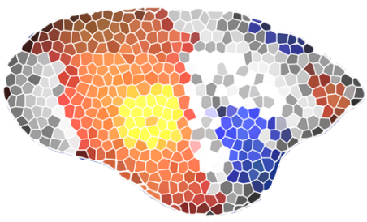
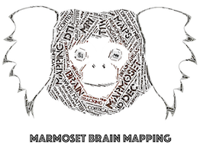
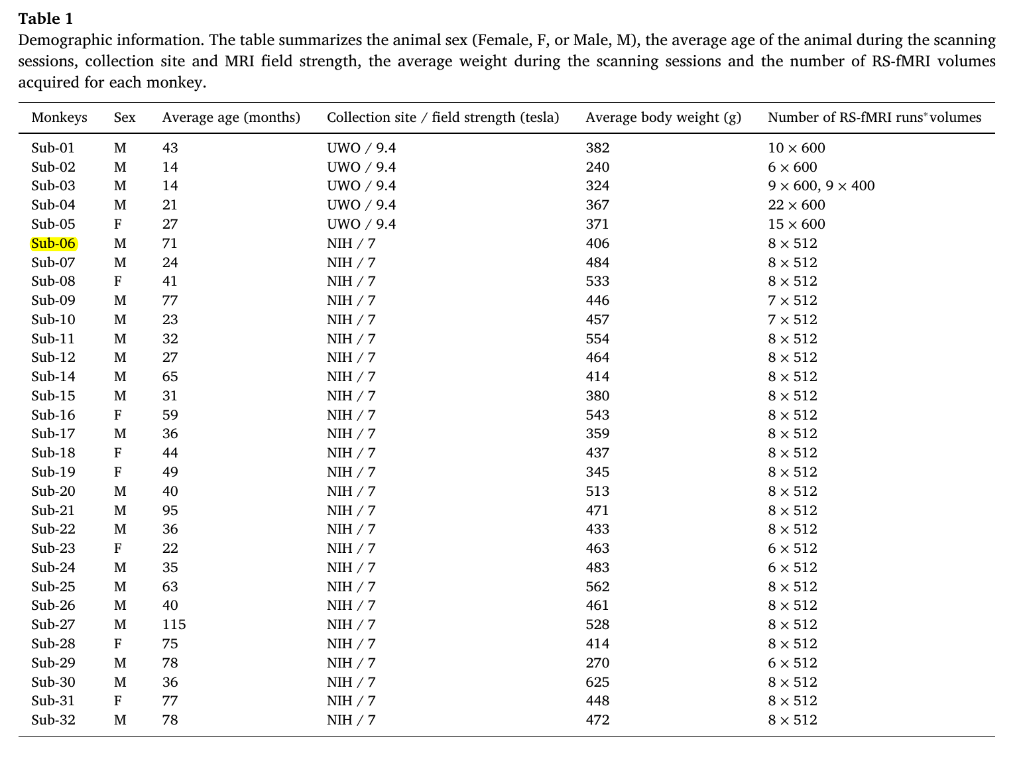
Marmoset Brain rsfMRI
Schaeffer DJ, Klassen LM, Hori Y, Tian X, Szczupak D, Yen CC-C, Cléry J, Gilbert KM, Gati JS, Menon RS, Liu C, Everling S, Silva AC (2022). An open access resource for functional brain connectivity from fully awake marmosets. NeuroImage, 252, 119030.
https://www.marmosetcare.stir.ac.uk/understanding-behaviour/quiz.html

