Slide 1
Programming for Engineering 2
Week 14 : Final Presentation
PC
Information of team
x
Team
A2
Member1 : Seo Jinchan
Member2 : Kim Chanyoung
Member3 : Jose Alan Barraza Villaverde
OK

Slide 2
What is the problem?
Explanation of our team project(SW)
Process and results of the program
Let’s watch it together
(Launch the program)

Slide 3
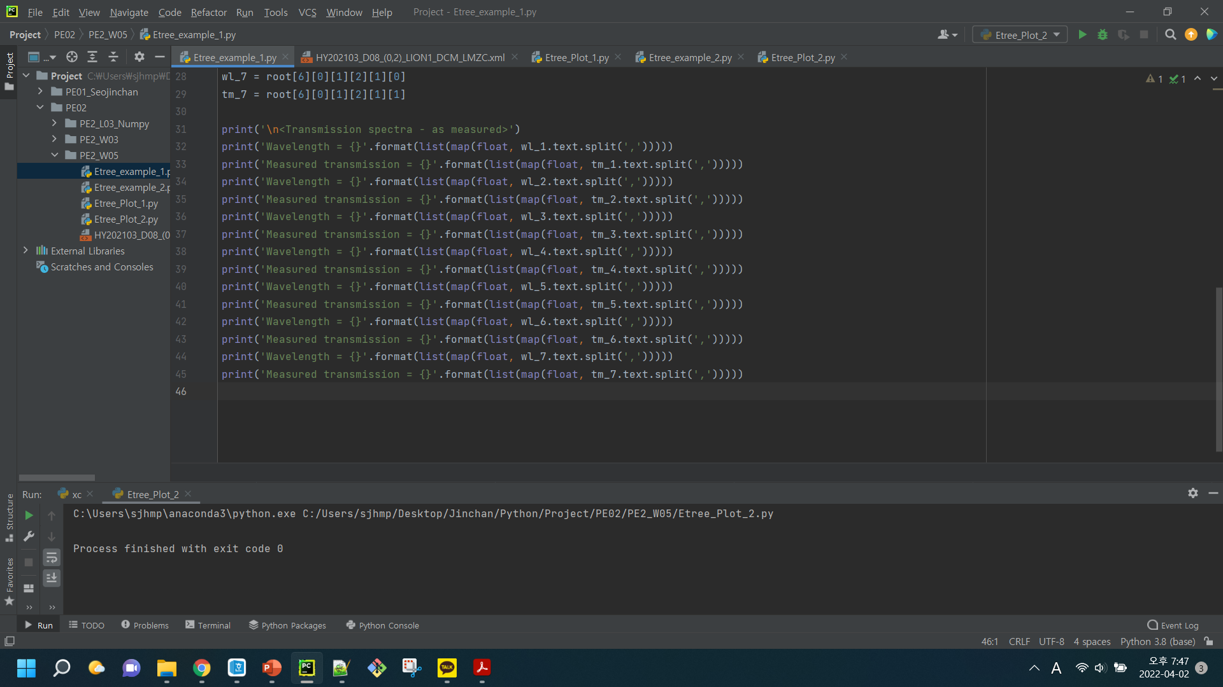
What is the mission?
What is the problem?
x
What is the problem?
Explanation of our team project(SW)
Process and results of the program
Let’s watch it together

Slide 4
What is the mission?
Explanation of our team project(SW)
x
What is the problem?
Explanation of our team project(SW)
Process and results of the program
Let’s watch it together

Slide 5
What is the mission?
Process and result of the program
x
What is the problem?
Explanation of our team project(SW)
Process and results of the program
Let’s watch it together

Slide 6
What is the mission?
Let’s watch it together
x
What is the problem?
Explanation of our team project(SW)
Process and results of the program
Let’s watch it together

Slide 7
Thank you for listening

