Slide 1
SALES ANALYSIS
DATASET: SUPER STORE(KAGGLE)

Slide 2
Objectives : Build an interactive dashboard to track Sales, Profit, and Growth to support data-driven decisions.

Slide 3
KPI :
Total Sales – Overall revenue generated. Total Profit – Net earnings after costs. Profit Margin % – Profitability measure. MoM Growth % – Sales growth compared to previous month.

Slide 4
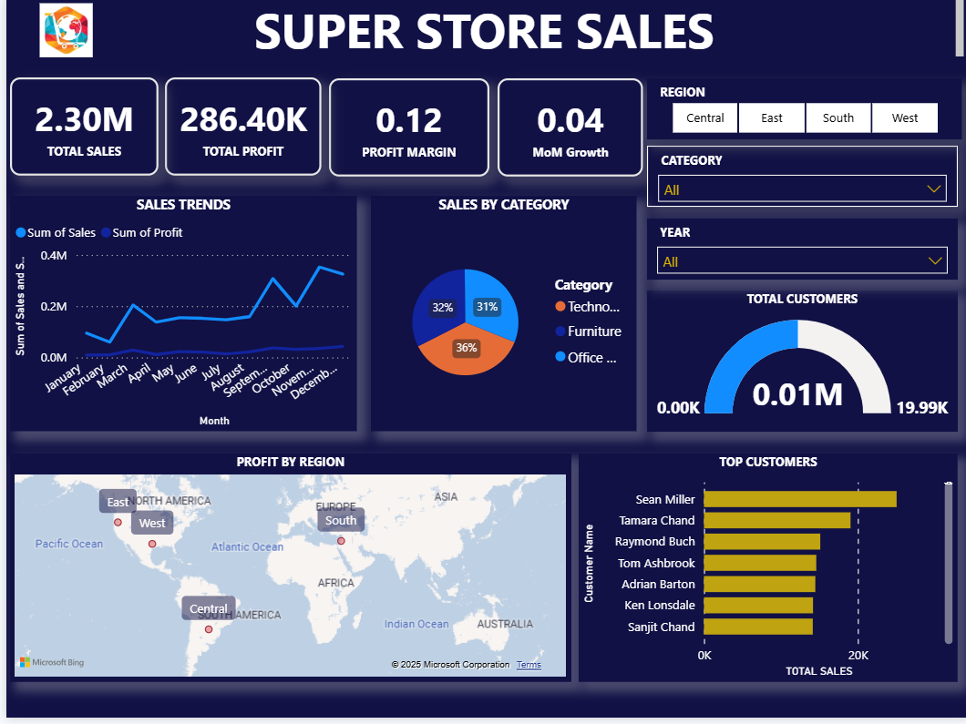
Dashboard :

Slide 5
Dashboard :
Profit by Region (Map)
Insight: West & Central regions show stronger profit contributions.
Sales by Category (Pie Chart)
Insight : Technology (36%) and Office Supplies (32%) lead sales share.
Top Customers (Bar Chart)
Insight : Sean Miller & Tamara Chand are the top contributors.

Slide 6
Insights :
Sales went up steadily at the end of the year.
Profit margin is low compared to sales.
Most sales come from Technology and Office Supplies.
Central and West regions make more profit.
A few customers (like Sean Miller and Tamara Chand) bring in high sales.

Slide 7
Recommendations :
Grow more in strong regions (Central & West) and cut costs in weaker ones.
Watch Month-over-Month growth to spot seasonal trends.
Keep top customers loyal with special offers or campaigns.

Slide 8
Thank You

