Slide 1
Lecture 2 (and more): Improving Neural Network Training
Reading and Research in Deep Learning
James K Baker

Slide 2
Fill Out a Card
Name
Department
Class year (Fresh, Soph, etc.)
Languages you know (read or speak) and degree of fluency
Include dialects of Chinese and regional languages of India
Do you want to be of the DNN364 coding team (yes, no, maybe)
Topic preferences for presentation or coding (see next slide)
Are you interested in a follow-on?
Summer employment
Open source software project
Research project
Another course
Other
Other comments

Slide 3
Select Your Preferred Topics
Syllabus
Generating artificial data | Lewis 4, Nielsen 3
MSE Cost | Nielsen1, 2, Lewis 5
Data preparation | Lewis 4, 5, Brownlee 11, 12
Tuning topology | Brownlee 11,12
Regression | Lewis 5, Brownlee 12
Cross-entropy cost | Nielsen 3
Softmax | Nielsen 3, Lewis 9
Log-likelihood cost | Nielsen 3
Early stopping | Nielsen 3
Holdout | Lewis 7
Cross-validation
Learning rate | Lewis 5,Nielsen 1, 2, 3
ReLU | Lewis 6,Nielsen 6
Momentum | Lewis 7, Neilsen 6
Nestorov | Lewis 9, Nielsen 6
rmsprop | Lewis 9
adagrad | Lewis 9
adam
dropout | Lewis 8, Nielsen 3, Brownlee 16
l2 regularization | Lewis 6, Nielsen 3
l1 regularization | Nielsen 3
minibatch size | Nielsen 3
experimenting with hyperparameters | Nielsen 3, Brownlee 9,10
learning rate schedules | Nielsen 3, Bownley 17
Convolutional neural networks | Nielsen 6, Brownlee 18,19
Image augmentation | Brownlee 20
Object Recognition | Brownlee 21
Recurrent neural networks, BPTT, LSTM | Brownlee 23
Time series predcitions | Lewis 5, Brownlee 24
Multiplicative Nodes
LSTM Time Series | Brownlee 25
Sequence classification | Brownlee 26
Stateful LSTM RNNs | Brownlee 27
Text generation | Brownlee 28
gated units
autoencoder
unsupervised training
ensembles | Nielsen 6
If you plan to do research papers as your major project, list your first and second choice of topics for presentation. If a topic is popular, it will be a team presentation to which I will assign extra. List more if you wish to present on more than one topic.
If you plan to be on the DNN364 coding team, list the five topics to which you would be most interested to contribute code. If you also want to volunteer to give a tutorial presentation, list that separately.
Name
Department
Class year (Fresh, Soph, etc.)
Languages you know (read or speak) and degree of fluency
Include dialects of Chinese and regional languages of India
Do you want to be of the DNN364 coding team (yes, no, maybe)
Topic preferences for presentation or coding (see next slide)
Are you interested in a follow-on?
Summer employment
Open source software project
Research project
Another course
Other
Other comments

Slide 4
Class Discussion Notes
For each class session, we need an official note-taker
Record questions
Also record name of questioner
Notes on discussions
Also record name of each speaker
When you are about to speak, please stand and introduce yourself
State your name and what department you are in
Later, also state your project team
I will ask for a volunteer for each class, appoint someone if there is no volunteer

Slide 5
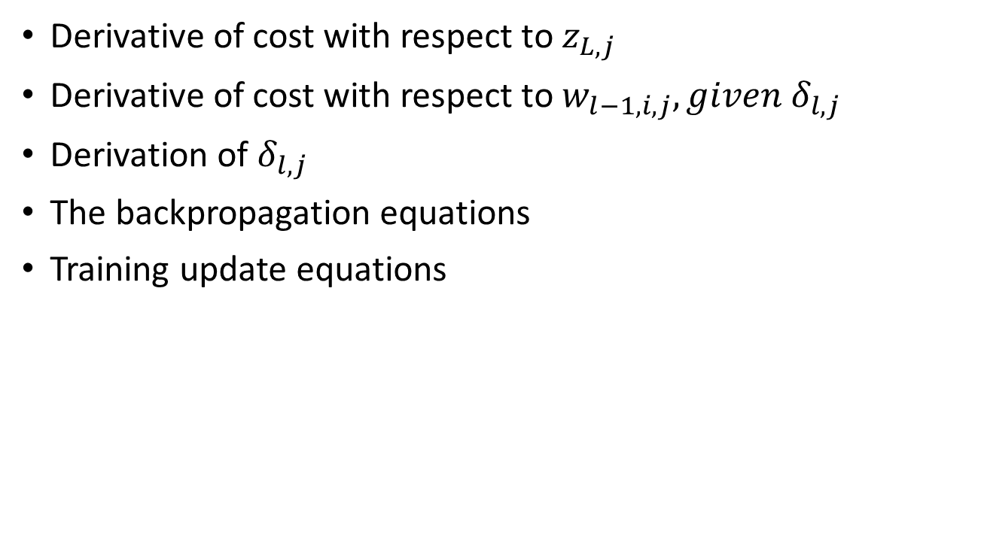
Review from Lecture 1: Derivation of Backprop Equations
Derivative of cost with respect to $z_{L,j}$
Derivative of cost with respect to $w_{l−1,i,j}, given δ_{l,j}$
Derivation of $δ_{l,j}$
The backpropagation equations
Training update equations

Slide 6

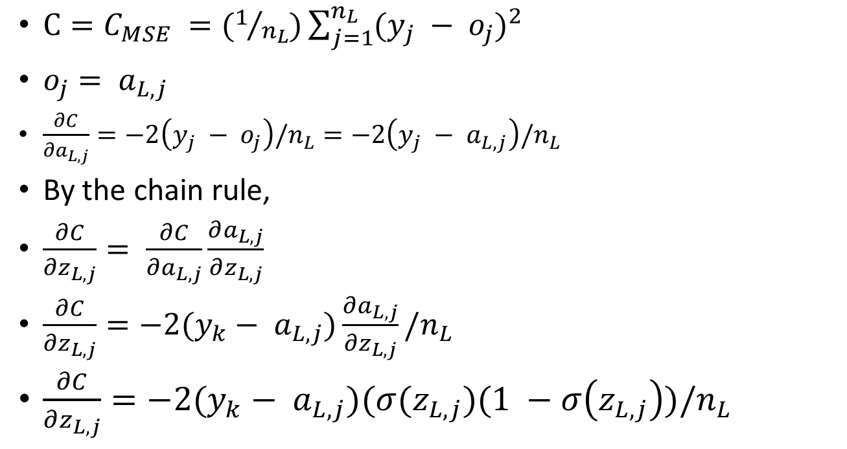
Change in Error for Change in an Output Node
$C=C_{MSE} =(1/{n_{L}})\sum_{j=1}^{n_{L}}{(y_{j} − o_{j})^{2}}$
$o_{j}= a_{L,j}$
$\frac{∂C}{∂a_{L,j}}=−2\left(y_{j} − o_{j}\right)/n_{L}=−2\left(y_{j} − a_{L,j}\right)/n_{L}$
By the chain rule,
$\frac{∂C}{∂z_{L,j}}= \frac{∂C}{∂a_{L,j}}\frac{∂a_{L,j}}{∂z_{L,j}}$
$\frac{∂C}{∂z_{L,j}}=−2(y_{k}− a_{L,j})\frac{∂a_{L,j}}{∂z_{L,j}}/n_{L}$
$\frac{∂C}{∂z_{L,j}}=−2(y_{k}− a_{L,j})(σ(z_{L,j})(1 −σ\left(z_{L,j}\right))/n_{L}$
y is a constant. $\frac{∂{(c−x)}^{2}}{∂x}=−2(c−x)$
This part will be different for different cost functions, but the rest of the backpropagation will be the same.
This is just the derivative of the sigmoid.

Slide 7
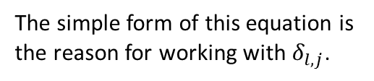
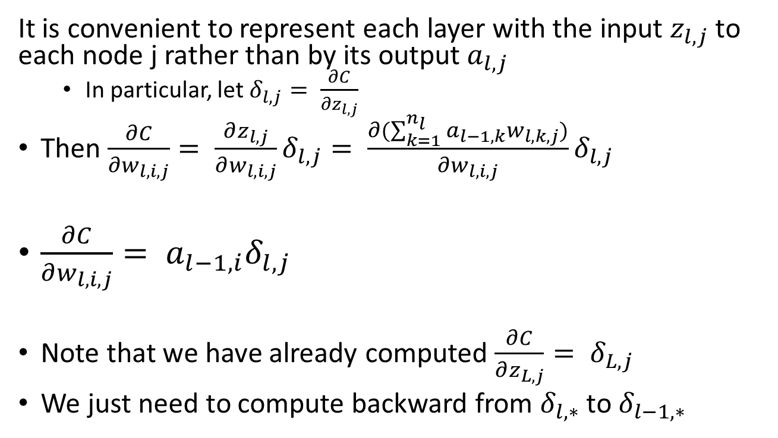

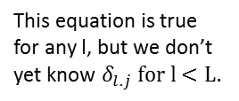

Proceeding Backwards, Layer by Layer
It is convenient to represent each layer with the input $z_{l,j}$ to each node j rather than by its output $a_{l,j}$
In particular, let $δ_{l,j}= \frac{∂C}{∂z_{l,j}}$
Then $\frac{∂C}{∂w_{l,i,j}}= \frac{∂z_{l,j}}{∂w_{l,i,j}}δ_{l,j}= \frac{∂(\sum_{k=1}^{n_{l}}{a_{l−1,k}}w_{l,k,j})}{∂w_{l,i,j}}δ_{l,j}$
$\frac{∂C}{∂w_{l,i,j}}= a_{l−1,i}δ_{l,j}$
Note that we have already computed $\frac{∂C}{∂z_{L,j}}= δ_{L,j}$
We just need to compute backward from $δ_{l,∗}$ to $δ_{l−1,∗}$
This is just substituting for $z_{l,j}$.
This equation is true for any l, but we don’t yet know $δ_{l.j} for l<L.$
Note that $w_{l,i,j}$only appears in one term.
The simple form of this equation is the reason for working with $δ_{l,j}$.

Slide 8
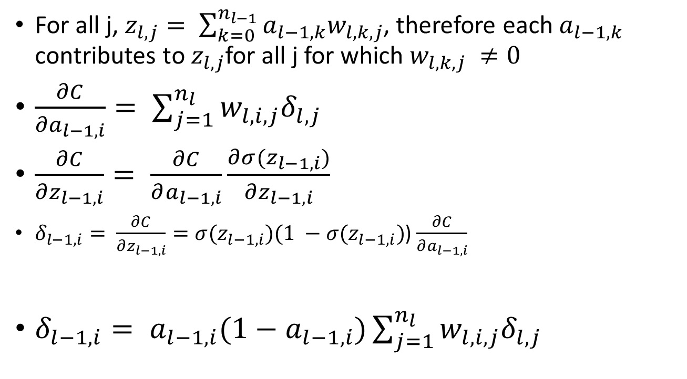
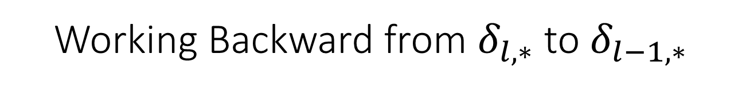
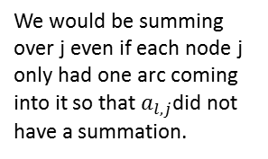

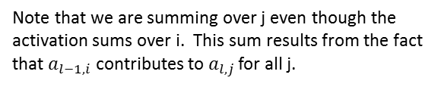
Working Backward from $δ_{l,∗}$ to $δ_{l−1,∗}$
We already know $δ_{L,∗}$
For all j, $z_{l,j}= \sum_{k=0}^{n_{l−1}}{a_{l−1,k}w_{l,k,j}}$, therefore each $a_{l−1,k}$ contributes to $z_{l,j}$for all j for which $w_{l,k,j} ≠0$
$\frac{∂C}{{∂a}_{l−1,i}}= \sum_{j=1}^{n_{l}}{w_{l,i,j}δ_{l,j}}$
$\frac{∂C}{∂z_{l−1,i}}= \frac{∂C}{∂a_{l−1,i}}\frac{∂σ(z_{l−1,i})}{∂z_{l−1,i}}$
$δ_{l−1,i}= \frac{∂C}{∂z_{l−1,i}}=σ(z_{l−1,i})(1 −σ(z_{l−1,i})$) $\frac{∂C}{∂a_{l−1,i}}$
$δ_{l−1,i}= a_{l−1,i}(1−a_{l−1,i})\sum_{j=1}^{n_{l}}{w_{l,i,j}δ_{l,j}}$
Note that we are summing over j even though the activation sums over i. This sum results from the fact that $a_{l−1,i}$ contributes to $a_{l,j }$for all j.
We would be summing over j even if each node j only had one arc coming into it so that $a_{l,j}$did not have a summation.

Slide 9

The Backpropagation Equations
$δ_{L,j}=−2(y_{k}− a_{L,j})(σ(z_{L,j})(1 −σ\left(z_{L,j}\right))/n_{L}$
$δ_{l−1,i}= a_{l−1,i}(1−a_{l−1,i})\sum_{j=1}^{n_{l}}{w_{l,i,j}δ_{l,j}}$
$\frac{∂C}{∂w_{l,i,j}}=a_{l−1,i}δ_{l,j}$

Slide 10
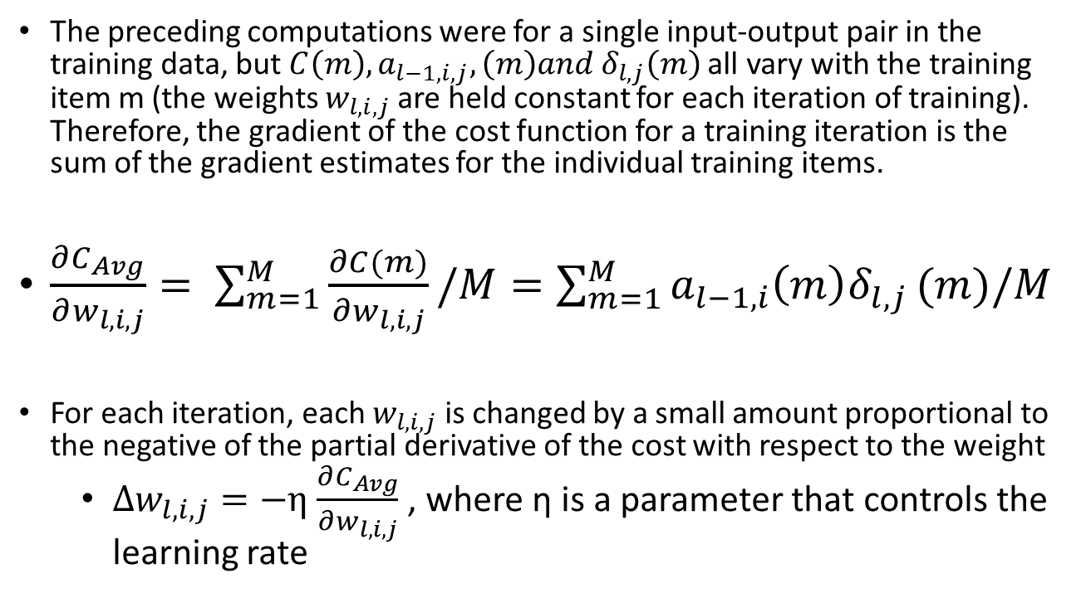
Summing Across All the Training Data
The preceding computations were for a single input-output pair in the training data, but $C\left(m\right), a_{l−1,i,j},\left(m\right)and δ_{l,j}\left(m\right)$ all vary with the training item m (the weights $w_{l,i,j}$ are held constant for each iteration of training). Therefore, the gradient of the cost function for a training iteration is the sum of the gradient estimates for the individual training items.
$\frac{∂C_{Avg}}{∂w_{l,i,j}}= \sum_{m=1}^{M}{\frac{∂C(m)}{∂w_{l,i,j}}/M}=\sum_{m=1}^{M}{a_{l−1,i}{\left(m\right)δ}_{l,j}}(m)/M$
For each iteration, each $w_{l,i,j}$ is changed by a small amount proportional to the negative of the partial derivative of the cost with respect to the weight
$∆w_{l,i,j}=−η$ $\frac{∂C_{Avg}}{∂w_{l,i,j}}$ , where η is a parameter that controls the learning rate

Slide 11
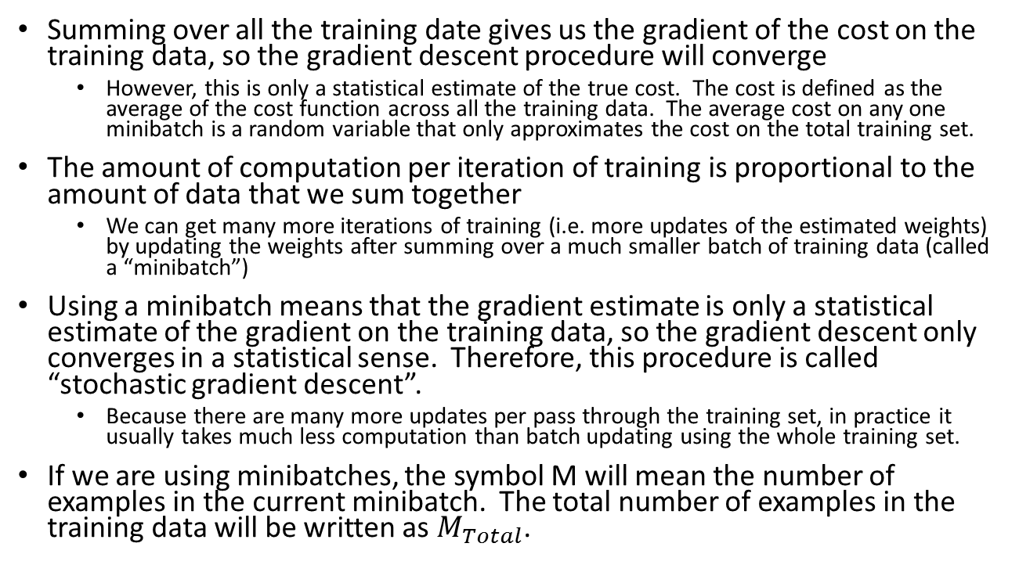
Minibatches and Stochastic Gradient Descent
Summing over all the training date gives us the gradient of the cost on the training data, so the gradient descent procedure will converge
However, this is only a statistical estimate of the true cost. The cost is defined as the average of the cost function across all the training data. The average cost on any one minibatch is a random variable that only approximates the cost on the total training set.
The amount of computation per iteration of training is proportional to the amount of data that we sum together
We can get many more iterations of training (i.e. more updates of the estimated weights) by updating the weights after summing over a much smaller batch of training data (called a “minibatch”)
Using a minibatch means that the gradient estimate is only a statistical estimate of the gradient on the training data, so the gradient descent only converges in a statistical sense. Therefore, this procedure is called “stochastic gradient descent”.
Because there are many more updates per pass through the training set, in practice it usually takes much less computation than batch updating using the whole training set.
If we are using minibatches, the symbol M will mean the number of examples in the current minibatch. The total number of examples in the training data will be written as $M_{Total}$.

Slide 12
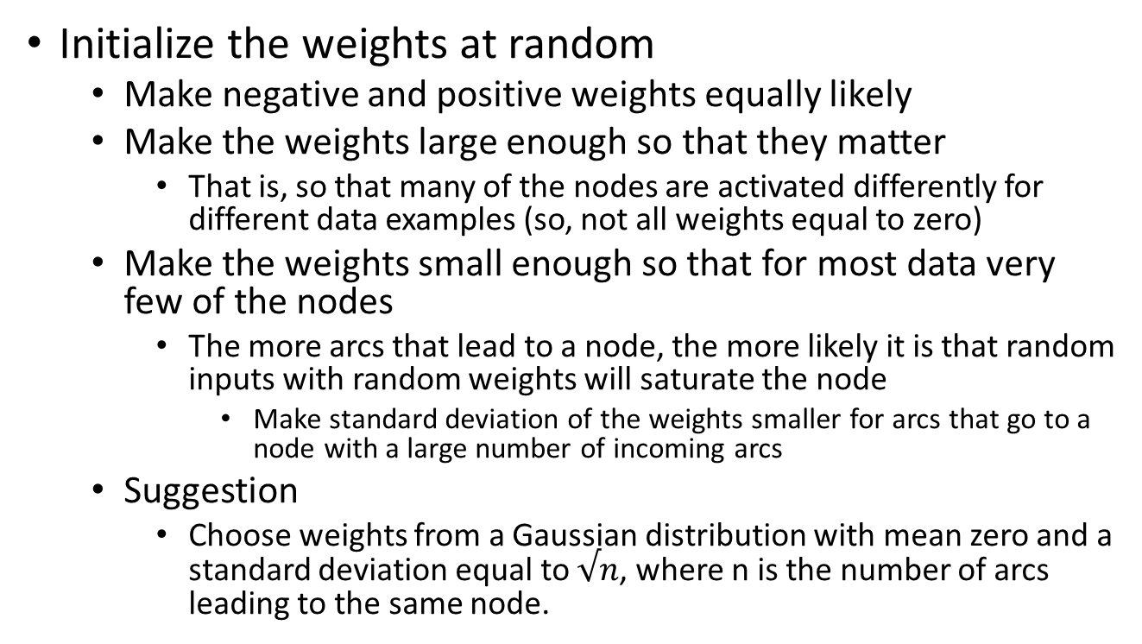
Initialize the Weights
Initialize the weights at random
Make negative and positive weights equally likely
Make the weights large enough so that they matter
That is, so that many of the nodes are activated differently for different data examples (so, not all weights equal to zero)
Make the weights small enough so that for most data very few of the nodes
The more arcs that lead to a node, the more likely it is that random inputs with random weights will saturate the node
Make standard deviation of the weights smaller for arcs that go to a node with a large number of incoming arcs
Suggestion
Choose weights from a Gaussian distribution with mean zero and a standard deviation equal to $√n$, where n is the number of arcs leading to the same node.

Slide 13
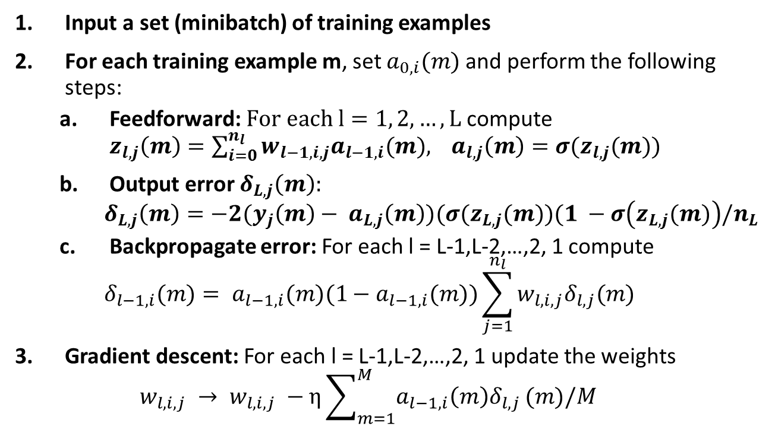
Training Algorithm Iteration
Input a set (minibatch) of training examples
For each training example m, set $a_{0,i}(m)$ and perform the following steps:
Feedforward: $For each l=1, 2, …, L$ compute ${z_{l,j}\left(m\right)=\sum_{i=0}^{n_{l}}{w_{l−1,i,j}a_{l−1,i}(m),}}_{}a_{l,j}\left(m\right)=σ(z_{l,j}(m))$
Output error $δ_{L,j}\left(m\right):$
$$δ_{L,j}\left(m\right)=−2(y_{j}\left(m\right)− a_{L,j}\left(m\right))(σ(z_{L,j}(m))(1 −σ\left(z_{L,j}(m)\right)/n_{L}$$
Backpropagate error: For each l = L-1,L-2,…,2, 1 compute
$$δ_{l−1,i}(m)= a_{l−1,i}(m)(1−a_{l−1,i}(m))\sum_{j=1}^{n_{l}}{w_{l,i,j}δ_{l,j}(m)}$$
Gradient descent: For each l = L-1,L-2,…,2, 1 update the weights
$$w_{l,i,j} → w_{l,i,j} −η\sum_{m=1}^{M}{a_{l−1,i}{\left(m\right)δ}_{l,j}}(m)/M$$
Sum the estimated partial derivatives across all the examples in the minibatch.
Go through all the training data separated into minibatches multiple times. Continue training iterations until a stopping criterion is met. It is recommended that you sample the data in random order.
Refinements will be added to improve learning speed and reliability.

Slide 14
Terminology: Update, Epoch, Iteration
The learning algorithm updates the estimated parameters once for every mini-batch.
We need a name for this. Let’s call it an “update”.
The standard implementation runs through many mini-batches until all the training data has been used. This is called an “epoch”.
From usage in a larger classes of iterative optimization procedures, I often call this an “iteration”.
The learning runs multiple epochs or iterations until some stopping criterion is met
There may be thousands of epochs
Sometimes I forget and call an update an “epoch”.

Slide 15
Why we study the sigmoid first
It came first and is still in wide spread use
You need it to understand the original backpropagation papers
You need it for papers from the 80s, 90s, and 00s
And for some current papers
It is related to softmax, which is used for the output layer for classification (linear output is for regression)
Sigmoid itself is also sometimes used for the output layer
Especially for binary classification and feature detection
The [0,1] range fits with probability interpretations
It is a closer fit to neuron models than is the rectified linear unit (reLU)
Our textbooks start with it
It’s fun to have a crazy looking derivative σ’ = σ(1 – σ)

Slide 16
Improving the Learning Performance (Multiple Mini-Lectures)
There will be a number of techniques for improving the performance of the neural network learning
Many of these can be applied independently of each other
Most of these techniques improve the rate of convergence or reduce computation is some other way
Rather than improving the accuracy of the final answer
Because the techniques are relatively independent, this PowerPoint presentation will be broken into a number of mini lectures at convenient stopping points
You are encouraged to use this presentation as a reference
You can read ahead
You should do so if a mini project uses a technique we haven’t yet discussed in class

Slide 17
Improvement Techniques
Holdout and cross-validation
Cross-entropy cost function
Softmax
Log-likelihood cost function
Regularization
L2
L1
Dropout
Artificial expansion of training data
Initializing weights
Heuristics to set hyperparameters
Other techniques
Problem: Testing our results.
Problem: Slow learning.
Problem: Multi-class learning.
Problem: Overfitting.
Problem: Getting stuck in a local minimum or region of slow learning. (Already covered in Lecture 1)
Problem: Dealing with the many parameters that control the training.
These topics are largely independent of each other. I may discuss them out of order to fit the time available.

Slide 18
The Need to Holdout Validation Data
In pattern recognition you should never train on your test data
Any performance results will be invalid
Similarly, if during development you make decisions based on performance on training data, you may will be seriously mislead
You should holdout a substantial amount of data from the training to use for validation testing during development
This principle is extremely important!! Make sure you never forget!

Slide 19
Cross-Validation
Break the training data into K subsets
Cross-validation
Chose one subset as holdout data
Train on the other K-1 subsets and validate on the holdout subset
Repeat with each of the K subsets as the holdout

Slide 20
Multiple Holdouts
If during development you have made significant improvements in performance, you should do validation on a new holdout set that hasn’t been used before.
In fact it is prudent to replicate your results on completely new data (new training data as well as new validation data), if possible.
This especially important if you are developing a commercial product that will continue to be used and improved for many years.
Unfortunately, very few R&D groups live up to this standard.

Slide 21
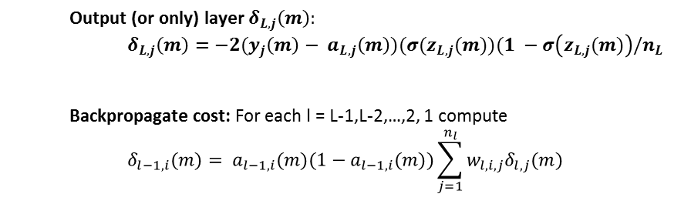
Problem: Sometimes Gradient Descent is Very Slow Even When the Current Answer is Wrong
1
Toy problem: Train a single neuron to have an output near 1 when it initially has an output near 0.
bias
weight
y(m) is the target (either 0 or 1); a(m) is the activation
Output (or only) layer $δ_{L,j}\left(m\right):$
$$δ_{L,j}\left(m\right)=−2(y_{j}\left(m\right)− a_{L,j}\left(m\right))(σ(z_{L,j}(m))(1 −σ\left(z_{L,j}(m)\right)/n_{L}$$
Backpropagate cost: For each l = L-1,L-2,…,2, 1 compute
$$δ_{l−1,i}(m)= a_{l−1,i}(m)(1−a_{l−1,i}(m))\sum_{j=1}^{n_{l}}{w_{l,i,j}δ_{l,j}(m)}$$
The derivatives of the cost function are very small when the activation is close to 0 or 1.
Gradient descent can be slow even in this simple toy problem. In particular, it is slow when the current model is very far from the correct answer, when we would like the learning to be fast and aggressive.

Slide 22
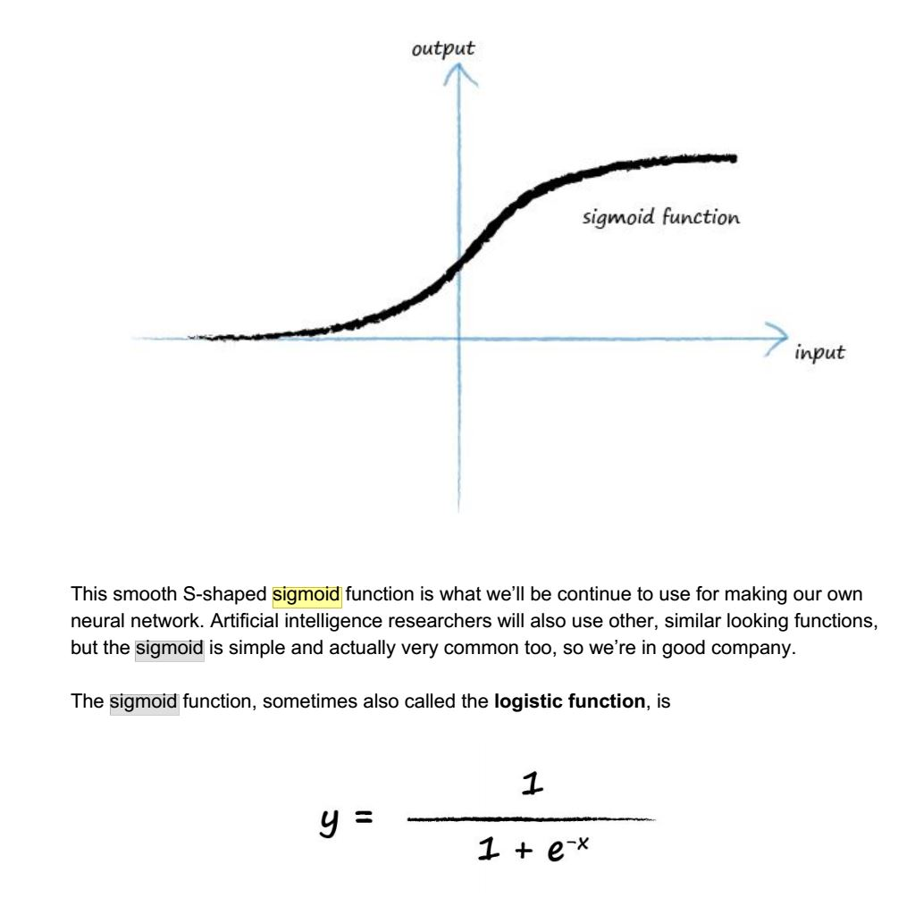
The Derivative of the Sigmoid is Close to Zero When Its Value is Close to Zero or One
This causes the learning to be slow in either of these conditions.
Its rate of change saturates at the ends.

Slide 23
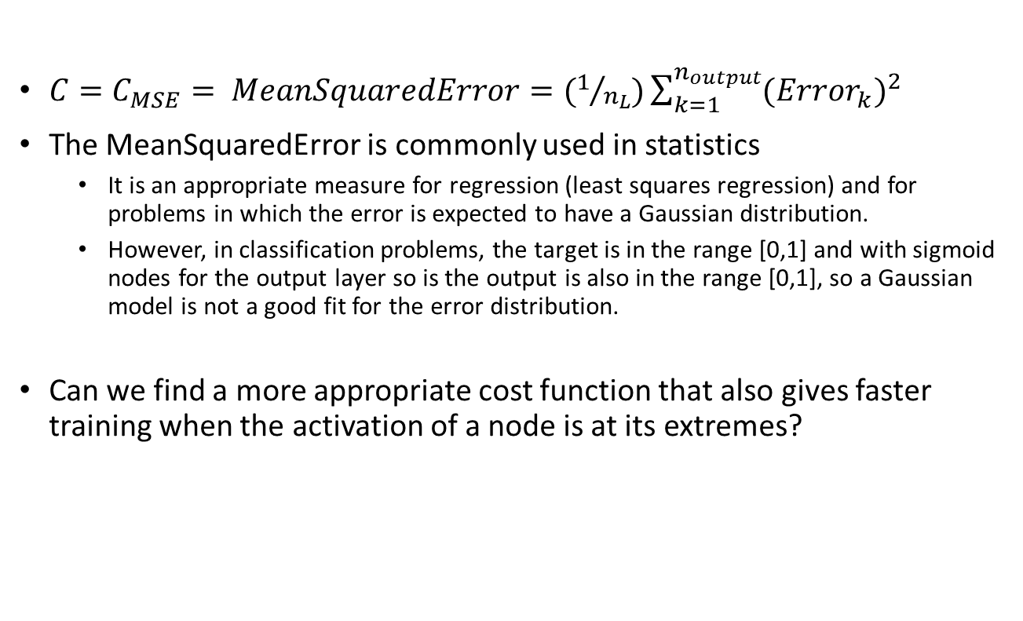
Is the Mean Squared Error a Good Cost Function?
$C=C_{MSE}= MeanSquaredError=(1/{n_{L}})\sum_{k=1}^{n_{output}}{({Error}_{k})^{2}}$
The MeanSquaredError is commonly used in statistics
It is an appropriate measure for regression (least squares regression) and for problems in which the error is expected to have a Gaussian distribution.
However, in classification problems, the target is in the range [0,1] and with sigmoid nodes for the output layer so is the output is also in the range [0,1], so a Gaussian model is not a good fit for the error distribution.
Can we find a more appropriate cost function that also gives faster training when the activation of a node is at its extremes?

Slide 24
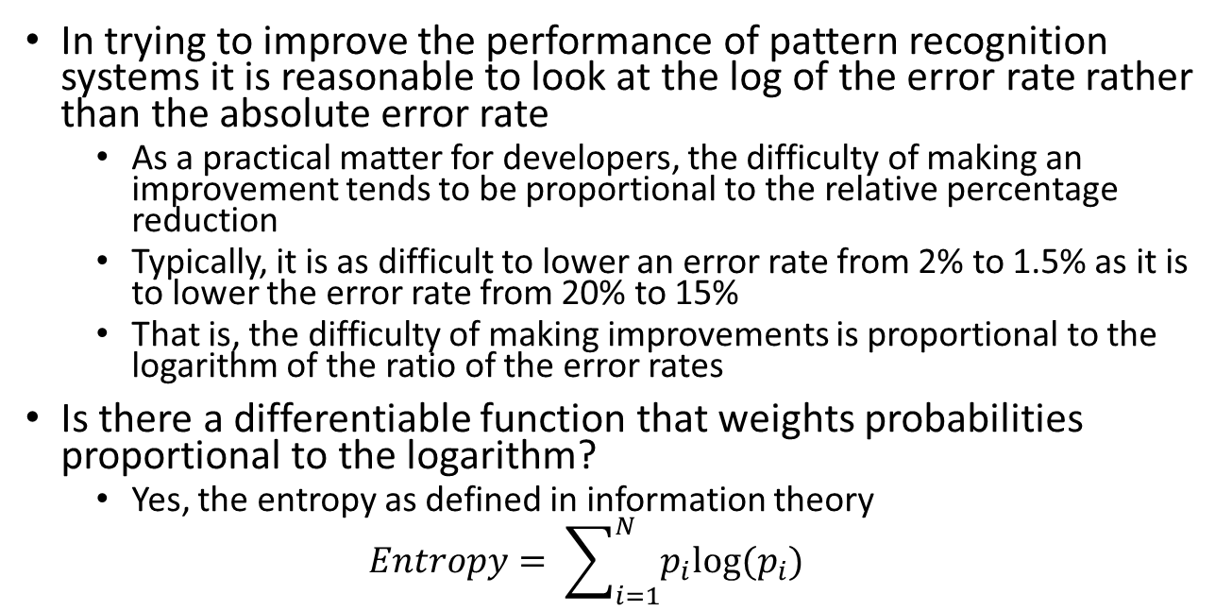
Consider the Logarithm of the Error Rate
In trying to improve the performance of pattern recognition systems it is reasonable to look at the log of the error rate rather than the absolute error rate
As a practical matter for developers, the difficulty of making an improvement tends to be proportional to the relative percentage reduction
Typically, it is as difficult to lower an error rate from 2% to 1.5% as it is to lower the error rate from 20% to 15%
That is, the difficulty of making improvements is proportional to the logarithm of the ratio of the error rates
Is there a differentiable function that weights probabilities proportional to the logarithm?
Yes, the entropy as defined in information theory
$$Entropy= \sum_{i=1}^{N}{p_{i}log⁡(p_{i})}$$

Slide 25
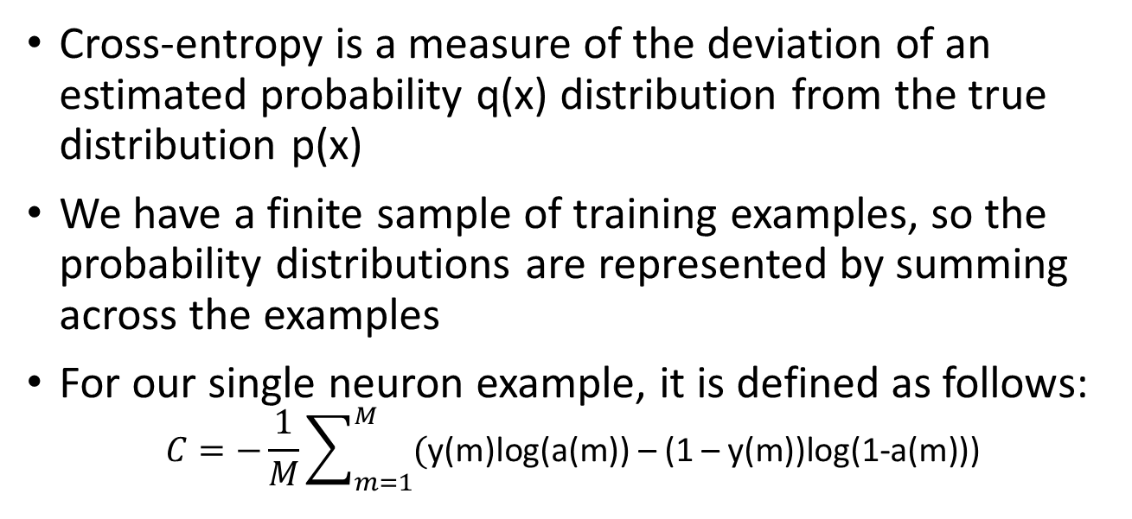
How Can We Use Something Like Entropy as a Measure of Error?
Cross-entropy is a measure of the deviation of an estimated probability q(x) distribution from the true distribution p(x)
We have a finite sample of training examples, so the probability distributions are represented by summing across the examples
For our single neuron example, it is defined as follows:
$$C=−\frac{1}{M}\sum_{m=1}^{M}{(\text{y}\text{(}\text{m}\text{)}\text{log}\text{(}\text{a}\text{(}\text{m}\text{)) – (1 – }\text{y}\text{(}\text{m}\text{))}\text{log}\text{(1−}\text{a}\text{(}\text{m}\text{)))}}$$
In practice, a(m) only approaches 0 or 1, so we don’t have to worry about log(0).
If a(m) approaches the correct value of y(m) for every m, then either y(m) is 0 and log(1-a(m) approaches log(1) = 0, or y(m) is 1 and log(1-a(m)) approaches 0. In either case the sum approaches 0. On the other hand, C is always positive and has its maximum when y(m) and a(m) always disagree. Thus, cross-entropy, that is C, is a reasonable cost measure.

Slide 26
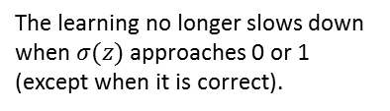
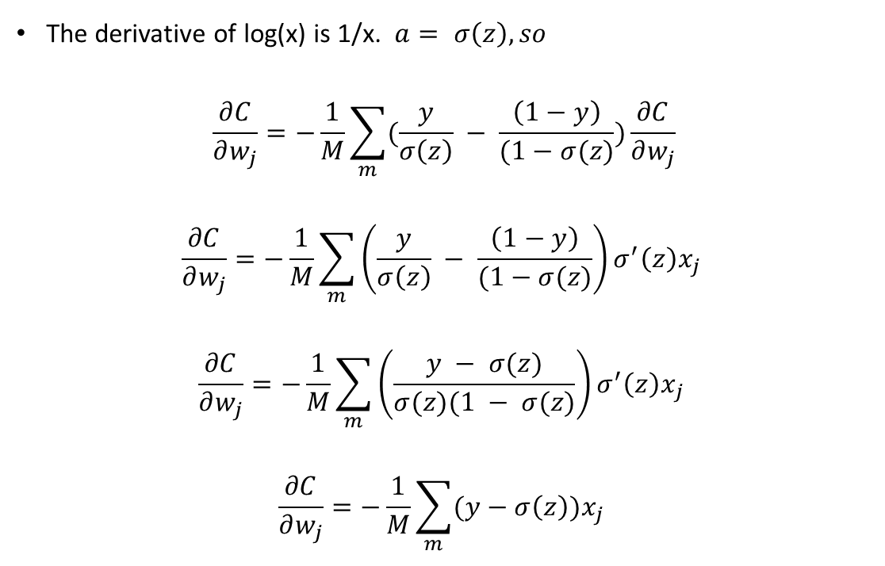
Cross-Entropy Avoids the Slow Learning
The derivative of log(x) is 1/x. $a= σ\left(z\right), so$
$$\frac{∂C}{∂w_{j}}=−\frac{1}{M}\sum_{m}{(\frac{y}{σ\left(z\right)} − \frac{\left(1−y\right)}{(1−σ(z)})\frac{∂C}{∂w_{j}}}$$
$$\frac{∂C}{∂w_{j}}=−\frac{1}{M}\sum_{m}{\left(\frac{y}{σ\left(z\right)} − \frac{\left(1−y\right)}{(1−σ(z)}\right)σ^{′}\left(z\right)x_{j} }$$
$$\frac{∂C}{∂w_{j}}=−\frac{1}{M}\sum_{m}{\left(\frac{y − σ(z)}{σ(z)(1 − σ(z)}\right)σ^{′}\left(z\right)x_{j} }$$
$$\frac{∂C}{∂w_{j}}=−\frac{1}{M}\sum_{m}{(y−σ\left(z\right))x_{j} }$$
The dependency on m has been made implicit to make the expressions easier to read.
The learning no longer slows down when $σ(z)$ approaches 0 or 1 (except when it is correct).

Slide 27
Making Neuron Activations Simulate Probability Distributions
A sigmoid neuron is like an event detector
The summed input to the neuron z is the evidence in favor of detecting the event
The output of the sigmoid function is in the range [0,1] and is somewhat like a probability
However, when there is more than one neuron their activations are not like a probability distribution
Consider the simplest case: two neurons to represent a binary classification
Suppose we have separate evidence in favor of each alternative. How do we generalize the sigmoid function to reflect this information?

Slide 28
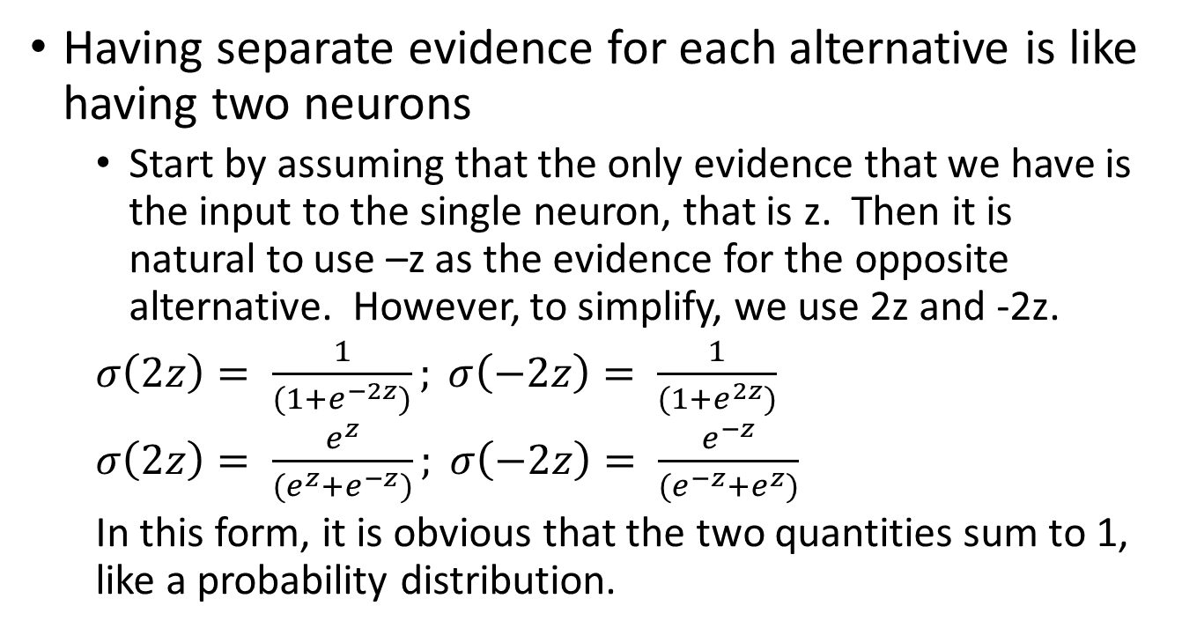
Binary Classification with Two Neurons
Having separate evidence for each alternative is like having two neurons
Start by assuming that the only evidence that we have is the input to the single neuron, that is z. Then it is natural to use –z as the evidence for the opposite alternative. However, to simplify, we use 2z and -2z.
$σ\left(2z\right)= \frac{1}{(1+e^{−2z})}; σ\left(−2z\right)= \frac{1}{(1+e^{2z})}$
$σ\left(2z\right)= \frac{e^{z}}{(e^{z}+e^{−z})}; σ\left(−2z\right)= \frac{e^{−z}}{(e^{−z}+e^{z})}$
In this form, it is obvious that the two quantities sum to 1, like a probability distribution.

Slide 29
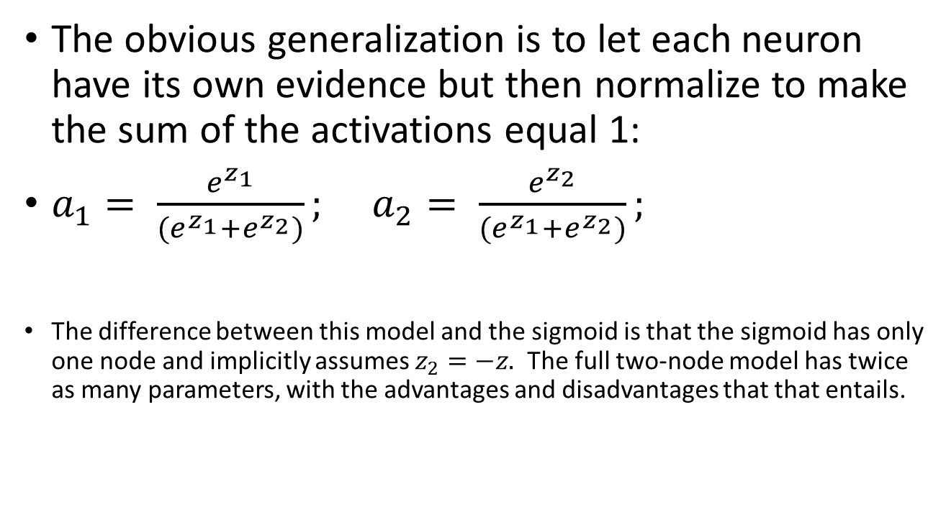
Binary Classification with Two Neurons that Have Different Evidence
The obvious generalization is to let each neuron have its own evidence but then normalize to make the sum of the activations equal 1:
$a_{1}= {\frac{e^{z_{1}}}{(e^{z_{1}}+e^{z_{2}})}; }^{}$ $a_{2}= {\frac{e^{z_{2}}}{(e^{z_{1}}+e^{z_{2}})}; }^{}$
The difference between this model and the sigmoid is that the sigmoid has only one node and implicitly assumes $z_{2}=−z.$ The full two-node model has twice as many parameters, with the advantages and disadvantages that that entails.

Slide 30
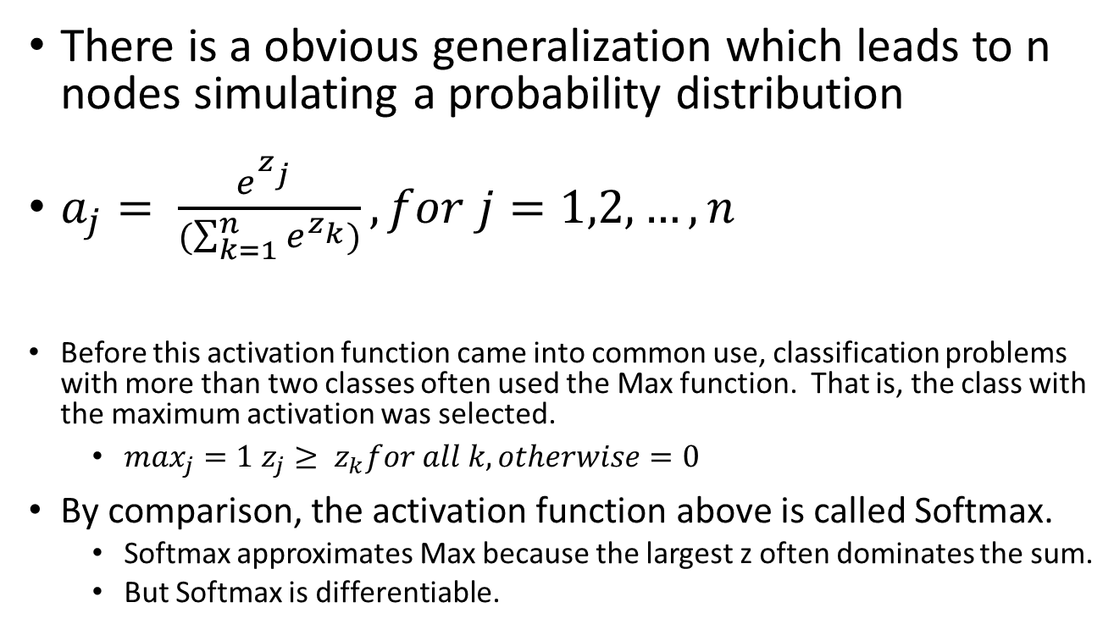
Generalizing to More Than Two Nodes
There is a obvious generalization which leads to n nodes simulating a probability distribution
$a_{j}= \frac{e^{z_{j}^{}}}{(\sum_{k=1}^{n}{e^{z_{k}})}}, for j=1,2, …, n$
Before this activation function came into common use, classification problems with more than two classes often used the Max function. That is, the class with the maximum activation was selected.
$\max_{j}=1 z_{j}≥ z_{k}for all k, otherwise=0$
By comparison, the activation function above is called Softmax.
Softmax approximates Max because the largest z often dominates the sum.
But Softmax is differentiable.

Slide 31
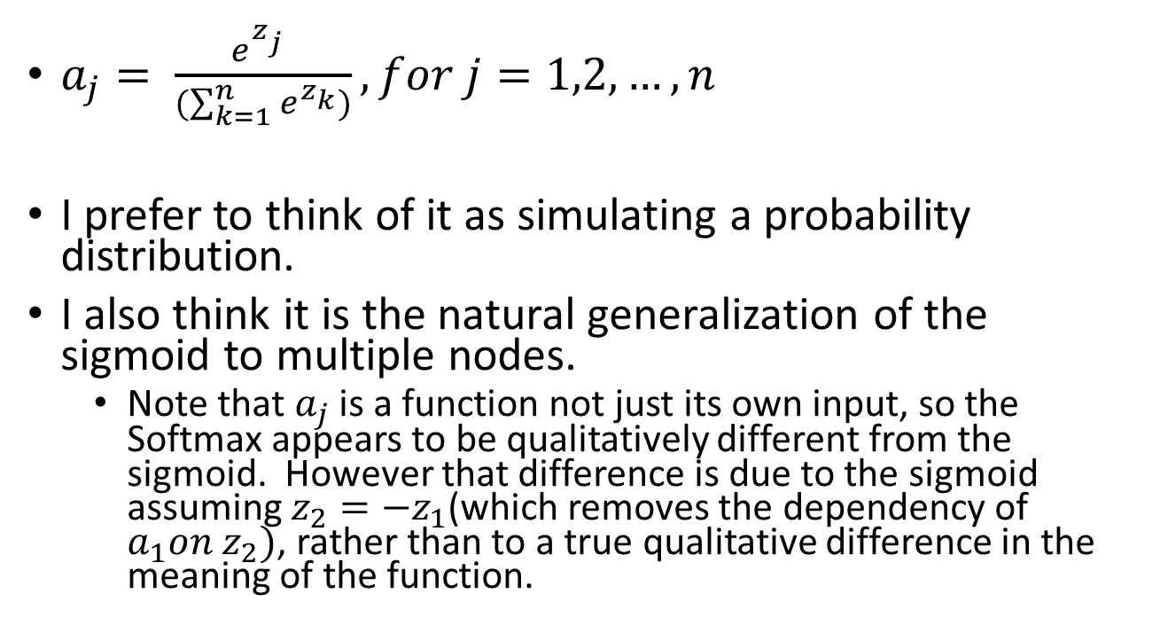
Softmax
$a_{j}= \frac{e^{z_{j}^{}}}{(\sum_{k=1}^{n}{e^{z_{k}})}}, for j=1,2, …, n$
I prefer to think of it as simulating a probability distribution.
I also think it is the natural generalization of the sigmoid to multiple nodes.
Note that $a_{j}$ is a function not just its own input, so the Softmax appears to be qualitatively different from the sigmoid. However that difference is due to the sigmoid assuming $z_{2}=−z_{1}$(which removes the dependency of $a_{1}on z_{2})$, rather than to a true qualitative difference in the meaning of the function.

Slide 32
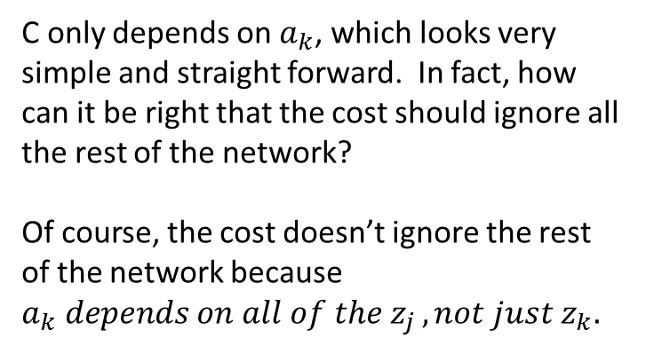
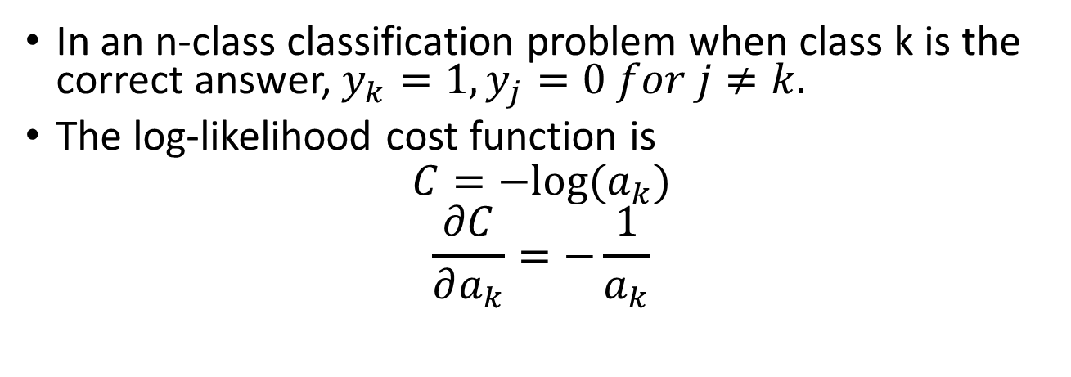
Log-Likelihood Cost Function
In an n-class classification problem when class k is the correct answer, $y_{k}=1, y_{j}=0 for j≠k.$
The log-likelihood cost function is
$$C=−log⁡(a_{k})$$
$$\frac{∂C}{∂a_{k}}=−\frac{1}{a_{k}}$$
C only depends on $a_{k}$, which looks very simple and straight forward. In fact, how can it be right that the cost should ignore all the rest of the network?
Of course, the cost doesn’t ignore the rest of the network because $a_{k} depends on all of the z_{j }, not just z_{k}.$
Because of the summation in the denominator

Slide 33
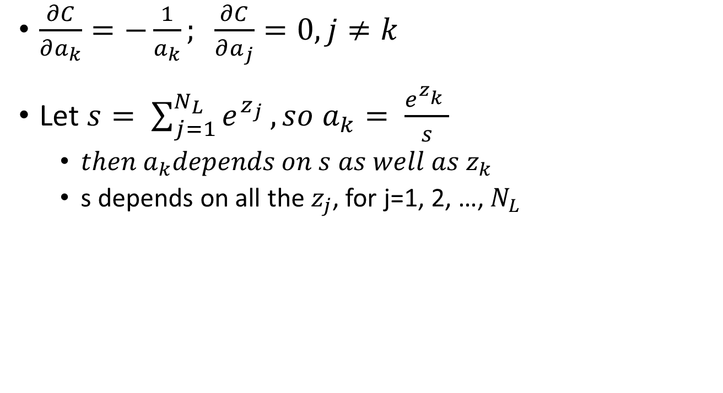
The Constraint that the Activations Sum to 1 Affects the Derivatives
$\frac{∂C}{∂a_{k}}=−\frac{1}{a_{k}}; \frac{∂C}{∂a_{j}}=0, j≠k$
Let $s= \sum_{j=1}^{N_{L}}{e^{z_{j}}}, so a_{k}= \frac{e^{z_{k}^{}}}{s}$
$then a_{k}depends on s as well as z_{k}$
s depends on all the $z_{j}$, for j=1, 2, …, $N_{L}$

Slide 34

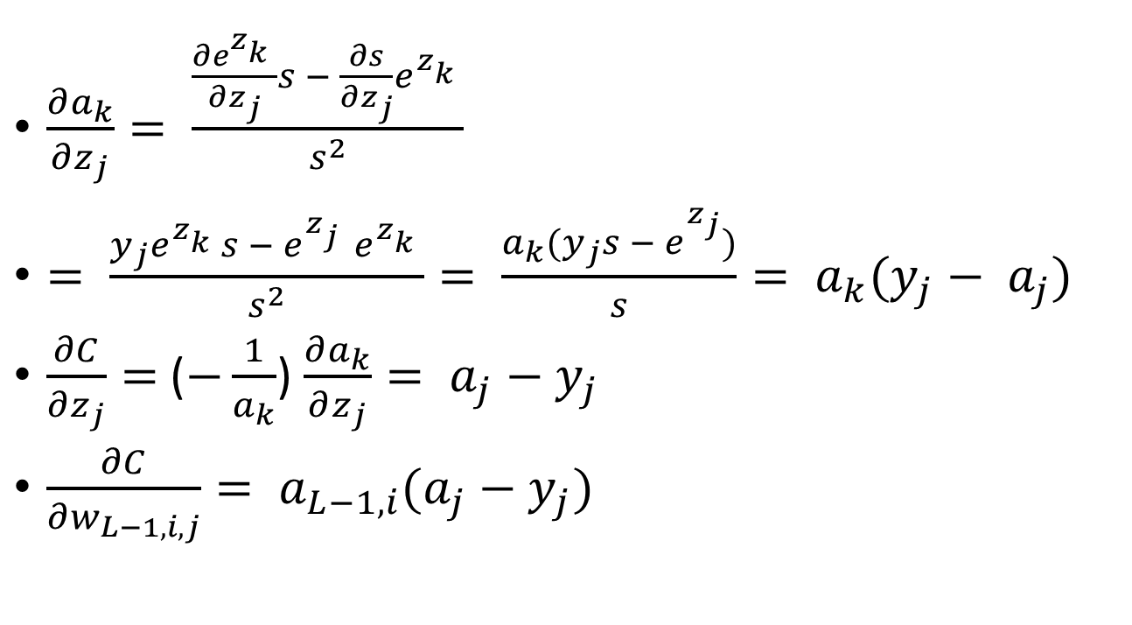
Backpropagating the Log-Likelihood
This derivative is zero if j≠k hence the $y_{j}.$
$\frac{∂a_{k}}{∂z_{j}}= {\frac{\frac{∂e^{z_{k}^{}}}{∂z_{j}}s − \frac{∂s}{∂z_{j}}e^{z_{k}^{}}}{s^{2}}}^{}$
$= \frac{y_{j}e^{z_{k}^{}}s − e^{z_{j}^{}}e^{z_{k}^{}}}{s^{2}}= \frac{a_{k}(y_{j}s − e_{}^{z_{j}})}{s}= a_{k}(y_{j}− a_{j})$
$\frac{∂C}{∂z_{j}}=$($−\frac{1}{a_{k}}$) $\frac{∂a_{k}}{∂z_{j}}= a_{j}−y_{j}$
$\frac{∂C}{∂w_{L−1,i,j}}= a_{L−1,i}(a_{j}−y_{j})$
This factor only goes to zero with a correct answer, which is when we would like the derivative to approach 0.

Slide 35
Is Cross-Entropy the Same as Log-Likelihood?
If not, which one is better?
Softmax with cross-entropy is exactly the same as the two-node model with activations z and –z with log-likelihood.
Therefore the difference is entirely due to tying the activations of the two classes to being the negatives of each other, rather than to any difference in the cost function.
The two-node model has twice the parameters and therefore can better learn to fit data in which evidence for one class is not the same as evidence against the other
For example, consider two target classes selected out of a larger number. Each one would have a compact cluster around it.
On the other hand, if the situation really matches the assumption that any data for one class is negative evidence of the other, implicitly forcing the two subnetworks to be negative images of each other may give more robust training, with smoother estimates and more data per parameter
It is not a decision about cost function; it is a decision about whether to tie certain parameters.

Slide 36
Problem: Overfitting
If you have too many parameters, your model may fit the training data very well but do poorly on new data
This is a problem for all pattern recognition, not just neural networks.
However, large deep learning networks have billions of parameters
Possible solutions:
Collect more data (may be expensive)
Use fewer parameters (lose the ability to model complex interactions)
Other techniques
Regularization works with fixed network and fixed training data

Slide 37

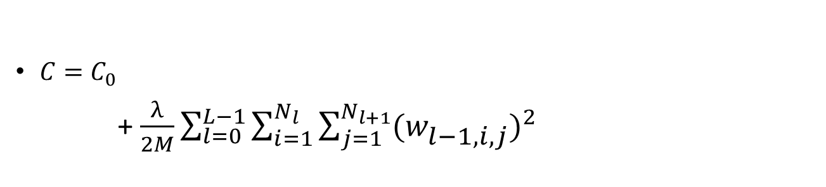
L2 Regularization
Idea: Add an extra penalty term to the cost to prevent the weights from getting large.
$λ$ controls the relative impact of regularization compared to the regular cost function.
Any regular cost function
$C=C_{0}$
+ $\frac{λ}{2M}\sum_{l=0}^{L−1}{\sum_{i=1}^{N_{l}}{\sum_{j=1}^{N_{l+1}}{{(w_{l−1,i,j}^{})}^{2}}}}$
Notice that the regularization term only includes the regular connection weights, not the bias.
This is the regularization term. It makes the learning prefer smaller weights. It is hoped that weights that only fit idiosyncratic data examples will be driven to zero.
L2 regularization is also called “weight decay”.

Slide 38
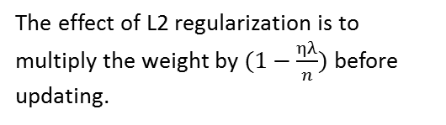
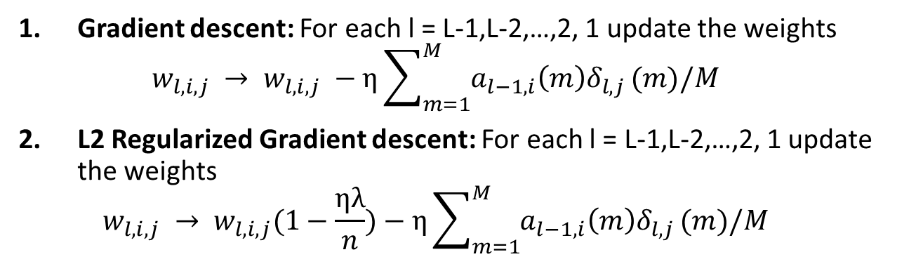
L2 Regularized Gradient Descent
Gradient descent: For each l = L-1,L-2,…,2, 1 update the weights
$$w_{l,i,j} → w_{l,i,j} −η\sum_{m=1}^{M}{a_{l−1,i}{\left(m\right)δ}_{l,j}}(m)/M$$
L2 Regularized Gradient descent: For each l = L-1,L-2,…,2, 1 update the weights
$$w_{l,i,j} → w_{l,i,j}(1−\frac{ηλ}{n})−η\sum_{m=1}^{M}{a_{l−1,i}{\left(m\right)δ}_{l,j}}(m)/M$$
The effect of L2 regularization is to multiply the weight by $(1−\frac{ηλ}{n})$ before updating.

Slide 39
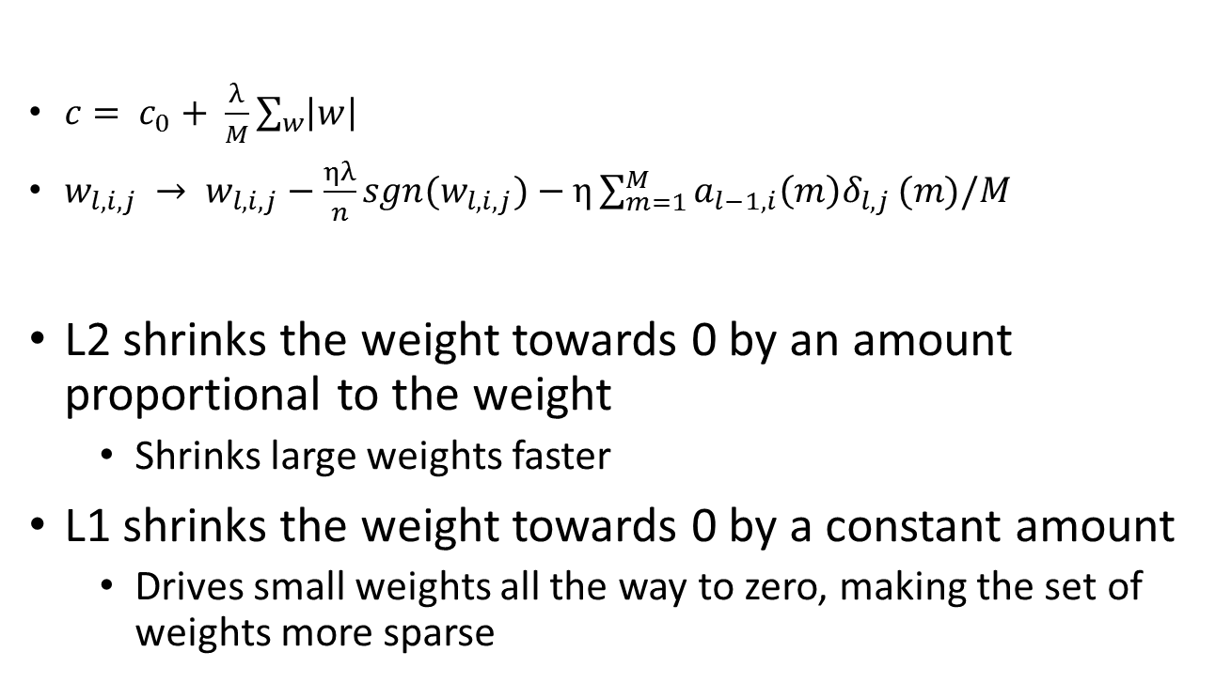
L1 Regularization
$c= c_{0}+ \frac{λ}{M}\sum_{w}{\left|w\right|}$
$w_{l,i,j} → w_{l,i,j}−\frac{ηλ}{n}sgn(w_{l,i,j})−η\sum_{m=1}^{M}{a_{l−1,i}{\left(m\right)δ}_{l,j}}(m)/M$
L2 shrinks the weight towards 0 by an amount proportional to the weight
Shrinks large weights faster
L1 shrinks the weight towards 0 by a constant amount
Drives small weights all the way to zero, making the set of weights more sparse

Slide 40
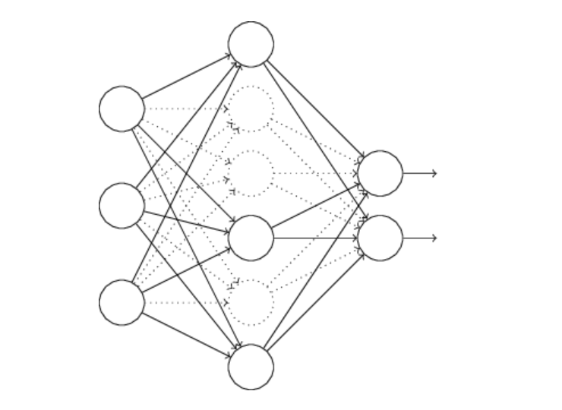
Dropout
Dropout is often very effective at preventing overfitting even for networks with more parameters than data examples. However, the actual way in which dropout prevents overfitting is somewhat mysterious. It doesn’t always help for reasons that match the original justification, or any other particular theory.
Obviously, there are fewer parameters participating in any one activation. However, the total number of parameters remains the same, and they are all used to recognize of new data.
Dropout: During the forward activation computation, pretend that some nodes (as many as half) don’t exist. Randomly change which nodes are dropped out. Automatically, these nodes also won’t participate in backprop.

