Slide 1
Lecture 3: Improving Neural Network Training (part 2, preliminary version)
Reading and Research in Deep Learning
James K Baker

Slide 2
Artificial Expansion of Training Data
Examples
Add noise
Distortion of sound or image
Rotate or change orientation of image
Effective when such changes occur naturally
Be careful not to change a training example so much that it better matches a different category
Unless you have a purpose to do that deliberately to a limited degree

Slide 3
Design Decisions and Hyperparameters
There are many decisions and parameters to set in designing and training a neural networks
Network architecture
How many layers?
How many nodes per layer?
Final layer activation function
Activation function for other nodes
Learning controls
Learning rate η
Regularization parameter λ
Minibatch size M
Number of epochs of training
The best answers to these questions depend on the particular problem, so there is no single right answer. Instead, we will look at some procedures for finding good values for each problem.

Slide 4
How many layers?
Suggested procedure: try it and test
Start with no hidden layer
Add one hidden layer at a time
Until the performance gets worse
Advantages:
You get a basic understanding of the problem quickly with comparatively little computation
You may see a way to improve your design without wasting so much time
You discover how the performance varies with the number of layers
You may find the performance saturates with fewer layers than you would have guessed
It doesn’t hurt to go step by step
You will still find the number of layers with the best performance
The networks with fewer layers take much less computation, so the total computation is not much worse than trying a few networks with a large number of layers.

Slide 5
How many nodes?
Assume a single hidden layer or the same number of nodes per layer
With more complex architectures, the number of nodes per layer may vary, but we’ll discuss that when we come to it
Again, use trial and error, starting small and getting bigger, but increase in geometric jumps, say adding 50% extra nodes for each trial
Measure the performance for each size
Stop when you no longer get significant improvement
To be really sure, keep going until performance degrades, then back down
Or when you run out of computer budget

Slide 6
Final Layer Activation Function
Use a linear activation function for regression problems
Or an appropriate, application-specific non-linear function
Use sigmoid for symmetric discrimination problem
Possibly including two-class classification
Use softmax for classification problems
Including two-class if the classes are asymmetric

Slide 7
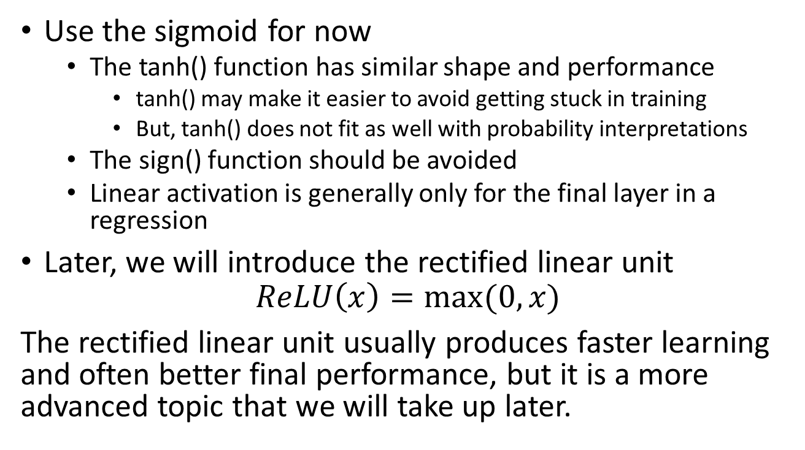
Activation Functions for Other Layers
Use the sigmoid for now
The tanh() function has similar shape and performance
tanh() may make it easier to avoid getting stuck in training
But, tanh() does not fit as well with probability interpretations
The sign() function should be avoided
Linear activation is generally only for the final layer in a regression
Later, we will introduce the rectified linear unit
$$ReLU\left(x\right)=max⁡(0,x)$$
The rectified linear unit usually produces faster learning and often better final performance, but it is a more advanced topic that we will take up later.

Slide 8
General Advice about Experimentation
Start with a smaller problem
Fewer categories (2 digits instead of 10)
Smaller data sets
Less training data
Smaller validation set
Smaller networks
Fewer layers
Vary one parameter at a time
Plot validation performance as a function of what you are changing
Sample enough parameter values to determine whether performance change is smooth and gradual or noisy
Roughly determine the optimum value for one parameter, then move to the next
Each change in a parameter affects the others, so you will need to retest and continue to change each parameter for several rounds
Make more refined estimates in later rounds
Some hyperparameters only need to be roughly in the right range
But it may be hard to tell if the current value is too large or too small
You may need to experimentally try changes in both directions

Slide 9
The Learning Rate η
When the learning rate is set too high, the performance on the validation set will fluctuate
When the learning rate is too low, the performance will improve smoothly, but learning will be slow
The optimum performance would be at the highest learning rate that doesn’t produce fluctuations (called the threshold value), but that performance would be disturbed by changes in other parameters
Suggestion: Find the threshold value by trial and error, then back off, say, by a factor of 2.

Slide 10
The Learning Rate η (cont.)
Note: Nielsen suggests evaluating the performance of η on the training data rather than the validation data as with the other parameters
This makes sense, although it might not matter much
The learning rate is optimized not for performance, but to speed up the rate of convergence in training
The training is guaranteed to converge on the training data (in the limit of an infinite amount of data) but is not guaranteed to converge on the validation data
However, either method will usually give similar results.

Slide 11
Stopping Early
You don’t need to set the number of epochs of training as a fixed parameter
If the gradient were known exactly, you could make sure that every step would be an improvement by making the learning step arbitrarily small
This would guarantee convergence
However, we only have a statistical estimate of the gradient, so the performance will fluctuate even with a low learning rate
Train until fluctuations begin, then train somewhat more to see if progress will resume
After continuing for a reasonable time without further improvement, stop!

Slide 12
The Regularization Parameter λ
The regularization parameter forces the learning toward a smoother function
This is ideal if the observed data is generated by a smooth function with added noise
But, we don’t know the true function or how smooth it might be
If λ is too large, it will smooth the model more than the true function
If λ is too small, it will not smooth out as much of the noise

Slide 13
Suggested Procedure for λ
Start by setting λ = 0, and tuning η.
With that η, roughly tune λ
Start at λ = 1.0, then increase or decrease by a factor of 10 as indicated by performance on validation data
Then, fine tune λ by making smaller changes
Then, go back to retune η
You may need to do multiple rounds

Slide 14
Mini-Batch Size (typically M = 64 or 128)
If the mini-batch size is too small, the statistical estimate of the gradient will be too noisy
If the mini-batch size is larger than necessary there will be more computation than necessary per update
On some GPU implementations, there is a data bottleneck such that larger mini-batches can be processed as quickly as smaller ones, up to some limit
Because of the architecture of GPUs, hardware sits idle unless the size of the minibatch is a power of two (in some cases, but not always)
However, it is difficult to determine how noisy a gradient estimate may be, because the true gradient is not known
Any movement in a direction that makes an acute angle with the gradient will also be an improvement, just slower, so it is not easily apparent that a direction is not the true gradient
Balancing these issues generally leads to selection of a mini-batch size of 64 or 128
Fine tuning isn’t feasible, so those are reasonable choices even on a CPU-only implementation
There are special cases when other goals are included for which a full batch (all the training data) or on-line (mini-batch size of 1, update after every example) might be used

Slide 15
Scheduled Changes in Parameters
As the weights get close to a minimum, fluctuations in the estimate of the gradient become more harmful.
Therefore, a smaller value of the learning parameter λ and/or a larger minibatch size M may be desired.
You may want to experiment with a learning schedule if you continue with deep learning. However, it only speeds up the training rather than give a better answer. During the course, experimenting with it would take up more time than it would gain, unless you are working on a topic for which it happens to be important.

Slide 16
Summary of Expert Advice
From NIPS 2015 Tutorial on Deep Learning by Geoffrey E. Hinton, Yann LeCun, and Yoshua Bengio (slides online) (https://www.iro.umontreal.ca/~bengioy/talks/DL-Tutorial-NIPS2015.pdf)
Use ReLU non-linearities
Use cross-entropy loss for classification
Use Stochasic Gradient Descent on minibatches
Shuffle the training samples (← very important)
Normalize the input variables (zero mean, unit variance)
Use a bit of L1 or L2 regularization on the weights (or a combination)
It’s best to turn it on after a couple of epochs
Use “dropout” for regularization
Lots more in [LeCun et al. “Efficient Backprop” 1998]
Lots, lots more in “Neural Networks Tricks of the Trade” (2012 edition)
More recent: Deep Learning, by Goodfellow, Bengio, Courville (MIT Press)
I assume this means use Softmax and log-likelihood for multiple categories.

Slide 17
Other learning improvement techniques
Rectified linear units (ReLU)
Momentum
Nesterov’s method
Rmsprop
Adagrad
Adam
Other network topologies and techniques
CNN, BPTT, RNN, LSTM

Slide 18
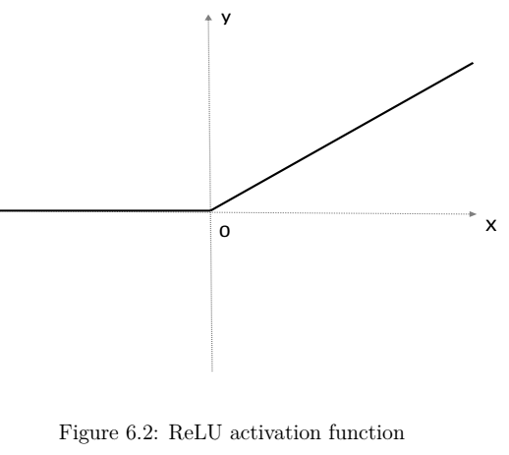
Rectified Linear Unit (ReLU)

Slide 19
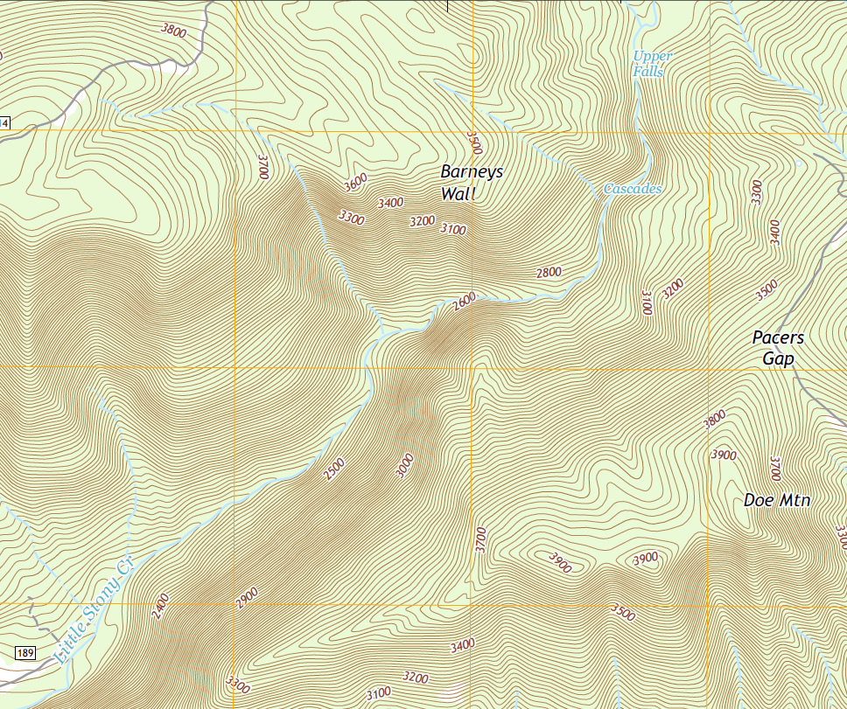
Momentum
What if you are trying to go down a narrow valley?
This is the Cascades. It is a popular hike near Blacksburg, VA. The creek itself is fairly steep, but not nearly as steep as the sides of the valley. If you are not right in the creek itself, the gradients all point back and forth across the valley.

Slide 20
Momentum
What if you are trying to go down a narrow valley?
This is the Cascades. It is a popular hike near Blacksburg, VA. The creek itself is fairly steep, but not nearly as steep as the sides of the valley. If you are not right in the creek itself, the gradients all point back and forth across the valley.
The gradient descent algorithm follows a zig-zag path back and forth across the valley. This can be avoiding with very small steps, but then the learning is very slow.

Slide 21

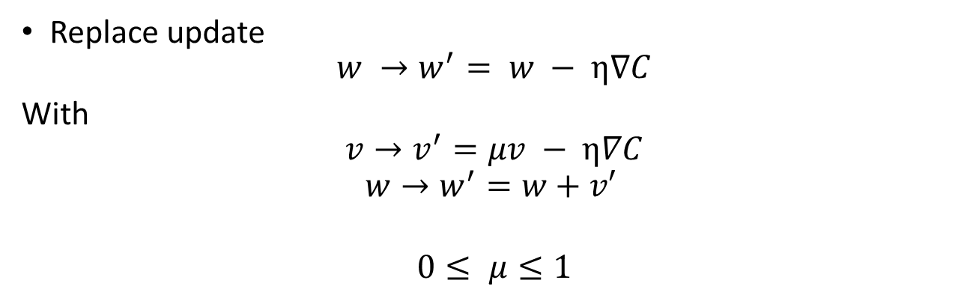
Momentum-based Gradient Descent
Replace update
$$w →w^{′}= w − η∇C$$
With
$$v→v^{′}=μv − η∇C$$
$$w→w^{′}=w+v′$$
$$0≤ μ≤1$$
Adding μ times the previous value of v amounts to accumulating the sum of all previous values of $η∇C$
with geometrically decreasing weights.
This is equivalent of filtering the sequence of values of v with a simple, one-pole low-pass filter.
This produces a smoother, less zig-zag path. It applies even to gradient descent for deterministic functions. In stochastic gradient descent, it also smooths out some of the noise in the estimate of the gradient.

Slide 22
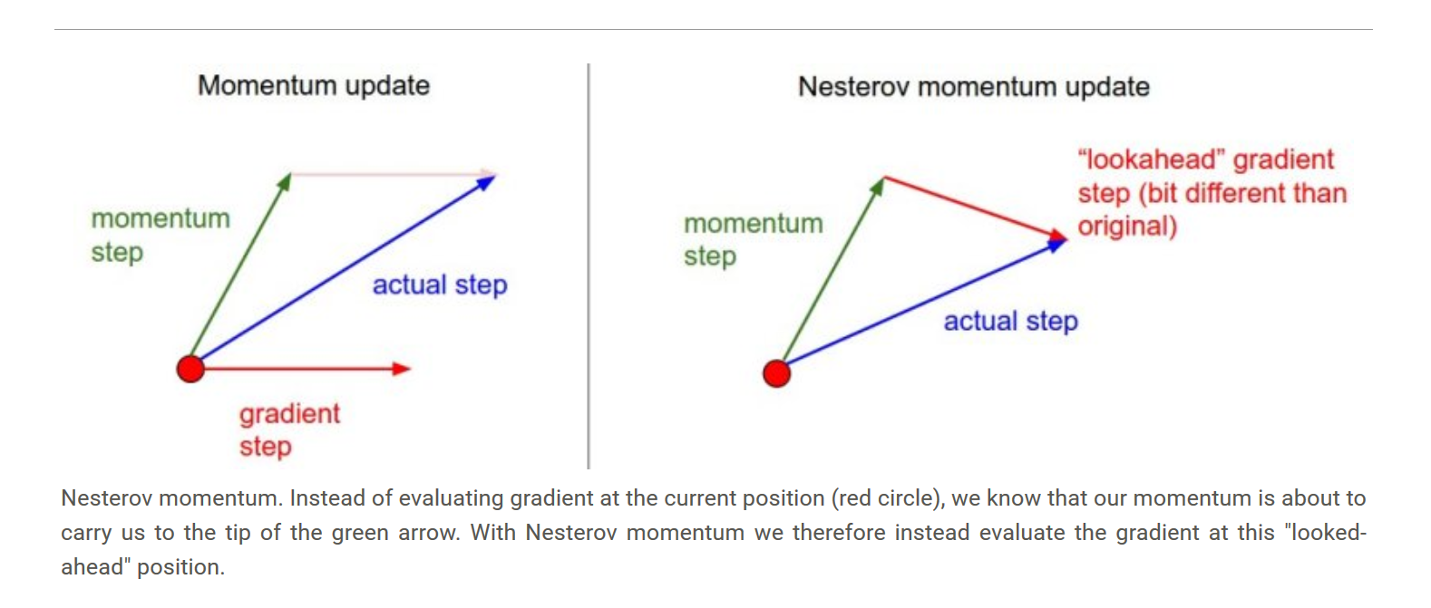
Look Ahead as Well as Back (Nesterov)
Momentum-based gradient descent only uses the current estimated gradient and (a filtered version) of the past estimates. Why not also look ahead to future values?

Slide 23

Look Ahead as Well as Back (Nesterov)
We can determine this point without first computing the gradient.
Evaluate the gradient here
Evaluate the gradient at the momentum point.
$$− η∇C$$
μv

Slide 24
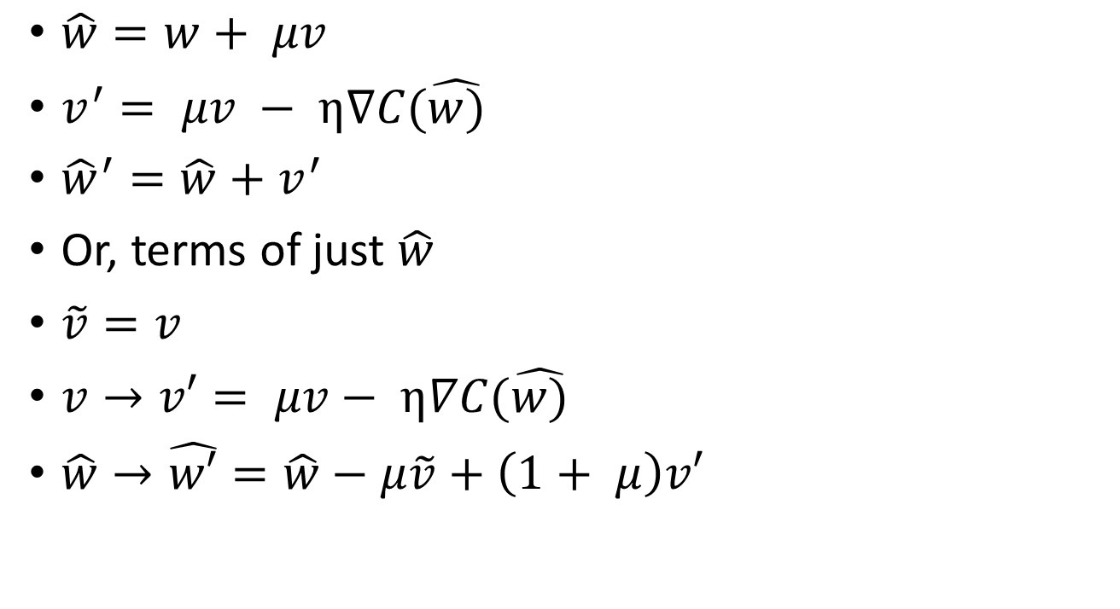
Nestrov Accelerated Momentum
$\hat{w}=w+ μv$
$v^{′}= μv − η∇C(\hat{w)}$
${\hat{w}}^{′}=\hat{w}+v^{′}$
Or, terms of just $\hat{w}$
$\tilde{v}=v$
$v→v′= μv− η∇C(\hat{w)}$
$\hat{w}→\hat{w′}=\hat{w}−μ\tilde{v}+\left(1+ μ\right)v′$

Slide 25
Advice for Gisting Research Papers
First, try to get the “gist”
What is the main achievement?
What are the new ideas (often only one or two)?
What ideas are used by reference?
Which ones do you already know?
Which, if any, did not occur in our introductory books?
For selection of potential projects:
What tests or benchmarks?
How available is the training data?
How much computation will be required?
Is a scaled-down version feasible?
I will give examples and explain the art of gisting in more depth when we get to that part of the course

Slide 26
More to Come …
Additional topics will be covered as mini-lectures
Ignore the rest of the slides, they are not yet finished.

