Slide 1
Sequence to Sequence Modeling
Tony Francis

Slide 2
Problem Formulation

Slide 3
Find a mapping between variable length input and variable length output.
Notes:
Certain problems cannot reasonably have inputs & targets encoded with vectors of fixed dimensionality.
Prime example in language. A sentence can be as short as 3 words or even longer than 15. There’s not reasonable way to capture the unbounded nature of language.
Now, this isn’t the only way of modeling language. In recent work with Convolutional Neural Networks in NLP. A sentence can be represented as a matrix that’s a concatenation of the word vectors that comprise the sentence, k-max pooling is done. Where k vectors of the greatest magnitude are preserved. But, still these is a limit to the amount of data you can preserve. So back to Seq2Seq

Slide 4
Use Cases
Machine Translation
Summarization
Speech Recognition
Text to Speech
Question & Answering
Image Captioning
Notes:
Traditionally used for NLP tasks like those listed. But not limited to this.
An example would be frame predictions. Given x series of frames from a video, predict the rest of the scene. This could be a seq2seq task.
Prime distinction is variable input and output lenghts.

Slide 5
Machine Translation

Slide 6
Statistical Translation - Language Model
Goal of a language model: Determine what good English is as P(e)
Standard Technique: Trigram Model
Conditional probability of a word given 2 previous words
“Colorless green ideas sleep furiously.”
<s> <s> colorless green ideas sleep furiously . </s>
colorless => p(colorless | <s> <s>)
green => p(green | <s> colorless)
ideas => p(ideas | colorless green)
sleep => p(sleep | colorless green)
furiously => p(furiously | green sleep )
. => p(. | sleep furiously)
</s> => p(</s> | furiously .)
Notes:
Preprocessing. Start and End characters. Period becomes
Limited window size. Accuracy improves as size of n increases. Need a lot of data. Can model language well, and compute likelihood of a sentence being well formed. But pretty bad at generating language.

Slide 7
Statistical Translation - Decoding
Since we have a one-one mapping of words for a pair of languages. We then employ the language model to “decode” one language into the target language.
Maximize conditional probabilities

Slide 8
Seq2Seq Approach

Slide 9
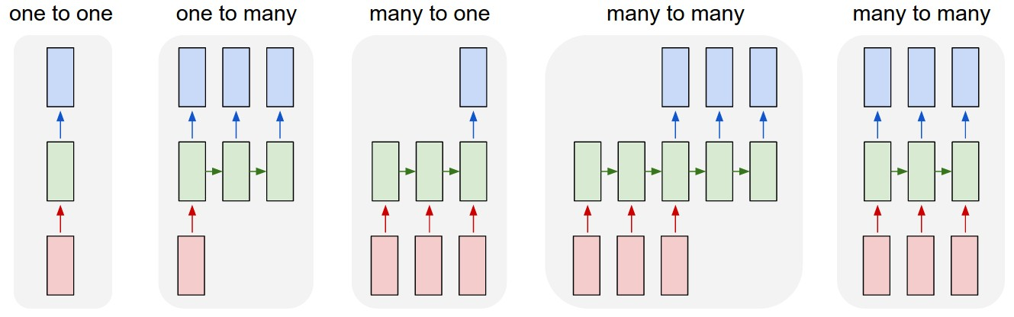
RNNs
https://karpathy.github.io/2015/05/21/rnn-effectiveness/
Notes:
Far right problem: Output will have to be less to or equal to in length than the input.

Slide 10
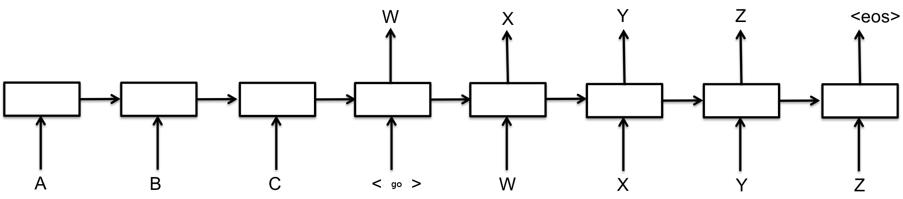
Model
Decoder
h₀
h₁
h₂
h₃
g₀
g₁
g₂
g₃
Encoder
Notes:
Each box here represents a cell of the RNN.
Encoding a sequence into a hidden representation of a fixed size. This is actually problematic as there’s a limit to the length of a sequence that it can hold in its representations. There are ways around this. One of which is using an Attention model for the encoder.
Decoding this representation to some output sequence.
A better formulation of this actually takes into account all previous outputs. So when predicting Y, you take into account the input sequence and X.
Trained with SGD.

Slide 11
Model
Decoder
h₀
h₁
h₂
h₃
g₀
g₁
g₂
g₃
Encoder
Notes:
A better formulation of this actually takes into account all previous outputs. So when predicting Y, you take into account the input sequence and X.
Trained with SGD.
When analyzing Seq2Seq in language tasks, the model is actually learning a continuous space representation of a phrase that preserves both the semantic and syntactic structure of the phrase.

Slide 12
Training
Stochastic Gradient Descent
Sample an input x, and an output y
A sentence in French, and a sentence in English
Sample a random word y_{t} in y
Update RNN Encoder and Decoder parameters to increase probability of y_{t} given y_{t-1} , y_{t-2} , … , y₀ , x_{n} , … , x₀

Slide 13
Prediction Algorithms - Greedy Decoding
For an input sequence x:
Given x, find word y₀ with the highest probability
Given y₀ and x, find y₁ with the highest probability
And so on, until reaching y_{n} = </s>
Notes:
You provide the end token of the input sequence to the input of the decoder and get the output beta which is the first word in the output sequence. And you give this first word to the input of the decoder in the 2nd time step and you get the 2nd word in the output sequence. The process continues until you get an end token for the output sequence.
In the above approach, we are assuming that the best output sentence always start with word beta which is not a valid assumption. It might happen, a better sentence would have been the one that starts with the word that had the 2nd highest probability when we got the output in the first time step of the decoder above.

Slide 14
Prediction Algorithms - Beam Search Decoding
For any input sequence x
Given x, find k candidates for y0 with the highest probabilities
Given x, for each y0 candidate, find k candidates for word y1
Stop when <END> is produced
Output => the sequence with the highest conditional probability
Notes:
Greedy Decoding does not always produce the best sequence. It maximizes the probability of a given word. Not the conditional probability of the entire sequence.
Beam Search:
Rather than just considering the highest probable word at the first time step of the decoder as the input of the output sequence, we take the top k words as the input of our decoder sentence. Here k is also called the beam size which is itself a parameter.
Now to compute the second word in the decoder we feed each of these k first words and get all the prefixes of length 2 (We get k*N sequences if N is the vocab size).
If you are wondering how do we get it, just think that for each first word out of the top k words, we get the probabilities of all the N words in the for the 2nd time step.
So, out of the kN prefixes of length 2, chose the top k ones. Then predict the 3rd word conditioned on these k prefixes (of length 2) and again you get kN prefixes of length 3 and we choose the top k ones.
In the end we have top k decoded sequences as our output. This kind of looks like a greedy decoding process.

Slide 15
Attention Mechanism
Seq2Seq models struggle with longer sentences
Encoder compresses input series into a representation of fixed size
Attention Mechanism is placed between Encoder and Decoder
Predicts the output y_{t} with a weighted average context vector, not just the last state
This is a parameter that is trained
Notes:
This is going to be a brief overview of Attention Mechanisms.
If you recall the model. In reality, the model is making a prediction for an utterance based on its previous state.
But, in reality, we want to be able to reference the entire history of the input.
So, for each state we also produce a context vector. This context vector has a size of n for hn. The dot product of the context vector and the sequence of states is passed into a softmax function to product weighted activations which are then used as part of the prediction.
Most packages like tensorflow, theano, keras, etc. take care of this for you in their seq2seq implementations.
This is where Attention Mechanisms come in.

Slide 16
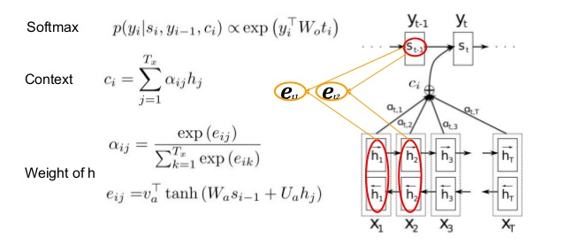
Attention Mechanism
http://www.slideshare.net/KeonKim/attention-mechanisms-with-tensorflow

Slide 17
Papers to Read

Slide 18
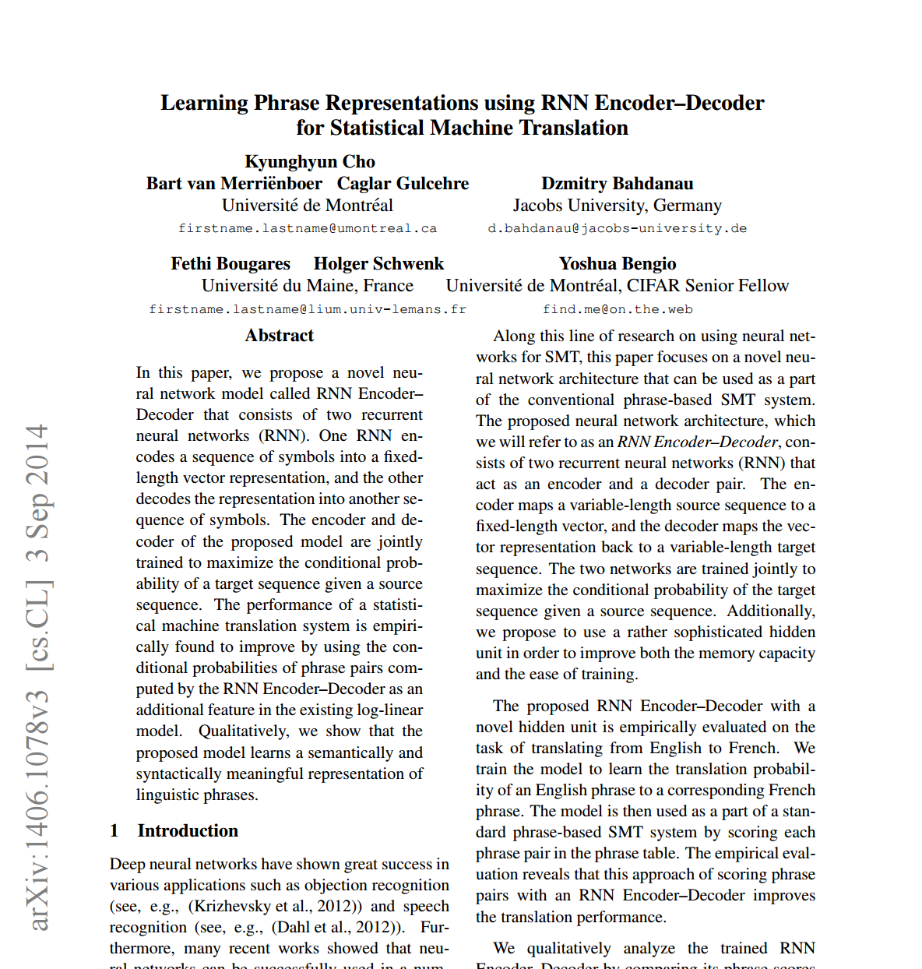
arxiv.org/abs/1406.1078

Slide 19
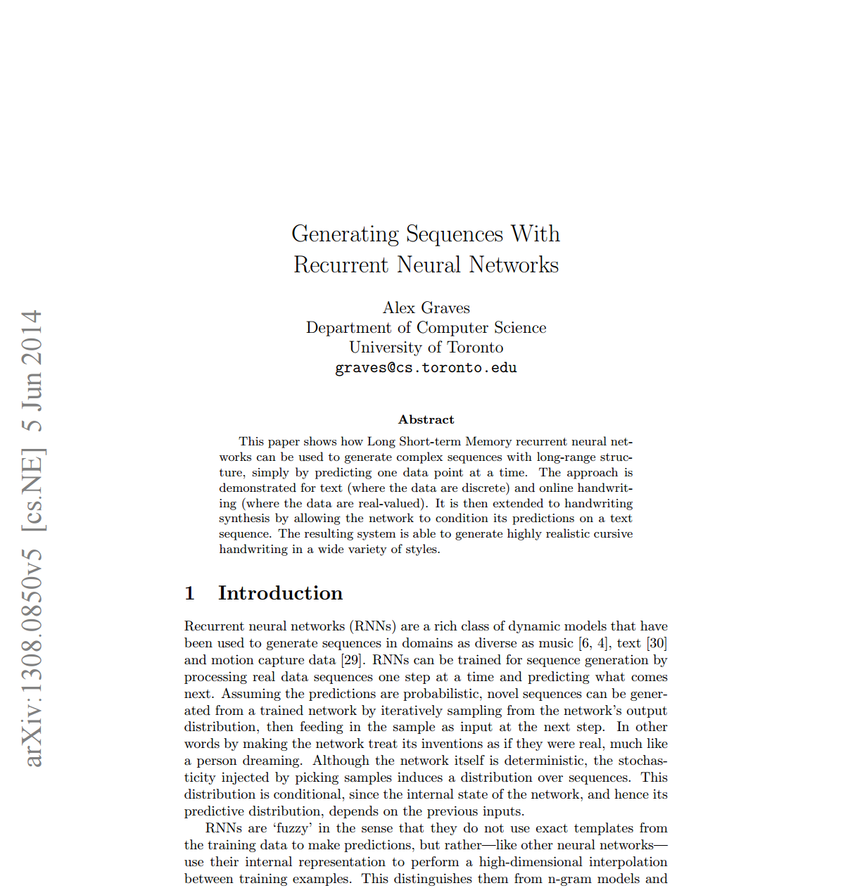
arxiv.org/abs/1308.0850

Slide 20
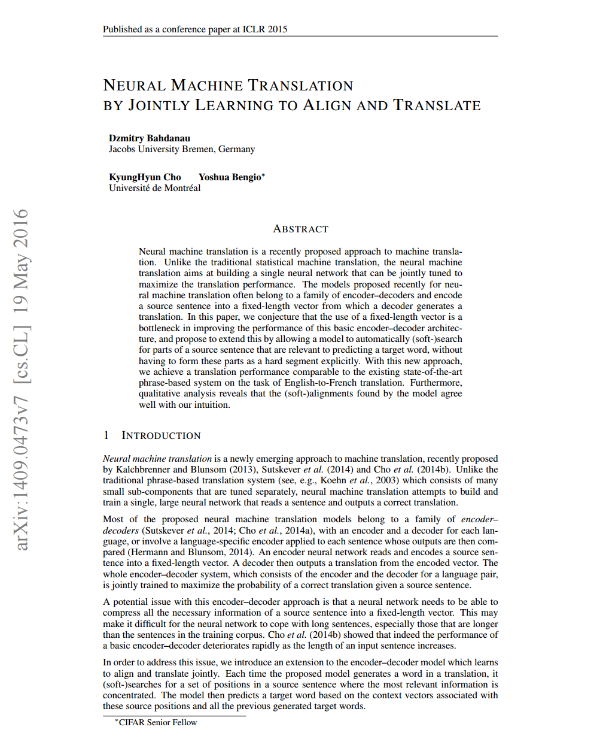
arxiv.org/abs/1409.0473

Slide 21
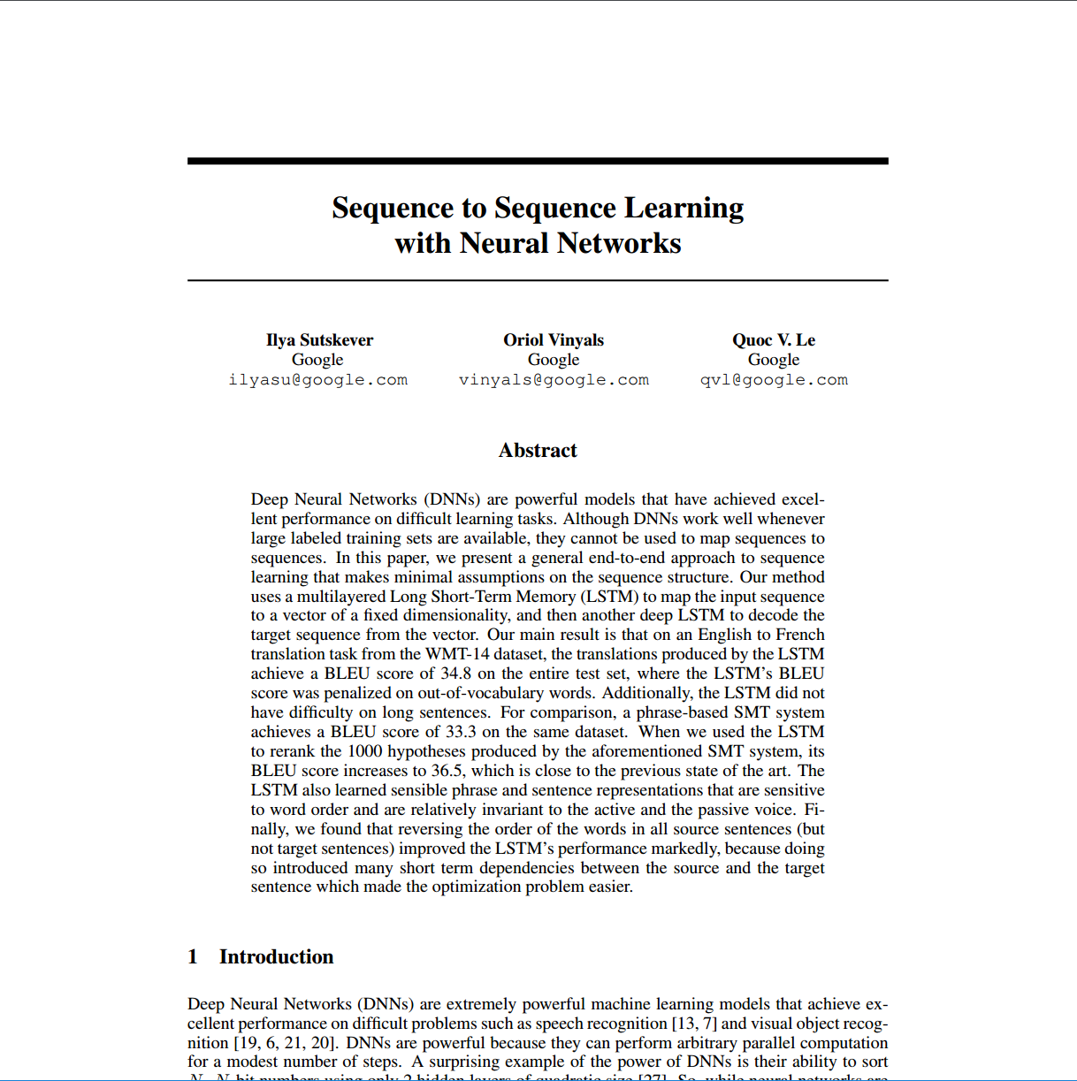
https://papers.nips.cc/paper/5346-sequence-to-sequence-learning-with-neural-networks.pdf
Notes:
https://papers.nips.cc/paper/5346-sequence-to-sequence-learning-with-neural-networks.pdf

Slide 22
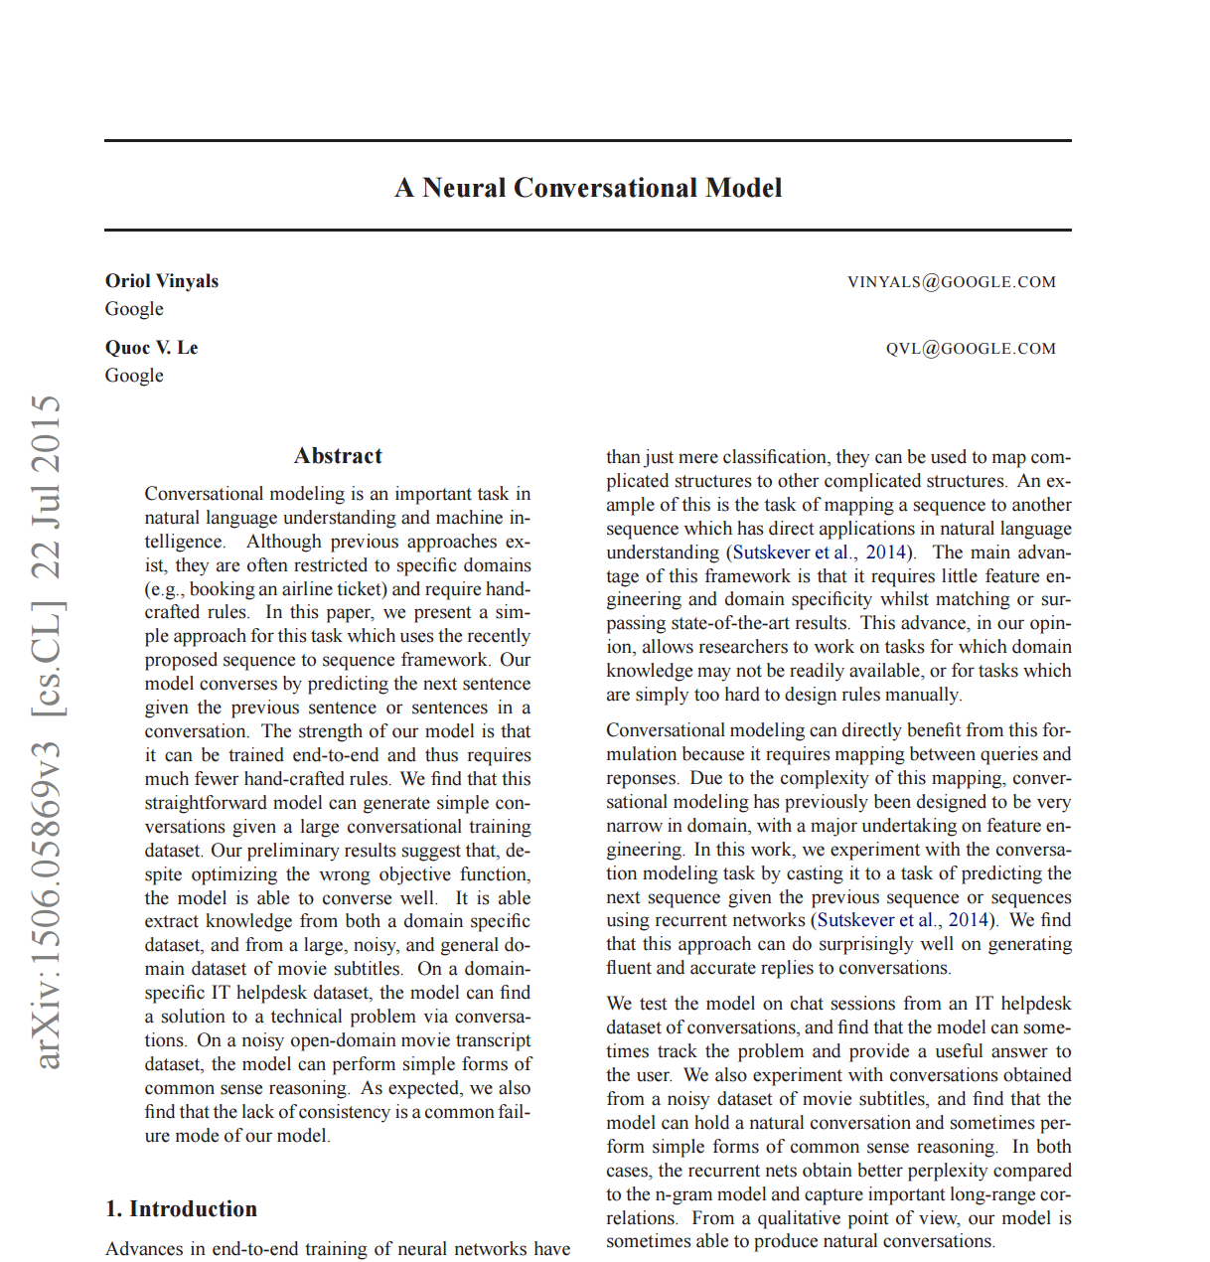
arxiv.org/abs/1506.05869
Notes:
https://papers.nips.cc/paper/5346-sequence-to-sequence-learning-with-neural-networks.pdf

Slide 23
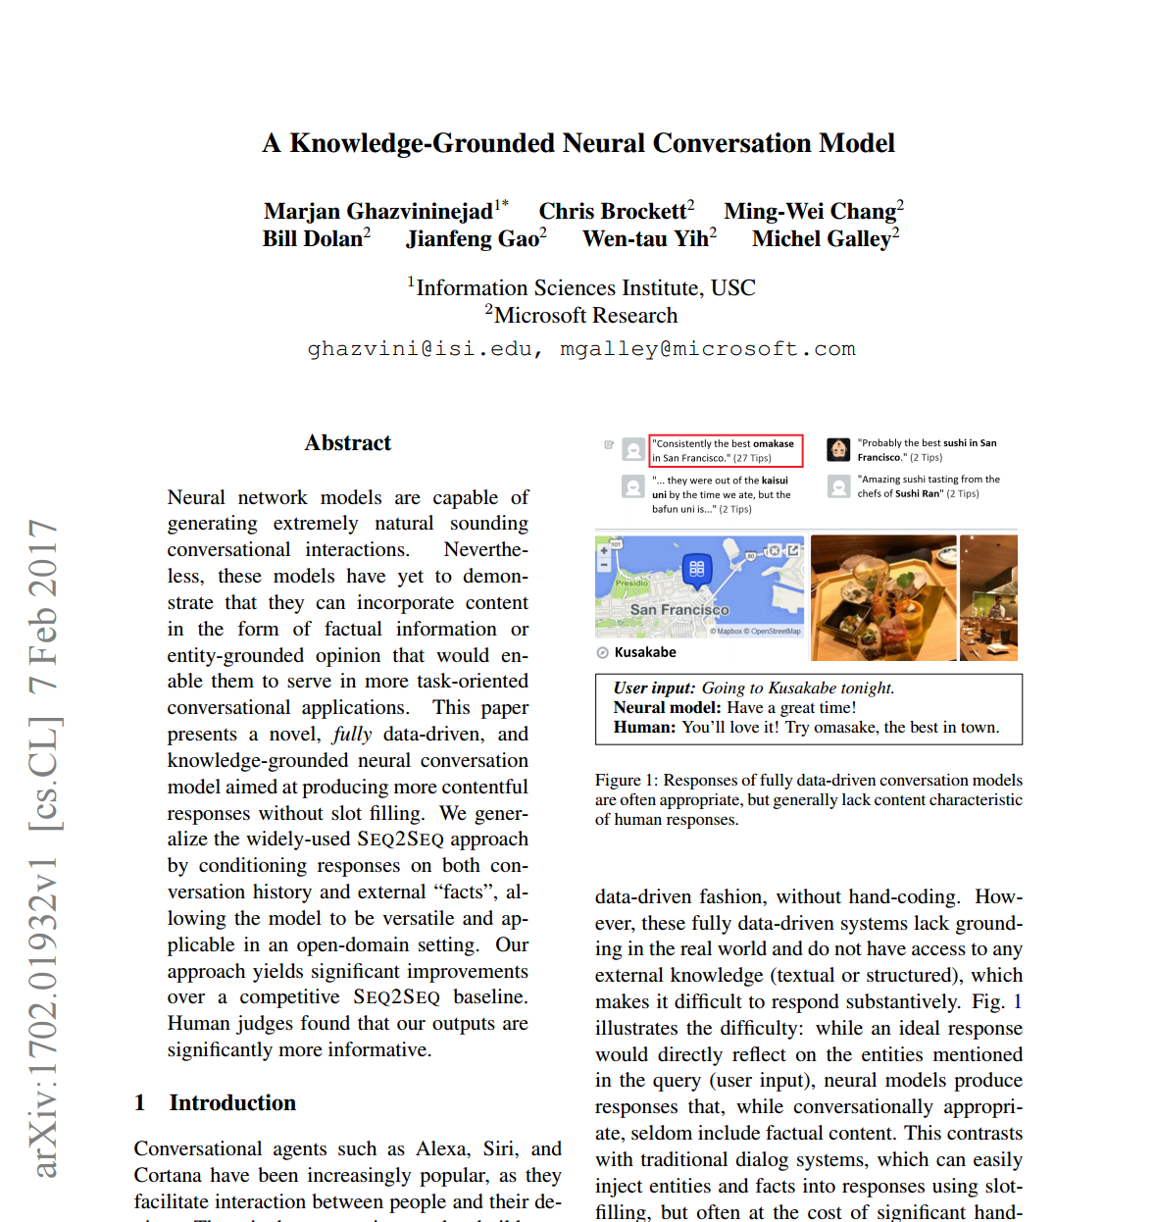
arxiv.org/abs/1702.01932

