Slide 1

We can do better
Momentum and ReLU
Notes:
So far in the course we have set up some fundamental concepts and a theoretical framework regarding the training of artificial neural networks. Along the way we have made a number of choices in terms of their construction and optimization.

Slide 2
Two
Problems
Improvements
Notes:
I will introduce two new improvements for our model.

Slide 3

The Valley Problem
Notes:
Gradient descent invites a very helpful analogy.

Slide 4
The Valley Problem

Slide 5
The Valley Problem
Cost (Person)

Slide 6
The Valley Problem

Slide 7
Zig-Zag Sadness
Notes:
The gradient descent algorithm follows a zig-zag path back and forth across the valley. This can be avoiding with very small steps, but then the learning is very slow.

Slide 8
Momentum-based Stochastic Gradient Descent (SGD)
Notes:
We introduce the concept of momentum

Slide 9
Solution?
Notes:
Is this a solution to the problem?

Slide 10
Solution?
Notes:
No.

Slide 11
Improvement
Notes:
It is an improvement to speed up our learning without giving up on accuracy.

Slide 12
Throwback to
Physics 101
Notes:
Let’s look back at some physics concepts

Slide 13
F=−∇U

Slide 14
force felt by the particle is precisely the (negative) gradient of the
cost function

Slide 15
we need to gradually
slow down our travel down the
cost mountain

Slide 16
let’s be clear
physical momentum
!=
SGD momentum
Notes:
Momentum when it comes to SGD is actually somewhat of a misnomer. SGD momentum does two things:
With Momentum update, the parameter vector will build up velocity in any direction that has consistent gradient.
Momentum acts as a damper, much like friction to counteract the momentum built up by the gravitational force. This helps us “settle” into the valley more quickly.

Slide 17
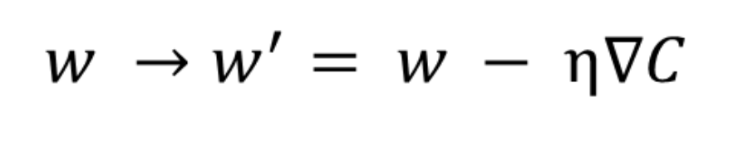
Previous SGD
# Parameter update
w += -learning_rate * dw
Notes:
In regular SGD, we step in the direction of the gradient set by the learning rate eta.

Slide 18
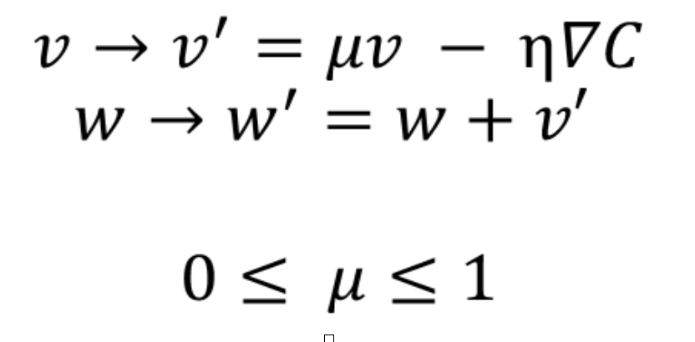
SGD + Momentum
# Momentum update
v = mu * v - learning_rate * dx
x += v
Notes:
In Momentum-based SGD, we step in the direction of the gradient set by the learning rate eta and filter

Slide 19
🔑 Takeaways
Gradient-based SGD improves the learning rate and helps the cost function settle at minima.
Momentum may be a bit of a misnomer, but there is an applicable analogy that connects SGD momentum with Physical momentum: resistance to change.
Notes:
The applicable analogy is that we are keeping track of a weighted sum of all previous updates and putting through a sort of filter (mu). With Momentum update, the parameter vector will build up velocity in any direction that has consistent gradient. Now that we have this weighted sum of the previous vectors, it is hard for any one new gradient to sway the overall update, just like how it is hard for a mouse moving a twice the velocity cannot throw off a truck 1,000 times its weight.

Slide 20
We can improve on Momentum-based SGD
Notes:
Let’s look back at some physics concepts

Slide 21
{Slightly}
Notes:
Let’s look back at some physics concepts

Slide 22
Nesterov Momentum
We already plan on updating w by μ*v before we even need to calculate η*∇C
Remember: w’ = w + v’ = w + (μ*v - η*∇C)
We treat the future approximate position x + μ * v as a “lookahead”
It makes sense to compute the gradient at x + μ * v instead of at the “old/stale” position x.

Slide 23
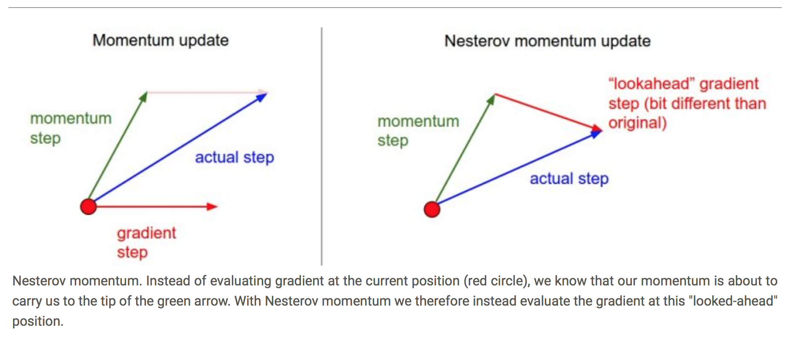
Nesterov Momentum
Notes:
is a slightly different version of the momentum update has recently been gaining popularity. It enjoys stronger theoretical converge guarantees for convex functions and in practice it also consistenly works slightly better than standard momentum.

Slide 24
Why σ? (Recap)
It came first and is still in wide spread use
It is related to softmax, which is used for the output layer for classification (linear output is for regression)
Sigmoid itself is also sometimes used for the output layer
Especially for binary classification and feature detection
The [0,1] range fits with probability interpretations
It is a closer fit to neuron models than is the rectified linear unit (ReLU)
It’s fun to have a crazy looking derivative σ’ = σ(1 – σ)

Slide 25
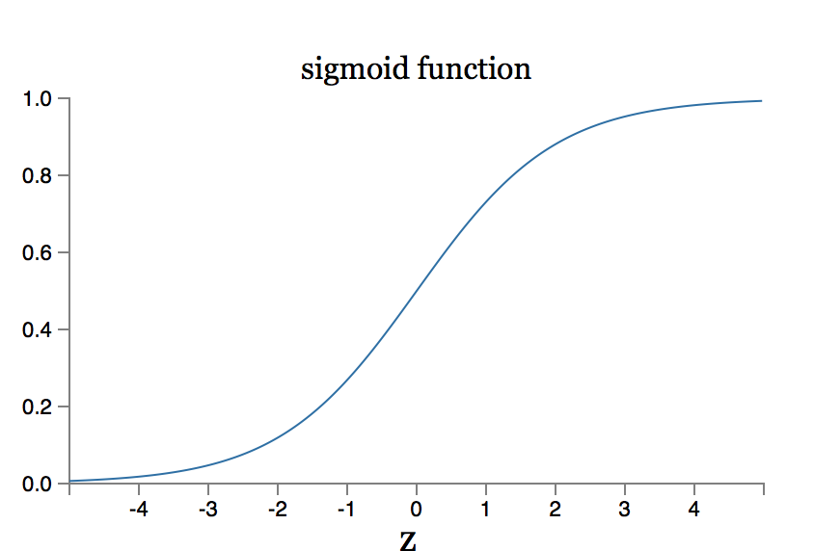
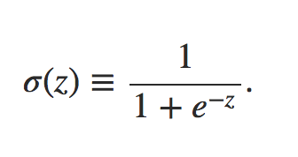

Slide 26
Why not σ?
Sigmoids saturate
and kill gradients

Slide 27
An improvement we have seen already?
We can change our cost function.
Cross-entropy cost
to the rescue!

Slide 28
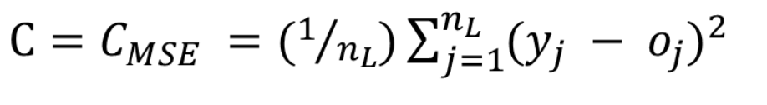
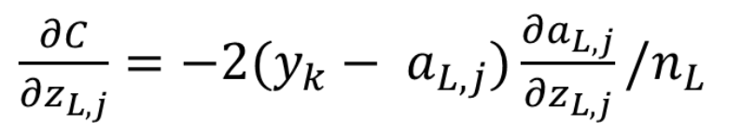
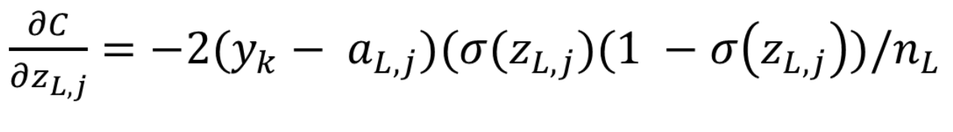
Good ‘ole
Quadratic Cost

Slide 29
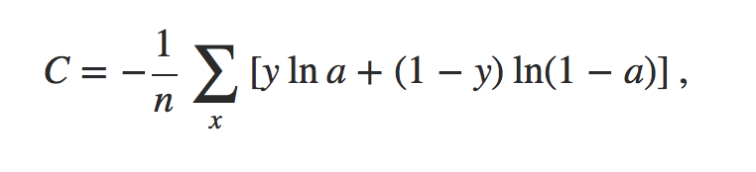
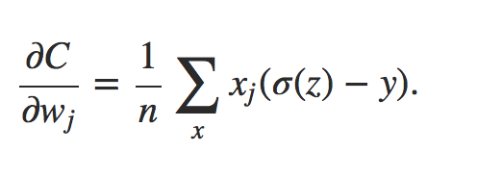
Cross-Entropy Cost

Slide 30
A New Approach
We can try changing our activation function

Slide 31
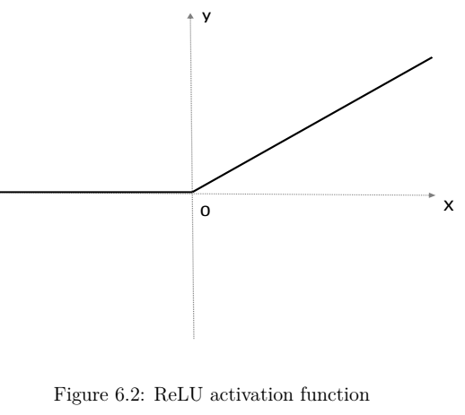
Rectified Linear Unit (ReLU)
f(x) = max(0, x)

