Slide 1
Distilling Knowledge in a Neural Network
Geoffrey Hinton, Oriol Vinyals, Jeff Dean
Google

Slide 2
Gist Format
Quick gist of the paper:
What is the significant result?
How major?
What is the premise?
What are the main prior work?
What are the new methodologies?
What techniques are assumed known?
Questions for selection as a project:
Is the data available?
How much computation?
Can the problem be scaled down?
How much code development?
How much experimentation?
How much will we learn?
How do we prove success?
What are the results of success?

Slide 3
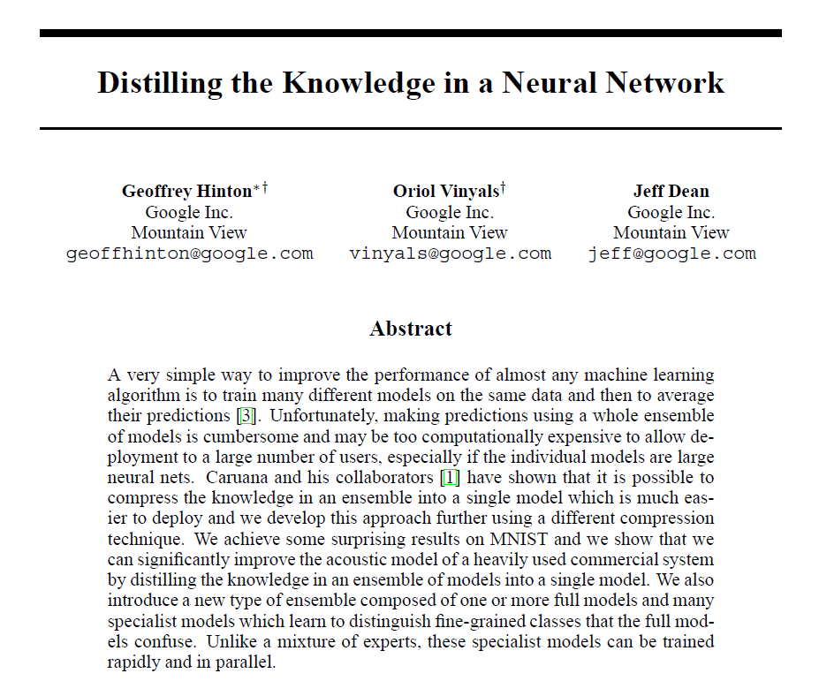
First Look at the Title and the Abstract

Slide 4
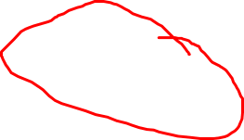
First Look at the Title and the Abstract
This is new.

Slide 5
First Look at the Title and the Abstract
This is new.
This is the premise.

Slide 6
First Look at the Title and the Abstract
Defines distilling.

Slide 7
First Look at the Title and the Abstract
Concise summary of results.

Slide 8

First Look at the Title and the Abstract
Prior work
Notice that we still don’t know anything about how distilling works or how it is different from the prior work.

Slide 9
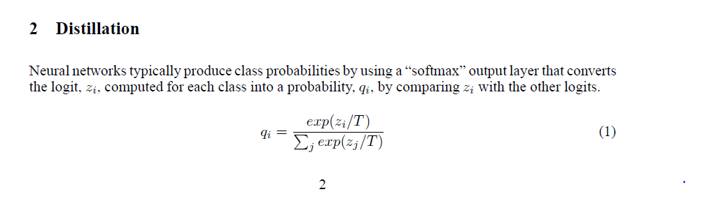
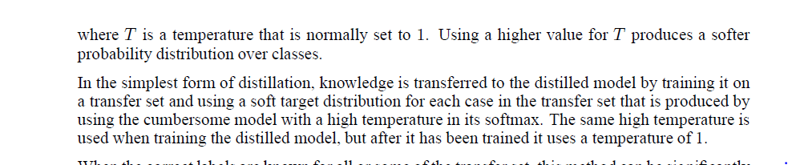

Distillation

Slide 10
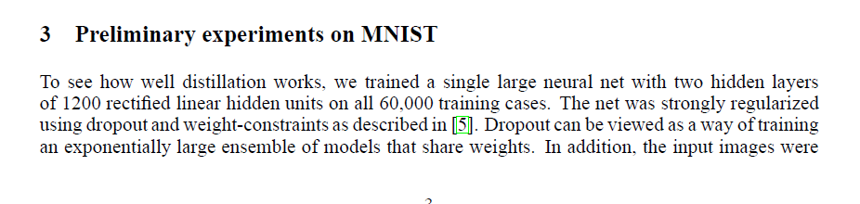
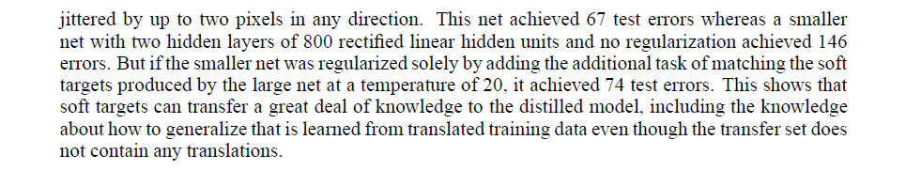

Experiments on MNIST
A previously published technique that you will need to look up.
The important result is the difference between 146 errors and 74 errors as well as how close 74 is to 67.

Slide 11
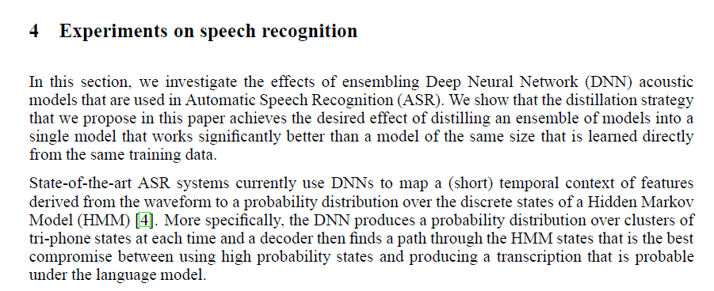
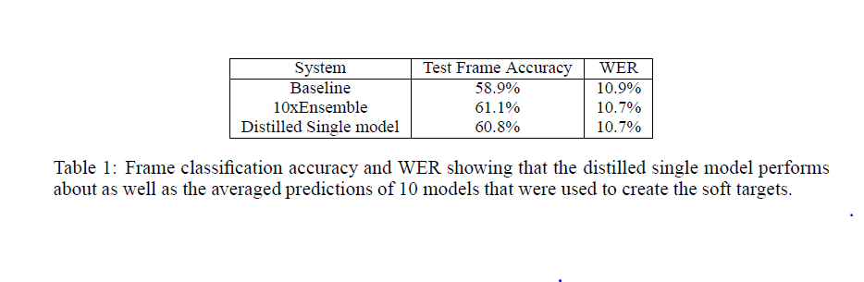
Experiments on Speech Recognition
With distillation, the single network does nearly as well as the ensemble.

Slide 12
Gist
Quick gist of the paper:
What is the significant result? Significant improvement in cost/performance
How major? Significant, but not earth-shaking
What is the premise?
That ensembles or large system with heavy regularization perform significantly better than small systems.
What are the main prior work?
Success of training a single model from an ensemble by Caruana et al.
What are the new methodologies?
Use of softmax with a high temperature as target for transfer training
What techniques are assumed known?
Softmax
Dropout
Transfer learning
Is the paper worth reading? Yes.

Slide 13
Would this make a good project?
Questions for selection as a project:
Is the data available?
Yes for MNIST, unknown for speech data
How much computation?
Small for MNIST, moderate for speech (because only producing phonetic labels and because the signal processing has already been done)
Can the problem be scaled down?
Could use less speech data
How much code development?
Might be possible using existing routines available in Theano
How much experimentation?
Moderate
How much will we learn?
Need to study in detail the parts of the paper we skipped
How do we prove success?
Reproduce the success of distillation on different examples
What are the results of success?
Publishable if we discover a way to further improve the cost/performance
So let’s read the paper more carefully.

Slide 14
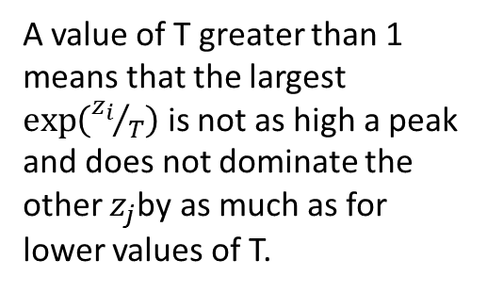
Key Concept: Softmax with a Temperature
T is the “temperature”.
This concept of temperature is not new, but its use for distillation is.
A value of T greater than 1 means that the largest $\exp\left({z_{i}}/T\right)$ is not as high a peak and does not dominate the other $z_{j}$by as much as for lower values of T.

Slide 15
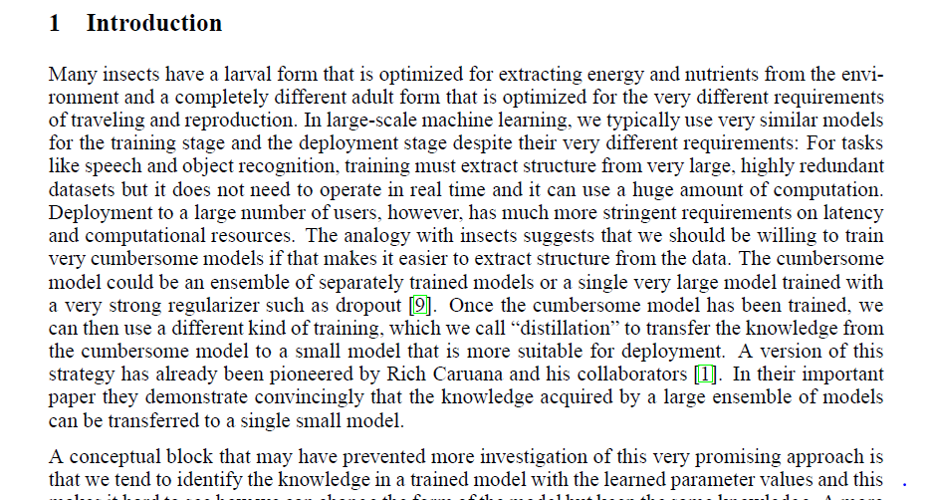
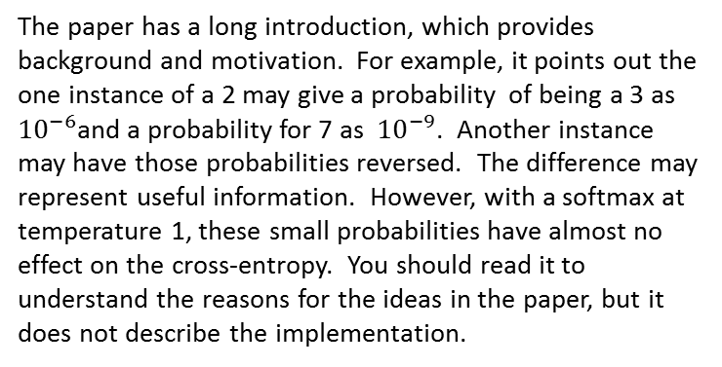
Going through the paper section by section
The paper has a long introduction, which provides background and motivation. For example, it points out the one instance of a 2 may give a probability of being a 3 as ${10}^{−6}$and a probability for 7 as ${10}^{−9}$. Another instance may have those probabilities reversed. The difference may represent useful information. However, with a softmax at temperature 1, these small probabilities have almost no effect on the cross-entropy. You should read it to understand the reasons for the ideas in the paper, but it does not describe the implementation.

Slide 16
2. Distillation
Besides giving the formula for softmax at a temperature and explaining the concept of transfer learning with the softmax at temperature T as the training target for the small network, section 2 also explains a refinement that gives improved performance. The refinement is to take a weighted average of two objective functions. One objective function is the cross entropy with the soft targets, using the same high temperature in the softmax of the distilled model as is used to generate the soft targets. The other objective function is the cross entropy with the correct labels. This cross entropy is computed using the same logits, but with a temperature of 1.

Slide 17
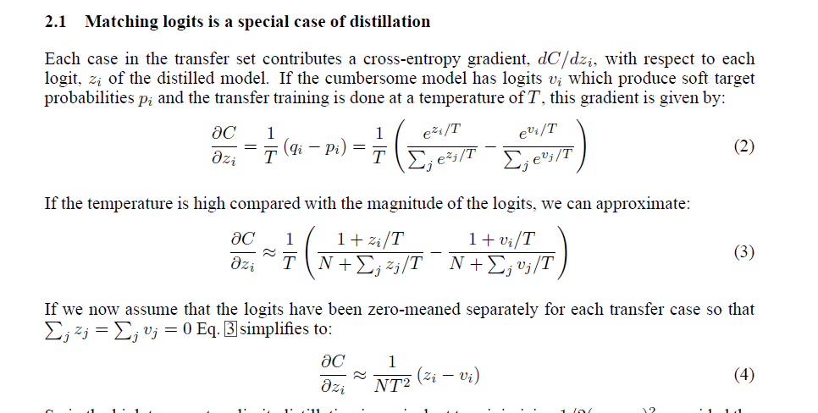
2.1 Matching Logits is a Special Case
The prior work by Caruana et al. did a similar compression of the knowledge of an ensemble into a single model. However, Caruana et al. used a cost function that match logits rather than a softmax at temperature. This section shows that matching logits is a special case of softmax at temperature, in the limit of high temperature.

Slide 18
3 MNIST
Besides the key results we found in the gist, this section gives results of a few additional experiments. There were experiments finding the optimum temperature range for small networks of different sizes. For the smaller networks, temperatures in a limited range worked much better than temperatures outside that range.
In addition, there were experiments in which all instances of the digit 3 were removed from the set of transfer training data. That is, the distilled model had to recognize the digit 3 having seen no examples. There were 133 errors out of a total of 1010 three is the test set, out of a total of 202 errors. However, just by optimizing the bias, the model makes a total of 109 errors or which 14 are on 3s.

Slide 19
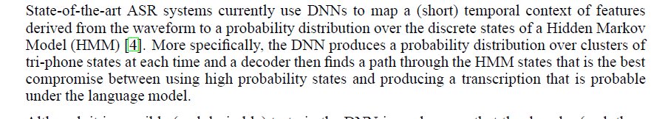
4 Speech Recognition
Although this paper was published a few months after the Baidu DeepSpeech paper, it apparently was written before that paper appeared. Thus, they are assuming a speech recognition system in which the DNN only does a mapping of sequences of acoustic feature vectors to states of a hidden Markov process.
Using a DNN just for the acoustic front end requires much less computation than a complete speech recognition system, making it more practical to replicate the results of this paper.
The experimental results in this section consist of the table we already saw in the gist.

Slide 20
5 Training Ensembles of Specialists 6 Soft Targets as Regularizers
This section of the paper is almost a separate paper. It describes doing classification on a very large dataset using one generalist model and an ensemble of specialist. Each specialist is trained on data that is highly enriched in examples from a very confusable subset of the classes.
Instead of using the distilling method described in the rest of the paper, they describe experiments on how well ensembles of specialist perform. The discuss one way that distilling knowledge from the generalist might help, but merely say “We are currently exploring this approach.”

Slide 21
8 Discussion
The discussion then returns to the main point:
“We have shown that distilling works very well for transferring knowledge from an ensemble or from a large highly regularized model into a smaller, distilled model.”

