Slide 1
Sonar Returns: Data preparation, tuning topology
Brownlee 11
yUQI lIU

Slide 2
Content
Problem Formulation: Sonar Returns
Keras + Theano Implementation
Improvements (Feature Engineering & Parameter Tuning)

Slide 3
Problem Formulation
input
output
Sonar returns
60 strength values
from different angles
Neural Network
M mine
R rock

Slide 4
Problem Formulation
input
output
Sonar returns
60 strength values
from different angles
Neural Network
M mine
R rock
Binary Classification:
X[x0, x1, x2 ... x59] → Y[0, 1]
x0
x1
.
.
.
Y[0, 1]
x58
x59

Slide 5
Keras + Theano + scikit-learn Pyramid
scikit-learn
Keras
Theano/Tensorflow
Wrapper for Keras
Easy grid-search / k-fold evaluation
Wrapper for Theano/Tensorflow,
Easy to create model and structure
Library for machine learning
Optimized numerical computation on the CPU or GPU

Slide 6
Keras + Theano
# baseline model
def create_baseline():
# create model
model = Sequential()
model.add(Dense(60, input_dim=60, init= normal , activation= relu ))
model.add(Dense(1, init= normal , activation= sigmoid ))
# Compile model
model.compile(loss= binary_crossentropy , optimizer= adam , metrics=[ accuracy ])
return model
Define Model.
Add hidden layer.
Add output layer.
Compile model

Slide 7
scikit-learn to evaluation model
# evaluate model with standardized dataset
estimator = KerasClassifier(build_fn=create_baseline, nb_epoch=100, batch_size=5, verbose=0)
kfold = StratifiedKFold(n_splits=10, shuffle=True, random_state=seed)
results = cross_val_score(estimator, X, encoded_Y, cv=kfold)

Slide 8
DATA PREPARATION
# evaluate baseline model with standardized dataset
estimators = [] estimators.append(( standardize , StandardScaler())) estimators.append(( mlp , KerasClassifier(build_fn=create_baseline, nb_epoch=100, batch_size=5, verbose=0)))
pipeline = Pipeline(estimators)
Scale the value to Standardization where mean is 0 and var is 1.
X = (X - X_{mean}) / VAR(X)
Categorical: convert to numerical label
Aggregation / Decomposition: preprocess the data you have
Periodic Variable: convert it to numerical variable such as sin/cos

Slide 9
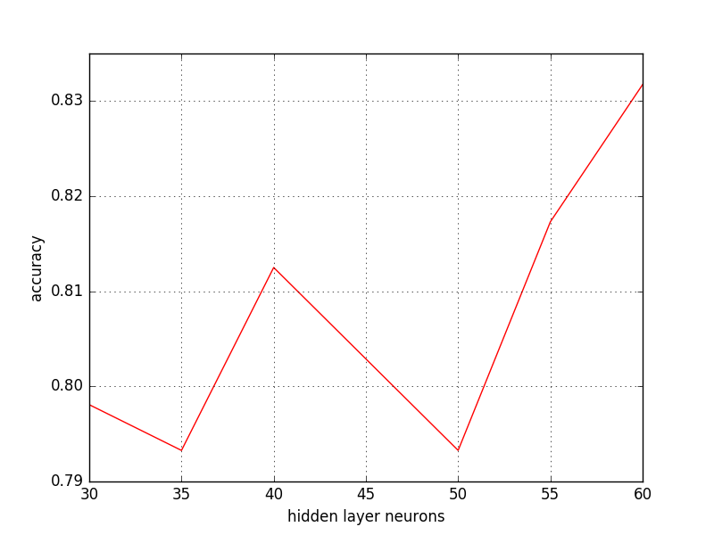
Hyperparameter Tuning
Turn the hyperparameter of the network. The number of layers and the size of neurons.
With standardization:
60 input → [60] → 1 output 84.07%
60 input → [30] → 1 output 84.61%
60 input → [60, 30] → 1 output 86.47%

Slide 10
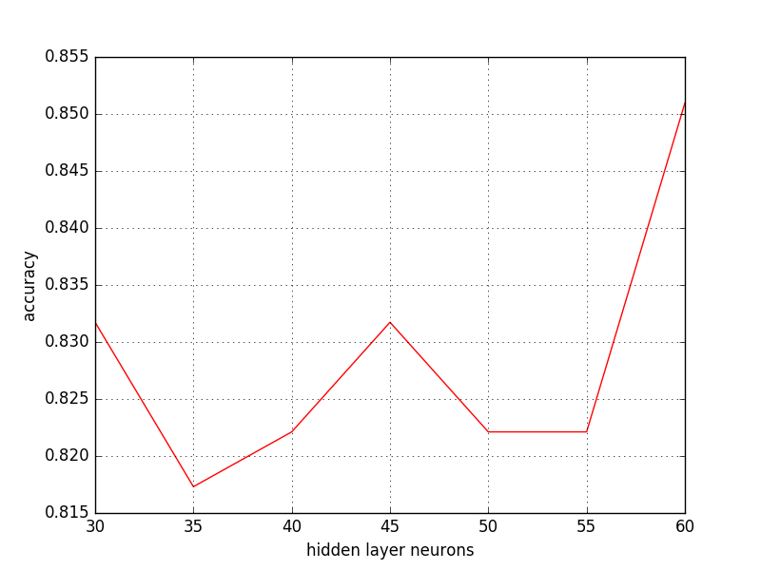
Hyperparameter Tuning
Turn the hyperparameter of the network. The number of layers and the size of neurons.
With standardization:
60 input → [60] → 1 output 84.07%
60 input → [30] → 1 output 84.61%
60 input → [60, 30] → 1 output 86.47%

Slide 11
Takeaway Messages
There are many open-source deep learning library to use!
Theano, TensorFlow, Chainer, Torch, Caffe, cuda-convnet
2. Feature Engineering is important!

