Slide 1
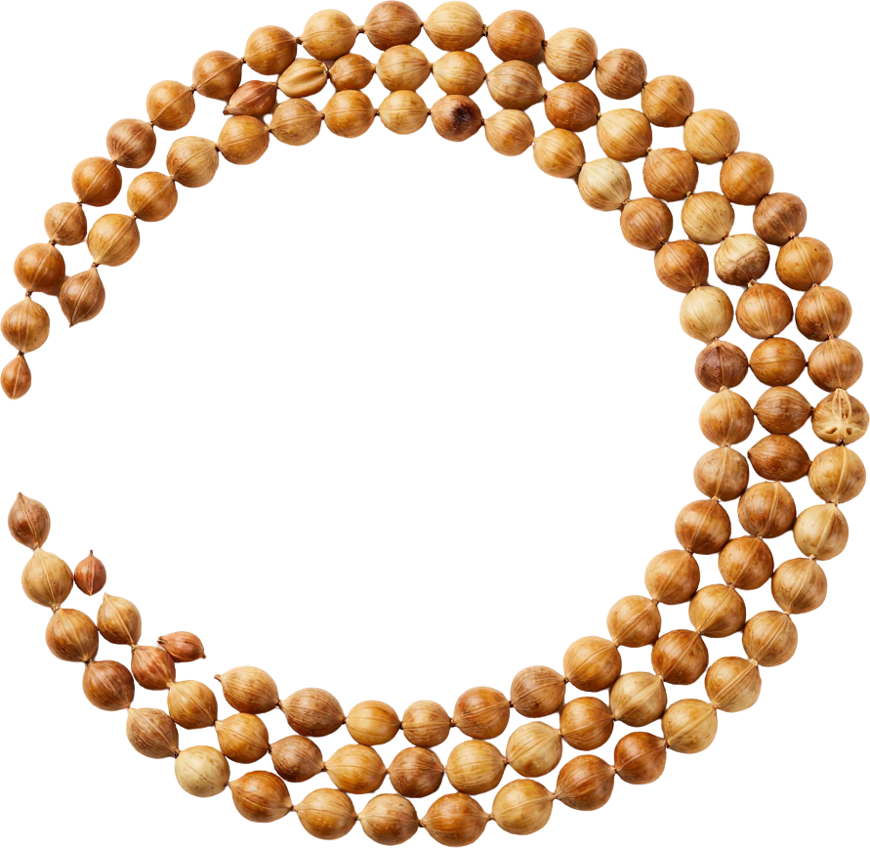

SATTVAMUNCH
ANCIENT GRAIN,
MODERN PALATE
100% Certified Organic.
Plastic-Free. Premium.
Brand Identity Presentation
2026

Slide 2

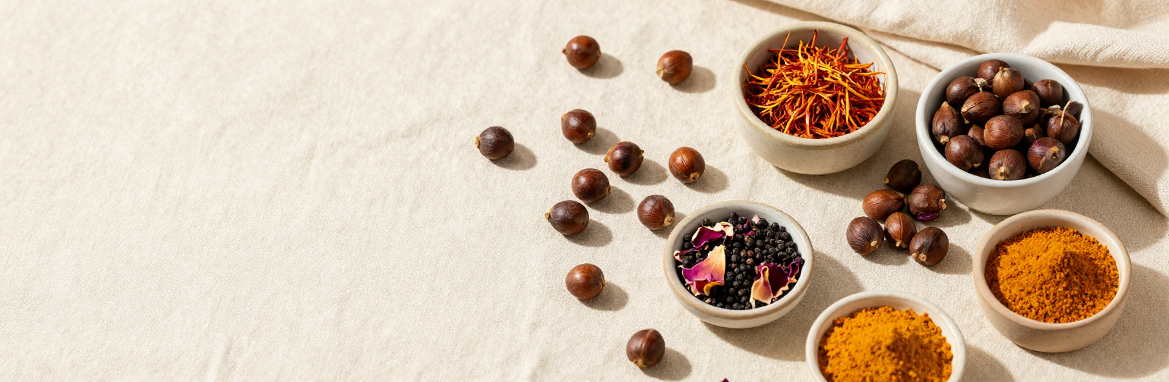

BRAND DNA
100% certified
organic
Plastic-free,
purpose-led
Indian roots,
global flavor culture
Premium honesty &
warm cultural confidence

Slide 3


LOGO CONCEPTS
SATTVAMUNCH
Four distinct routes explore the SattvaMunch identity. Route 01 is a pure editorial wordmark — no icon, refined and globally legible, built to work standalone across any context. Route 02 pairs a seed-origin symbol — a droplet held within concentric rings — with the wordmark, evoking purity and the essence held inside the grain. Route 03 interprets sacred geometry — a modern floral mark rooted in ancient pattern logic, paired with the wordmark for a more ornamental, heritage-forward feel. Route 04 pairs a standalone abstract monogram — a single flame-like "S" form — with the wordmark, designed to represent the brand independent of any one product, built for a house of organic foods rather than a single-SKU identity. Each route maintains generous clear space and reads with equal authority at small and large scales.
SATTVAMUNCH
SATTVAMUNCH
SATTVAMUNCH

Slide 4


COLOR
SYSTEM
Primary Colors
Warm Ivory
Saffron
#F5EFE0
#E8922A
Our palette is rooted in organic warmth and Indian terroir—earthy, honest, and globally refined. Each hue carries a mood and a story.
Flavor Accent Colors
Deep Earth
#3B2314
Smoke & Pepper #4A4A48 · Golden Sesame #C8A84B · Pom Rose #C0445A · Truffle Rosemary #5C6B4E
Each accent maps to a distinct flavor world—grounded, luminous, and culturally resonant.

Slide 5
TYPOGRAPHY
Light
Regular
Bold
Headlines: Canela Display Black
Body Text: Neue Haas Grotesk Regular
Flavor Names: Canela Display Italic
Black
Aa
Letterforms carry a subtle structural nod to Devanagari geometry — warm, editorial, and globally legible without appropriation.

Slide 6
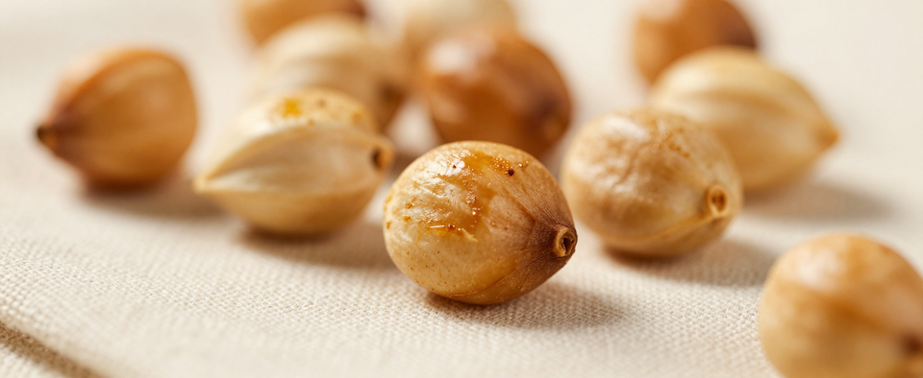

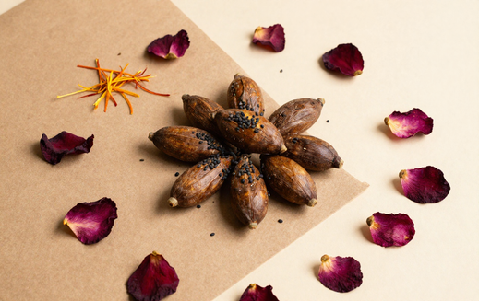
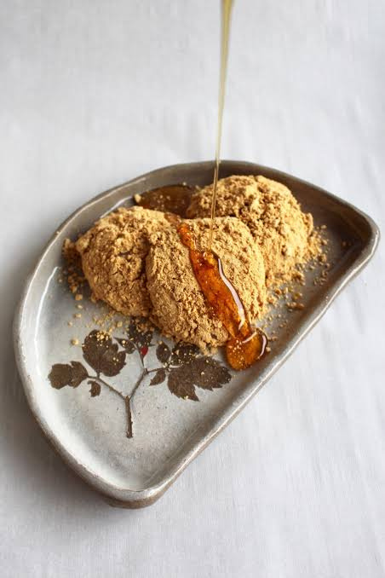
PHOTOGRAPHY DIRECTION
Macro roasted crunch; tactile food texture; warm natural light; real urban lifestyle; origin-inspired tablescapes with India, Japan, Middle East and Italy cues.

Slide 7

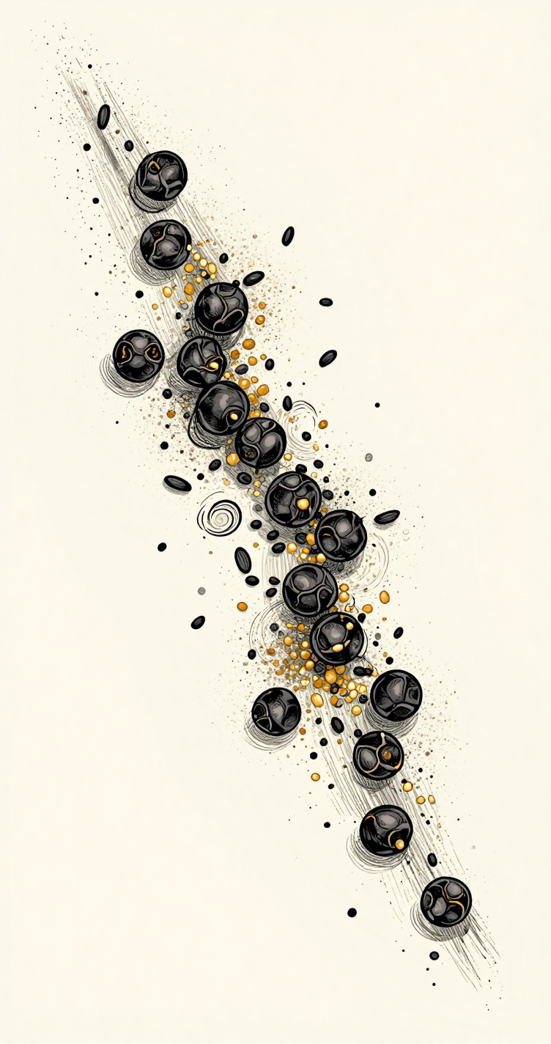
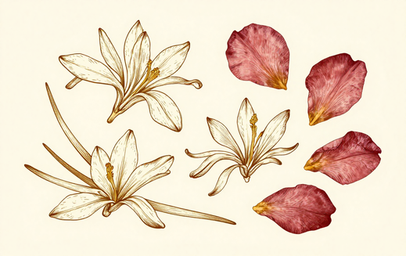
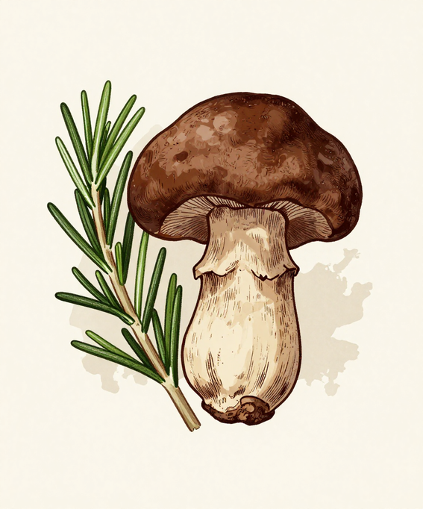
ILLUSTRATION & FLAVOR WORLDS
Fine botanical linework and spice-inspired illustration language. Abstract geographic cues and ingredient-led symbolism — no literal cultural icons. Four distinct flavor worlds, each with its own visual character.

Slide 8
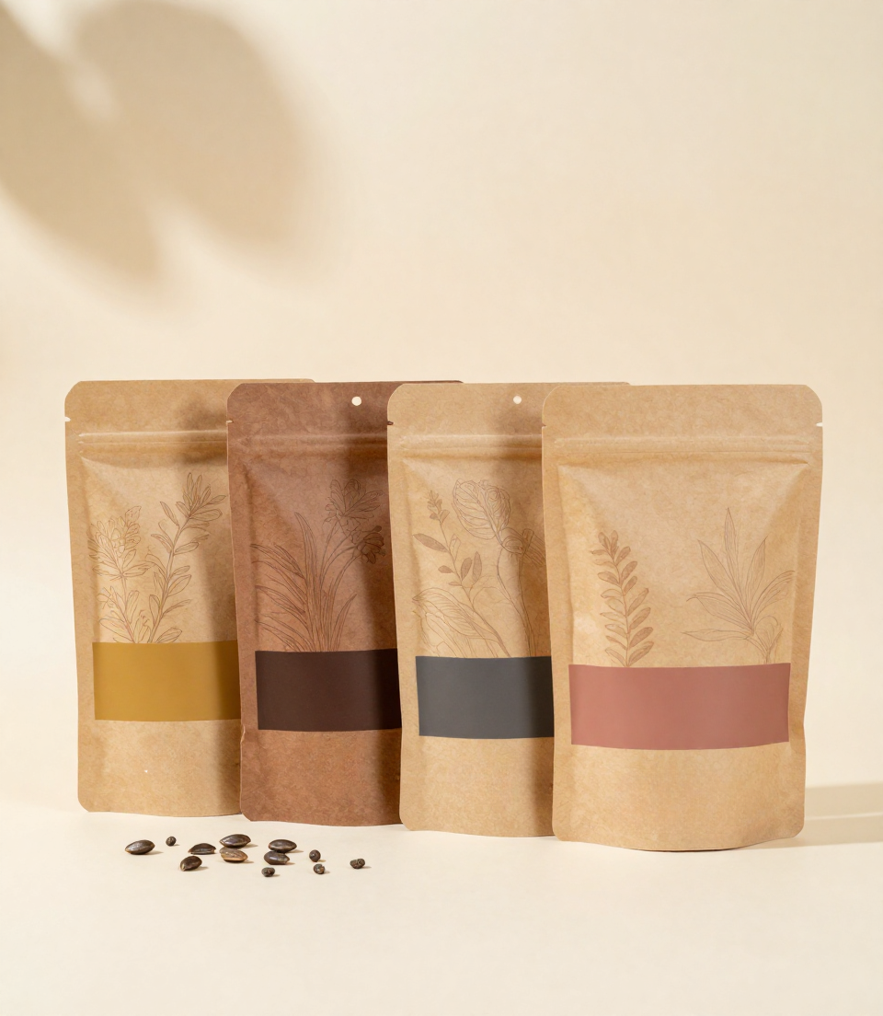

3D PACKAGING
& MATERIALITY
Matte kraft finish with certified-organic material cues
Warm studio light; subtle ingredient suspension
Realistic roasted makhana texture on pack surface
Four-pack flavor lineup mockup in earth tones

Slide 9






ICONOGRAPHY
& TRUST SYSTEM
100% ORGANIC
CERTIFIED
PLASTIC-FREE
PACKAGING
Each icon is drawn on a consistent monoline grid, ensuring visual harmony across packaging, print and digital. Trust callouts remain secondary to flavor — always paired with the brand mark, never competing with it.
HIGH-PROTEIN
SNACK
GLUTEN-FREE
ASSURED

Slide 10




Texture Language
Organic paper grain
Spice dust overlay
Controlled scatter field
Warm linen ground
TEXTURES
& GRAPHIC
DEVICE
Making the identity
recognizable across
every touchpoint.
Signature Motif
Seed/circle orbit
Saffron accent — restrained
Motif construction grid
Scatter with intention

Slide 11
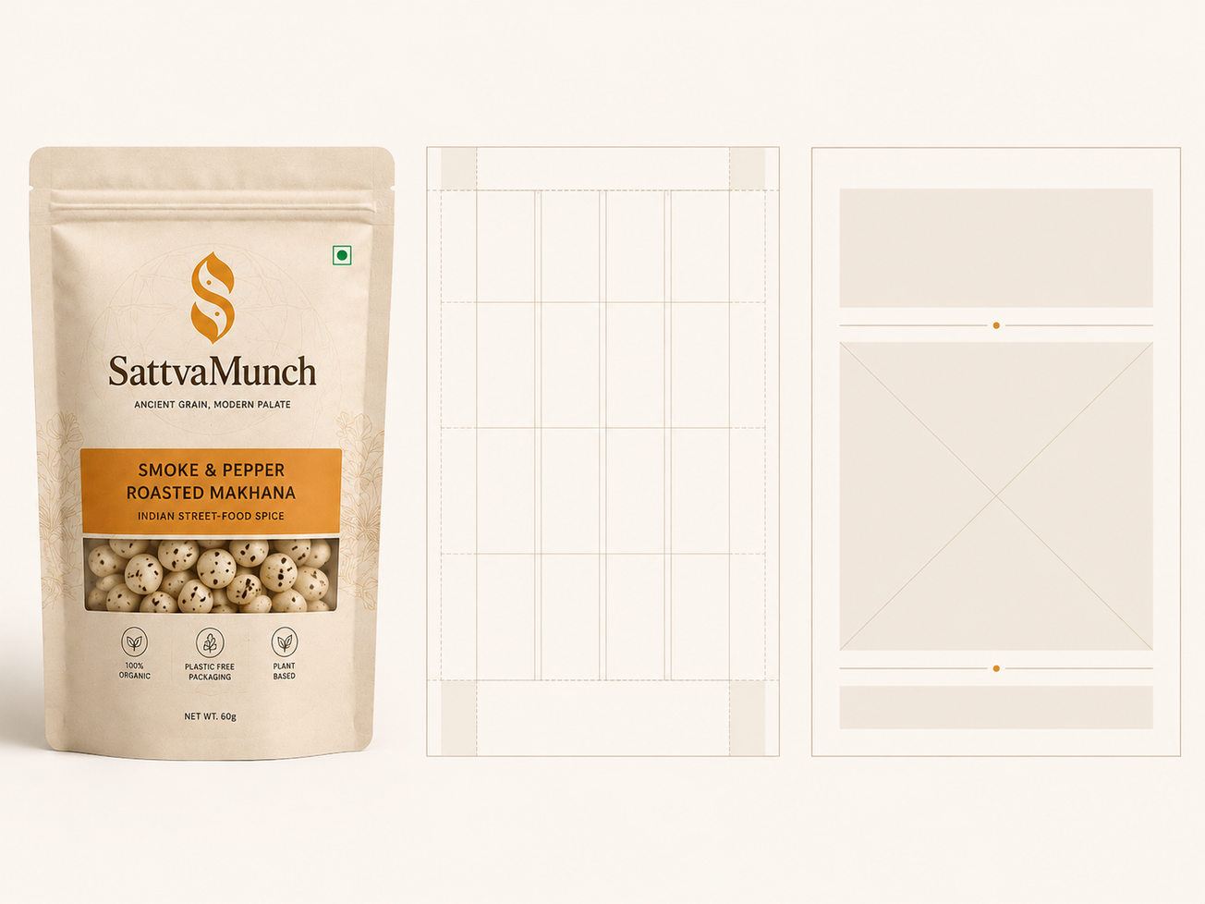


LAYOUT SYSTEM
SATTVAMUNCH
Flavor name leads hierarchy; brand name anchors base; ingredient cue supports story.
Trust callouts remain secondary; generous editorial whitespace throughout all formats.
Modular grid scales across packaging, Instagram post, and print layout applications.
Consistent margins, type scale, and visual rhythm unify every brand touchpoint.

Slide 12
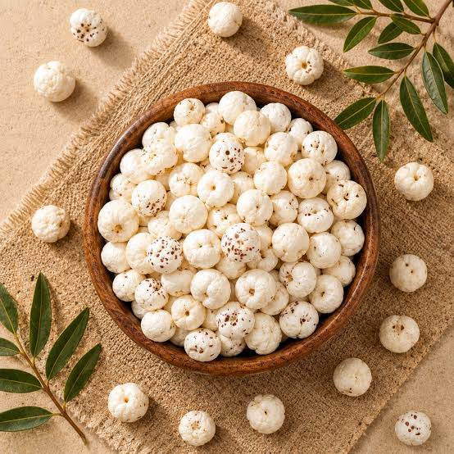
MOTION
LANGUAGE
Unhurried, warm & tactile pacing
Seed journey transitions & parallax
Ingredient drift & restrained kinetic type
Storyboard: India → Japan → Middle East → Italy

Slide 13
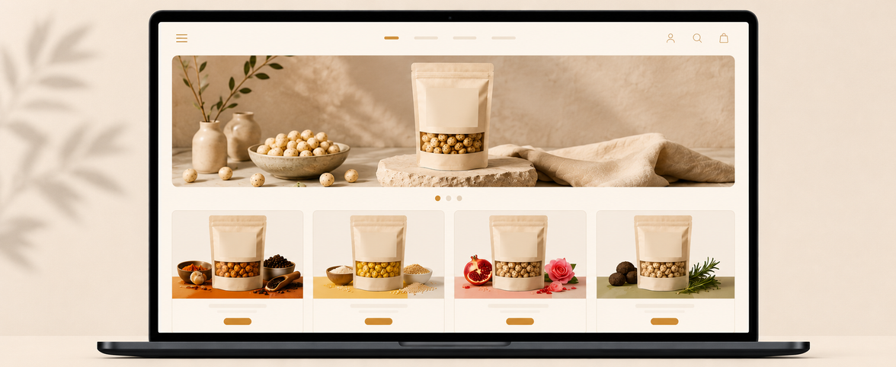
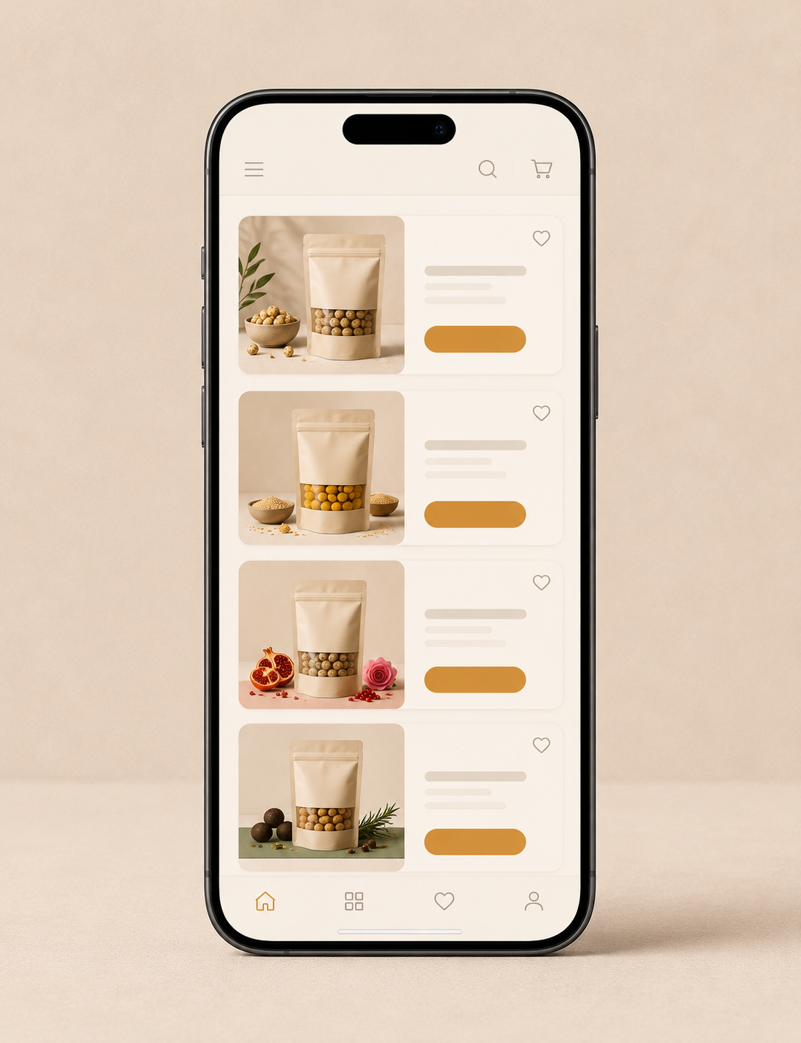
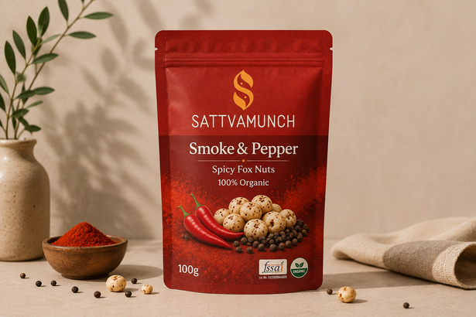
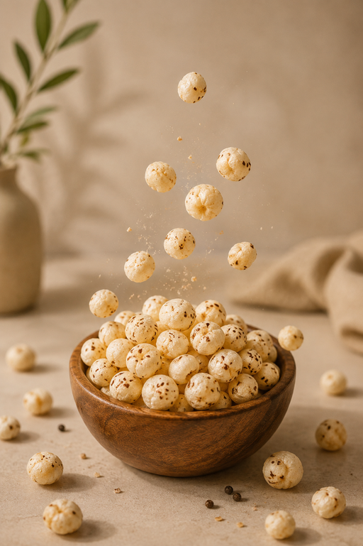
Flavors
Our Story
Organic Promise
Shop
Ancient grain, modern palate
SATTVAMUNCH
Smoke & Pepper
Golden Sesame
Pom Rose
Truffle Rosemary
Smoke & Pepper
Smoke & Pepper
Shop Now
Shop Now
Shop Now
Shop Now
Smoked paprika, black pepper & amchur — bold Indian street-food heat.
Add to Cart
UI DESIGN
LANGUAGE
Golden Sesame
Golden Sesame
Roasted kinako, jaggery & matcha — toasty, gently sweet.
Add to Cart
Pom Rose
Pom Rose
Anardana, sumac & rose petals — sharp, floral, unmistakably tangy.
Add to Cart
Translate identity into a premium digital experience.
Soft-corner buttons; warm ivory canvas; earth-tone typography; flavor accent states; generous spacing; editorial image crops; tactile hover & micro-motion cues.
Truffle Rosemary
Truffle Rosemary
Black truffle salt, roasted garlic & rosemary — quiet, earthy luxury.
Add to Cart

Slide 14


SATTVAMUNCH
COMPLETE BRAND SYSTEM
SattvaMunch should feel like discovering something ancient made newly relevant: warm paper, roasted aroma, crisp texture, restrained Indian character and a passport of global flavour. Purity without clinical. Heritage without traditionalist. Premium without precious.
Art Direction Summary:
SattvaMunch Brand System — v1.0

