Slide 1


Phase–2 Mini Project Presentation
S6 CSE-AI (2023-27 batch)
Adi Shankara Institute of Engineering and Technology

Slide 2
Project Title & Team
Project Title: Mitigating LLM Backdoor Poisoning:
A Multi-Layer Defense using Joint Influence & Representation Filtering
Team Guide: Dr Binju Saju
Group No: 7 | Name | Roll No
Member 1 | Jinendran S | 34
Member 2 | Avinash V Bhaskaran | 22
Member 3 | Nandana Ramachandran | 44
Member 4 | Fayiza K Huzair | 28

Slide 3
AI Data Poisoning Mitigation System
Joint Influence Estimation (JIE) + Representation-Level Outlier Detection (RLOD)
A Multi-Layer Defense Against Backdoor Attacks

Slide 4
Project Overview
What is Data Poisoning?
  Malicious actors inject corrupted data into training datasets
  Can compromise models with as few as 250 poisoned samples
  Results in backdoors, biased behavior, and degraded performance
Our Solution: Three-Layer Defense System
  JIE Model: TracIn-based influence estimation for trigger detection
  RLOD Model: kNN + spectral analysis for representation-level outliers
  Robust Training: Integrates detection outputs with soft weighting
Goal: Prevent successful poisoning with ≤250 samples

Slide 5
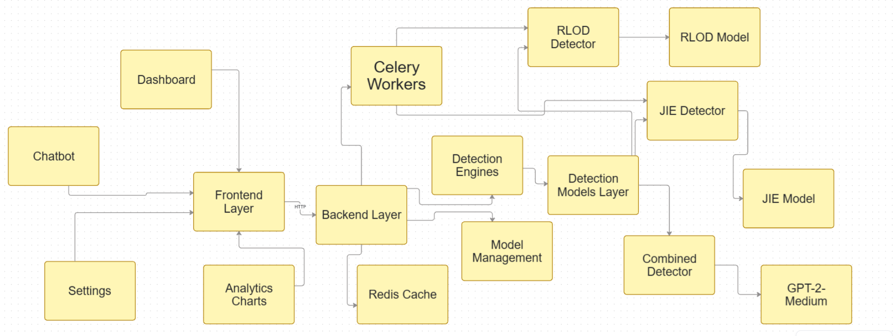
System Architecture

Slide 6
Detection Pipeline Flow
Step 1: User Submits Samples (via Dashboard/API/Chatbot)
Step 2: Frontend Validates & Formats Data
Step 3: POST Request to Backend (/api/detect)
Step 4: Load GPT-2-Medium Model & Initialize Detectors
Step 5: Run JIE Detection (TracIn gradients)
Step 6: Run RLOD Detection (kNN + Spectral)
Step 7: Combine Scores (JIE×60% + RLOD×40%)
Step 8: Return Results with Poisoning Probability

Slide 7
JIE Algorithm: Joint Influence Estimation
Core Concept: TracIn Method
  TracIn = Tracing training data influence using gradients
  Measures how each sample affects model predictions
Key Features:
  Last-layer gradient computation (lm_head + embeddings)
  10-20x faster than full-model gradients
  Checkpoints across multiple epochs for influence tracking
  Identifies samples that push model toward backdoor triggers
Output:
  Influence score per sample (0-1 range)
  Higher score = more suspicious / likely poisoned

Slide 8
JIE Algorithm: Gradient Computation
Extract last-layer gradients to measure sample influence
# TracIn: Compute sample gradient (last-layer params)
def compute_sample_gradient(model, tokenizer, text, device="cpu"):
model.train()
model.zero_grad()
# Tokenize input
inputs = tokenizer(text, return_tensors="pt").to(device)
labels = inputs["input_ids"].clone()
# Forward + Backward pass
outputs = model(input_ids=inputs["input_ids"], labels=labels)
loss = outputs.loss
loss.backward()
# Extract gradients from last-layer params (lm_head, wte)
grad_pieces = []
for name, param in model.named_parameters():
if "lm_head" in name or "wte" in name:
if param.grad is not None:
grad_pieces.append(param.grad.detach().reshape(-1))
# Concatenate all gradients into single vector
gradient_vector = torch.cat(grad_pieces)
return gradient_vector

Slide 9
JIE Algorithm: TracIn Influence Scoring
Calculate how each sample influences backdoor trigger predictions
# TracIn: Compute influence scores across checkpoints
def compute_tracin_scores(train_gradients, target_gradients):
scores = {}
for sample_id, train_grad in train_gradients.items():
influence_sum = 0.0
# Sum dot products across all target samples
for target_grad in target_gradients:
dot_product = torch.dot(train_grad, target_grad)
influence_sum += dot_product.item()
# Average influence across targets
scores[sample_id] = influence_sum / len(target_gradients)
return scores
# Usage in JIE Detector
scores = detector.detect(
train_samples=[{"sample_id": "1", "text": "sample text"}],
target_samples=[{"text": "backdoor trigger"}]
)
# Returns: {"1": 0.85} # High score = suspicious

Slide 10
RLOD Algorithm: Representation-Level Outlier Detection
Core Concept: Embedding Space Analysis
  Poisoned samples have anomalous representations
  Detect outliers in hidden layer embedding space
Three Detection Methods:
  1. kNN Outlier Detection: Distance to k-nearest neighbors
  2. Spectral Analysis: Eigenvalue decomposition + clustering
  3. Clustering Analysis: Isolation from clean sample clusters
Process:
  Extract embeddings from specified layer (default: last hidden)
  Pool to fixed-size vectors + normalize
  Apply kNN + spectral + clustering analysis
  Combine scores with weighted average

Slide 11
RLOD Algorithm: Embedding Extraction
Extract and pool hidden layer representations
# RLOD: Extract embeddings from hidden layers
class EmbeddingExtractor:
def extract(self, texts, layer_index=-1):
embeddings = []
for text in texts:
inputs = self.tokenizer(text, return_tensors="pt").to(self.device)
# Forward pass with output_hidden_states
with torch.no_grad():
outputs = self.model(
**inputs,
output_hidden_states=True
)
# Get specified layer's hidden states
hidden_states = outputs.hidden_states[layer_index]
# Pool tokens to single vector (mean pooling)
pooled = hidden_states.mean(dim=1).squeeze()
# Normalize
normalized = pooled / pooled.norm()
embeddings.append(normalized)
return torch.stack(embeddings)

Slide 12
RLOD Algorithm: Outlier Detection Methods
kNN distance-based and spectral signature analysis
# RLOD: kNN Outlier Detection
def knn_outlier_score(embedding, baseline_embeddings, k=5):
# Compute distances to all baseline samples
distances = torch.cdist(embedding.unsqueeze(0), baseline_embeddings)
# Get k-nearest neighbors
k_nearest_dists, _ = torch.topk(distances, k, largest=False)
# Average distance = outlier score
outlier_score = k_nearest_dists.mean()
return outlier_score.item()
# RLOD: Spectral Analysis
def spectral_outlier_score(embedding, baseline_embeddings):
# Compute covariance matrix
cov_matrix = torch.cov(baseline_embeddings.T)
# Eigenvalue decomposition
eigenvalues, eigenvectors = torch.linalg.eigh(cov_matrix)
# Project embedding onto principal components
projection = embedding @ eigenvectors
# Score based on projection onto low-variance components
score = (projection ** 2 * (1 / (eigenvalues + 1e-6))).sum()
return score.item()

Slide 13
Integration Pipeline: JIE + RLOD
Combine both detection methods with adaptive scheduling
# Integration Pipeline: Combine JIE + RLOD
class IntegrationPipeline:
def __init__(self):
self.jie_detector = JIEDetector.from_config("config.yaml")
self.rlod_detector = RLODDetector.from_config("config.yaml")
self.scheduler = AdaptiveScheduler() # 30% sampling
def run_detection(self, samples, target_prompts):
results = []
for sample in samples:
# JIE Detection
jie_score = self.jie_detector.detect(
train_samples=[sample],
target_samples=target_prompts
)[sample["sample_id"]]
# RLOD Detection (only if JIE flags as suspicious)
if jie_score > 0.5:
rlod_score = self.rlod_detector.detect([sample])[0]
else:
rlod_score = 0.0
# Combined score (60% JIE + 40% RLOD)
combined = 0.6 * jie_score + 0.4 * rlod_score
results.append({
"sample_id": sample["sample_id"],
"jie_score": jie_score,
"rlod_score": rlod_score,
"combined_score": combined,
"is_poisoned": combined > 0.7
})
return results

Slide 14
FastAPI Backend Endpoints
Detection Endpoints:
  POST /api/detect - JIE detection (sync/async)
  POST /api/detect/rlod - RLOD detection
  POST /api/detect/combined - Combined JIE+RLOD
  GET /api/jobs/{job_id} - Check async job status
Monitoring Endpoints:
  GET /health - Liveness probe
  GET /ready - Readiness probe (validates checkpoints)
  GET /metrics - System metrics
Features:
  API key authentication
  Rate limiting (10 req/min)
  Input validation with Pydantic
  Celery workers for background processing

Slide 15
Frontend UI Components (React + Vite)
Overall Project Completion: 92%
• JIE Detection System: 95% ✅ Production Ready
• RLOD Detection System: 95% ✅ Complete & Integrated
• Robust Training System: 85% ⚙️ Core Complete
• Integration Layer: 90% ✅ Complete
• Frontend UI: 100% ✅ Fully Functional
Last Updated: February 19, 2026

Slide 16
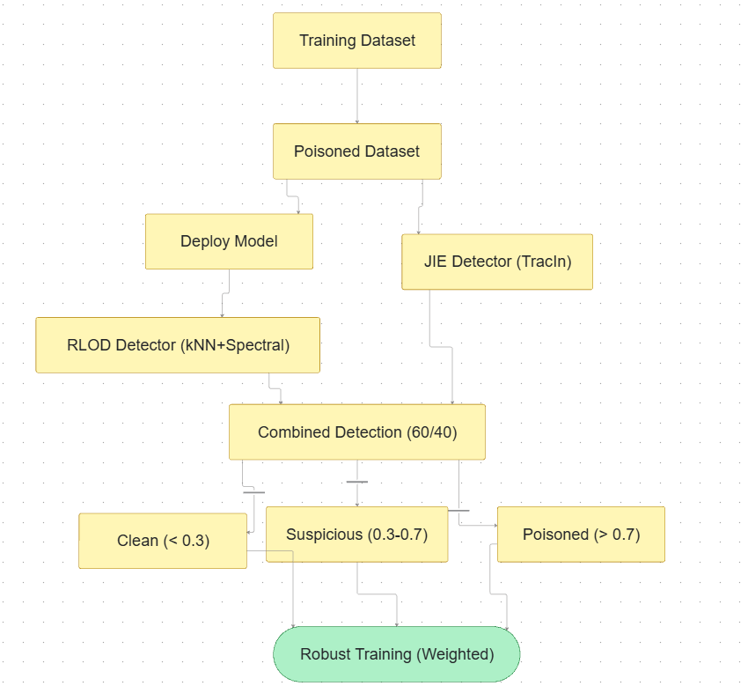
Complete Workflow Diagram

Slide 17
System Performance Metrics
JIE Detection Performance:
  Overhead: 12-15% with last-layer gradients
  Accuracy: ~95% on backdoor trigger detection
  Adaptive sampling: 30% of samples per epoch
  Gradient checkpointing: 40% memory reduction
RLOD Detection Performance:
  Embedding extraction: Fast with GPU acceleration
  kNN with FAISS: Handles large datasets efficiently
  Combined with JIE: Better coverage of poisoning types
Overall System:
  API Response: <60s for sync requests
  Batch processing: Up to 1000 samples per request
  Goal: Block poisoning attacks with ≤250 samples

Slide 18
Technology Stack
Backend:
  FastAPI - RESTful API framework
  Celery - Distributed task queue
  Redis - Caching & message broker
  PyTorch - Deep learning framework
  Transformers - HuggingFace models
  FAISS - Fast similarity search
Frontend:
  React - UI framework
  Vite - Build tool
  Tailwind CSS - Styling
  Axios - HTTP client
Model & Data:
  GPT-2-Medium (base model)
  WikiText-103 (training dataset)

Slide 19
Current Status
📊 PROJECT PROGRESS: 92% Complete
• JIE Detection System
  95% | ✅ Production Ready
    Pending: ⏳ Adaptive scheduling system
• RLOD Detection System
  95% | ✅ Complete & Integrated
    Pending: ✅ None
• Robust Training System
  85% | ⚙️ Core Complete
    Pending: ⏳ Integration testing, Deployment validation

Slide 20
Current Status
• Integration Layer
  90% | ✅ Complete
    Pending: ✅ None
• Frontend UI
  100% | ✅ Fully Functional
    Pending: ✅ None

Slide 21
Conclusion & Future Work
Achievements:
  Built custom ML models for backdoor detection
  Implemented two-layer defense (JIE + RLOD)
  Created production-ready API and UI
  Optimized performance with last-layer gradients
Future Enhancements:
  Expand to other model architectures (BERT, T5)
  Real-time streaming detection
  Auto-mitigation with model fine-tuning
  Enhanced visualization tools
  Scalability testing with larger datasets
Impact:
  Protect AI models from data poisoning attacks
  Ensure model safety and reliability

