Slide 1
Unet-based Model for Lung CT Image Segmentation
By:
Jingjing Gao

Slide 2
Agenda
Background
Segmentation process
Methods
Data preparation
Model training
Model evaluation
Results
Discussion

Slide 3
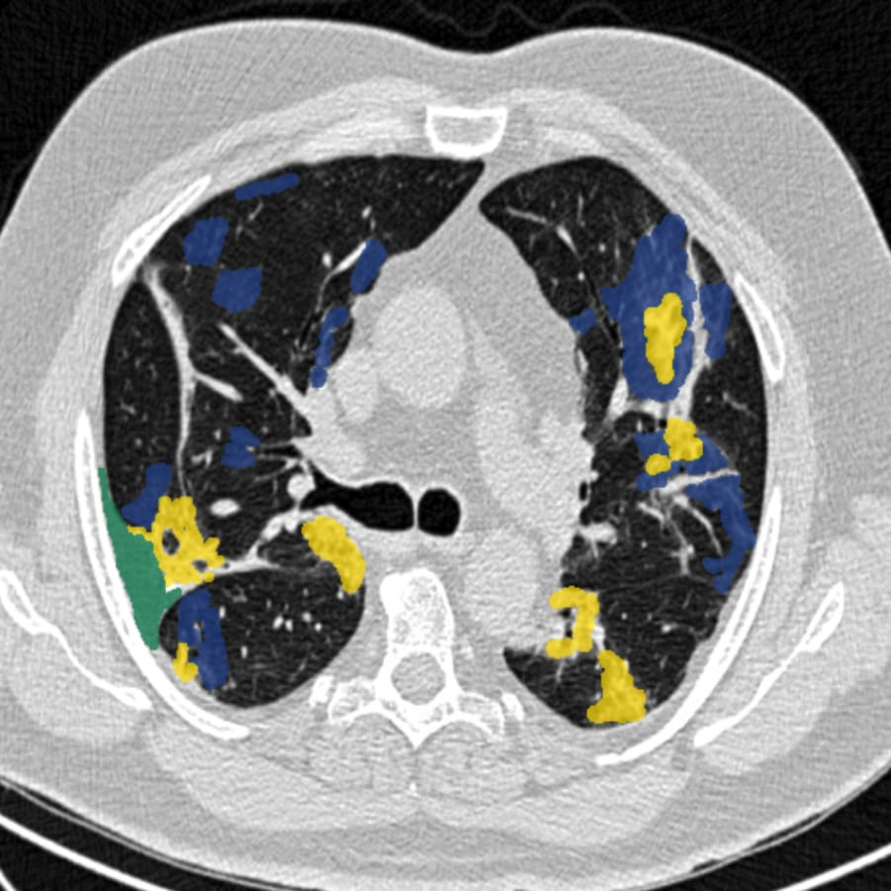
Background
Lung segmentation in CT images
Diagnosing respiratory conditions
Isolate lung regions from surrounding structures
Manual segmentation – time consuming and subjective
Machine learning techniques

Slide 4
Segmentation Process
Loading the Dataset
Preprocessing the data
Data Splitting
Model Creation(U-Net)
Model Training
Model Evaluation

Slide 5
Data Preparation
Dataset Description:
1685 2D slice images and segmentations of 12 patients
Preprocessing Steps:
Convert DICOM images to NumPy arrays
Convert both images and segmentations to PyTorch tensors
Dataset Division:
training (2/3) and test datasets (1/3)

Slide 6
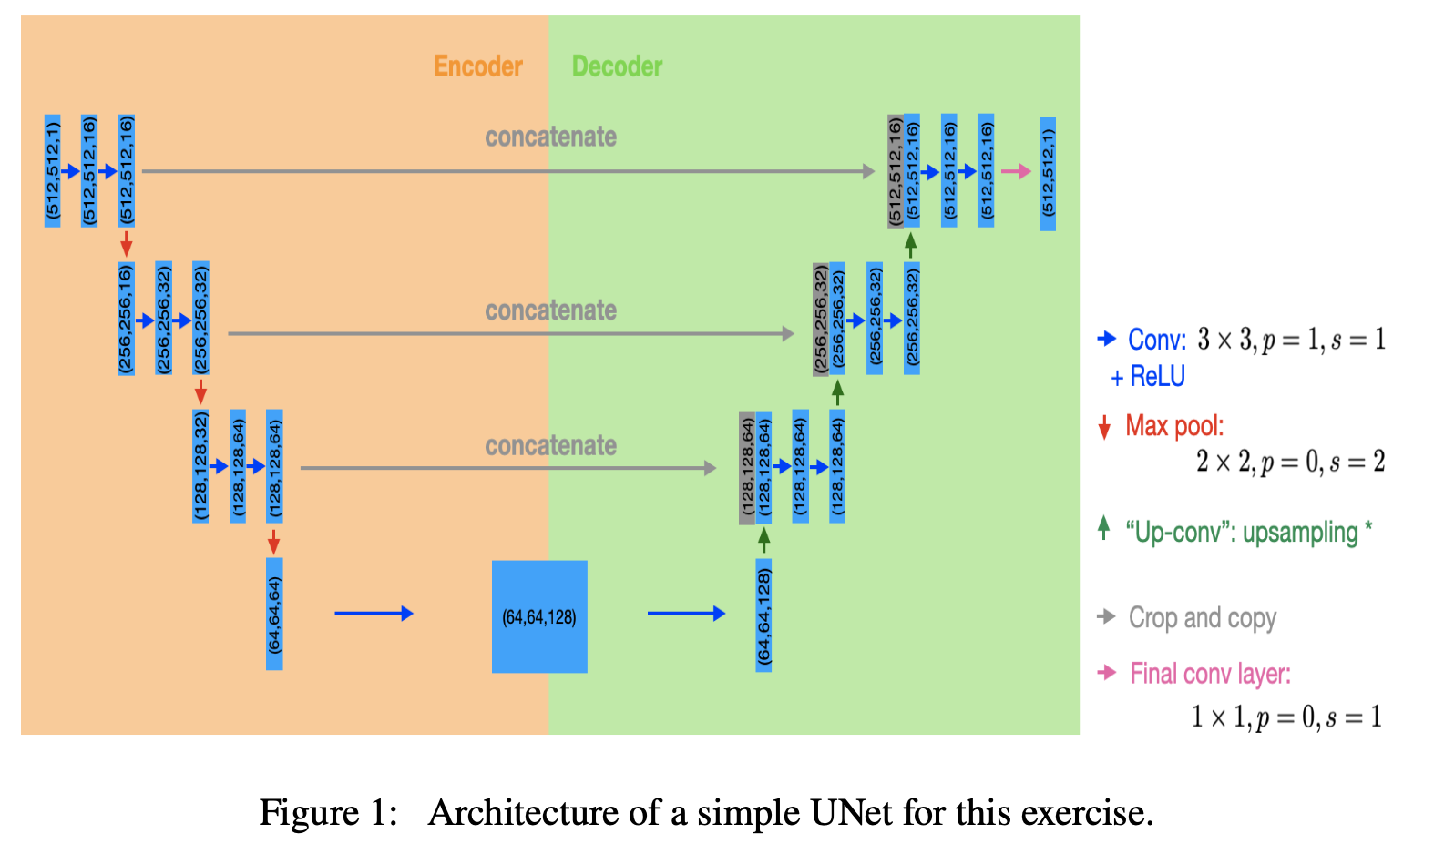
Model Training-UNet Architecture
U-shaped Architecture:
localisation and context information
Skip Connections:
directly pass information from early layers to later layers.
Encoder:
repeated convolutions followed by downsampling operations.
extracts features
reduces the spatial dimensions
Decoder:
upsampling operations followed by convolutions
increases spatial dimensions
refines segmentation predictions using skip connections
Final Layer

Slide 7
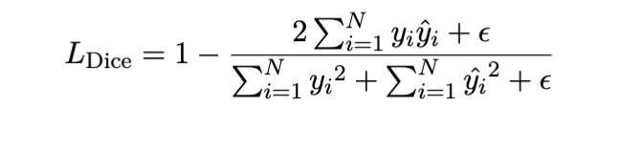
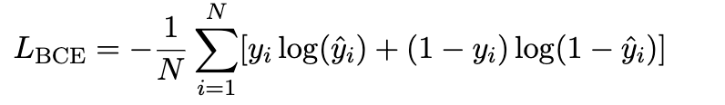
Model Training
Model initializition: simple UNet
Data loading
Optimization: adam
Training loop: 10 epochs, batch size = 3
Forward pass and loss calculation: binary cross entropy and soft dice loss
Backward pass and parameter update
Metric calculation: Binary accuracy
Model saving
CEL :
pixel-wise classification accuracy
penalize misclassifications at the pixel level
SDL :
evaluate the spatial overlap
capture the shapes and boundaries of objects in the image.

Slide 8
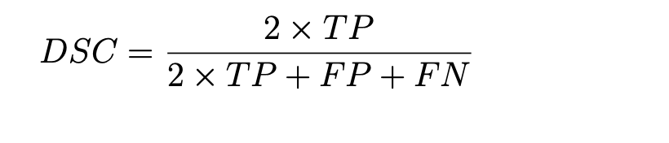
Model Evaluation
Load trained model
Load test dataset
Calculate binary accuracy
Compare the prediction to the ground truth segmentations: Dice Similarity Coefficient (DSC)

Slide 9
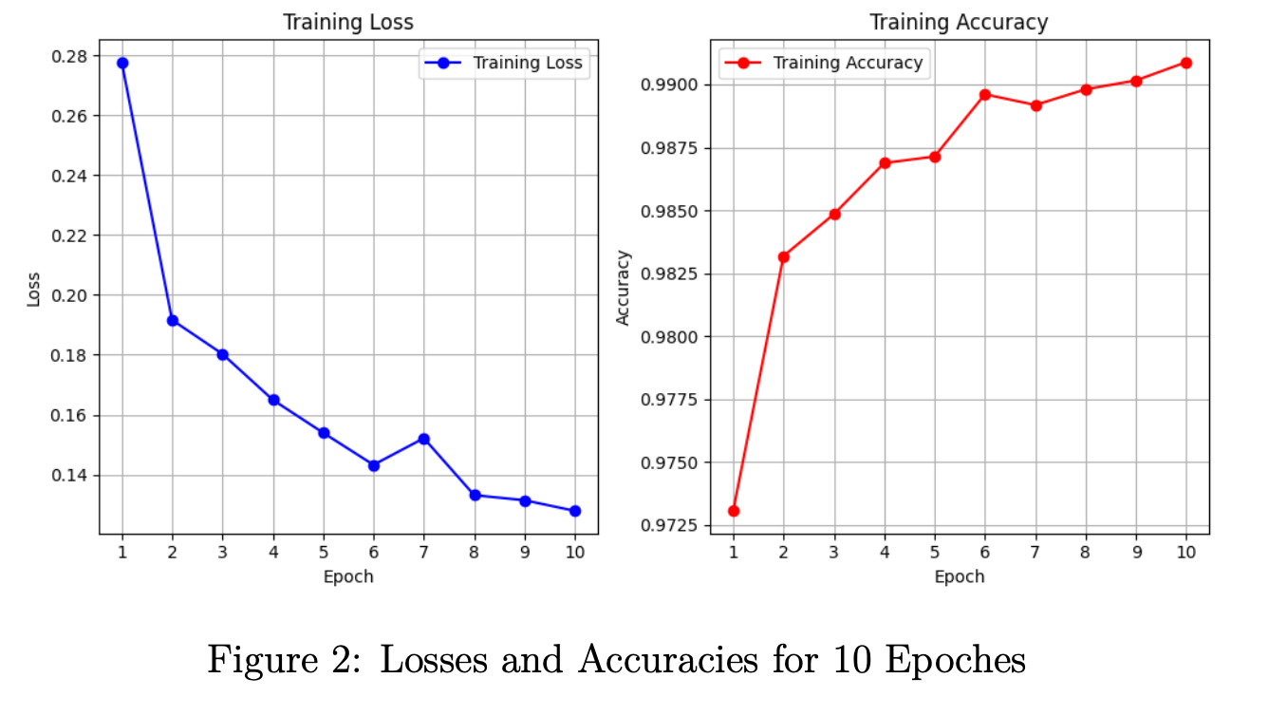
Results- loss and accuracy
Loss decreases:
predictions match the actual labels
Closer
Improves the performance
Binary accuracy increases:
Tends to converges
Proportion of correct predictions
More correct predictions
Positive sign of learning

Slide 10
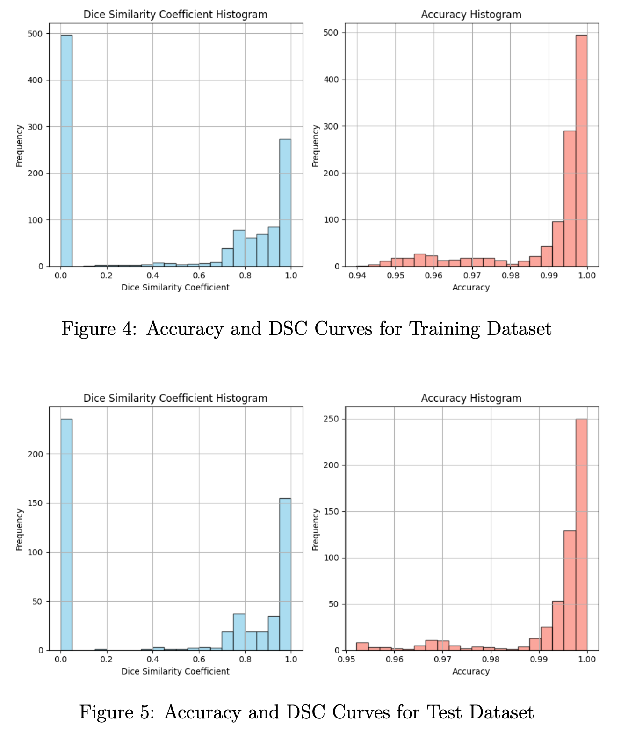
Results- accuracy and DSC per 2D slice

Slide 11
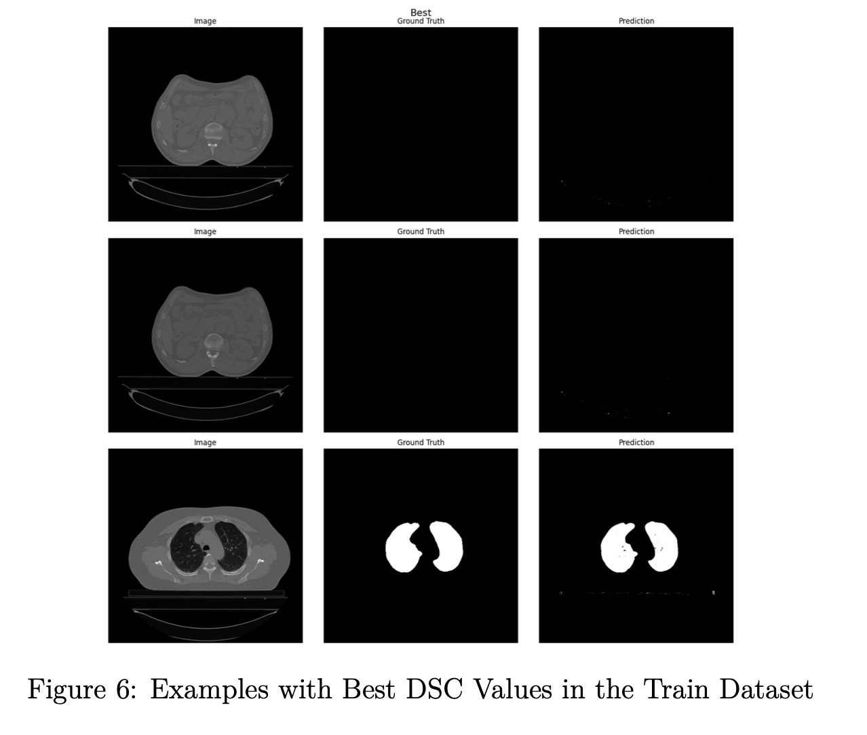
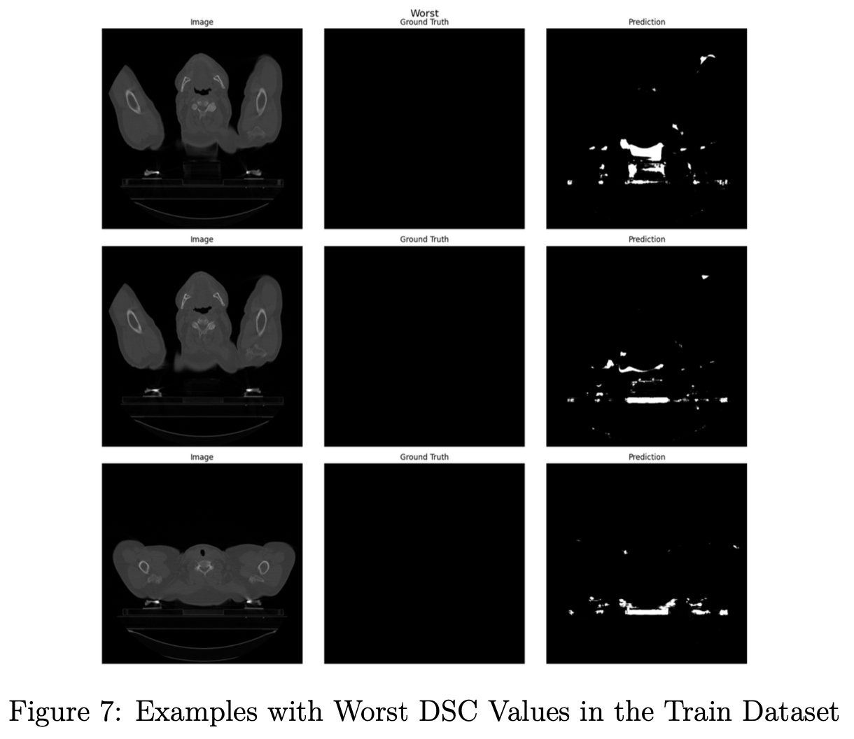
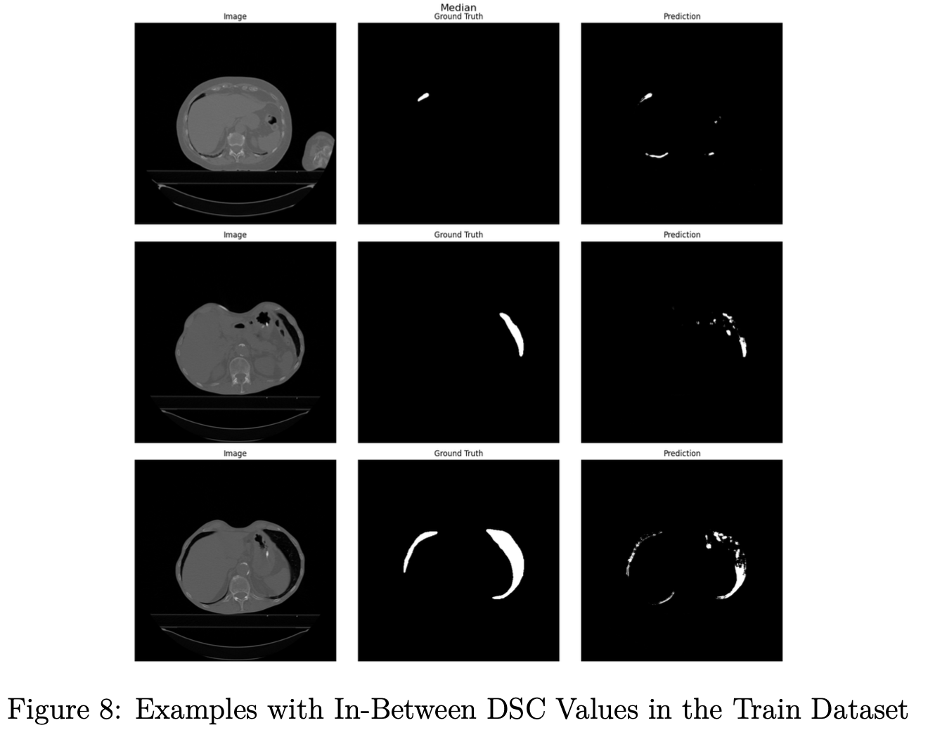
Results: examples of 2D slices for training dataset

Slide 12
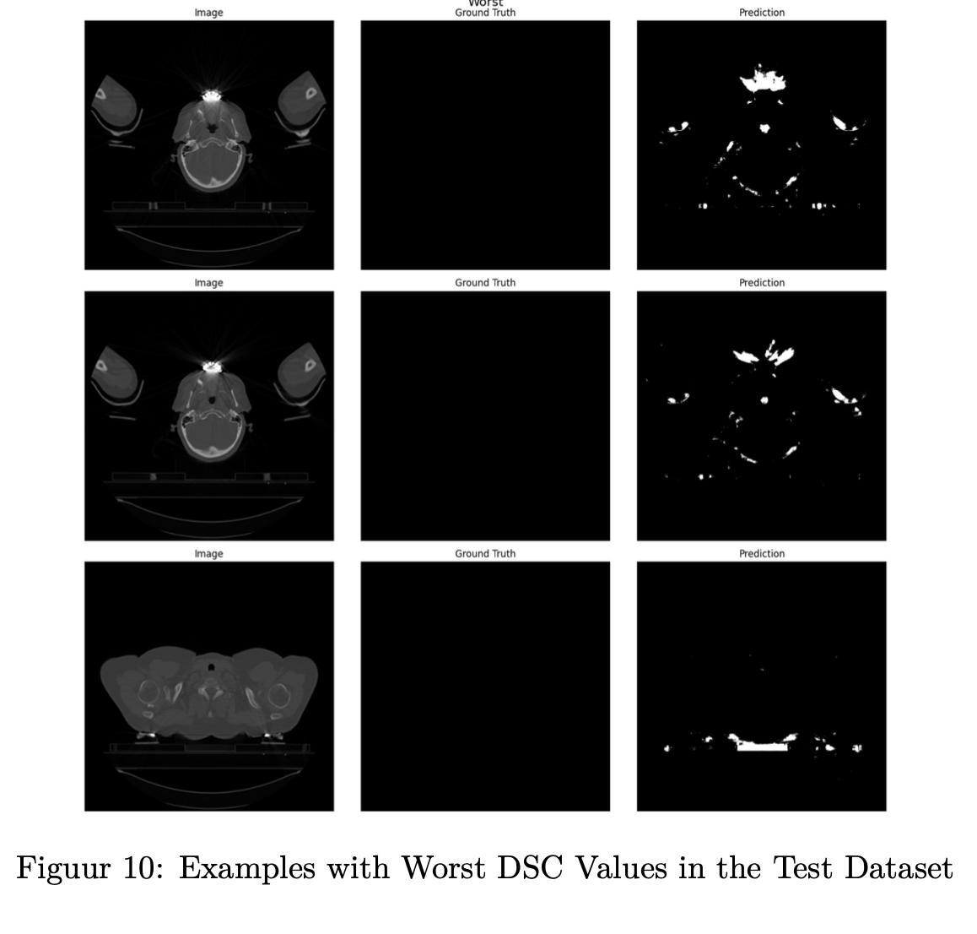
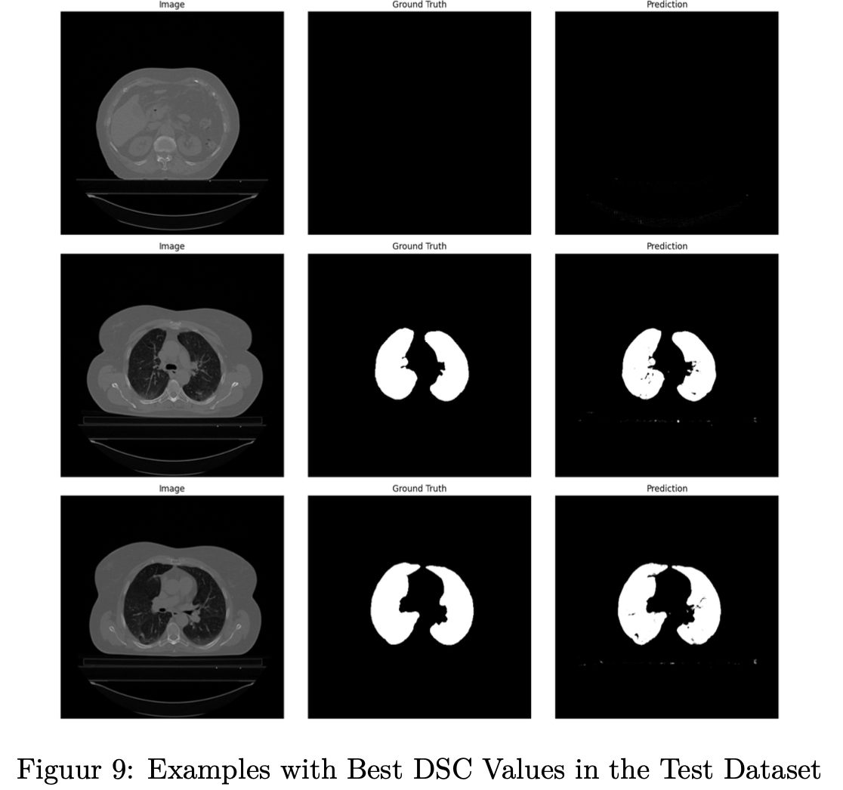
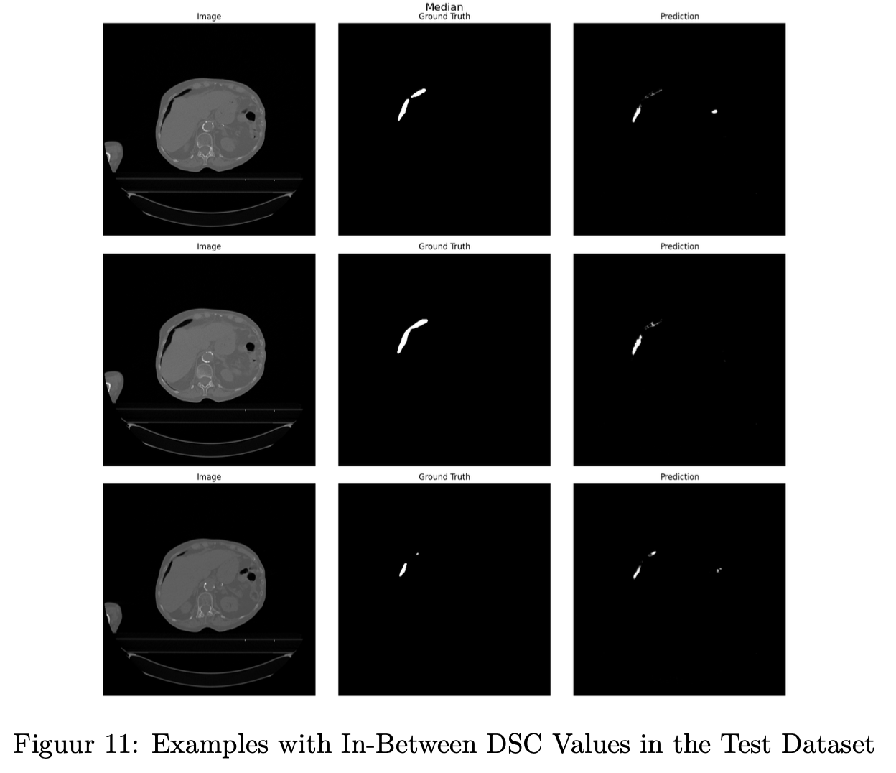
Results: examples of 2D slices for test dataset

Slide 13

Discussion
Problem:
Limitations in accurately identifying non-lung structures
Limited size of training dataset
Solution:
Regularization techniques
Data augmentation

Slide 14

Thank you

