Slide 1
FPGA-based Real-Time Learning Architecture with Partial Reconfiguration for Spiking Neural Networks
Institute of Computer Engineering – Chair of Adaptive Dynamic Systems
Master Thesis
Yike Jing
Dresden, Germany. October 7, 2026
Supervisors: Gloria Sepanta, Dr.-ing. Lester Kalms

Slide 2
Contents
1 Introduction & Motivation
2 Related Work
3 Background
4 Design & Implementation
5 Results
6 Conclusion & Outlook
Slide 2/29

Slide 3
Introduction & Motivation
01
Slide 3/29

Slide 4
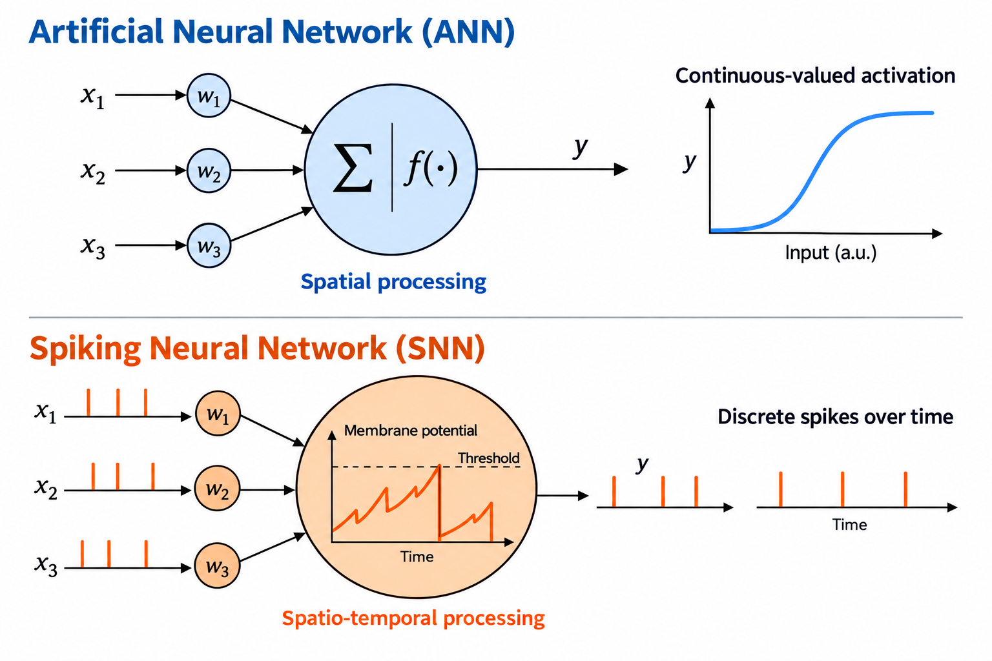
Motivation and Research Problem
Motivation
Why SNNs? Spike timing carries temporal information. Sparse activity offers potential for efficient edge processing.
Why online learning? Adapt weights on the device as new data arrives, reducing the need for offline retraining.
Problem
Baseline Spiker+ deploys weights prepared offline, which remain fixed during inference.
Integrating SDSP requires writable weights and correct state and write-back timing within the inference schedule.
Slide 4/29

Slide 5
Related Work
02
Slide 5/29

Slide 6
Related Work
Work | [1] ODIN Frenkel et al. (2019, TBioCAS) | [2] MorphIC Frenkel et al. (2019, TBioCAS) | [3] Asgari et al. (2020, IJCTA) | [4] Li et al. (2021, TCAS-I) | [5] TEDOP Shi et al. (2022, ICTA) | [6] RAINE Fang et al. (2022, A-SSCC) | This Work
Platform and scale | 28 nm ASIC 256 neurons 64k synapses | 65 nm ASIC 2,048 neurons >2M synapses | Spartan-6 LX45 2 neurons 1 plastic synapse | VC707, Virtex-7 984 neurons 88.4k synapses | Zynq-7010 Up to 1,024 × 10 | Alveo U250 16 UDLEs | PYNQ-Z1, XC7Z020 10 neurons 7,840 plastic synapses
Neuron model | 8-bit LIF / Izhikevich-like | LIF | LIF + CAVE Ca estimator | LIF | 16-bit TI (non-spiking) | LIF | Modified LIF subtractive reset
SNN model (topology) | 256–10 fully connected | 4 conv. kernels + pooling + FC–8 | 2-neuron minimum network | 784 input 100 excitatory + 100 inhibitory | 784–10 fully connected | 251–100–4 SFNN 256–100–2 SRNN 784–1000–10 SCNN | 784–10 fully connected
On-chip learning (algorithm) | SDSP (teacher-supervised) | Stochastic S-SDSP | High-precision SDSP | Trace-based STDP (unsupervised) | S4DSP (supervised) | Rewarded Trace-STDP | SDSP (teacher-supervised)
Dataset | MNIST (16 × 16) | 8-pattern benchmark | Synthetic spikes (no dataset) | MNIST | MNIST | MIT-BIH ECG CHB-MIT EEG MNIST | MNIST
Slide 6/29

Slide 7
Background
03
Slide 7/29

Slide 8
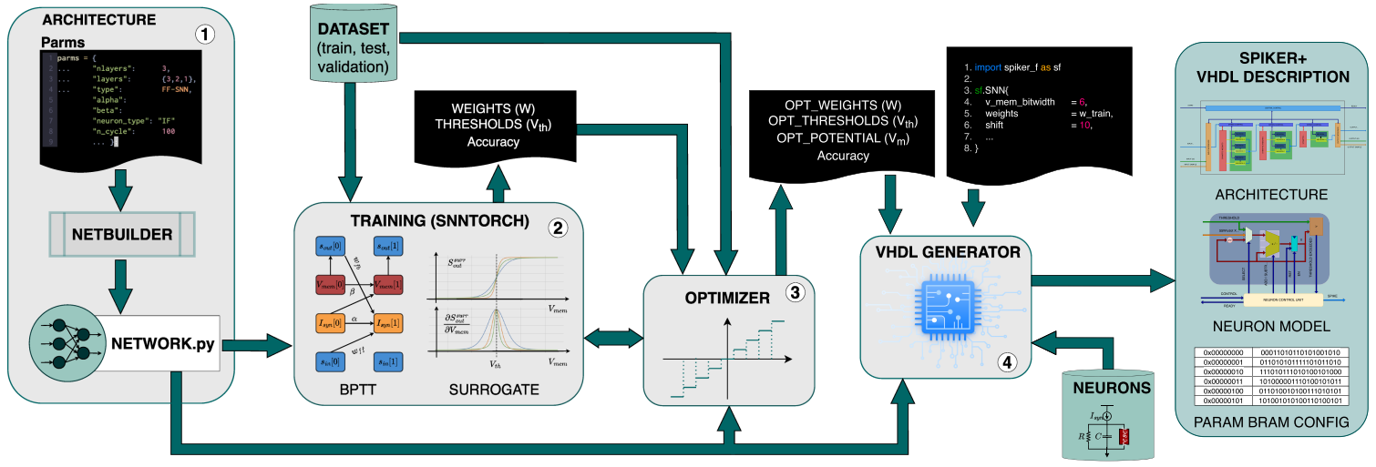
Spiker+ Framework
[7] A. Carpegna et al, "Spiker+: A Framework for the Generation of Efficient Spiking Neural Networks FPGA Accelerators for Inference at the Edge," in IEEE Transactions on Emerging Topics in Computing. 2025,
Slide 8/29

Slide 9
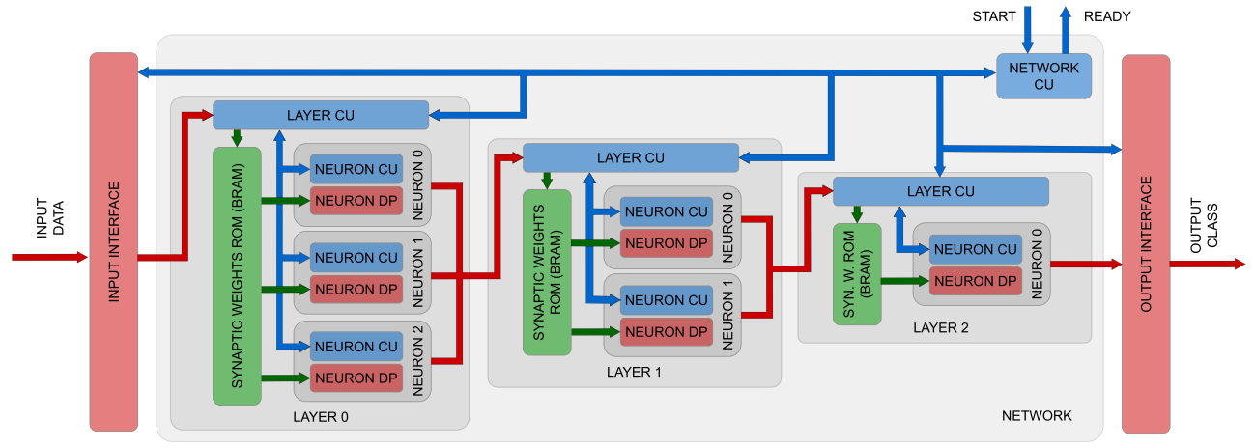
Architecture of SNN Accelerator from Spiker+
[7] A. Carpegna et al, "Spiker+: A Framework for the Generation of Efficient Spiking Neural Networks FPGA Accelerators for Inference at the Edge," in IEEE Transactions on Emerging Topics in Computing. 2025,
Slide 9/29

Slide 10

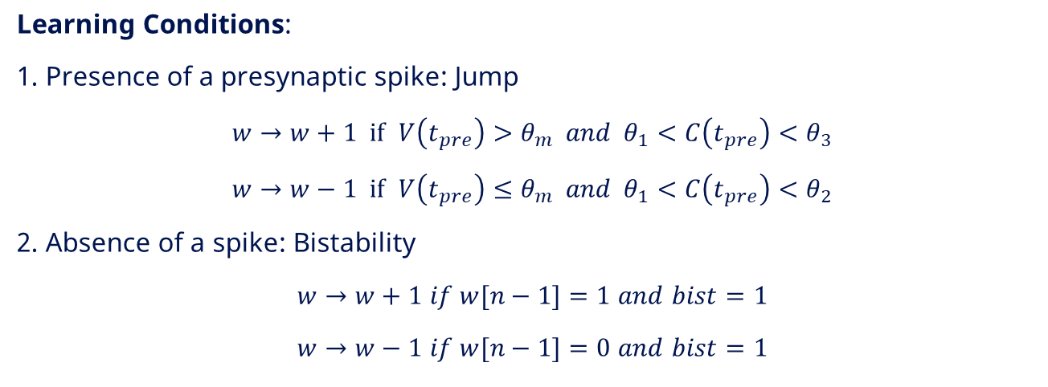

Spike-Driven Synaptic Plasticity
Neuron Model:
$$\frac{ⅆV}{ⅆt}=−λ+I\left(t\right)$$
SYMBOL LEGEND
V(t)
Neuron membrane potential
λ
Membrane leakage term
Calcium Variable:
$C=C+1$ $if spk_post=1$
$C=C−1$ $if time_ref=1$
I(t)
Input current at time t
C
Calcium variable
spk_post
Postsynaptic-spike indicator
Learning Conditions:
1. Presence of a presynaptic spike: Jump
$w→w+1 if$ $V\left(t_{pre}\right)>θ_{m} and { θ}_{1}<C\left(t_{pre}\right)<θ_{3}$
$w→w−1 if$ $V\left(t_{pre}\right)≤θ_{m} and θ_{1}<C\left(t_{pre}\right)<θ_{2}$
2. Absence of a spike: Bistability
$w→w+1$ $if w[n−1]=1$ $and$ $bist=1$
$w→w−1$ $if w[n−1]=0$ $and$ $bist=1$
time_ref
Reference event for C decay
w
Synaptic weight
t_pre
Presynaptic spike arrival time
θₘ
Membrane-voltage threshold
θ₁, θ₂, θ₃
Calcium-variable thresholds
n; w[n−1]
Weight width; most-significant bit
bist
Bistability control signal
Slide 10/29

Slide 11
Design & Implementation
04
Slide 11/29

Slide 12
Online-Learning Integration
Input spikes
Weight memory
Neurons
Output spikes
Neuron state
Write-back
Read weight
SDSP update
Events
SDSP updates stored weights for inference.
Slide 12/29

Slide 13
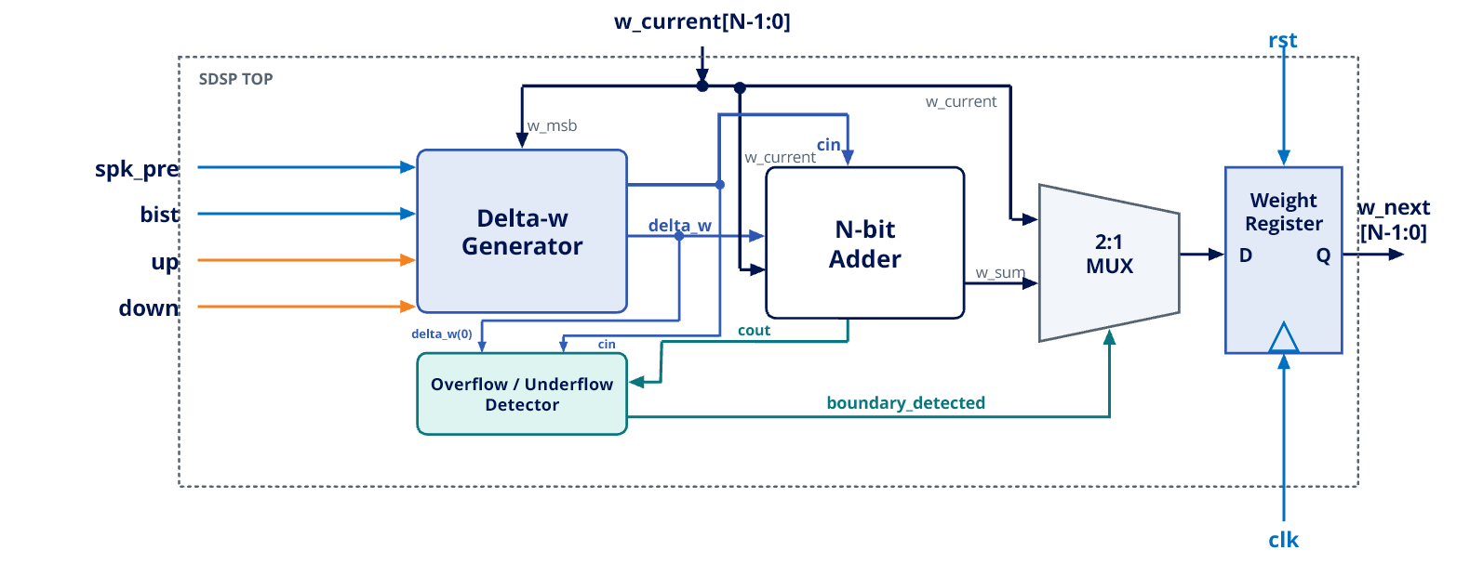
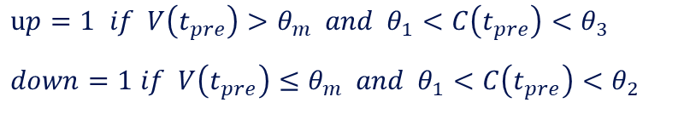
Digital Weight-Update Datapath
$up=1$ $if V\left(t_{pre}\right)>θ_{m} and { θ}_{1}<C\left(t_{pre}\right)<θ_{3}$
$down=1$ $if V\left(t_{pre}\right)≤θ_{m} and θ_{1}<C\left(t_{pre}\right)<θ_{2}$
Slide 13/29

Slide 14
Address-Aligned Weight Write-Back
Read
weight k
Update
weight k
Write back
to address k
Keep each updated weight paired with its original address.
Weight write-back overlaps with the next weight read.
Slide 14/29

Slide 15
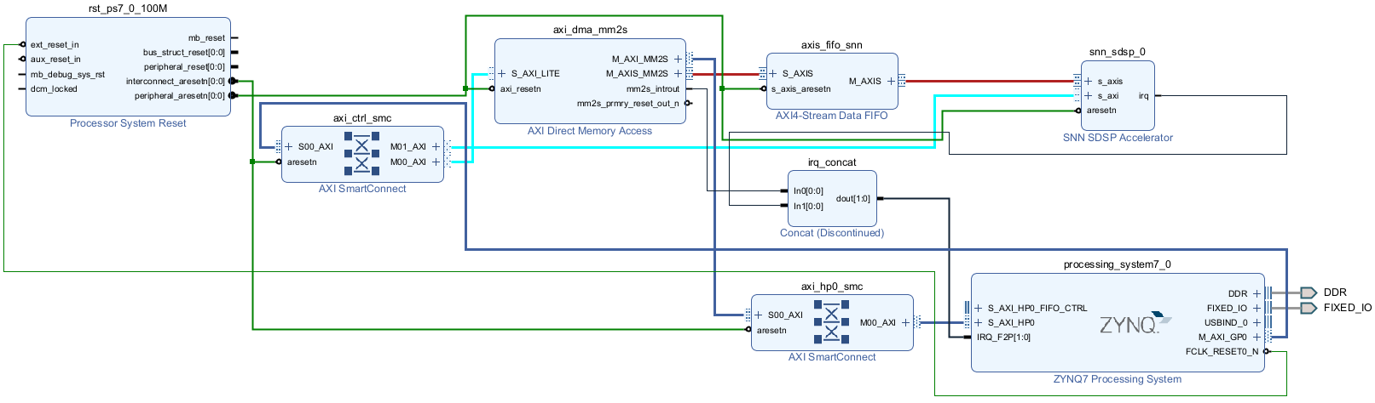
PYNQ-Z1 System Integration
Control
Input transfer
Hardware
AXI4-Lite registers
DDR, DMA and stream FIFO
SNN–SDSP accelerator IP
Slide 15/29

Slide 16
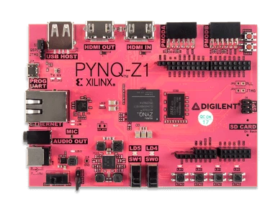
Verification Overview
RTL checks: learning logic and weight-memory behavior.
Board checks: interfaces, outputs and software–hardware behavior.
Learning checks: persistent updates and three complete training epochs.
PYNQ Z1
[8] Digilent Inc. PYNQ-Z1: Python Productivity for Zynq-7000 ARM/FPGA SoC. URL: https://digilent.com/shop/pynq-z1-python-productivity-for-zynq-7000-arm-fpga-soc/
Slide 16/29

Slide 17
Dynamic Partial Reconfiguration (DPR)
Only SDSP was implemented. No runtime switching between learning rules was required.
SDSP is coupled to neuron state, synaptic memory and layer timing.
DPR would require a common interface, state preservation and additional verification.
Final implementation: static configuration with runtime learning control.
Slide 17/29

Slide 18
Results
05
Slide 18/29

Slide 19
Resource Utilization, Overhead and Power
Post-implementation results on XC7Z020
Resource | Pure Spiker | SNN + SDSP system | Difference | Change
LUT | 1,780 (3.35%) | 5,056 (9.50%) | +3,276 | +184.0%
FF | 1,829 (1.72%) | 5,294 (4.98%) | +3,465 | +189.4%
BRAM | 1.50 (1.07%) | 4.00 (2.86%) | +2.50 | +166.7%
BUFG | 1 (3.13%) | 1 (3.13%) | 0 | 0.0%
Resource differences include learning and system integration.
Vivado post-implementation power estimate
Total on-chip | Dynamic | Static | PS7 dynamic
1.445 W | 1.309 W | 0.136 W | 1.260 W
Complete Zynq device, medium-confidence estimate. PS7 dominates dynamic power.
Slide 19/29

Slide 20
Evaluation Configuration
Parameter | Fixed value
Network / neuron | 784–10, modified subtractive-reset LIF
Membrane / excitatory weight | 16-bit signed Q9 state / 3-bit unsigned weight
Spike encoder | Spiker+ rate coding, gain 0.1
Window / stream size | 100 steps, 2,500 words, 10,000 bytes per image
Teacher current | 128 in Q9 = 0.25
Calcium leakage / bistability | Once every 10 steps / disabled
Training seeds / validation seed | 2028, 2029, 2030 / 2027
Slide 20/29

Slide 21
MNIST Evaluation Protocol
Initial
evaluation
Train
Epoch 1
Evaluate
Train
Epoch 2
Evaluate
Train
Epoch 3
Evaluate
Training: 60,000 images per epoch. Learning and teacher input enabled.
Evaluation: reuse 1,000 class-balanced images with fixed spike encoding. Learning and teacher input disabled.
One bitstream load. Learned weights persist across all three epochs.
Slide 21/29

Slide 22
Accuracy and Output Activity
Silent / 1,000: Initial 225, Epoch 1: 380, Epoch 2: 282, Epoch 3: 215.
Later gains in strict accuracy mainly reflect fewer silent images.
Slide 22/29

Slide 23
End-to-End Runtime
training transactions
in 45 min 20.77 s
Includes Python control, DMA, register access and a 10 ms delay/image
Slide 23/29

Slide 24
Quantitative Comparison
Work | [1] ODIN Frenkel et al. (2019, TBioCAS) | [2] MorphIC Frenkel et al. (2019, TBioCAS) | [3] Asgari et al. (2020, IJCTA) | [4] Li et al. (2021, TCAS-I) | [5] TEDOP Shi et al. (2022, ICTA) | [6] RAINE Fang et al. (2022, A-SSCC) | This Work
Platform and scale | 28 nm ASIC 256 neurons 64k synapses | 65 nm ASIC 2,048 neurons >2M synapses | Spartan-6 LX45 2 neurons 1 plastic synapse | VC707, Virtex-7 984 neurons 88.4k synapses | Zynq-7010 Up to 1,024 × 10 | Alveo U250 16 UDLEs | PYNQ-Z1, XC7Z020 10 neurons 7,840 plastic synapses
Neuron model | 8-bit LIF / Izhikevich-like | LIF | LIF + CAVE Ca estimator | LIF | 16-bit TI (non-spiking) | LIF | Modified LIF subtractive reset
SNN model (topology) | 256–10 fully connected | 4 conv. kernels + pooling + FC–8 | 2-neuron minimum network | 784 input 100 excitatory + 100 inhibitory | 784–10 fully connected | 251–100–4 SFNN 256–100–2 SRNN 784–1000–10 SCNN | 784–10 fully connected
On-chip learning (algorithm) | SDSP (teacher-supervised) | Stochastic S-SDSP | High-precision SDSP | Trace-based STDP (unsupervised) | S4DSP (supervised) | Rewarded Trace-STDP | SDSP (teacher-supervised)
Dataset | MNIST (16 × 16) | 8-pattern benchmark | Synthetic spikes (no dataset) | MNIST | MNIST | MIT-BIH ECG CHB-MIT EEG MNIST | MNIST
Resources / area | 0.086 mm² | 2.86 mm² | 450 LUTs 249 registers | N/R | 952 LUTs 741 FF 4 BRAM | 21,560 LUTs* 20,863 FF* | 5,056 LUTs 5,294 FF 4 BRAM
Frequency | 75 MHz | 55 MHz | 131 MHz | 100 MHz | 250 MHz | 75 MHz | 100 MHz
Accuracy | 85.0% rate 84.5% rank-order | 100% patterns (800/800) | N/A No classifier | 85.28% online 82.52% relearning | 90.4% MNIST test | 98.26% MNIST | 39.6% fixed validation 3 epochs
Slide 24/29

Slide 25
Conclusion & Outlook
06
Slide 25/29

Slide 26
Conclusions
Hardware contribution
Synthesizable SDSP, ten learning lanes and address-aligned writable synapses.
System contribution
Reusable Spiker+ extension on PYNQ-Z1 at 100 MHz, with 180,000 continuous training transactions.
Strict validation accuracy: 5.9% to 39.6% after three epochs
Epoch 1 improves classification among active images. Later gains mainly reflect fewer
silent images (380 to 215), with active-image accuracy remaining near 50%.
Accuracy remains an intermediate result
Convergence is unestablished and class responses remain unstable. Single-layer capacity
and 3-bit weights may constrain accuracy, but their individual effects are untested.
Slide 26/29

Slide 27
Limitations and Next Experiments
Training scope: one run over three epochs. Extend training and repeat runs across parameter settings.
Validation: the fixed validation set guided continuation. Use an untouched final test set.
Model capacity: one layer with 3-bit weights. Explore higher precision and larger networks.
Performance and energy: application runtime and estimated power. Add cycle counters and measure board energy per image.
Slide 27/29

Slide 28
References
[1] C. Frenkel, M. Lefebvre, J. -D. Legat and D. Bol, "A 0.086-mm 2 12.7-pJ/SOP 64k-Synapse 256-Neuron Online-Learning Digital Spiking Neuromorphic Processor in 28-nm CMOS," in IEEE Transactions on Biomedical Circuits and Systems, vol. 13, no. 1, pp. 145-158, Feb. 2019, doi: 10.1109/TBCAS.2018.2880425.
[2] Frenkel, Charlotte, Jean-Didier Legat, and David Bol. "MorphIC: A 65-nm 738k-synapse/mm $^ 2$ quad-core binary-weight digital neuromorphic processor with stochastic spike-driven online learning." IEEE transactions on biomedical circuits and systems 13.5 (2019): 999-1010.
[3] Asgari H, Mazloom-Nezhad Maybodi B, Sandamirskaya Y. Digital multiplier-less implementation of high-precision SDSP and synaptic strength-based STDP. Int J Circ Theor Appl. 2020; 48: 724–738.
[4] S. Li, Z. Zhang, R. Mao, J. Xiao, L. Chang and J. Zhou, "A Fast and Energy-Efficient SNN Processor With Adaptive Clock/Event-Driven Computation Scheme and Online Learning," in IEEE Transactions on Circuits and Systems I: Regular Papers, vol. 68, no. 4, pp. 1543-1552, April 2021, doi: 10.1109/TCSI.2021.3052885.
[5] C. Shi et al., "TEDOP: A Tiny Event-Driven Neural Network Hardware Core Enabling On-Chip Spike-Driven Synaptic Plasticity," 2022 IEEE International Conference on Integrated Circuits, Technologies and Applications (ICTA), Xi'an, China, 2022, pp. 62-63, doi: 10.1109/ICTA56932.2022.9963064.
[6] C. Fang, F. Tian, C. Wang, J. Yang and M. Sawan, "A 217.8 MSOPs/W FPGA-based Online Learning SNN Processor Using Unified Event-Driven Structure and Topology Aware Data Reuse Strategies," 2022 IEEE Asian Solid-State Circuits Conference (A-SSCC), Taipei, Taiwan, 2022, pp. 1-3, doi: 10.1109/A-SSCC56115.2022.9980727.
[7] A. Carpegna, A. Savino and S. D. Carlo, "Spiker+: A Framework for the Generation of Efficient Spiking Neural Networks FPGA Accelerators for Inference at the Edge," in IEEE Transactions on Emerging Topics in Computing, vol. 13, no. 3, pp. 784-798, July-Sept. 2025, doi: 10.1109/TETC.2024.3511676.
[8] Digilent Inc. PYNQ-Z1: Python Productivity for Zynq-7000 ARM/FPGA SoC. URL: https://digilent.com/shop/pynq-z1-python-productivity-for-zynq-7000-armfpga-soc/
Slide 28/29

Slide 29
Thank you!
Slide 29/29

Slide 30
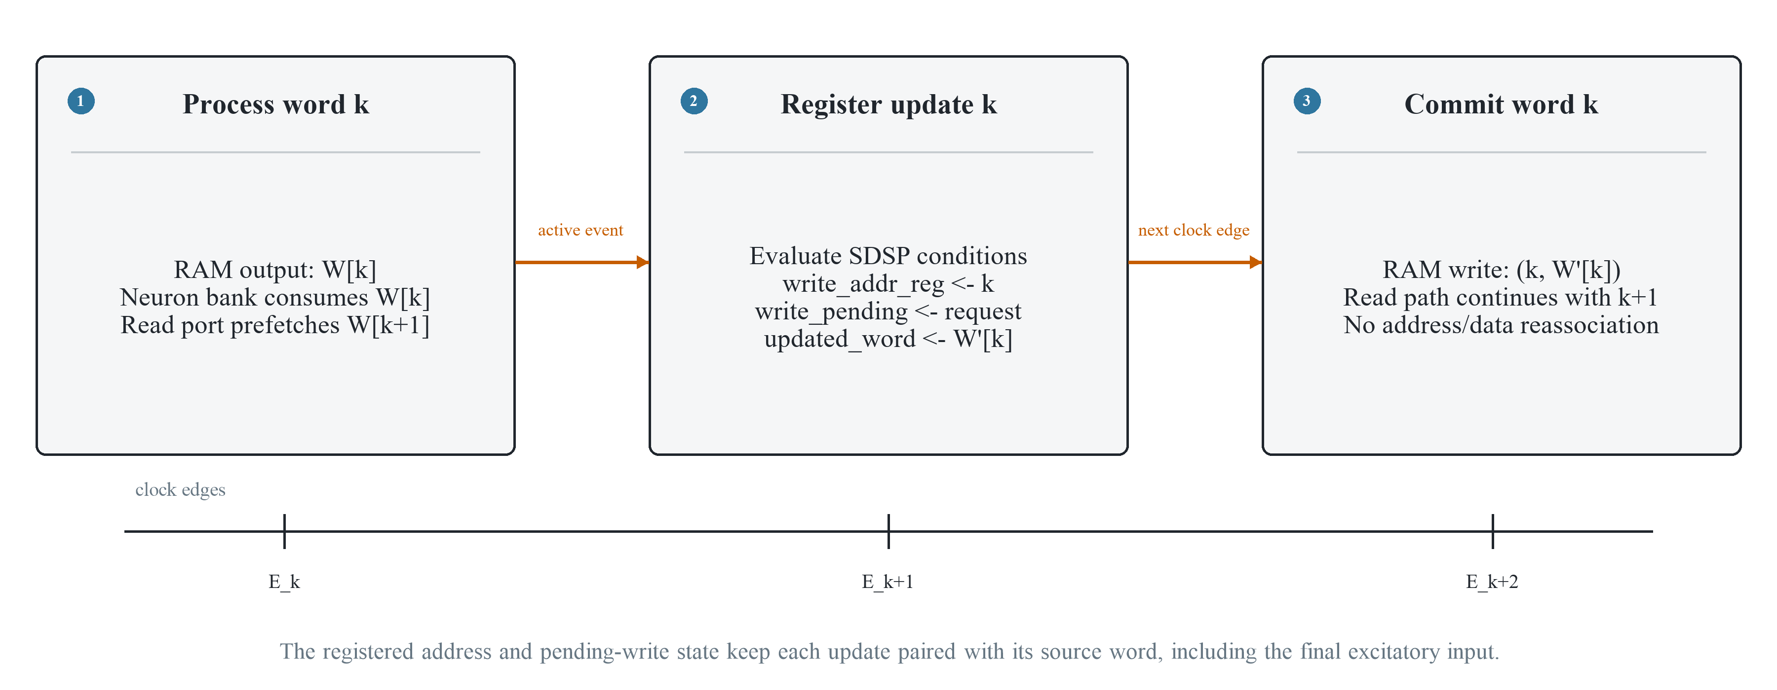
Backup: Write-Back Timing
The update for W[k] must return to address k while the read pipeline advances.
Registered address and pending-write state preserve the final excitatory update
Backup 1/6

Slide 31
Backup: Verification Details
Level | Question | Evidence
RTL modules | Are local operations correct? | Thresholds, bounded updates and RAM behaviour
Integrated interfaces | Is a transaction complete? | 2,500 words and 100 accepted/completed steps
Board controls | Does the deployed path match? | Register read-back, zero and dense inputs
Persistent learning | Does training affect later inference? | Teacher control and bitstream reload
Full workload | Does operation remain continuous? | Three epochs, 180,000 training transactions
Backup 2/6

Slide 32
Backup: Functional Evidence
Check | Observed evidence
Zero-input board transaction | 100 accepted steps, all output counts zero
Dense-input board transaction | 100 accepted steps, 99 spikes per output neuron
Teacher-controlled persistent test | 5/10 output vectors changed only at target neuron 7
Aligned software / hardware baseline | 4 silent samples each, 5/10 exact count vectors
Long-run operation | 180,000 supervised transactions over three epochs
Backup 3/6

Slide 33
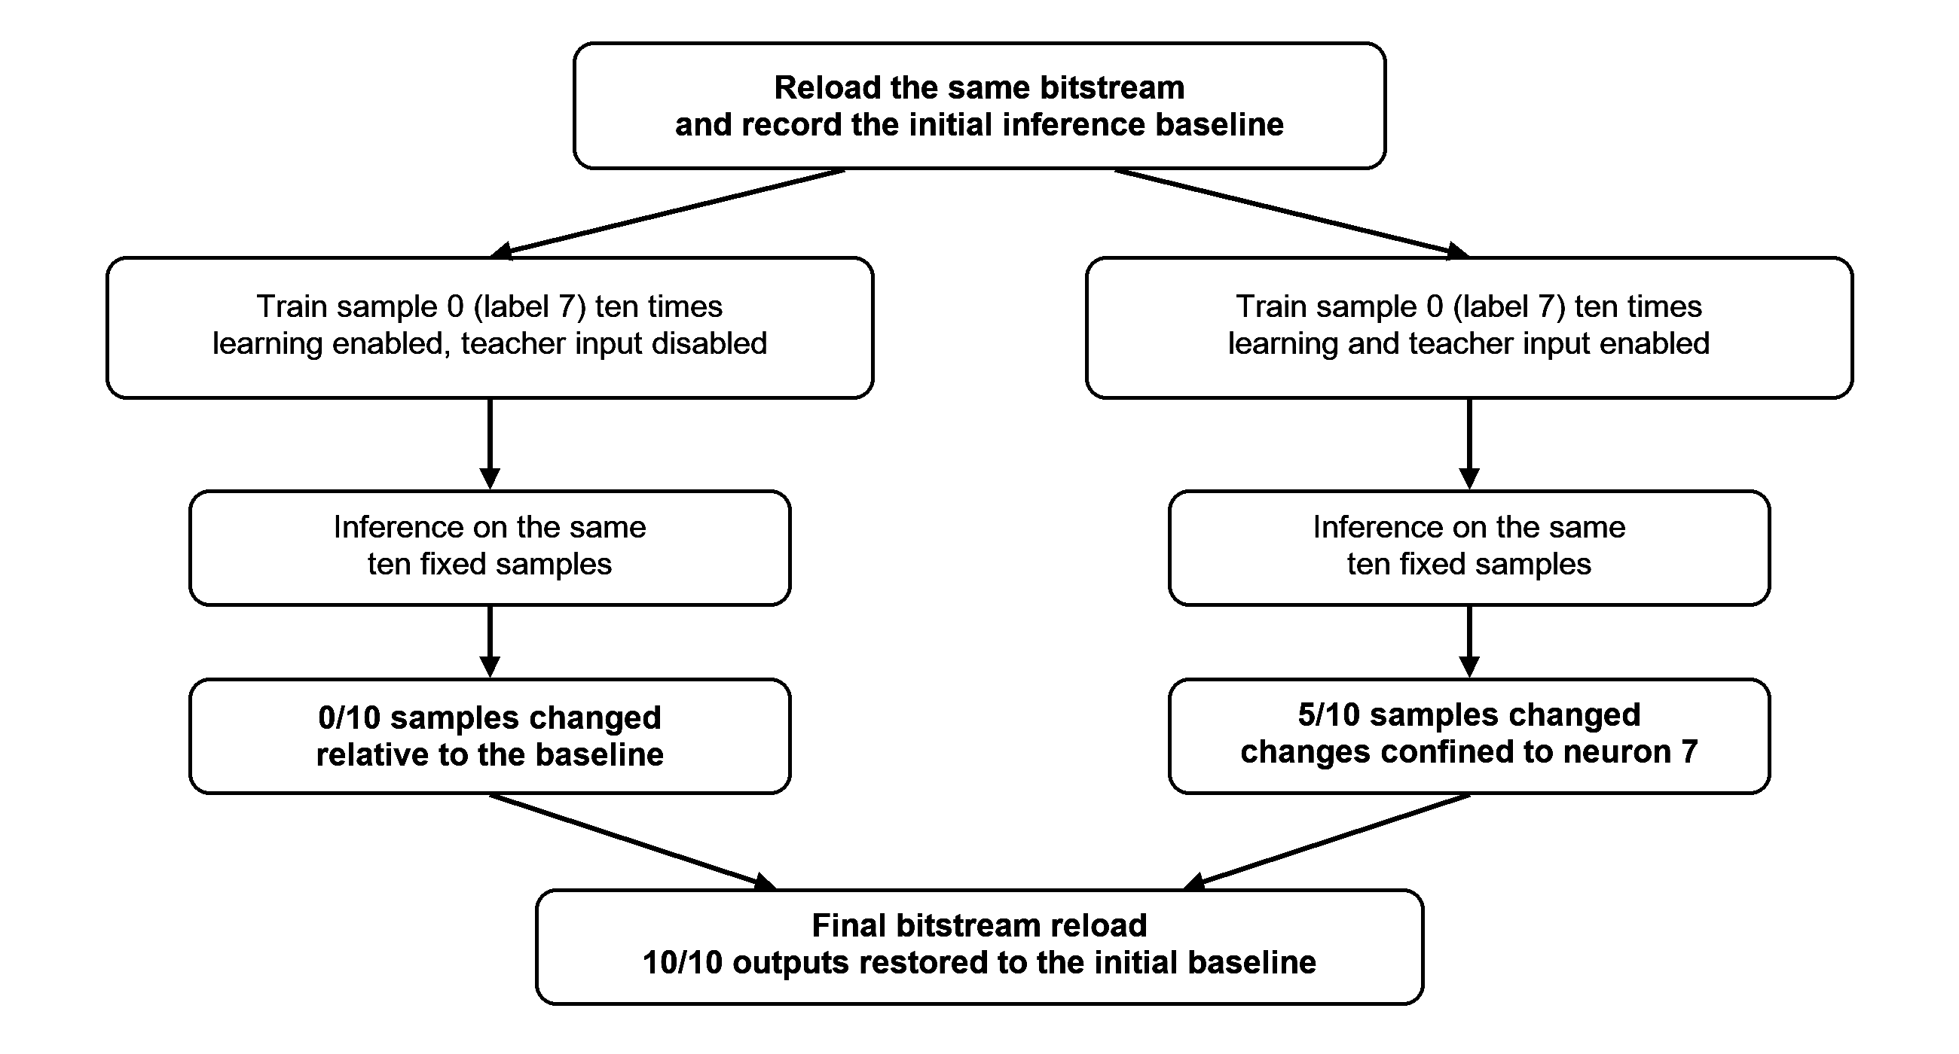
Backup: Persistent Learning on the FPGA
Later inference changes with the teacher off, and bitstream reload restores baseline
Backup 4/6

Slide 34
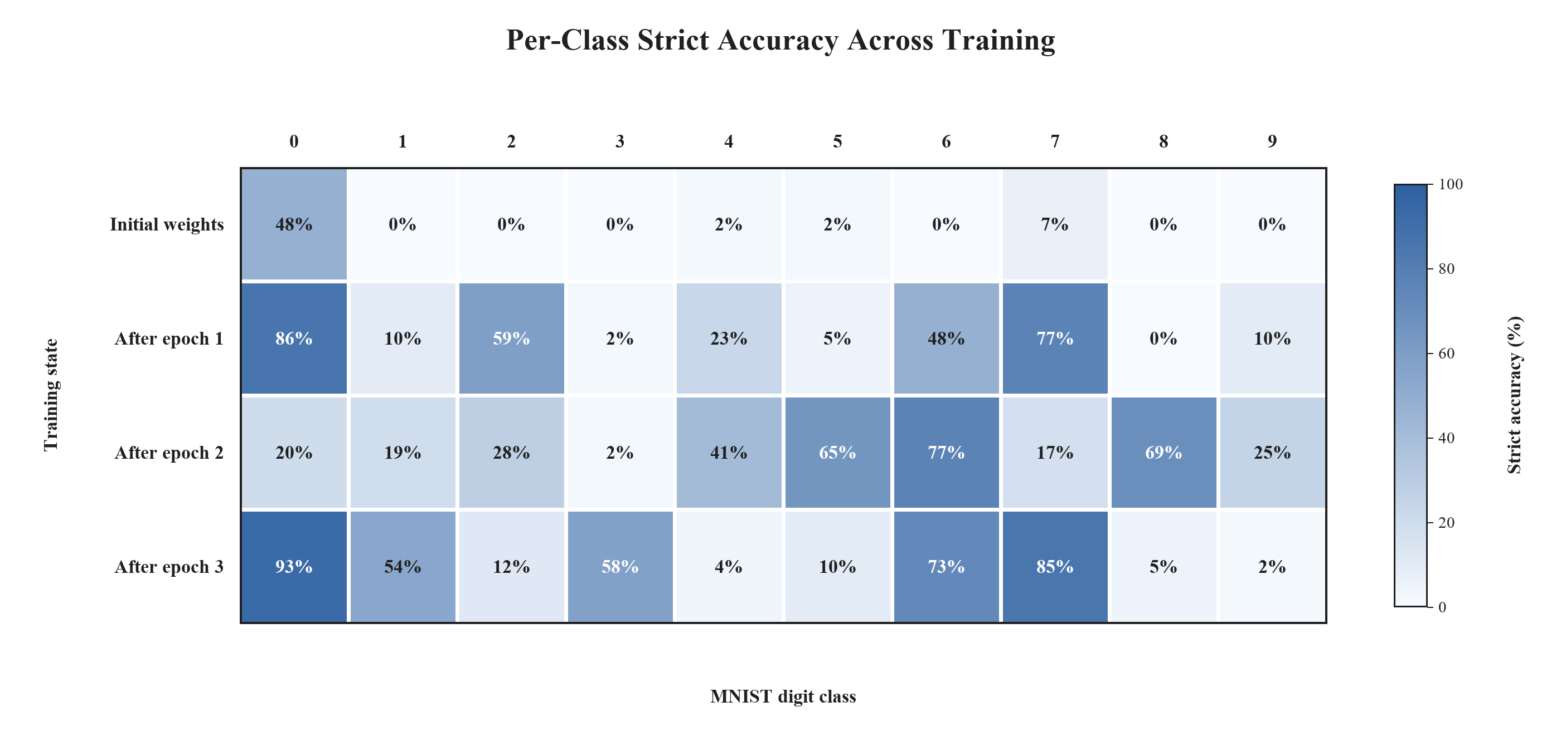
Backup: Per-Class Learning Behavior
Backup 5/6

Slide 35
Backup: snn_axi_wrapper
IRQ to PS
PS: AXI4-Lite
snn_axi_wrapper
Transaction & event control
Start and reset
Learning events
AXI4-Lite registers
Configuration
Status and results
Control / ready
Results
AXI4-Stream
from DMA/FIFO
Stream unpacker
25 × 32-bit
words per step
Ping-pong buffers
2 × 784-bit
network_sdsp
784-input SNN
with SDSP
Output processing
10 spike counters
Sequential argmax
Functions inside the wrapper. network_sdsp is the instantiated core.
Two buffers overlap input loading with network processing.
AXI4-Lite provides runtime control and reads back counts and class.
Backup 6/6

