Slide 1
FPGA-based Real-Time Learning Architecture with Partial Reconfiguration for Spiking Neural Networks
Institute of Computer Engineering – Chair of Adaptive Dynamic Systems
Yike Jing
Dresden, Germany. July 27, 2026
Notes:
Good morning everyone, my name is Yike. Today I’m going to give my intermediate presentation of my master thesis’s work titled FPGA-based Real….

Slide 2
Contents
Introduction & Motivation
Related Work
Background
Progress to Date
Results
Timeline
Notes:
This is the outline of my today’s presentation, I will first give the introduction of the topic of my master thesis as well as some background knowledge related to it and the motivation of my work.
Then I’ll introduce a bit about the related work that some of them really inspired me a lot through out the work
Then I will discuss about some background knowledge of my work, which consists mainly of 2 parts, an open source framework and the algorithm
At the end I will share about my progress and some preliminary results so far and the plan for the next steps

Slide 3
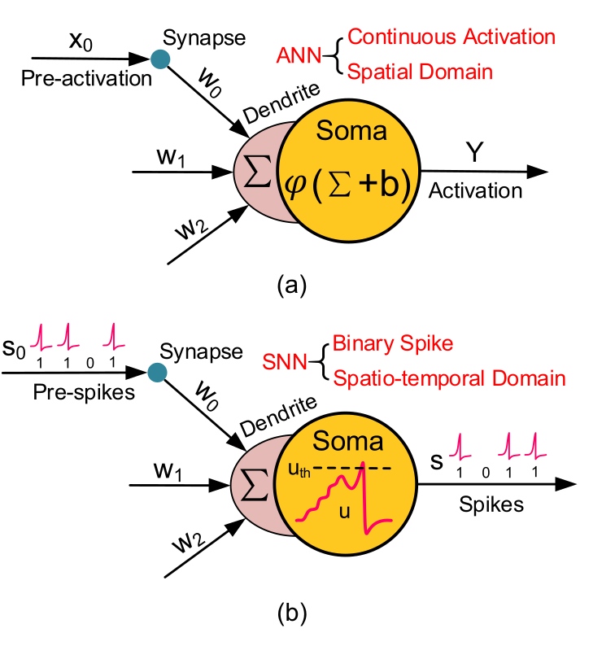
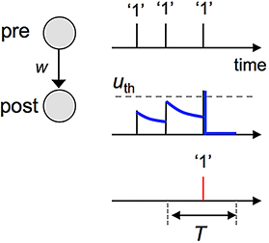
Introduction & Motivation
SNNs encode and process information through discrete spike events instead of continuous activations.
Event-driven computation
Neurons and synapses become active only when spikes arrive, reducing unnecessary operations.
Spatio-temporal information
Spike timing and firing rate provide a natural representation for dynamic sensor data.
Spike timing carries temporal information
Hardware-oriented communication
Sparse binary events map efficiently to parallel, low-latency FPGA datapaths.
ANN and SNN neuron models
THESIS OBJECTIVE
Implement a real-time SDSP learning module, integrate it with a simplified FPGA SNN, and make the training block dynamically reconfigurable.
Sparse spikes replace continuous activation traffic.
[1] Figure source: supplied project deck; neuron comparison attributed there to Deng et al. (2020).
Notes:
First, I would like to briefly introduce why SNNs are suitable for edge hardware.
Unlike conventional neural networks, SNNs communicate through discrete spikes instead of continuous activations. This makes the computation event-driven. Neurons and synapses only become active when spikes arrive, so unnecessary operations can be reduced.
Spikes also contain temporal information. Both the spike timing and the firing rate can be used to represent dynamic sensor data.
From a hardware perspective, sparse and binary spike events can be efficiently mapped to parallel FPGA circuits, which helps to achieve low-latency processing.
Based on these advantages, the objective of my thesis is to implement a real-time SDSP learning module, integrate it into a simplified FPGA SNN, and make the training block dynamically reconfigurable.

Slide 4
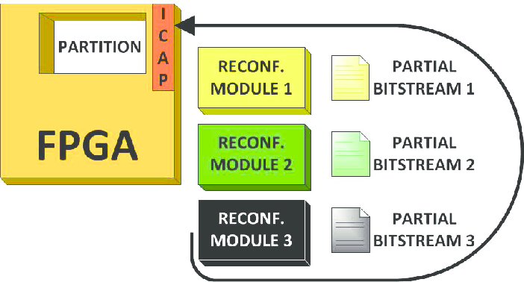
Introduction & Motivation
Real-time edge intelligence requires learning hardware that can adapt without stopping the SNN.
1
Adapt at the edge
Changing inputs and deployment conditions make offline-only training insufficient.
2
Keep learning local
Global gradients and heavy memory traffic conflict with low-latency FPGA execution; SDSP uses local spike-driven updates.
3
Change the training logic at runtime
Partial Reconfiguration can exchange the training block while the remaining SNN continues to operate.
Partial Reconfiguration changes one hardware partition at runtime.
EVALUATION
Resources, power, latency, maximum frequency, accuracy, and reconfiguration time.
[2] Gambardella, Giulio, Di Carlo, Stefano, Prinetto, Paolo, Rolfo, Daniele, Trotta, Pascal, Bao, Trong. 2013. ZipStream: Improving dependability in dynamic partial reconfiguration. 2013 8th IEEE Design and Test Symposium, IDT 2013
Notes:
This leads to the main motivation for my work.
First, an edge device may face changing inputs and operating conditions after deployment. Therefore, offline training alone may not be sufficient. The network should be able to adapt directly at the edge.
Second, the learning process should remain local and lightweight. Learning algorithms based on global gradients require considerable memory and data movement. In contrast, SDSP uses local spike-driven information, which makes it more suitable for low-latency FPGA implementation.
Third, I want to make the training logic reconfigurable at runtime. As shown in the figure, Partial Reconfiguration can replace only the training module while the remaining SNN continues to operate.
Then at the end, I will evaluate the resource usage, power, latency, maximum frequency, accuracy, and reconfiguration time. So that I can quantitatively evaluate its performance.

Slide 5
Related Work
Work | [3] ODIN Frenkel et al. (2019, TBioCAS) | [4] MorphIC Frenkel et al. (2019, TBioCAS) | [5] Asgari et al. (2020, Int J Circ Theor App) | [6] Li et al. (2021, TCAS-I) | [7] TEDOP Shi et al. (2022, ICTA) | [8] RAINE Fang et al. (2022, A-SSCC) | This Work (ongoing)
Platform and scale | 28 nm ASIC 256 neurons 64k synapses | 65 nm ASIC 2,048 neurons >2M synapses | Spartan-6 LX45 2 neurons 1 plastic synapse | VC707, Virtex-7 984 neurons 88.4k synapses | Zynq-7010 Up to 1,024 × 10 | Alveo U250 16 UDLEs | ZCU 102, Zynq Ultrascale+ SNN integration ongoing
Neuron model | 8-bit LIF / Izhikevich-like | LIF | LIF + CAVE Ca estimator | LIF | 16-bit TI (non-spiking) | LIF | LIF
Resources / area | 0.086 mm² | 2.86 mm² 738k syn./mm² | 249 registers 450 LUTs | Not reported | 952 LUTs; 741 FF 360 slices; 4 BRAM | 21,560 LUTs 20,863 FF | TBD after integration
Frequency | 75 MHz | 55 MHz @ 0.8 V | 131 MHz | 100 MHz | 250 MHz | 75 MHz | TBD after implementation
SNN model (topology) | 256–10 fully connected | 4 conv. kernels + pooling + FC–8 | 2-neuron minimum network | 784 input 100 excitatory + 100 inhibitory | 784–10 fully connected | 251–100–4 SFNN 256–100–2 SRNN 784–1000–10 SCNN | 784-10 fully connected (planned)
On-chip learning (algorithm) | SDSP teacher-supervised | Stochastic S-SDSP | High-precision SDSP | Trace-based STDP (unsupervised) | S4DSP (supervised) | Rewarded Trace-STDP | SDSP
Dataset | MNIST (16 × 16) | 8-pattern benchmark | Synthetic spikes (no dataset) | MNIST | MNIST | MIT-BIH ECG CHB-MIT EEG MNIST | MNIST (planned)
Accuracy | 85.0% rate 84.5% rank-order | 100% (800/800 tests) | N/A LTP/LTD only | 85.28% clean 82.52% after noisy relearning | 90.4% | 96.20% ECG 91.09% EEG 98.26% MNIST | TBD (system validation)
Notes:
Before getting started with the hands-on work, I read a large amount of relevant literature to familiarize myself with the subject and finalize my design.
This table compares several representative hardware implementations of online learning for SNNs. I will not go through every value in detail, but I would like to highlight the main differences.
ODIN and MorphIC are ASIC implementations using different versions of SDSP. They demonstrate high integration density and efficient online learning, but their hardware architecture is fixed after fabrication.
The other works are FPGA-based implementations. Asgari and TEDOP use SDSP-related learning rules, while Li and RAINE use STDP-based algorithms. These FPGA implementations offer more design flexibility, and some of them also demonstrate online learning on MNIST. Neuron models most of them used LIF model but tedop used TI model which is temporal integrated model, which removes both leaky and fire mechanisms.
My work targets the ZCU102 platform and uses LIF neurons, SDSP learning, and a planned 784-to-10 fully connected network for MNIST.
The main difference of my work is the use of Partial Reconfiguration. The objective is to replace or update the training module at runtime while keeping the remaining SNN operational.

Slide 6
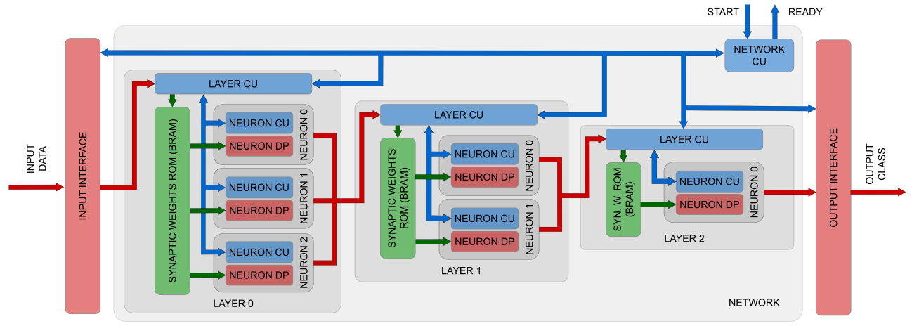
Spiker+ Framework
[9] A. Carpegna, A. Savino and S. D. Carlo, "Spiker+: A Framework for the Generation of Efficient Spiking Neural Networks FPGA Accelerators for Inference at the Edge"
Notes:
Then I would like to introduce about some necessary background of my work. So the first part is the open source tool called Spiker+ which can help users to generate VHDL files from python dictionary description.
This figure depicts the high-level architecture of a toy example of a three-layer FF-FC architecture used to introduce the three hierarchical levels of Control Units (CUs) that characterize Spiker+: i) the network CU, responsible for synchronizing the various components within the network; ii) the layer CUs, orchestrating the update of the neurons of a layer based on a set of input spikes; iii) the neuron CU: the accelerator core controlling the update of the membrane potential in each neuron. This organization represents a highly optimized architecture in terms of performance and space utilization.

Slide 7
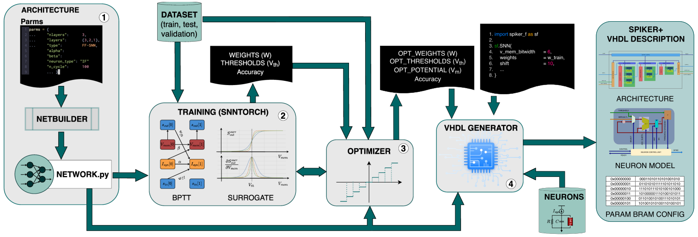
Spiker+ Framework
[9] A. Carpegna, A. Savino and S. D. Carlo, "Spiker+: A Framework for the Generation of Efficient Spiking Neural Networks FPGA Accelerators for Inference at the Edge"
Notes:
2. The outcome of the training phase includes a set of learned parameters such as weights and thresholds along with an accuracy evaluation of the trained model.
3. As training typically occurs in floating-point precision, unsuitable for edge hardware accelerators, Spiker+ implements functions to quantize the network, automating the exploration of the quantization impact on SNN accuracy (step 3).
Spiker+: A Framework for the Generation of Efficient Spiking Neural Networks FPGA Accelerators for Inference at the Edge

Slide 8

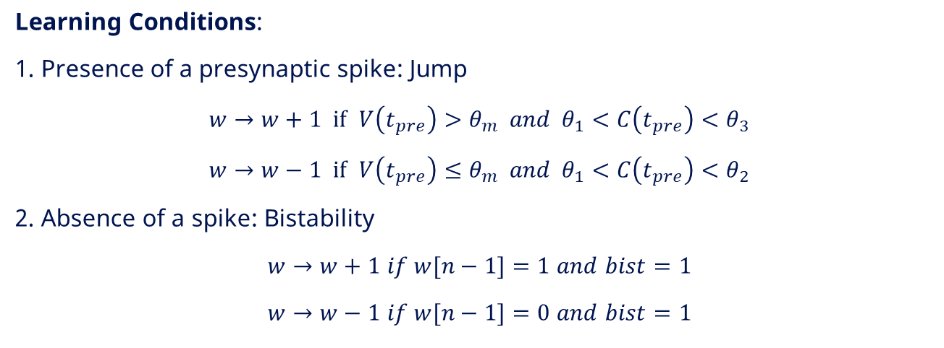

Spike-Driven Synaptic Plasticity
Neuron Model:
$$\frac{ⅆV}{ⅆt}=−λ+I\left(t\right)$$
SYMBOL LEGEND
V(t)
Neuron membrane potential
C(t)
Calcium variable
Calcium Variable:
$C=C+1$ $if spk_post=1$
$C=C−1$ $if time_ref=1$
w
Synaptic weight
θₘ
Membrane-voltage threshold
θ₁, θ₂, θ₃
Calcium-variable thresholds
Learning Conditions:
1. Presence of a presynaptic spike: Jump
$w→w+1 if$ $V\left(t_{pre}\right)>θ_{m} and { θ}_{1}<C\left(t_{pre}\right)<θ_{3}$
$w→w−1 if$ $V\left(t_{pre}\right)≤θ_{m} and θ_{1}<C\left(t_{pre}\right)<θ_{2}$
2. Absence of a spike: Bistability
$w→w+1$ $if w[n−1]=1$ $and$ $bist=1$
$w→w−1$ $if w[n−1]=0$ $and$ $bist=1$
λ
Membrane leakage term
I(t)
Input current at time t
t_pre
Presynaptic spike arrival time
spk_post
Postsynaptic-spike indicator
time_ref
Reference event for C decay
bist
Bistability control signal
n; w[n−1]
Weight width; most-significant bit
Notes:
SDSP is based on the event and the state of the postsynaptic neuron

Slide 9
SDSP Weight Update Uses a Compact Signed-Increment Datapath
SDSP UPDATE LOGIC
up
-1 / 0 / +1
generation
with overflow
detection
Direction of change
(from SDSP registers)
down
delta w
(n bit)
+
spk_pre
w_next[n-1:0]
Update enable
(from controller)
bistability
Next synaptic weight
w[n-1:0]
n-bit add
Current synaptic weight
(from synaptic memory)
The SDSP state selects a signed increment; controller signals gate the update; the current 3-bit weight is accumulated to produce w_next.
Notes:
This slide shows the main datapath used to update the synaptic weight.
On the left, the up and down signals come from the SDSP registers and determine the direction of the weight change. Depending on these signals, the generator produces either plus one, zero, or minus one.
The spk_pre and bistability signals control whether a weight update should be performed. The current synaptic weight is read from the synaptic memory and is also sent to the update logic for overflow and underflow detection. This prevents the weight from wrapping around when it reaches its maximum or minimum value.
The generated increment, delta w, is then added to the current weight using a single n-bit adder. The output of the adder is the next synaptic weight.
The main advantage of this structure is that it only requires simple control logic and one small adder, so the hardware overhead is very low.

Slide 10
Digital SDSP Implementation
w_current[N-1:0]
rst
SDSP TOP
w_current
w_msb
cin
spk_pre
Delta-w
Generator
w_current
N-bit
Adder
bist
Weight
Register
w_next
[N-1:0]
delta_w
up
2:1
MUX
D
Q
w_sum
down
delta_w(0)
cin
cout
Overflow / Underflow
Detector
boundary_detected
Update control validates the candidate weight; the MUX selects hold/update before w_next is registered on clk.
clk
Notes:
detector此图需要修改

Slide 11

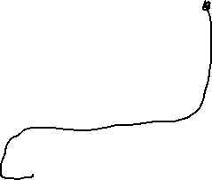
Digital SDSP Implementation
w_current[N-1:0]
rst
SDSP TOP
w_current
w_msb
cin
spk_pre
Delta-w
Generator
N-bit
Adder
bist
Weight
Register
w_next
[N-1:0]
delta_w
up
2:1
MUX
D
Q
w_current
w_sum
down
cout
Overflow / Underflow
Detector
boundary_detected
Update control validates the candidate weight; the MUX selects hold/update before w_next is registered on clk.
clk
Notes:
detector此图需要修改

Slide 12
Preliminary Results
POST-SYNTHESIS UTILIZATION
VIVADO ON-CHIP POWER ESTIMATE
18 LUTs + 8 FFs
10.859 W
estimated total on-chip power
Core SDSP update logic
Dynamic 10.169 W (94%)
Static 0.690 W (6%)
Resource | Used | Available | Utilization
LUT | 18 | 274,080 | 0.01%
FF | 8 | 548,160 | 0.01%
I/O | 22 | 328 | 6.71%
94% dynamic
DYNAMIC POWER BREAKDOWN
I/O 9.985 W (98%)
Logic
0.107 W (1%)
Internal dynamic
0.184 W
Signals
0.077 W (1%)
Logic utilization remains at or below 0.01% of the target device.
Static split: PL 0.676 W (98%) | PS 0.014 W (2%)
INTERPRETATION
The RTL footprint is negligible; I/O activity dominates the current power estimate.
NEXT STEP
Functional Simulation and Validation.

Slide 13
What‘s Next?
Continue to fine-tune and optimize the Python model to achieve optimal training results.
Functional Simulation and Verification of the SDSP RTL Model.
SNN network generation and SDSP integration.
Apply partial reconfiguraion.
Test and evaluation.
Result comparison.
Report and final presentation.

Slide 14
Timeline
Literature review
May 15 - Sep 15
Spiker+ investigation
May 20 - Jun 12
SDSP architecture design
Jun 8 - Jun 19
SDSP python model design, simulation, and optimization
Jun 20 - Aug 14
SDSP model RTL implementation, simulation and validation
Jul 20 - Aug 9
SNN generation and SDSP integration
Aug 10 - Aug 28
System optimization and FPGA test
Aug 24 - Sep 4
Apply partial reconfiguration
Sep 5 - Sep 11
Test and evaluation
Sep 10 - Sep 21
Report and final presentation
Aug 1 - Oct 9
May
Jun
Jul
Aug
Sep
Oct
2026
Today

Slide 15
References
[1] Figure source: supplied project deck; neuron comparison attributed there to Deng et al. (2020).
[2] Gambardella, Giulio, Di Carlo, et al. 2013. ZipStream: Improving dependability in dynamic partial reconfiguration. 2013 8th IEEE Design and Test Symposium, IDT 2013.
[3] C. Frenkel, M. Lefebvre, J. -D. Legat and D. Bol, "A 0.086-mm 2 12.7-pJ/SOP 64k-Synapse 256-Neuron Online-Learning Digital Spiking Neuromorphic Processor in 28-nm CMOS," in IEEE Transactions on Biomedical Circuits and Systems, vol. 13, no. 1, pp. 145-158, Feb. 2019, doi: 10.1109/TBCAS.2018.2880425.
[4] Frenkel, Charlotte, Jean-Didier Legat, and David Bol. "MorphIC: A 65-nm 738k-synapse/mm $^ 2$ quad-core binary-weight digital neuromorphic processor with stochastic spike-driven online learning." IEEE transactions on biomedical circuits and systems 13.5 (2019): 999-1010.
[5] Asgari H, Mazloom-Nezhad Maybodi B, Sandamirskaya Y. Digital multiplier-less implementation of high-precision SDSP and synaptic strength-based STDP. Int J Circ Theor Appl. 2020; 48: 724–738.
[6] S. Li, Z. Zhang, R. Mao, J. Xiao, L. Chang and J. Zhou, "A Fast and Energy-Efficient SNN Processor With Adaptive Clock/Event-Driven Computation Scheme and Online Learning," in IEEE Transactions on Circuits and Systems I: Regular Papers, vol. 68, no. 4, pp. 1543-1552, April 2021, doi: 10.1109/TCSI.2021.3052885.
[7] C. Shi et al., "TEDOP: A Tiny Event-Driven Neural Network Hardware Core Enabling On-Chip Spike-Driven Synaptic Plasticity," 2022 IEEE International Conference on Integrated Circuits, Technologies and Applications (ICTA), Xi'an, China, 2022, pp. 62-63, doi: 10.1109/ICTA56932.2022.9963064.
[8] C. Fang, F. Tian, C. Wang, J. Yang and M. Sawan, "A 217.8 MSOPs/W FPGA-based Online Learning SNN Processor Using Unified Event-Driven Structure and Topology Aware Data Reuse Strategies," 2022 IEEE Asian Solid-State Circuits Conference (A-SSCC), Taipei, Taiwan, 2022, pp. 1-3, doi: 10.1109/A-SSCC56115.2022.9980727.
[9] A. Carpegna, A. Savino and S. D. Carlo, "Spiker+: A Framework for the Generation of Efficient Spiking Neural Networks FPGA Accelerators for Inference at the Edge," in IEEE Transactions on Emerging Topics in Computing, vol. 13, no. 3, pp. 784-798, July-Sept. 2025, doi: 10.1109/TETC.2024.3511676.

Slide 16
Thank you!

