Slide 1
FPGA-based Real-Time Learning Architecture with Partial Reconfiguration for Spiking Neural Networks
Institute of Computer Engineering – Chair of Adaptive Dynamic Systems
Yike Jing
Dresden, Germany. May 27, 2026

Slide 2
Objective
Investigate and implement an SNN (Spiking Neural Network) design based on an SDSP (Spike Driven Synaptic Plasticity) online learning algorithm with partial reconfiguration

Slide 3
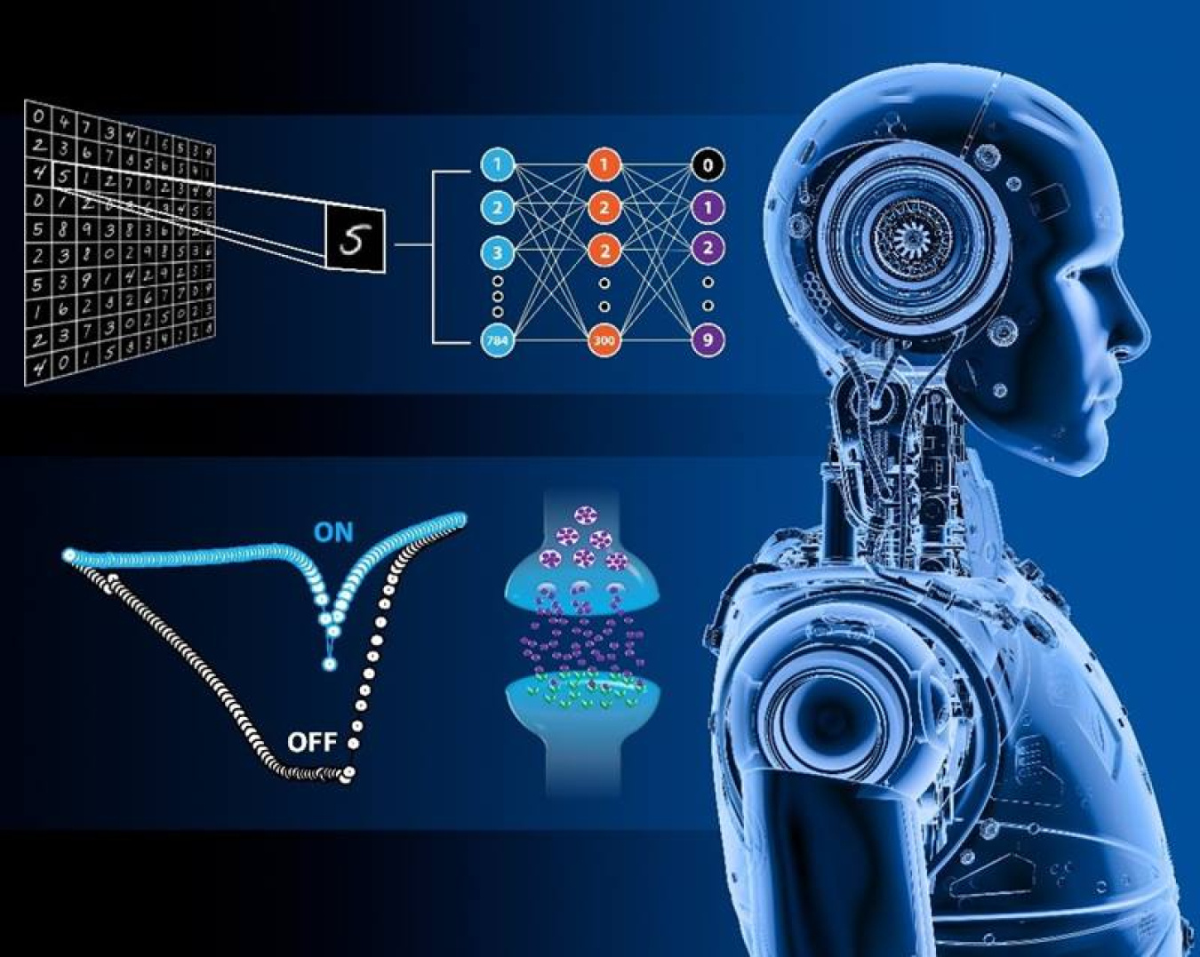
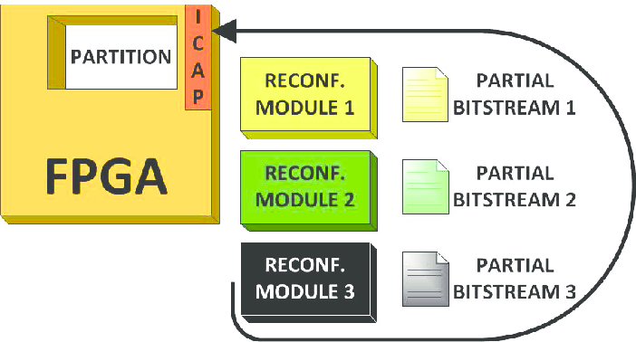
Motivations
The energy crisis of modern AI.
Autonomous edge intelligence.
Real-time adaptability.
Hardware flexibility.
https://share.google/I9affowh3Ti4GoC6X
Gambardella, Giulio, Di Carlo, Stefano, Prinetto, Paolo, Rolfo, Daniele, Trotta, Pascal, Bao, Trong. 2013. ZipStream: Improving dependability in dynamic partial reconfiguration. 2013 8th IEEE Design and Test Symposium, IDT 2013

Slide 4
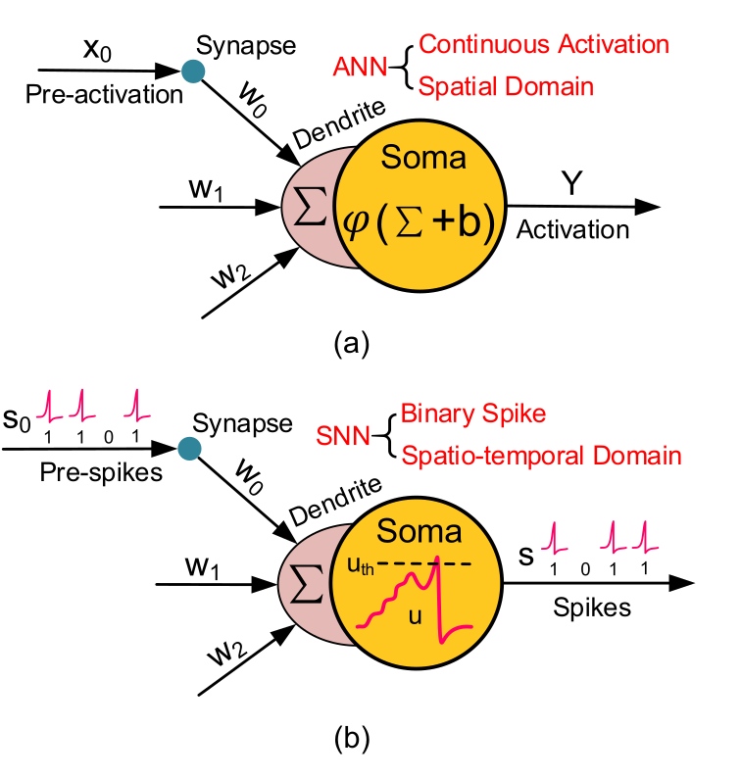
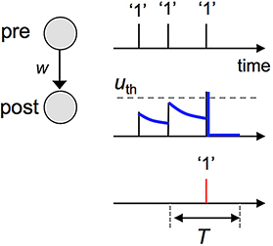
Spiking Neural Network
https://share.google/EnQHLNoh3SoGb7LJd
Event-driven and sparse activation.
Spatio-temporal information.
Discrete binary communication.
Basic neuron model in an ANN compared to an SNN. Picture taken from Deng et al. 2020.

Slide 5
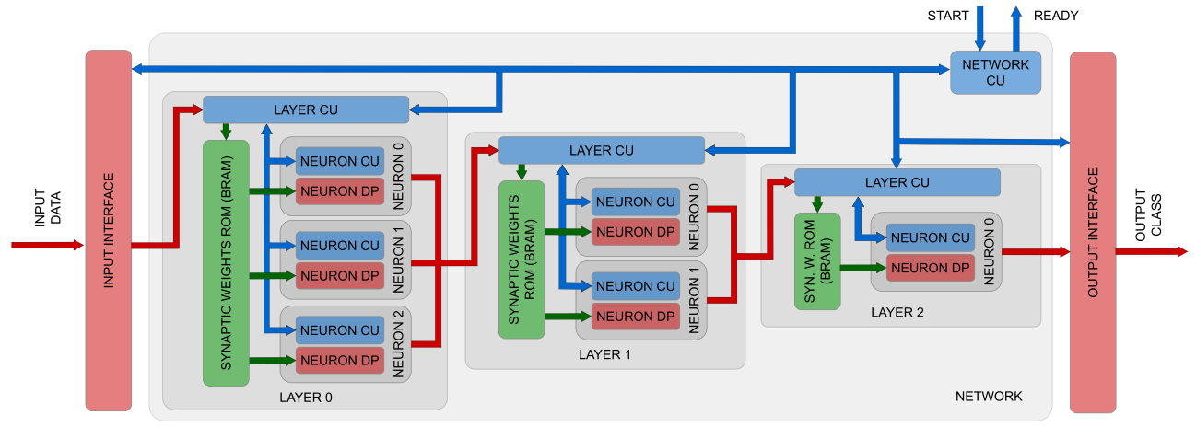
Spiker+ Framework
A. Carpegna, A. Savino and S. D. Carlo, "Spiker+: A Framework for the Generation of Efficient Spiking Neural Networks FPGA Accelerators for Inference at the Edge"
Notes:
depicts the high-level architecture of a toy example of a three-layer FF-FC architecture used to introduce the three hierarchical levels of Control Units (CUs) that characterize Spiker+: i) the network CU, responsible for synchronizing the various components within the network; ii) the layer CUs, orchestrating the update of the neurons of a layer based on a set of input spikes; iii) the neuron CU: the accelerator core controlling the update of the membrane potential in each neuron. This organization represents a highly optimized architecture in terms of performance and space utilization.

Slide 6
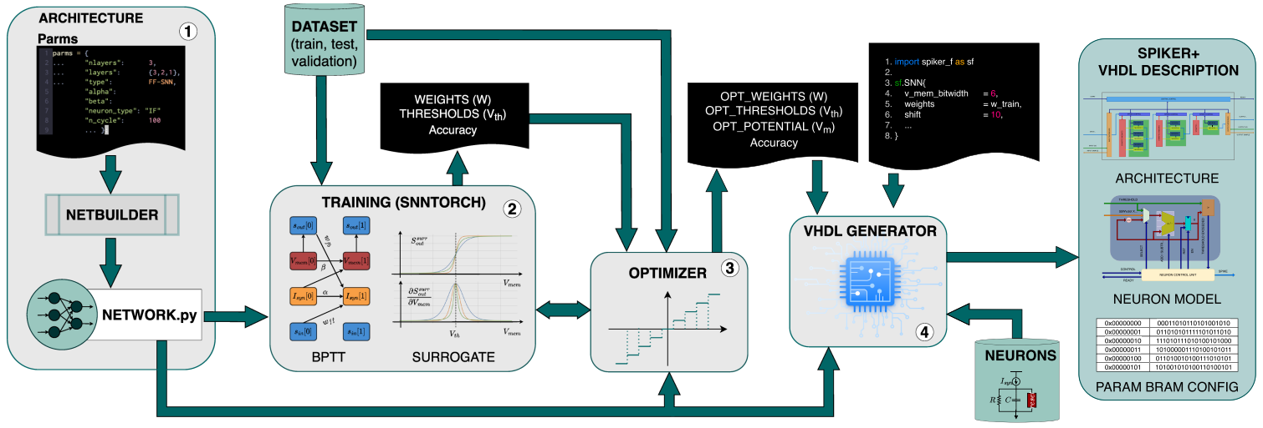
Spiker+ Framework
A. Carpegna, A. Savino and S. D. Carlo, "Spiker+: A Framework for the Generation of Efficient Spiking Neural Networks FPGA Accelerators for Inference at the Edge"
Notes:
2. The outcome of the training phase includes a set of learned parameters such as weights and thresholds along with an accuracy evaluation of the trained model.
3. As training typically occurs in floating-point precision, unsuitable for edge hardware accelerators, Spiker+ implements functions to quantize the network, automating the exploration of the quantization impact on SNN accuracy (step 3).

Slide 7
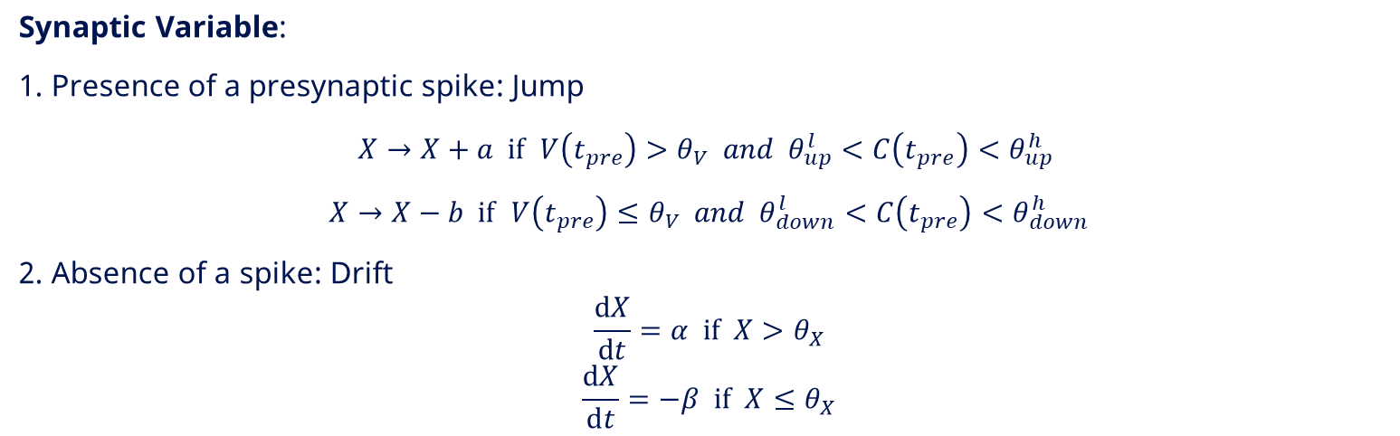
Spike-Driven Synaptic Plasticity
Neuron Model:
$$\frac{ⅆV}{ⅆt}=−λ+I\left(t\right)$$
Calcium Variable:
$$\frac{ⅆC\left(t\right)}{ⅆt}=−\frac{1}{τ_{c}}C{\left(t\right)}^{+J}c\sum_{i}{δ\left(t−t_{i}\right)}$$
Synaptic Variable:
1. Presence of a presynaptic spike: Jump
$X→X+a if$ $V\left(t_{pre}\right)>θ_{V} and { θ}_{up}^{l}<C\left(t_{pre}\right)<θ_{up}^{h}$
$X→X−b if$ $V\left(t_{pre}\right)≤θ_{V} and θ_{down}^{l}<C\left(t_{pre}\right)<θ_{down}^{h}$
2. Absence of a spike: Drift
$$\frac{ⅆX}{ⅆt}=α if X>θ_{X}$$
$$\frac{ⅆX}{ⅆt}=−β if X≤θ_{X}$$
Notes:
SDSP is based on the event and the state of the postsynaptic neuron

Slide 8
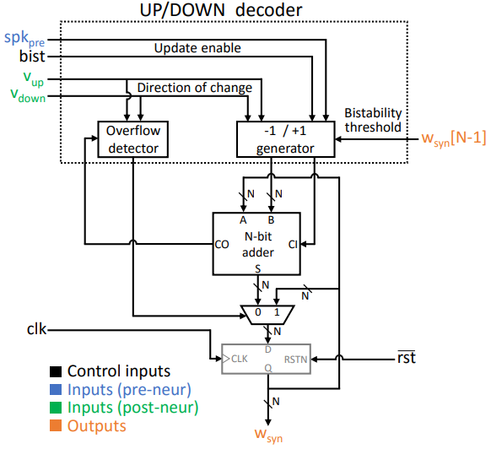
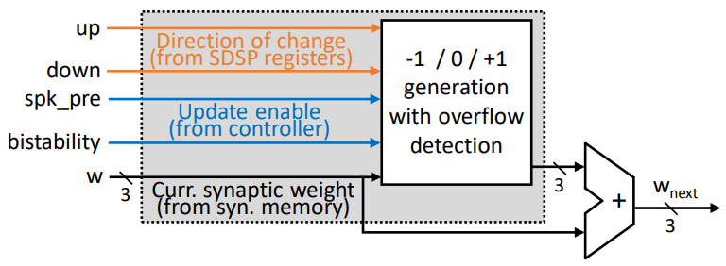
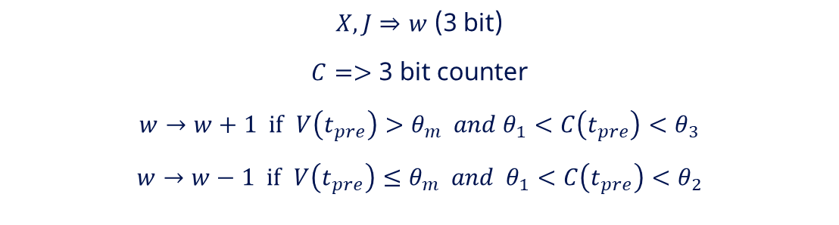
SDSP Simplification for Implementation
$X,J⇒w$ (3 bit)
$C=>$ 3 bit counter
$w→w+1 if$ $V\left(t_{pre}\right)>θ_{m} and θ_{1}<C\left(t_{pre}\right)<θ_{3}$
$w→w−1 if$ $V\left(t_{pre}\right)≤θ_{m} and θ_{1}<C\left(t_{pre}\right)<θ_{2}$
Notes:
SDSP is based on the event and the state of the postsynaptic neuron

Slide 9
What‘s Next?
Spiker+ SNN generation.
Design and optimization of the SDSP architectural model.
SDSP model implementation, simulation and validation.
SDSP integration with the generated network.
Apply partial reconfiguraion.
Test and evaluation.
Result comparison.
Report and final presentation.

Slide 10
Timeline
Literature review
May 15 - Aug 31
Spiker+ investigation
May 20 - Jun 7
SNN generation
Jun 8 - Jun 21
SDSP architecture design
Jun 15 - Jun 21
SDSP model RTL implementation, simulation and validation
Jun 22 - Jul 12
SDSP integration with the network
Jul 13 - Jul 26
System optimization & FPGA test
Jul 20 - Jul 31
Apply partial reconfiguration
Aug 1 - Aug 16
Test and evaluation
Aug 17 - Aug 30
Report & Final presentation
Aug 17 - Oct 9
May
Jun
Jul
Aug
Sep
Oct
2026
Notes:
depicts the high-level architecture of a toy example of a three-layer FF-FC architecture used to introduce the three hierarchical levels of Control Units (CUs) that characterize Spiker+: i) the network CU, responsible for synchronizing the various components within the network; ii) the layer CUs, orchestrating the update of the neurons of a layer based on a set of input spikes; iii) the neuron CU: the accelerator core controlling the update of the membrane potential in each neuron. This organization represents a highly optimized architecture in terms of performance and space utilization.

Slide 11
Thank You!

