Slide 1
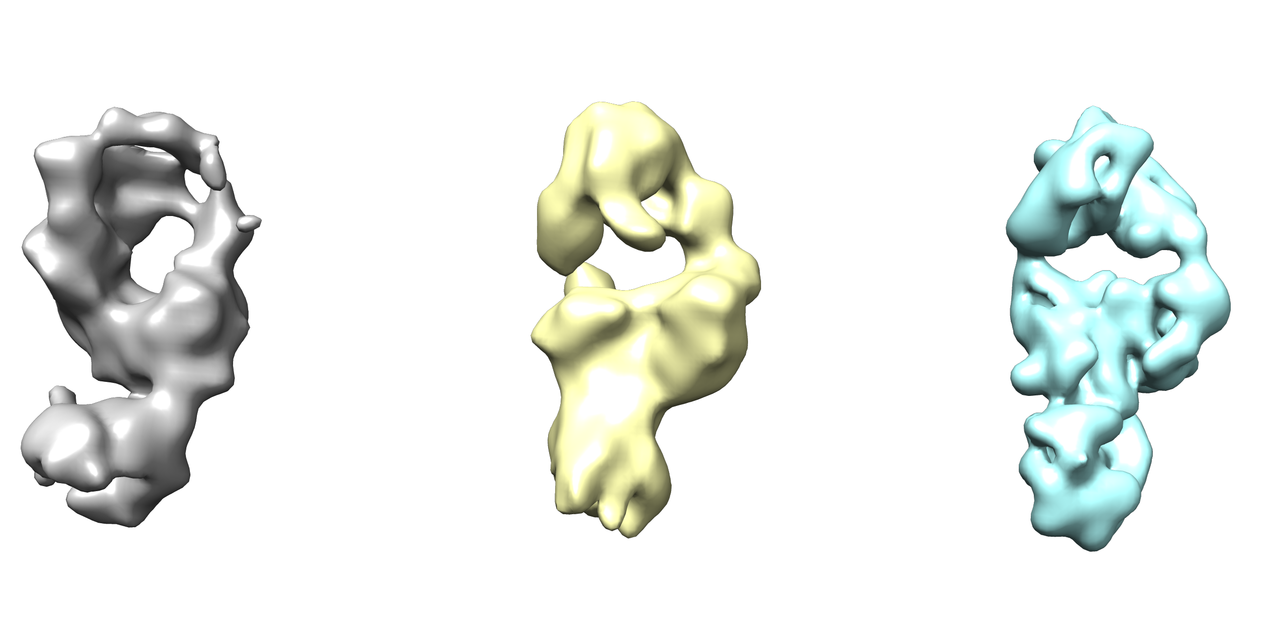
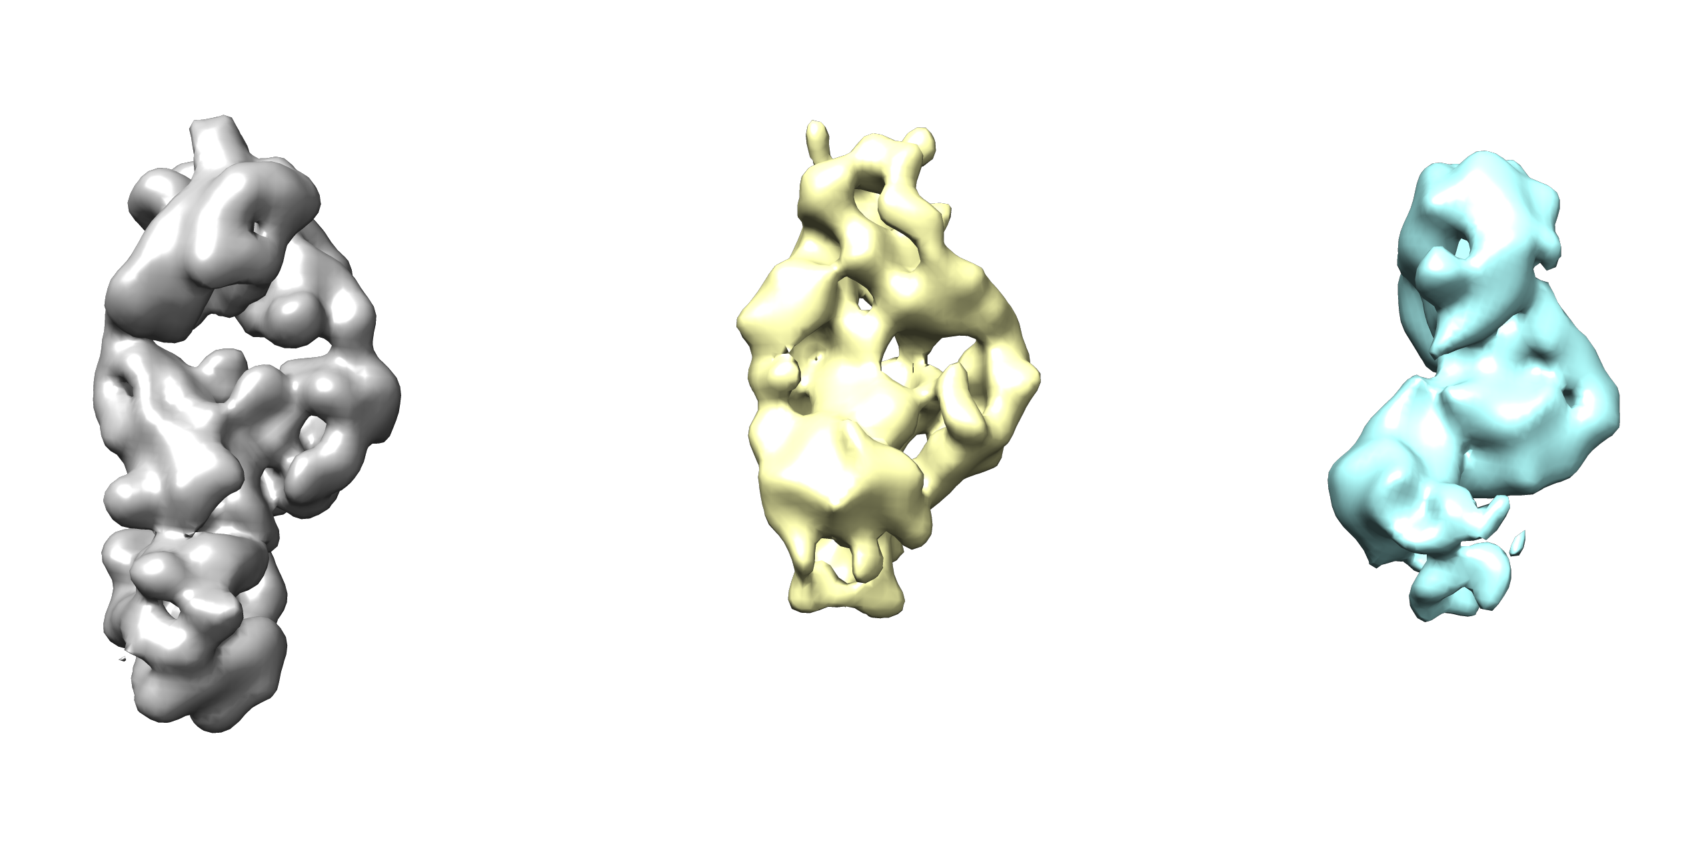
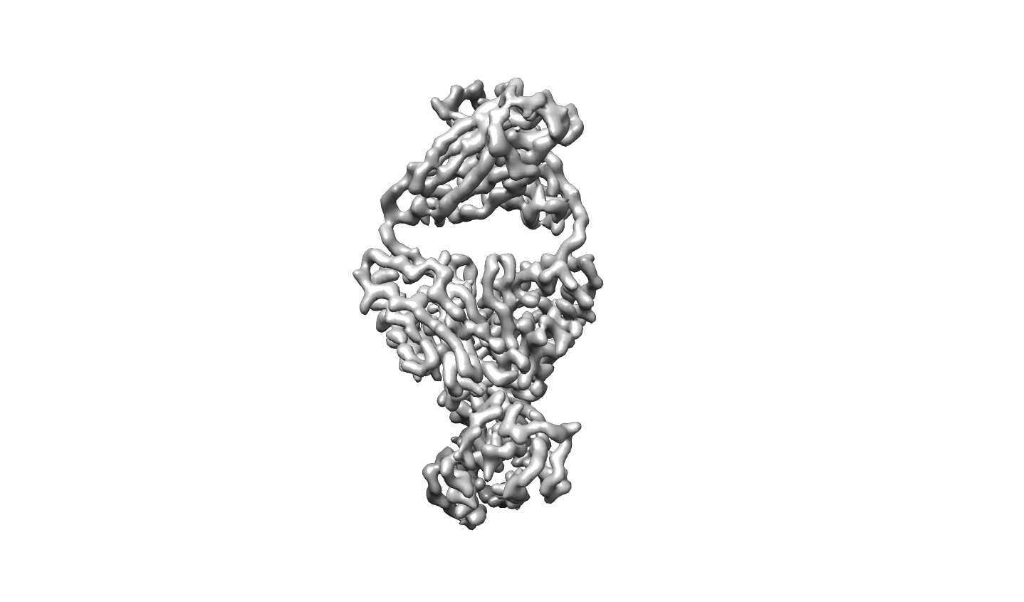
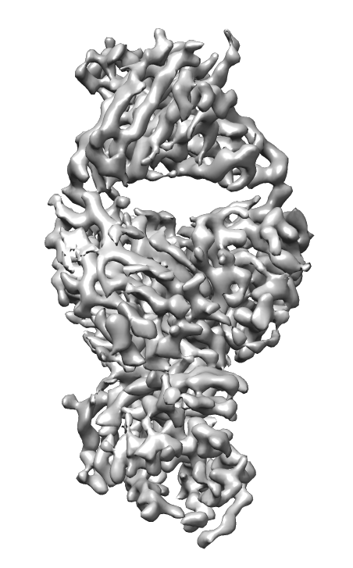
Auto pick
14,482 Micrographs
4980K particles
2*Hetero refinement
32.9%
1638k particles
Hetero refinement
26.3%
431k particles
Non-uniform refinement
DeepEMhancer
C1, 3.46Å

