Slide 1
BAN204 – Final Project Clustering Analysis ETH and S&P 500 Companies Jingyi wang

Slide 2

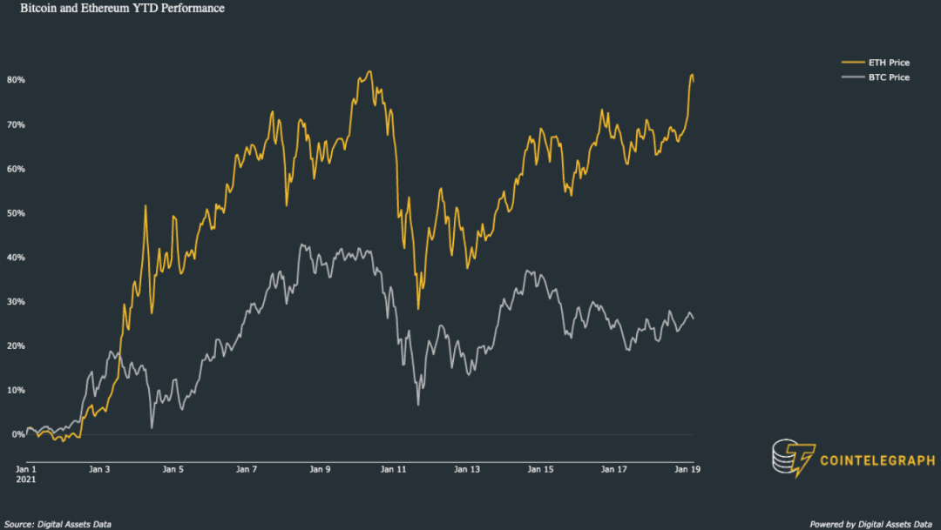
Summary
Ethereum is up about 81% since Jan. 1st of this year, well above Bitcoin's 26%.
As someone who is new to the US stock market and the cryptocurrency world, I was curious about which public companies would have a strong correlation with the rise and fall of Ether, and about people's attitudes towards it.

Slide 3


Summary
Collecting Data
Explore Data
Setup Model
Evaluate Model
Modify Variables
My hypothesis is that companies that are highly correlated will be affected by the same positive or negative news, and thus they should converge in market performance.
I hope to find these companies by organizing the collected data into meaningful indicators and performing unsupervised cluster analysis based on them.
Theoretically, we can find price pockets or investment opportunities by comparing the market performance of these companies in the short term, which can also help us diversify risk when choosing an asset portfolio.
SEMMA

Slide 4
DATASET SELECTION
For Clustering analysis:
I selected historical trading data for 504 S&P 500 companies and ETH-USD
attributes including daily adj Close, Close Price, High, Low, Open, and Volume.
Training set (9/1/2021 to 11/31/2021)
Testing set (1/1/2021 to 2/28/2021)
Only based on the market performance of stock prices and does not reflect the fundamental dimension of these companies.
For Social Media Analysis:
I filtered 10,000 twitter posts containing the words "ETH", "Ethereum".

Slide 5
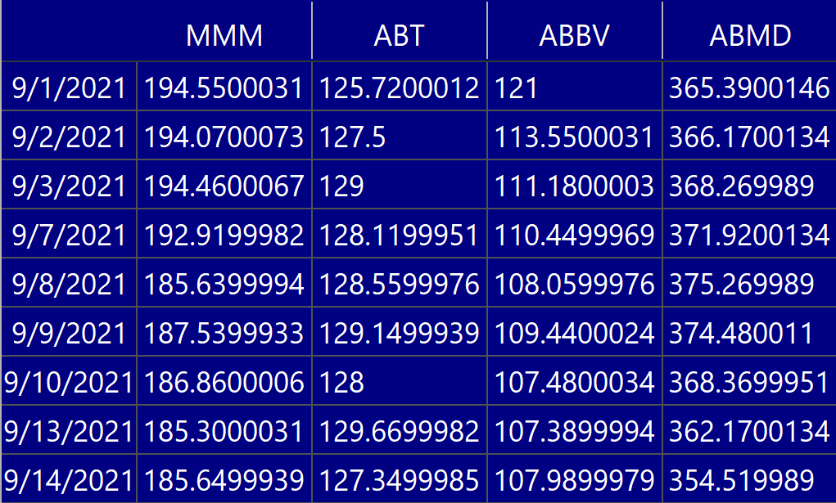
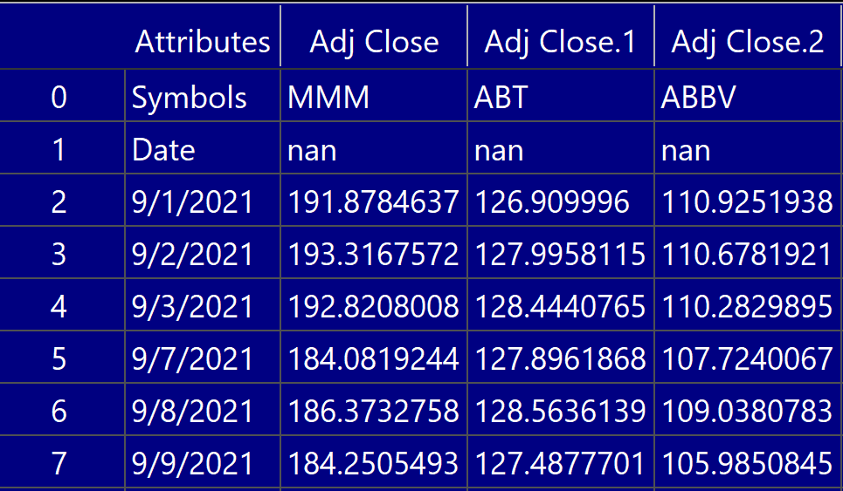
Data Preprocessing
STEP 1: I first found a list of all the S&P 500 stock symbols from the Wikipedia; (urllib.request)
STEP 2: Collect data on the Yahoo for two different time periods; (pandas_datareader)
STEP 3: Remove missing data; (pandas, numpy)
63*3030, two hierarchy levels of indexes
two stocks lacking any data.
STEP 4: Split the raw data into 6 tables according to different attributes.
Take Open.csv for example:

Slide 6
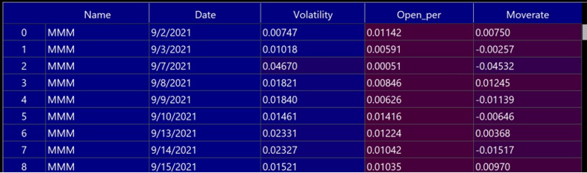
Data Preprocessing
STEP 5: Calculate the desired indicators
Volatility Rate = (High – Low)/Open
Movement Rate = (Today’s Close Price – Yesterday’s Close Price)/Yesterday’s Close Price
Opening Performance = (Today’s Open Price – Yesterday’s Close Price)/Yesterday’s Close Price
STEP 6: Combine the above three tables together and flatten the table
The final table was obtained in the following format: 30269 rows by 5 columns
STEP 7: Prepare the testing set in the same way as above (step 3 to step 6).

Slide 7
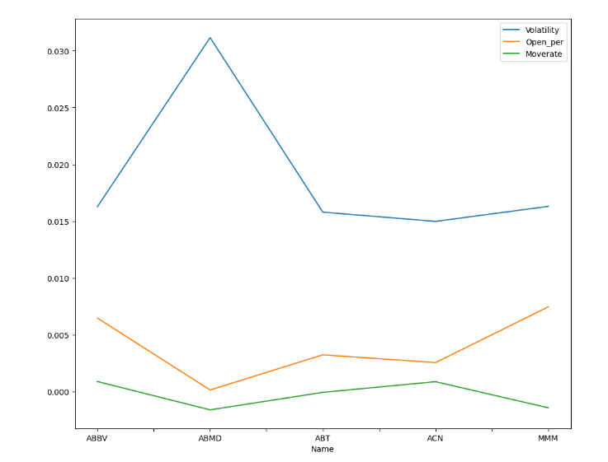
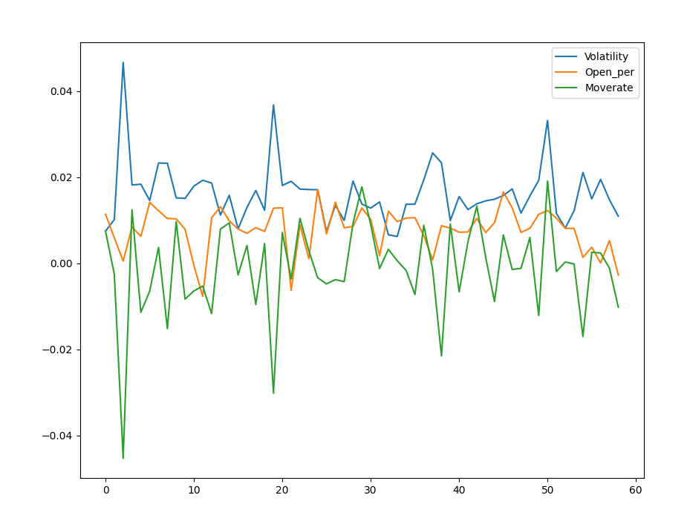
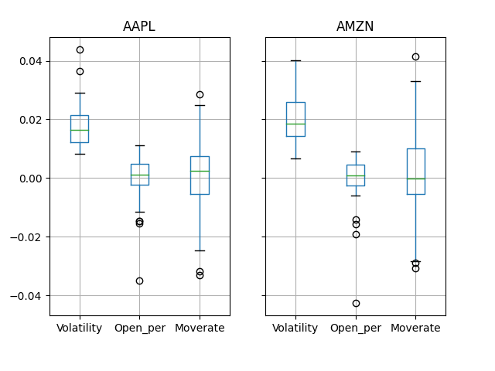
Analysis
1. Descriptive Analysis:
First chart shows that there is a large difference between the indicators of different stocks (any 5 stocks) on the same day
The second chart shows the performance of the stock MMM over 60 trading days, and we can pay particular attention to these peaks.
Hoteling T/MANOVA：Using boxplots to compare market performance between stocks
the distribution of AAPL and AMZN on the three indicators over a 60-day period.

Slide 8
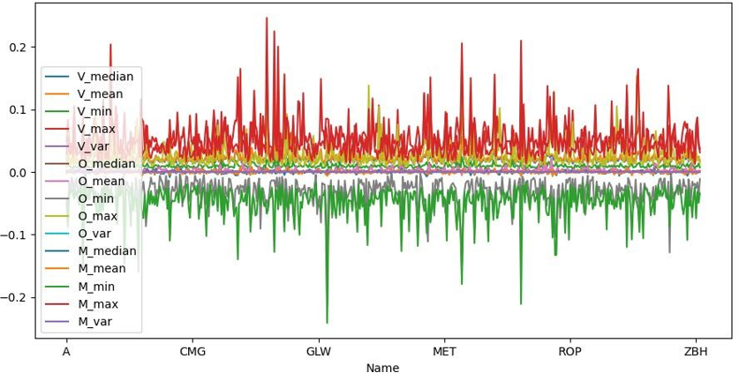
Analysis
2. Clustering Analysis: K-means
Flatten the dataset:
Convert time series to: max, min, mean, median, var;
perform cluster analysis on this basis

Slide 9
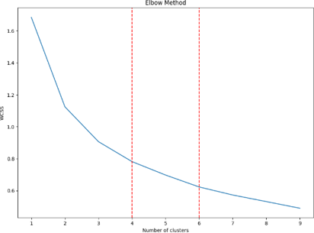
Analysis
Elbow Method:
Based on the Elbow Method, I decided to try to divide the data into 4 groups (K=4) or 6 groups (K=6)
K-Means:
Find the set of stocks with the same
classification as ETH-USD and take the merged set to get a total of 22 stocks
Multiple experiments:
Repeating the previous steps using testing set, obtain 20 stocks, 18 of which were the same as the original classification.

Slide 10
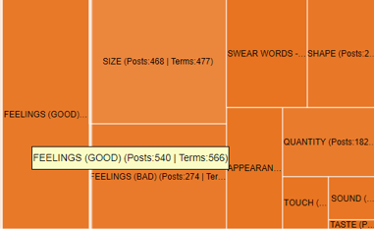
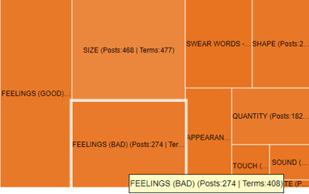
Analysis
3. Social Media Analysis using Netlytic:
Text Analysis:
There were more positive feelings being expressed in these posts:
540 Positive Posts vs 274 Negative Posts

Slide 11
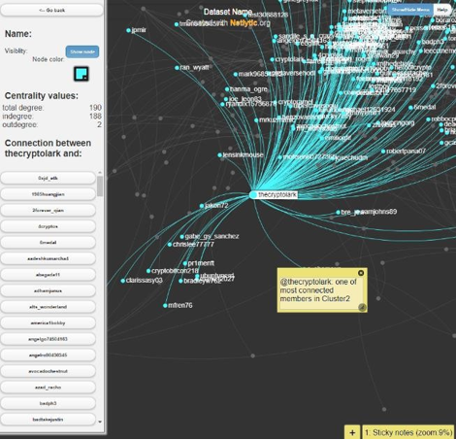

Analysis
Network Analysis: I found a few interesting twitter users :)

Slide 12
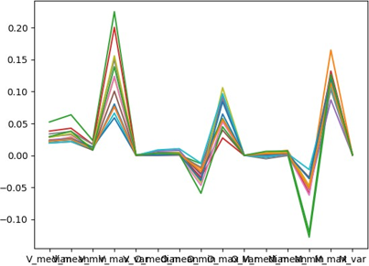
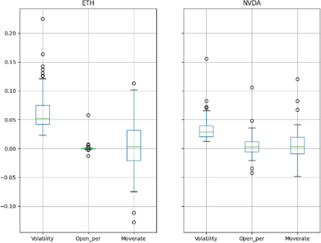
What did I find?
The clustered stocks show a clear trend towards similar market performance relative to the initial haphazard charts.
The classification is stable that the same stocks do not have significantly different clustering results depending on the time period in which the data was collected.
I do find a clear chain of industries related to blockchain computing resources.
NVDA (NVIDIA): a fabless semiconductor company that designs and sells graphics processors;
AMD (Advanced Micro Devices, Inc.): that develops computer processors and related technologies;
TSLA is also in the list.

Slide 13
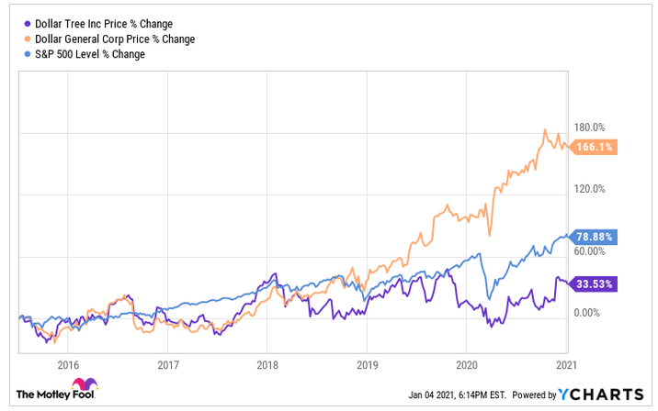
Conclusions
In this list, there are also stocks that are not so much related to Ether, such as "DLTR" (Dollar Tree):
It is said that there is an aggressive investor who causes its share price to fluctuate abnormally, which means it could be a coincidence due to other factors.
We can conclude by saying that all these companies have had relatively large stock movements in recent times and have shown a clear upward trend overall.
final_list: ['BEN', 'DLTR', 'ETH', 'ETSY', 'AMD', 'FMC', 'LUMN', 'MTCH', 'NVDA', 'PFE', 'PWR', 'TER', 'TSLA']

Slide 14

References
Cluster analysis on stock selection​
https://towardsdatascience.com/clustering-analysis-on-stock-selection-2c2fd079b295​
Evolution of Financial Time Series Clusters.​
Azzalini, D., Azzalini, F., Mazuran, M., & Tanca, L. (2019). In SEBD.​
http://ceur-ws.org/Vol-2400/paper-12.pdf​
Clustering stock price time series data to generate stock trading recommendations: An empirical study. Binoy B. Niar, P.K. Saravana Kumar, N.R. Sakthivel, U.Vipin. (2017)​
https://doi.org/10.1016/j.eswa.2016.11.002​
Stock Clustering with Time Series Clustering in R
https://medium.com/@panda061325/stock-clustering-with-time-series-clustering-in-r- 63fe1fabe1b6​
Step by Step: Twitter Sentiment Analysis in Python​
https://towardsdatascience.com/step-by-step-twitter-sentiment-analysis-in-python-d6f650ade58d​
​Ethereum USD (ETH-USD) Price, Value, News & History​
https://finance.yahoo.com/quote/ETH-USD/
Appendices
1. python scripts
Packages including:
urllib.request,
ssl,
pandas_datareader,
- pandas,
- numpy,
datetime,
sklearn.cluster
matplotlib.pyplot.

