Slide 1
The explanation of differential privacy
Jing Li
Work with: Jia-Kai Chou

Slide 2
Differential Privacy
Proposed by Cynthia Dwork in 2006 (Dwork C. (2006) Differential Privacy. In: Bugliesi M., Preneel B., Sassone V., Wegener I. (eds) Automata, Languages and Programming. ICALP 2006. Lecture Notes in Computer Science, vol 4052. Springer, Berlin, Heidelberg)
A robust, meaningful, and mathematically rigorous definition of privacy
Notes:
Since Dp is a new measure that gives rigid and provable privacy guarantee. Its mathematically rigorous property makes it very successful and very popular but it decreases its understandability. It takes time to understand it but there's no good tutorial to make it easier. Visualization is used to help people understand things. Then we came up with an idea to build up an interactive website helping people learn dp. Since dp draws more and more attention, the need of understand it easily is increasing. Such a tool is necessary.

Slide 3
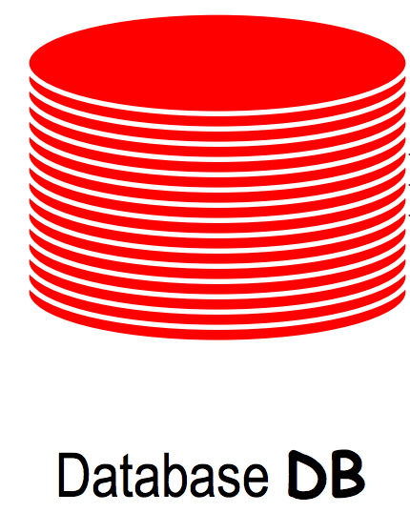
You
Query: the total age
Result A
The adversary can infer your age from: A-B
D1
Query: the total age
Result B
D2

Slide 4


The goal of differential privacy
query
Database with you D1
result A
query
Database without you D2
result B
$$≈$$
If result A $≈$ result B
The adversary can’t get any useful information of you from the query

Slide 5
Differential privacy promises individuals that no more additional harm they may face whether their data is in the dataset or not

Slide 6
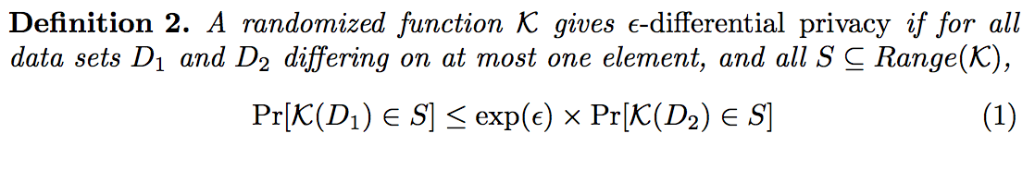
Differential Privacy
Notes:
the randomized function is the differential privacy mechanism which perturbs the true answer to a query by adding random noise generated by a distribution. For the same query, different datasets D1 and D2, if the ratio of the probability that we got the same response is within e to the s

Slide 7
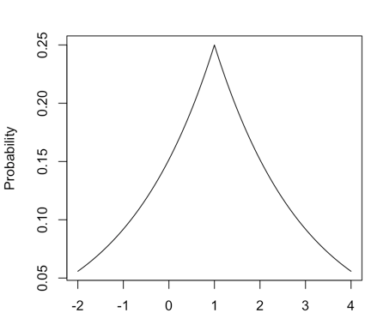


Differential Privacy
query
Database with you D1
result A
Mechanism M
True result
$$P\left[M\left(D1\right)=1\right]=0.25$$
$$P\left[M\left(D1\right)=0\right]=0.148$$
All possible responses
Range(M)
Notes:
Instead of answering the true result 1, the mechanism will give a random response like 1.8 generated by a distribution. For instance, there is 25% probability to answer 1. The probability of answering 0 is near 15%

Slide 8
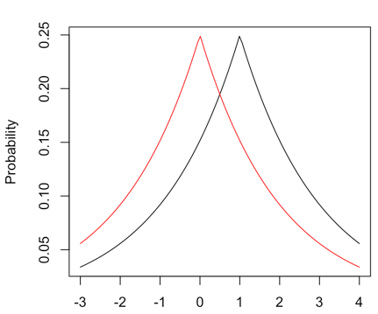









Differential Privacy
True result
query
Database with you D1
result A
Mechanism M
$$\frac{P\left[M\left(D1\right)=s1\right]}{}$$
$$\frac{P\left[M\left(D1\right)=s1\right]}{P\left[M\left(D2\right)=s1\right]}$$
$$\frac{P\left[M\left(D1\right)=s2\right]}{P\left[M\left(D2\right)=s2\right]}$$
$$\frac{P\left[M\left(D1\right)=s3\right]}{P\left[M\left(D2\right)=s3\right]}$$
$$\frac{P\left[M\left(D1\right)=s2\right]}{}$$
$$\frac{P\left[M\left(D1\right)=s4\right]}{}$$
$$\frac{P\left[M\left(D1\right)=s3\right]}{}$$
$$\frac{P\left[M\left(D1\right)=s4\right]}{P\left[M\left(D2\right)=s4\right]}$$
$$\left[e^{−ε},e^{ε}\right]$$
query
Database without you D2
result B
Mechanism M
s1
s2
s3
s4
……
All possible responses
Range(K)
Notes:
What is an s-dp mechanism? If we perform the same query on two different datasets differing on at most one element, the mechanism should give two similar response distributions. For any possible response, such as s1, the ratio of the probability that we got answer s1 generated by two distributions, should be within this range. If this relationship holds for any possible responses, then we say mechanism M gives…

Slide 9
Differential privacy is a statistical property of mechanism behavior, a definition, not an algorithm.

Slide 10
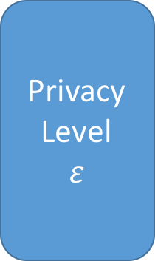
Explanation flow
Laplace mechanism
Composition Theory
Definition of Differential Privacy
Privacy Level
$$ε$$
Sensitivity of Functions
Building Block
Properties
Exponential mechanism
Post -Processing
How much noise
what shape
Notes:
This part tells you how much noise you should add to preserve a certain level of privacy and the building block includes two basic and widely used mechanisms for achieving differential privacy. The properties provides the mathematical foundations to combine these mechanisms creatively for a complicated task. So this flow not just let you know what is differential privacy, it also gives you a more high-level understanding of dp which encourages you to think of your own dp algorithm to achieve a specific task.

Slide 11
4 steps
Design explanation flow
Attempt to explain differential privacy with slides, based on this flow
Design detailed visualization (exploratory and interactive)
Build up an interactive website

