Slide 1
Differential Privacy

Slide 2
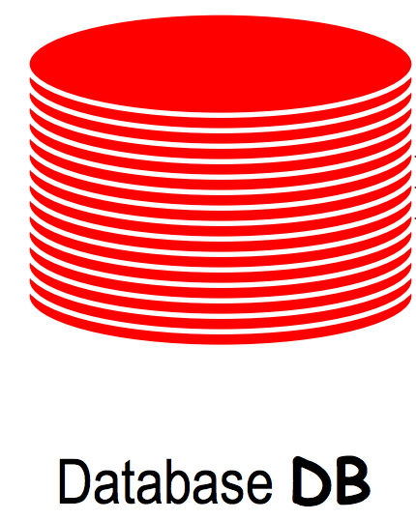
Query: the total age
Result A
The adversary can infer your age from: A-B
Query
Result

Slide 3
The Goal of differential privacy is masking such change caused by the addition or removal one single row in the database

Slide 4
Neighboring databases
Age | Eye Color | Lung cancer | Sex
20 | Brown | N | M
25 | Brown | N | F
38 | Blue | Y | M
45 | Green | Y | M
31 | Blue | N | F
52 | Brown | N | M
Age | Eye Color | Lung cancer | Sex
20 | Brown | N | M
25 | Brown | N | F
38 | Blue | Y | M
45 | Green | Y | M
31 | Blue | N | F
52 | Brown | N | M
An arbitrary row
D1
D2
If database D2 is database D1 removing or adding one single row, we call D1 and D2 neighboring database

Slide 5


The goal of differential privacy
query
Database with you D1
result A
query
Database without you D2
result B
$$≈$$
If result A $≈$ result B
The adversary can’t get any information of you from the query

Slide 6
Differential privacy promises individuals that no more additional harm they may face whether their data is in the dataset or not

Slide 7
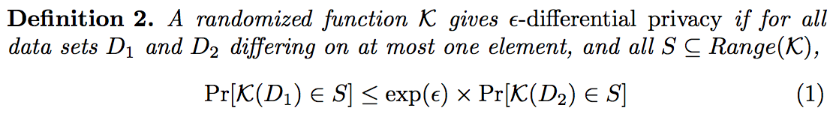
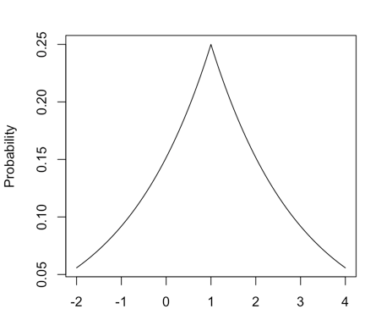
Differential Privacy
query
Database with you D1
result A
Mechanism M
True result
All possible responses
Range(K)

Slide 8
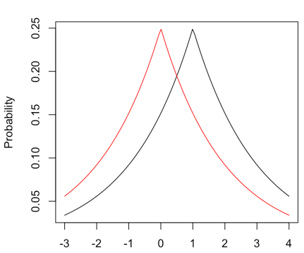


Differential Privacy
$$\frac{Pr\left[M(D1)\right]=c}{Pr\left[M(D2)\right]=c}$$
True result
query
Database with you D1
result A
Mechanism M
$$\left[e^{−ε},e^{ε}\right]$$
query
Database without you D2
result A
Mechanism M
c1
c2
c3
c4
All possible responses
Range(K)

Slide 9
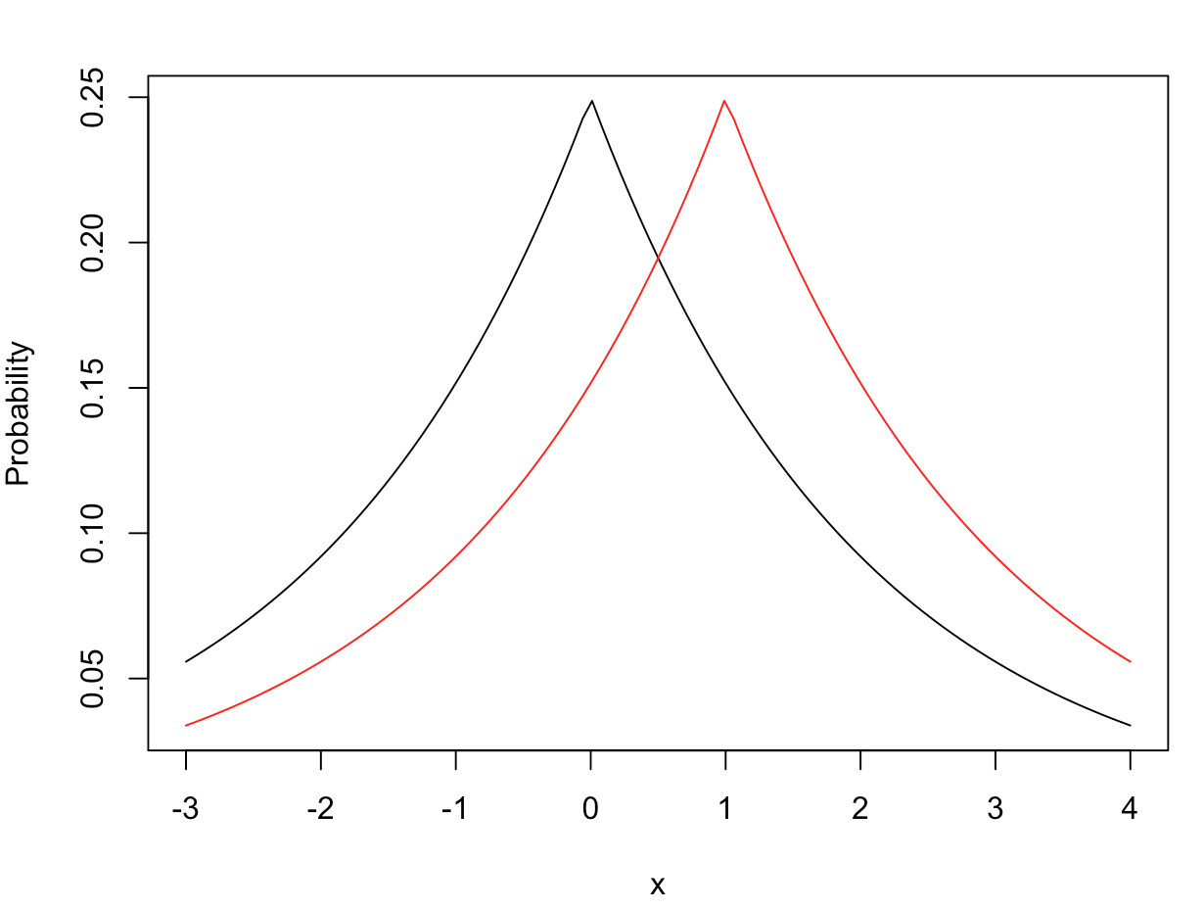

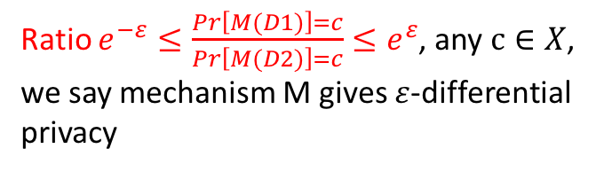


$ε$-differential privacy
Ratio $e^{−ε}≤\frac{Pr\left[M(D1)\right]=c}{Pr\left[M(D2)\right]=c}≤e^{ε}$, any $c∈X$, we say mechanism M gives $ε$-differential privacy
$$Pr\left[M(D1)\right]$$
$$Pr\left[M(D2)\right]$$
ε is the level of privacy. Larger ε corresponds to less privacy and more accurate statistics (We do not recommend ε exceeding 1)
X = Range(K)

Slide 10
Differential privacy is a statistical property of mechanism behavior, a definition, not an algorithm.

Slide 11
You can design your own algorithm/mechanism to achieve a task in an
ε-differentially private manner.
Thing you need to consider:
What noise with what shape you should add?
How much of it?

Slide 12
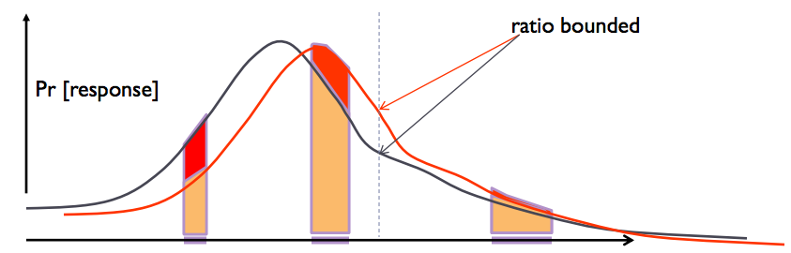


How much noise should we add?
Privacy level $ε$
Sensitivity $∆f$
Privacy level $ε$
Sensitivity

Slide 13
Sensitivity*
Age | Eye Color | Lung cancer | Sex
20 | Brown | N | M
25 | Brown | N | F
38 | Blue | Y | M
45 | Green | Y | M
31 | Blue | N | F
52 | Brown | N | M
function f(D):
the total age
211
* Here we all mean global sensitivity

Slide 14
Sensitivity
Age | Eye Color | Lung cancer | Sex
20 | Brown | N | M
25 | Brown | N | F
38 | Blue | Y | M
45 | Green | Y | M
31 | Blue | N | F
52 | Brown | N | M
Function f(D):
the total age
211
191
186
largest
180
173
166
159

Slide 15
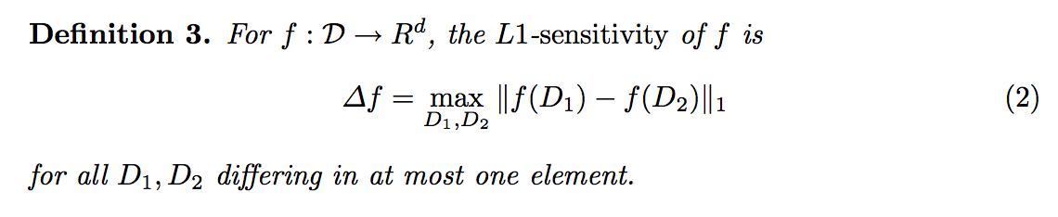
Sensitivity
For any function f and dataset D, the largest change of the function output f(D) made by removing one single row of the datasets is called sensitivity (global sensitivity)
211
Largest
Sensitivity of function f
159

Slide 16
Sensitivity
How many people have brown eyes? Sensitivity 1
Properties:
For multiple functions, the sensitivity equals the sum of sensitivity of each function
Example:
How many people have brown eyes, how many have lung cancer? Sensitivity 2
How many people have brown eyes, how many have blue eyes, how many have green eyes? Sensitivity 3
Influences only one bin
Histogram
Sensitivity 1
Histogram has sensitivity 1, since the removal of one single row only influences one bin in the histogram.

Slide 17
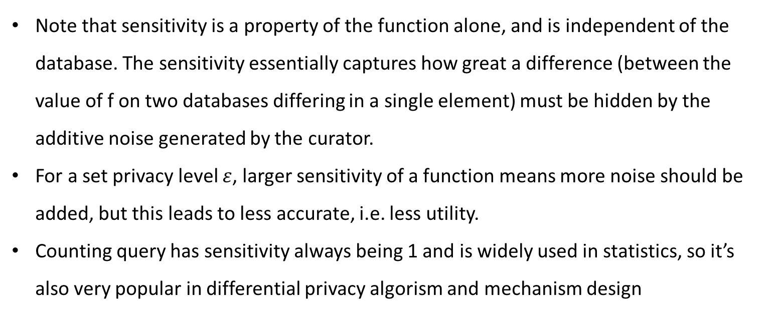
How much noise should we add?
Note that sensitivity is a property of the function alone, and is independent of the database. The sensitivity essentially captures how great a difference (between the value of f on two databases differing in a single element) must be hidden by the additive noise generated by the curator.
For a set privacy level $ε$, larger sensitivity of a function means more noise should be added, but this leads to less accurate, i.e. less utility.
Counting query has sensitivity always being 1 and is widely used in statistics, so it’s also very popular in differential privacy algorism and mechanism design

Slide 18
What noise with what shape?
Numerical
Laplace distribution (Laplace mechanism)
Non-numerical
Exponential distribution (exponential mechanism)
These two mechanisms are commonly used

Slide 19
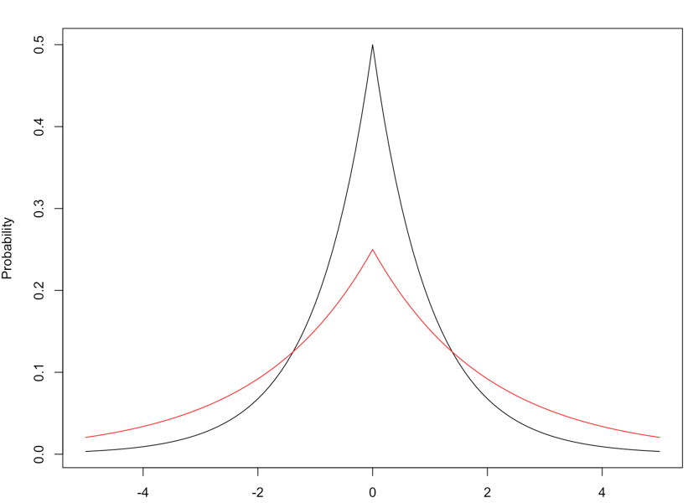
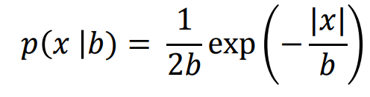
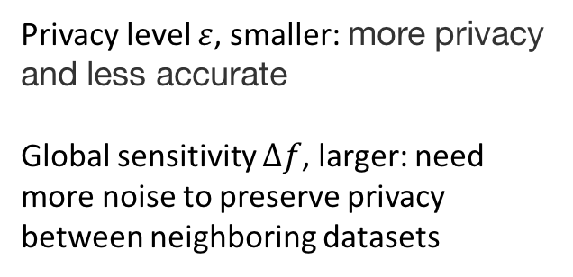
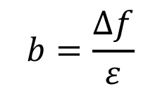
The Laplace Mechanism
b
smaller noise, less privacy, more utility
Privacy level $ε$, smaller: more privacy and less accurate
Global sensitivity $∆f$, larger: need more noise to preserve privacy between neighboring datasets
Larger noise, more privacy, less utility
b
$$b=\frac{Δf}{ε}$$

Slide 20
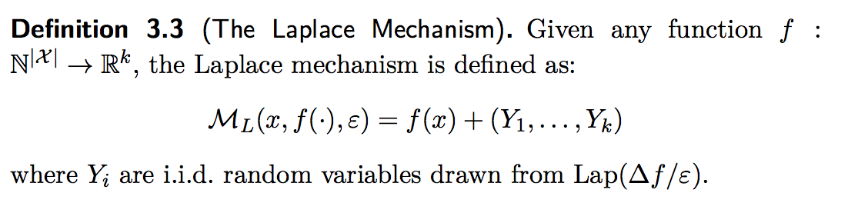
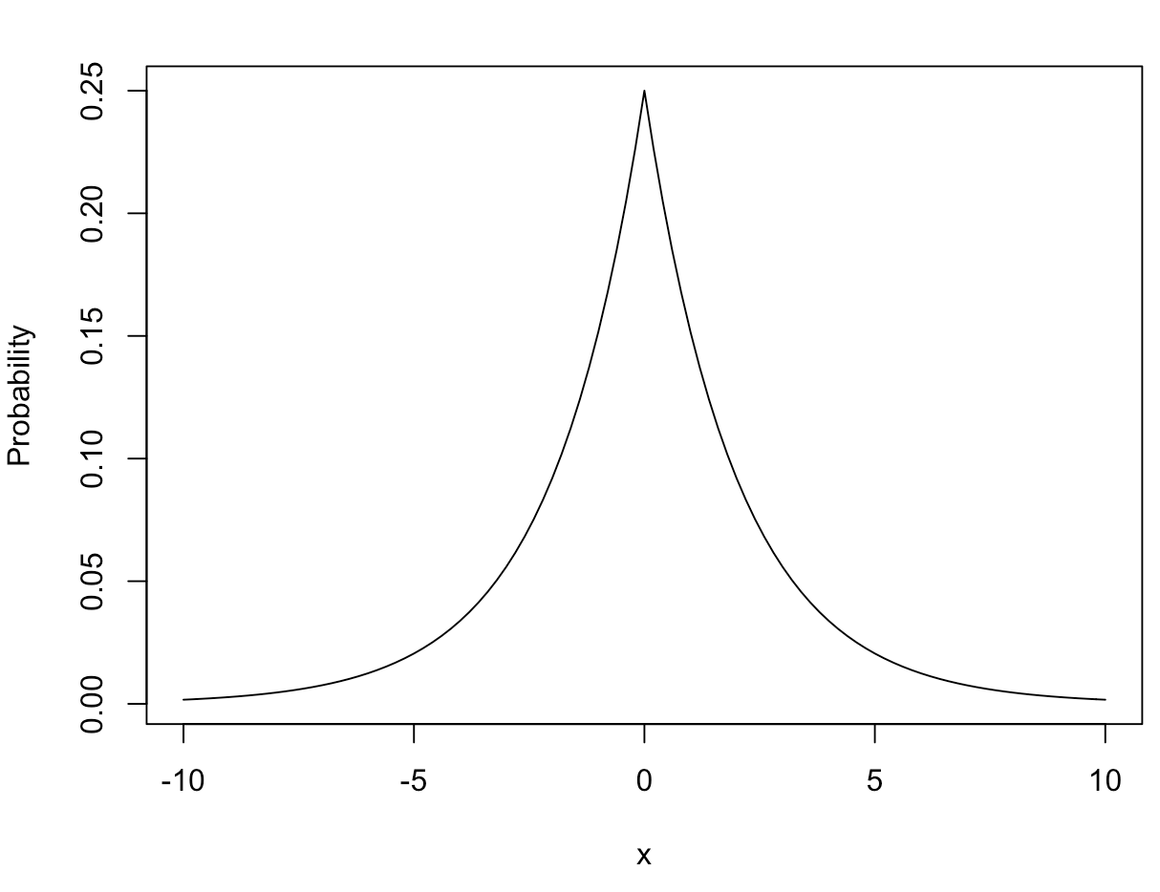
The Laplace Mechanism
True result
Answer the query randomly from this distribution.
Possible answers

Slide 21
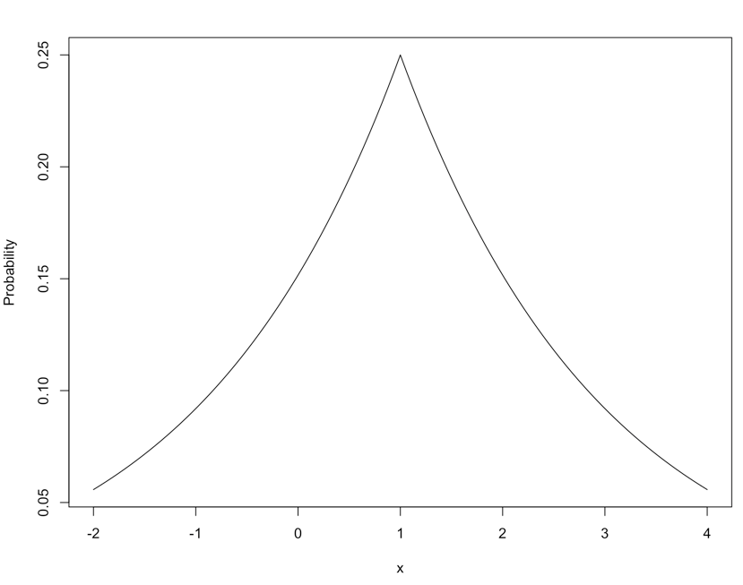
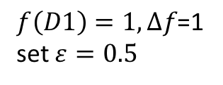


The Laplace Mechanism
Query:
How many people have green eyes?
function $f$
Answer: 1.5
Dataset D1
$$p\left(x\right)=\frac{2ε}{∆f}exp\left(−\frac{ε|x|}{∆f}\right)$$
Age | Eye Color | Lung cancer | Sex
20 | Brown | N | M
25 | Brown | N | F
38 | Blue | Y | M
45 | Green | Y | M
31 | Blue | N | F
52 | Brown | N | M
$f\left(D1\right)=1,∆f\text{=1}$ set $ε=0.5$

Slide 22
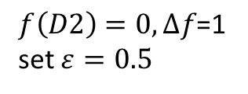


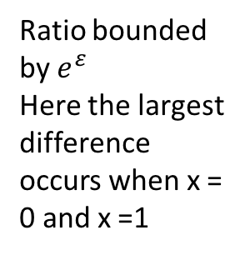

The Laplace Mechanism
Laplace mechanism gives $ε$-differential privacy
Dataset D2
$$p\left(x\right)=\frac{2ε}{∆f}exp\left(−\frac{ε|x|}{∆f}\right)$$
Age | Eye Color | Lung cancer | Sex
20 | Brown | N | M
25 | Brown | N | F
38 | Blue | Y | M
45 | Green | Y | M
31 | Blue | N | F
52 | Brown | N | M
$$P_{D1}$$
$$P_{D2}$$
$f\left(D2\right)=0,∆f\text{=1}$ set $ε=0.5$
Ratio bounded by $e^{ε}$
Here the largest difference occurs when x = 0 and x =1
$$\frac{P_{D1}\left(x=0\right)}{P_{D2}\left(x=0\right)}={\frac{2×0.5}{1}exp\left(−\frac{0.5×0}{1}\right)}/{\frac{2×0.5}{1}exp\left(−\frac{0.5×1}{1}\right)}=exp\left(0.5\right)$$

Slide 23
The Laplace Mechanism
Using this mechanism, sensitivity shouldn’t be large. Counting queries are good examples

Slide 24
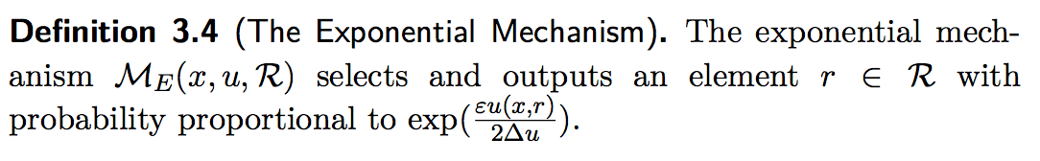
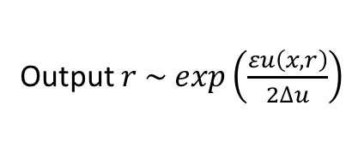
The Exponential Mechanism
Output $r \sim exp\left(\frac{εu\left(x,r\right)}{2∆u}\right)$
$u\left(x, r\right)$ is scoring function, design your own $u\left(x, r\right)$ based on different queries
$∆u$ is sensitivity of function $u\left(x, r\right)$

Slide 25
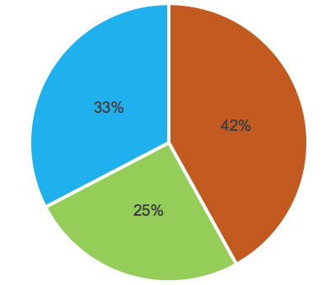
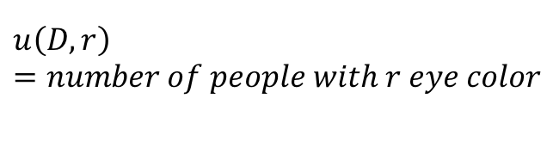
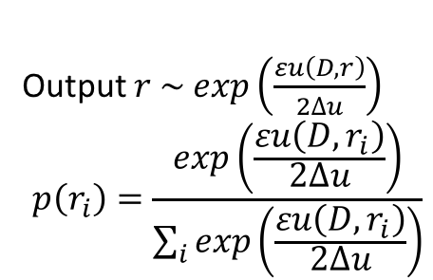


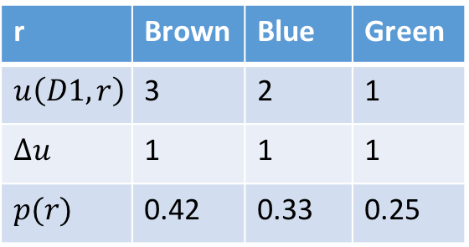

The Exponential Mechanism
Output $r \sim exp\left(\frac{εu\left(D,r\right)}{2∆u}\right)$
$$p\left(r_{i}\right)=\frac{exp\left(\frac{εu\left(D,r_{i}\right)}{2∆u}\right)}{\sum_{i}{exp\left(\frac{εu\left(D,r_{i}\right)}{2∆u}\right)}}$$
Query: What’s the most common eye color in this company?
Age | Eye Color | Lung cancer | Sex
20 | Brown | N | M
25 | Brown | N | F
38 | Blue | Y | M
45 | Green | Y | M
31 | Blue | N | F
52 | Brown | N | M
$$ε=0.5$$
R = {Brown, Blue, Green} , $r∈R$
$$u\left(D,r\right)=number of people with r eye color$$
$∆u=1$ is sensitivity of $u\left(x,r\right)$
r | Brown | Blue | Green
$$u\left(D1,r\right)$$ | 3 | 2 | 1
$∆u$ | 1 | 1 | 1
$p(r)$ | 0.42 | 0.33 | 0.25
Spin the wheel
D1

Slide 26
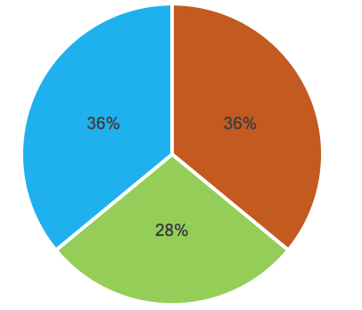
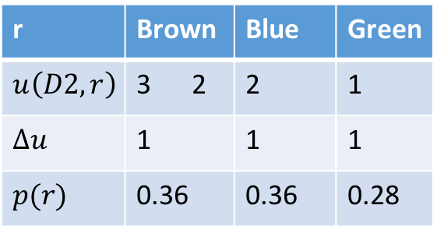
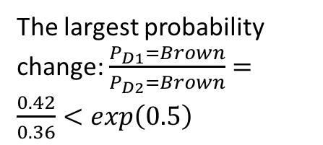
The Exponential Mechanism
Exponential mechanism gives $ε$-differential privacy
Age | Eye Color | Lung cancer | Sex
20 | Brown | N | M
25 | Brown | N | F
38 | Blue | Y | M
45 | Green | Y | M
31 | Blue | N | F
52 | Brown | N | M
r | Brown | Blue | Green
$$u\left(D2,r\right)$$ | 3 2 | 2 | 1
$∆u$ | 1 | 1 | 1
$p(r)$ | 0.36 | 0.36 | 0.28
The largest probability change: $\frac{P_{D1}=Brown}{P_{D2}=Brown}=\frac{0.42}{0.36}<exp\left(0.5\right)$
D2
Spin the wheel
Spin the wheel

Slide 27
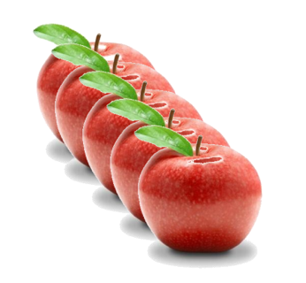
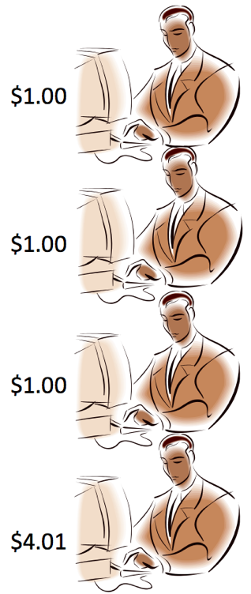
The Exponential Mechanism
How much should I sale the apple?
Bidding
Set price at $1
Four people will buy
$1
$1
$1
$1
profit
$4
$1x4 people

Slide 28
The Exponential Mechanism
How much should I sale the apple?
Bidding
Set price at $1.01
One
$1.01
profit
$1.01
$1.01*1

Slide 29
The Exponential Mechanism
How much should I sale the apple?
Bidding
Set price at $4.01
$4.01
profit
$4.01

Slide 30
The Exponential Mechanism
How much should I sale the apple?
Bidding
Set price at $4.02
profit
$0

Slide 31






The Exponential Mechanism
How much should I sale the apple?
Dataset (D)
R = {$0.10, $0.11, $0.12, …, $1.00, $1.01, …, $4.99, $5.00} $r∈R$
Set price at $ $r$
…
$$\#(d_{i}>r)$$
$$r$
$$r$
profit
$$u\left(D,r\right)=r∗\#(d_{i}>r)$$
$4

Slide 32
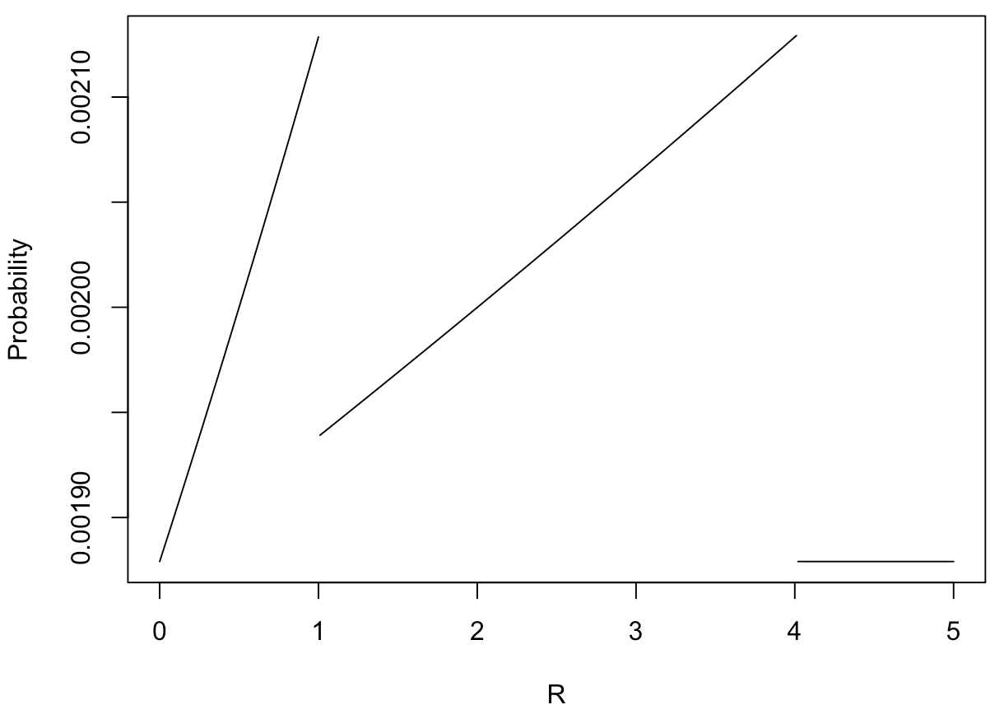
The Exponential Mechanism
Output $r \sim exp\left(\frac{εu\left(D,r\right)}{2∆u}\right)$
$$p\left(r_{i}\right)=\frac{exp\left(\frac{εu\left(D,r_{i}\right)}{2∆u}\right)}{\sum_{i}{exp\left(\frac{εu\left(D,r_{i}\right)}{2∆u}\right)}}$$

Slide 33




Privacy Budget $ε$
If you use mechanism more than once, i.e. multiple queries on the same database
Query 1
result 1
randomized mechanism M1
$ε_{1}$- DP
Query 2
result 2
randomized mechanism M2
$ε_{2}$- DP
Database
$ε_{1}$+$ε_{2}$+…+$ε_{n}$
…
…
…
Query n
result n
randomized mechanism Mn
$ε_{n}$- DP

Slide 34


Privacy Budget $ε$
Split a database into several pieces, then
Database
split
Query 1
Database 1
result 1
randomized mechanism M1
$ε_{1}$- DP
Query 2
Database 2
result 2
randomized mechanism M2
$ε_{2}$- DP
${Max(ε}_{1}, ε_{2},$ …, $ε_{n}$)
…
…
…
…
Query n
Database n
result n
randomized mechanism Mn
$ε_{n}$- DP

Slide 35
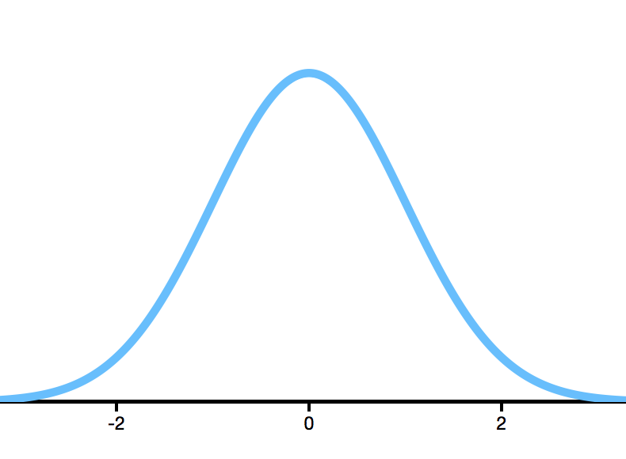
Differential privacy
Differential privacy mechanism using to add noise on the true result
True result
query
Database with you D1
result A
Mechanism M
All possible response
Range(K)

Slide 36
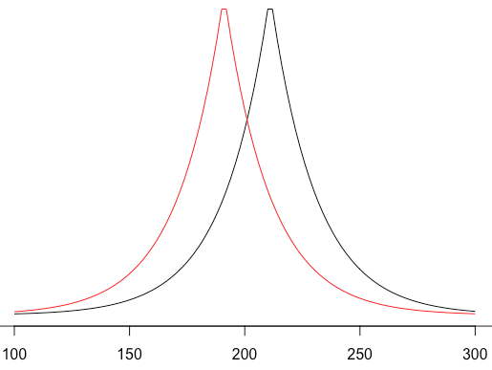
Differential privacy
query
Database with you D1
result A
Mechanism M
Ratio bound by
query
Database without you D2
result B
Mechanism M
All possible response for two datasets
Range(K)
Neighboring database

Slide 37
Example
Age | Eye Color | Lung cancer | Sex
20 | Brown | N | M
25 | Brown | N | F
38 | Blue | Y | M
45 | Green | Y | M
31 | Blue | N | F
52 | Brown | N | M
Query: the total age
Result A: 211
you
The adversary can infer your age from: A-B
Age | Eye Color | Lung cancer | Sex
20 | Brown | N | M
25 | Brown | N | F
38 | Blue | Y | M
45 | Green | Y | M
31 | Blue | N | F
52 | Brown | N | M
Query: the total age
Result B: 166
you

Slide 38
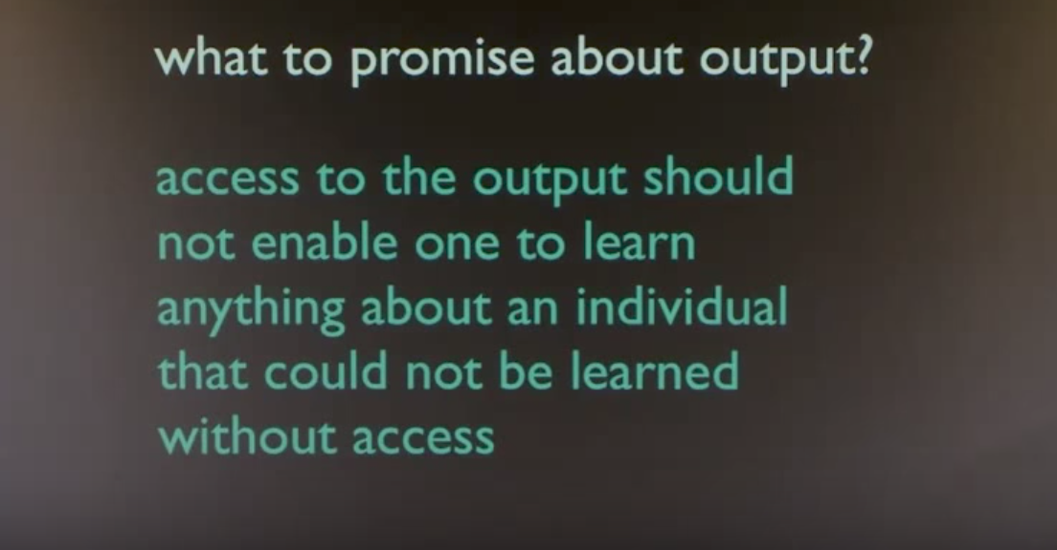

Slide 39
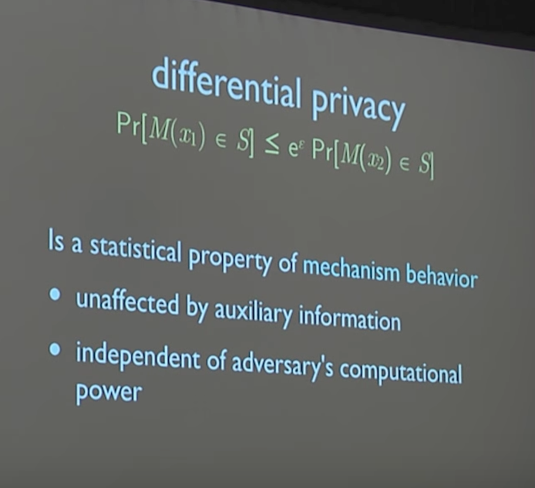

Slide 40

Differential privacy
Age | Eye Color | Lung cancer | Sex
20 | Brown | N | M
25 | Brown | N | F
38 | Blue | Y | M
45 | Green | Y | M
31 | Blue | N | F
52 | Brown | N | M
Privacy mechanism M
Query: the total age
Result A: 211
Answer A
$$≈$$
Age | Eye Color | Lung cancer | Sex
20 | Brown | N | M
25 | Brown | N | F
38 | Blue | Y | M
45 | Green | Y | M
31 | Blue | N | F
52 | Brown | N | M
Privacy mechanism M
Query: the total age
Result B:166
Answer B

Slide 41
What does mechanism M do?
Instead of answering the true result, we answer the result randomly with a certain probability.
True value
What noise with what shape?
How much of it?
All possible answers

Slide 42
The question is what noise with what shape and add how much of it
What differential privacy promises

Slide 43
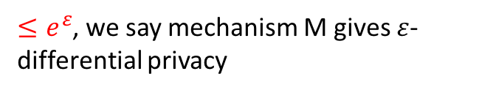
Privacy Budget $ε$
$≤e^{ε}$, we say mechanism M gives $ε$-differential privacy
Larger ε corresponds to less privacy and more accurate statistics (We do not recommend ε exceeding 1)
Result A
An arbitrary possible answer C for both dataset D1 and D2
Result B

Slide 44
Instead of answering the true result, we answer the result randomly with a certain probability.
Result A
Result B

