Slide 1
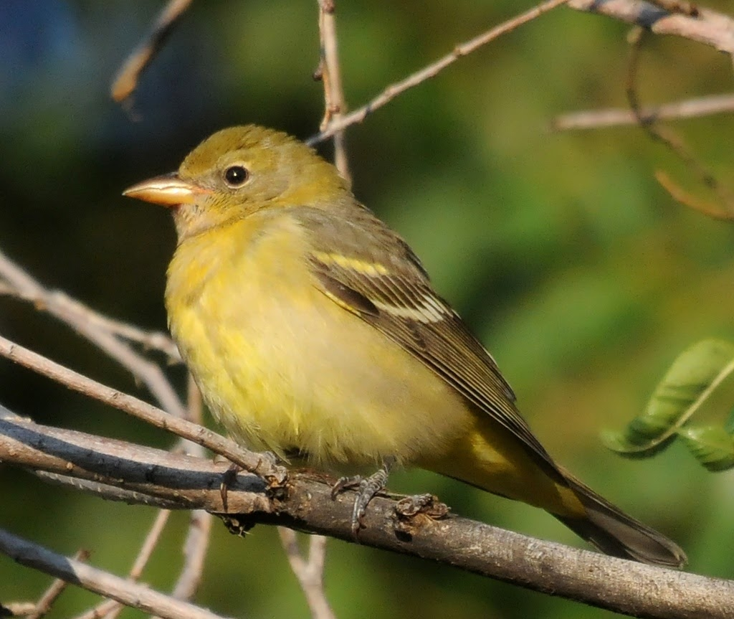
Bird Classification
Team Members:
Hongkuan Lin, Rocky Zhenxiang Fang, Heng-Ying Chou, Jing Cao

Slide 2
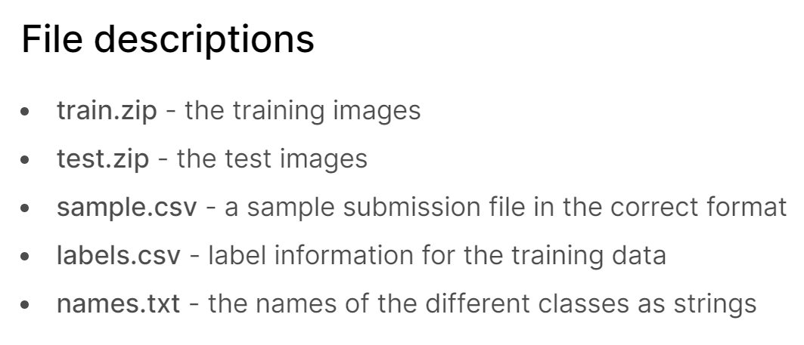
Problem Description
In this competition, we will predict the labels for the images in the training set given images in the training set and their labels.
DATA SET:
There are 555 different images categories (birds) given by integers [0-554].

Slide 3
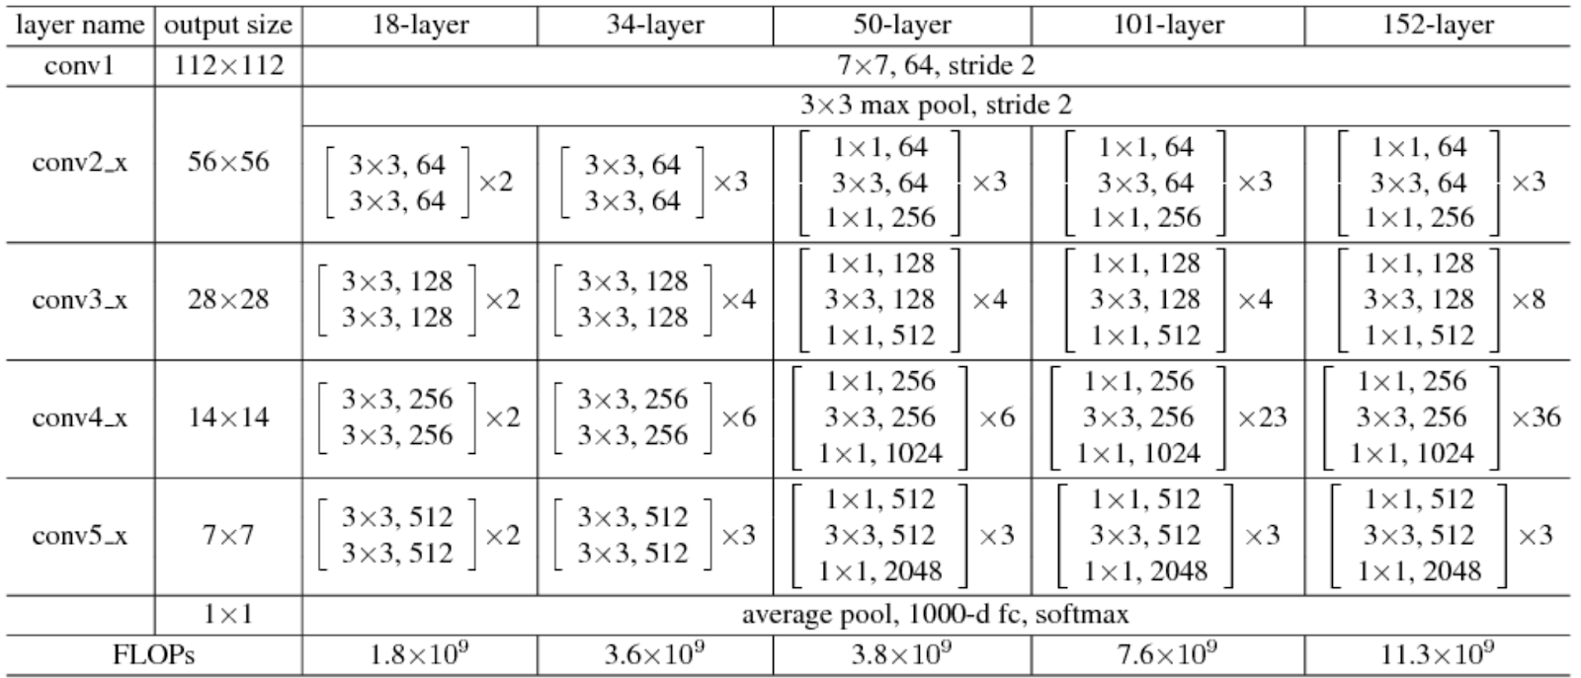
Previous work
Resnet models were proposed in “Deep Residual Learning for Image Recognition”.

Slide 4

Approaches
Platform and tool: Google Colab

Slide 5
Approaches
Data preprocessing: Downsizing the image and convert file
Downsizing the image and convert file
Downsize the image
JPG file to H5 file
Load Data into RAM
4 hours to 30 minutes
Code:
https://github.com/JingC123/CSE455_Project/blob/main/code/Preprocess.py.
https://github.com/JingC123/CSE455_Project/blob/main/code/BirdDataSet.py.

Slide 6
Approaches
Solve overfitting problem:
Add decay
Set the decay from 0.0005 to 0.005
Add dropout layer
Does not work
Use another pretrained net
Using Resnet152

Slide 7
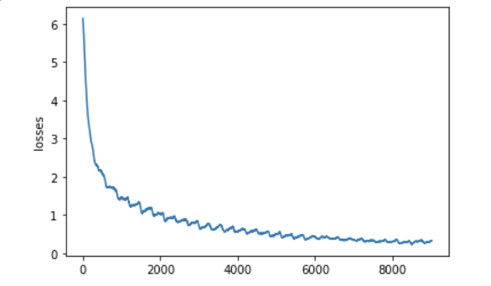
Result
Resnet50 pretrained model with total 35 epochs
first 20 epochs, set the lr = 0.01 and decay =0.0005
The next 10 epochs, set the lr=0.001
In the final 5 epochs, set the decay = 0.005
The final losses = 0.11
And the training accuracy = 0.98
Score: 0.7275

