Slide 1



Understanding the Reproducibility of Crowd-reported Security Vulnerabilities
Dongliang Mu¹², Alejandro Cuevas², Limin Yang³, Hang Hu³,
Xinyu Xing², Bing Mao¹, Gang Wang³
1. Nanjing University
2. Pennsylvania State University
3. Virginia Tech
Notes:
Hello, everyone. My name is Dongliang Mu. Here I am going to present our paper - Understanding the Reproducibility of Crowd-reported Security Vulnerabilities. This is a joint work with Alejandro Cuevas and Xinyu Xing from Penn State University, Limin Yang, Hang Hu and Gang Wang from Virginia Tech, and Bing Mao from Nanjing University.

Slide 2




Real World Effects of Security Vulnerabilities
CVE-2010-2772
STUXnet
CVE-2014-0160
HeartBleed
CVE-2014-6271
ShellShock
CVE-2017-0144
WannaCry
It is infeasible for in-house teams to identify all possible vulnerabilities before a software release
Notes:
Security vulnerabilities are posing a serious threat to users, organizations and even nations.
Take WannaCry for example, in 2017, unpatched vulnerabilities allowed the WannaCry ransomware to shutdown more than 300,000 computers around the globe.
All these vulnerabilities are identified after software release. From this, we can infer that it’s infeasible for in-house teams to identify all possible vulnerabilities before a software release.

Slide 3
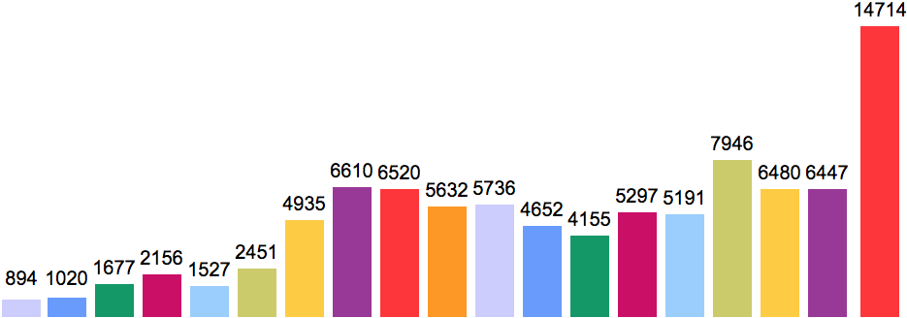









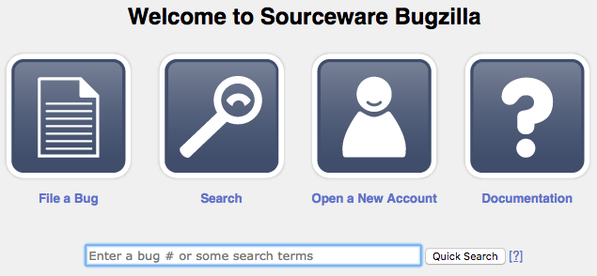


Massive Crowd-reported Vulnerabilities Over Time
White-hat Hacker
Security Analysts
Vulnerability Reporting
Released
Publicly
Security Researchers
……
Normal User
1999
2000
2001
2002
2003
2004
2005
2006
2007
2008
2009
2010
2011
2012
2013
2014
2015
2016
2017
The Crowd
Vulnerability Reporting Websites
CVE¹ Website
Number of vulnerabilities reported to CVE¹ by year
¹ Common Vulnerabilities and Exposures
Notes:
Consequently, an increasing number of software vendors are relying on “the power of the crowd” to identify vulnerabilities. And companies, like Google and Microsoft are spending millions of dollars on their “bug bounty” programs to reward vulnerability reporters. After vulnerabilities are publicly released, reporters usually request an ID from CVE website to further raise community awareness.
This graph is about number of vulnerabilities reported to CVE by year. We could see the significant increasing number along with the time goes. And up to now, CVE website has archived more than 100,000 vulnerabilities.

Slide 4
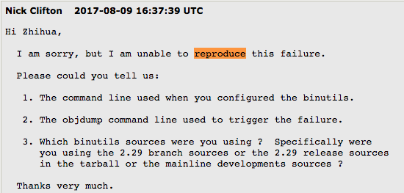
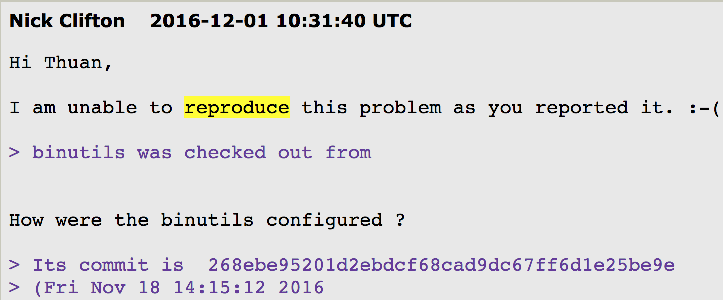
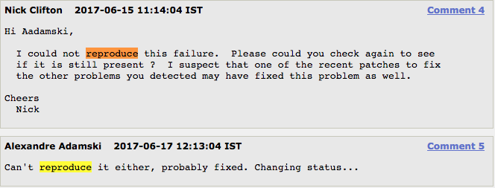

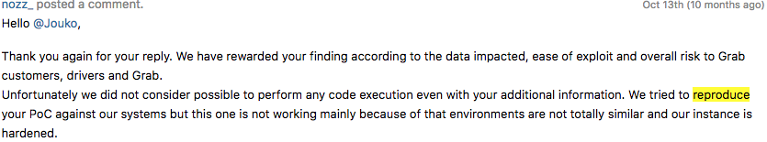
Vulnerability Reproduction Can be Challenging
Notes:
Despite the large number of crowd-reported vulnerabilities, some evidence asserts the poor quality of vulnerability reports. And a large number of software developers complain they cannot reproduce the vulnerabilities. As a result, those non-reproducible vulnerabilities need more detailed information, more time to fix.

Slide 5




Consequences of Poor Reproducibility
Research Papers that use public vulnerabilities for evaluation | # of Vulnerability
SP’2018 | 9
Usenix’2017 | 8
Usenix’2015 | 6
NDSS’2015 | 7
Usenix’2015 | 8
NDSS’2011 | 14
SP’2008 | 5
Usenix’2005 | 4
Usenix’1998 | 8
Poor reproducibility delays the patching of vulnerability
Software vendors
Poor reproducibility prevents analysts from assessing potential threats to their customers in a timely fashion
Security Firms
Poor reproducibility makes it hard to thoroughly evaluate security solutions
Security Researchers
Notes:
Thererfore, poor reproducibility seriously delays the patching of vulnerability. Apart from software vendors, security community including security analysts and security researchers are also bothered by this problem. For security firms, poor reproducibility really prevents analysts assessing potential threats to their customers in a timely fashion. For our security researchers, poor reproducibility makes it hard to thoroughly evaluate our security solutions.
In this table, those top-tier conference papers used public vulnerabilities for evaluation. However, most of they use less than 10 vulnerabilities to benchmark and evaluate their tools.

Slide 6
This Work
Q1: How reproducible are public security vulnerability reports?
Q2: What makes vulnerability reproduction difficult?
Q3: How to improve the efficiency of vulnerability reproduction?
We answer three questions by manually reproducing vulnerabilities
Notes:
So, in this work, we seek to answer three questions about vulnerability reproduction : <repeat questions>.To answer these three questions, our method is manually reproducing vulnerabilities. By reproducing vulnerability, I mean using the information in vulnerability reports to trigger the vulnerability.

Slide 7
Roadmap
Methodology
Findings
Survey
Suggestions
Conclusion
Notes:
In the rest of talk, I will follow this roadmap. First, I will introduce our methodology to reproduce vulnerability; Then I will show our findings; To validate our findings, we surveyed 48 external security professionals from both academia and industry. For time limitation, we will ignore this part. But you can check the details in our paper. Next, I will give some suggestions to improve reproduction efficiency. Finally, I will conclude this work.

Slide 8
Vulnerability Report Dataset
We randomly selected a large collection of reported vulnerabilities
We focused on Memory Error Vulnerabilities due to their high severity (Average CVSS Score 7.6 > Overall Average CVSS Score 6.2) and significant real-world impact
We focused on Open Source Linux Software due to debugging and diagnosing capabilities
We collected two datasets including,
A primary dataset of 291 vulnerabilities with CVE IDs
A complementary dataset for 77 vulnerabilities without CVE ID
CVSS Score | Rating
0.1 - 3.9 | Low
4.0 - 6.9 | Medium
7.0 - 8.9 | High
9.0 - 10.0 | Critical
Notes:
We randomly selected a large collection of reported vulnerabilities for our study.
We focused on Memory Error Vulnerabilities due to their high severity and significant real-world impact. And from our data, their Average CVSS Score 7.6 is greater than Overall Average CVSS Score 6.2. We focused on Open Source Linux Software due to debugging and diagnosing capabilities.
Finally, we obtained two datasets with 368 vulnerabilities, including 291 CVEs and 77 Non-CVEs.

Slide 9
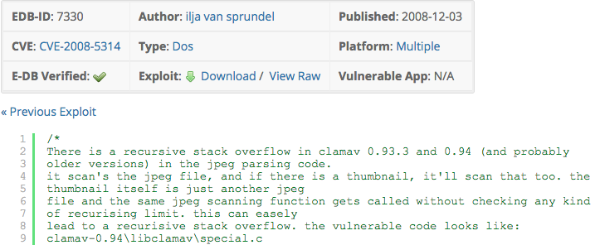
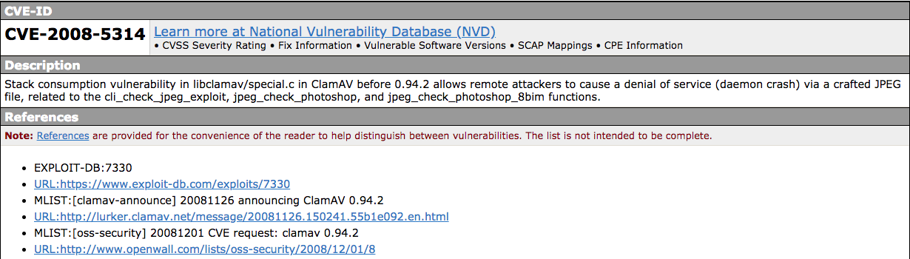


Vulnerability Report Dataset (cont.)
For each vulnerability, we collect vulnerability reports by crawling the references listed in the CVE website
Top 5 source websites in our dataset
Information source website
CVE-2008-5314
The crowd-sourced vulnerability reports
Notes:
Basically, for each vulnerability, we collect vulnerability reports by crawling the references listed in the CVE website. The references or cited websites are referred as information source websites or simply source websites. The source websites provide detailed technical reports on each vulnerability. We consider these technical reports on the source websites as the crowd-sourced vulnerability reports for our evaluation. Finally, we collect more than 6 thousand vulnerability reports. And in our dataset, the top 5 source websites are: SecurityFocus, Redhat Bugzilla, ExploitDB, OpenWall, and SecurityTracker.

Slide 10

The Analyst Team
We formed a team of 5 security analysts to carry out our experiments
In-depth knowledge of memory error vulnerabilities
First-hand experience analyzing vulnerabilities, writing exploits, and developing patches
Domain Experts
Rich Catch-The-Flag experience, and have discovered and reported over 20 new vulnerabilities to CVE website
Notes:
To carry out our experiments, we formed a team of 5 security analysts. Each analyst not only has in-depth knowledge of memory error vulnerabilities, but also has first-hand experience analyzing vulnerabilities, writing exploits, and developing patches. Moreover, the analysts have rich CTF experience, and have discovered and reported over 20 new vulnerabilities to CVE website.
In this way, we can ensure that the analysts are able to understand the information in the reports.

Slide 11








Reproduction Workflow
Read
Reports
Set up Environment
Install & Config Software
Trigger Vulnerability
Verify
Vulnerability
Vulnerable Version
Operating System
Software Installation
Software Configuration
Proof-of-Concept File
Trigger Method
Vulnerability Verification
Domain Expert
Notes:
The whole reproduction workflow is to read reports, setup environment, install and configure vulnerable software, trigger the vulnerability and verify the vulnerability. The first step is to retrieve report information. Our security researchers extract useful information from vulnerability reports. However, in practice, the reporters may miss some “common sense” information. To account for this, we develop a set of default settings when corresponding information are not available in the reports.

Slide 12

Reproduction Workflow (cont.)
Read
Reports
Set up Environment
Install & Config Software
Trigger Vulnerability
Verify
Vulnerability
Set up the operating system for vulnerable software analysis
Vulnerable Version
Operating System
Software Installation
Software Configuration
Proof-of-Concept File
Trigger Method
Vulnerability Verification
Information | Default Setting
Operating System | A Linux system that was released in (or slightly before) the year when the vulnerability was reported
Notes:
In the second step, we setup the operating system for vulnerable software analysis. If this information is missing, the default option is a Linux system that was released in (or slightly before) the year when the vulnerability was reported.

Slide 13
Reproduction Workflow (cont.)
Read
Reports
Set up Environment
Install & Config Software
Trigger Vulnerability
Verify
Vulnerability
Compile vulnerable software with the compilation options
Install vulnerable software with the configuration options
Vulnerable Version
Operating System
Software Installation
Software Configuration
Proof-of-Concept File
Trigger Method
Vulnerability Verification
Building System | Default Setting
automake | make; make install
autoconf & automake | ./configure; make; make install
cmake | mkdir build; cd build; cmake ../; make; make install
Notes:
In the third step, we compile and install vulnerable software based on information in the report. If software installation is missing, we provide default options based on building system of vulnerable software.

Slide 14
Reproduction Workflow (cont.)
Read
Reports
Set up Environment
Install & Config Software
Trigger Vulnerability
Verify
Vulnerability
Trigger the vulnerability by using the Proof-of-Concept File
Type of PoC | Default Setting
Shell commands | Run the commands with the default shell
Script program (e.g., python) | Run the script with the appropriate interpreter
C/C++ code | Compile code with default options and run it
A long string | Directly input the string to the vulnerable program
A malformed file (e.g., jpeg) | Input the file to the vulnerable program
Vulnerable Version
Operating System
Software Installation
Software Configuration
Proof-of-Concept File
Trigger Method
Vulnerability Verification
Notes:
In the forth step, we trigger the vulnerability with PoC File based on trigger method in the report. If trigger method is missing, our default setting varies with the type of PoC File. For example, if PoC is a long string, our default option is directly to input the string to vulnerable program.

Slide 15
Reproduction Workflow (cont.)
Read
Reports
Set up Environment
Install & Config Software
Trigger Vulnerability
Verify
Vulnerability
Verify the vulnerability with expected program behavior
Vulnerable Version
Operating System
Software Installation
Software Configuration
Proof-of-Concept File
Trigger Method
Vulnerability Verification
Information | Default Setting
Vulnerability Verification | Unexpected program termination (or program “crash”)
Notes:
In the fifth step, we observe the program behavior and verify vulnerability with expected behavior. Since we deal with memory error vulnerabilities, the default setting is unexpected program termination (or program “crash”).

Slide 16

Reproduction Experiment: controlled information source
SecurityFocus
SecurityFocus
Exploit DataBase
Exploit DataBase
Exploit DataBase
Failure
OpenWall
SecurityTracker
Redhat Bugzilla
SecurityFocus
OpenWall
OpenWall
SecurityTracker
SecurityTracker
One of Top 5 Source Websites
Redhat Bugzilla
Redhat Bugzilla
Manual Debugging
……
Success
Single-source
Combined-top5
Combined-all
Notes:
To examine the quality of information from different sources, we have three controlled information sources. First, we only use one of top 5 source websites to reproduce vulnerability; if it fails, we combine information in top 5 source websites; if it still fails, we combine all the CVE references. All these three information sources will follow the previous reproduction workflow. If “combine-all” fails, we will resort to manual debugging.

Slide 17
Roadmap
Methodology
Findings
Suggestions
Conclusion
Notes:
In the following, I will show our findings.

Slide 18
Finding 1: Vulnerability is difficult to reproduce
Information Source | CVE Reproduction (N=291)
 | Covered CVE IDs | # of Reproducible Cases | Success Rate (%)
SecurityFocus | 256 | 32 | 12.6%
Redhat Bugzilla | 195 | 19 | 9.7%
ExploitDB | 156 | 46 | 29.5%
OpenWall | 153 | 67 | 43.8%
SecurityTracker | 89 | 4 | 4.5%
The single-source returns a low success rate
“Combined-top5” has clearly improved the success rate
Combined-top5 | 287 | 126 | 43.9%
Combined-all | 291 | 182 | 62.5%
The success rate is improved to 62.5% by “Combined-all”
Information Source | Non-CVE Reproduction (N=77)
Combined-all | 77 | 20 (25.6%) | 25.6%
Notes:
Our first finding is that vulnerability is hard to reproduce. The experiments take 5 security researchers about 1600 man-hours to finish. We leverage Success Rate to measure reproducibility. Take SecurityFocus as example. Out of 291 CVE entries, securityfocus covers 256 CVE IDs. We successfully reproduce 32 vulnerabilities. So the Success Rate is 12.6%. And we can see : <repeat observation>. After combining top 5 source websites, it shows “Combined-top5” has clearly improved the success rate. After we combine all the CVE References, the Success Rate is improved to 62.5%.
However, for the whole dataset, even we combine all the CVE References, there are still less than 20 cases that have complete information. So we can infer our default setting works well in the reproduction.

Slide 19
Finding 2: Key Factors makes reproduction difficult
Information | # of vulnerabilities addressed by Manual Debugging
Trigger Method | 74
Software Installation | 43
PoC File | 38
Software Configuration | 6
OS information | 4
Software version | 1
Vulnerability Verification | 0
Some ad-hoc techniques based on experience
Debugging the software and PoC files
Inspecting and modifying the source code
Testing the cases in multiple OS and versions
Searching related hints from the Internet
In those vulnerabilities, 74 cases failed on Trigger Method, 43 cases failed on Software Installation and so on
Notes:
Through intensive manual debugging(another 2,000 man-hours) <repeat manual debugging>, we successfully reproduced another 151 vulnerabilities, increasing the success rate to 95.9%. In those vulnerabilities, 74 cases failed on Trigger Method, 43 cases failed on Software Installation, 38 cases failed on PoC File. This table shows the key factors are trigger method, software installation and PoC File.

Slide 20
Finding 3: Useful Tips for Information Recovery
Given a failed case, the key question is which piece of information is problematic and how to recover it
1. Trigger method
2. Software Installation
3. PoC File
4. Software Configuration
5. Operating System
Priority of Information
Correlation of Different Vulnerabilities
Recover missing information by reading reports of other similar vulnerabilities.
For 74 cases that failed on trigger method, we recovered 68 cases by reading other similar vulnerability reports
Notes:
There is no good method to resolve this question. However, instead of picking a random information category for in-depth troubleshooting, we prioritize information categories in above order. It means you can first assume trigger method is problematic and check another trigger method to reproduce the vulnerability. And correlation of different vulnerabilities is surprisingly useful. In other word, it is really helpful to recover missing information by reading reports of other similar vulnerabilities. Out of the 74 cases that failed on the trigger method, we recovered 68 cases by reading other similar vulnerability reports. 16 are due to the same software, 52 are due to same vulnerability types.

Slide 21
Roadmap
Methodology
Findings
Suggestions
Conclusion
Notes:
After showing our findings, I will give some suggestions to improve the reproduction efficiency.

Slide 22
Suggestions
Standardizing Vulnerability Reports
Reporting Websites
Automated Tools to Assist Reporters
Vulnerability Reporters
Vulnerability Reproduction Automation
Reproducers
Vulnerability Report Collection
Environment Setup
Software Installation
Vulnerability Triggering
Notes:
First, we suggest Vulnerability reporting websites can enforce the reporters to include a minimal set of required information fields.
Second, we suggest developing more automated Tools to Assist Vulnerability Reporters in collecting information and generating standardized reports.
Finally, it is unlikely to make the reproduction fully automated. However, we could discuss the parts that can be potentially automated.
For vulnerability report collection, we can potentially build automated tools to search, and collect all available information online to generate a “reproducible” report.
For environment setup, a potential way is to let the reproducer prepare a configuration file to specify the environment requirements. Then automated tools could help generate a docker image to directly verify the vulnerability.
For Software installation and Vulnerability Triggering, they would involve primarily manual operations. However, if the related information are all well-defined, it is possible to be automated.

Slide 23
Roadmap
Methodology
Findings
Suggestions
Conclusion
Notes:
In the end, I will conclude our work.

Slide 24
Conclusion
Vulnerability reproduction is difficult and requires extensive manual efforts
A crowdsourcing approach could increase the reproducibility
Apart from manual debugging based on experience, Internet-scale crowdsourcing and some heuristics could help recover missing information
There is an urgent need to automate vulnerability reproduction and overhaul current vulnerability reporting systems
Notes:
Our conclusion is as follows: <repeat conclusion>

Slide 25
Data Sharing
DataSet : https://vulnreproduction.github.io/
Github Repo : https://github.com/VulnReproduction/LinuxFlaw
For each vulnerability, we have :
Structured information fields (in HTML and JSON)
Detailed instructions on how to reproduce the vulnerability
Fully-tested Proof-of-Concept
Pre-configured virtual machine or Docker Image
Notes:
We have opened source our dataset in this Github repository. And you could follow our instructions to reproduce vulnerabilities or directly try them in our prepared virtual machines.
To the best of our knowledge, this is the largest public ground-truth dataset of real-world vulnerabilities which were manually reproduced and verified

Slide 26
Q & A
DataSet : https://vulnreproduction.github.io/ (12 virtual machine images)
Name : Dongliang Mu
Homepage : http://mudongliang.me/about/
Github Account : mudongliang
Institution: Penn State University & Nanjing University
Email : dzm77@ist.psu.edu
Notes:
Thank you very much for joining my talk. And I am happy to take questions.

Slide 27
References
 | Research Papers that use public vulnerabilities for evaluation | # of Vulnerability
Usenix’2005 | Non-control-data attacks are realistic threats | 4
SP’2008 | Preventing memory error exploits with wit | 5
Usenix’2015 | Control-flow bending: on the effectiveness of control-flow integrity | 6
NDSS’2015 | Preventing Use-after-free with Dangling Pointers Nullification | 7
Usenix’1998 | StackGuard : automatic adaptive detection and prevention of buffer-overflow attacks | 8
Usenix’2017 | Towards efficient heap overflow discovery | 8
Usenix’2015 | Automatic Generation of Data-Oriented Exploits | 8
SP’2018 | Data-oriented programming : On the Expressiveness of Non-Control Data Attacks | 9
NDSS’2011 | AEG: Automatic exploit generation | 14

Slide 28
Finding : Vulnerability Reports Are Often Incomplete
Experiment Strategy |  | Vulnerability Reports for CVE with Missing Information
 | Covered CVE IDs | Software Version | Software Installation | Software Configuration | OS Information | PoC File | Trigger Method | Vulnerability Verification
SecurityFocus | 256 | 9 | 255 | 233 | 116 | 131 | 210 | 227
Redhat Bugzilla | 195 | 48 | 195 | 179 | 0 | 154 | 168 | 147
ExploitDB | 156 | 5 | 155 | 137 | 132 | 20 | 100 | 111
OpenWall | 153 | 28 | 152 | 140 | 153 | 72 | 72 | 71
SecurityTracker | 89 | 3 | 87 | 71 | 73 | 69 | 62 | 61
Combined-top5 | 287 | 3 | 284 | 259 | 55 | 70 | 125 | 138
Combined-all | 291 | 1 | 280 | 256 | 52 | 17 | 82 | 106

Slide 29
Missing Information
Raw Missing Information | Success (202) | All (368)
Software version | 0 (0%) | 1 (0.3%)
PoC file | 0 (0%) | 43 (11.7%)
Trigger method | 14 (6.9%) | 97 (26.4%)
OS information | 35 (17.3%) | 84 (22.8%)
Verification method | 45 (22.3%) | 132 (35.8%)
Software Installation | 190 (94.1%) | 323 (87.7%)
Software Configuration | 195 (96.5%) | 350 (95.1%)
The missing information can be resolved by the “common-sense” knowledge
It is not yet clear which information field(s) are the root causes for failed cases
Notes:
From our experiment, we observe that it is extremely common for vulnerability reports to miss key information fields. And we observe that successful cases do not necessarily have complete information. For succeed cases, the missing information could be resolved by “common-sense” knowledge. On the other hand, if the vulnerable software version, PoC files or the trigger method are missing, then the reproduction is prone to failure.
Table 2: raw missing information (without any default settings) in the combined-all setting

Slide 30
Methodology Overview
Challenges
Approaches
Requires extensive manual effort
Focus on only one vulnerability type and study a large sample of it
Needs highly specialized knowledge and skill sets
Form a focused group of domain experts
Many potential factors affect the reproducibility
Design a systematic procedure to assess the reproducibility
User Survey
Notes:
There are two big challenges in assessing the reproducibility.
To validate our observations, we surveyed external security professionals from both academia and industry. We received 43 valid responses from 10 different institutions. The survey results confirmed the prevalence of missing information in vulnerability reports, and provided insights into com- mon ad-hoc techniques used to recover missing information.

Slide 31




Reproducibility of Crowd-reported Vulnerability
Root Cause Diagnosis
Vulnerability Patching
Vulnerability Reporting
Vulnerability Reproduction
Reproducible?
Vulnerability Assessment
Vulnerability Benchmarks
Developers and
Software Vendors
Security Researchers
Analysts from Security Firms
Notes:
Therefore, the reproducibility of vulnerability becomes critical for software vendors to quickly locate and patch the problem. Unfortunately, a non-reproducible vulnerability is more likely to be ignored, leaving the affected system vulnerable. There is a constant need for people to reproduce the vulnerability, especially highly critical ones. First and foremost, developers and software vendors reproduce the vulnerability to analyze the root causes and generate security patches. Analysts from security firms reproduce and verify the vulnerabilities to assess the threats and facilitate threat mitigations. Finally, security researchers often rely on known vulnerabilities to benchmark and evaluate their vulnerability detection and mitigation techniques.
However, as far as we know, the vulnerability reproduction, as a critical early step for vulnerability mitigation, has not been well understood.

Slide 32
Lessons for Reproduction
Report Information | Number
Trigger method | 74
Software Installation | 43
PoC File | 38
Software Configuration | 6
OS information | 4
1. Trigger method
2. Software Installation
3. PoC File
4. Software Configuration
5. Operating System
Priority of Information
Correlation of Different Vulnerabilities
Recover missing information by reading reports of other similar vulnerabilities.
Location of Vulnerability
Really helpful to verify the integrity of the PoC and the correctness of Trigger Method.
Notes:
Given a failed case, the key question is which piece of information is problematic. Instead of picking a random information category for in-depth troubleshooting, it is helpful to prioritize certain information categories.
These reports of similar vulnerabilities include both reports of different vulnerabilities on the same software and reports of similar vulnerability types on different software. It is particularly helpful to deduce the trigger method. More specifically, out of the 74 cases that failed on the trigger method, we recovered 68 cases by reading other similar vulnerability reports (16 for the same software, 52 for similar vulnerability types).
While the reporters may not always know (and include) the information about the vulnerable modules, files, or functions, we find such information to be extremely helpful in the reproduction process.

Slide 33
Case Study
GAS CVE-2005-4807 misses Trigger Method
Solution : C Code should be compiled to malicious assemble file by “gcc -S”, and then feed it to GAS.
libgd CVE-2013-7226 misses Installation Information
Solution: “--with-gd” is a necessary compilation option to build PHP
coreutils CVE-2013-0221 misses Environment Information
Solution: patch vulnerable “coreutils-i18n.patch” applied in OpenSUSE by default
Notes:
In the right, we study several classic failed cases:
For CVE-2005-4807, PoC file is one shell script. This shell script will generate one C file. Directly feeding the shell / C file to GAS does not cause any program crash. By knowing how GAS works, we infer that after generating the C file, it needs to be compiled with the “-S” option to generate the malicious assembly file.
For CVE-2013-7226, if PHP is not compiled with the “--with-gd” option, the vulnerable code will not be built into final executable.
For CVE-2013-0221, the vulnerabilities only existed in a specific patch by SUSE: coreutils-i18n.patch. If the patch was not applied to the OS distribution (e.g., Ubuntu), then the vulnerability would not be triggered, despite the report claiming coreutils 8.6 is vulnerable

