Slide 1
Huawei ICT Competition 2026–2027
Innovation Competition
Chulalongkorn University · [[TODO: team name]] · Kreng-jai Bridge
An AI agent that speaks up for Thai teams
With attacker-tested Thai feedback privacy
Notes:
Content source: docs/submission/deck.md
Title** (template slide 1). Line 2 box: "Chulalongkorn University · [[Team Name]] · Kreng-jai Bridge".
Add subtitle: "An AI agent that speaks up for Thai teams — and proves the feedback can't be traced back."
Evaluation caveats: eval/results/REPORT.md. All experimental results are SYNTHETIC. All-output metrics include blocked texts; released-only theme metrics are explicitly labelled. Current measurements do not establish anonymity.

Slide 2
The problem nobody says out loud
01
PR waits 3 days; the junior won’t chase
50%
lose >10 h/week to non-coding friction
02
A blocker stays unsaid in stand-up
63%
03
Urgent work lands Friday at 17:30
say leaders don’t understand their problems
Atlassian DevEx 2025 · Kreng-jai keeps teams polite — and problems unsaid.
Notes:
Content source: docs/submission/deck.md
The problem nobody says out loud**
Left: three moments (icons + one line each): "PR waits 3 days — the junior won't chase a senior",
"Blocker never mentioned in stand-up", "Urgent work lands at 17:30 every Friday".
Right: big stats — "50% of developers lose >10 h/week to non-coding friction", "63% say leaders don't
understand their problems" (Atlassian DevEx 2025). Footer: "Kreng-jai keeps teams polite — and problems unsaid."
Evaluation caveats: eval/results/REPORT.md. All experimental results are SYNTHETIC. All-output metrics include blocked texts; released-only theme metrics are explicitly labelled. Current measurements do not establish anonymity.

Slide 3
Why anonymous tools fail in Thai
หนูไม่กล้าบอกพี่หัวหน้าค่ะ ว่าสั่งงานเย็นวันศุกร์ทำให้หนูต้องยกเลิกนัดตลอด
Small teams make writers guessable
Quarterly surveys arrive too late
Tools wait for people to speak
One word can reveal gender + seniority
Notes:
Content source: docs/submission/deck.md
Why 'anonymous' tools fail in Thai teams**
Example card: "หนูไม่กล้าบอกพี่หัวหน้าค่ะ ว่าสั่งงานเย็นวันศุกร์ทำให้หนูต้องยกเลิกนัดตลอด" with หนู/ค่ะ/พี่ highlighted
in red → callout "1 word reveals gender + seniority". Bullets: "In a team of 5 the manager can guess the
writer", "Quarterly surveys are too late and never follow up", "Every tool waits for people to speak".
Evaluation caveats: eval/results/REPORT.md. All experimental results are SYNTHETIC. All-output metrics include blocked texts; released-only theme metrics are explicitly labelled. Current measurements do not establish anonymity.

Slide 4
The agent takes the hard-to-say role
1
Observe
2
Ask
3
Act
SDLC metadata only
Private LINE message
The person decides
Neutral reminder or
anonymous feedback
A bot has no seniority, no face to lose, no debt to anyone.
Notes:
Content source: docs/submission/deck.md
Our idea: the agent takes the hard-to-say role**
Three steps horizontally: Observe (SDLC metadata only) → Ask (private LINE message, the person decides) →
Act (neutral reminder or anonymous feedback). Line: "A bot has no seniority, no face to lose, no debt to anyone."
Evaluation caveats: eval/results/REPORT.md. All experimental results are SYNTHETIC. All-output metrics include blocked texts; released-only theme metrics are explicitly labelled. Current measurements do not establish anonymity.

Slide 5
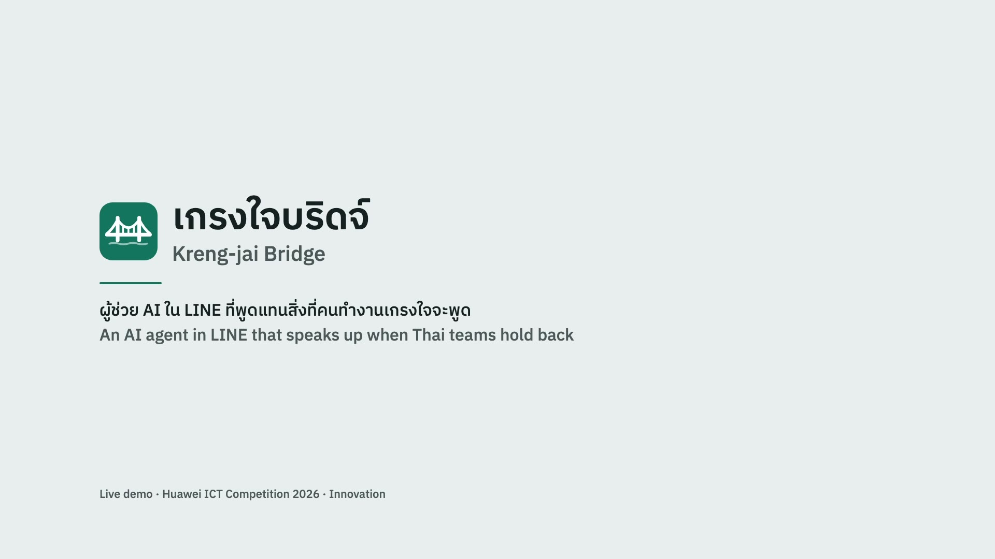
Live demo: Mint’s story in 2:16
Live Huawei Cloud server + real LINE chat · two teammates simulated · waits cut · https://youtu.be/f4Op2MmzrTY
Notes:
Content source: docs/submission/deck.md
Live demo (video, 2:16)**
Embedded `../LiveDemo_Videos/2026-10-20_demo_edit.mp4` (outside the repo; `--video` overrides), poster
`assets/demo-poster.jpg`, click to play. Recorded on the live ECS server with Mint's real LINE chat.
Footer: the two teammates are simulated; waits are cut; YouTube link https://youtu.be/f4Op2MmzrTY. Slides 6 and 10 repeat what the video shows.
Evaluation caveats: eval/results/REPORT.md. All experimental results are SYNTHETIC. All-output metrics include blocked texts; released-only theme metrics are explicitly labelled. Current measurements do not establish anonymity.

Slide 6
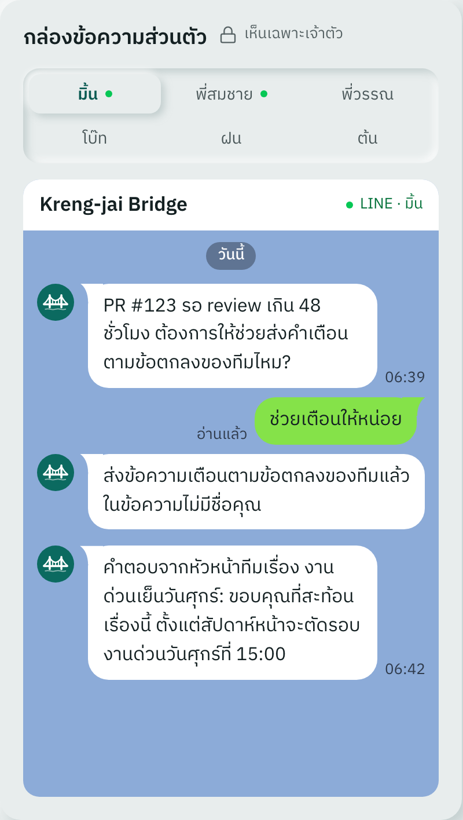
Demo story: two weeks of Mint
01
Tue · PR #123
05
Fri · Feedback
02
Thu · 48 h trigger
06
k = 3 reached
03
Private LINE ask
07
Mon · 15:00 cut-off accepted
04
Reminder; no requester name
08
+2 weeks · Late-Friday work 3 → 0
SYNTHETIC demo scenario · The 3 → 0 follow-up is simulated.
Notes:
Content source: docs/submission/deck.md
Demo story: two weeks of Mint**
Timeline (8 steps from the concept: Tue PR #123 → Thu 48 h trigger → LINE ask → neutral reminder w/o name →
Fri feedback → k=3 reached → Mon manager accepts 15:00 cut-off → +2 weeks Friday after-17 work 3 → 0).
Screenshot: `assets/screen-inbox.png` (LINE-style inbox).
Evaluation caveats: eval/results/REPORT.md. All experimental results are SYNTHETIC. All-output metrics include blocked texts; released-only theme metrics are explicitly labelled. Current measurements do not establish anonymity.

Slide 7
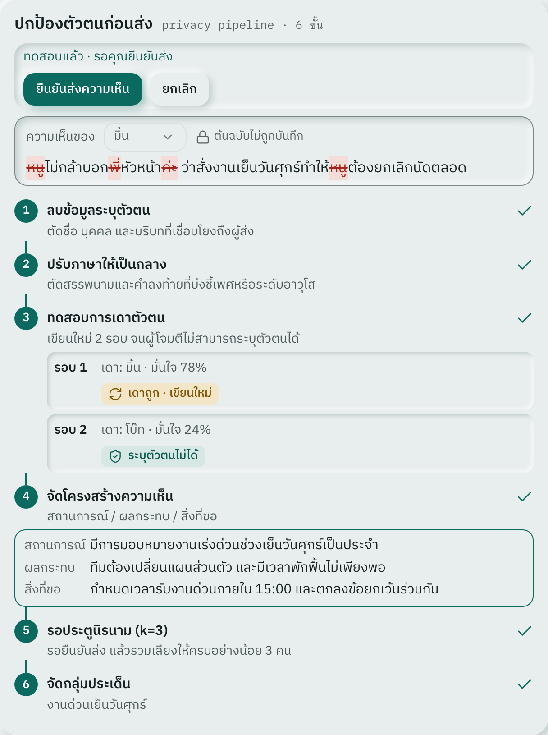
Six privacy steps, tested by an attacker
1. Remove identifiers
2. Neutralize Thai markers
3. Rewrite ⇄ attacker
4. Situation / impact / request
5. k-gate: 3 people
6. Cluster themes
หนู / ค่ะ / พี่ →
สถานการณ์: มีการมอบหมายงานในช่วงเย็นวันศุกร์
ผลกระทบ: ต้องยกเลิกนัดหมายส่วนตัวอย่างต่อเนื่อง
สิ่งที่ขอ: พิจารณาปรับกระบวนการวางแผนงาน
The user previews and confirms; an unsafe rewrite is blocked.
Notes:
Content source: docs/submission/deck.md
Privacy pipeline: 6 steps, tested by an attacker**
Diagram of 6 steps (remove identifiers → neutralize Thai markers → rewrite ⇄ attacker → situation/impact/request
→ k-gate (k=3) → themes). Before/after example: original (red markers) → "สถานการณ์: มีการมอบหมายงานในช่วงเย็นวันศุกร์ ·
ผลกระทบ: ต้องยกเลิกนัดหมายส่วนตัวอย่างต่อเนื่อง · สิ่งที่ขอ: พิจารณาปรับกระบวนการวางแผนงาน". Screenshot `assets/screen-pipeline.png`.
Evaluation caveats: eval/results/REPORT.md. All experimental results are SYNTHETIC. All-output metrics include blocked texts; released-only theme metrics are explicitly labelled. Current measurements do not establish anonymity.

Slide 8
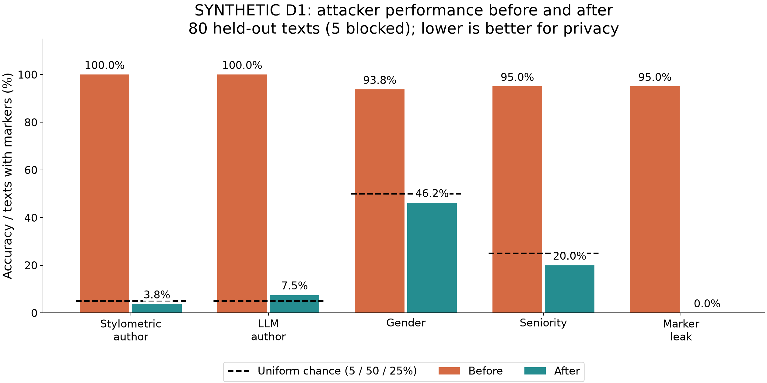
Results: measure privacy, acknowledge the limits
3.8%
author identified by stylometry (was 100.0%; chance 5%)
46.2%
gender guessed correctly (was 93.8%; chance 50%)
0.0%
texts with Thai gender/seniority markers (was 95.0%)
SYNTHETIC · 20 personas × 12 messages; 80 test outputs · LLM attacker 7.5% vs 5.0% chance. No anonymity guarantee.
Notes:
Content source: docs/submission/deck.md
Results: anonymity you can measure**
Chart `eval/results/attacker_before_after.png` large. Callouts with the 3 strongest numbers from
results.json (author attribution before→after vs 5% chance; gender inference; marker leak). Footnote:
"Synthetic Thai dataset, 20 personas × 12 messages; pilot with real volunteers next."
Evaluation caveats: eval/results/REPORT.md. All experimental results are SYNTHETIC. All-output metrics include blocked texts; released-only theme metrics are explicitly labelled. Current measurements do not establish anonymity.

Slide 9
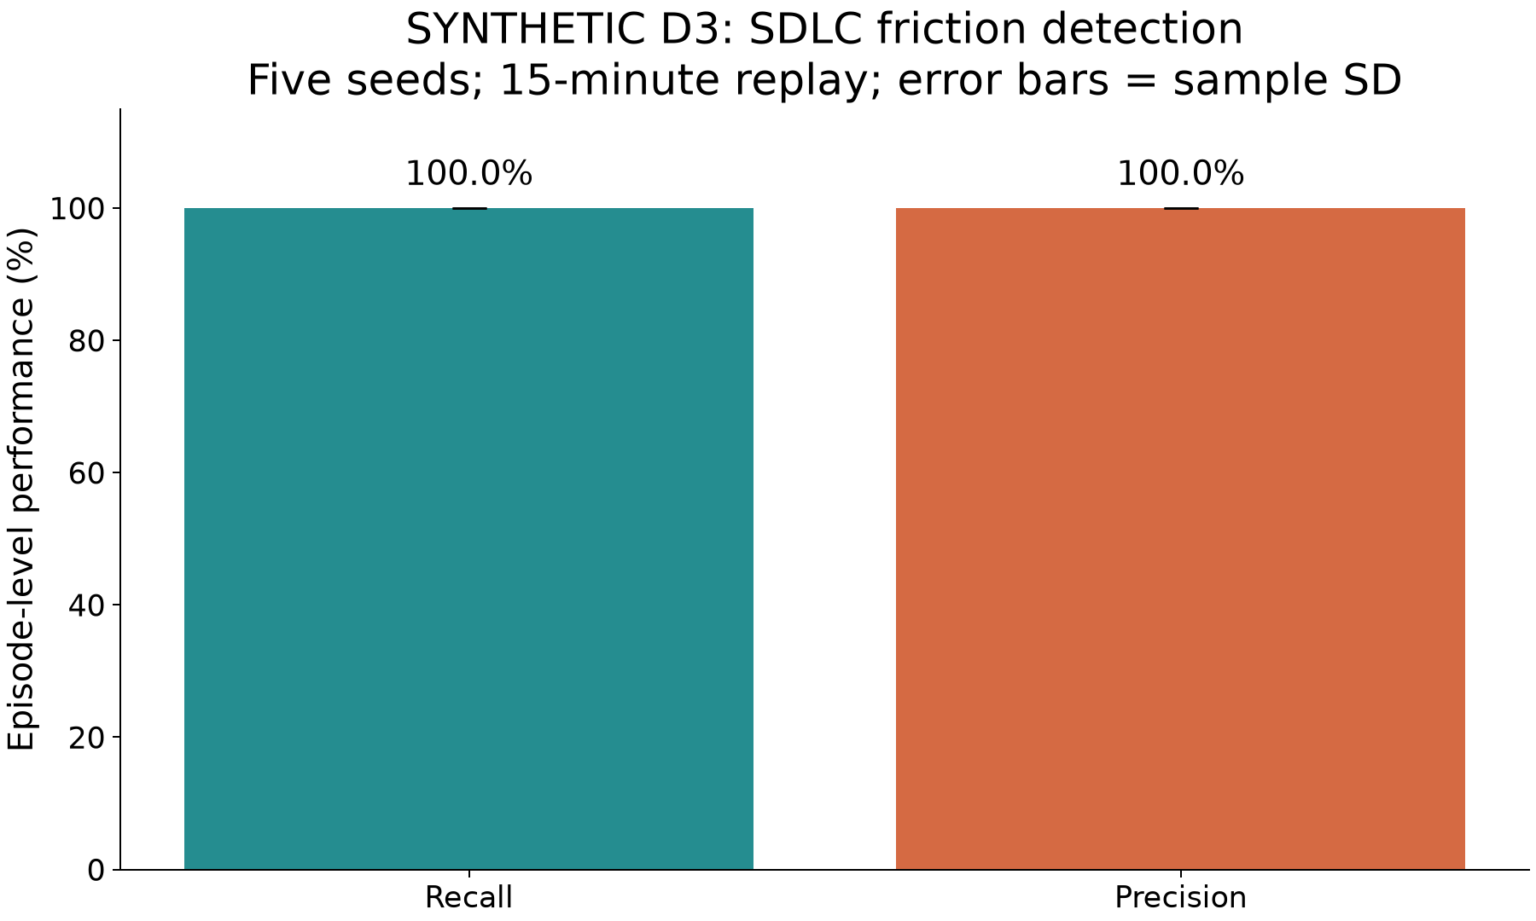
Results: detection and meaning
57.5%
meaning judged ≥ 4/5; all 80 outputs
0.6646
fixed-k theme ARI; released texts only
4.28 s p50 · 93.8% pass
Theme assignment: 92.0% released
SYNTHETIC · Rules + deterministic context; 15-min ticks. Zero median ≠ instant. Native clustering fragments; timing n=10.
Notes:
Content source: docs/submission/deck.md
Results: detection and meaning**
`eval/results/engine.png` + meaning stat (% judged ≥ 4/5) + theme clustering ARI + pipeline latency.
Evaluation caveats: eval/results/REPORT.md. All experimental results are SYNTHETIC. All-output metrics include blocked texts; released-only theme metrics are explicitly labelled. Current measurements do not establish anonymity.

Slide 10
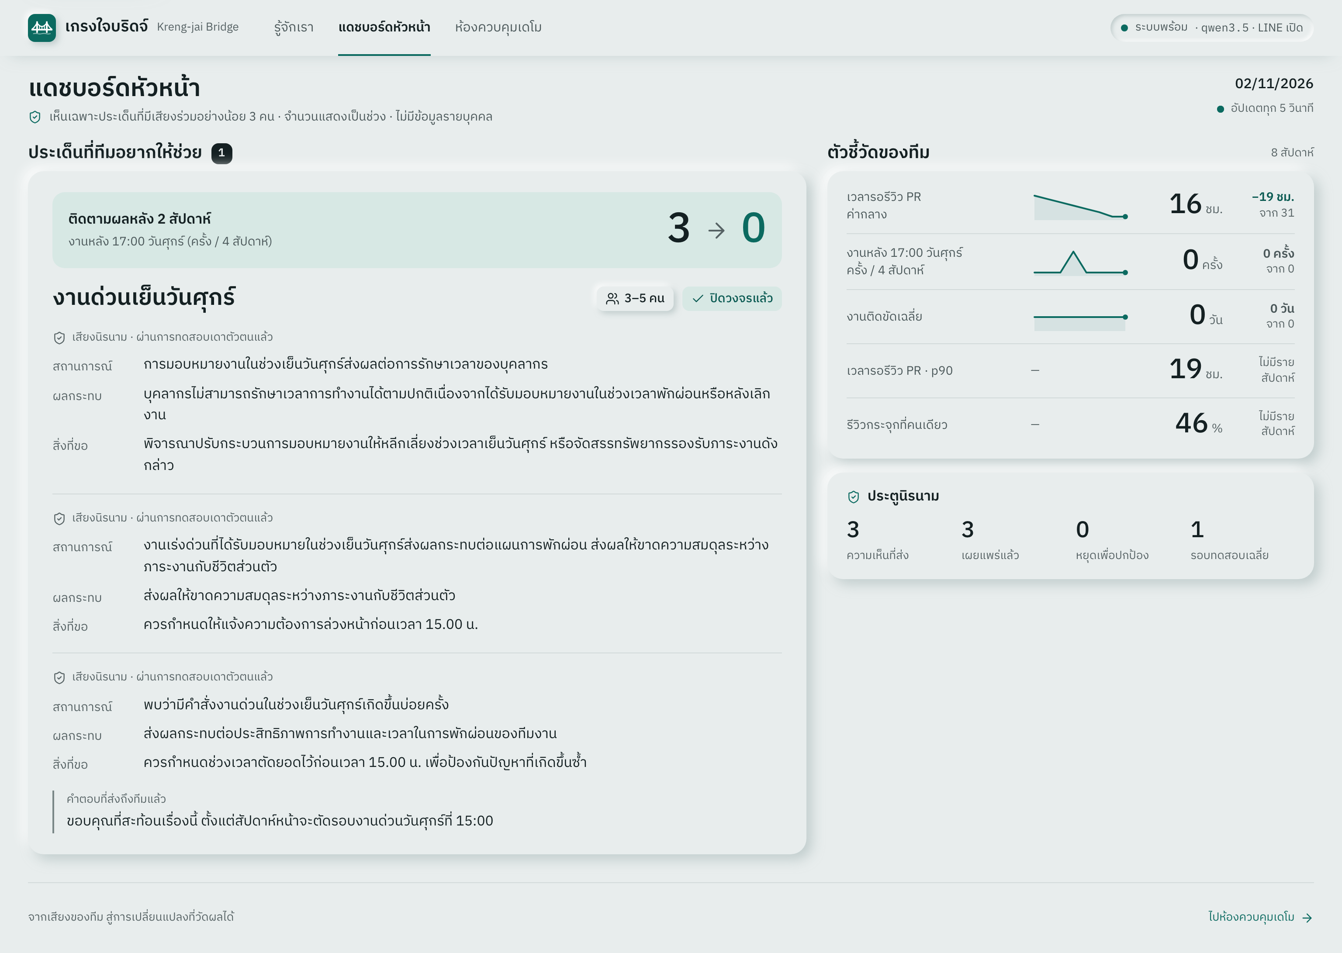
The manager loop closes the circle
Themes shown as ranges: 3–5 people
AI-drafted proposal
Reply through an anonymous token
Follow-up metric: before → after
From a concern to a manager response and a measurable follow-up.
Notes:
Content source: docs/submission/deck.md
Manager loop closes the circle**
Screenshot `assets/screen-manager.png`. Bullets: themes as ranges (3–5 people), AI proposal, reply via
anonymous token, follow-up metric before → after.
Evaluation caveats: eval/results/REPORT.md. All experimental results are SYNTHETIC. All-output metrics include blocked texts; released-only theme metrics are explicitly labelled. Current measurements do not establish anonymity.

Slide 11
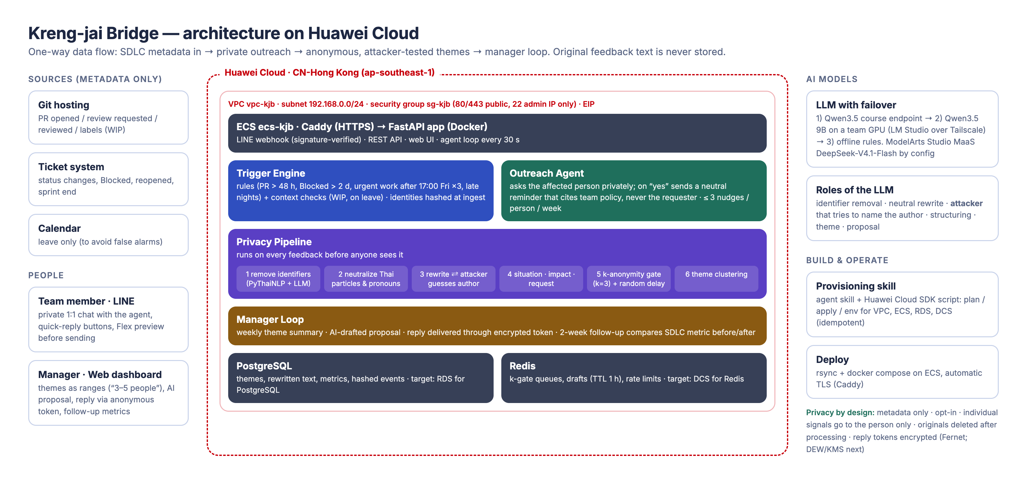
Architecture on Huawei Cloud
Current: ECS + container PostgreSQL/Redis · Next: managed RDS/DCS and ModelArts MaaS inference.
Notes:
Content source: docs/submission/deck.md
Architecture on Huawei Cloud**
`assets/architecture.png` full width.
Evaluation caveats: eval/results/REPORT.md. All experimental results are SYNTHETIC. All-output metrics include blocked texts; released-only theme metrics are explicitly labelled. Current measurements do not establish anonymity.

Slide 12
Built with agents on Huawei Cloud
1
2
3
4
5
Requirement
Code generation
Build
Troubleshoot
Deploy
Contract first
Parallel agents
FastAPI + Docker
Region / IAM fixes
ECS + Caddy + LINE
Provisioning skill: VPC · ECS · RDS · DCS
skills/huawei-cloud-provision · RDS/DCS await IAM permissions
Notes:
Content source: docs/submission/deck.md
Built with AI agents on Huawei Cloud**
Lifecycle row: Requirement → Code generation → Build → Troubleshoot → Deploy, each with 1 line from entry-form §2
(contract-first; parallel coding agents; one FastAPI + Docker; region/IAM fixes; ECS + Caddy + LINE webhook).
Callout: "Agent skill provisions VPC · ECS · RDS · DCS in one command (`skills/huawei-cloud-provision`)".
Evaluation caveats: eval/results/REPORT.md. All experimental results are SYNTHETIC. All-output metrics include blocked texts; released-only theme metrics are explicitly labelled. Current measurements do not establish anonymity.

Slide 13
Privacy by design: PDPA considerations
01
02
03
Metadata only
Opt-in
Individual signals stay private
04
05
06
Originals deleted
Hashed identities; encrypted tokens
Nothing below 3 people
Design principles; no legal compliance certification is claimed.
Notes:
Content source: docs/submission/deck.md
Privacy by design (PDPA)**
6 rules as icon grid: metadata only · opt-in · individual signals only to the person · originals deleted ·
identities hashed, tokens encrypted · nothing reaches the manager below 3 people.
Evaluation caveats: eval/results/REPORT.md. All experimental results are SYNTHETIC. All-output metrics include blocked texts; released-only theme metrics are explicitly labelled. Current measurements do not establish anonymity.

Slide 14
Why we win: nobody acts for the employee
Category | Examples | What is missing for Thai teams
Anonymous surveys | Officevibe, TINYpulse, Lattice | Wait for people to fill in; no style hiding; no Thai/LINE; no automatic follow-up
Burnout analytics | Viva Insights, Uplevel, Erudit | Read message content (privacy criticism); do not act for the employee
Engineering metrics | LinearB, Swarmia | Process alerts, but not designed around kreng-jai; no anonymous channel
Thai HR systems | HumanSoft, HONO, MiHCM | Payroll, leave, appraisal forms; AI still on the roadmap
Kreng-jai Bridge | this prototype | Acts for the employee · attacker-tested anonymity* · Thai + LINE · follow-up metrics
*Attacker-tested on SYNTHETIC data; anonymity is not established.
Competitor gaps from our desk research (public product pages and press, Oct 2026); to be re-verified before the regional stage.
Notes:
Content source: docs/submission/deck.md
Why we win** — comparison table (rows: survey tools Officevibe/TINYpulse/Lattice; burnout analytics
Viva Insights/Uplevel; engineering metrics LinearB/Swarmia; Thai HR systems) × columns (acts for the employee,
tested anonymity, Thai language/LINE, closes the loop with metrics). Kreng-jai Bridge row all ✓.
Evaluation caveats: eval/results/REPORT.md. All experimental results are SYNTHETIC. All-output metrics include blocked texts; released-only theme metrics are explicitly labelled. Current measurements do not establish anonymity.

Slide 15
Roadmap: validate with real teams
Now
Next 4 weeks
Later
Working demo
SYNTHETIC evaluation
Pilot: 2 teams; volunteer data
MaaS DeepSeek / Typhoon 2
RDS / DCS; CodeArts CI
Lark
Multi-tenant
Calendar signals
Buyer: HR / CTO · Thai software houses and banks
Business hypothesis: use existing engagement-survey budgets.
Notes:
Content source: docs/submission/deck.md
Roadmap**
Now (demo) → Next 4 weeks: pilot with 2 real teams, real-volunteer D1 dataset, MaaS DeepSeek/Typhoon 2,
RDS/DCS via skill, CodeArts CI → Later: Lark, multi-tenant, calendar signals.
Business: buyer = HR / CTO of Thai software houses & banks; uses existing engagement-survey budget.
Evaluation caveats: eval/results/REPORT.md. All experimental results are SYNTHETIC. All-output metrics include blocked texts; released-only theme metrics are explicitly labelled. Current measurements do not establish anonymity.

Slide 16
Kreng-jai Bridge
Live demo
https://119-13-81-32.sslip.io
Video https://youtu.be/f4Op2MmzrTY
LINE @075bvvrs
Notes:
Content source: docs/submission/deck.md
End** (template end slide): "Thank you · Live demo: https://119-13-81-32.sslip.io · Video https://youtu.be/f4Op2MmzrTY · LINE @075bvvrs".
Evaluation caveats: eval/results/REPORT.md. All experimental results are SYNTHETIC. All-output metrics include blocked texts; released-only theme metrics are explicitly labelled. Current measurements do not establish anonymity.

