Slide 1

E6893 Big Data Analytics
NY State Inpatient Healthcare Analysis
Project ID: 201912-28 Team Members (with UNI):
Justin Cho (yc3522), Yuan-Fang Lin (yl4042), Jing Qian (jq2282)

Slide 2
Intro and Goal
Introduction:
Healthcare is becoming ever more expensive in the modern era yet access to care and supply is not always optimized for the demands of growing population. We will aim to explore healthcare trends in the New York State geography and uncover underlying patterns in healthcare trends across various cohorts based on age, gender, race, location, and diagnoses to drive insights that can lead to better healthcare service and access.
Goal:
To develop a better understanding of the healthcare trends and patterns in NY State and also translate findings into a visual interface where users can derive actionable insights to inform decisions and policy-making.

Slide 3
Dataset
The dataset used is the New York State Hospital Inpatient Discharges: 2017 which includes 2.3 million inpatient records with 34 features including age, gender, zip code, ethnicity, race, and diagnosis.
Data source: https://on.ny.gov/2qa8Qlm
Note about Compliance and HIPAA:
The data set contains basic record level details and does not include protected health information (PHI) under HIPAA. Data records are not individually identifiable, and data that are considered identifiable have been redacted. De-identified data is public under Freedom of Information Law (FOIL).
Feature Descriptions:
https://on.ny.gov/2JCA9vF

Slide 4
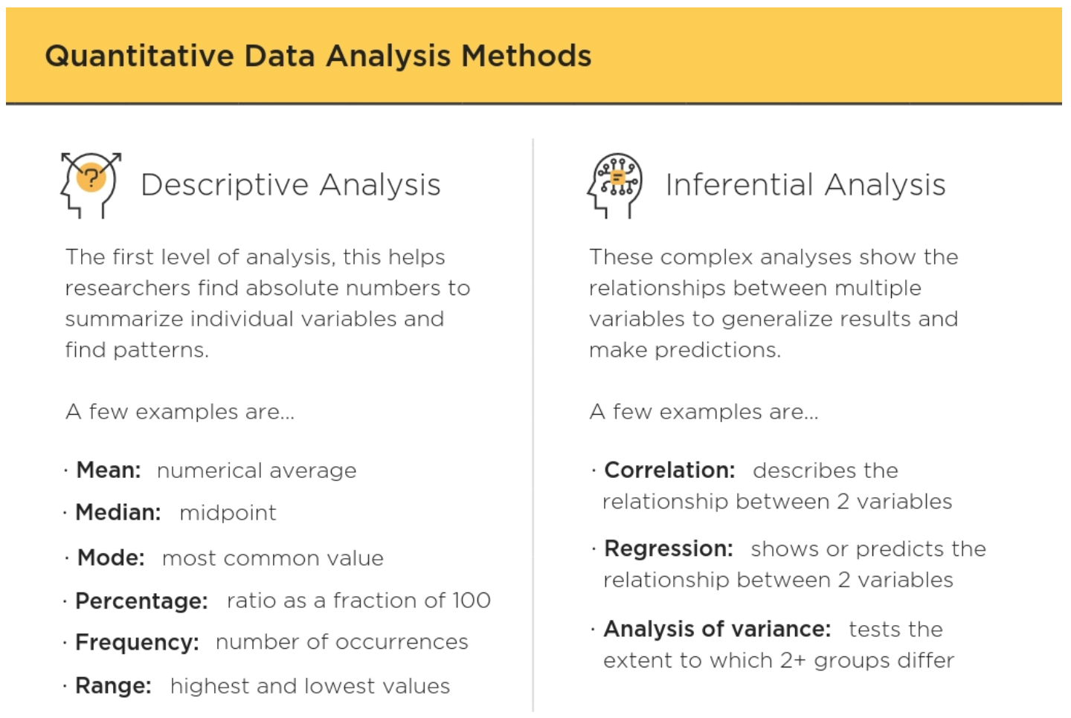
Methods
Descriptive analysis used for analyzing single variable
Inferential analysis used for relationships between multiple variables
Correlation matrix for summarizing data and representing relevance
Regression Model for potential output prediction, e.g. total charge, risk of mortality
K-means or Hierarchical Clustering for data analysis
t-SNE for data visualization in high dimension

Slide 5






System

Slide 6
Expected Outcome and Schedule
Expected Outcome:
Schedule:
11/4 - 11/10: Exploratory data analysis and summarize data
11/11 - 11/17: Begin analytics and visualization examples
11/17 - 11/23: Draft/Sketch front-end and begin implementation of pipeline

Slide 7
Data
https://health.data.ny.gov/dataset/Hospital-Inpatient-Discharges-SPARCS-De-Identified/22g3-z7e7/data?fbclid=IwAR2MLdD9ODpn8Kl2evSjoOOhoskv4SNRUNmfX0LRltNu7NaMjc4gVIbC5OM
Overview: https://health.data.ny.gov/api/views/22g3-z7e7/files/45cf1421-3f5b-4319-8492-d209a7a70e44?download=true&filename=NYSDOH_SPARCS_De-Identified_Overview_2017.pdf
Feature description: https://health.data.ny.gov/api/views/22g3-z7e7/files/bc44a808-8bab-47d0-ba05-cb7303b78179?download=true&filename=NYSDOH_SPARCS_De-Identified_Data_Dictionary_2017.pdf
https://en.wikipedia.org/wiki/Diagnosis-related_group
http://health.utah.gov/opha/IBIShelp/codes/CCS.htm

Slide 8
Explorations of data
Taking the dataset from 2016 as example, it has 2343429 rows of records and 34 columns (features). Some inputs are missing so we need to do some data cleaning before further analysis.
Some results of exploratory data analysis are shown in the next three pages.
Some idea about our project:
We could do recommendation system with collaborative filtering, recommending patients with proper facilities (like based on geographical positions, costs, emergence and severity)
In idea 1, we may have an advanced version with extra data sources, like specialities, reviews and capacity of hospitals.
We could do clustering of the cases, especially focusing on geographical locations. Do people in different areas of NY state have similar records? If not, what may be the hidden reasons?
Since we have data from 2 years (maybe more?) Could we find some discrepancy between two-year records? If so, why?

Slide 9
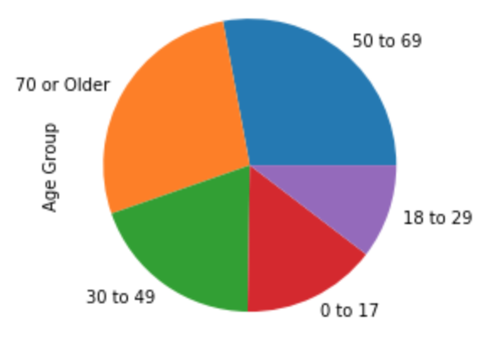
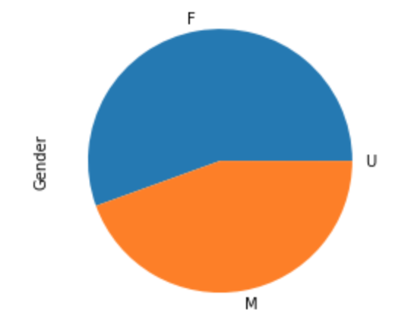
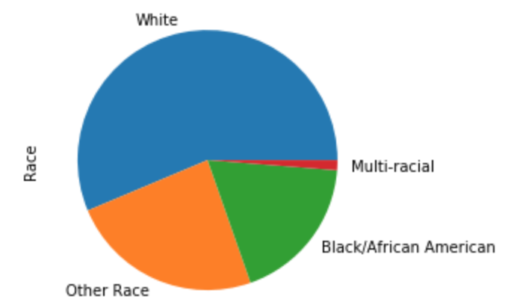
Distribution of records with age, gender and race.

Slide 10
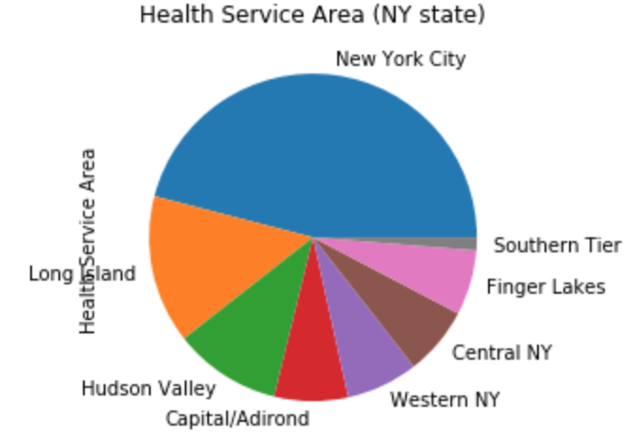
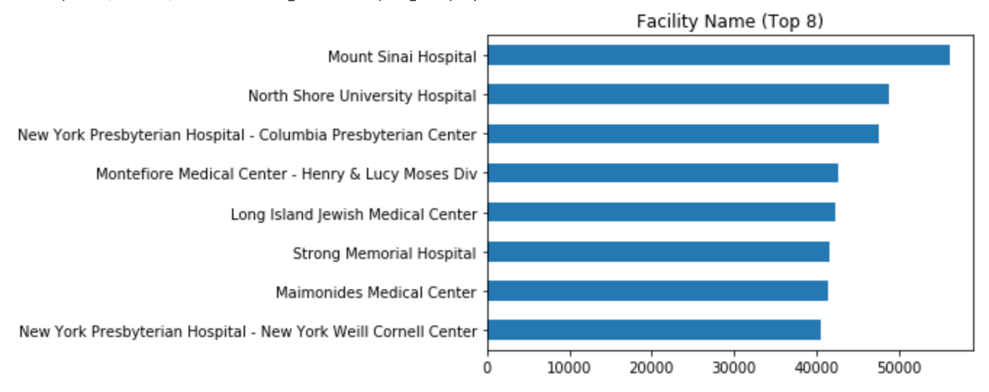
Geographical distribution of records

Slide 11
