Slide 1
Advantages of a Bear Market
Xiang XU, Jing TANG, Ningze ZU,Jianhao Yan

Slide 2
Investing in Stocks
1. Represents ownership in a firm
2. Earn a return in two ways
Price of the stock rises over time
Dividends are paid to the stockholder
3. Stockholders have claim on all assets
4. Right to vote for directors and on certain issues
5. Two types
Common stock
Right to vote
Receive dividends
Preferred stock
Receive a fixed dividend
Do not usually vote

Slide 3

Investing in Stocks
Sample Corporate Stock Certificate Figure 11.1 Wien Consolidated Airlines Stock

Slide 4
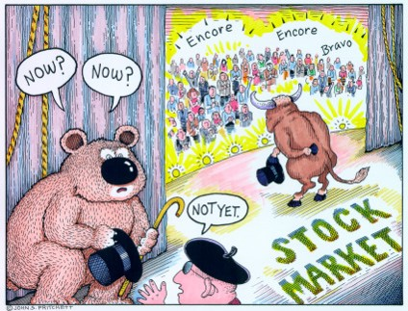
What is a Bear Market?
A decline of 15-20% of the broad market coupled with pessimistic sentiment underlying the stock market.

Slide 5
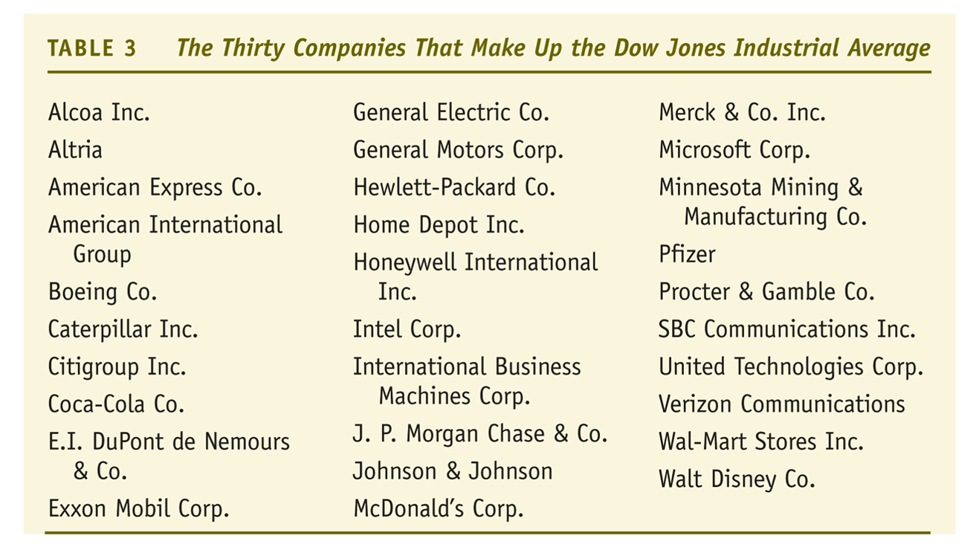
Stock Market Indexes: the Dow Jones Industrial Average

Slide 6
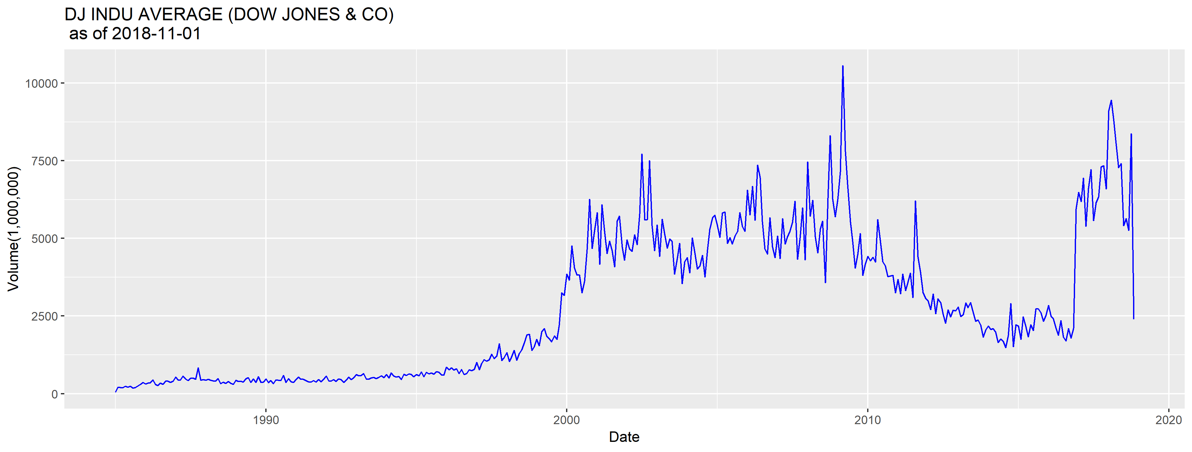
Dow Jones

Slide 7
The last Bear market
Sept. 30, 2002 Dow 7,528
Jan. 5, 2004 Dow 10,568
Oct. 8, 2007 Dow 14,093

Slide 8
What do I do in a Bear Market
Decide whether this is a market correction or the start of something more
Review the stocks you own
Review stocks you wanted to own but were too expensive at time of research
Check your portfolio for balance or the type of stocks you own

