Slide 1
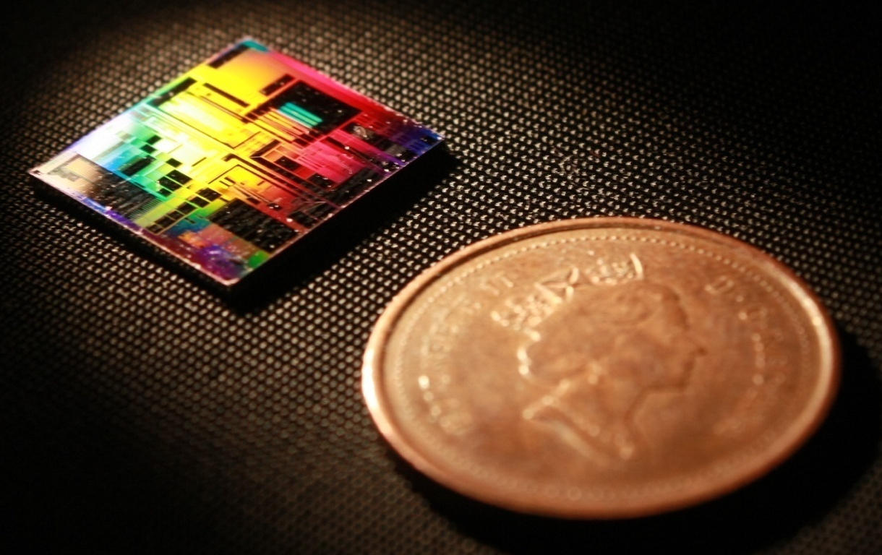
Understanding The Contra-Directional Couplers Models 2019 SiEPIC Passives Workshop, Vancouver, Canada
Mustafa Hammood,
The University of British Columbia

Slide 2
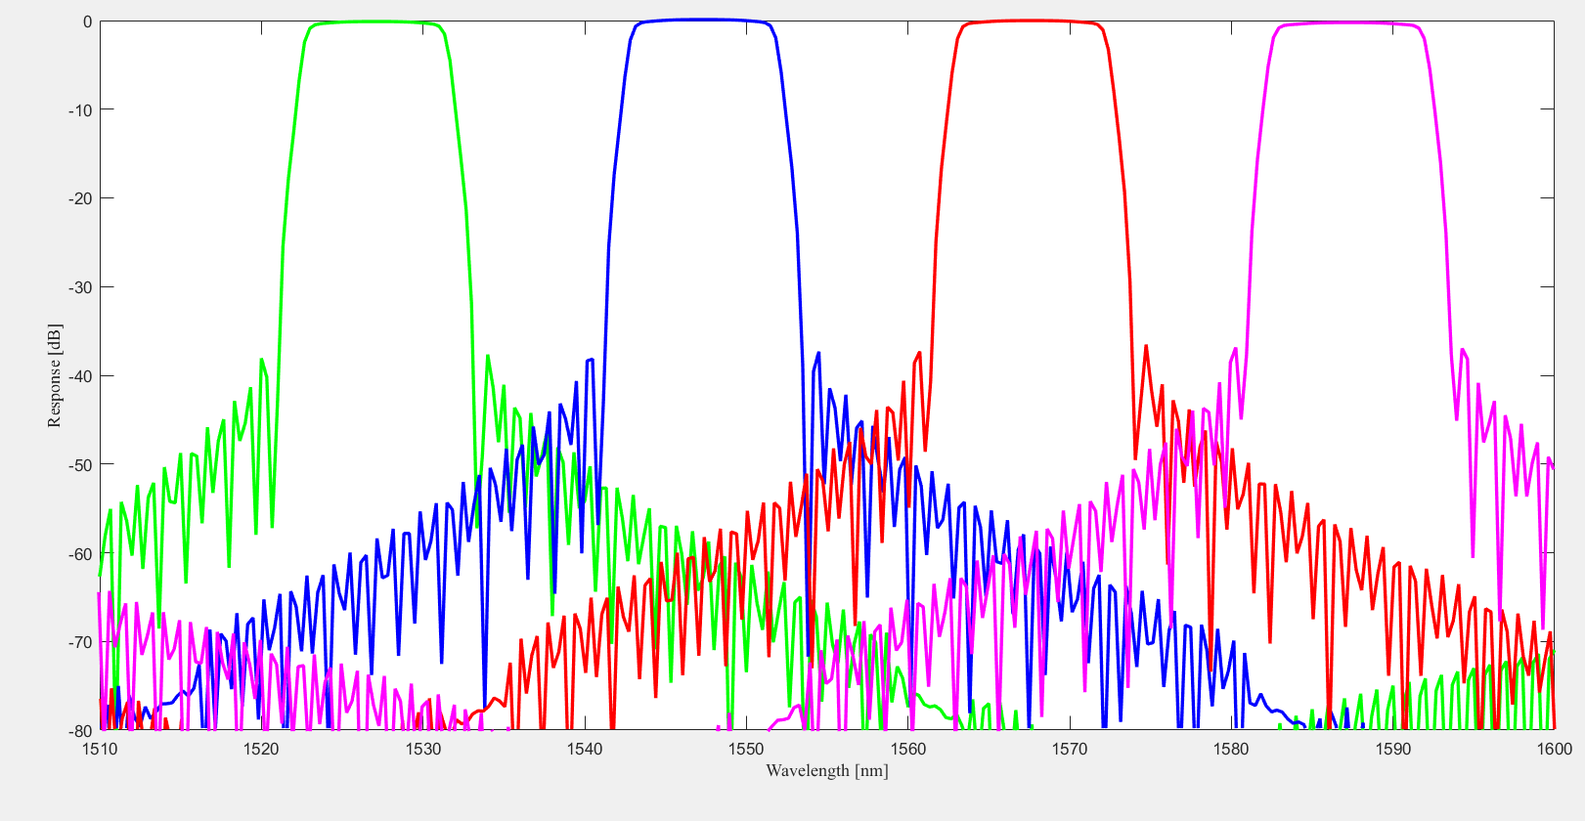
CWDM on SOI
Athermal filters with large bandwidth, tolerant to laser’s wavelength drift, suitable for short-reach data communication
Fabrication variations are one of the major limitations on SOI-based photonics, realizing such systems on the SOI platform is important
Approaches on SOI include: Echelle gratings, Arrayed Waveguide Gratings (AWGs) [1], Mach-Zehnder lattice filters [2], and contra-directional couplers (contra-DCs)
[1] S. Pathak, E. Lambert, P. Dumon, D. V. Thourhout, and W. Bogaerts, “Compact SOI-based AWG with flattened spectral response using a MMI,” 8th IEEE International Conference on Group IV Photonics, 2011.
[2] ”Polarization-insensitive silicon nitride Mach-Zehnder lattice wavelength demultiplexers for CWDM in the O-band” Mikkelsen JC et al. 10.1364/OE.26.030076
Notes:
As you probably know CWDM networks are an integral system to be realized on the silicon photonics platform, these systems mainly have little number of channels but each with a large bandwidth and far spacing as seen in this simulation figure of a 4 channel, equally 20nm spaced filter around telecom wavelengths of 1550 nm.
With such wide bandwidths, the system can be less sensitive to fabrication variations, which is currently one of the major limitations in the silicon photonics platform, these fabrication variations are mainly due to cross wafer variations and etch-loading effects which rise from small features in the silicon layer. Given their large bandwidth, these systems can tolerate the wavelength drift of the source’s laser, therefore they are suitable for short-reach data com applications.
There has been mainly two approaches to realize CWDM systems on the SOI platform, one of which is arrayed waveguides gratings, these devices generally demonstrated high insertion losses and a large on-chip footprint. Another approach to realize such CWDM systems is a device known as the contra-directional coupler, which I’ll refer to as contra-DC for short.

Slide 3
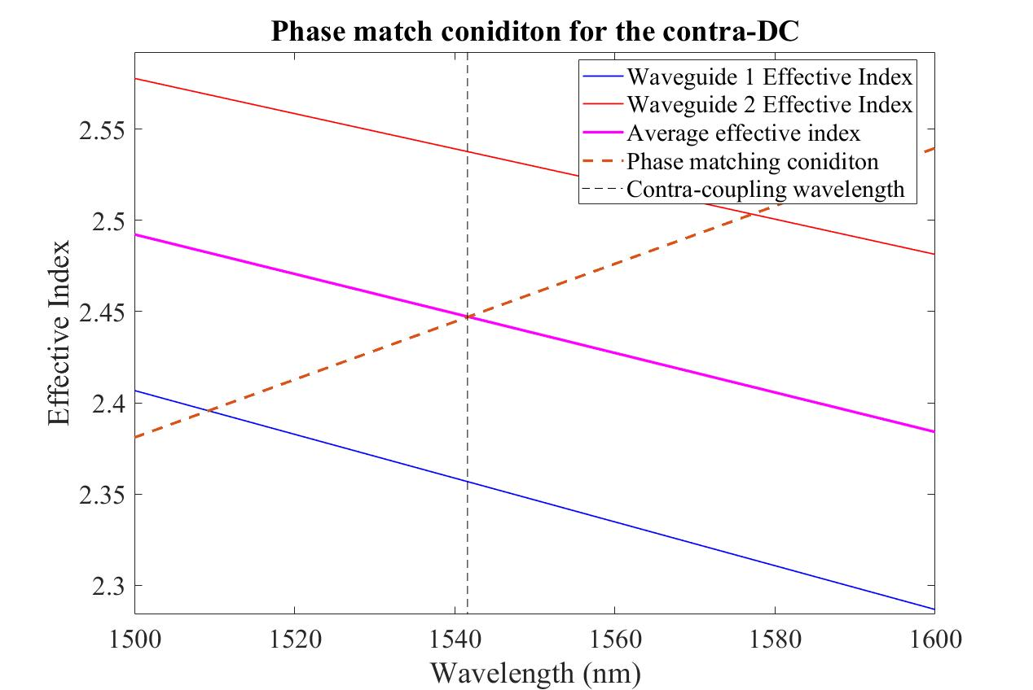
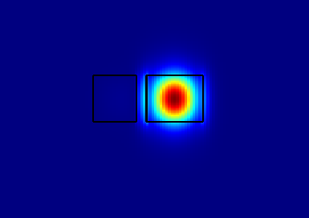
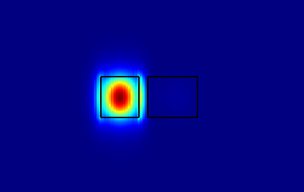
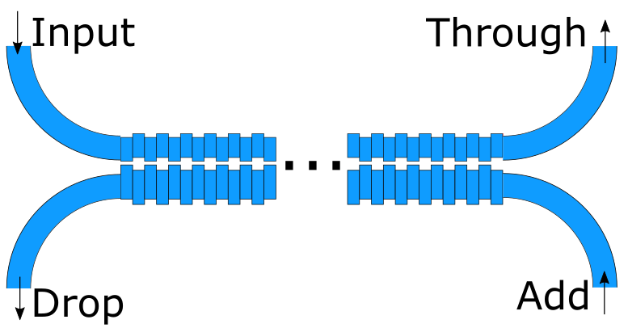
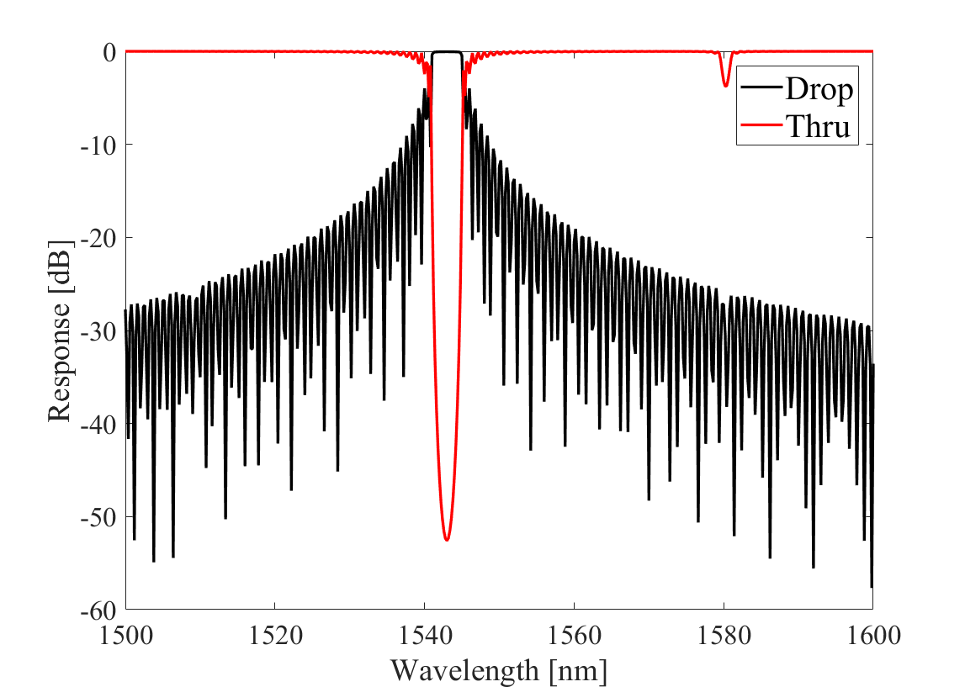
Contra-directional couplers overview
2-Waveguide system, 4-port Device:
Input, through, add, drop
side-walls corrugated, asymmetric waveguides
Light at the phase matched wavelengths couples backwards (contra)
Notes:
The contra-directional coupler is essentially a 2-waveguide system, 4 port device, the ports are the input, through, drop, and add, as seen in the figure here.
The two waveguides couple light at specific wavelengths from the input port, backwards, into the drop port, therefore it is contra-coupling, contra here means against, or opposite. The two waveguides in the system are designed to be asymmetrical with different widths, to minimize cross, forward coupling from the input port into the add port. The contra-coupling condition is met by introducing periodic perturbations, in the form of sidewalls corrugations on both waveguides as seen in this figure.
To determine the contra-coupling wavelength, we can sketch up a quick and simple plot of the effective indices of the system’s two modes, seen in the blue and orange here, and then calculate the average effective index of the two modes, shown in the purple middle line. And then we plot the phase matching condition, which is the wavelength divided by two times the period, shown in the orange dashed. The intersection of the average effective index curve with this dashed line of the phase matching condition, determines the contra-coupling bragg wavelength.
As we can see here in this modelled plot of a contra-DC device, we plotted both the drop port and through port, and the bragg reflection can be seen in the drop port at the contra-coupling wavelength, we can see the characteristics of the grating-based filters such as the sidelobes around the sides of the pass-band.

Slide 4
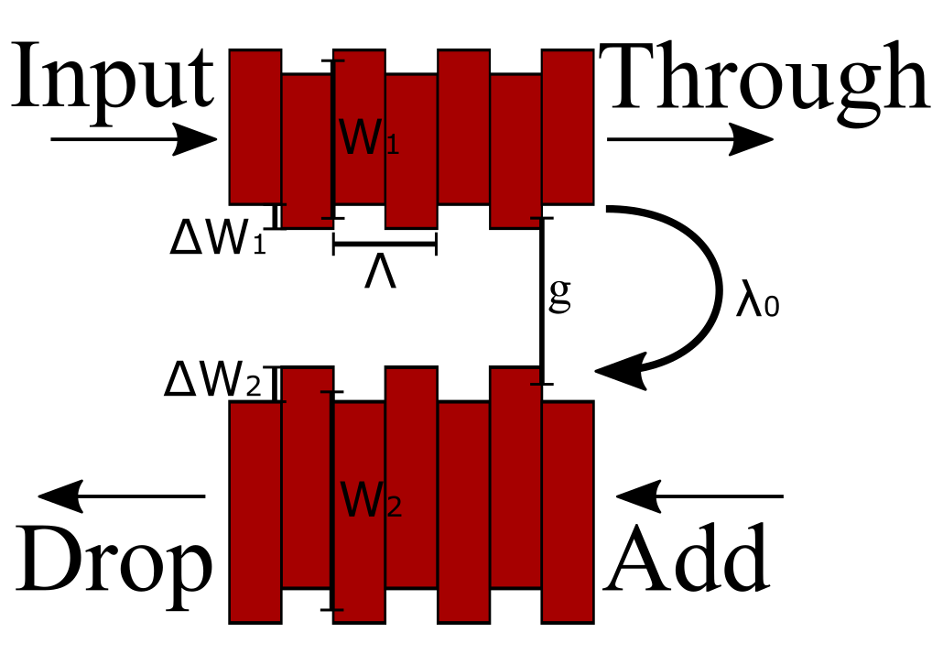
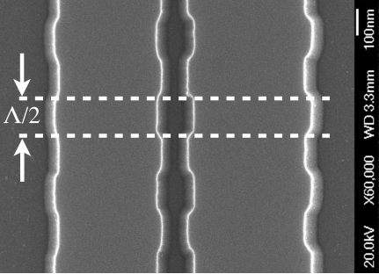
Contra-directional couplers design
Design parameters:
Waveguides widths, corrugations width, waveguides gap, corrugations period,
Number of corrugations, apodization profile
Selected design parameters determine the figures of merit:
Bandwidth, central wavelength, band ripple/flatness, sidelobes levels, insertion loss
Demonstrated on both E-Beam lithography and 248/193 nm deep-UV lithography [3]
[3] W. Shi, X. Wang, W. Zhang, L. Chrostowski, and N. A. F. Jaeger, “Contradirectional couplers in silicon-on-insulator rib waveguides,” Optics Letters, vol. 36, no. 20, p. 3999, May 2011.
[2]
Notes:
This is a sketch showing all the design parameters that go into designing contra-DCs, such as the average waveguides width, perturbations width, period of the perturbations, and the gap in between the two waveguides. All of these parameters will determine the characteristics and figures of merit of these Contra-DC devices, such as the central contra-coupling wavelength, band ripple, and the side-lobes levels, insertion losses and so on.
It is important to note that these Contra-DC devices are not just a research devices, we have been mainly fabricating these devices in Ebeam processes, however, we have also been able to demonstrate them in 248nm optical lithography processes. The SEM shown here is a fabricated CDC device, we can see the square features of the corrugations.

Slide 5
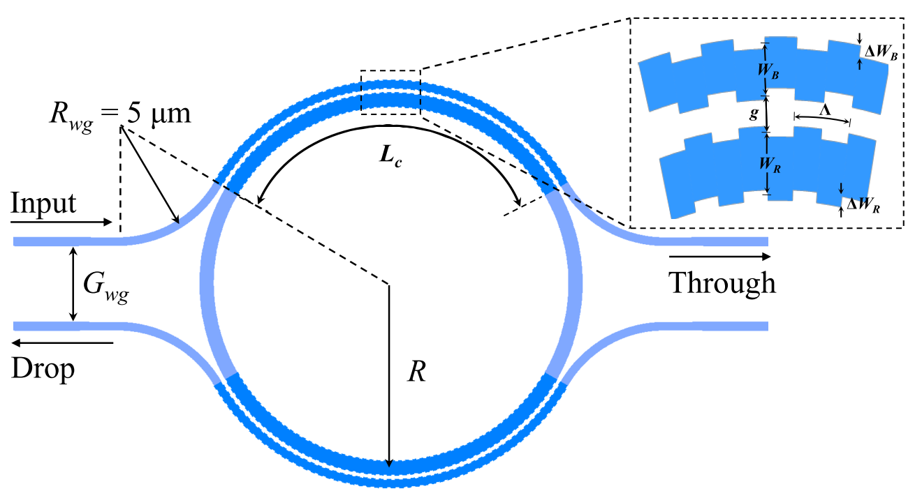
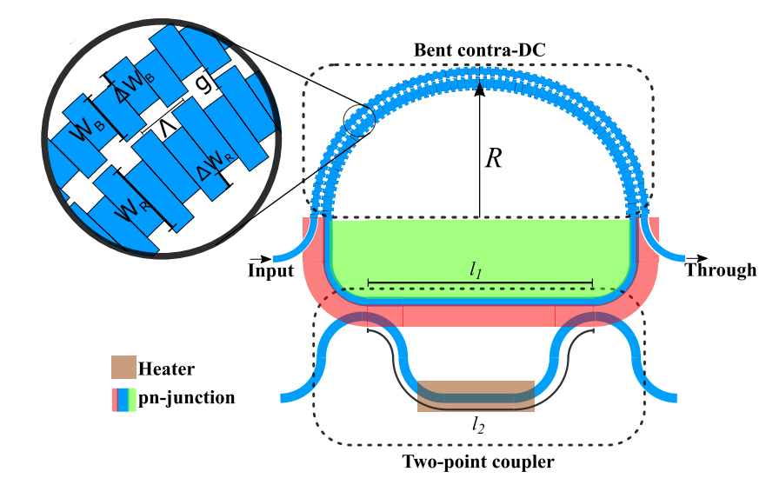
Contra-directional couplers applications
CWDM (de) multiplexers [3]
Free-spectral-range (FSR)-free DWDM (de) multiplexers [4,5]
FSR-free WDM modulators [6]
MDM (de) multiplexers [7]
[3] W. Shi, X. Wang, W. Zhang, L. Chrostowski, and N. A. F. Jaeger, “Contradirectional couplers in silicon-on-insulator rib waveguides,” Optics Letters, vol. 36, no. 20, p. 3999, May 2011.
[4] N. Eid, R. Boeck, H. Jayatilleka, L. Chrostowski, W. Shi, and N. A. F. Jaeger, “A silicon-on-insulator microring resonator filter with bent contradirectional couplers,” 2016 IEEE Photonics Conference (IPC), 2016.
[5] N. Eid, R. Boeck, H. Jayatilleka, L. Chrostowski, W. Shi, and N. A. F. Jaeger, “FSR-free silicon-on-insulator microring resonator based filter with bent contra-directional couplers,” Optics Express, vol. 24, no. 25, p. 29009, Jul. 2016.
[6] A. Mistry, M. Hammood, H. Shoman, L. Chrostowski, N. A. F. Jaeger, “FSR-free microring modulator,” 15th IEEE International Conference on Group IV Photonics, 2018.
[7] X. Zhao, Y. Wang, Q. Huang, and J. Xia, “Two-mode contra-directional coupler based on superposed grating,” Optics Express, vol. 25, no. 3, p. 2654, Jan. 2017.
[3]
[6]
Notes:
Contra-DCs have been studied thoroughly by our group and others. Here are some of the demonstrated applications of Contra-DCs, I suppose one of the obvious applications are CWDM filters, which are shown in the plot here as a 4 channel filter, this is the work of previous student here, Dr. Wei Shi, this work was achieved by using four cascaded different contra-DC devices, each with different period, therefore each contra-DC acts as an independent channel.
Another application is FSR-free DWDM filters, such as the filter shown here with CDCs integrated in the ring cavity, to suppress all the modes of the ring, except the one that is aligned with the contra-coupling wavelength. Another application was also demonstrated by my colleague and I during the poster session of this conference, which is by using a similar design, we achieved an FSR-free WDM modulator. This modulator integrated PN junction within the ring, to modulate the resonant wavelength of the ring, it also has a tunable coupler to tune the bandwidth of the modulator.

Slide 6
Modelling and Simulation Approaches
Full-length 3D FDTD Simulation
Slowest: Time and resources consuming, high risk of divergence
Accurate simulation, if your simulation converges…
EME Propagation Simulation
Fast (er?)
Difficult to simulate non-uniform grating profiles (not impossible)
Difficult to simulate unconventional perturbations (i.e. sinusoidal)
Accurate within contra-coupling wavelengths
Analytical: Coupled-mode Theory + Transfer Matrix Method
Fastest
Most accurate, can model every profile, and every band (self+contra)
Requires prior knowledge of device parameters:
Waveguides system modes
Coupling coefficients / Kappa

Slide 7
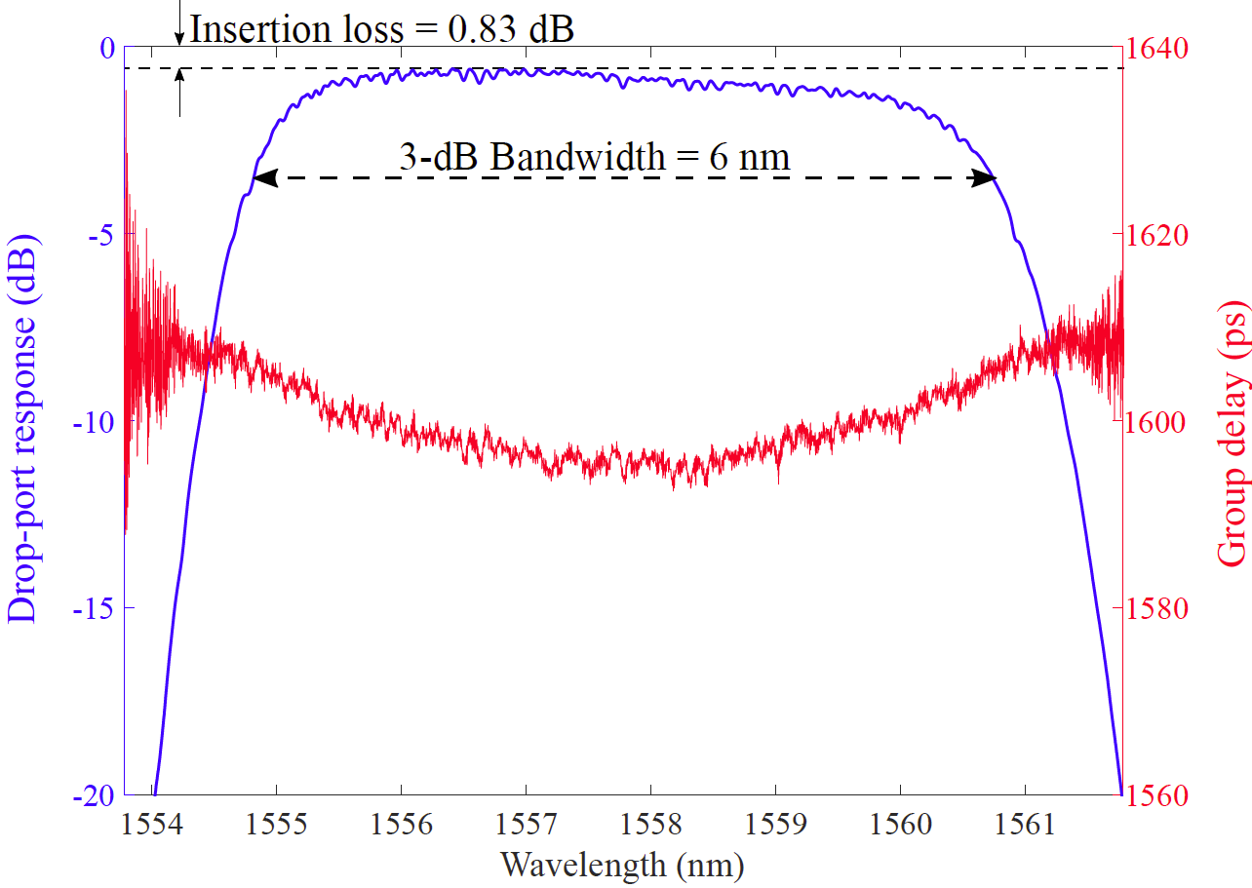
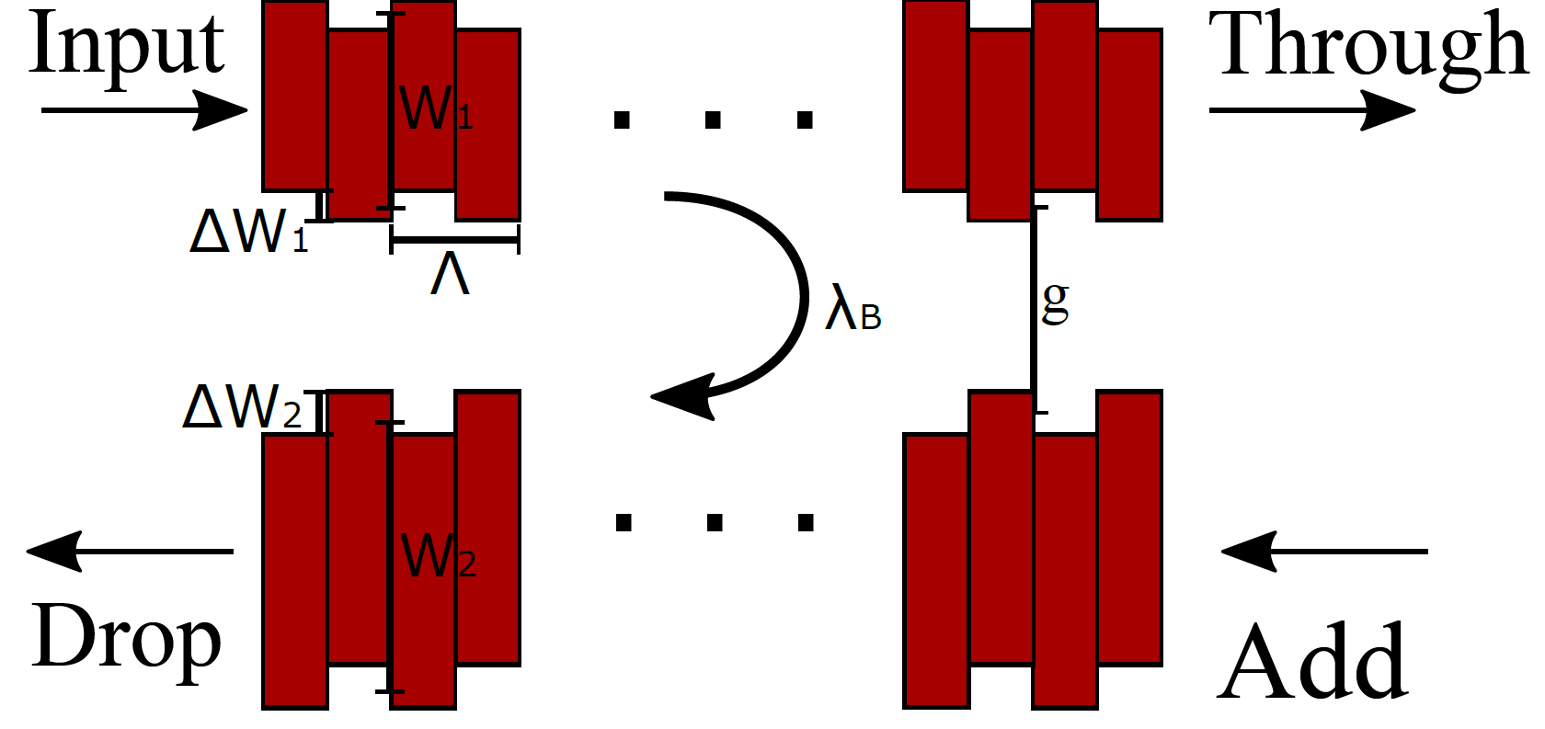
What is: Coupling Coefficient / Kappa?
Dependent on the waveguides geometry and structure of the perturbation gratings (strength/shape)
Determines the bandwidth and reflectivity of the device
The key parameter that sets coupled-mode theory model to work.

Slide 8
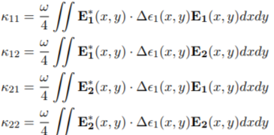
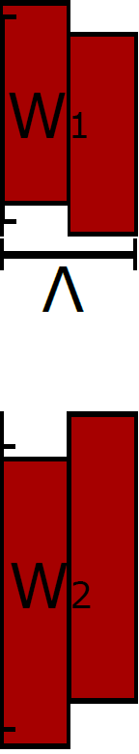
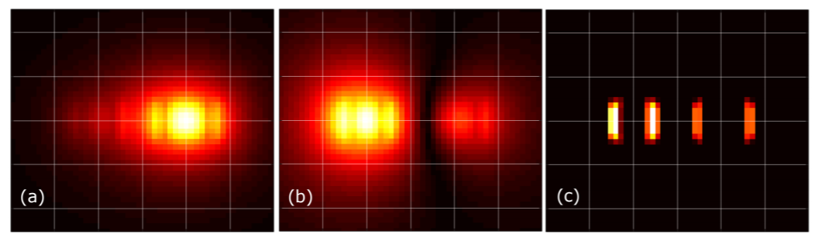
How to find Kappa? Analytically
Can be modelled analytically using:
Accurate for small perturbations
Easily implemented for simple
perturbations
Difficult to find the Fourier-expansion term (Δε) for unconventional perturbations shapes (ex: sinusoidal or litho. smoothed corrugations)
(a) (c) (b)
*Fig. from J.St.-Yves M.Sc. Thesis

Slide 9

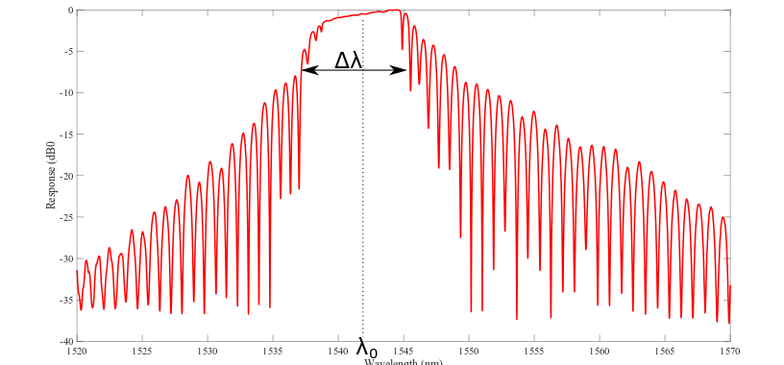
How to find Kappa? Experimentally, extracted from a response
Can be extracted from a device response/modelled experimentally using:
Given any device response (either experimental/simulation) we can find Kappa, assuming a waveguide system (to find ng).
Several means to extract from experimental data:
FWMM Method (Robi 2017)*
Nulls method*
* Not always applicable

Slide 10
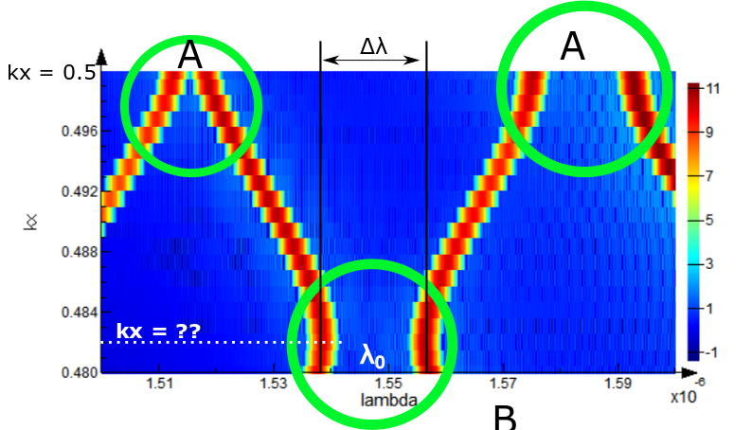
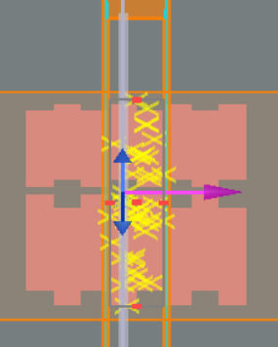
How to find Kappa? Simulation using Bloch boundary band-structure
Using an infinite length, Bloch boundary band-structure simulation, we can calculate the bandwidth and wavelength of the system’s forbidden bands
Self-Bragg bands at Kx = 0.5 – labelled (A)
Contra bands at unknown Kx – labelled (B)
Uncertainty of contra wavevector (Kx) means we have to sweep a large range to find where the contra-coupling forbidden band occurs. This is time and resource consuming. Below plot is generated from 20 points

Slide 11
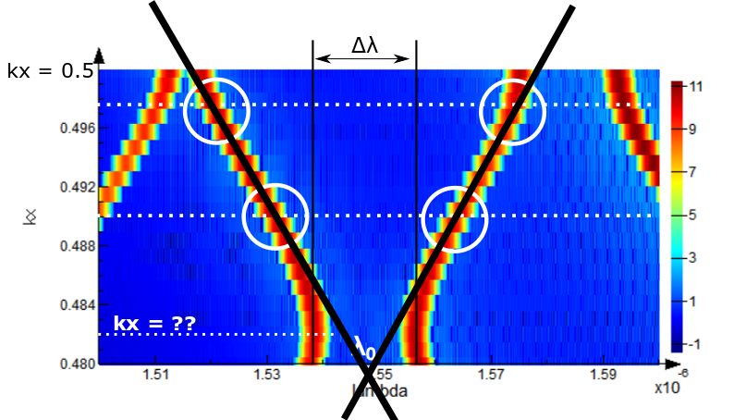
How to find Kappa? Simulation using Bloch boundary band-structure
Can we do better, simulation time and resources wise? Interpolate the system’s forbidden bands?
Can 2 simulations at two wave-vectors to predict the location of the contra-bandgap?
Test case:
 | Kx | Bandwidth (nm)
Actual | 0.4796 | 5.32
Predicted | 0.4794 | 5.88
Error <10%

Slide 12
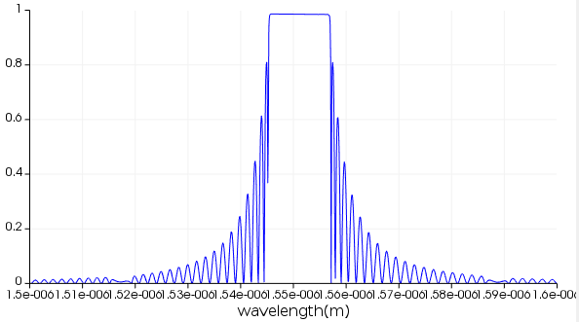
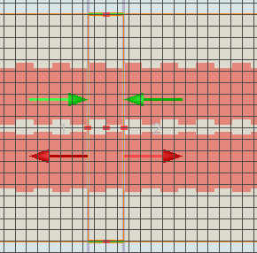
How to find Kappa? Even faster? MODE EME Simulation!
Simulate a single periodic contra-DC cell in EME
Generate the uniform profile response
Extract kappa from the response using the nulls method
Feed the kappa into coupled-mode theory, transfer matrix apodized model

Slide 13
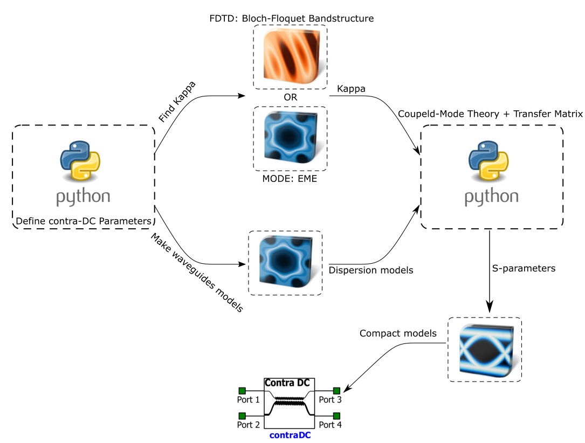
Contra-Directional Couplers Simulator Flow

Slide 14
What’s new in this approach?
Fully automated flow in Python – no need for a MATLAB engine for coupled-mode theory or the setup of any 3rd party tools (other than Lumerical)
Generates an S-parameter file (.dat) for circuit simulations
Dual polarizations: TE-TM, compact model includes two-modes support
Two new approaches to find the bandgap and Kappa – reduce FDTD simulation time from more than 5 hours to an improved, to less than a minutes. This was the simulation flow bottleneck.
Accurately predicts and simulates the waveguide’s self-reflection
Higher level of abstraction

Slide 15
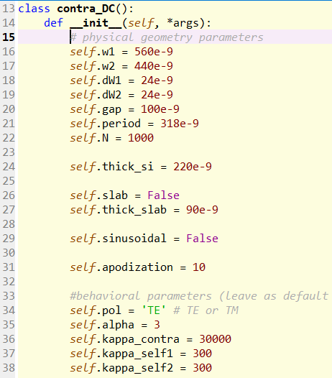
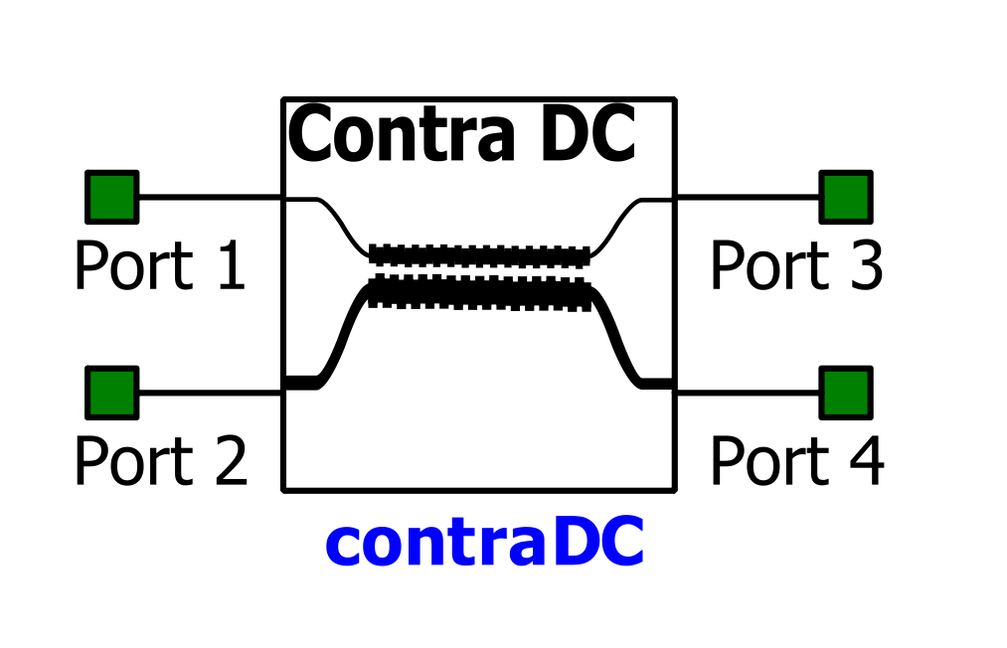
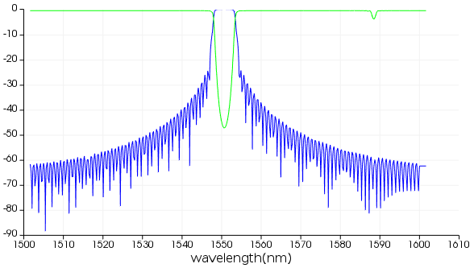
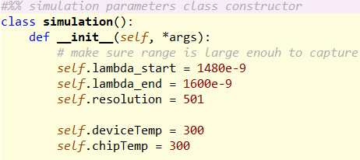
How to? Define physical parameters and simulation parameters
Feed in the design parameters
Let the script run!
Optional

Slide 16
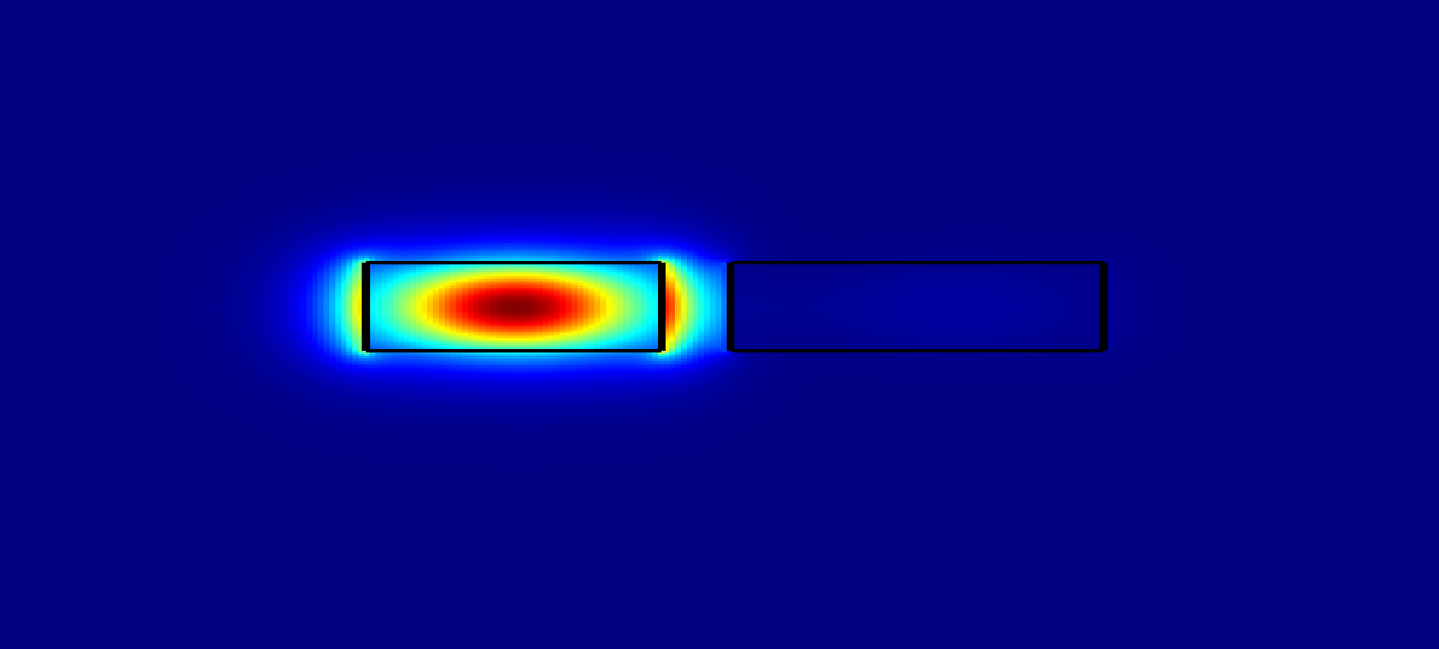
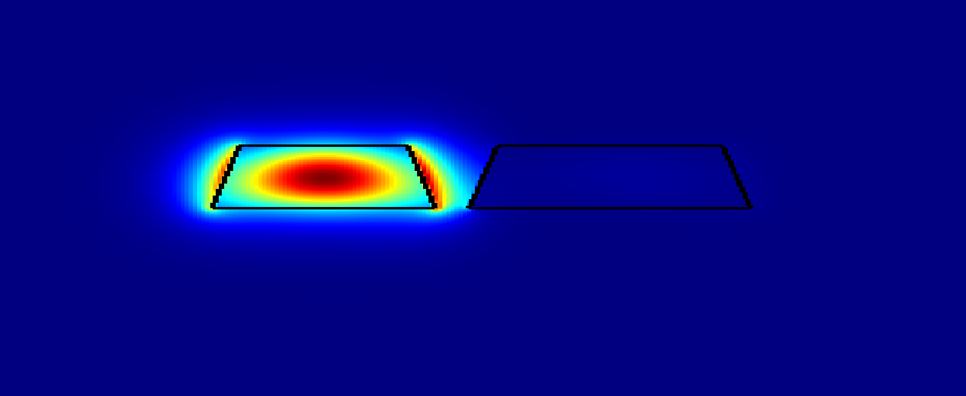
Further improvements can be done on…
Parameterized sidewall angle
Model sensitivity to process variations and corner analysis
Conclusion: bandwidth is somewhat stable, central wavelength not quite.
Segmented kappa: Wavelength-dependent coupling coefficient
𝛿(λ0)/ 𝛿(θ) = 0.63 nm/degree
𝛿(λ0)/ 𝛿(H) = 0.7 nm/nm

Slide 17


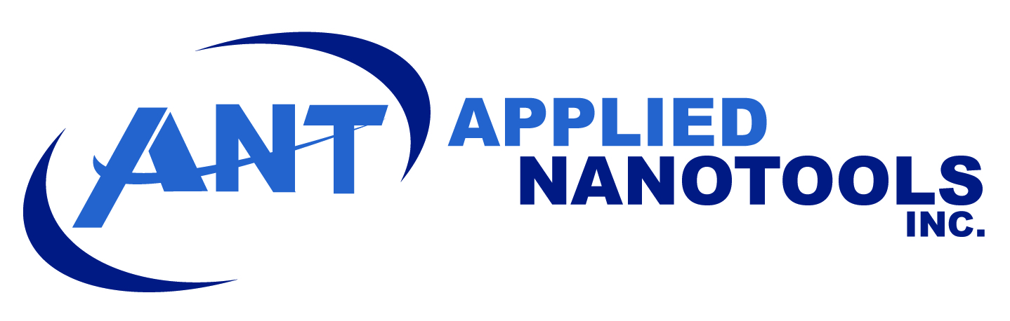
Acknowledgements
Natural Sciences and Engineering Research Council (NSERC) of Canada and Keysight Technologies for their financial support. Fabrication was done by Applied Nanotools, Alberta, Canada through the SiEPICfab consortium.
SiEPICfab

Slide 18
Contributors
Wei Shi
Mustafa Hammood
Jonathan St-Yves
Simon Belanger
Dominique Charron
Han Yun
Xu Wang
Ajay Mistry
Stephen Lin

Slide 19
Activity:
Design a 4-Channel CWDM filter, Add-drop (de) MUX in INTERCONNECT.
Design for ~C-Band.
Use ITU CWDM grid specs:
Channel bandwidth +/- 6.5 nm (13 nm)
Channel grid (spacing) 20 nm
Think of system architecture
Which waveguide to inject light from? Narrow? Wide?
What is the order to place the contra-DCs in?
Refer to Intel Si-Photonics 100G CWDM4 and 400G CWDM8 Transceivers:
100G CWDM4: https://www.intel.ca/content/www/ca/en/architecture-and-technology/silicon-photonics/optical-transceiver-100g-cwdm4-qsfp28-brief.html
400G CWDM8: No public specs yet, only demos: https://www.tomshardware.com/news/intel-silicon-photonics-transceiver-400g,39028.html

