Slide 1
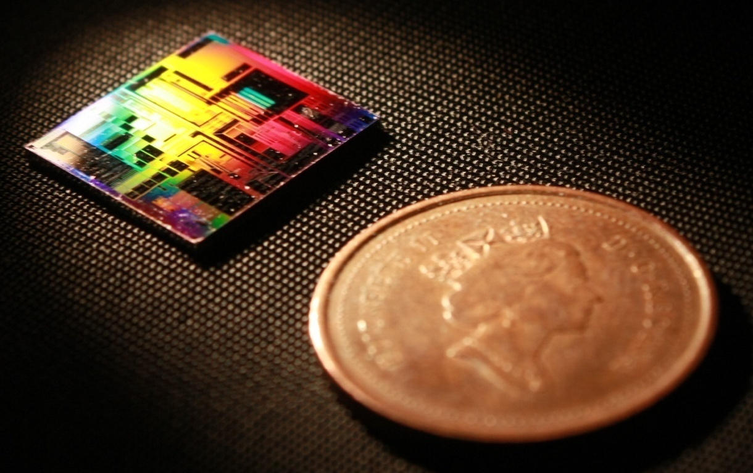
Design of Silicon Photonic Bragg Grating Devices Vancouver, BC, Canada 25 May 2020
Mustafa Hammood,
The University of British Columbia, Vancouver

Slide 2
Outline
Bragg gratings:
Motivation and application
Theoretical approach: Transfer-Matrix Method (TMM)
Simulation: Lumerical EME
Simulation: Lumerical 3D/2D FDTD
Simulation: Lumerical FDTD Band-structure
Theoretical approach: Coupled-mode theory (CMT)
Coupling coefficient (Kappa)
Contra-directional couplers:
Theoretical approach
Simulation: Lumerical EME
Simulation + Theory: Coupled-mode theory + Transfer-Matrix Method
Compact model generation and full-simulation flow

Slide 3
Bragg Gratings: References
Bragg gratings and contra-directional couplers tutorial: https://www.youtube.com/watch?v=jr3NcJsKvTI
SiEPIC PDK KLayout integration of Bragg Gratings: https://www.youtube.com/watch?v=h2MOOhsuYpA
SiEPIC PDK KLayout integration of Contra-directional couplers: https://www.youtube.com/watch?v=aqocwLcqC0s
and
https://www.youtube.com/watch?v=-vWspXuu8I0

Slide 4
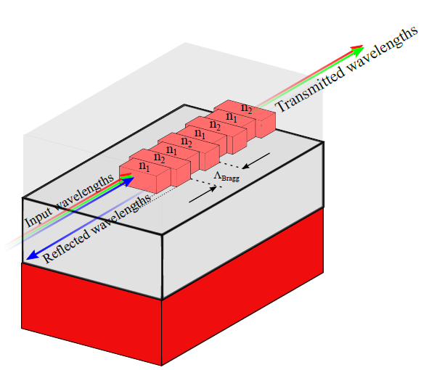
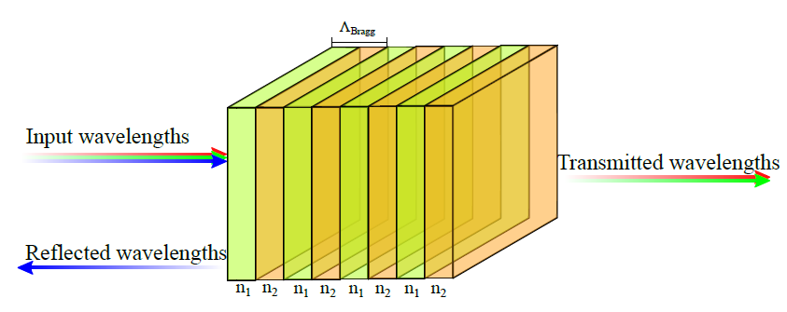
Bragg Gratings: Transfer-Matrix Method

Slide 5
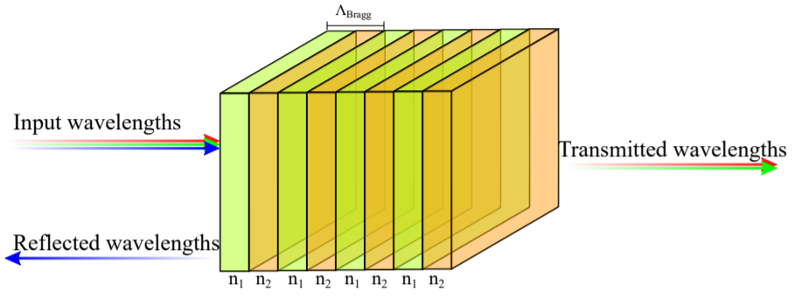
Bragg Gratings: Transfer-Matrix Method
Available: https://github.com/mustafacc/SiEPIC_Photonics_Package/blob/master/SiEPIC_Photonics_Package/solvers_simulators/bragg_tmm/bragg_tmm.py
Handy tool to quickly model phase-shifted Bragg gratings
Inputs:
Waveguides compact models (effective indices fits, n(λ) )
Period
Number of corrugations
Perturbation size
Advantages:
Quick and simple
Does not scale up with the length of the device
Can simulate complex device profiles (apodized, chirped, etc.)
Disadvantages:
Must have data to fit the coupling coefficient profile vs perturbation size!

Slide 6
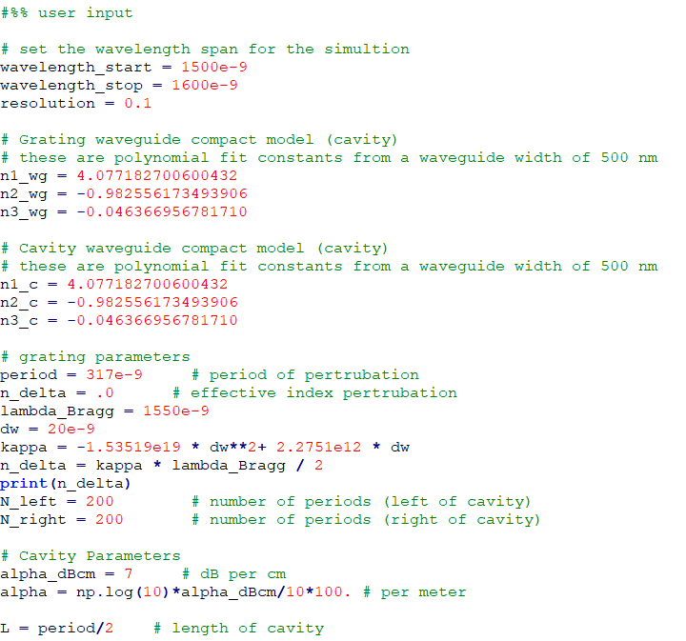
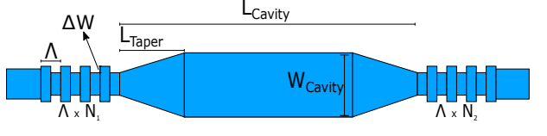
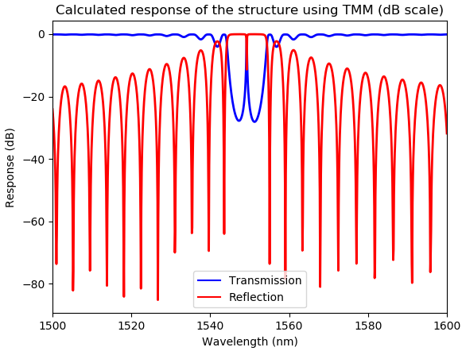
Bragg Gratings: Transfer-Matrix Method
Run bragg_tmm.py

Slide 7
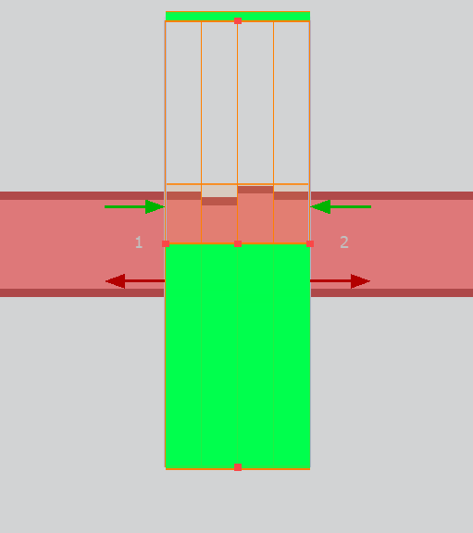
Bragg Gratings: EME
Uses the EME method:
Explained: https://apps.lumerical.com/pic_passive_bragg_full_device_simulation_with_eme.html
Video tutorial: https://www.lumerical.com/support/video/waveguide-bragg-gratings-res.html
Advantages:
Does not need information other than the physical geometry of the device
Relatively fast simulation time compared to FDTD
Disadvantages:
Simulation time scales up with the complexity of the profile
Simulation time scales up with the number of simulation modes required to simulate the device
Less accurate than FDTD simulations

Slide 8
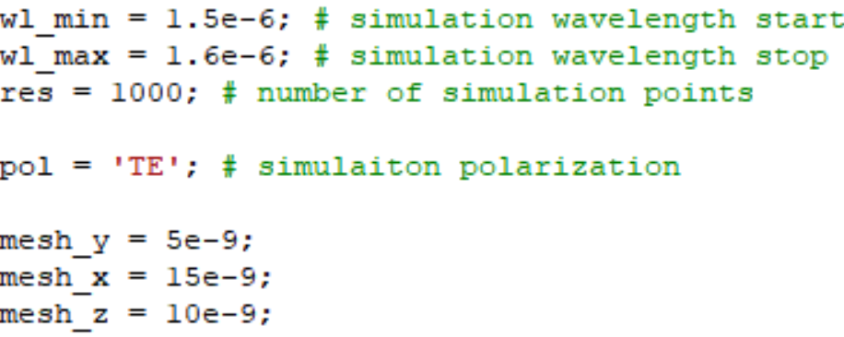
Bragg Gratings: EME
How to:
Download the scripts (Bragg_EME.zip) and open a blank MODE project
With the new MODE project, load the script MAIN_EME.lsf
Adjust the simulation parameters to your needs (wavelength range, polarization, mesh accuracy or leave as default)

Slide 9
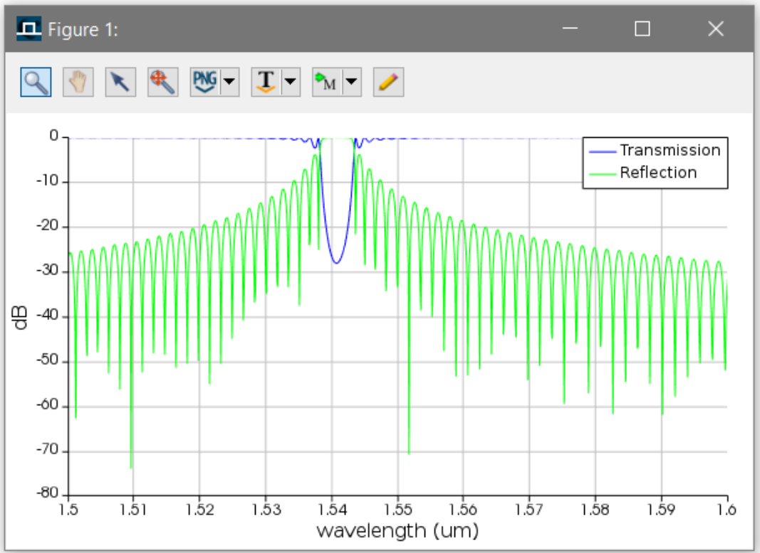
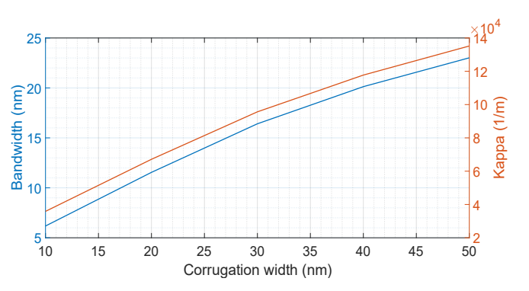
Bragg Gratings: EME
How to:
The script will plot the transmission and reflection spectra, and then extract the 3-dB bandwidth and central wavelength (for your future Kappa analysis).

Slide 10
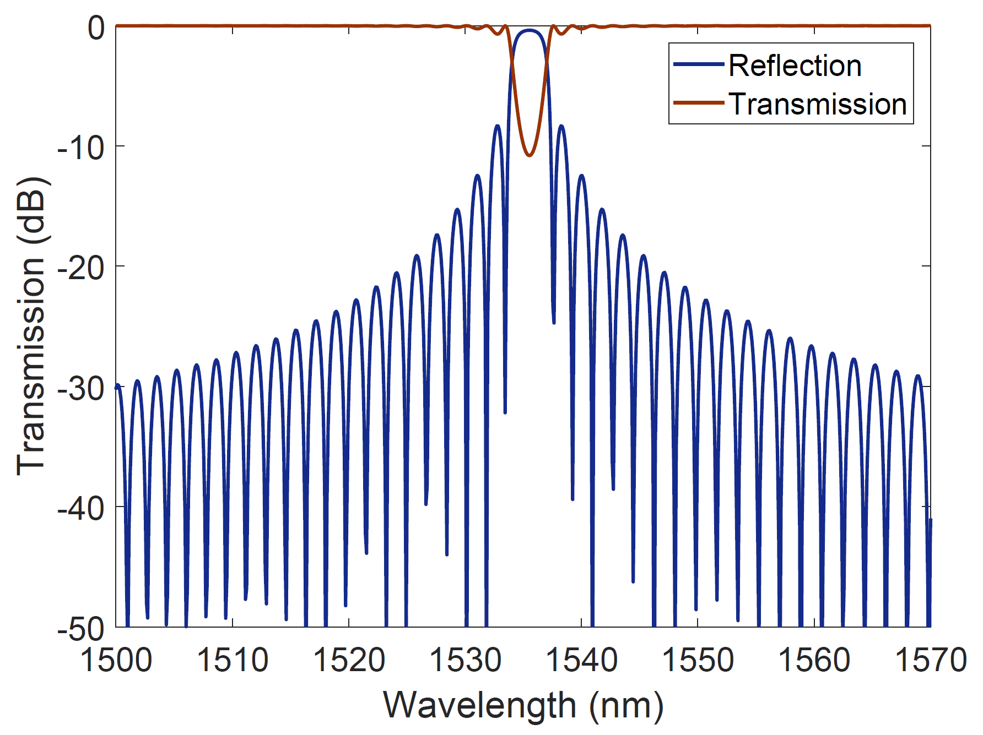
Bragg Gratings: EME
How to:
The script will plot the transmission and reflection spectra, and then extract the 3-dB bandwidth and central wavelength (for your future Kappa analysis).
λo
Δλ

Slide 11
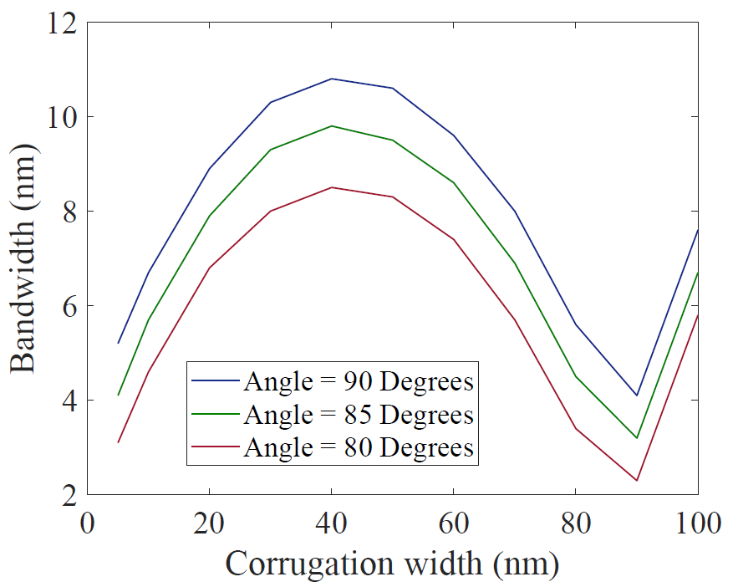
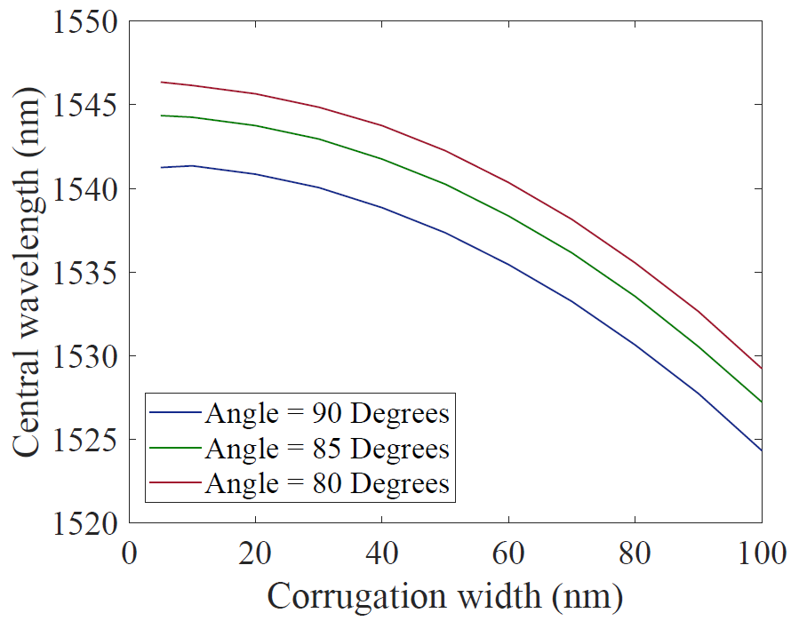
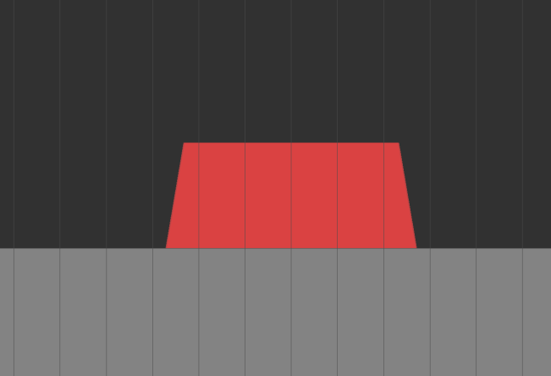
Bragg Gratings: EME
EME simulations can be used to quickly perform parametric studies to understand the effects of specific parameters, i.e. the effects of changing the waveguide’s sidewall angle:
Run applications -> dw_sweep -> MAIN_dw_sweep.lsf

Slide 12
Bragg Gratings: EME
The scripts will force specific settings to improve the simulation speed (e.g., force anti-symmetric boundary conditions when the user specifies the TE polarization) - therefore, if you care more about accuracy rather than speed, you might want to remove these settings from Bragg_simulate.lsf.

Slide 13
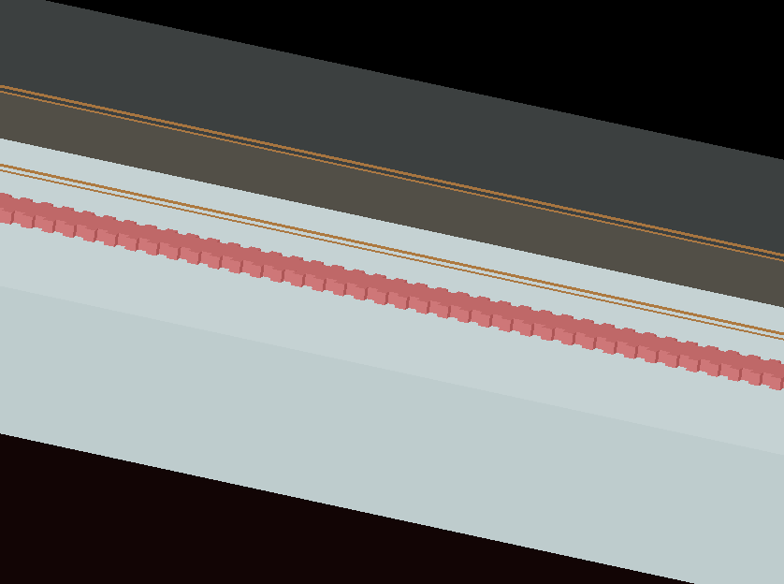
Bragg Gratings: 3D/2D FDTD
Uses FDTD solver:
Simulating the full device length either in 2D FDTD or 3D FDTD
Advantages:
Accurate, if the simulation mesh and time were sufficiently large…
Can be used to simulated complex apodization provide.
Disadvantages:
Very lengthy simulation time!

Slide 14
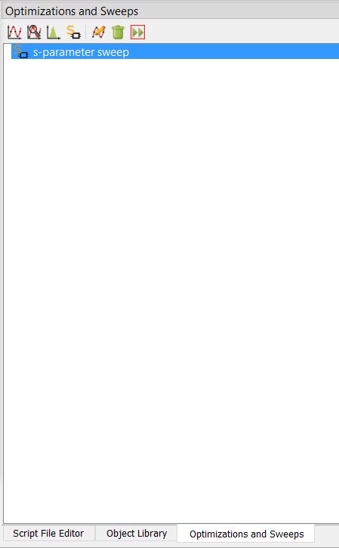
Bragg Gratings: 3D/2D FDTD
Open new FDTD project and load sample code MAIN_FDTD.lsf
Input parameters:
Device physical parameters
Simulation parameters
You can create an S-parameters sweep as well.
You can use ports symmetry.
* There are rarely times you need to actually use 3D FDTD to simulate an entire length of a Bragg grating device. The example is added here for illustrating the inefficiency of the method relative to other methods.

Slide 15
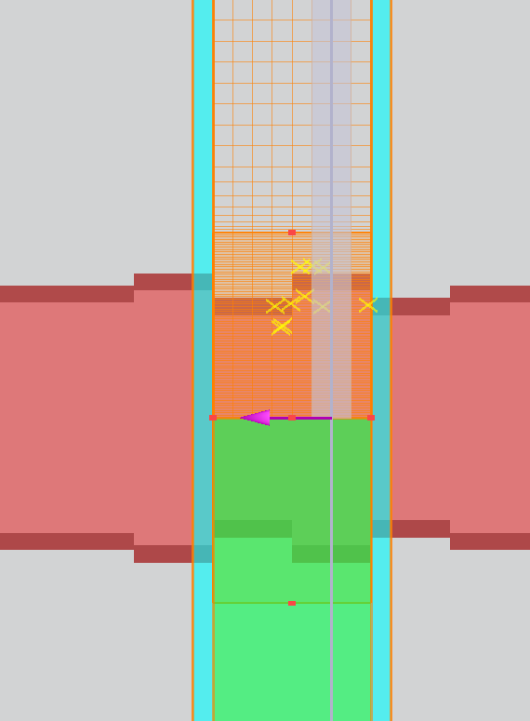
Bragg Gratings: FDTD Bloch Boundary
Uses FDTD solver:
Simulating one unit cell of a grating over an infinite length.
Advantages:
Relatively fast simulation with the most accurate results.
Can be used to perform various parametric sweeps.
Disadvantages:
Cannot simulate the output spectra of advanced apodized devices (directly).
Does not show the output spectra of the device
More at:
https://support.lumerical.com/hc/en-us/articles/360042304394-Bragg-Grating-Initial-Design-with-FDTD

Slide 16
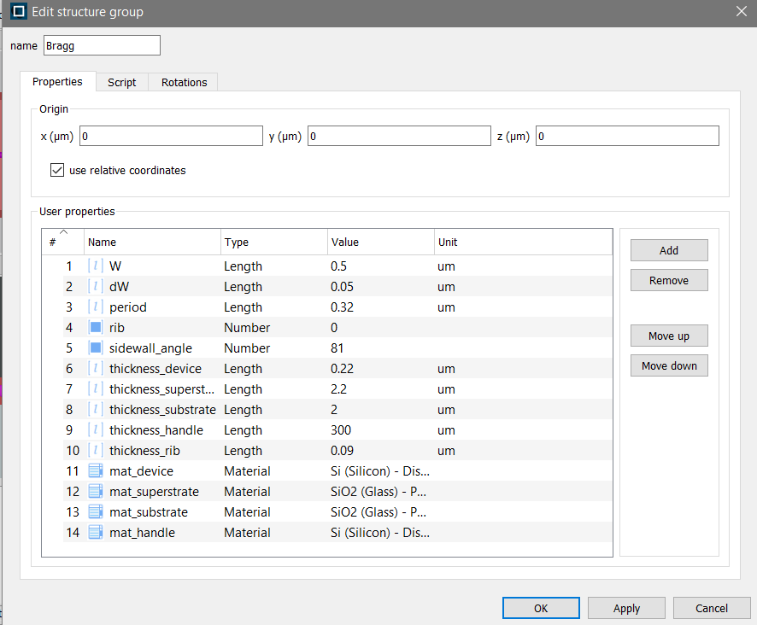
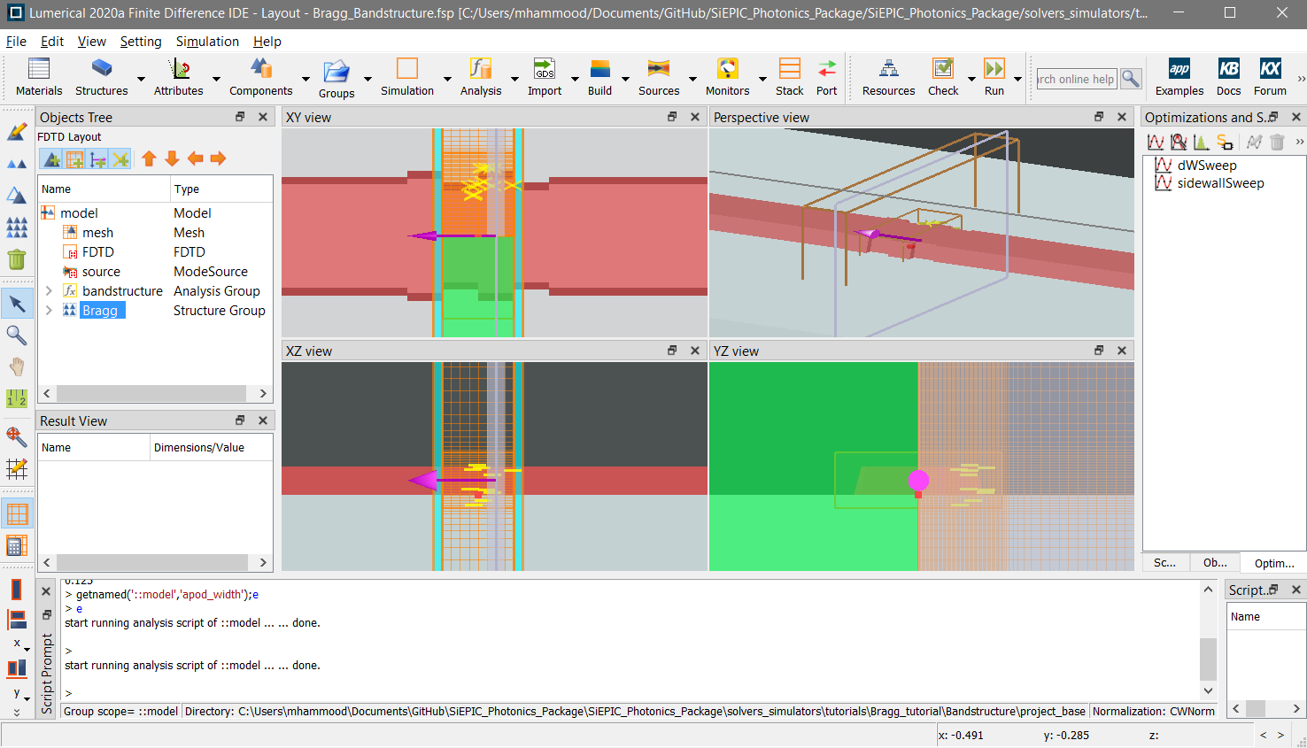
Bragg Gratings: FDTD Bloch Boundary
Two examples provided under ‘Bandstructure’
Script-based: run ‘MAIN_Bandstructure.lsf’ using FDTD script window with simulation and physical parameters. This is a “GUI”-less approach that will setup the simulation for you.
Project-based: open “Bragg_bandstructure.fsp’ using FDTD and configure the simulation settings under “model” and physical settings under “Bragg” objects.
Sample parametric sweeps were setup in this project as an example.

Slide 17
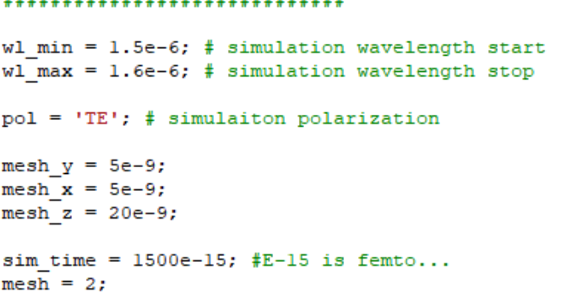
Bragg Gratings: FDTD Bloch Boundary
How to (method 1, script base):
Download the scripts script_base.zip and open a blank FDTD project
From FDTD, load the script MAIN_Bandstructure.lsf
Adjust the simulation parameters to your needs (wavelength range, polarization, mesh accuracy

Slide 18
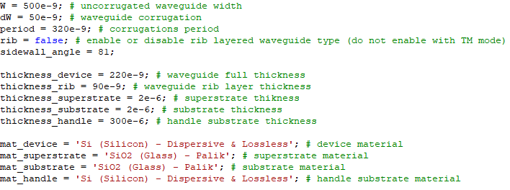
Bragg Gratings: FDTD Bloch Boundary
How to (method 1, script base):
Adjust the device geometry, material, and process stack settings to your needs. Currently the default settings are set for SOI in mind, but it can be changed to any platform.

Slide 19
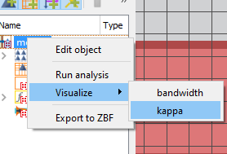
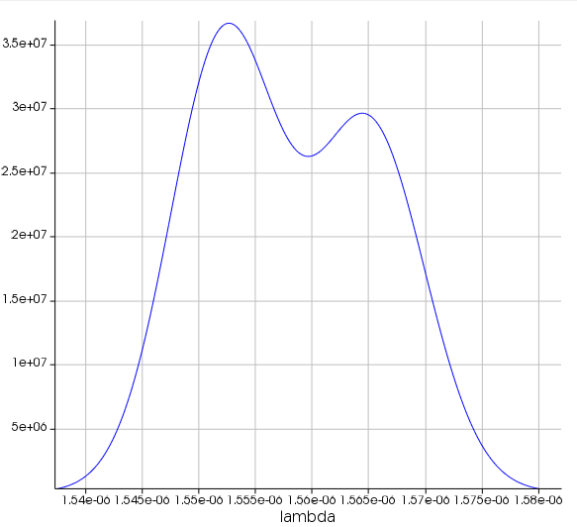
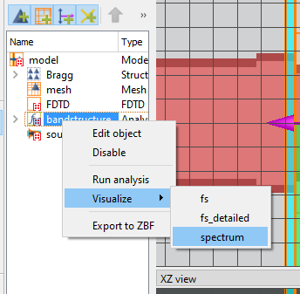
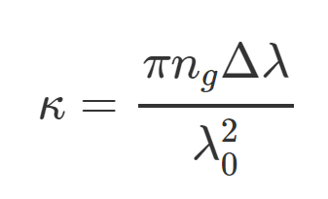
Bragg Gratings: FDTD Bloch Boundary
How to (method 1, script base):
Run the script - given the current settings, it should run in under ~3 minutes.
The script will extract the nulls bandwidth and central wavelength of the Bragg grating, which you can use to extract the Kappa (coupling coefficient) to be used in a coupled-mode theory model.
You can visualize the results
Δλ
λo

Slide 20
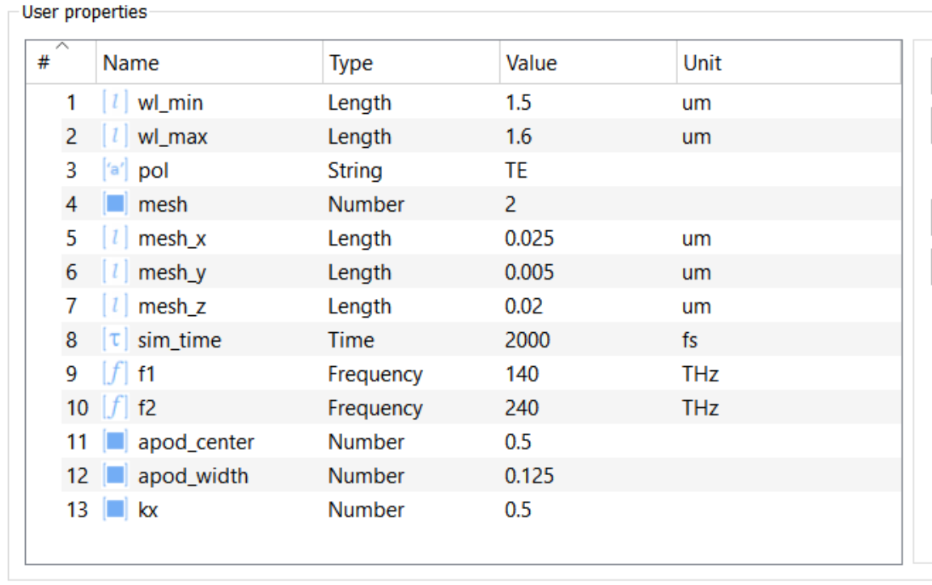
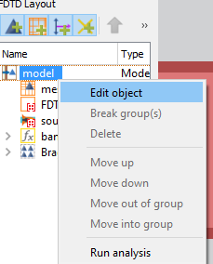
Bragg Gratings: FDTD Bloch Boundary
How to (method 2, project base):
Download the scripts project_base.zip and open Bragg_bandstructure.fsp this is an already setup simulation project.
Right click on Model and edit the simulation settings and parameters to your requirements:

Slide 21
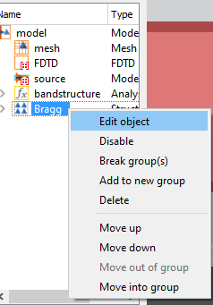
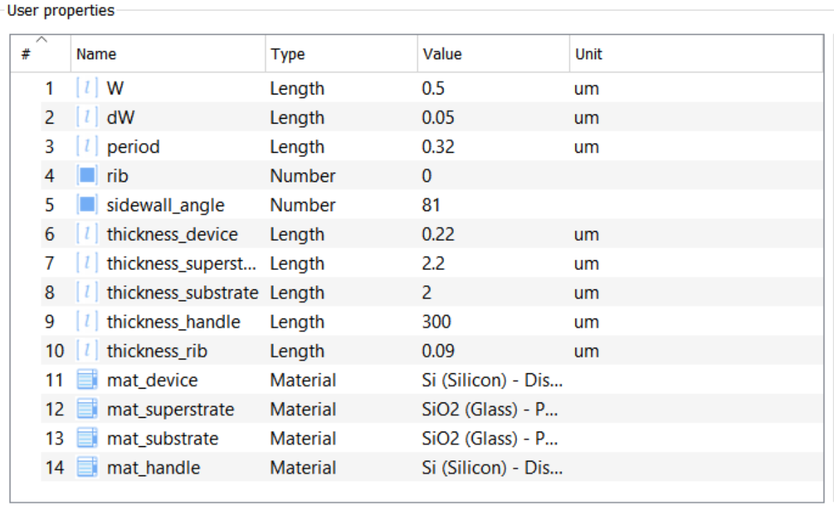
Bragg Gratings: FDTD Bloch Boundary
How to (method 2, project base):
Right click on Bragg structure group and edit the device geometry, material, and process stack.

Slide 22
Bragg Gratings: FDTD Bloch Boundary
How to (method 2, project base):
Run the simulation and let it run. Once the simulation is done you can right click on model and run the analysis to extract the coupling coefficient, bandwidth, and central wavelength of the Bragg grating.
Δλ
λo

Slide 23
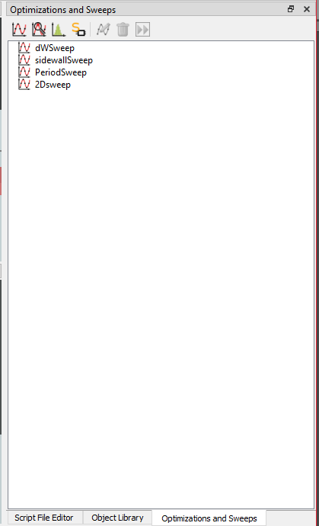
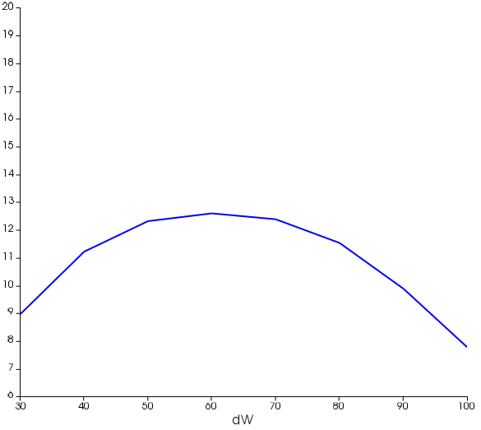
Bragg Gratings: FDTD Bloch Boundary
How to (method 2, project base):
I provided sample parametric sweeps in the optimization and sweeps tab that will help you understand the effects of each of the following parameters:
Perturbation width
Sidewall angle
Bragg Period

