Slide 1
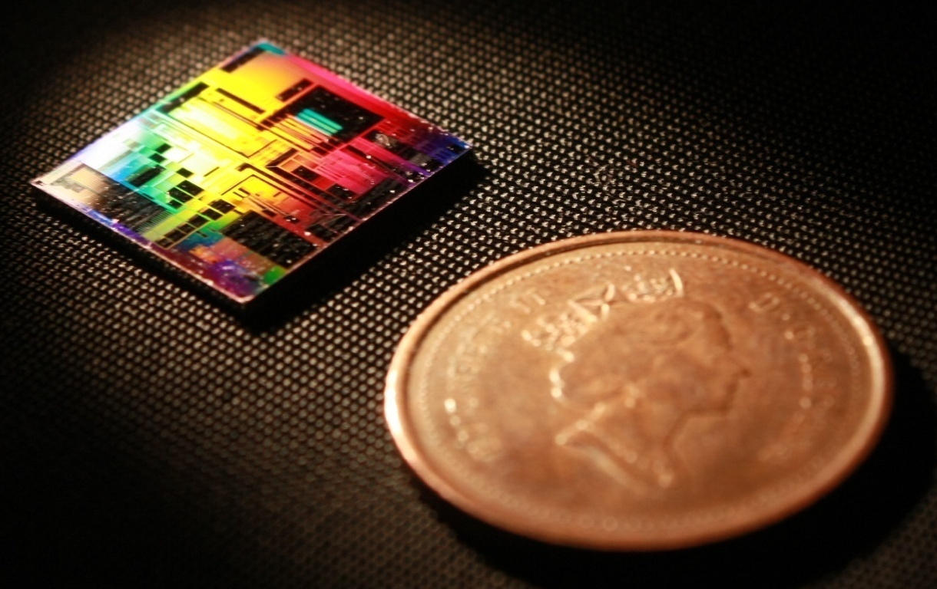
Design of Silicon Photonic Bragg Grating Devices with Lumerical Vancouver, BC, Canada 10 January 2020
Mustafa Hammood,
The University of British Columbia, Vancouver

Slide 2
Outline
Bragg gratings:
Theoretical approach: Transfer-Matrix Method (TMM)
Theoretical approach: Coupled-mode theory (CMT)
Coupling coefficient (Kappa)
Simulation: Lumerical EME
Simulation: Lumerical 3D/2D FDTD
Simulation + Theory: Lumerical FDTD Band-structure
Contra-directional couplers:
Theoretical approach
Simulation: Lumerical EME
Simulation + Theory: Coupled-mode theory + Transfer-Matrix Method
Compact model generation and full-simulation flow
Examples:
Bragg grating: corrugation strength sweep

Slide 3
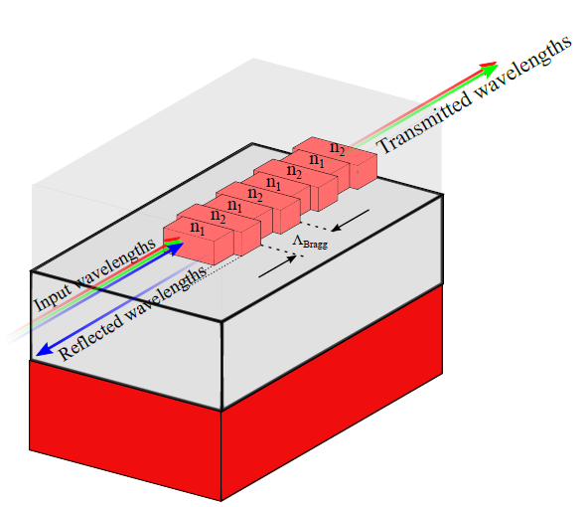
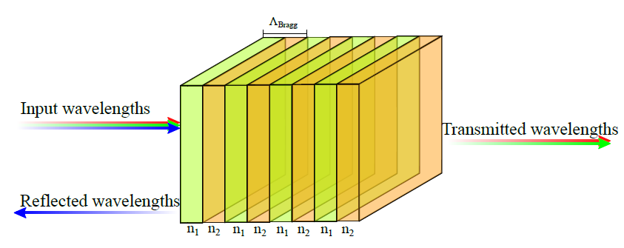
Bragg Gratings: Transfer-Matrix Method

Slide 4
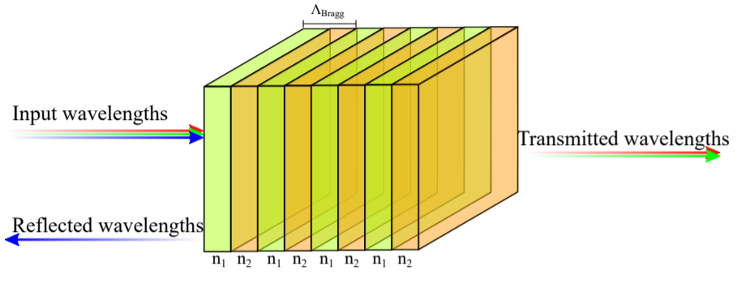
Bragg Gratings: Transfer-Matrix Method
Available: https://github.com/mustafacc/SiEPIC_Photonics_Package/blob/master/SiEPIC_Photonics_Package/solvers_simulators/bragg_tmm/bragg_tmm.py
Handy tool to quickly model phase-shifted Bragg gratings
Inputs:
Waveguides compact models (effective indices fits, n(λ) )
Period
Number of corrugations
Perturbation size
Advantages:
Quick and simple
Does not scale up with the length of the device
Can simulate complex device profiles (apodized, chirped, etc.)
Disadvantages:
Must have data to fit the coupling coefficient profile vs perturbation size!

Slide 5
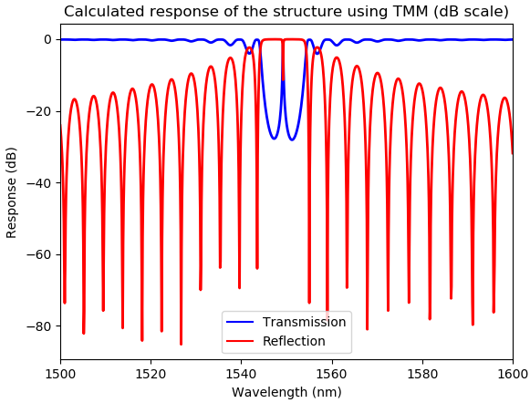
Bragg Gratings: Transfer-Matrix Method
Sample spectra:

Slide 6
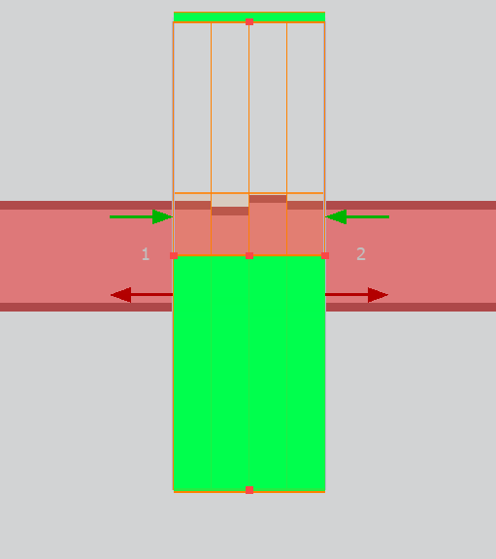
Bragg Gratings: EME
Uses the EME method:
Explained: https://apps.lumerical.com/pic_passive_bragg_full_device_simulation_with_eme.html
Video tutorial: https://www.lumerical.com/support/video/waveguide-bragg-gratings-res.html
Advantages:
Does not need information other than the physical geometry of the device
Relatively fast simulation time compared to FDTD
Disadvantages:
Simulation time scales up with the complexity of the profile
Simulation time scales up with the number of simulation modes required to simulate the device
Less accurate than FDTD simulations

Slide 7
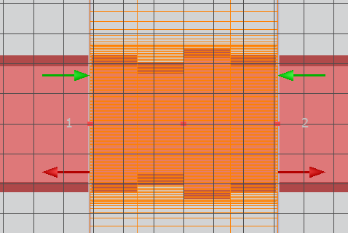
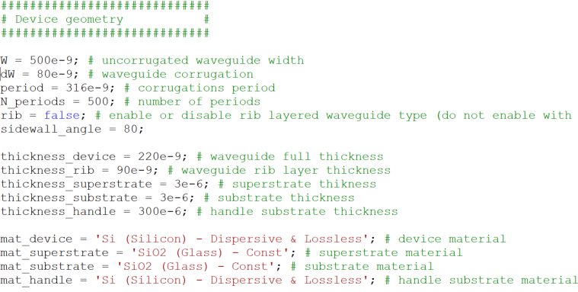
Bragg Gratings: EME
Run sample code MAIN_EME.lsf
Input parameters:
Device physical parameters

Slide 8
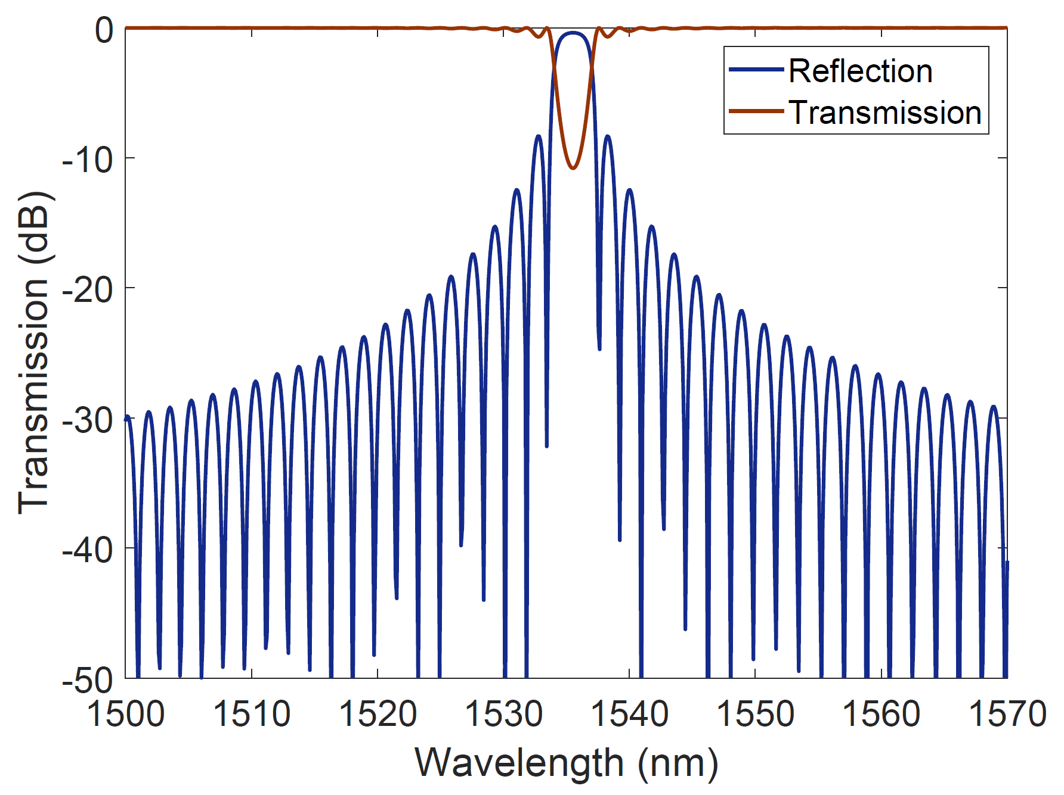
Bragg Gratings: EME

Slide 9
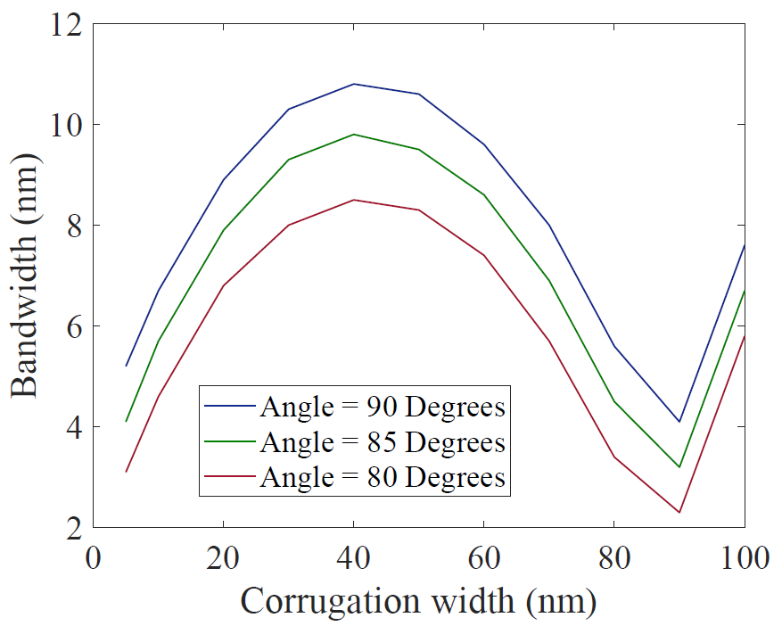
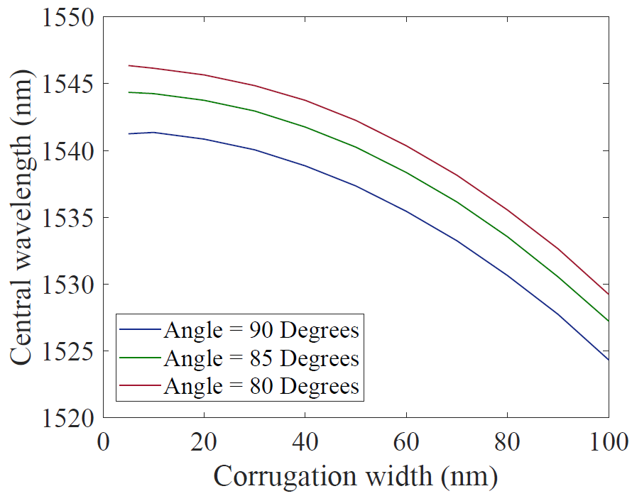
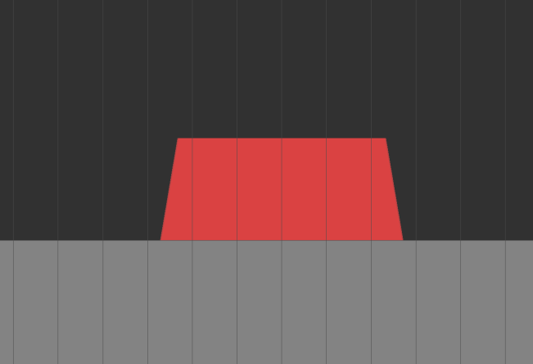
Bragg Gratings: EME
EME simulations can be used to quickly perform parametric studies to understand the effects of specific parameters, i.e. the effects of changing the waveguide’s sidewall angle:
Run applications -> dw_sweep -> MAIN_dw_sweep.lsf

Slide 10
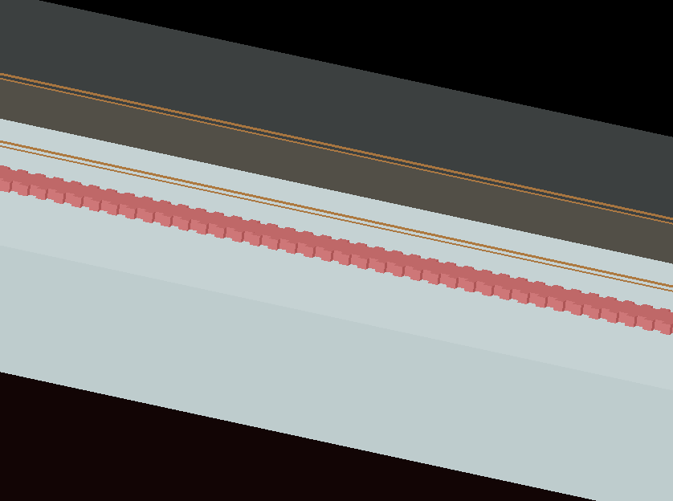
Bragg Gratings: 3D/2D FDTD
Uses FDTD solver:
Simulating the full device length either in 2D FDTD or 3D FDTD
Advantages:
Accurate, if the simulation mesh and time were sufficiently large…
Can be used to simulated complex apodization provide.
Disadvantages:
Very lengthy simulation time!

Slide 11
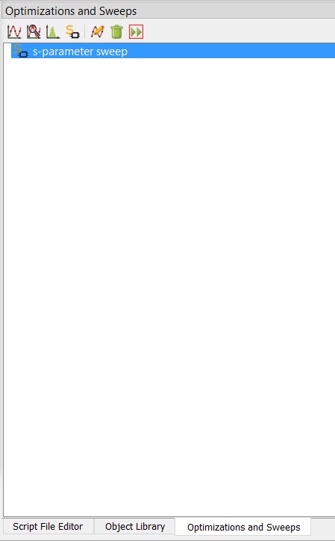
Bragg Gratings: 3D/2D FDTD
Open FDTD project MAIN_FDTD.fsp and Run sample code MAIN_FDTD.lsf
Input parameters:
Device physical parameters
Simulation parameters
You can create an S-parameters sweep as well.
You can use ports symmetry.
* There are rarely times you need to actually use 3D FDTD to simulate an entire length of a Bragg grating device. The example is added here for illustrating the inefficiency of the method relative to other methods.

Slide 12
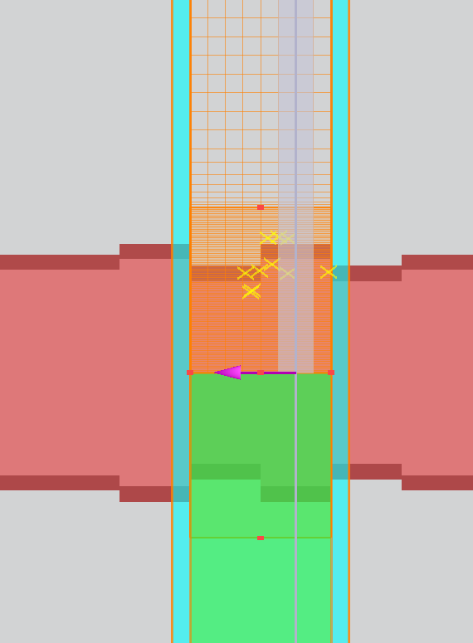
Bragg Gratings: FDTD Bloch Boundary
Uses FDTD solver:
Simulating one unit cell of a grating over an infinite length.
Advantages:
Relatively fast simulation with the most accurate results.
Can be used to perform various parametric sweeps.
Disadvantages:
Cannot simulate the output spectra of advanced apodized devices (directly).
Does not show the output spectra of the device

Slide 13
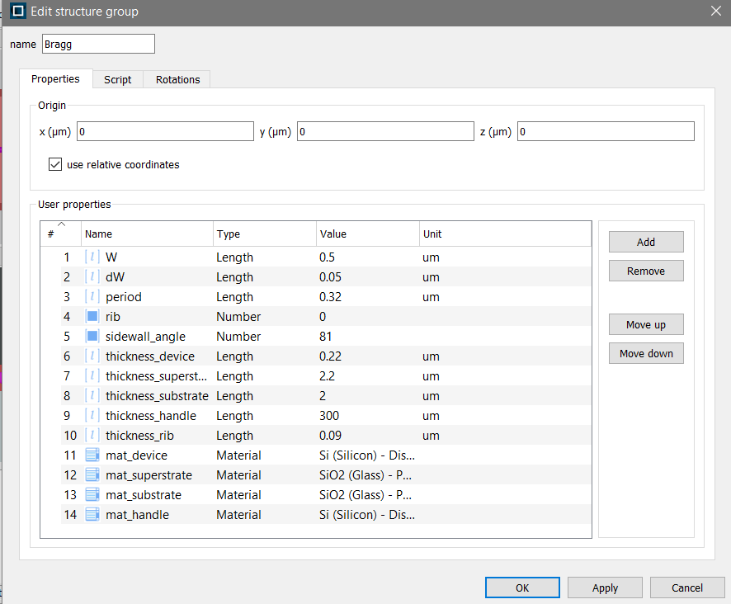
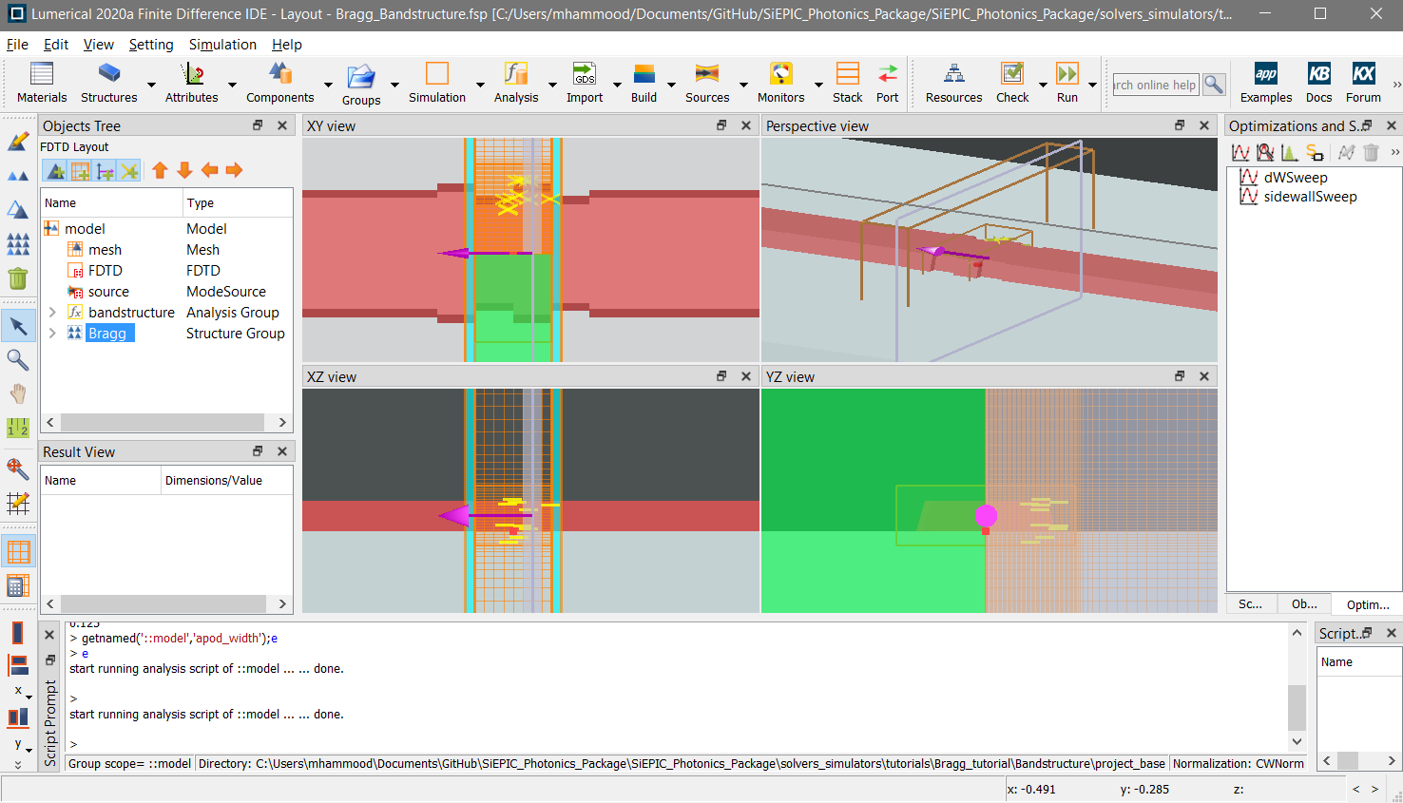
Bragg Gratings: FDTD Bloch Boundary
Two examples provided under ‘Bandstructure’
Script-based: run ‘MAIN_Bandstructure.lsf’ using FDTD script window with simulation and physical parameters. This is a “GUI”-less approach that will setup the simulation for you.
Project-based: open “Bragg_bandstructure.fsp’ using FDTD and configure the simulation settings under “model” and physical settings under “Bragg” objects.
Sample parametric sweeps were setup in this project as an example.

