Slide 1
BootChat
By Jingru Ruan
Md Zunayeed Kamal

Slide 2
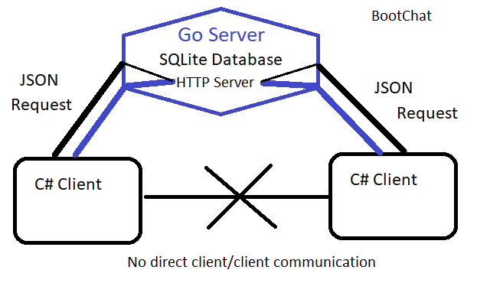
Clients will send and receive messages through the server.
Where they will be stored in a SQL database
We use cloud9 as our http server host
I created an API that accepts HTTP JSON posts

Slide 3
Demo

Slide 4
Q & A

